Slide 1
Oncology Nurses: Inspire,
Innovate, Influence
Brenda Nevidjon, MSN, RN, FAAN
Chief Executive Officer
Oncology Nursing Society

Slide 2
INSPIRE
Our chief want is someone who will inspire us to be what we know we could be. Ralph Waldo Emerson
Let hope inspire you, but let not idealism blind you. Don't look back, you can never look back.
Don Henley

Slide 3
Who Inspires You?

Slide 4
How We Inspire
Words
Actions
Passion
Presence

Slide 5
Becoming an Inspiration
Care about others
Be a good example
Share from your own experience - Be Vulnerable
Tell stories
Be a good communicator - Listen Actively
Read & share your knowledge

Slide 6
INNOVATE
Instead of worrying about what you cannot control, shift your energy to what you can create.
Roy T. Bennett
Innovation comes from the producer - not from the customer.
W. Edwards Deming

Slide 7
What Nurses Do You See As An Innovator?

Slide 8
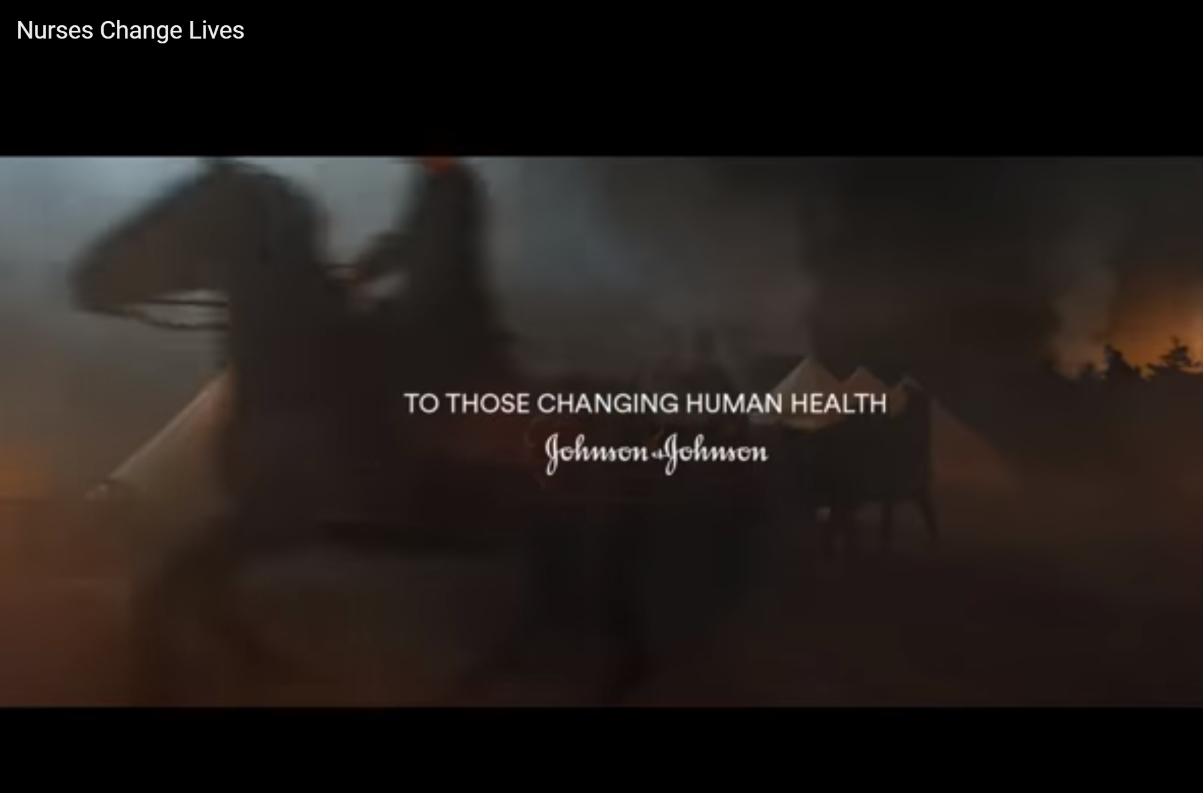
Nurses Who Innovate

Slide 9
How We Innovate
Lessons from work arounds
Patient care solutions
Innovation comes from the producer - not from the customer. W. Edwards Deming
Read more at https://www.brainyquote.com/quotes/w_edwards_deming_382723?src=t_innovation

Slide 10
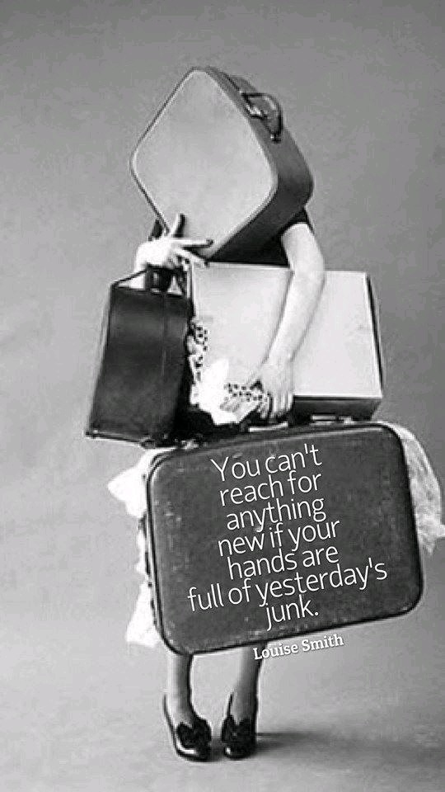
The First Step to Innovation

Slide 11
Innovation Step-by-Step
Darin Eich
Critical Thinking
Problem-solving
Strategic Thinking
Future vision
Creativity
Idea generation, design thinking
Collaboration
Relationships, networking
Understanding, influence
Communication
https://www.innovationtraining.org/innovation-skills-for-the-future/

Slide 12
ONS Center for Innovation
Purpose: To guide the development of new resources, projects, programs, and applications for ONS’s existing products as well as the creation of new, innovative ones that meet the needs of oncology nurses—both now and in the future.

Slide 13
INFLUENCE
Leadership is not about a title or a designation. It's about impact, influence and inspiration. Impact involves getting results, influence is about spreading the passion you have for your work, and you have to inspire team-mates and customers.
Robin S. Sharma

Slide 14
Who Influences You?
Who Do You Influence?

Slide 15
Influence
Local
State
National

Slide 16
Influence: Local
At work, in your chapter, other groups
  Gaining support
  Inspiring others
  Persuading other people to embrace a practice change
  Engaging others in a project
  Creating relationships

Slide 17
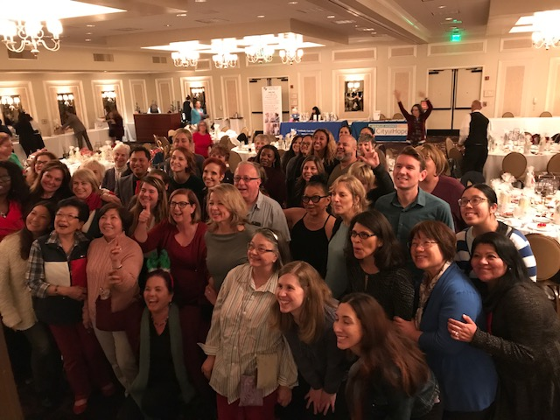
Influence: State

Slide 18
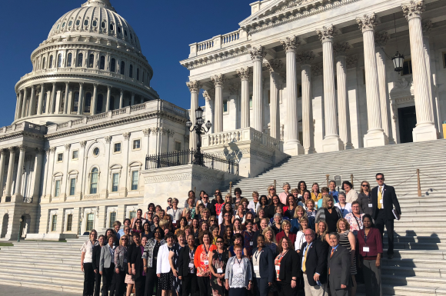
Influence: National

Slide 19
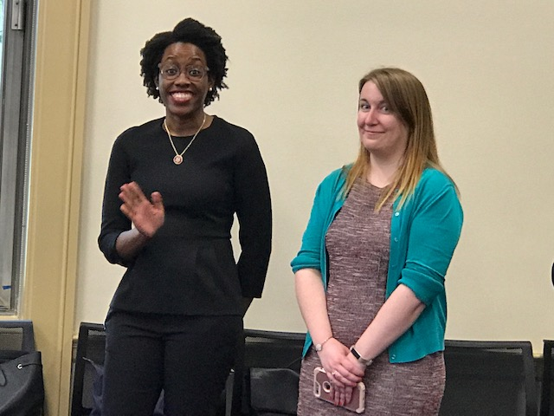
Influence: National

Slide 20
Influencing Skills
May need to adapt and modify personal style but still be true to self
  Interpersonal
  Communication
  Presentation
  Assertiveness

Slide 21
What is common to all 3?
The 4th “I”
  – interpersonal relationships
Leadership and followership

Slide 22
Why Inspire, Innovate, Influence?
For our patients and our profession.

Slide 23
Thank You
Keep Inspiring, Innovating, influencing

