Slide 1
Speech Disorders
Presented by:

Slide 2
Speech Disorder vs Language Disorder
When a person is unable to produce speech sounds correctly or fluently, or has problems with his or her voice, then he or she has a speech disorder

Slide 3
Speech Disorder vs Language Disorder
Difficulties pronouncing sounds (articulation) and stuttering are examples of speech disorders

Slide 4
Speech Disorder vs Language Disorder
When a person has trouble understanding others (receptive language), or sharing thoughts, ideas, and feelings completely (expressive language), then he or she has a language disorder.

Slide 5
Language is different from speech
Language is made up of socially shared rules that include the following:
What words mean (e.g., "star" can refer to a bright object in the night sky or a celebrity)
How to make new words (e.g., friend, friendly, unfriendly)

Slide 6
Language is different from speech
Speech is the verbal means of communicating. Speech consists of the following:
Articulation
Voice
Fluency

Slide 7
Language is different from speech
Articulation: How speech sounds are made (e.g., children must learn how to produce the "r" sound in order to say "rabbit" instead of "wabbit").

Slide 8
Language is different from speech
Voice: Use of the vocal folds and breathing to produce sound (e.g., the voice can be abused from overuse or misuse and can lead to hoarseness or loss of voice).

Slide 9
Language is different from speech
Fluency: The rhythm of speech (e.g., hesitations or stuttering can affect fluency).

Slide 10
Speech Disorders
There are many types of Speech Disorders. These include:
Apraxia
Dysarthria
Stuttering
Voice

Slide 11
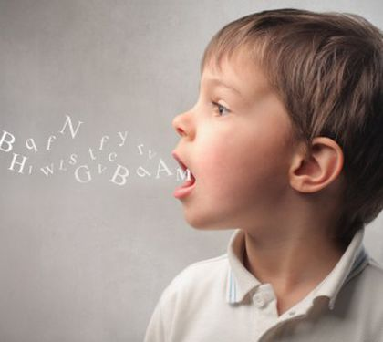
Apraxia

Slide 12
Apraxia
Apraxia of speech is a motor speech disorder. The messages from the brain to the mouth are disrupted, and the person cannot move his or her lips or tongue to the right place to say sounds correctly, even though the muscles are not weak. The severity of apraxia depends on the nature of the brain damage.

Slide 13
Apraxia
Apraxia can occur in conjunction with dysarthria (muscle weakness affecting speech production) or aphasia (language difficulties related to neurological damage). Apraxia of speech is also known as acquired apraxia of speech, verbal apraxia, and dyspraxia.
Children can also have apraxia, referred to as childhood apraxia of speech.

Slide 14
Apraxia
Signs and Symptoms:
Individuals with apraxia of speech know what words they want to say, but their brains have difficulty coordinating the muscle movements necessary to say all the sounds in the words. As a result, they may say something completely different or make up words (e.g., "bipem" or "chicken" for “kitchen").

Slide 15
Apraxia
Signs and Symptoms:
The person may recognize the error and try again—sometimes getting it right, but sometimes saying something else entirely. This situation can become quite frustrating for the person.

Slide 16
Apraxia
Individuals with apraxia may demonstrate:
difficulty imitating and producing speech sounds, marked by speech errors such as sound distortions, substitutions, and/or omissions
inconsistent speech errors
groping of the tongue and lips to make specific sounds and words

Slide 17
Apraxia
Individuals with apraxia may demonstrate:
slow speech rate
impaired rhythm and prosody (intonation) of speech
better automatic speech (e.g., greetings) than purposeful speech
inability to produce any sound at all in severe cases.

Slide 18
Apraxia
Causes:
Apraxia of speech is caused by damage to the parts of the brain that control coordinated muscle movement. A common cause of acquired apraxia is stroke.
Other causes include traumatic brain injury, dementia, brain tumors, and progressive neurological disorders.

Slide 19
Apraxia
Diagnosis:
A speech-language pathologist (SLP) uses a combination of formal and informal assessment tools to diagnose apraxia of speech and determine the nature and severity of the condition.
The assessment typically includes examinations of the individual’s oral-motor abilities, melody of speech, and speech sound production in a variety of contexts

Slide 20
Apraxia
Treatment:
An SLP can work with people with apraxia of speech to improve speech abilities and overall communication skills. The focus of intervention is on improving the planning, sequencing, and coordination of muscle movements for speech production. The muscles of speech often need to be "retrained" to produce sounds correctly and sequence sounds into words. Exercises are designed to allow the person to repeat sounds over and over and to practice correct mouth movements for sounds.

Slide 21
Apraxia
Treatment:
The person with apraxia of speech may need to slow his or her speech rate or work on "pacing" speech so that he or she can produce all necessary sounds. In severe cases, augmentative and alternative communication may be necessary (e.g., the use of simple gestures or more sophisticated electronic equipment).

Slide 22
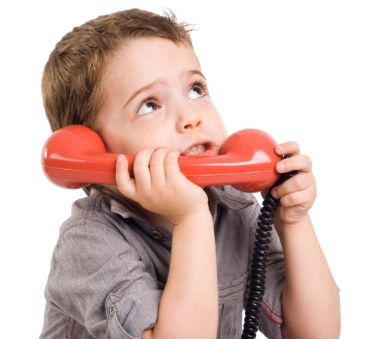
Dysarthria

Slide 23
Dysarthria
Dysarthria is a motor speech disorder. It results from impaired movement of the muscles used for speech production, including the lips, tongue, vocal folds, and/or diaphragm. The type and severity of dysarthria depend on which area of the nervous system is affected

Slide 24
Dysarthria
Signs & Symptoms:
A person with dysarthria may demonstrate the following speech characteristics:
"Slurred," "choppy," or "mumbled" speech that may be difficult to understand
Slow rate of speech

Slide 25
Dysarthria
Signs & Symptoms:
Rapid rate of speech with a "mumbling" quality
Limited tongue, lip, and jaw movement
Abnormal pitch and rhythm when speaking
Changes in voice quality, such as hoarse or breathy voice or speech that sounds "nasal" or "stuffy"

Slide 26
Dysarthria
Causes:
Dysarthria is caused by damage to the brain. This may occur at birth, as in cerebral palsy or muscular dystrophy, or may occur later in life due to one of many different conditions that involve the nervous system, including:

Slide 27
Dysarthria
Causes:
stroke
brain injury
tumors
Parkinson's disease
Lou Gehrig's disease/amyotrophic lateral sclerosis (ALS)
Huntington's disease
multiple sclerosis

Slide 28
Dysarthria
Diagnosis:
A speech-language pathologist (SLP) can evaluate a person with speech difficulties and determine the nature and severity of the problem. The SLP will look at movement of the lips, tongue, and face, as well as breath support for speech and voice quality. The assessment will also include an examination of speech production in a variety of contexts

Slide 29
Dysarthria
Treatment:
Treatment depends on the cause, type, and severity of the symptoms. An SLP works with the individual to improve communication abilities. Some possible goals of treatment include:
Slowing the rate of speech
Improving the breath support so the person can speak more loudly
Strengthening muscles

Slide 30
Dysarthria
Treatment:
Increasing tongue and lip movement
Improving speech sound production so that speech is more clear
Teaching caregivers, family members, and teachers strategies to better communicate with the person with dysarthria
In severe cases, learning to use alternative means of communication (e.g., simple gestures, alphabet boards, or electronic or computer-based equipment)

Slide 31
Dysarthria
Communication Tips for the Person with Dysarthria
Introduce your topic with a single word or short phrase before beginning to speak in more complete sentences.
Check with the listeners to make sure that they understand you.
Speak slowly and loudly and pause frequently.
Try to limit conversations when you feel tired—when your speech will be harder to understand.
If you become frustrated, try to use other methods, such as pointing or gesturing, to get your message across or take a rest and try again later.

Slide 32
Dysarthria
Communication Tips for the Listener
Reduce distractions and background noise.
Pay attention to the speaker.
Watch the person as he or she talks.
Let the speaker know when you have difficulty understanding him or her.
Repeat only the part of the message that you understood so that the speaker does not have to repeat the entire message.
If you still don't understand the message, ask yes/no questions or have the speaker write his or her message to you.

Slide 33


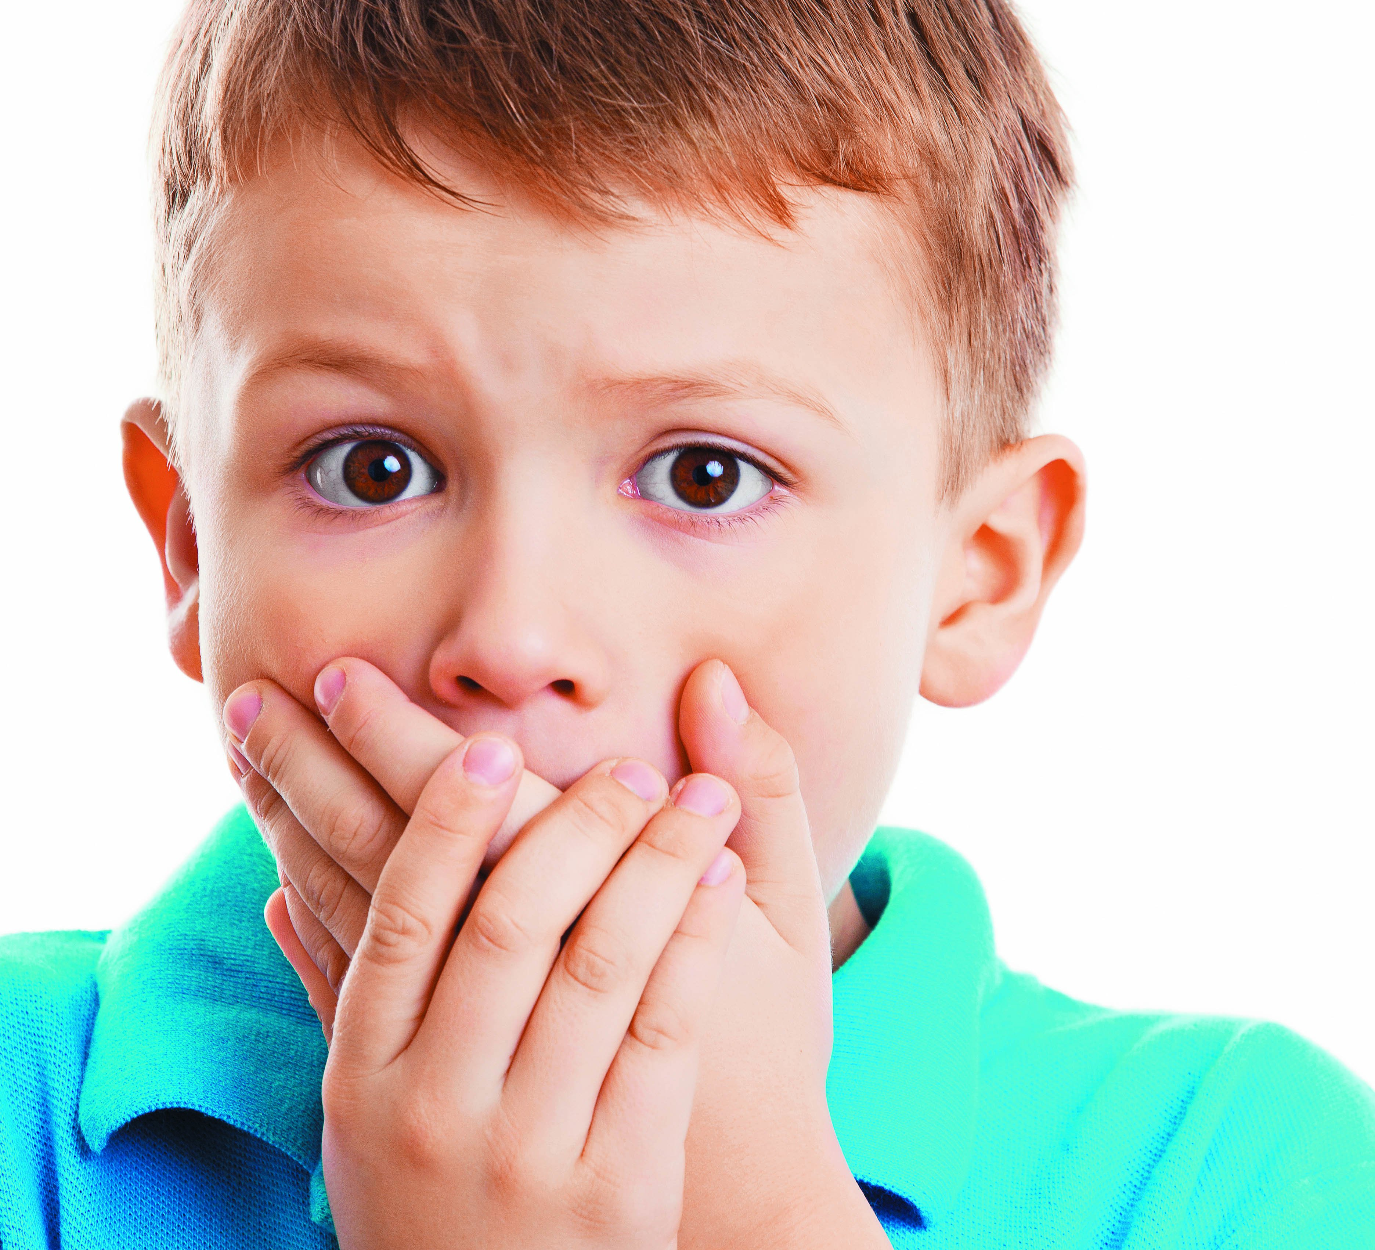
Stuttering

Slide 34
Stuttering
Stuttering affects the fluency of speech. It begins during childhood and, in some cases, lasts throughout life. The disorder is characterized by disruptions in the production of speech sounds, also called "disfluencies." Most people produce brief disfluencies from time to time. For instance, some words are repeated and others are preceded by "um" or "uh." Disfluencies are not necessarily a problem; however, they can impede communication when a person produces too many of them.
In most cases, stuttering has an impact on at least some daily activities. The specific activities that a person finds challenging to perform vary across individuals. For some people, communication difficulties only happen during specific activities, for example, talking on the telephone or talking before large groups. For most others, however, communication difficulties occur across a number of activities at home, school, or work. Some people may limit their participation in certain activities. Such "participation restrictions" often occur because the person is concerned about how others might react to disfluent speech. Other people may try to hide their disfluent speech from others by rearranging the words in their sentence (circumlocution), pretending to forget what they wanted to say, or declining to speak. Other people may find that they are excluded from participating in certain activities because of stuttering. Clearly, the impact of stuttering on daily life can be affected by how the person and others react to the disorder.

Slide 35
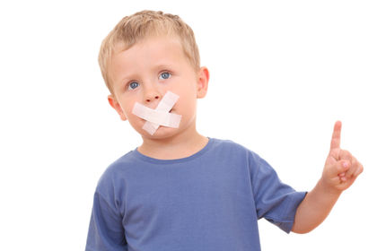
VOICE

Slide 36

Thank You

