Slide 1
MUSIC HISTORY OF EARLY NORTH AMERICA Slides 10-17
Mr. McSymphony™’s
A Mr. McSymphony™ Program
©2015 all right reserved
1 B

Slide 2
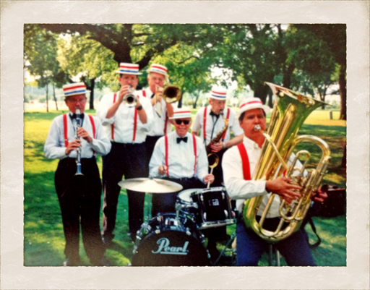
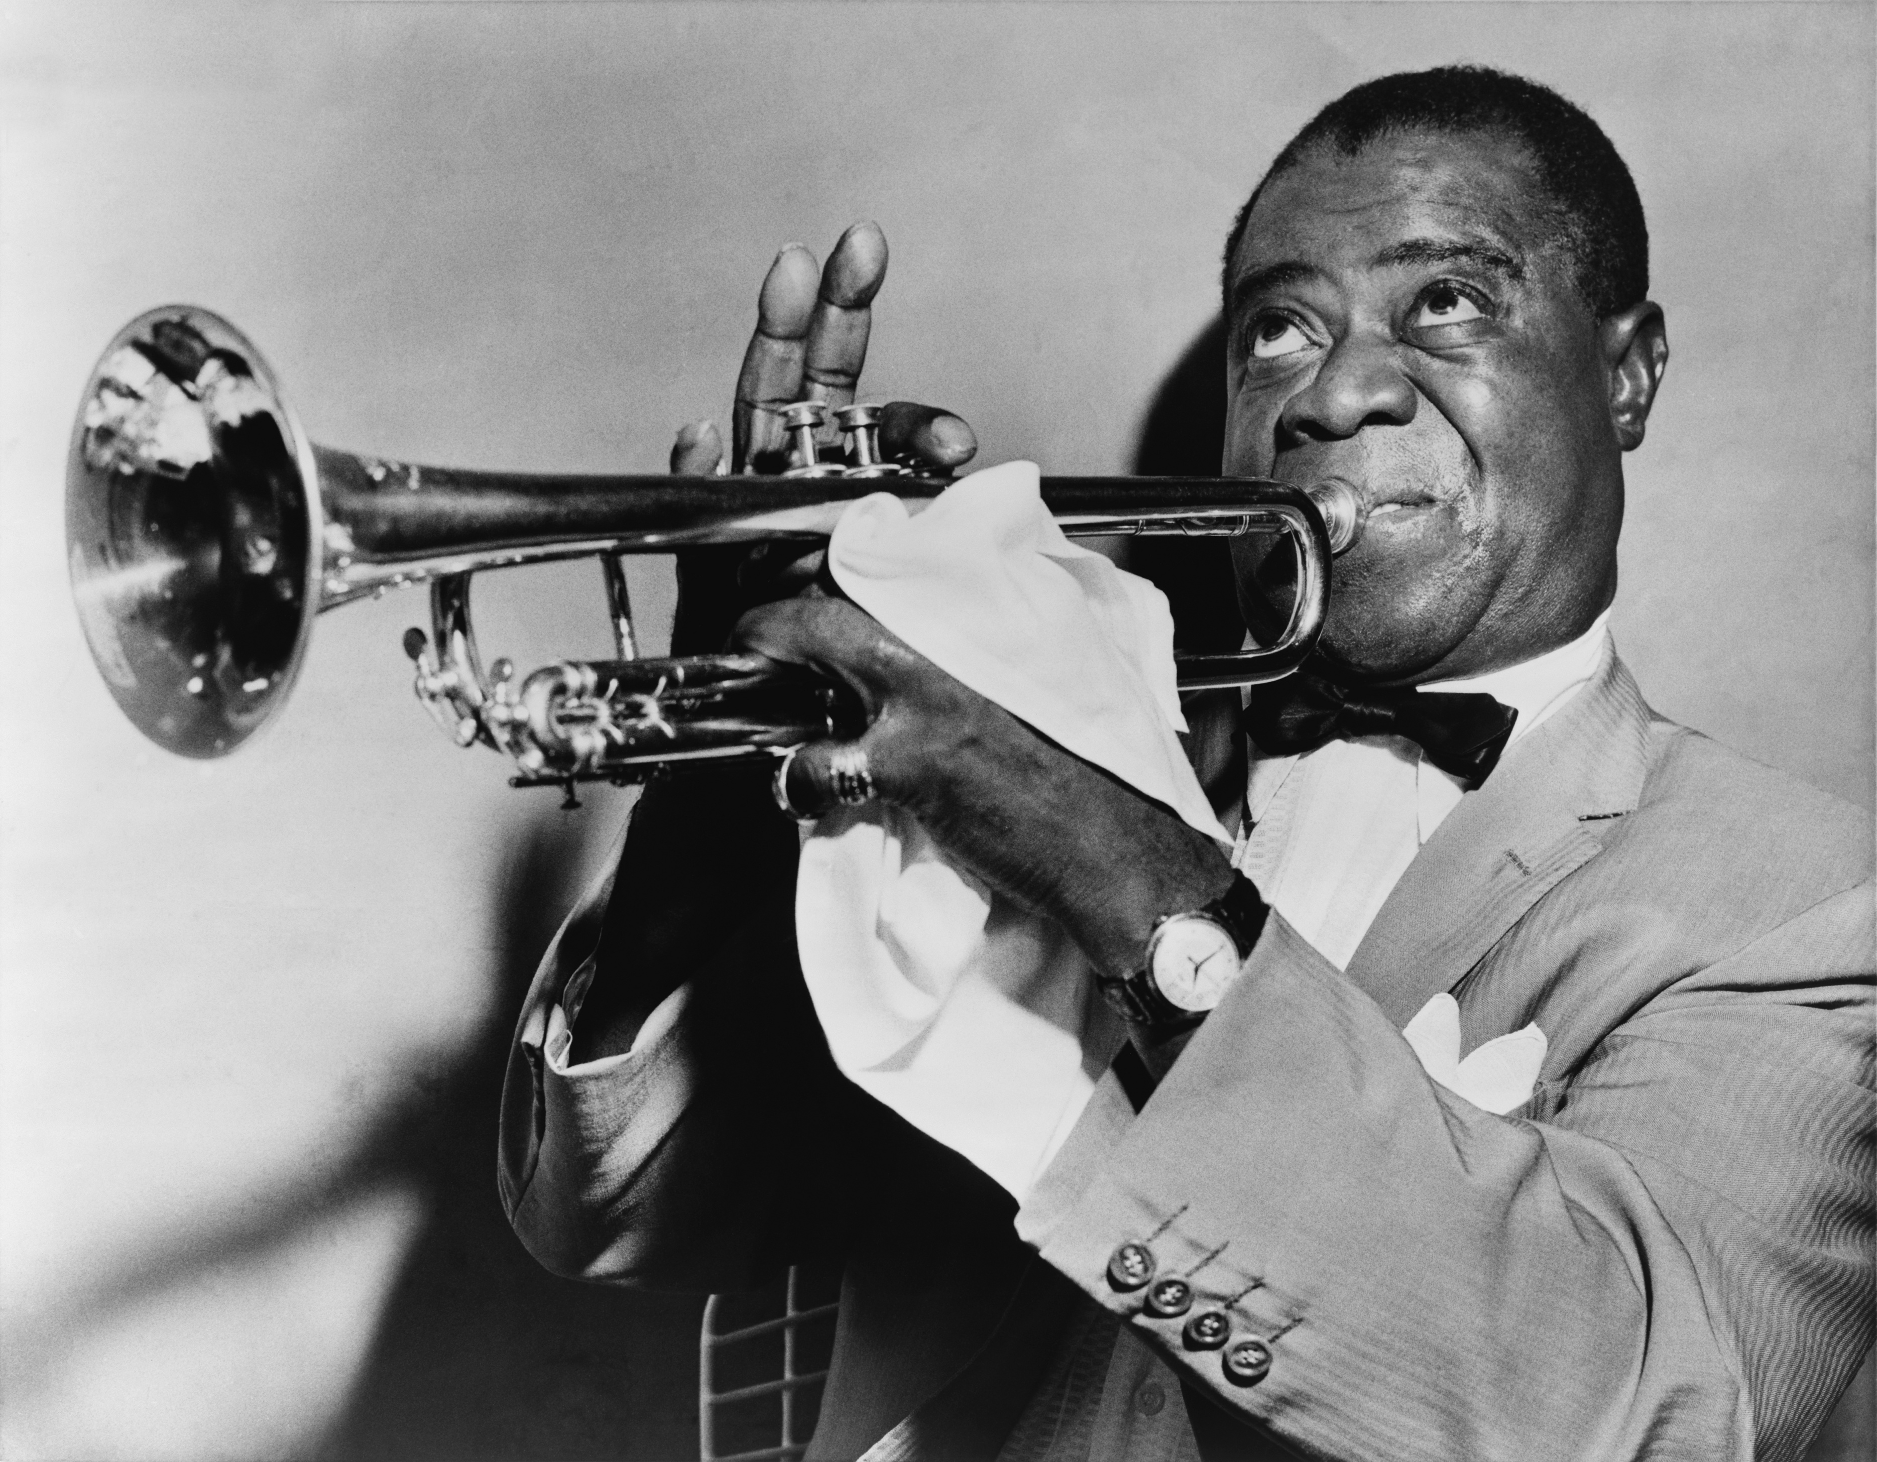
DIXIELAND JAZZ
A JAZZ BAND
LOUIS “SATCHMO”” ARMSTRONG
10

Slide 3
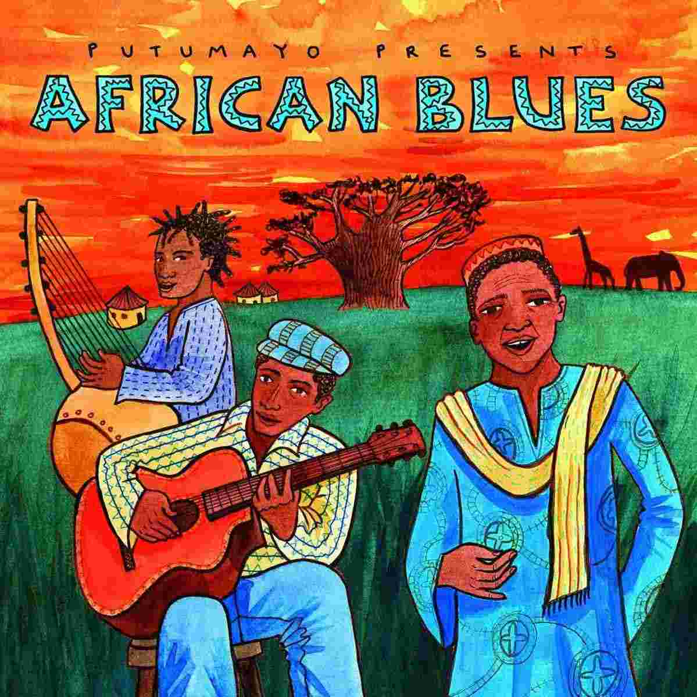
THE BLUES
Duke Ellington and his Orchestra
11

Slide 4
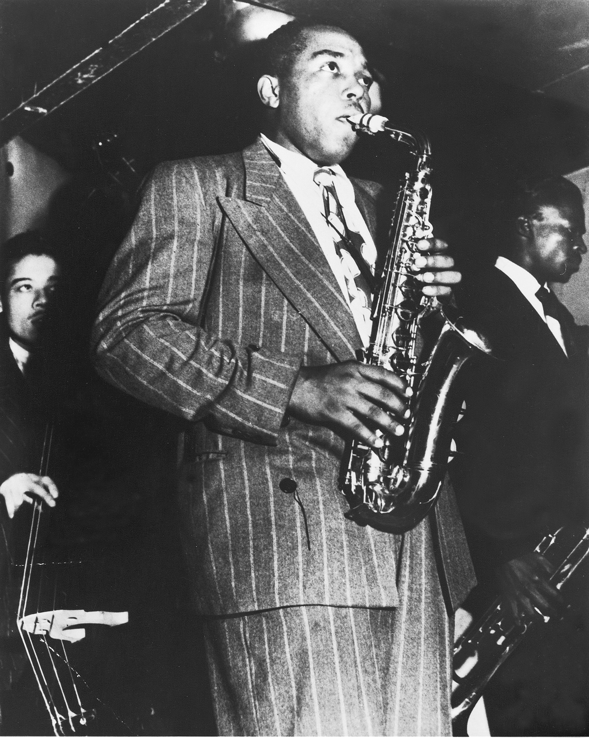
BEBOP
CHARLIE “YARDBIRD” PARKER
12

Slide 5
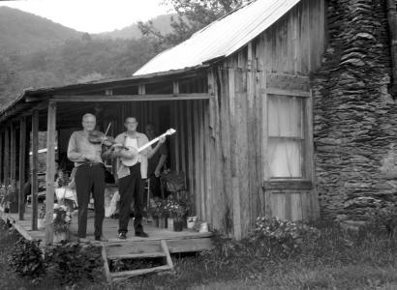
APPALACHIA
13

Slide 6
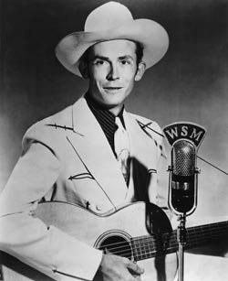
COUNTRY MUSIC
THE FATHER
OF
MODERN COUNTRY MUSIC
HANK WILLIAMS
14

Slide 7
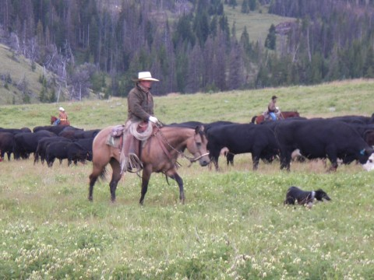
WESTERN MUSIC
A CATTLE ROUNDUP
15

Slide 8
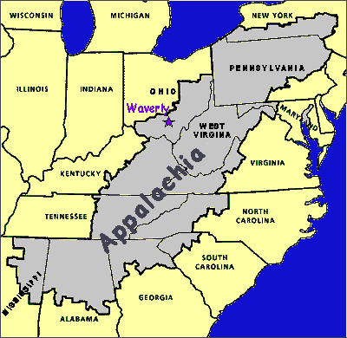
BLUEGRASS MUSIC
BLUEGRASS INSTRUMENTS
APPALACHIA TERRITORY
16

Slide 9
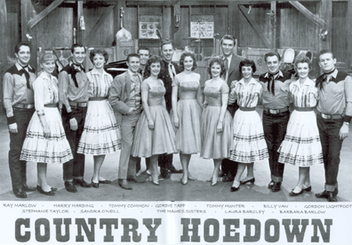
AARON COPLAND
CONDUCTOR AND COMPOSER
17

