Slide 1
O365 & AD Integration
January 2017

Slide 2
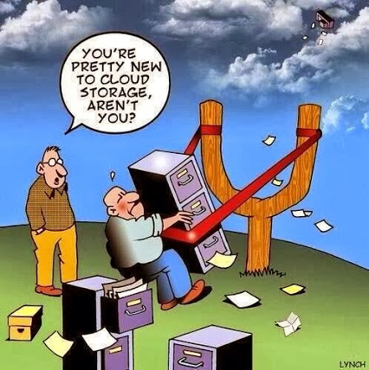
Benefits of Office 365 for Education
Install Office on up to 5 PC’s/Macs + 5 tablets + 5 smartphones per user
Access to Office Online
OneDrive for Business 1 TB online personal storage

Slide 3
Benefits of Office 365 for Education
Email
Sway (Report and presentation creator)
SharePoint Sites
Yammer (Social Networking)
Skype for Business (Web conferencing, IM, Video, presence)
24\7 phone support from Microsoft

Slide 4
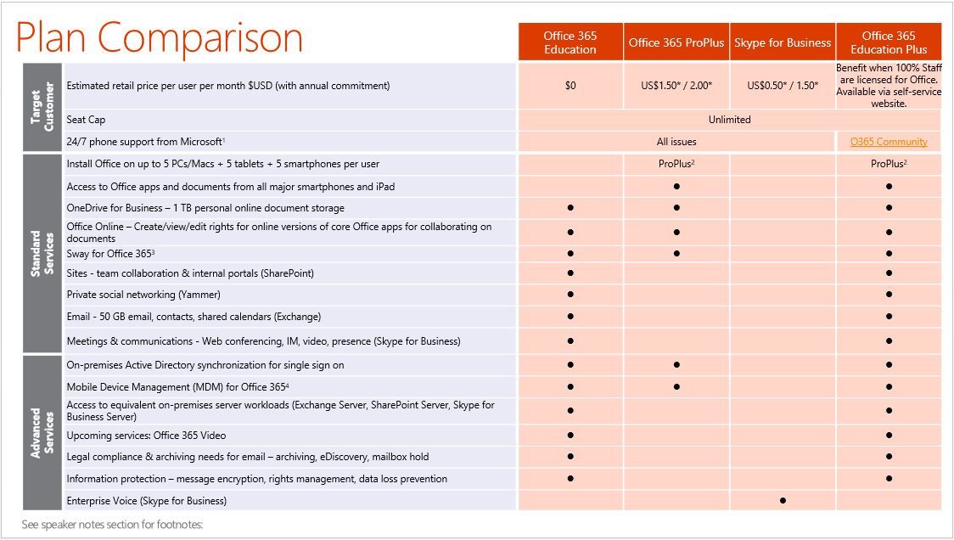
Sampl Slide 3

Slide 5
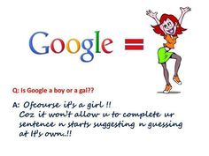
Office 365 Benefits Colleges even if they do not use Cloud Exchange.
Colleges using Gmail can now offer Microsoft Office Applications to all Faculty, Staff and Students.
Cloud based and full Applications are available at no additional charge when the college maintains a Campus Agreement licensing 100% of the staff for office.
* Office 365 can be deployed fully self-service without AD Integration.

Slide 6
Pros and Cons of Office 365
Questions or Comments
A few answers and a lot of networking!

Slide 7
Benefits of Active Directory Integration
AD Connect
Access On Premise Applications and Cloud Services with Single Identity
Single Tool for deployment

Slide 8
Synchronization of Specified Organizational Units from your on-premise Active Directory to the cloud.
Allows synchronization of Specified AD Attributes
Allows timed synchronizations, every 30 minutes is the default.

Slide 9
User Information and changes occur in only one location. On-Premise Active Directory
Usernames
Passwords
Addresses
Groups
Mail list
Attributes

Slide 10
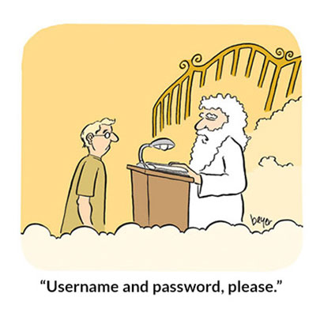
User Passwords can be set once for an Active Directory User and the change automatically occurs at Office 365.
Office 365 uses local AD password policy.
Passwords synchronize immediately
Any AD Password Reset Server that resets the AD password can be used as the tool to reset AD integrated Office 365 Users.

Slide 11
Ease of Implementation
AD Connect runs on Windows 2008R2, 2012R2 or 2016
Dedicated Server on same vlan as at least one Domain Controller
Be sure to physically and cyberly SECURE access to this server. It contains your AD Database. (Treat it like a domain controller.)

Slide 12
AD Connect server can be Virtual
(recommended to be virtual)
Provision as follows:
100GB Disk (Thin Provisioned)
16GB RAM
2-4 CPU
(Over 10,000 users, Less Ram and CPU will slow sync, Over 50,000 users should have 32GB+ Ram)

Slide 13
Installation and Configuration of AD Connect Discussion

Slide 14
How Azure AD works
https://docs.microsoft.com/en-us/azure/active-directory/connect/active-directory-aadconnect
Azure AD is made up of 3 components
The Synchronization Module
Active Directory Federation Services (Optional)
The Monitoring component

Slide 15
Azure Powershell vs
Windows Powershell
Windows Powershell
Windows PowerShell is a scripting platform.
You can run various commands using it.
You can also write scripts which are a set of commands.
Those scripts are called Cmdlets.
You can find a lot of Cmdlets written by others.
For example, the Windows Azure team has written some Cmdlets, which they call Windows Azure PowerShell. So Windows Azure PowerShell is a set of scripts that rely on Windows PowerShell platform to run. But it also relies on the Windows Azure SDK, just like you can write your own PowerShell script that uses a third party SDK, thus the script requires both Windows PowerShell and that third party SDK (aka a Software Development Kit).

Slide 16
Windows Powershell
Is installed as a part of Windows Server 2008R2 and newer Windows Server OS
Location:
C:\WINDOWS\system32\WindowsPowerShell\v1.0
Manages all Active Directory Attributes
Create, Modify, Delete
(some can only be modified via powershell)
Can Manage other Applications with imported modules

Slide 17
Windows Powershell can and should be upgraded to the latest:
Windows Management Framework (4.0 at least)
Should almost always be: Run as Administrator
Can be automated with Task Scheduler
Windows Powershell can manage most of the AD Connect components without installing Azure Powershell
(AD Connect installation adds necessary SDK’s)

Slide 18
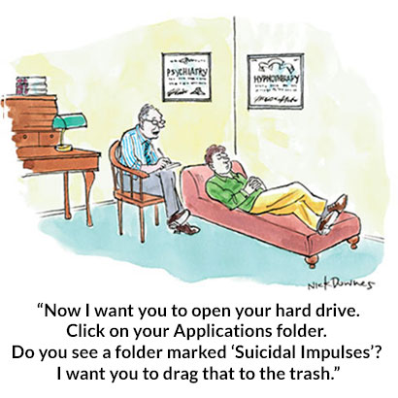
Windows Azure Active Directory Powershell
Best to install Windows AZURE Active Directory Powershell on AD Connect Server
Also install Windows AZURE Active Directory Powershell on at least one Domain Controller
(This server will run scheduled task involving both AD and O365…ie licensing O365 users by OU.)

Slide 19
Azure powershell is a subset of scripts pre-populated specifically for managing Office 365
Set number of Deletions in a 24 hour period
Manual Synchronizations
Single Sign on and Federation of Tenant
Many other management options
Change User Principal Names
Verify user information
Proxy addresses
Applied Licenses
Apply Address Book separations
Many more available options

Slide 20
Verification and Modification of AD or O365 object information
Export information via .csv or email
Examples of items for verification, modification and export
Proxy addresses
Licenses
Address Book attributes
Group Memberships
User Counts per OU or Domain

Slide 21
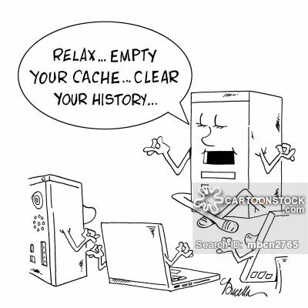
Questions
A few answers
A lot of comments
Powershell scripting is one item that could be discussed for weeks…months…. You can accomplish almost anything with a script ☺

Slide 22
AD and Office 365 Integration should be an extension of your Colleague Webadvisor and AD LDAP integration
Colleague Webadvisor User creation drives creation of Active Directory Accounts.
Accounts are placed in Active Directory OU’s based on Colleague Users HR.STATUS
(Other options are available) SE or NULL becomes a Student, Everything else is an employee

Slide 23
Once we distinguish between Students and Employees we can further divide into OU’s
Faculty\Staff go into a single OU: newemp
(users easily located to assign other AD rights and permissions then moved to proper OU)
Students
A
B
C
etc
(users are easily located to assign other AD rights and permissions then moved to proper OU)
(based on first or last name, This will normally make the OU have less than 5000 objects, thus working around some LDAP limitations)

Slide 24
Once we have users in an OU we can proceed to manage things such as:
Type of O365 license
Members of Groups can be based on OU
Students_A, Students_B
Eliminates the >5000 user send issue associated with most mail servers
UPN (Universal Principal Name)
userid@domain.edu
userid@students.domain.edu
ETC…!!!

Slide 25
Lots of Discussion
Maybe a few answers
A lot of NETWORKING (find some peer partners)
A great deal of food for thought!
I like food….let’s have ice cream
(my favorite…Heavenly Hash)

Slide 26
O365 and AD Integration
Presentation to lead discussion
Compiled by:
Sherry Johnson
EIS Data Systems, Inc.
January 2017
All cartoons thankfully copied from internet!
Thank you Google!

