Slide 1

RSAI Regional Meeting
SE Region
June 9, 2020

Slide 2


New to Zoom
Toolbar at the bottom – activates when you move your cursor to the bottom
Mute when not speaking (remember to unmute when speaking)
Stop video if you are having bandwidth problems (or if you are in your PJs and don’t want to share)
View – upper right hand corner
Voting/reactions – use thumbs up for yes
Under manage participants – white screen to the right, includes yes and no

Slide 3
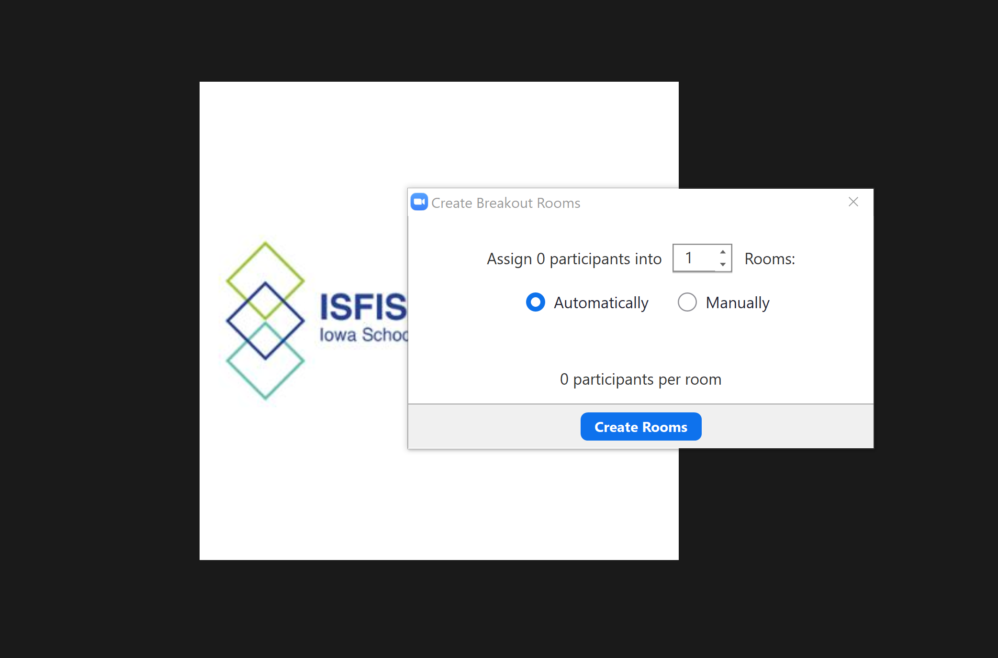
Breakout Rooms for conversation
Will assign a few participants to each breakout room. Tasked with answering two questions:
1: Should all of the existing RSAI 2020 priorities continue?
2: What additional priorities should be considered?

Slide 4
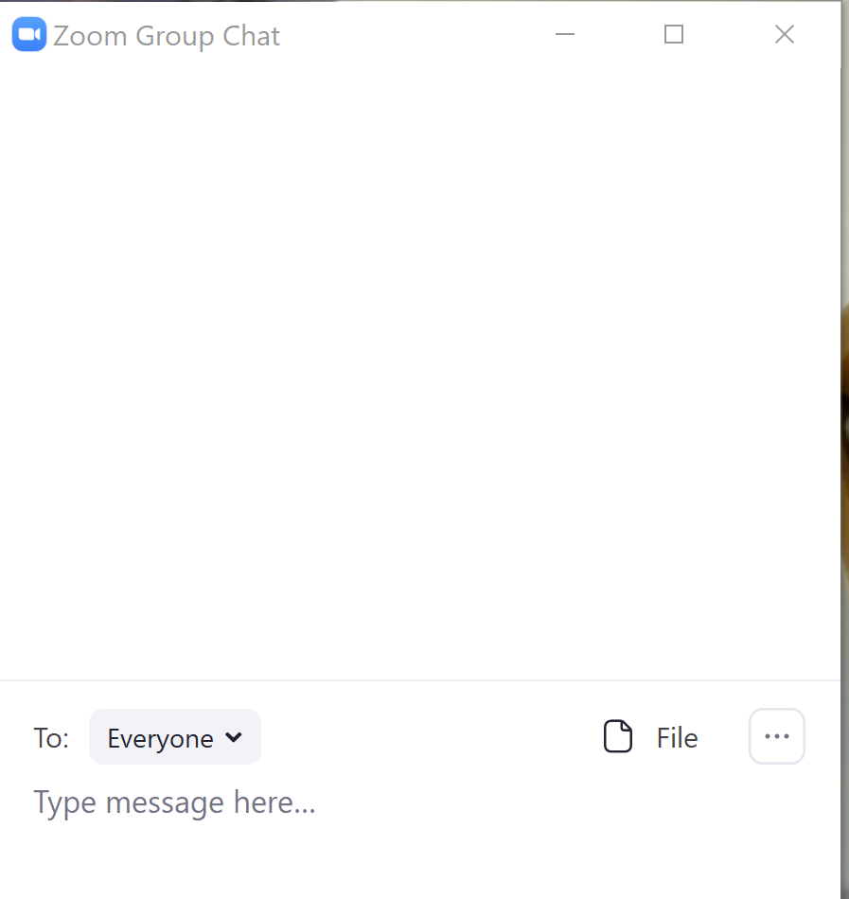
Chat
Chat allows you to send a message to everyone.
It’s a great way to ask a question, share your thoughts, resolve a technical issue, or create a record.
The Chat is saved after the meeting, so if we have a close vote, we may ask you to confirm your vote via chat to help with the minutes.

Slide 5

Voting / Reactions
Thumbs up will be used for any votes taken.
Under the reactions button at the bottom tool bar, you can click on the thumbs up.
Keep it up there (or if it clicks off on its own, select it again, until we get a count.

Slide 6
RSAI Regional Meeting
SE Region
June 9, 2020

Slide 7

RSAI Team
Laurie Noll, SE Region Rep
Joel Pedersen, Legislative Rep
Jen Albers, Administrator
Larry Sigel, ISFIS Partner
Margaret Buckton, Professional Advocate
Dave Daughton, Legislative Advocate

Slide 8
Introductions
Name ____________________________________
District Role ____________________________________
One great thing about rural education
____________________________________
____________________________________

Slide 9
Agenda – uploaded in your chat window (2020 priorities on Page 2)
Laurie will chair the meeting
Vote with thumbs up
If there’s any doubt, we’ll take an official vote via poll question or chat
Let’s practice – go to your tool bar, click on reactions, and select thumbs up

Slide 10
1. Motion to approve the agenda _____________ second _________
2. Election of SE Representative to Leadership Group – current term ending. New three-year term is Sept 2020- Aug 2023
    Laurie has served for three years, but there are no term limits.
    Leadership Group involves almost monthly virtual meetings, October 21 Annual Meeting and arranging for and chairing the summer regional meeting. Occasional signatures on letters to the media or outreach to legislators (all with your pre approval)
  Nominations? _____________ second ___________
  Nominations? _____________ second ___________

Slide 11
3. Election of RSAI District Liaison to Legislative Group
  Attends two meetings: Legislative Group meeting at ISFIS Aug. 14 and Annual Meeting in Ankeny, Oct. 21, 2020
  Supports legislative advocacy during the 2021 Session
  Thanks to Joel Pedersen for serving in 2020 (there are no term limits)
  Nominations? _____________ second ___________

Slide 12
4. Consideration of Proposed Amendments to RSAI Bylaws if Any
  (requires 2/3 majority of those present)
  No proposals received prior to the meeting
  Are there any proposals to come from the participants today?

Slide 13
5. Review of 2020 Legislative Session and Data supporting Key Issues Critical to RSAI member districts: Margaret Buckton, ISFIS Partner and RSAI Professional Advocate

Slide 14
Recent Accomplishments Benefiting Rural Districts
Before 2018:
  Management fund authority to pay for retirements over age 65 and costs of arbitration
  PPEL flexibility to pay for repairs over $1,500
  DoP Flexibility
  Home Rule Statute
  Categorical Fund Flexibility
In 2018 Session
  Even more DoP Flexibility
  Even more Categorical Fund Flexibility
  Staff Flexibility – CTE options for hard-to-staff content and local offerings of on-line learning
  Progress on Transportation (grants) and Formula Equality
  Extension of Operational Sharing Incentives
In 2019 Session
  Transportation in the Formula
  Formula Equity
  Extension of WGS/reorganization Incentives
  State Penny Extension
  Teacher shortage flexibility: Praxis waiver, concurrent enrollment STEM offer and teach, online learning flexibility

Slide 15

2020 Session
Some done, but not done yet
RSAI Priority action
Issues pending
COVID-19 Impact
Broadband Access Challenges

Slide 16


School Funding
Alton, IL

Slide 17
Action and Comments
SF 2142 sets SSA at 2.3% per pupil for FY 2021. Still short of the 3.75% RSAI request. Yet, 2nd highest increase in 11 years! ($7,048 is the FY21 SCPP)
2.3% growth rate also applies to each of the State categorical supplement and to the standing appropriation for the Transportation Equity Fund.
Provides additional property tax replacement funding, which keeps the additional levy amount frozen at $750 per pupil, regardless of the per pupil increase for FY 2021. (This provision prevents a per pupil property tax increase equivalent to one-eighth of the total per pupil increase.)
This 2.3% increase leaves 106 school districts with declining enrollment on budget guarantee, which is a one-year influx of local property tax dollars that will be subtracted from the regular program budget in the following year.

Slide 18

Student Mental Health
Shutterstock
UNL-Nebraska Today
2.6.2019

Slide 19
Action and Comments
HF 2192 Telehealth Parity: Approved by House and Senate Human Resources Committee, now on the Senate Calendar.
SF 2261 Telehealth Services at School: approved in both chambers and to the Governor.
SF 2360 Therapeutic Classrooms/Behavior (companion HF 2532): Approved by Senate and amended in House Appropriations; now on the House calendar
Appropriations process, which could include mental health funding, likely in HHS appropriations bill, is starting up again this week.
NOTE: CARES act includes student and staff mental health as allowable expenditures. Some COVID-19 impact on mental health is expected.

Slide 20

Educator and Staff Shortage
Pennsylvania PressandJournal.com

Slide 21
Action and Comments
HF 2629 and SF 2414 Governor Reynolds’ Future Ready Act bills require a half unit of computer science to meet offer and teach requirements. RSAI amendment was accepted to allow financial literacy, foreign language and this new CS course, even if offered exclusively online, to meet offer and teach requirements and to eliminate the need for a waiver for those specific courses. The mandate is delayed until July 1, 2022. Bills on respective calendars.
SF 2310 Online Learning: requires AEAs to serve as clearinghouse, require districts that create online learning coursework submit to DE for confirmation that it aligns to core standards, and corrects a typo in the Iowa Code to allow districts up to two additional offer and teach courses be allowed online under certain conditions. Approved by Senate, amended in House Ed Committee, now on the House Floor. Will be the vehicle for all kinds of district flexibility (PD or management fund to pay for additional instruction, virtual learning, etc.)
HF 2359 Teacher Preparation Reports: removes the requirement that students applying to a college of education have a minimum test score on the Praxis I, eliminates the mandate for teacher prep programs to administer the test before entrance into the program. On Senate Calendar.
HF 2454 Community College Instructors: allows a community college instructor to teach CTE courses with a bachelor's degree & 18 credit hours in the CTE field or an associate degree if that is the final degree in the CTE field & 3,000 hours of relevant work experience. Signed by the Governor.
NOTE: Economic fallout due to COVID-19 may encourage some to return to teaching. However, challenges of distance learning, unknown future and continued pressures of school improvement may also encourage more senior staff to retire. Budget issues may further compound ability of schools to pay competitive wages. Lots of unknowns.

Slide 22
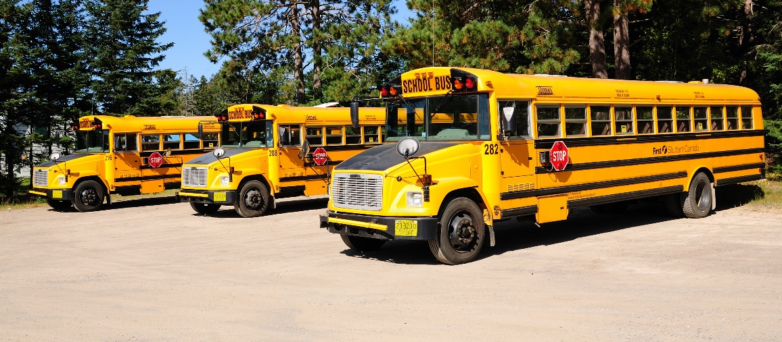
Transportation Equity
Formula Equality

Slide 23
Action and Comments
Transportation Equity : SF 2164 enacted
Formula supplement instead of a grant – much more secure.
Reimbursement is based on prior year’s expenditures (and other factors in a formula)
Brings all districts down to $348 per pupil enrolled (state average per FY 2019 Annual Transportation Report)
DE is required to review usage and the formula.
Formula Equality: SF 2164 enacted
Progress to close the gap in the $165 district cost per pupil.
Raises the minimum by $10 per pupil (RSAI asked for faster pace than prior years’ $5 per pupil and they delivered)
Remaining gap is $155 per pupil
This faster pace will close the gap in 15 years rather than 33.
NOTE: Age and health conditions of bus drivers may be an issue in school reopenings. Unsure of how Spring 2020 Closures will impact transportation expenditures or of staffing needs in Fall 2020.

Slide 24
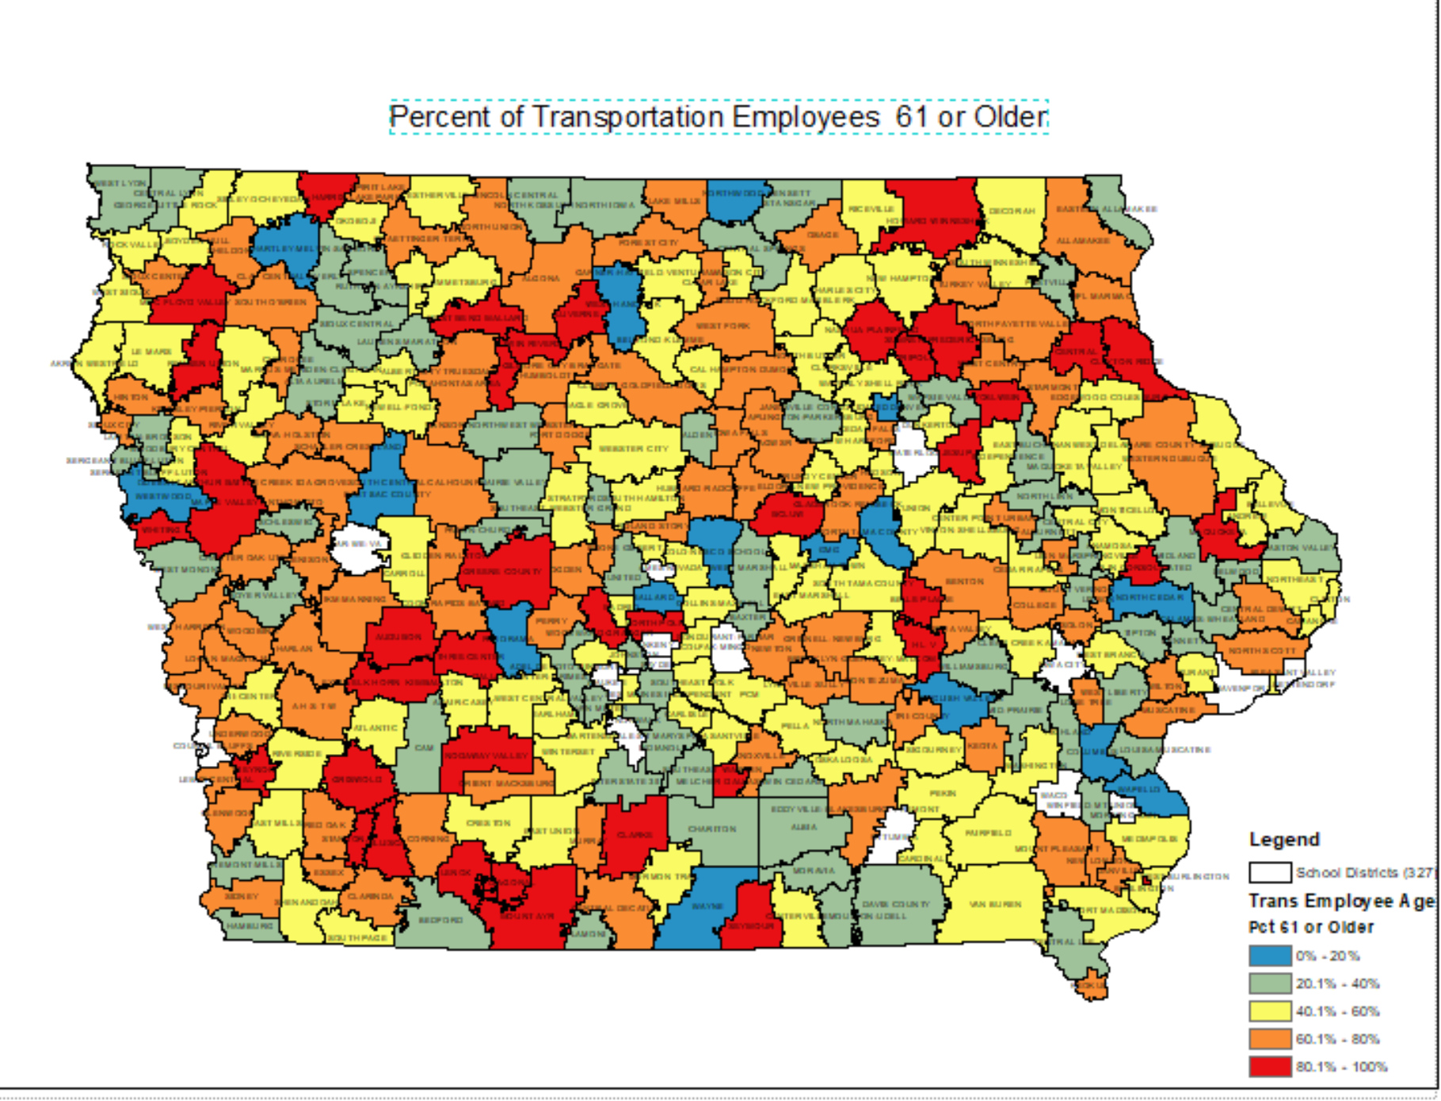

Slide 25
Source: Fall 2019 BEDS Staff file

Slide 26
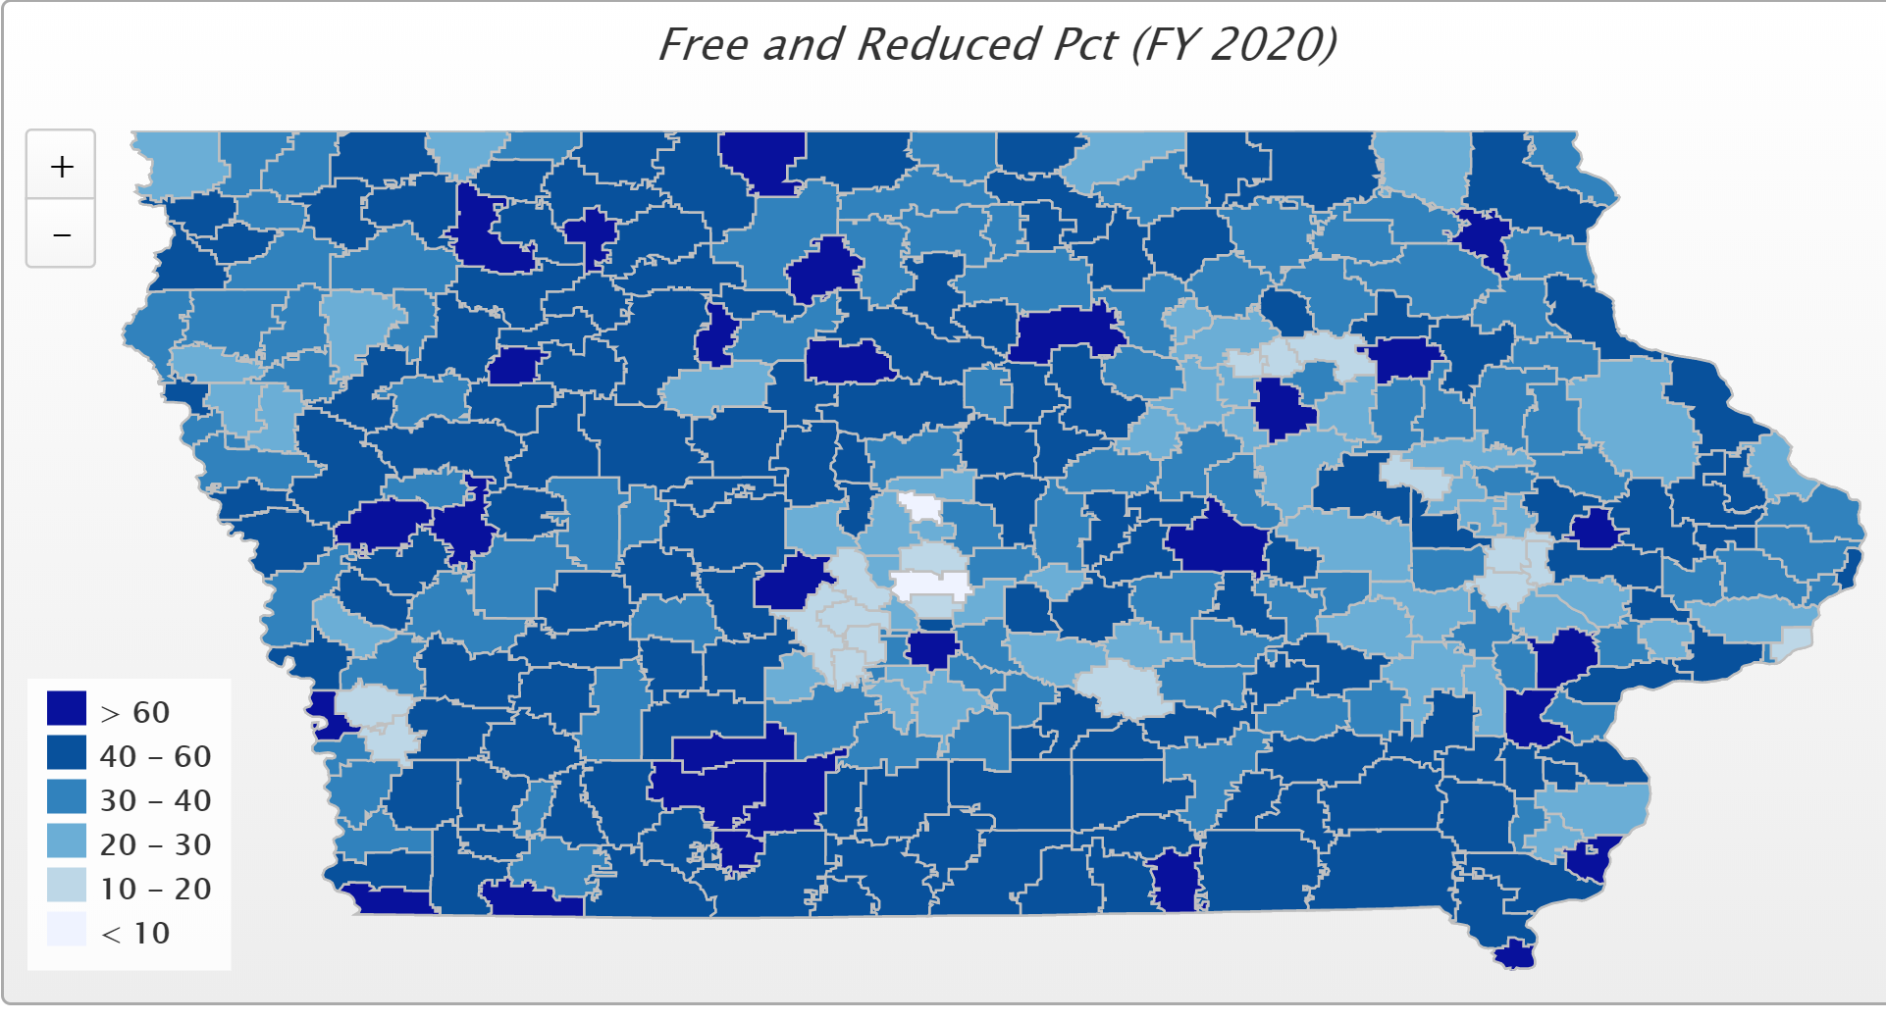
Funding/Equity for At-risk Students

Slide 27
Action and Comments
School Finance Interim Committee unanimously recommended studying impact of poverty on education and other state approaches to funding (ISFIS Presentation on categorical funding approaches shared other state experience and stated that poverty is the next major inequity)
HF 2490 requires the Department of Education to convene a poverty study workgroup. Approved in House Education. In House Appropriations with subcommittee recommending passage, but not likely to move further.
HF 2497 DoP Equity would allow school districts with a cap in dropout prevention authority lower than 5% to annually request the additional authority up to 5% from the School Budget Review Committee.
In the House Appropriations Committee. A subcommittee of Rep. Dolecheck, Kerr and Winckler was assigned on March 11, but has not yet met on the bill.
COVID closures likely to increase learning gaps and bring poverty inequities to light.

Slide 28
Reorganization and Whole Grade Sharing Incentives Extension
47 fewer districts today than in 2003-04

Slide 29
Sharing and Reorganization
HF 2629 and SF 2414 Governor Reynolds’ Future Ready Act add a position of work-based learning coordinator to operational shared positions (doesn’t expand 21 student cap).
SF 284 from 2019 is still in Senate Education Committee. Would add SRO to operational shared positions.
Operational sharing incentives last school year is 2023-24. Should begin to work on extension in 2022 Session.
Reorganization incentives extended for reorgs effective on or before July 1, 2024. Should target 2023 Session for extension.
Both the operational sharing and reorg/WGS incentives are critical to rural schools, so keep legislators apprised of the benefits along the way.

Slide 30

Quality Preschool at 1.0 Weighting
https://news.psu.edu/story/496131/2017/12/04/research/preschool-program-helps-boost-skills-necessary-academic-achievement

Slide 31
Action Comments
None to extend weighting or create all-day programs
HF 2460 PK Eligibility would allow districts to serve and count young 5‐year‐olds.
3-year pilot project.
In House Appropriations Committee. RSAI registered in support.
5-years olds currently count for 1.0 weighing, even if in transitional K, so this recommended policy is a two-edged sword.

Slide 32

School Safety
https://www.thresholdsecurity.com/blog/14-school-safety-techniques-for-a-safer-campus/

Slide 33
School Safety
SF 2155 ISL Authority for SRO by Education; this bill allows a school board by resolution to annual request additional Instructional Support Levy authority above its limitation to pay for the costs of one school resources officer and associated safety equipment for that one SRO. RSAI is registered in support.
In Senate Ways and Means Committee with a subcommittee of Senators Chapman, Quirmbach and R. Smith assigned.
SF 284 from 2019 is still in Senate Education Committee. Would add SRO to operational shared positions.
Transportation Rules Chapter 43
Effective Oct 1, 2019
Seat belts required on new school buses.
Extended ride times with some local control (board resolution)

Slide 34
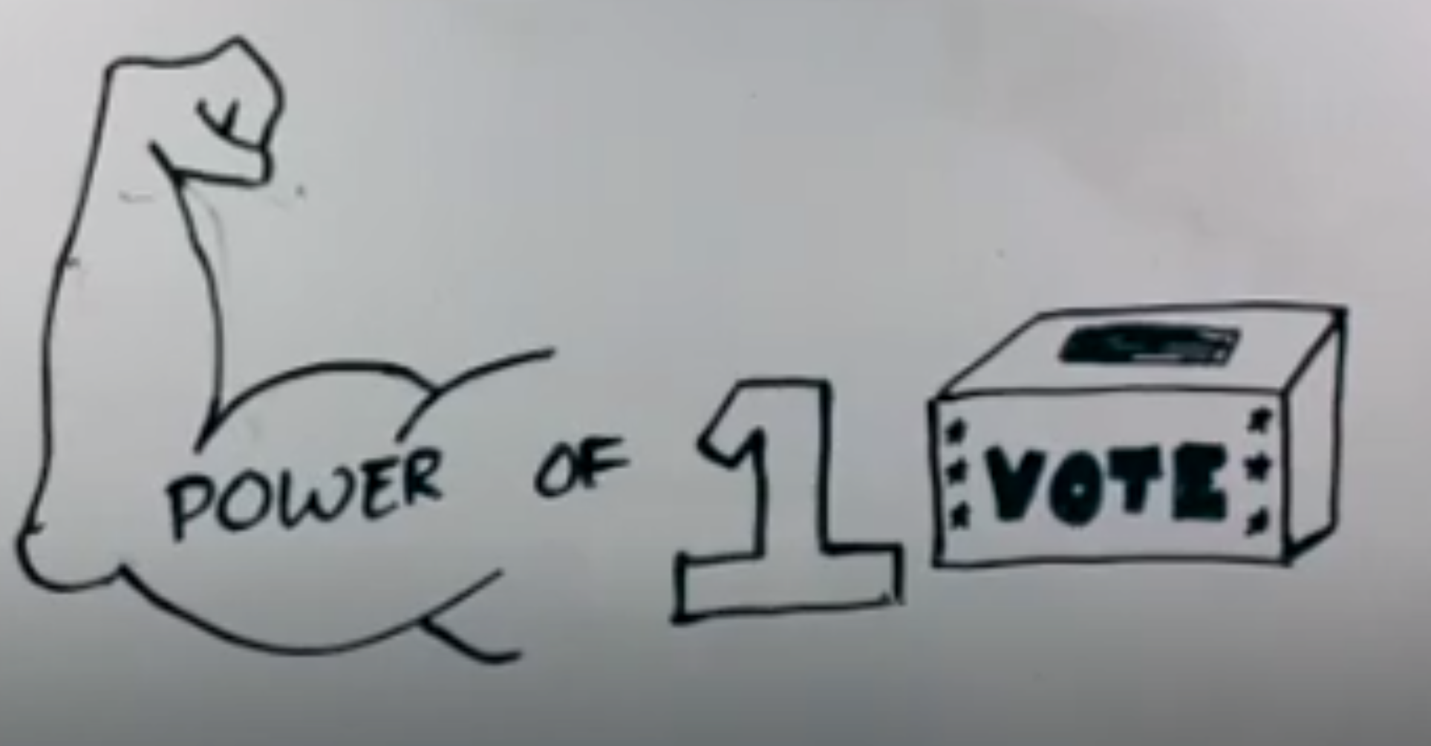
Bonding Vote: Simple Majority
Kate Whitson student video project https://www.youtube.com/watch?v=bh7z9D1bx_Y

Slide 35
SF 2410 SAVE Athletic Facility Processes: this bill, authored by Ways and Means Chair Sen. Chapman, sets a lower threshold for petition signatures to require a vote on a school board decision to use SAVE funds for athletic facilities, currently at 30% of those voting in the prior election, to instead the lower of 30% or 1,000 signatures. It retains the minimum number of signatures required at 100.
An amendment further limited the 30% to those who specifically voted for school board during the combined city and school elections.
The bill also requires a supermajority approval of 60% of voters at the special election to approve the SAVE expenditure on athletic facilities.
The bill also invalidates any board action to use SAVE for athletic facilities from May 1 until the enactment date of the bill.
Bill was approved 47:2 in the Senate and is in the House.
HF 2060 School Bond Elections by Salmon: this bill limits the election time for school bond elections to the regular school election date. The bill is in the House State Government Committee. RSAI is opposed.
Subcommittee of Rep. Sexton, Donahue and Mitchell did not move it forward.
No bills introduced to lower the supermajority requirement to a simple majority requirement for a school bond issue.

Slide 36
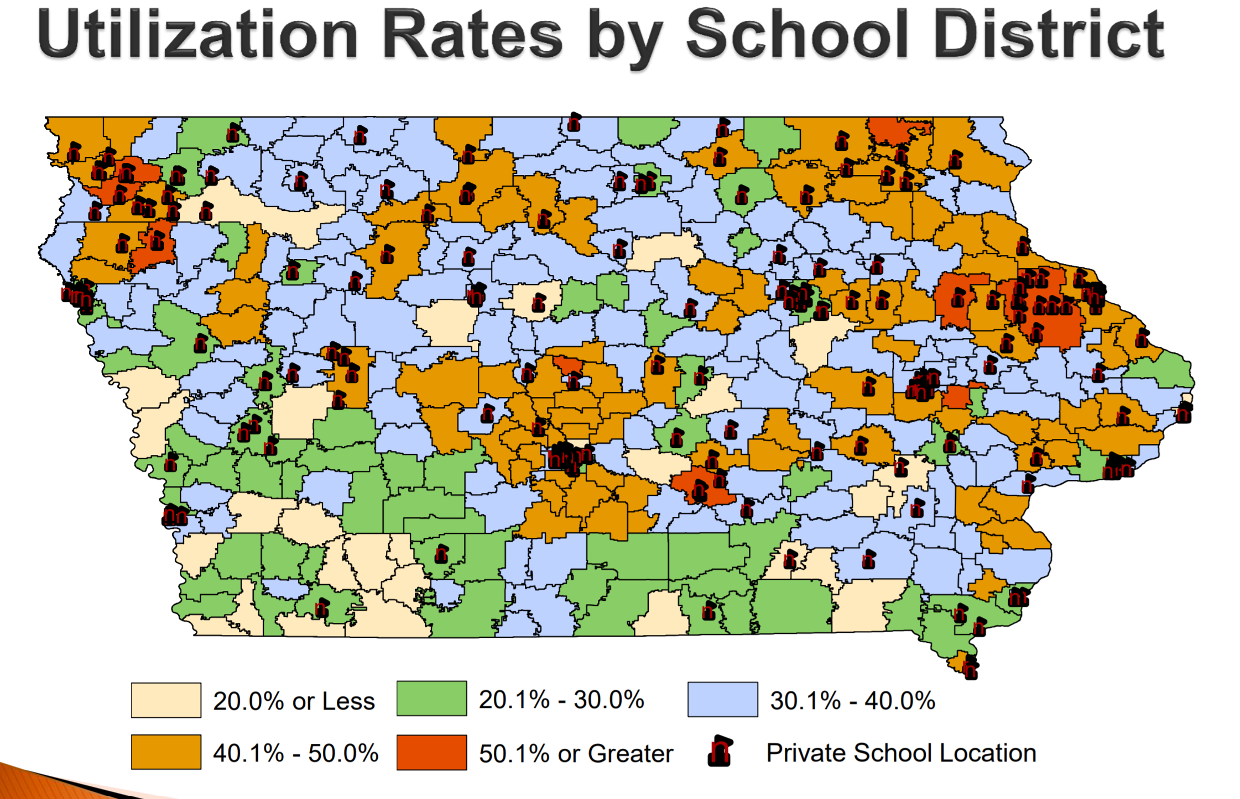
Other Issues
School Choice/Pro-public School Advocacy HF 663 Education Savings Grants (vouchers) Subcommittee of Gassman, Shipley and Staed voted 2:1 to move it forward. Still in House Education Committee.
HF 2242 Holding Office: prohibits city council members, agricultural extension members and any other elected office from also being school board members. RSAI opposed it. Was amended to limit just County Supervisors, so RSAI has changed registration to undecided. The bill is on the House Calendar.
Source: Legislative tax Expenditure Committee DOR Report on Tuition and Textbook Tax Credits https://www.legis.iowa.gov/docs/publications/SD/865242.pdf (in RSAI School Choice Position Paper)
COVID-19 and distance learning is shining a bright light on broadband access inequities for staff, students, and families.

Slide 37
2020 Session: Resumes June 3
Budget development is still behind the scenes. Rules were changed so there is no notice requirement for subcommittee meetings or committee action, no waiting period on the calendar for debate.
Budget impacts yet unknown: national experts estimate most states will see a 15-25% revenue reduction, mostly in FY 2021. Iowa is better positioned than most, but may have to revisit FY 2021 original budget intentions. (SSA and Transportation and formula equity are the only two major appropriations already signed by the Governor.) REC lowered the revenue estimate but within the ability to use EEF and surpluses to manage it. (0.8% reduced for FY 2021)
CARES federal funds – 90% of $71 million
Federal CRF (Corona Virus Relief Fund) $1.25 billion to Iowa for Legislature to use on costs of COVID-19. Some allocated for economic and health uses. Could include costs of delivering educational virtually, including high-speed Internet or other costs associated with COVID that weren’t already in the budget (summer school or early start days to remediate, etc.) Governor and Iowa Legislature will yet to determine how to use the funds remaining, in excess of $700 million.

Slide 38

Internet Access Gap
https://iowacapitaldispatch.com/2020/04/13/pandemic-highlights-gaps-in-internet-access/?eType=EmailBlastContent&eId=53042f8e-aca3-4bd5-bfca-5aea45f35e1c

Slide 39


Slide 40
Pandemic highlights gaps in internet access
WASHINGTON — Lawmakers are urging congressional leaders to prioritize emergency funding for high-speed internet access in upcoming coronavirus relief legislation.
More than two dozen lawmakers sent a bipartisan letter April 6 asking Democratic and Republican leaders of the U.S. House and Senate to set aside funding for a temporary emergency relief fund at the Federal Communications Commission (FCC) that would help small broadband providers continue service for students and low-income families.
Since the onset of the pandemic, access to high-speed broadband service has become essential as jobs and schools have shifted online, health care providers deliver remote care, people shop online and civic and social life goes virtual.
Iowa is one of the ten worst states when it comes to internet coverage, speed and price, according to a report by BroadbandNow Research:

Slide 41
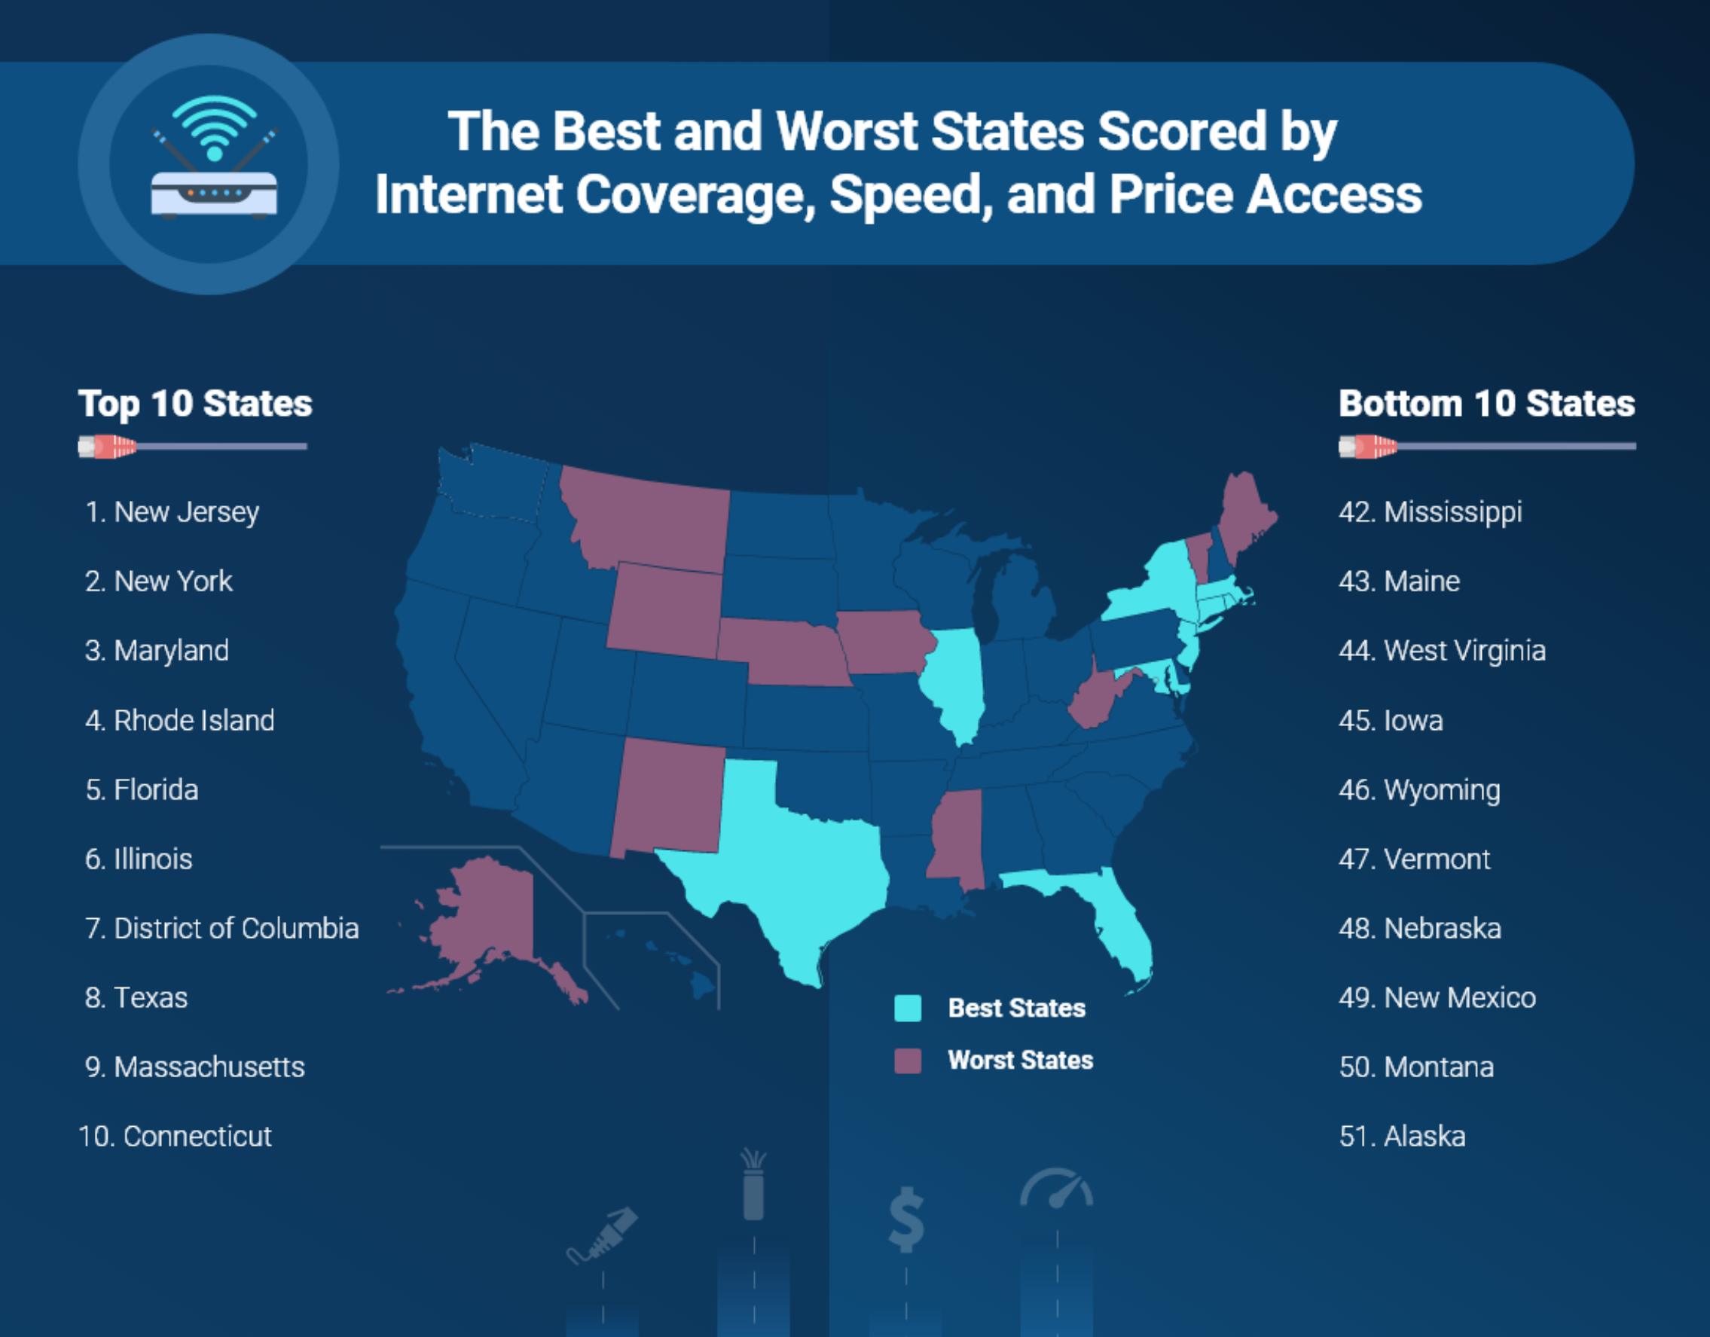
https://broadbandnow.com/research/best-states-with-internet-coverage-and-speed

Slide 42
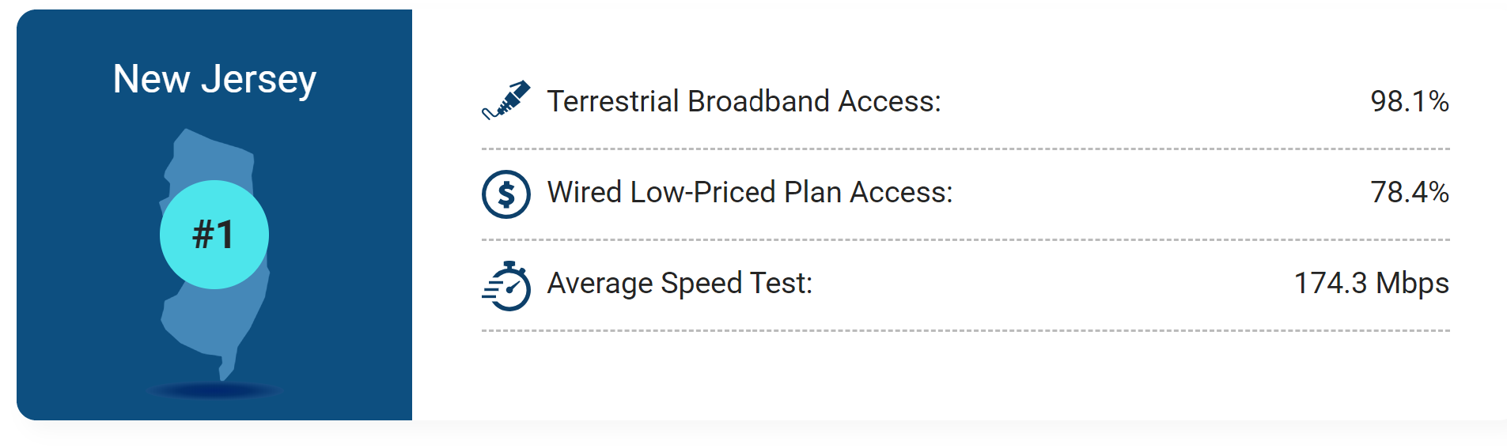
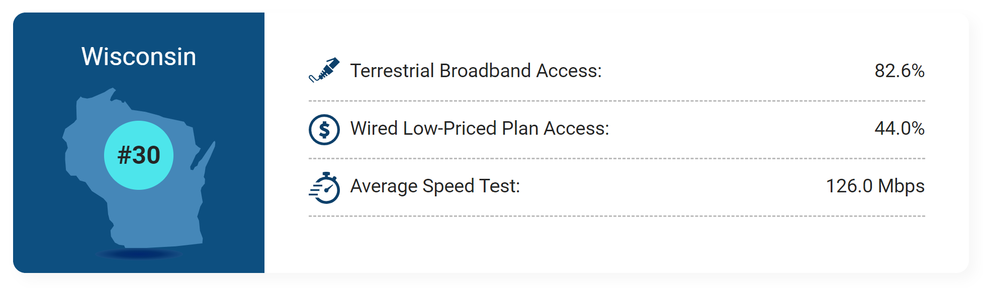
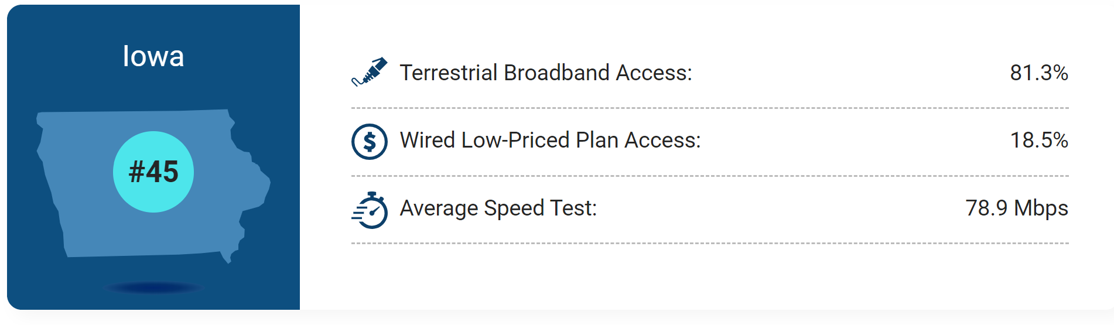
Access
Price
Speed

Slide 43
RSAI 2020 Legislative Priorities
The Legislative Group reviews and refines the Regional meeting activity, then submits to the Leadership Group and then the RSAI members at the annual meeting.
The members at the annual meeting discuss, amend and approve the slate of priorities.
See the RSAI website meeting tab for more information such as RSAI Legislative Digest, Position Papers, Draft Platform, Annual Meeting Information, and this PPT on the regional meetings tab
www.rsaia.org
Click on legislative tab
Click on 2020 Session – page down for list

Slide 44
6. Establish RSAI Region legislative priorities for the upcoming Iowa Legislative Session to forward to the RSAI Legislative Group (requires simple majority vote of members participating)
Process: Start with 2020 priorities and determine which should stay on the list (and if any can come off)
Discuss other priorities that have emerged. Add to the list if there is consensus
Approve revised list to send to Legislative Group, which will prepare draft platform for the Annual Meeting, where the entire group will be able to discuss and further refine or add to the list.

Slide 45
RSAI 2020 Priorities
Adequate School Resources
Student Mental Health
Educator Shortage and Quality Instruction
Formula and Transportation Equity
Opportunity Equity for Low SES
Sharing Incentives and Efficiencies
Quality Preschool
School Safety
Bond Elections Simply Majority

Slide 46
You’ll be assigned to a Breakout Room for small group discussion on two questions:
1) should all 2020 RSAI priorities stay on the list?
2) should any other priorities be added to the list?
Get a volunteer from your breakout room to share.
Send us notes of importance or reflections, if any.
Time to reconvene : ________________

Slide 47
Additional Priorities mentioned from small groups

Slide 48
New Priorities
Of those topics, which would you like to add to the list of priorities for 2021? (motion and second for each + vote for each one)

Slide 49
6. Approval of RSAI SE region platform of priorities
  motion to continue 2020 priorities _____________ second ___________ except for __________________________
  motion to add new priorities _____________ second ___________

Slide 50
7. Any Other Business?
8. Motion to Adjourn _____________ Second ___________

Slide 51
THANK YOU FOR YOUR VOICE on behalf of rural students!
Stay connected through the Interim and into the Legislative Session
Let us know what you need to beef up your advocacy efforts.
Professional Advocate
Margaret Buckton, margaret@iowaschoolfinance.com
1201 63rd Street, Des Moines, IA 50311 (515) 201-3755 cell

