Slide 1
INDIAN EDUCATION
TULSA PUBLIC SCHOOLS
2020/2021 School year

Slide 2
Continuing Culture through COVID
The past year and a half have been one of the most difficult to provide resources to our students. Tulsa Public Schools went to a completely virtual format for the remainder of the 2020 school year (immediately after spring break) and through the first 6 months of the 2020/2021 school year. Our students still had needs. We developed creative ways to reach our students while still following TPS COVID protocol. We will show a few ways in which we reached our students.

Slide 3
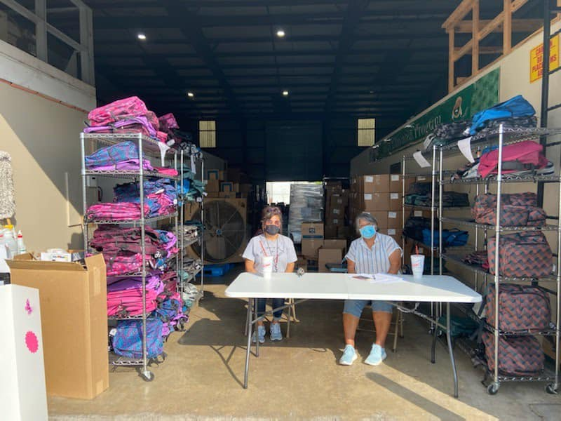
We held school supply Drive-Thrus

Slide 4
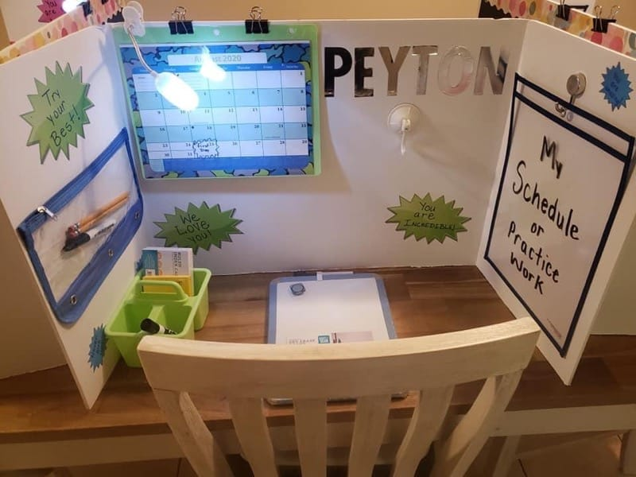
Supply Drive-Thrus were held monthly
We tried to help students personalize their workspace at home. Special computer backpacks were handed out also. Along with PPE.

Slide 5
SMORE Newsletters
The TPS Indian Education team created a “SMORE” weekly newsletter to go home electronically to students and their families.
These Newsletters would provide a monthly theme and would include information, photos and videos, at home activities, and a virtual field trip.
Example of our Smores:
https://www.smore.com/82c6p-tales-from-indian-education

Slide 6
Canvas
The TPS Indian Education team created a Canvas lesson weekly to be accessed online by students and parents along with all their other courses.
The Canvas lessons were set up with a monthly cultural theme and then weekly lessons were set up as the following:
Introduction to theme
Activities (kits provided at drive-thrus)
Virtual Field Trip recorded
Show and Tell submissions

Slide 7
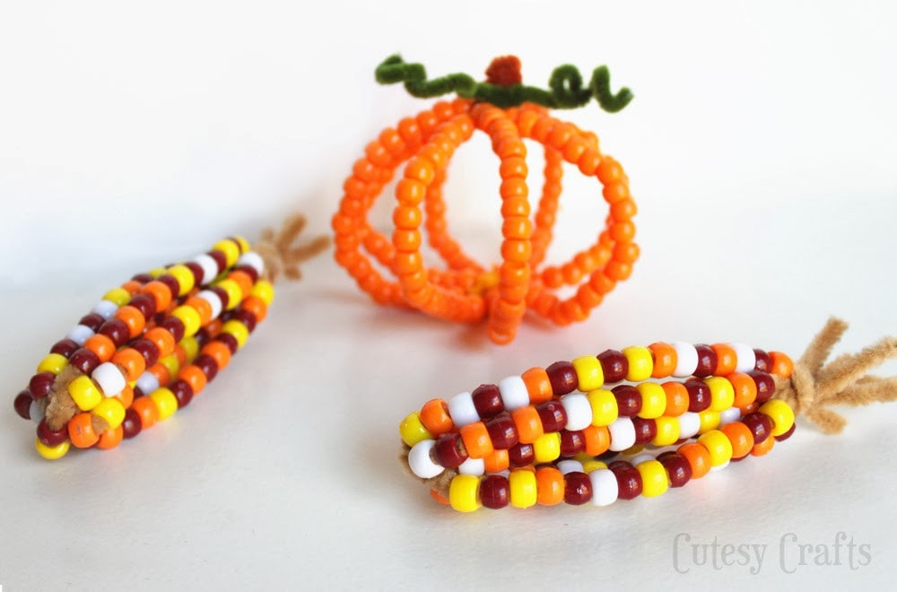
Monthly Drive-thru Cultural Kits
We made kits with all the supplies and instructions to create artifacts corresponding the month's theme.

Slide 8
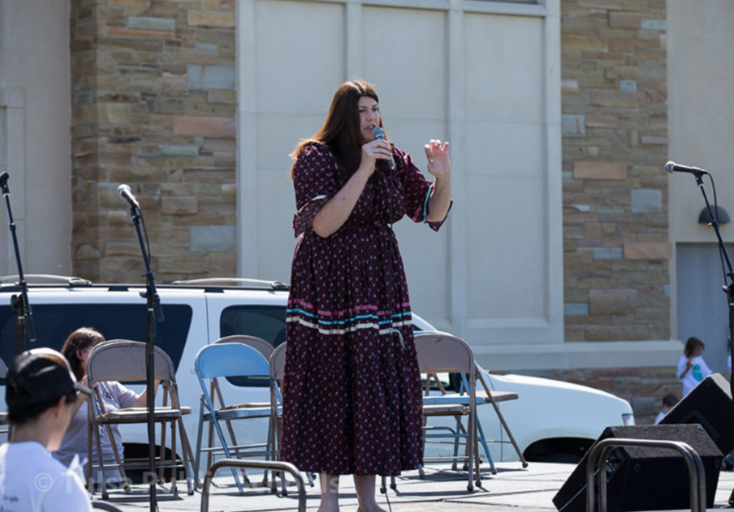
We read stories every week on Facebook Live
https://www.facebook.com/557818954381083/videos/723751378431848

Slide 9
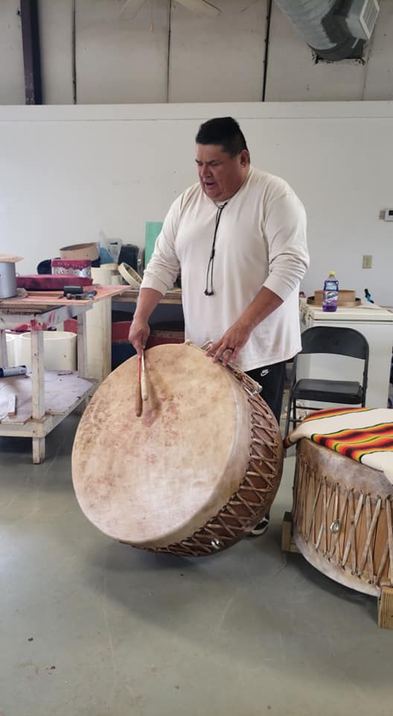
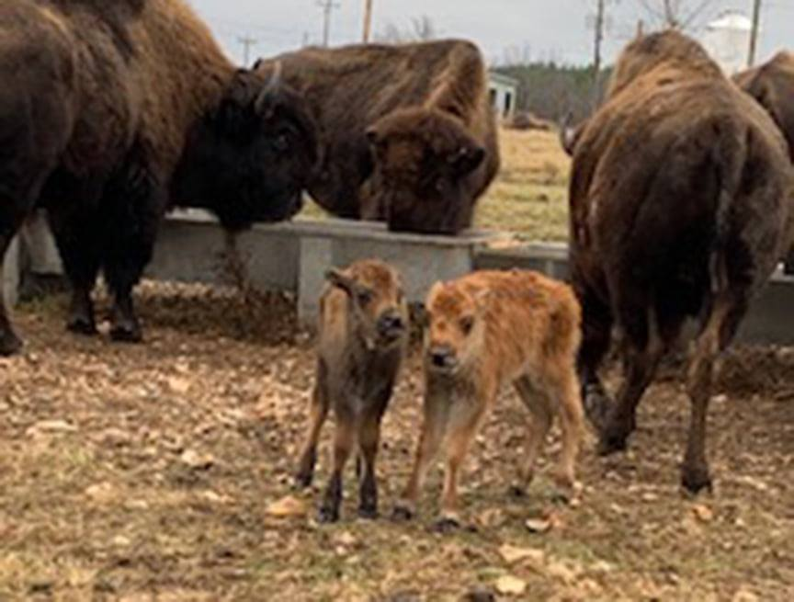
Virtual Field Trips
The staff took a virtual field trip every month. The destinations were designed to enhance the current month’s theme. TIE went to:
Woolaroc Museum & Wildlife Preserve
Eleanor's Book Shop, a Native owned bookstore
Supernaw’s Oklahoma Indian Supply
live cooking demo with Cherokee Chef Nico Albert
2-part live video on how to make a Native drum with Rock Pipestem

Slide 10
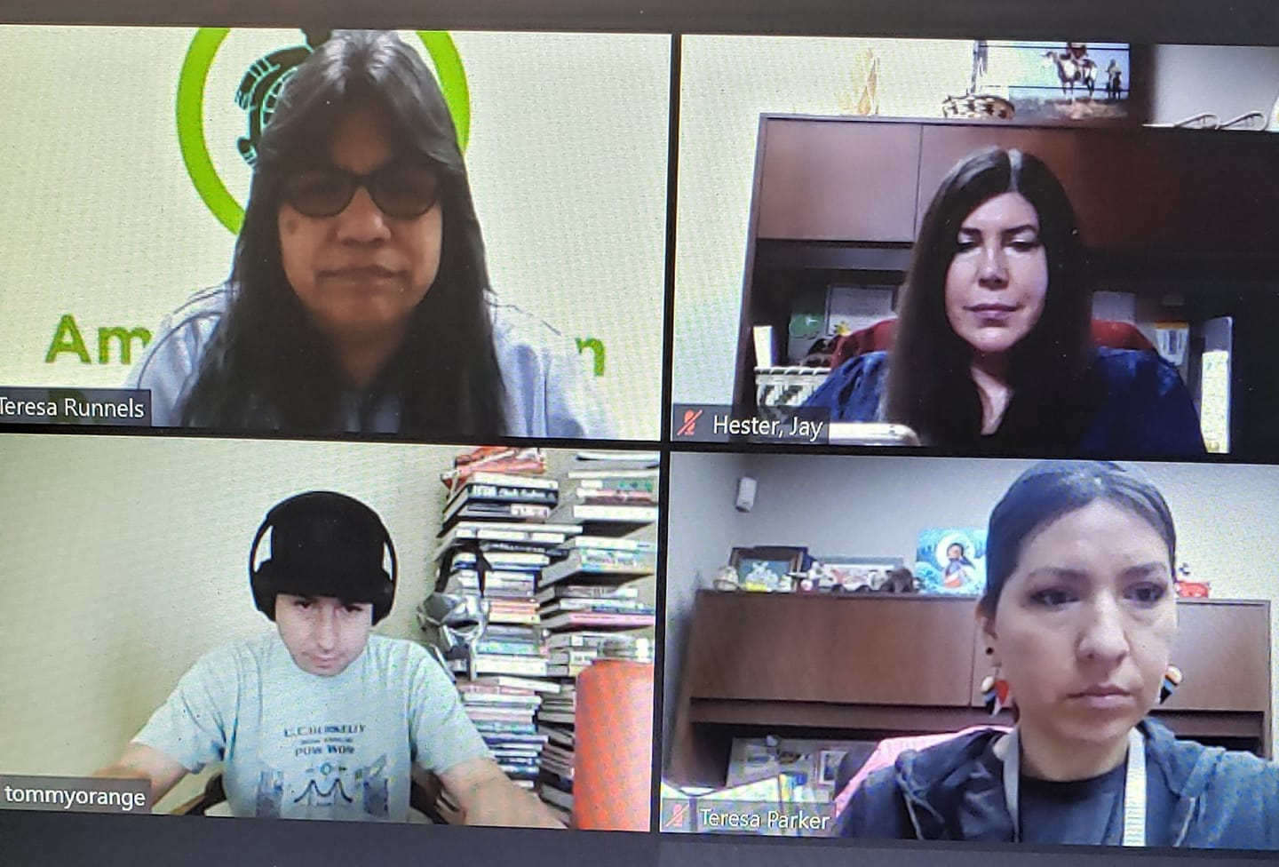
ZOOM
The staff had Zoom meetings for everything from talking with students to having their Tulsa Native Youth Board meetings to having interactive discussions. Pictures below is the Zoom with Tommy Orange.

Slide 11
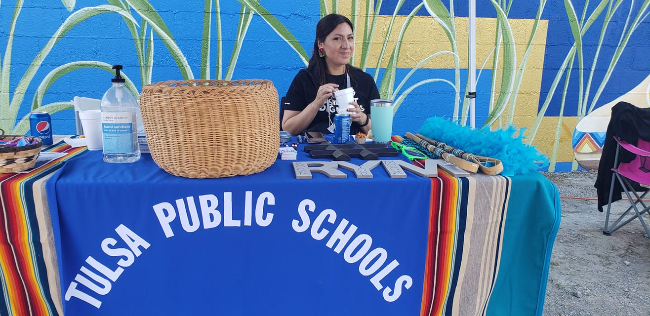
Community Activities
Tulsa Indian Education took part in “Rock Your Mocs” and “TPS Turquoise Day” where the entire district was invited to wear turquoise in support of Native American Heritage month.
TPS IE set up an info table and RYM Selfie Wall at a “Rock the Native Vote” outdoor event.
TPS IE also sponsored a Native American film night at the Admiral Twin Drive-In. Students in the program were treated to the Chickasaw movie “Te Ata”.

Slide 12
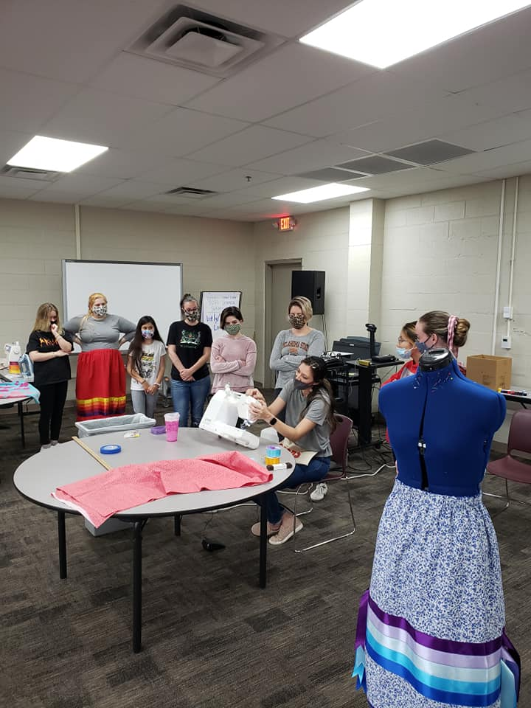
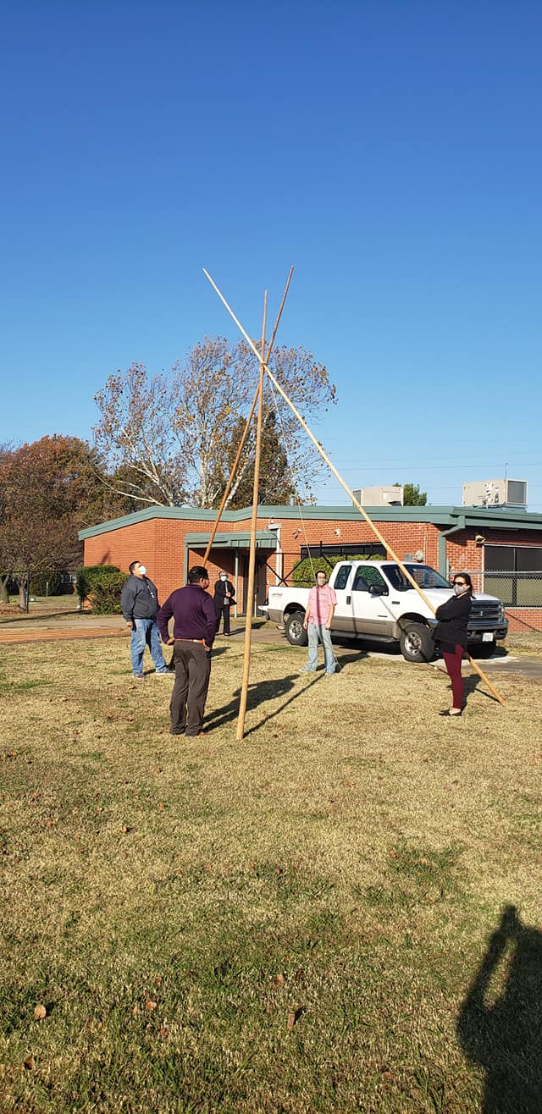
Socially distanced cultural education
Our program hosted a ribbon skirt making class and brought and set up a tipi for students to view and ask questions.

Slide 13
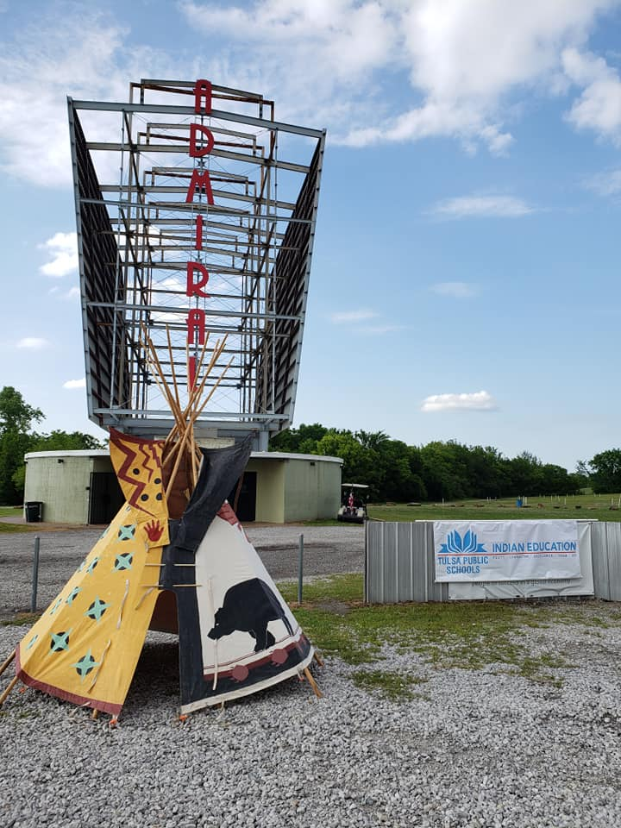
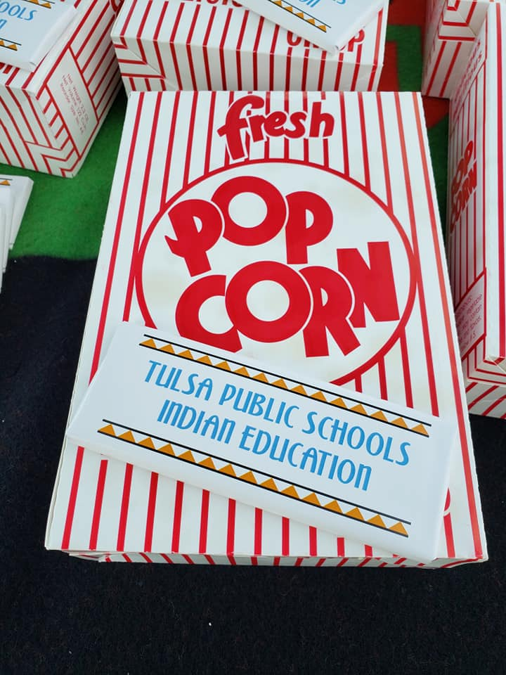
TPS Indian ED Awards Drive-Thru @ Admiral Twin Drive-in

Slide 14
We will always strive to serve our students!

