Slide 1

Almost 30 Years of CRO Success
September 11, 2019
Rick McLeod
SRSCRO President/CEO

Slide 2
What is a
Community Reuse Organization (CRO)?
Section 3161 of the Defense Authorization Act of 1993 initiated the creation of “Community Reuse Organizations” across the US in response to the negative social and economic impacts of workforce restructuring
DOE made a commitment to provide financial assistance for economic development and site reuse activities developed by the affected communities
15 CROs were formed across the US

Slide 3
CRO Foundational Functions
Community Reuse Organizations are DOE recognized organizations who serve three foundational functions;
    Collaboratively represent affected communities surrounding DOE sites
    Promote opportunity for workforce re-training and restructuring
    Support and work towards the economic development of affected communities

Slide 4
CRO Guiding Policy and Direction
Section 3161, National Defense Authorization Act 1993, “DOE Defense Nuclear Facilities Work Force Restructuring Plan”
Interim Planning Guidance for Contractor Work Force Restructuring – 1998
Title 10 Code of Federal Regulation Part 770, “Transfer of Property at Defense Nuclear Facilities for Economic Development” - Feb. 29, 2000, as amended Nov. 13, 2013

Slide 5
CRO Guiding Policy and Direction
Policy and Planning Guidance for Community Transition Activities – Federal Register 1997
    Like the Department of Defense, DOE has developed a financial assistance program that, for the most part, consists of awards to broadly representative, community reuse organizations (CROs) who either expend or sub-award the funds for projects to stimulate the local economy under an approved Community Transition Plan developed with public input.
Owen Amendment, Disposition of Excess Personal Property – 2003
    The purpose od this memorandum is to provide guidance to CROs and DOE Field Offices regarding the disposition of excess personal property.

Slide 6
FY 20 House Appropriations Report
Real Property.—The Department is reminded of its authority to transfer excess personal property and equipment to DOE-designated Community Reuse Organizations in order to promote economic diversification and job creation in communities where the Department’s sites are located and is encouraged to ensure that relevant agency employees throughout the Department are aware of current policies to implement this authority.
    Senate considering similar language - “encourage” could be changed to “direct”.
    Fully expect something out of Conference which basically reminds and/or directs DOE to promote and utilize CROs across the DOE organizations.

Slide 7
Existing Community Reuse Organizations
Actively functioning as Designated CROs
Tri-City Development Council (TRIDEC) – Hanford site
Community Reuse Organization of East Tennessee (CROET) – Oak Ridge Site
Paducah Area Community Reuse Organization (PACRO) – Paducah Site
Southern Ohio Diversification Initiative (SODI) – Portsmouth Site
SRS Community Reuse Organization (SRSCRO) – Savannah River Site
Previously functioning as Recent Designated CROs
Regional Development Corporation (RDC) – Los Alamos Site
Miamisburg Mound Community Improvement Corporation (MMCIC), now Mound Development Corporation (MDC) – Mound Site
Regional Development Alliance, Inc. (RDA) - Idaho National Laboratory Site

Slide 8
SRRDI to SRSCRO
Regional Economic Development entity, formerly known as the Savannah River Regional Diversification Initiative (SRRDI)
Chartered in 1993
Business Leaders, Elected Officials, Educators, Economic Developers
Designated as the Community Reuse Organization for the Savannah River Site by DOE-SR in 1996
Named formally changed to SRSCRO in 2006

Slide 9
SRS Employee Headcount
1993-2018

Slide 10
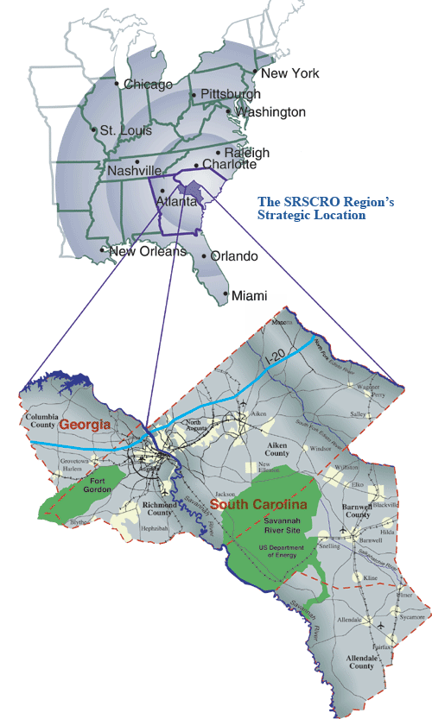
A Regional Organization
Board = 22 members (11 from each state)
Five Counties, Two States
Designated by DOE-SR as the CRO for SRS
Private Non-Profit 501 (c) 3
Funding – Non-Federal Operating Dollars

Slide 11
SRSCRO Main Focus Areas
Economic Development
  Asset Transition Program
  New SRS Missions
  Continue Current Missions
  HLW Reclassification Efforts
Workforce
  Nuclear Workforce Initiative (NWI®)
  Regional Workforce Efforts (Manufacturing, Health Care, Cyber, etc.)
Community Issues
  SRS Economic Impact Study
  Facilitate SRS Advocacy
  Coordinate DOE Issues/Policies with other CROs, ECA, and other Organizations

Slide 12
Assets Transition Program
What is it?
Mutual agreement between Department of Energy and SRS Community Reuse Organization (SRSCRO) – officially known as Savannah River Site Asset Transition Plan for Economic Diversification, signed in December 2005, revised May 2012
Allows for official transfer of selected excess personal property and related personal property assets from SRS to SRSCRO
Bottom line is most DOE assets are 60 years old, and not suitable for modern competitive business, so the large majority of assets get liquidated for cash.
How we do this more efficiently is a constant process, striving for more efficiency for SRSCRO as well as the SRS Contractors, at the same time managing DOE's risks.

Slide 13
ATP Process
Asset Transition Program
    Excess personal property will be picked-up from the N-Area laydown yard or other designated area by SRSCRO. Any loading will be accomplished by DOE-SR contractor personnel in the N-Area laydown yard. Inter-organizational hand offs, double handling, rework, process defects (more paper than assets) - ”spend a dollar to take out a nickel’s worth of trash”
Asset For Removal Projects
    New Way - SRSCRO counts, tags, loads and transports - SRSCRO self-performs. SRSCRO will perform these designated services in return for the identified assets. Lower margin for SRSCRO, but assets received quicker and in better condition
Asset For Services Projects
    Targeting “non-traditional“ assets by taking assets out of M&O contract. Takes advantage of SRSCRO lower labor cost -SRSCRO is doing the work previously performed by the M&O - removal, transport, counting, bagging, etc.- risks are managed. SRSCRO works under DOE CTM and real estate license, uses OSHA processes - OSHA vs. 10CFR851. SRSCRO willingness to expand capabilities to increase volume/revenue

Slide 14
SRSCRO 5-Year Community Investments
2014
$1,102,163
2015
$858,579
2016
$529,841
2017
$715,380
2018*
$1,275,428
*Includes obligated match funds
5-Year Total
$4,481,391
Typical Projects
Point Salkehatchie Industrial Park
Regional Workforce Study
Career Connection Forum – Manufacturing & Cyber
Asset Revitalization
Sage Mill Industrial Park
SRS Economic Impact Study
TechNet Augusta
Congressional Staffer Workshop
Nuclear Science Week Educational Outreach
Unisys Project

Slide 15
Real Estate License Agreement
Use designated space within, or around, certain Government- owned facilities at SRS
Grants permission to use designated structures, together with ingress and egress, for purposes of preparing and removing such real property structures, installed equipment and/or related personal property for transfer to SRSCRO as personal property

Slide 16
DOE Real Property and CROs
The primary non-federal recipients of properties for which EM was responsible are CROs, though some local governments have also received EM property.
DOE should develop and document an approach to property transfer consistent with DOE’s policy to identify and transfer properties appropriate for economic development, including clearly defining who is responsible for identifying those properties, when they should be identified, and how.

Slide 17
CRO Benefits
Facility Reuse and Property Transfer
Direct Community Investments
Coordinate/Facilitate Community Leaders Meetings
Site Specific Studies and Reports
M&O Cost Avoidance
Lower Labor Costs
Low Cost Fiscal Agent for Grants
DOE Site Advocate
Congressional Interaction

