Slide 1
It’s All About OPERA !
Sponsored by “ The Steinway Society of Riverside”
Mr. McSymphony™s
Power Point by Carrie Radelbough amd Stephen Battaglia
A Mr. McSymphony™ Program
©2015 all Rights Reserved
1

Slide 2
Opera House in Michigan
2

Slide 3
OPERA WORDS
1. What is an Opera?
2. Overture
3. Marquee
4. Libretto
5. Aria
6 . Duet
7. The Singers:
female- soprano, mezzo-soprano
male- tenor, baritone
3

Slide 4
Carmen Composer: George Bizet
Carmen With Bullfighter
Carmen – So Beautiful
4

Slide 5
Africa
World Map
Location of the opera
Aida
Egypt - orange
Elthiopia – light green,
5

Slide 6
Aida opera Composer: Guiseppe Verdi
Victorious Egyption Army
Princess Aida and General
6

Slide 7
“die walkure” Composer: Richard Wagner
The Ride of the Valkyries
visits that homunculus Alberich
Warrior maidens take hero soldiers to
Valhalla (soldier heaven).
7

Slide 8
Gianne schicchi (Pronounced: Johnny Skeekee) Composer: Guacomo Puccini
Reading the will (a paper that says who gets the money)
8

Slide 9
Rigoletto opera Composer: Giuseppe Verdi
9
Duke singing to girl in tavern

Slide 10
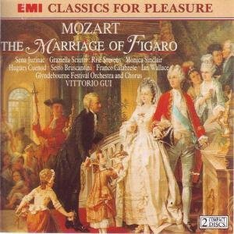
“Le Nozze di Figaro” by Wolfgang Amadeus Mozart
10

Slide 11
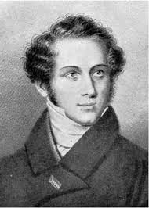
“ Norma” by Vincenzo Belini
11

Slide 12
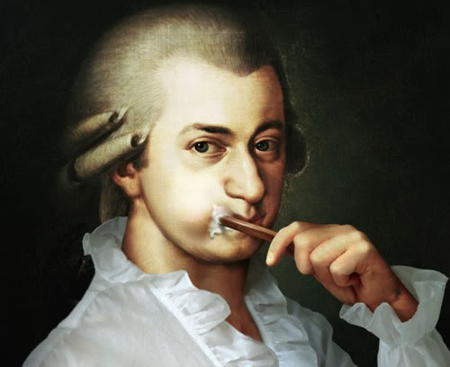
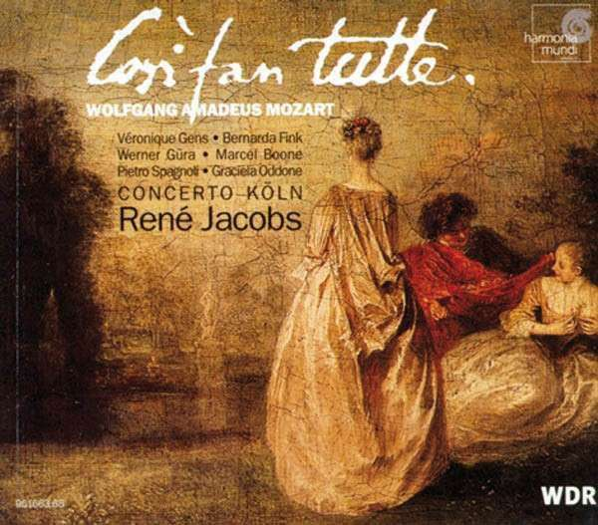
“Cosi fan Tutte” by Wolfgang Amadeus Mozart
OPERA BUFFA
12

Slide 13
Turandot opera Composer: Giacomo Puccini
Calef answering riddles to Princess Turandot
13

Slide 14
Three Riddles
A RIDDLE is a question that is phrased so that the answer requires ingenuity and cleverness.
What is born every night and dies every day?
What is it that grows cold when we die and is warm when we are alive?
What is the ice that sets you on fire?
14

Slide 15
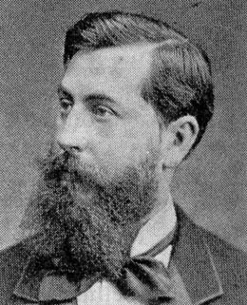
“Lakme” by Leo delibes
The “Flower Song”
15

Slide 16
Tales of Hoffman Composer: Jacques Offenback
Gulietta and girlfriend sing a duet while riding in gondola (like a canoe)
16

Slide 17
La boheme Means “Poor Artist” Composer: Giacomo Puccini
Rodolfo saying goodby to Mimi who is dying.
17

Slide 18
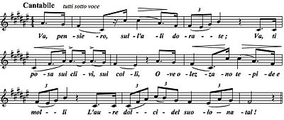
“Nabucco” by Guiseppi Verdi
“Va, Pensiro”,
Chorus of the Hebrew Slaves
18

Slide 19
The End
19

