Slide 1
Water Use for Panther Trace
What are your options?
Dana J. Gaydos
GHS Environmental

Slide 2
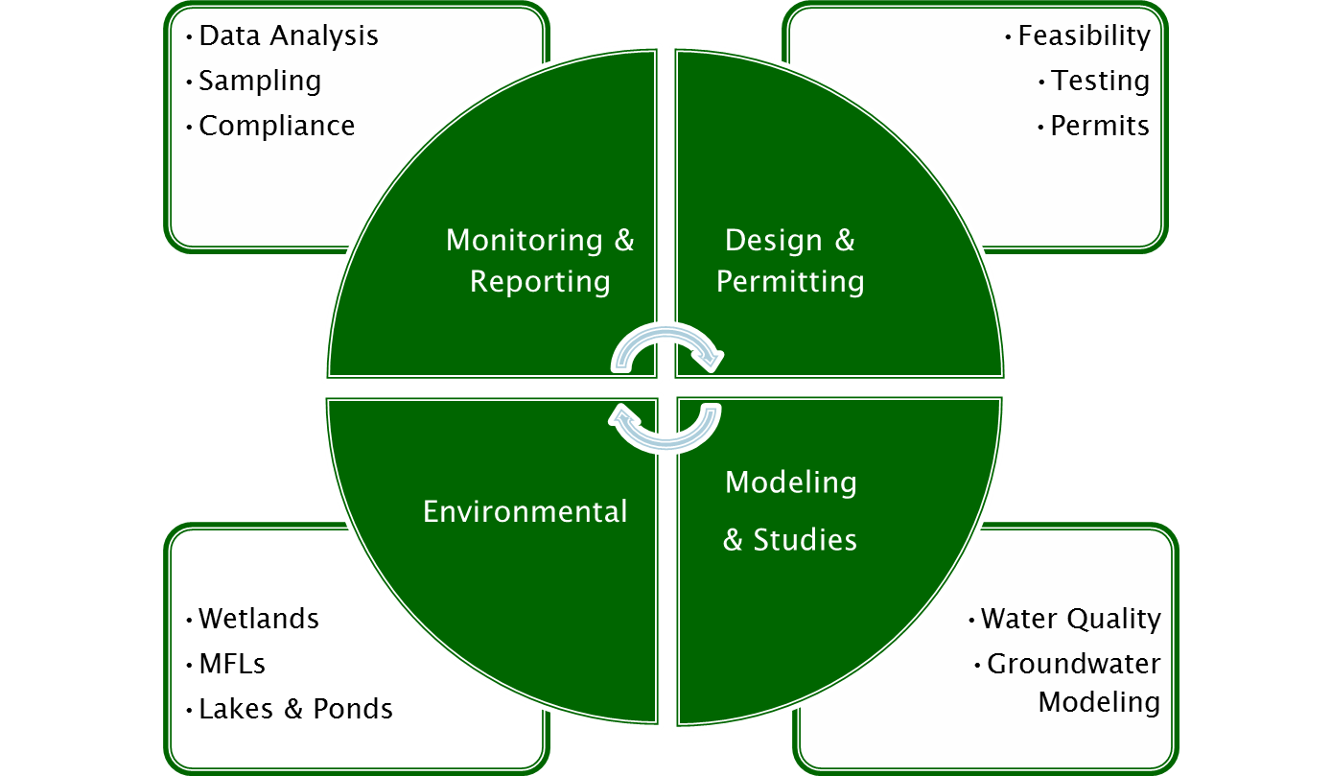
Who We Are & Why We Are Here
GHS Environmental (GHS) - Dana Gaydos
Water resources, water quality, wetlands,
marine resources
We are a small, woman-owned firm that is focused on giving quality service by providing solutions that fit the clients needs both immediately and for the future.

Slide 3
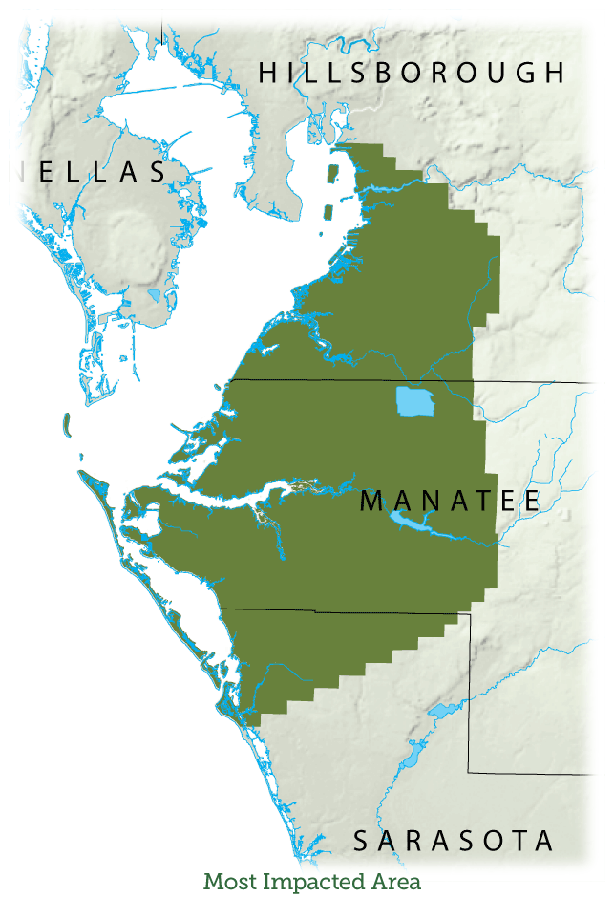
Water Use Permit Rules
Most Impacted Area (MIA)
Allocated due to saltwater intrusion
Covers 708 mi² from southern Hillsborough, Manatee & northwestern Sarasota
Major pumpage for mining, agricultural and potable water uses
Limits groundwater pumpage in the Floridan Aquifer
No NEW Water Use Permits (WUP’s)
Need WUP for cumulative well diameter of 6 inches or greater OR
Groundwater withdrawal of 100,000 gallons per day (gpd) annual average

Slide 4
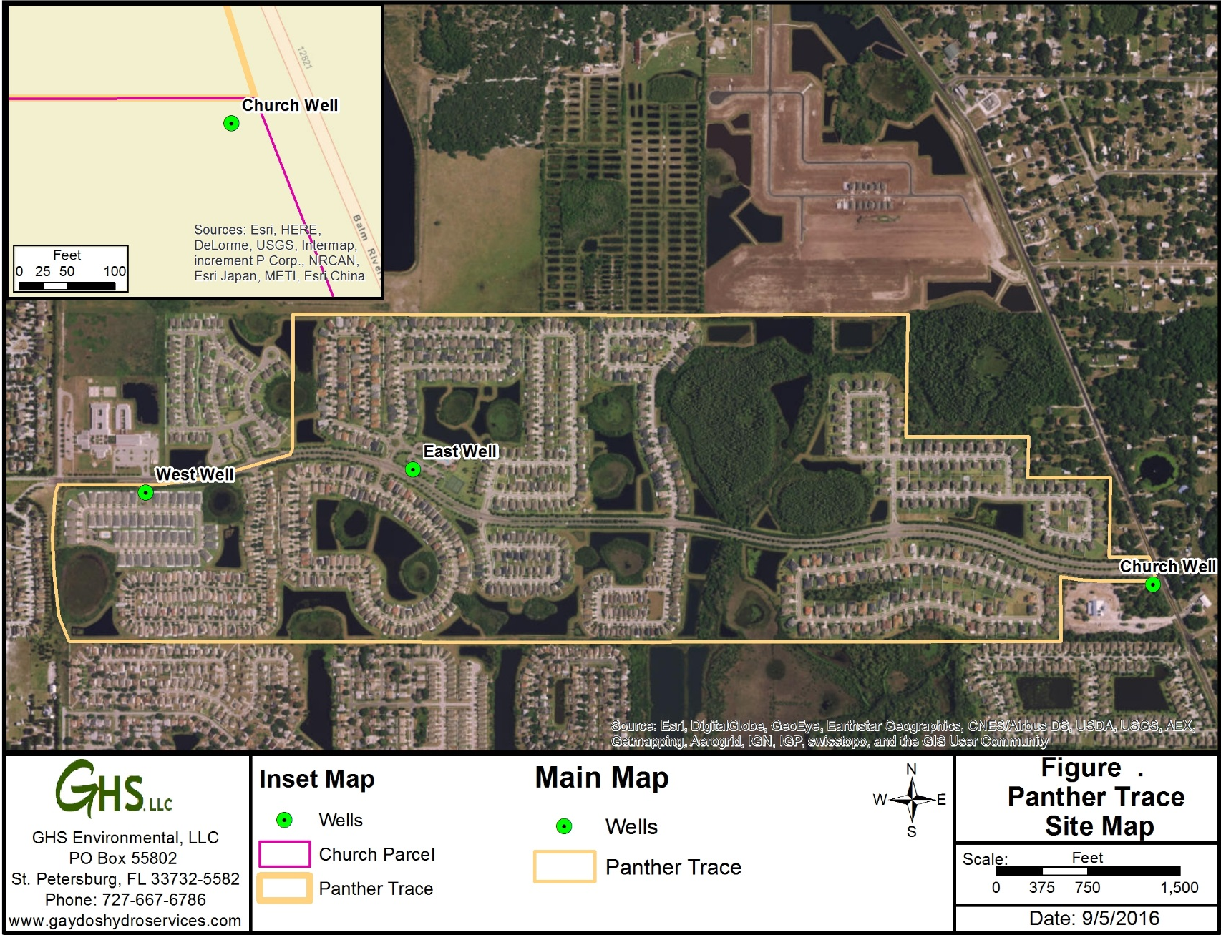

Slide 5
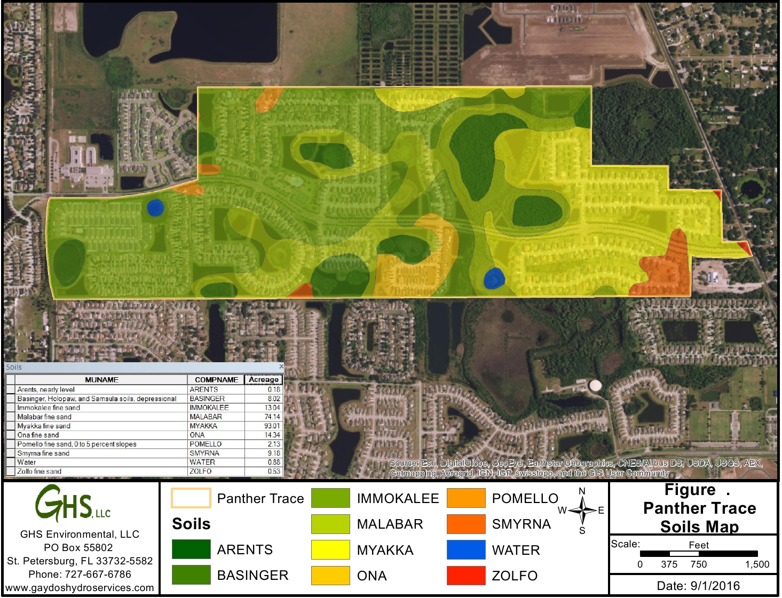
Initial Irrigation Calculation
Annual Average =
121,200 gpd
Peak Month =
387,600 gpd
Notes:
Immokalee soil type
Sprinkler over plant
Large pumpage capacity
Individual Permit for Greater than 100,000 gpd

Slide 6
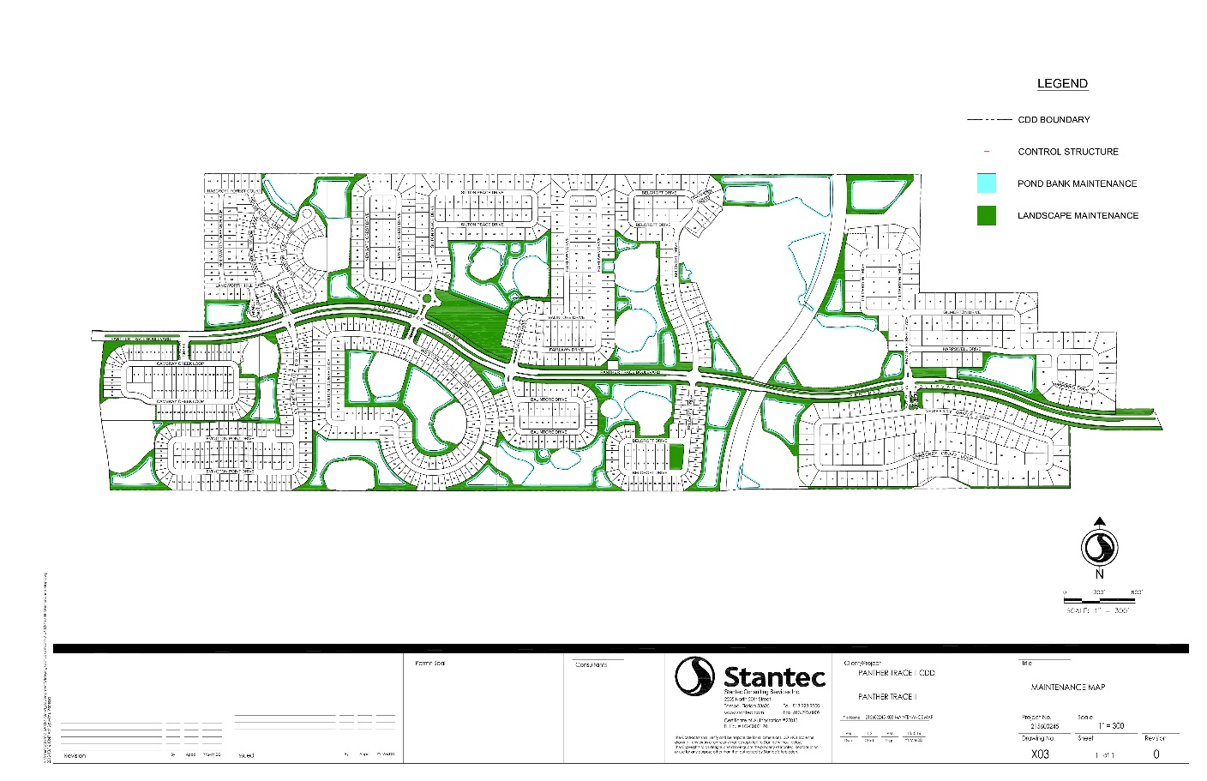
Option #1: Drill Replacement Well
Withdrawals not included in SWFWMD’s modeling effort
Impacts are existing
Confirm irrigated area for each well
Requires GW modeling
Meet with SWFWMD to establish need for WUP
Cannot guarantee approval by SWFWMD

Slide 7
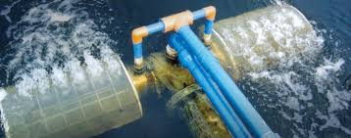
Option #2: Surface Water
Surface water withdrawals are allowable/easily permitted
Intermediate Aquifer wells are allowable/easily permitted
Can be used for entire demand
Could use multiple ponds to support entire community
EASIEST solution but most expensive

Slide 8
Recommendations
Gather information
Prepare initial strategy based on communities needs
Conduct Pre-App Meeting with SWFWMD
Report back to community for next steps
Cost Estimate $1,500
Includes graphics
Irrigation demand calculations
Initial proposal to SWFWMD
Preliminary GW modeling (if necessary)
Summary Letter
Additional Effort Estimate $3,500 - $4,500
to complete WUP application
Cost based on limited knowledge of project and community’s needs.
This does not include any additional requests for information from SWFWMD.

