Slide 1
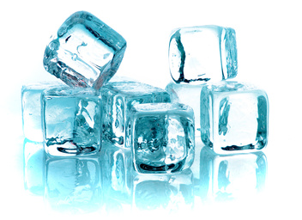
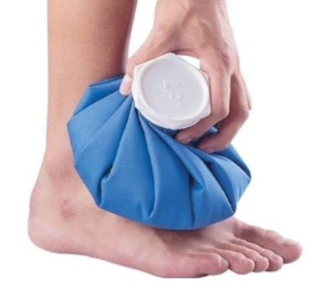
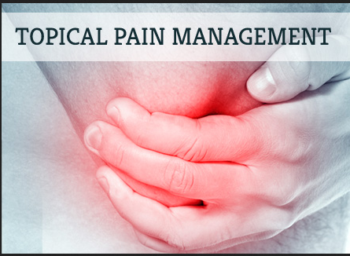
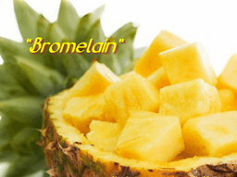
The Use of Adjunct Therapies to Control
Post-operative Pain and Swellings
JAMES M. DEJESUS, DPM, FACFAS
Section Chief of Podiatric Surgery
St. Mary’s Hospital
Waterbury, CT
http://www.acles.org/about.html

Slide 2
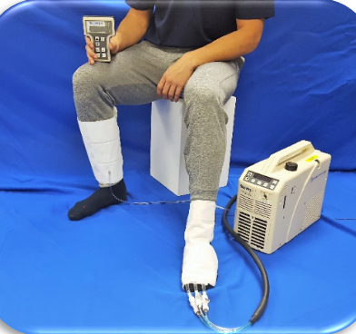
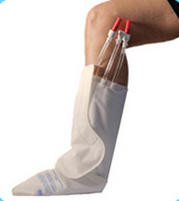
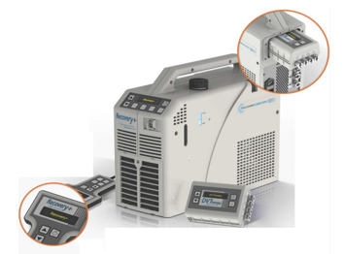
Cryotherapy

Slide 3
Deep Vein Thrombosis (DVT)
Formation of thrombus in deep vein causing pain, swelling, redness, warmness and engorged superficial veins. Pulmonary embolism is caused by detachment of the clot traveling to the lung.
DVT and PE constitute Venous Thromboembolism (VTE)

Slide 4
Virchow’s Triad
Venous stasis
Hypercoagulability
Changes to blood vessel wall

Slide 5
DVT Risk Factors
Cancer
Trauma
Antiphospholipid syndrome
Surgery
Older age
Immobilization (bed rests and casts)
Long flights

Slide 6
DVT Prophylaxis
Pharmacological methods
a. Platelet-active drugs (aspirin)
50-100mg/day decrease DVT by 30%
b. Coumarins (Vit K antagonists)
target INR 2.5 decrease DVT by 60%
c. Heparins (anticoag and antithrombotic)
5000 units Q8h decrease DVT 60-70%
d. Low Molecular Weight Heparins (Lovenox)
decrease DVT by 70-80%
Mechanical Methods
a. Passive devices
1. Graduated compression stockings
b. Active devices
1. External pneumatic compression or intermittent pneumatic compression (IPC)
2. Venous foot pumps.

Slide 7
IPC Devices
Decrease DVT by 60%
Decrease venous stasis
Improve blood flow velocity
Increase level of circulating fibrinolysins
No monitoring
No increase in bleeding
Applied to foot, calf or thigh
Compliance can be an issue

Slide 8
IPC Indications
Adjunct to anti-coagulant based prophylaxis
Pt with high risk of bleeding
Low risk patients

Slide 9
Controlling Post Op Edema
Ice pack
apply 4-5 times a day for 20 to 30 minutes
Compression Garments
Massage and elevation

Slide 10
DVT Prevention
The best way to prevent DVT is to get the patient back on their feet and moving.
Until they are completely ambulatory, Mechanical DVT Prophylaxis is a great AID in reducing the chance of DVT.
How better to get them up and about than using Cold Compression to reduce pain, swelling and pain meds.
Combination of Pharma and Mechanical solutions are becoming more prevalent as an added level of protection against both DVT and Bleeding due to excessive use of Blood Thinners.* (6% of all surgery patients experience excessive bleeding.)
Every 5 minutes someone dies of a blood clot or DVT.**
*J Bone Joint Surg AM. 2014;96:177-83
*J Bone Joint Surg 2012; 94-B:729-34
**Vascular Disease Foundation.

Slide 11
Benefits of Cold Compression
Clinically Proven versus Ice Packs **
Significantly better Compliance versus crushed Ice and ice packs.
Reduces Swelling.
Reduce use of Pain Meds. (reduced hydrocodone bitartrate with acetaminophen use)
Lowered all measureable pain scores.
Increased Range of Motion.
New generation of machines require no water or ice. Completely Self Contained.
Iceless Waterless system requires no “re-filling” by the patient.
No “Thermal Shock”; gradual reduction in temperature as the machine begins operating.
Frostbite protection built in! Machine thermally protects patient.
**Barber FA, Am J Knee Surg 13(2): 97-101, 2000

Slide 12
Reduction of Hospital Stay
and
Decrease of Rehab Time
Less post operative pain and edema (swelling).
Feel better faster. (greater patient comfort and enhanced rehabilitation)*
Decrease length of time for wound and soft tissue healing.
Patients are on their feet sooner.
Decrease rehabilitation and recovery time.
Reduction in incidence of Deep Vein Thrombosis.
*Speer KP, et al., J Shoulder Elbow Surg 5(1): 62-8, 1996

Slide 13
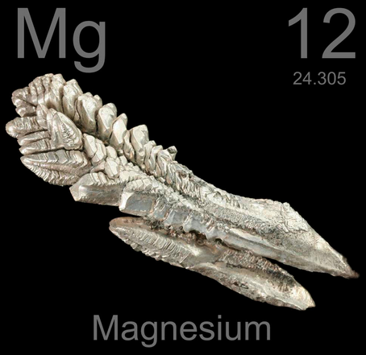
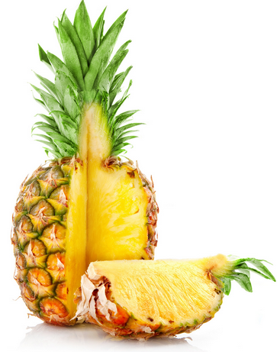
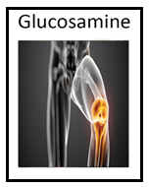
Supplements
Bromelain

Slide 14
Pycnogenol
Pycnogenol is a trademarked name for pine bark extract from the bark of the French maritime pine tree.
Also known as oligomeric proanthocyanidin (OPC).
Powerful antioxidant.
Pine bark extract is used to treat a variety of medical conditions.
Used for treating circulation problems.
Demonstrates anti-inflammatory activity.
Promotes joint health.
Stimulate your immune system.
Helps reduce allergy symptoms.
Helps decrease asthma symptoms.

Slide 15
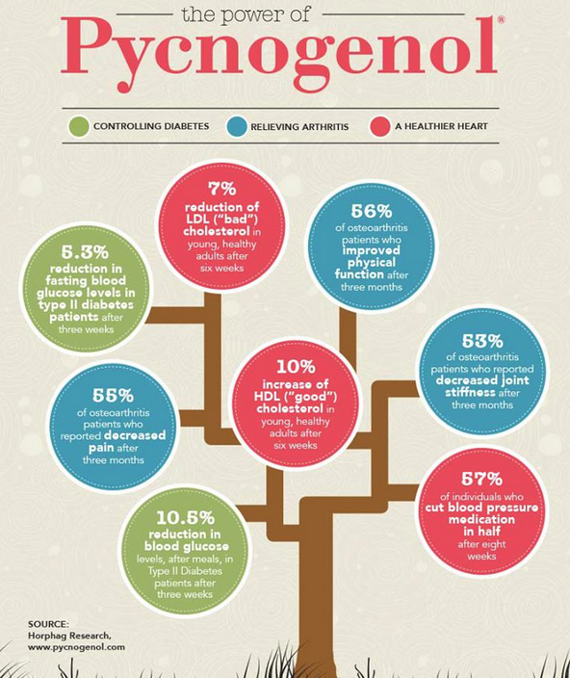

Slide 16
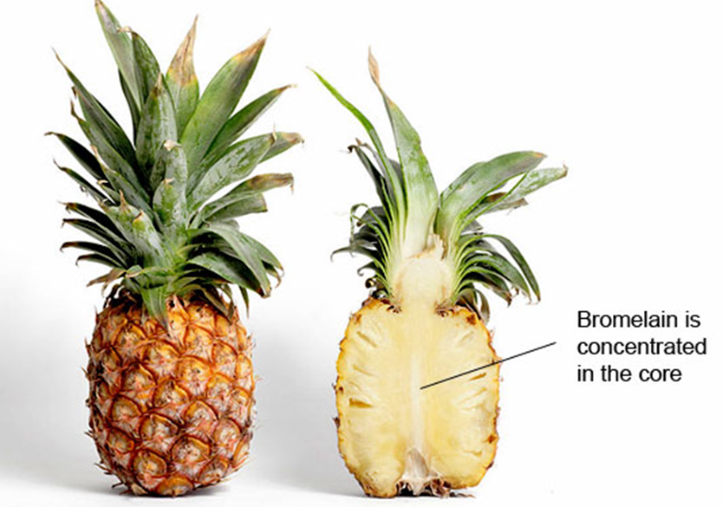
Bromelain
Bromelain is an enzyme found in the pineapple stem.
Used for reducing inflammation after surgery or injury.
Supports the body’s normal healing process.
Promotes optimal cell health.
Supports the body’s normal tissue recovery and repair process.

Slide 17
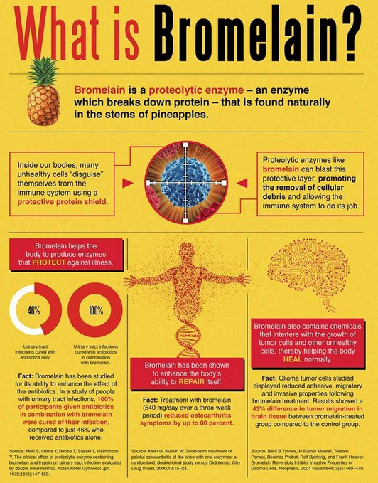

Slide 18
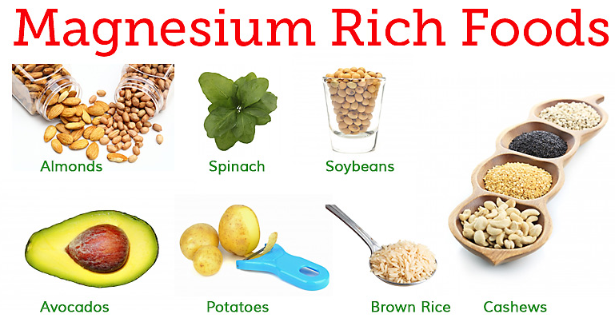
Magnesium
Magnesium is the fourth most abundant mineral in the body.
Magnesium is required for energy production, oxidative phosphorylation, and glycolysis.
It contributes to the structural development of bone and is required for the synthesis of DNA, RNA, and the antioxidant glutathione.
Magnesium helps keep blood pressure normal, bones strong, and the heart rhythm steady.
Relieves Muscle Aches and Spasms.
Calms Nerves & Anxiety.
Magnesium is also the main ingredient in many antacids and laxatives.

Slide 20
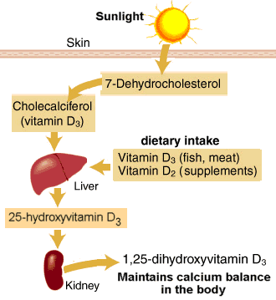
Vitamin D
Vitamin D is called the sunshine vitamin.
Vitamin D is essential for strong bones.
Promotes normal bone mineral density.
Promotes the normal formation of bone and normal bone.
Promotes the efficient intestinal absorption of calcium by supporting the synthesis of calcium-binding proteins to promote normal calcium absorption and retention.

Slide 22
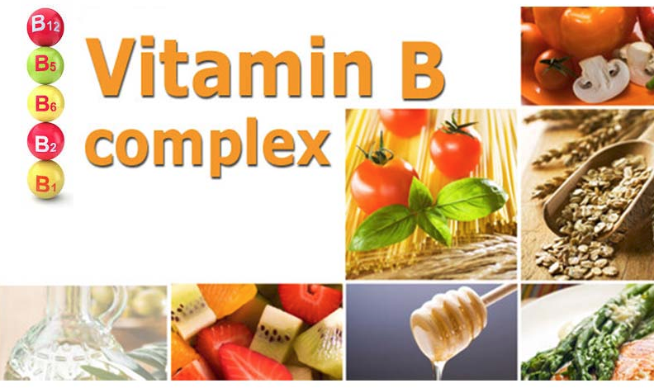
Vitamin B Complex
B complex vitamin is a dietary supplement that delivers all eight of the B vitamins: B1 (thiamine), B2 (riboflavin), B3 (niacin), B5 (pantothenic acid), B6, B7 (biotin), B9 (folate), B12.
Helps decrease stress and improve mood.
Promotes healthy levels of homocysteine.
Helps maintain healthy levels of serotonin.
Increases energy.
Promotes cardiovascular health.
Promotes normal cognitive performance.

Slide 23
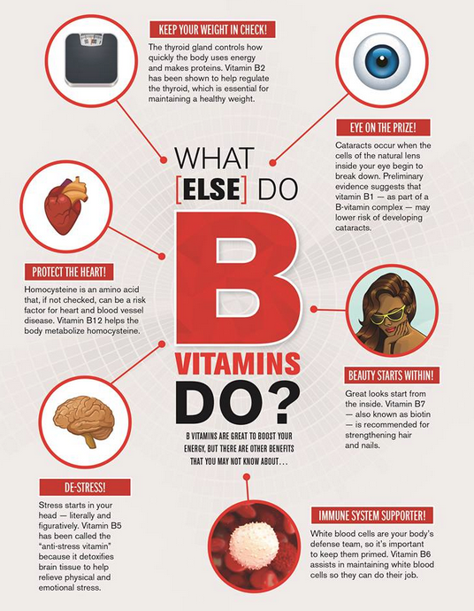

Slide 24
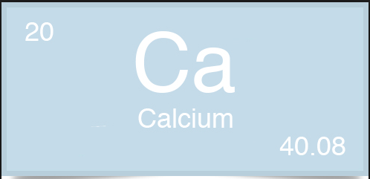
Calcium
Calcium is essential for building and maintaining strong bones.
The heart, nerves, and blood-clotting systems also need calcium to work.
The bones and teeth contain over 99% of the calcium in the human body.
Bone itself undergoes continuous remodeling, with constant resorption and deposition of calcium into new bone.
The balance between bone resorption and deposition changes with age.
Bone formation exceeds resorption in periods of growth in children and adolescents.
In aging adults, particularly among postmenopausal women, bone breakdown exceeds formation, resulting in bone loss that increases the risk of osteoporosis over time.
The two main forms of calcium in supplements are carbonate and citrate.

Slide 25
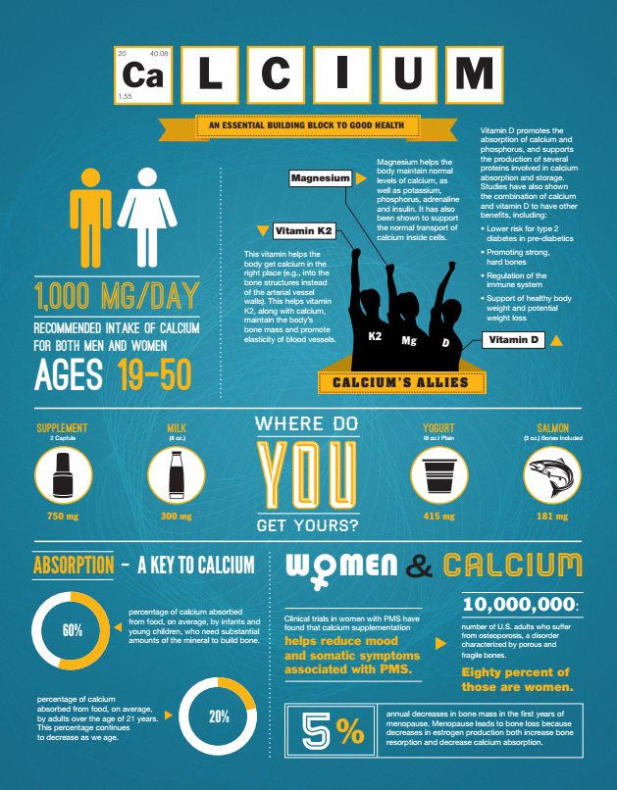

Slide 26
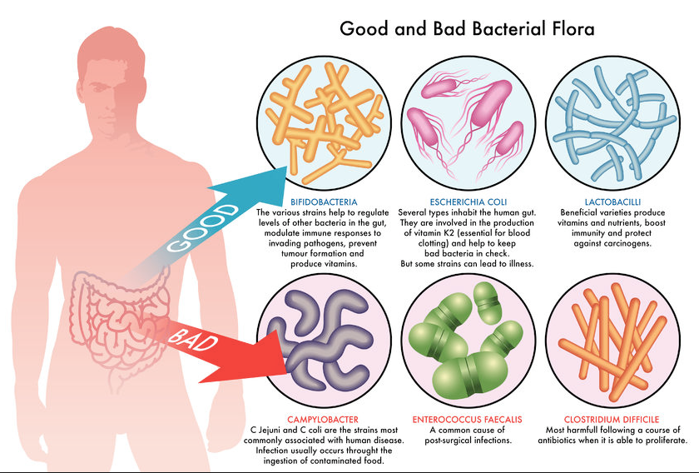
Probiotic
Your body is full of bacteria, both good and bad.
Probiotics are beneficial bacteria that work to help maintain an optimal bacterial balance in the digestive tract.
Probiotics are often called "good" or "helpful" bacteria because they help keep your gut healthy.
When you lose "good" bacteria in your body (like after you take antibiotics, for example), probiotics can help replace them.

Slide 27
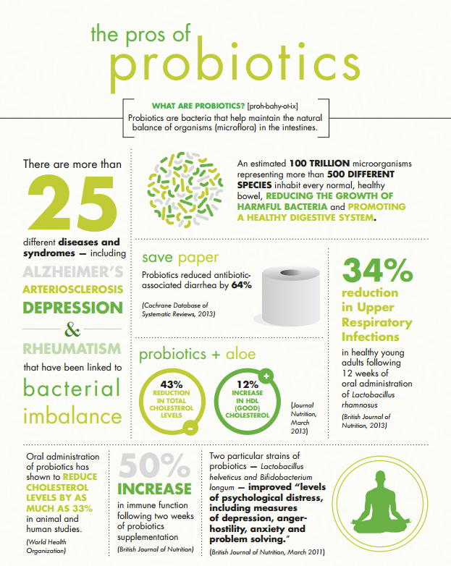

Slide 28
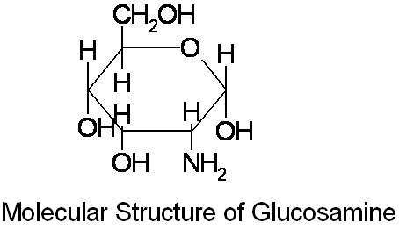
Glucosamine
Glucosamine is a natural chemical compound in your body.
The glucosamine in your body helps keep up the health of your cartilage.
As you get older, your levels of this compound begin to drop, which leads to the gradual breakdown of the joints.
There are two main types: hydrochloride and sulfate.
Promotes the retention and normal regeneration of cartilage.
Promotes joint health and flexibility as you age.
Supports healthy joint function and promotes the normal production of synovial fluid, which lubricates your joints and regenerates cartilage.
Helps maintain joint comfort.

Slide 29
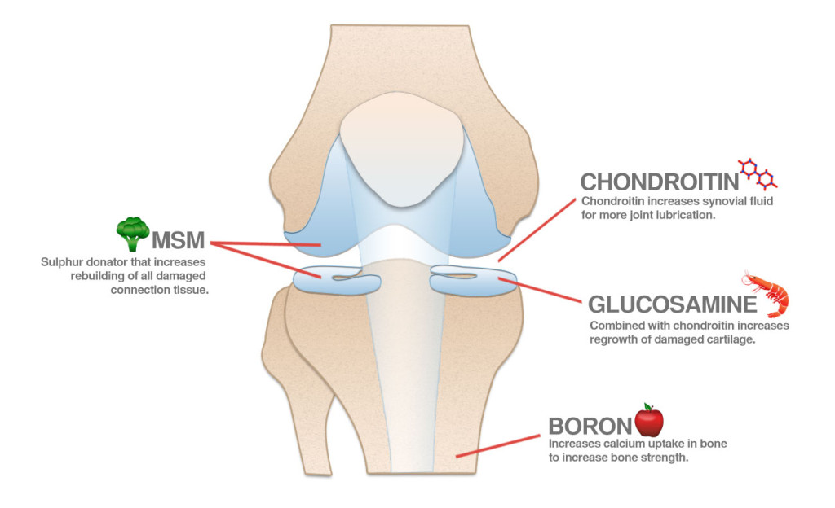

Slide 30
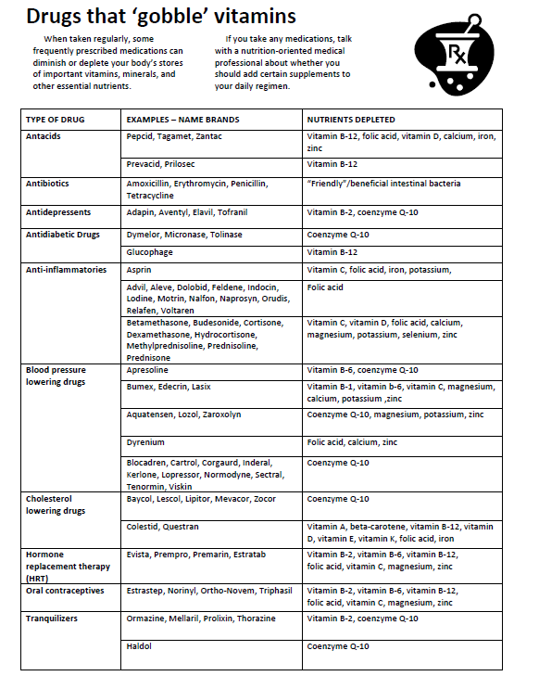

Slide 31
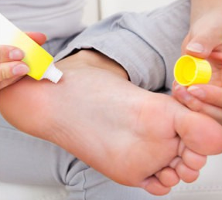
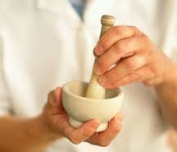
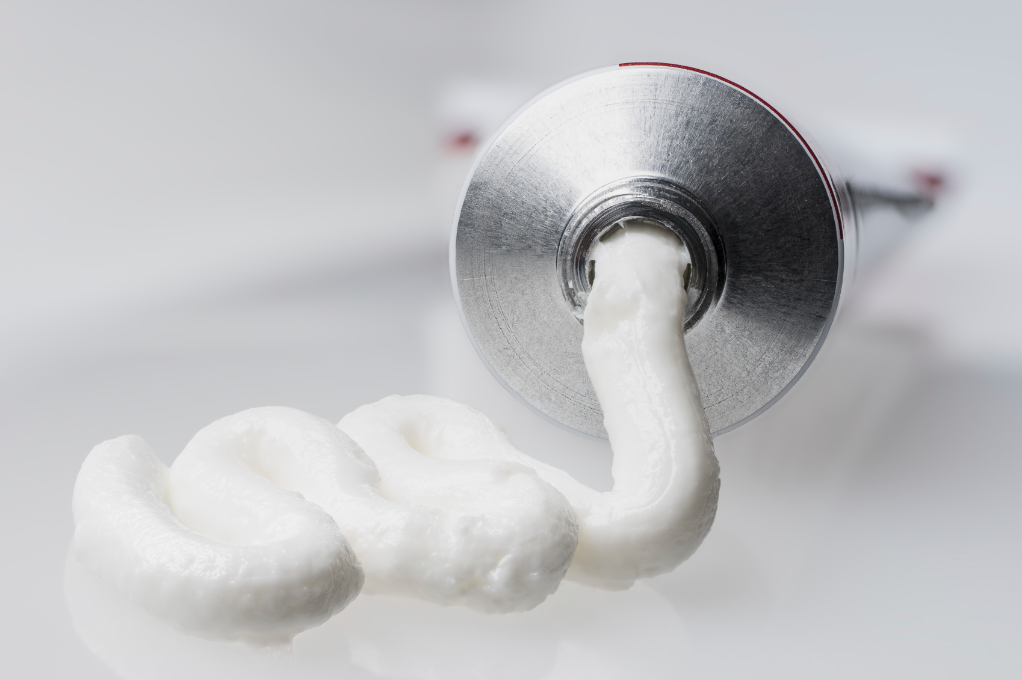
Alternatives To Oral Pain Medications

Slide 32
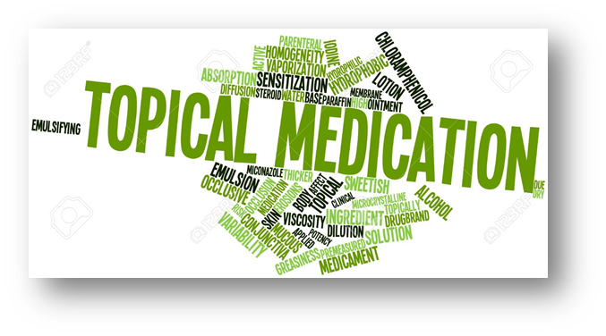
Compounding vs. Manufacturing
Manufacturing
No specific patient in mind when drug is produced
Has prescribers matching patients to the product available
Economic considerations limit choices in drug dosages and dosage forms
Compounding
Making the formula match the patient’s needs
Administering the drug to the site of action in the most effective dosage form available
Most prescription topical pain relievers are non steroidal anti-inflammatory drugs (NSAIDs).
Safer because topical pain relievers don’t travel through the bloodstream before they get to the area that needs relief.
Absorbed directly through the skin over the area of pain.
Offer customized options for your pain medication.
Alternate ways to deliver your pain medication.

Slide 33
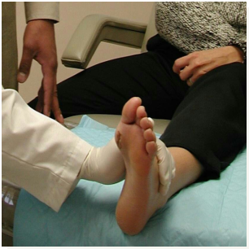
Meeting Unique Needs: Podiatry
Fungal infections
Decubitus ulcers
Diabetic neuropathy
Circulation problems
Warts and Calluses
Heel spurs

Slide 34
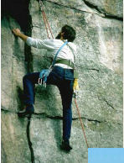
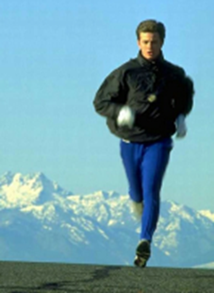
Meeting Unique Needs: Exercise and Sports Injuries
Transdermal gels
NSAIDs
Muscle relaxants
Neuropathic agents
Speed gels
Iontophoresis solutions
Phonophoresis (ultrasound) gels
Hank’s balanced salt solution
Anesthetic sprays and gels
Antifungals for athlete’s foot and jock itch

Slide 35
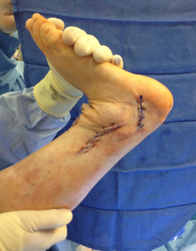
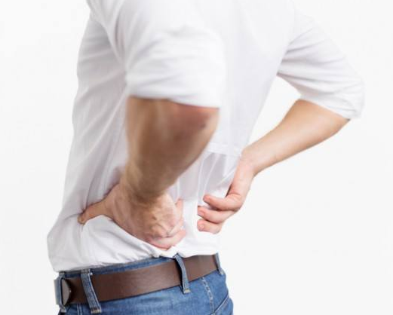
Meeting Unique Needs: Pain Management
Arthritis
Fibromyalgia
Headaches
Nerve pain
Muscle pain
Post-surgical pain

Slide 36
WHY TREAT PAIN TOPICALLY?

Slide 37
Advantages to Topical Use
Placebo effect
Act of rubbing may produce beneficial signals
Expectation of benefit
Combination therapy
Easy to combine drugs with different mechanisms
without increasing pill burden
Lower incidence of drug interactions
Reduced systemic effect, including adverse effects
Use of topical diclofenac led to maximum serum concentrations 0.4-2.2% of levels with oral diclofenac, but acted with equal or greater efficacy

Slide 38
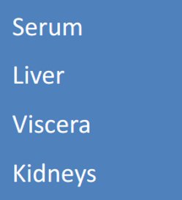
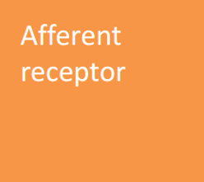
Dosage Consideration
CENTRAL
PERIPHERAL
IV / PO
K
TOPICAL
K (elim)

Slide 39
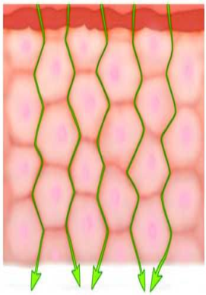
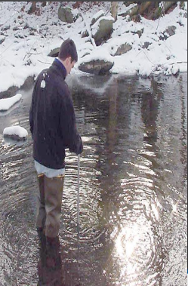
Common Questions
How much gets absorbed?
How deep is the penetration?

Slide 40
Factors for Drug Absorption
Transcutaneous flow of compounds across the stratum corneum is directly proportional to the concentration gradient & therefore can be attributed to passive diffusion
As surface area increases & thickness of epidermis decreases, the rate of transdermal flux increases
The underlying epidermal layers & the dermis area are an aqueous environment
Highly hydrophilic drugs will absorb poorly through the stratum corneum but better in the aqueous layers of the epidermis
Highly lipophilic drugs will absorb better through the stratum corneum but slowed when they reach the aqueous layers of epidermis

Slide 41
Potential Outcomes of Therapy
No Improvement with no side effects
– Increase dose until fixed or side effect OR
– Start with new route or therapy
No improvement, experience side effect
– Reduce dose, discontinue therapy, start new route or therapeutic mechanism
Partial Improvement with no side effects
– Increase dose/strength until no further improvement or side effect
Fixed
– Celebrate!

Slide 42
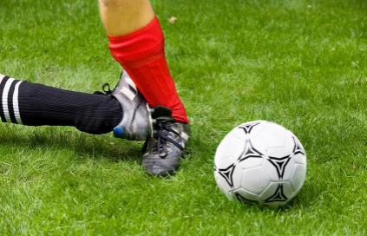
Where to Apply Transdermal Therapy
Where it hurts
Site of original injury
Dermatome(s)
Any trigger point locations

Slide 43
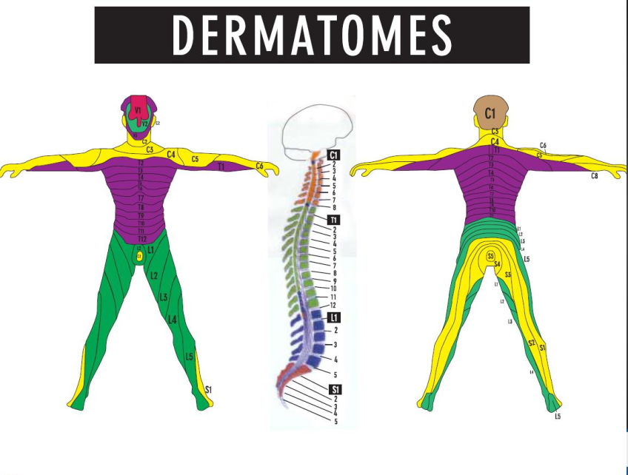

Slide 44
NSAIDs
Voltaren® Emulgel (1% diclofenac, 20, 50, 100 gm)
• Directions: use up to 16 gm / day
Feldene® gel (0.5% piroxicam, 25 & 50gm tubes)
• Directions: use up to 4 gm / day
Orudis® gel (2.5% ketoprofen, 30 & 60gm tubes)
• Directions: use up to 4 gm / day
Nurofen® gel (5% ibuprofen, 30, 50 % 100gm tubes)
• Directions: use up to 10 gm / day
**per site of application

Slide 45
Voltaren® Gel
1% gel indicated for osteoarthritis of knees and hands
Not evaluated for joints of the spine, hip, or shoulder
Apply 4 gm for each knee, ankle, or foot QID
Apply 2 gm for each elbow, wrist, or hand QID
“For the treatment of osteoarthritis.” Clinical Pharmacology. 4 April 2009.
<http://www.clincalpharmacology-ip.com/Forms/Monograph...>

Slide 46
Voltaren® (diclofenac) Gel
Max is 16 grams daily to lower extremity
Max is 8 grams daily to upper extremity
Total max of 32 grams daily
- What is the best volume to apply to a knee, wrist, ankle? You need to know this!
“For the treatment of osteoarthritis.” Clinical Pharmacology. 4 April 2009.
<http://www.clincalpharmacology-ip.com/Forms/Monograph...>

Slide 47
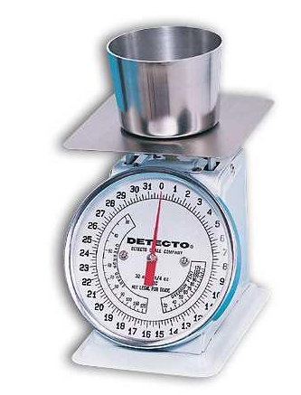
Diclofenac
2-10% in Lipoderm
Apply TID then PRN
Keep in mind
– gm vs. mL

Slide 48
Ketoprofen
10-20% in Lipoderm
Apply TID then PRN
t is 17-18 hours in synovial fluid
– About 10 hrs in serum
DOC for Rheumatoid Arthritis
– A.J.’s transdermal NSAID of choice
~
1/2

Slide 49
Ibuprofen
20% in Lipoderm
Apply 4-6 times daily then PRN
Excellent for soft tissue inflammation
Onset in 15-30 minutes and lasts 4-6 hours
Combine with longer-acting NSAID’s (Piroxicam)

Slide 50
Piroxicam
2% in Lipoderm
Apply QD
Onset time 4-6 hours and last all day
Great for combining with Ibuprofen
DOC for Plantar Fasciitis (heal spurs)
– Apply to site of pain and trigger point

Slide 51
NSAIDs Plus…
NSAID’s in Lipoderm with
– Glucosamine 10% (RA)
– Magnesium Chloride 10% (Muscle relaxant)
– Guaifenesin 10% (Muscle relaxant)
– Lidocaine HCl 2-5% (Anesthesia)
– Capsaicin 0.025% (substance p)
– Lipoic Acid 2% (anti-oxidant)
“Capsicum.” American Cancer Society.2008. 20 April 2008.
<http://www.cancer.org/docroot/ETO/content/ETO_5_3X_Capsicum.asp?sitearea=ETO>

Slide 52
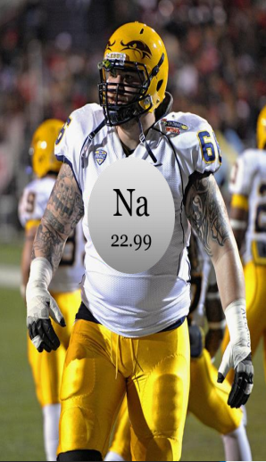
Sodium Channel Blockers
Anesthetics
– Lidocaine
– Tetracaine
– Bupivicaine
– Mexilitine
Anticonvulsants
– Carbamazepine
– Lamotrigine
– Valproate

Slide 53
Suggested Topical Doses
Lidocaine
– 2% - 5%
Tetracaine
– 0.5% - 2%
Bupivicaine
– 1% - 5%
Mexilitene
– 2-10% BID

Slide 54
Carbamazepine
Suggested dose
– 10% TID
Peripheral mechanism
– Blockade of voltage-dependent sodium channels
– Also believed that anticholinergic activity provides analgesia

Slide 55
Conditions for Na+ Channel Blockers
Acute pain
Diabetic neuropathy
Neuralgias
Peripheral nerve injury
Reflex Sympathetic Dystrophy / CRPS
Postherpetic neuralgia

Slide 56
Nifedipine
Suggested dose
2-5% TID
Mechanism
Causes peripheral vasodilation and aids in tissue perfusion
Conditions
Diabetic peripheral neuropathy
Raynaud's disease

Slide 57
GABA-B Agonist
Baclofen

Slide 58
Baclofen
Suggested dose
– 2% - 5% TID
Peripheral Mechanism
– Promotes the efflux of K+
from the inside of the afferent
nerve to the outside via GABA-B
– Inside becomes “less positive” or “more negative”

Slide 59
NMDA-NA/CA Channel Blocker
Ketamine
Amantadine
Dextromethorphan
Magnesium

Slide 60
Ketamine
Central Mechanism
– Noncompetitive NMDA receptor antagonist
– Subanesthetic doses produce analgesia and modulate central sensitization, hyperalgesia, and opioid tolerance
Suggested Dose
– 2% - 10% TID-QID
Peripheral Mechanism
– Proposed to produce analgesic effects through blockade of peripheral NMDA receptors present on afferent receptors and efferent sympathetic fibers
Enhances the effects of local anesthetics
Alteration of cholinergic actions
Interactions with opioid mechanisms
Blockade of Ca2+ channels

Slide 61
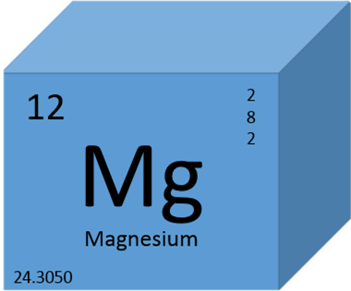
Magnesium
PCCA suggested dose
– 5-15% TID
Peripheral mechanism
– Blockade of NMDA receptor

Slide 62
Α -Agonists
Clonidine
Tizanidine
Phenoxybenzamine
2

Slide 63
Clonidine
Suggested dose
– Up to 0.2% TID
Peripheral mechanism
– Locally administered clonidine inhibits presynaptic release of NE from sympathetic nerves
– α -receptors located on nociceptors in epidermis decrease adenylate cyclase and cAMP, thereby reducing the excitability of nociceptors
– Effect seen only in injured nerves due to increased nerve coupling
2

Slide 64
Gabapentin
Suggested dose
– 6% - 10% TID
Peripheral mechanism is unclear (proposed mechansim)
– Binding with the α /δ calcium channel subunit to reduce Ca2+ influx
– Reduces the release of Substance P as well as membrane proteins that form channels (ex. AMPA)
2
1

Slide 65
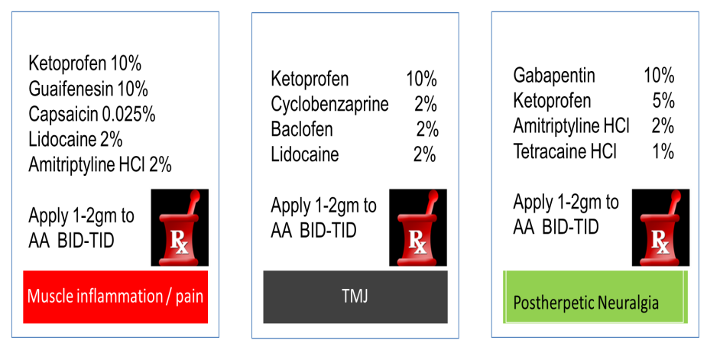

Slide 66
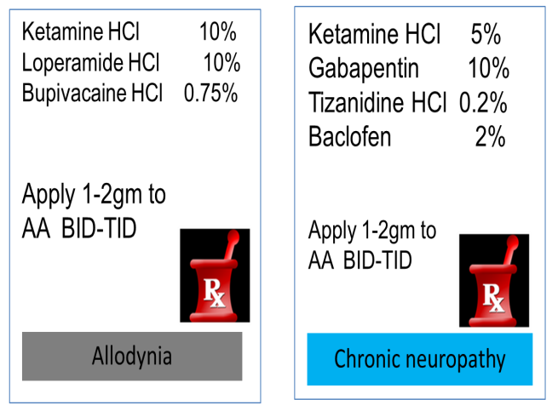

Slide 67
THANK YOU

