Slide 1
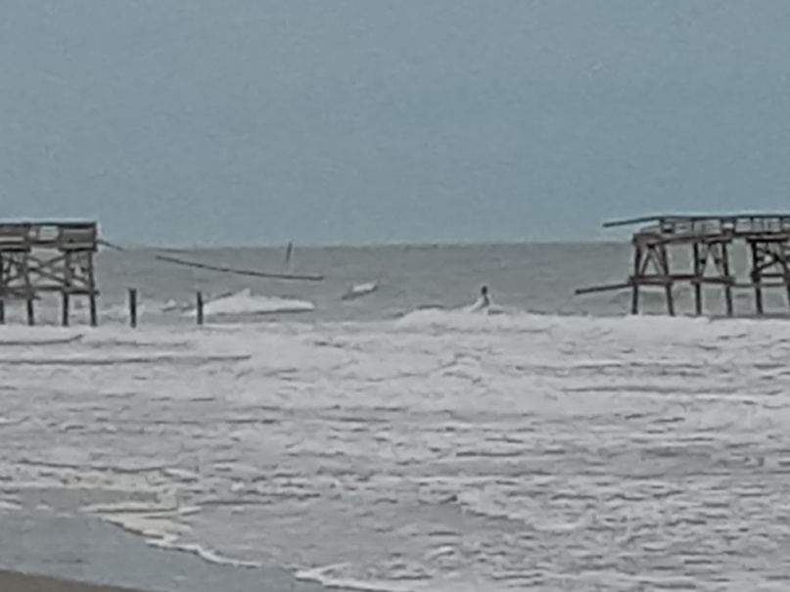
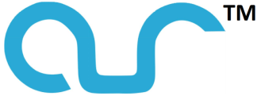
New Omni-directional Scour-Resistant Design
for Bridge and Pier Circular Monopiles
Roger L. Simpson, Ph.D., P.E.¹ and Gwibo Byun, Ph.D.
^{ICSE-11 Paper 045 Session 10}
Countermeasures for Scour and Erosion
¹ President AUR, Inc. rogersimpson@aurinc.com (540)-961-3005
www.noscour.com
Example of Tidal Surge Washout: Hurricane Ian, Sept. 2022,
Cherry Grove Pier,
North Myrtle Beach, SC, USA
© AUR, Inc. 2023
Notes:
Describe how scAUR works.

Slide 2
Introduction and Background of Dr. Simpson
An internationally recognized fluid dynamics researcher, inventor, and author on vortex producing “juncture flows”, such as those that occur in bodies of water around hydraulic structures such as bridge piers and abutments, and surface roughness effects on flow. Past President & Fellow AIAA; Fellow ASME, M. ASCE.
Consultant and advisor to NASA on reducing adverse aspects of “juncture flows” between airplane wings and a fuselage.
For over 30 years his US Navy sponsored research at Virginia Tech, where he was the Jack E. Cowling Professor of Aerospace and Ocean Engineering, provided much data for the prevention of acoustic noise producing vortices on submarines.
Over the last years, he has applied this fluid dynamics background to designing and testing the scouring-vortex preventing streamlined fairings scAURTM for bridge piers and abutments.
Novel tetrahedral vortex generators VorGAURTM create counter-rotating vortices that oppose the effects of scouring vortices & prevent debris collection.
US Patents 8348553, 8434723, and 9453319 awarded.
Model and full-scale tests under the sponsorship of the National Co-operative Highway Research Program (NCHRP-IDEA Report 162) have proven these designs.
Cost-effective stainless steel retrofits for existing bridges and concrete forms for new bridges are available for various bridge and river-bed situations.

Slide 3
Outline of Topics
Bridge failures due to scour show that scouring-vortex-preventing designs of AUR would have prevented the scour failures and will prevent future failures at all flow speeds. See Simpson and Byun (2021), ICSE-10 Proceedings and www.noscour.com for details on scAURTM and VorGAURTM Designs. This new approach to prevent scour at all flow speeds is to prevent scouring vortices and create counter-rotating vortices. The axisymmetric design presented here is for flow-direction changing tidal, surge, and tsunami cases.
The Nature of Scouring Horseshoe Vortices Around Monopiles
New Omni-directional Scour-resistant Design for Bridge and Pier Circular Monopiles with the Proven ScAURTM and New picscAURTM
Permanent and Cost-effective Solution for Tidal and Surge Omni-Directional Flows
Conclusions

Slide 4
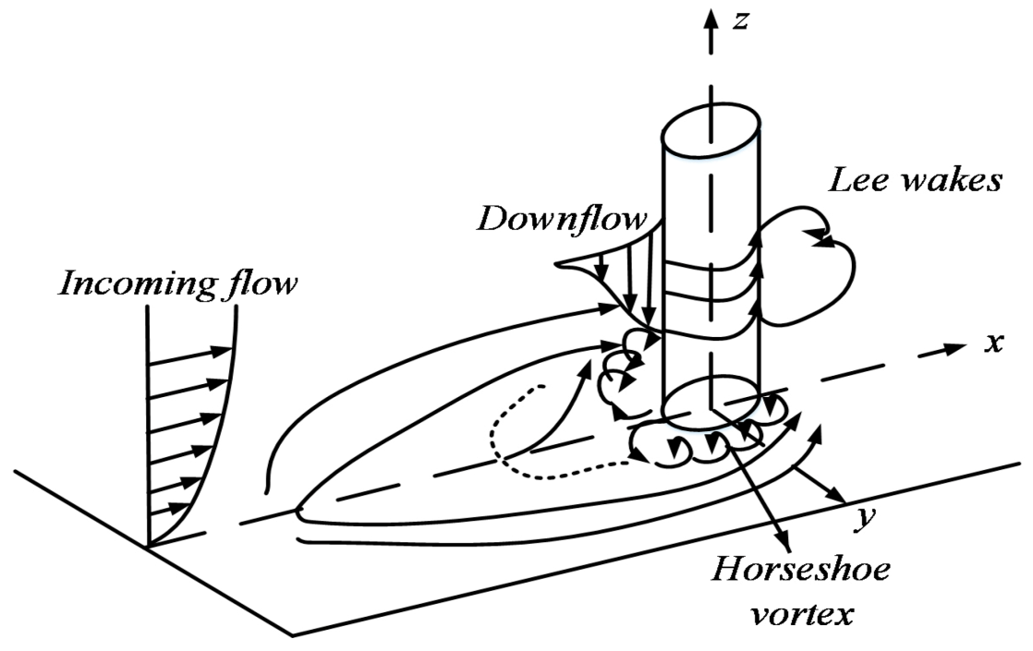
The Nature of Scouring Horseshoe Vortices Around Monopiles
Formed at upstream pile-bed junction.
Brings higher velocity water down to the bed.
Stretched around pile increasing scouring velocities.
Produces high turbulent shear stress on bed.
Removes rock and soil, leaving a scour hole.
High speed
Strength of the vortex varies with
the approach velocity and the
monopile width.

Slide 5
New Omni-directional Scour-resistant Design for Bridge and Pier Circular Monopiles with the Proven scAURTM And New picscAURTM
The axisymmetric scAURTM shape meets the key upstream streamlined fairing design requirement that the surface shape produces surface pressure gradients that limit the flux of new vorticity at the surface so discrete vortices are not formed.
This stacked axisymmetric design has a scAURTM shaped bottom structure next to the seabed, an inverted picscAURTM design next, followed by another scAURTM shaped structure, and finally picscAURTM ribs on the monopile itself.
The axisymmetric scAURTM surfaces may produce vortices of a scouring sense while the axisymmetric picscAURTM surfaces produce counter-rotating vortices, resulting in very low flow speeds next to the seabed and nearly no scour.

Slide 6
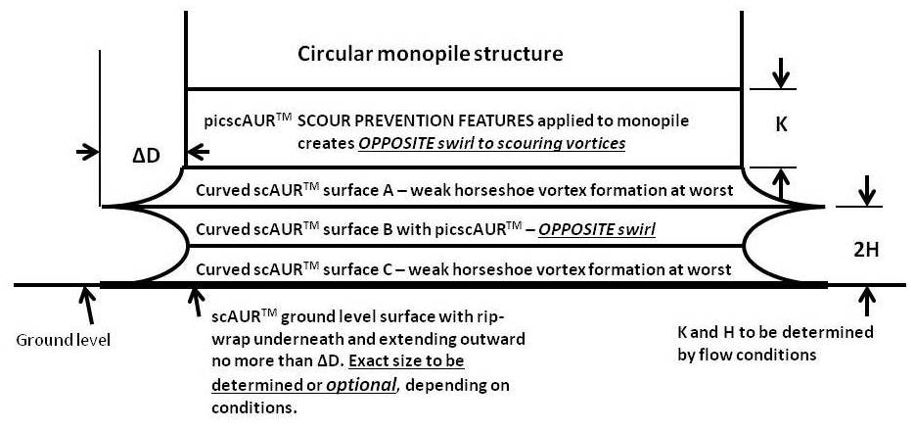
Axisymmetric scAURTM with picscAURTM Scour Prevention Features
for a Monopile, 2nd edition.

Slide 7
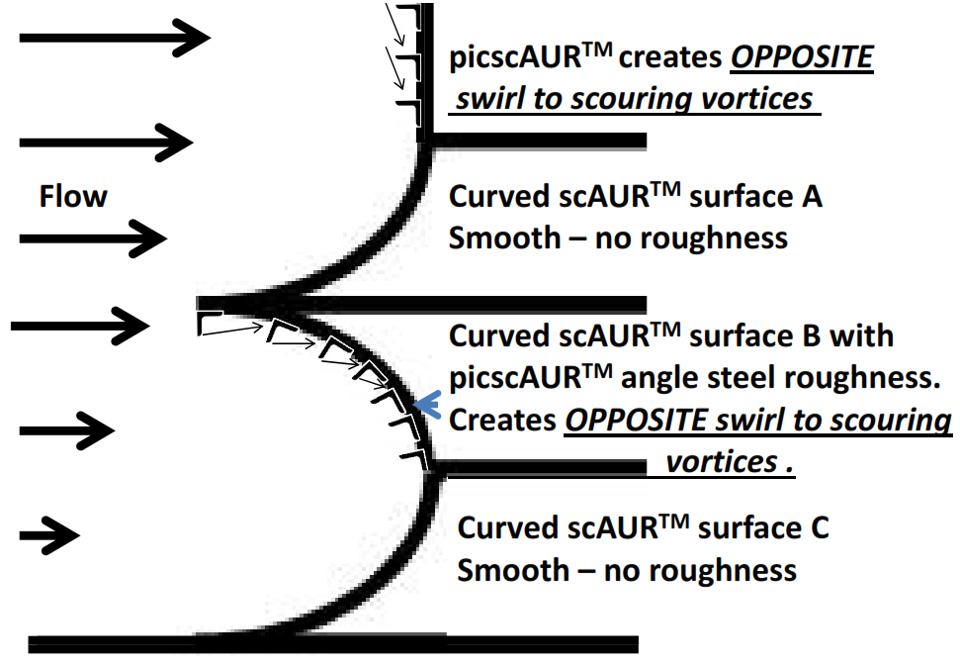
Closeup View of One Design for Axisymmetric scAURTM with
Axisymmetric picscAURTM Scour Prevention Features, 2nd Ed.
STRONGER
VORTICES
THAN
SCOURING
VORTICES

Slide 8
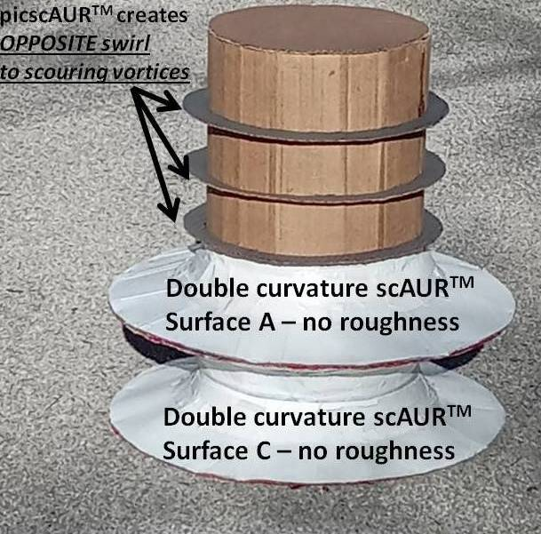
Pile test model (0.3048m diameter) for axisymmetric scAURTM with picscAURTM scour prevention features, 2nd edition, on a gravel bed.
Using published calculation methods, the strengths of the shed vortices were calculated.
Net bed surface speed < 10% of the speed with the monopile only.
Test flows: For the monopile only or Surface A only the 2.5mm gravel moved downstream due to scour: NO MOVEMENT OF 2.5mm GRAVEL WITH FULL MODEL

Slide 9
Permanent and Cost-effective Solution for Tidal and Surge Omni-Directional Flows: ScAURTM with picscAURTM Designs
A current practice for tidal and surge flows is to install monopiles for bridges and piers deeply into the bed to guarantee fixity at great cost. Example: 1.37m concrete piles driven 42.68m into the bed for a new bridge. Previous bridge at this location had 15.85m depth of scour!
The cost for one stainless steel (SS) scAURTM with picscAURTM unit varies with the size squared with a lifetime of 100 years even in seawater environments. For a 0.3048m diameter pile, the cost is less than several thousand US dollars.
For retrofits. units can be prefabricated onshore and installed on the ocean bed by divers, limiting the labor time required.
For new piles, a unit may be installed as the pile is driven into the bed.
While the scAURTM with picscAURTM design may not prevent all scour, especially for fine sandy soils, it is effective for a riprap covered bed.
It is clearly less costly than very deep piles. At bare minimum, the scAURTM with picscAURTM design is cost-effective for much more confidence that the pile will not lose fixity.
Even for bridges with little life left, current temporary countermeasures are much more expensive when the present value of future expenses is considered.

Slide 10
Conclusions
Many bridges over water are susceptible to scour of supporting rocks and soil by vortices created at the structure during peak flow events such as floods, tidal events, coastal storm surges, and tsunami situations.
The new omni-directional scour-resistant design for bridge and pier circular monopiles with scAURTM and a new picscAURTM design was presented for all flow speeds. It meets the design requirement that it prevents scour around a circular monopile for any time-varying flow approach direction, like tidal and surge flows. In these cases, strong high speed flows can occur, first in one direction and then the opposite or another direction.

Slide 11
Conclusions (Cont)
Since strong strength counter-rotating vortices are produced by the picscAURTM surfaces, the net water bottom bed surface velocity is < 10% of that produced by the horseshoe vortices when there is only the monopile.
The surface force for this scAURTM and new picscAURTM design is less than 1/100 of that for a monopile alone, resulting in no movement of small gravel.
The costs associated with the fabrication and installation of the scAURTM with picscAURTM design are very favorable compared with other traditional scour protection methods.

Slide 12
Contact Us for More Information About Other Cases or If You Have Questions
Roger L. Simpson, Ph.D., P.E. President, AUR, Inc. rogersimpson@aurinc.com
(540)-961-3005
ALL SLIDES AND EARLIER PAPERS AVAILABLE AT
www.noscour.com

