Slide 1
The Conceptual Transformation of Political Corruption
and the Insulation of Politically Motivated
Selective Prosecution
David Poplar
poplar@email.arizona.edu

Slide 2
1. The problem
1. THE PROBLEM ●○ ⏐ 2. THE BASIC IDEA ○ ⏐ 3. THE CONCEPTUAL TRANSFORMATION ○○○○ ⏐ 4. THE CONSEQUENCES ○○ ⏐ 5. OBSERVATIONS ○
Politically motivated federal prosecutions
Between 2001 and 2006, study of 375 reported cases and investigations found 79% of federal public corruption investigations and prosecutions involved Democratic officeholders (Shields & Cragan 2007a)
Updated results (study of 820): found 80% involved Democratic officeholders (Shields & Cragan 2007b)
Politically biased prosecutions took place under both Clinton and Bush administrations (Gordon 2009)
Studies Based on reported cases and investigations

Slide 3
1. The problem
1. THE PROBLEM ●● ⏐ 2. THE BASIC IDEA ○ ⏐ 3. THE CONCEPTUAL TRANSFORMATION ○○○○ ⏐ 4. THE CONSEQUENCES ○○ ⏐ 5. OBSERVATIONS ○
Questions
How did we get here?
Why aren’t people more concerned?
How can philosophy help answer these questions?

Slide 4
2. The basic idea
1. THE PROBLEM ●● ⏐ 2. THE BASIC IDEA ● ⏐ 3. THE CONCEPTUAL TRANSFORMATION ○○○○ ⏐ 4. THE CONSEQUENCES ○○ ⏐ 5. OBSERVATIONS ○
Conceptual transformation: Our basic conception of political corruption has transformed from a primarily moral concept to a much narrower legal one
Consequences: This has led to enabling misconduct like selective prosecution, while also making it harder to recognize as a form of corruption
  We have increasingly given federal prosecutors (our ‘corruption busters’) tremendous authority and discretion to go after political corruption
  But what qualifies as political corruption has become much more limited
  Selective prosecution doesn’t fit neatly into the narrow legal conception – it seems less like the kind of corruption we’re used to seeing prosecuted

Slide 5
3. The conceptual transformation
1. THE PROBLEM ●● ⏐ 2. THE BASIC IDEA ● ⏐ 3. THE CONCEPTUAL TRANSFORMATION ●○○○ ⏐ 4. THE CONSEQUENCES ○○ ⏐ 5. OBSERVATIONS ○
The concept of corruption: basic definition
“Political corruption” can be broadly defined as:
  Exercise of official action that violates an existing norm, for personal benefit at public expense
This embodies:
  Official action
  Existing norm of conduct
  Receipt of personal benefit
  At public expense

Slide 6
3. The conceptual transformation
1. THE PROBLEM ●● ⏐ 2. THE BASIC IDEA ● ⏐ 3. THE CONCEPTUAL TRANSFORMATION ●●○○ ⏐ 4. THE CONSEQUENCES ○○ ⏐ 5. OBSERVATIONS ○
The concept of corruption: as originally construed
Type of wrong: moral wrong
  A deviation from general norms of conduct (not rules or roles)
  A moral failing; focused on character of person
Type of harm: violation of a public right (to equal treatment)
  Right is not held by people as individuals, but in virtue of being citizens
  Harm is not to individuals but to society at large

Slide 7
3. The conceptual transformation
1. THE PROBLEM ●● ⏐ 2. THE BASIC IDEA ● ⏐ 3. THE CONCEPTUAL TRANSFORMATION ●●●○ ⏐ 4. THE CONSEQUENCES ○○ ⏐ 5. OBSERVATIONS ○
The concept of corruption: transformation from moral to legal
What are the reasons for the transformation?
  Growth of democratic institutions → reliance on institutional roles
  Institutional reasons: Desire to define boundaries between public and private realms led to bureaucratic rules – corruption became a breach of rules rather than of general standards of conduct (conduct not character)
  Rights-based reasons: Our general conception of a collective public right has morphed into a seemingly individual or private right (to services of one’s representatives)
  Practical (and/or retributive) reasons: the desire to punish this conduct and to enforce our rights leads to people looking to the legal system

Slide 8
3. The conceptual transformation
1. THE PROBLEM ●● ⏐ 2. THE BASIC IDEA ● ⏐ 3. THE CONCEPTUAL TRANSFORMATION ●●●● ⏐ 4. THE CONSEQUENCES ○○ ⏐ 5. OBSERVATIONS ○
The concept of corruption: transformation from moral to legal
Type of wrong: legal wrong
  Narrows the definition of what constitutes corruption to what can be legally prohibited and prosecuted (quid pro quo bribery, kickbacks, etc.)
  Negative liberty, due process, practical reality of burdens of proof
Type of harm: violation of a private right
  Less about harm to society – increasingly seen in terms of a tangible property interest that impacts constituents
  Ultimately, harm is seen as an element of a criminal offense to be proven – it becomes part of the transactional nature of the conduct

Slide 9
4. The consequences
1. THE PROBLEM ●● ⏐ 2. THE BASIC IDEA ● ⏐ 3. THE CONCEPTUAL TRANSFORMATION ●●●● ⏐ 4. THE CONSEQUENCES ●○ ⏐ 5. OBSERVATIONS ○
The unique nature of selective prosecution
“Political corruption” is misbehavior that violates certain laws, so we look to prosecutors to enforce these laws
But prosecutors can only go after certain kinds of misconduct
  Not about immoral conduct, but prosecutable conduct
  Not about conduct that harms society, but conduct that harms taxpayers
Selective prosecution does not fit into this modern conception of corruption (no kickback, no tangible property interest, etc.)
  We may recognize it’s wrong, but because it’s not explicitly criminal, we may view it as professional misconduct, rather than as political corruption (Ex: controversy over honest services fraud)

Slide 10
4. The consequences
1. THE PROBLEM ●● ⏐ 2. THE BASIC IDEA ● ⏐ 3. THE CONCEPTUAL TRANSFORMATION ●●●● ⏐ 4. THE CONSEQUENCES ●● ⏐ 5. OBSERVATIONS ○
Why don’t we view this conduct as serious as public corruption?
This type of misconduct is much harder to detect
U.S. Attys not seen as politicians but as impartial law enforcement
‘Corruption busters’ are still cloaked in moral authority even though they are enforcing narrow legal restrictions
Also: general public bias in favor of law enforcement – and attitude of no-harm no-foul as long as politicians are being punished
The point: our changed philosophical conception of political corruption has helped insulate this unique form of corruption

Slide 11
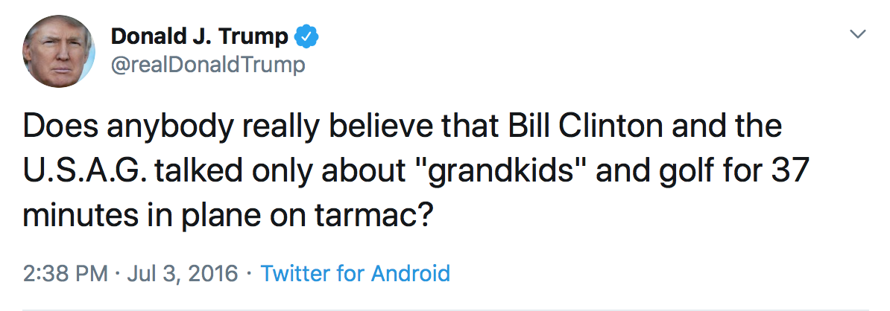
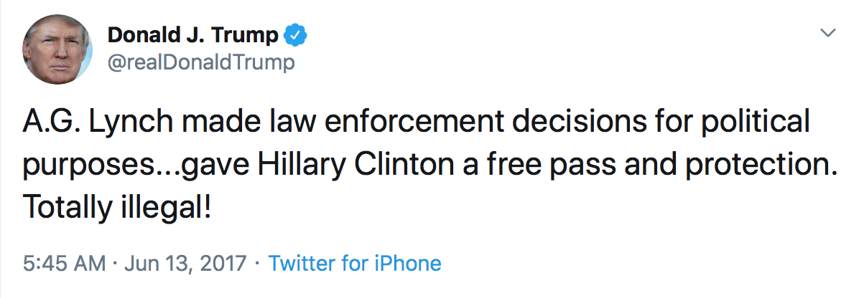
5. Observations
1. THE PROBLEM ●● ⏐ 2. THE BASIC IDEA ● ⏐ 3. THE CONCEPTUAL TRANSFORMATION ●●●● ⏐ 4. THE CONSEQUENCES ●● ⏐ 5. OBSERVATIONS ●
Disclaimer: not all U.S. Attorneys
Bill Clinton and A.G. Lynch (Sky Harbor tarmac 6/27/2016)

Slide 12
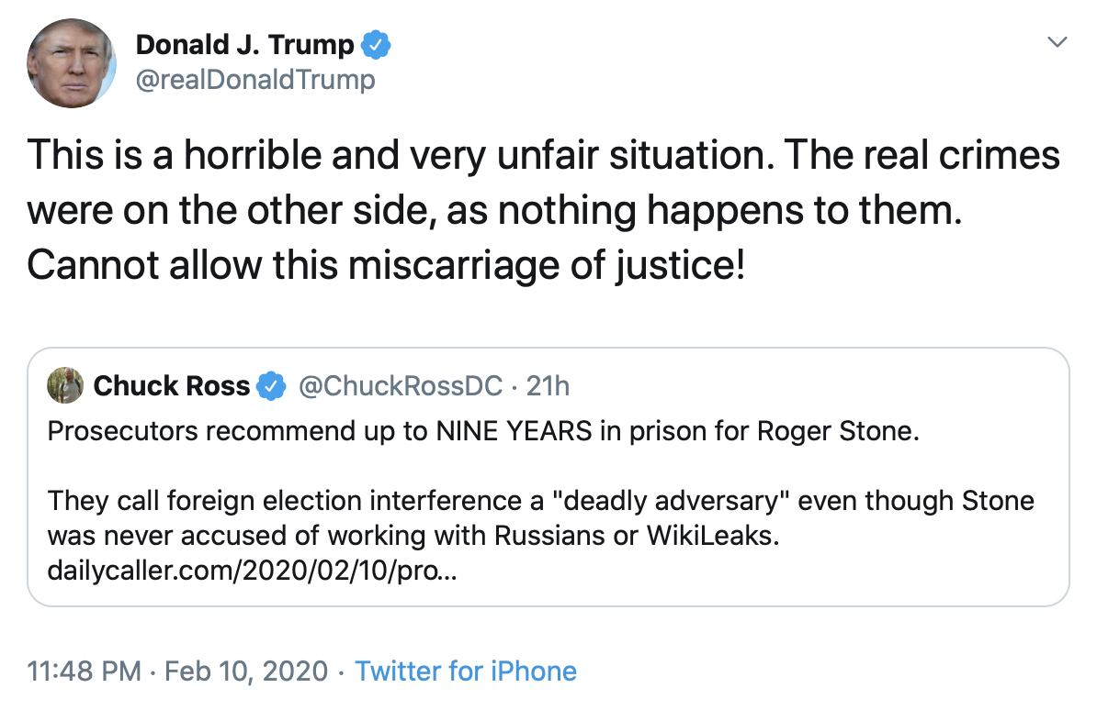
5. Observations
1. THE PROBLEM ●● ⏐ 2. THE BASIC IDEA ● ⏐ 3. THE CONCEPTUAL TRANSFORMATION ●●●● ⏐ 4. THE CONSEQUENCES ●● ⏐ 5. OBSERVATIONS ●
Disclaimer: not all U.S. Attorneys
Bill Clinton and A.G. Lynch (Sky Harbor tarmac 2016)
U.S. v. Roger Stone

Slide 13
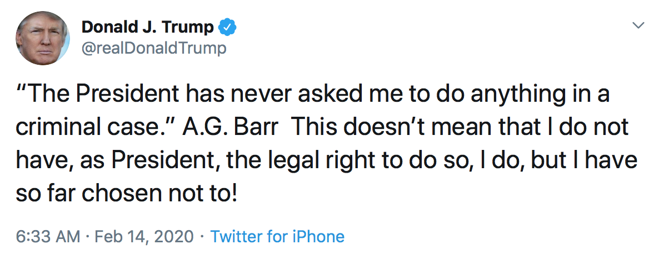
5. Observations
1. THE PROBLEM ●● ⏐ 2. THE BASIC IDEA ● ⏐ 3. THE CONCEPTUAL TRANSFORMATION ●●●● ⏐ 4. THE CONSEQUENCES ●● ⏐ 5. OBSERVATIONS ●
Disclaimer: not all U.S. Attorneys
Bill Clinton and A.G. Lynch (Sky Harbor tarmac 2016)
U.S. v. Roger Stone

Slide 14
END
1. THE PROBLEM ●● ⏐ 2. THE BASIC IDEA ● ⏐ 3. THE CONCEPTUAL TRANSFORMATION ●●●● ⏐ 4. THE CONSEQUENCES ●● ⏐ 5. OBSERVATIONS ○
  David Poplar
  poplar@email.arizona.edu
Works Cited
Gordon, Sanford C. “Assessing Partisan Bias in Federal Public Corruption Prosecutions.” American Political Science Review, vol. 103, no. 4, Nov. 2009, pp. 534–54.
Jackson, Robert H., “The Federal Prosecutor.” Journal of Criminal Law and Criminology, vol. 31, 1940-1941, pp. 3-6.
Shields, Donald, and John Cragan. Re-Visiting and Extending the Political Profiling of Elected Democratic Officials. 2007, https://journal.epluribusmedia.org/article/re-visiting-and-extending-political-profiling-elected-democratic-officials.
---. The Political Profiling of Elected Democratic Officials: When Rhetorical Vision Participation Runs Amuck. 2007, https://journal.epluribusmedia.org/article/political-profiling-elected-democratic-officials.
Warren, Mark E. “What Does Corruption Mean in a Democracy?” American Journal of Political Science, vol. 48, no. 2, Apr. 2004, pp. 328–43.

