Slide 1


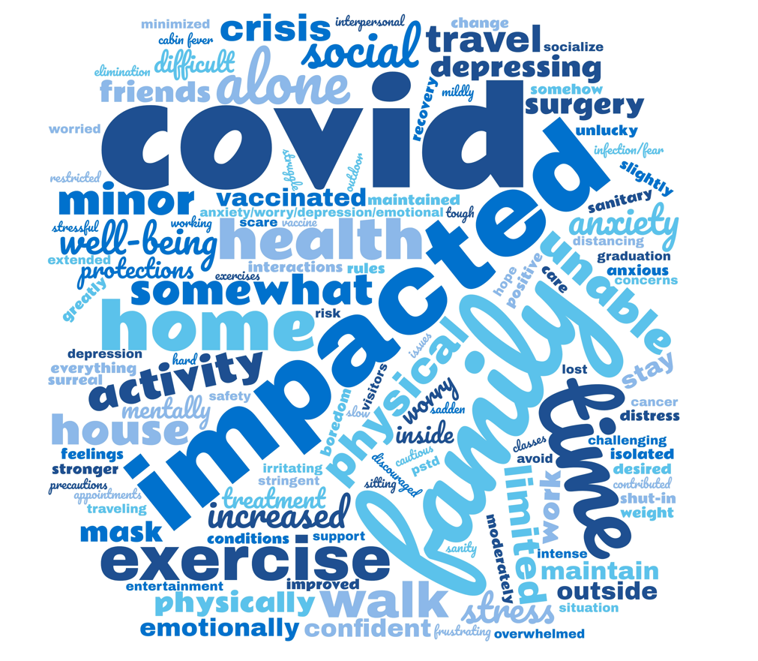
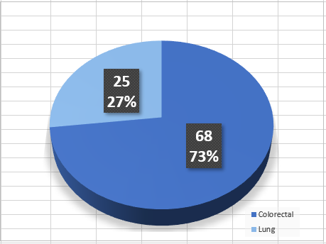
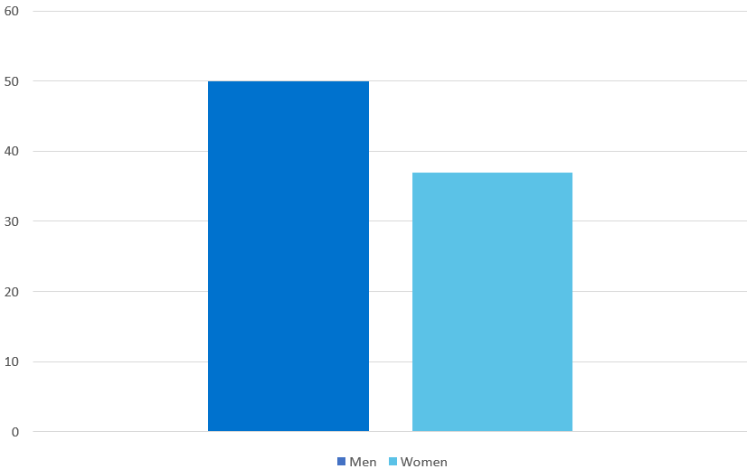
The Impact of the COVID-19 Pandemic on Post-Treatment Follow-Up Care for Survivors of Lung and Colorectal Cancer: A Qualitative Analysis
Suzanne P. Graf, MSN, RN, AGCNS-BC, OCN®, Evelyn Leyva, BSN, RN, Rosemary Prieto, MSN, RN, Jennifer Tee, BSN, RN and Virginia Sun, PhD, RN
Department of Population Sciences, Division of Nursing Research and Education
BACKGROUND
CHARACTERISTIC RESPONSES
CHARACTERISTIC RESPONSES
RESULTS
The SARS COVID-19 pandemic poses a higher risk for individuals that are immunocompromised and with other pre-existing conditions, including cancer. Due to the risk of infection, survivors with cancer report high levels of emotional burden as well as employment and financial difficulties. Additionally, challenges in post-treatment follow-up care may be exacerbated. The purpose of this study was to explore the impact of the pandemic on lung and colorectal cancer survivor’s perceptions of post-treatment follow-up care and quality-of-life.
How has the COVID-19 crisis impacted your care after finishing your cancer treatments?
How has the COVID-19 crisis impacted your work situation, your income, your finances, and your housing?
A total of 93 survivors participated in this study (68 colorectal and 25 lung). Their mean age was 62 and the majority were men. Care delivery was impacted in terms of the inability to have a significant other in attendance during appointments, delay of appointments, and the need to adapt to telehealth. Themes of isolation, decreased physical activity, fear of COVID-19 infection, and increased anxiety predominated. For the questions regarding care impact and work/income/finances/housing, approximately half the respondents stated there was little to no impact on their lives.
“Limited family participation in live medical appointments.”
“I did push off my reversal surgery for a while because of it”.
“I switched to telemedicine check up with my surgeon.”
“…Not able to have my husband by my side on day of surgery or hospitalization…”.
“I have a pay cut of 30% + some loss of benefits.”
“I’ve been on disability but all of this has eaten through all of my savings.”
“Hard to manage work, kids, and treatment. Have taken a leave of absence.”
“It exacerbated work stress and job dissatisfaction contributing to a recent decision to retire [early]….”
“COVID combined with cancer did require me to move.”
How has the COVID-19 crisis impacted your physical health and emotional well-being?
CONCLUSIONS
METHODS
COVID-19 impacted patients in the areas of care delivery, mental health, physical activity, and employment. As we continue to move through the pandemic, this data will help providers and health care systems understand patients’ on-going needs in these unprecedented times.
Survivors from one National Cancer Institute (NCI) designated cancer center in Southern California from Spring 2020 through Summer 2021 participating in a randomized trial of a self-management survivorship care intervention completed three questions on COVID’s impact on healthcare delivery and quality of life domains following informed consent and as part of baseline assessment.
The three questions explored the survivor patients’ perception of the impact of COVID-19 on their care after cancer treatment, physical health, emotional well-being, and work/income/finances/housing. Written comments were consolidated into an Excel document and a content analysis approach was used to identify themes. Comments were coded by all investigators and discrepancies were reconciled through meetings.
ACKNOWLEDGMENT
Research reported in this paper is supported by the National Cancer Institute of the National Institutes of Health under award number R01CA249501-01. The statements presented are solely the responsibility of the author(s) and do not necessarily represent the official views of the National Institutes of Health.
Diagnosis
Gender

