Slide 1
Ty Blackford
CH2M HILL Plateau Remediation Company
September 12, 2019

Slide 2
Protecting the River
100-H Hexavalent Chromium Remedy Progress
2008
2017
Notes:
From 2009-2019, CHPRC made great progress along the river:
Shrinking hexavalent chromium plumes at 100-H, preventing those contaminants from reaching the River.
Demolishing nearly 150 buildings at 100-K and remediating 92 waste sites.
Two reactors are there :
K West – almost done removing radioactive sludge from the basin, which is a critical step toward dewatering, deactivating and demolishing the basin – needed before the reactor can be deactivated.
K East – design work is underway on the interim safe storage enclosure

Slide 3
Advancing 100-K Completion
100-K Hexavalent Chromium Remedy Progress
2017
2008
Notes:
From 2009-2019, CHPRC made great progress along the river:
Shrinking hexavalent chromium plumes at 100-K, preventing those contaminants from reaching the River.
Two reactors are there :
K West – almost done removing radioactive sludge from the basin, which is a critical step toward dewatering, deactivating and demolishing the basin – needed before the reactor can be deactivated.
K East – design work is underway on the interim safe storage enclosure

Slide 4
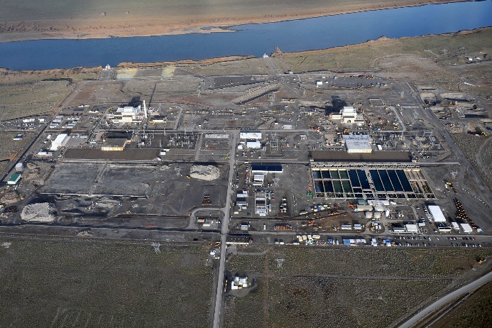
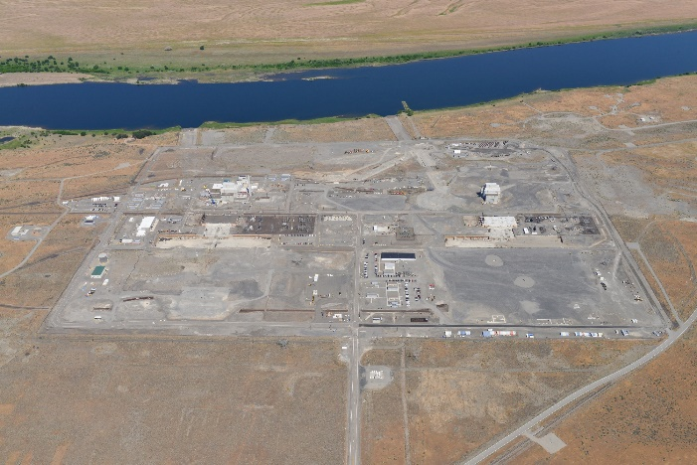
Advancing 100-K Completion
100-K Footprint Reduction
2019
2010
Notes:
From 2009-2019, CHPRC made great progress along the river:
Demolishing nearly 150 buildings at 100-K and remediating 92 waste sites.
Two reactors are there :
K West – almost done removing radioactive sludge from the basin, which is a critical step toward dewatering, deactivating and demolishing the basin – needed before the reactor can be deactivated.
K East – design work is underway on the interim safe storage enclosure

Slide 5
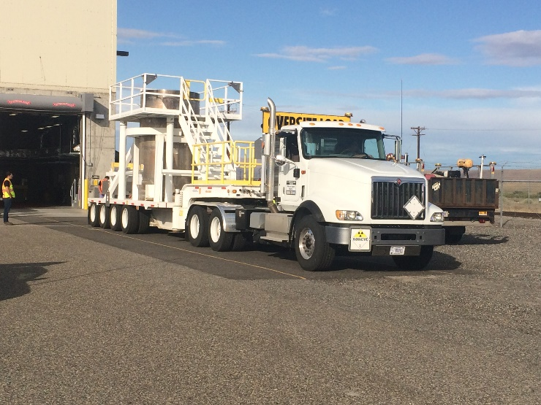
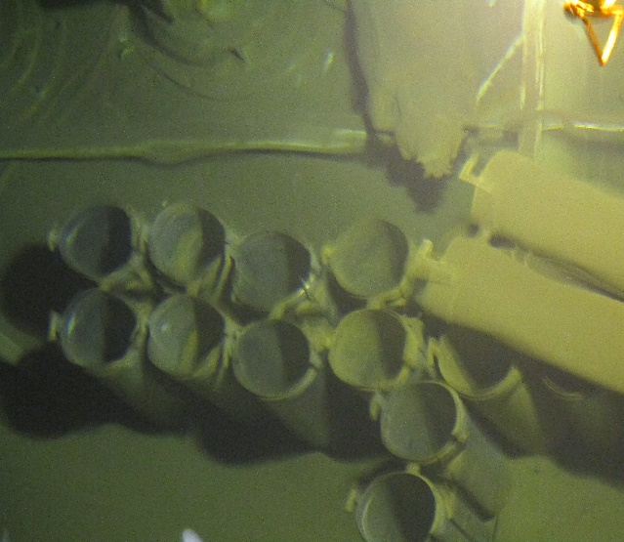
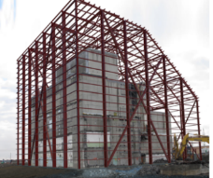
Advancing 100-K Completion
Significant Steps Toward Closure
Last Container of Sludge Shipped on September 9
Legacy Debris Removal Planning
Planning for Safe Storage
Notes:
From 2009-2019, CHPRC made great progress along the river:
Two reactors are there :
K West – almost done removing radioactive sludge from the basin, which is a critical step toward dewatering, deactivating and demolishing the basin – needed before the reactor can be deactivated.
K East – design work is underway on the interim safe storage enclosure

Slide 6
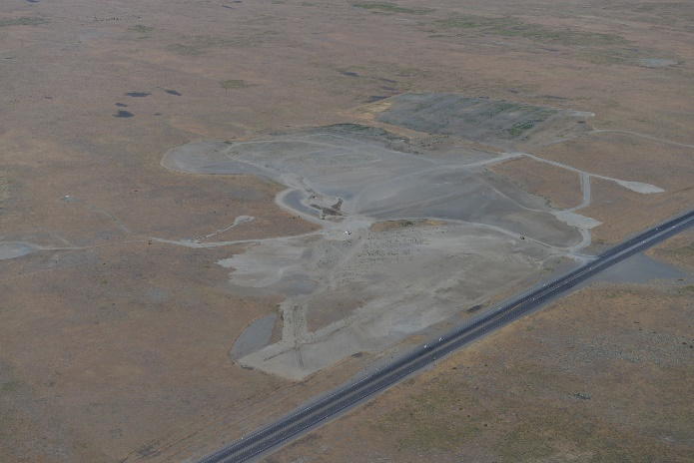
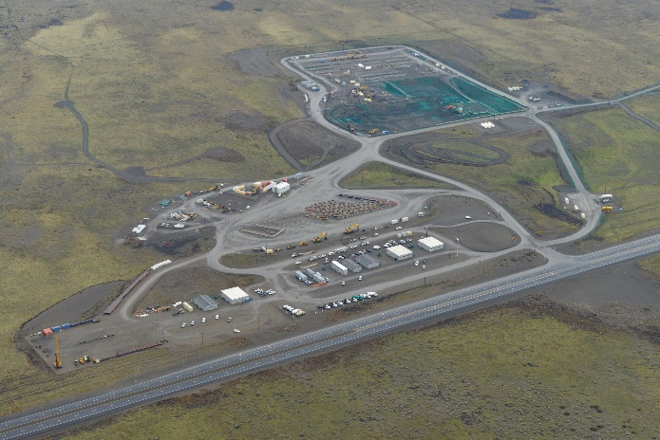
Risk Reduction Across the Site
Waste Site Along Public Highway Cleaned Up
2016
2018
Notes:
We have similar progress across the Site:
In 2018, we remediated the 618-10 burial grounds – a project some so challenging that they said it could never be done. We reduced risk next to a public highway.

Slide 7
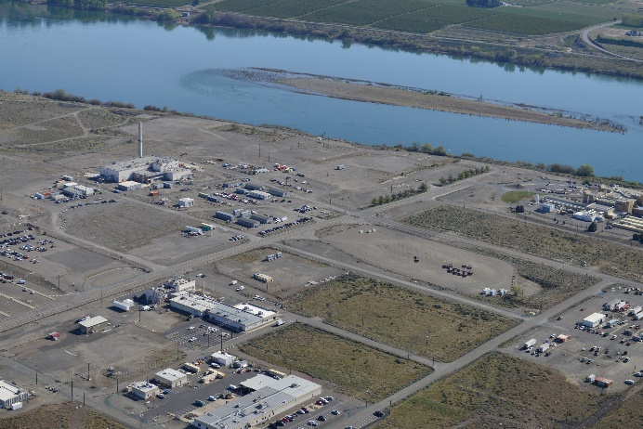
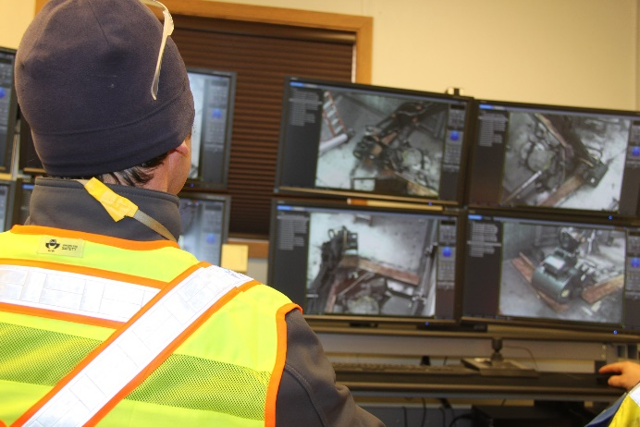
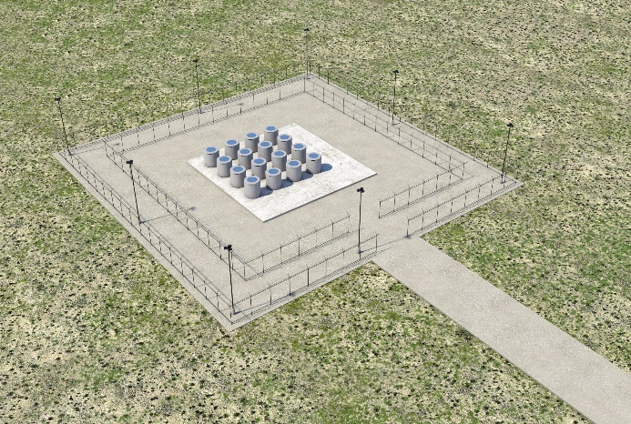
Risk Reduction Across the Site
Risk Reduction in the 300 Area
Radioactive Capsules to Dry Storage
Notes:
We have similar progress across the Site:
We are on a good path forward for the 324 Building, one of the final buildings to be torn down in the 300 Area, just north of Richland.
Years of development, including a mock-up, has already proven beneficial as we develop and implement the remote-operated tools to remove the highly radioactive soil beneath the building
We’re also preparing for the future at the Waste Encapsulation and Storage Facility.
We’ve spent the last ten years keeping 1,936 cesium and strontium capsules in a safe configuration, relocating them to reduce the heat load.
Capsules represent a third of the Site’s total radioactivity.
We just finished design work to move those capsules outside to a safer dry storage configuration.
Improves safety and reduces hotel costs.

Slide 8
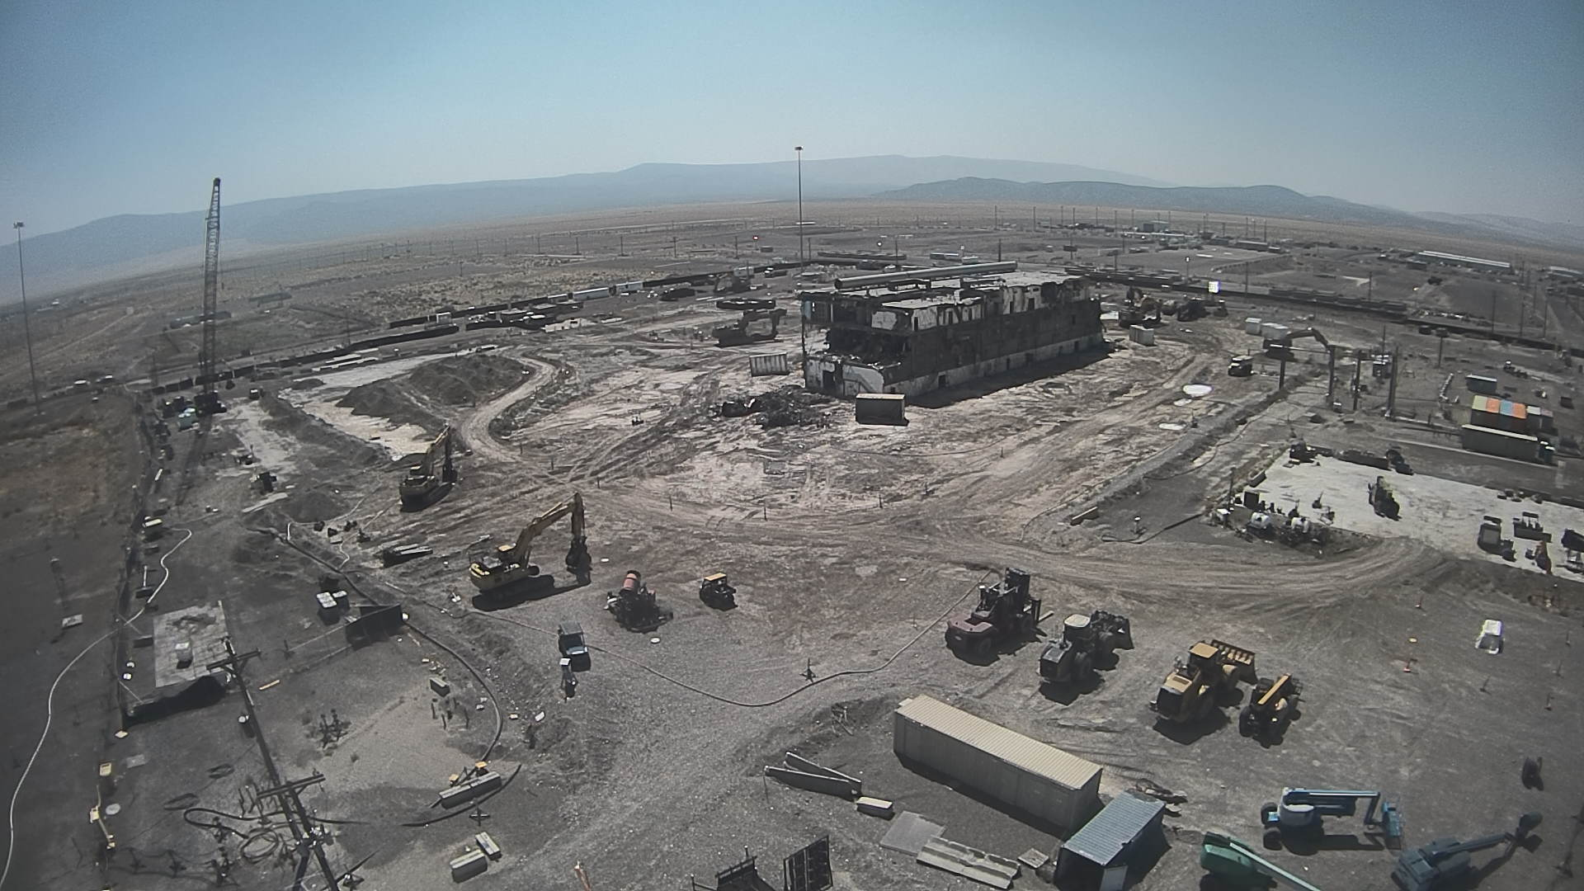
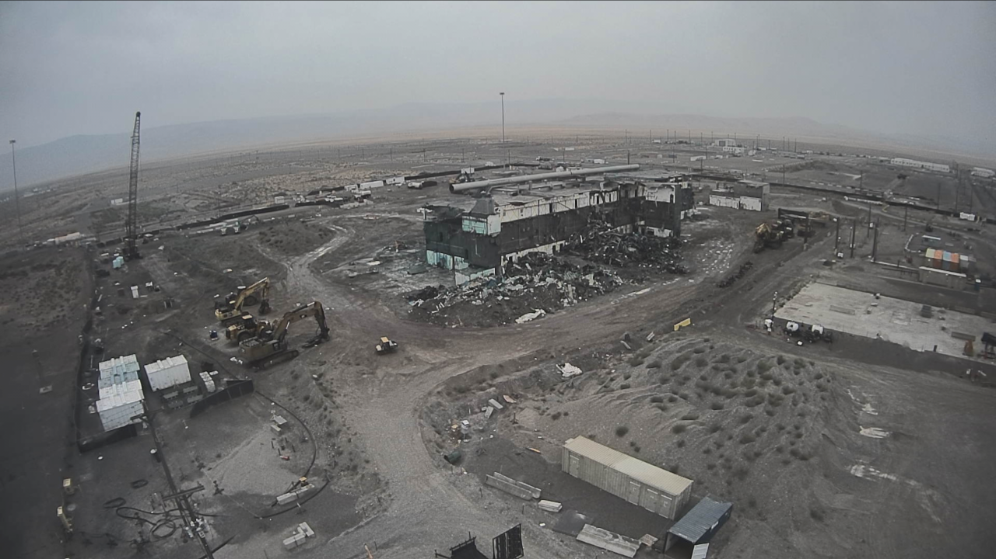
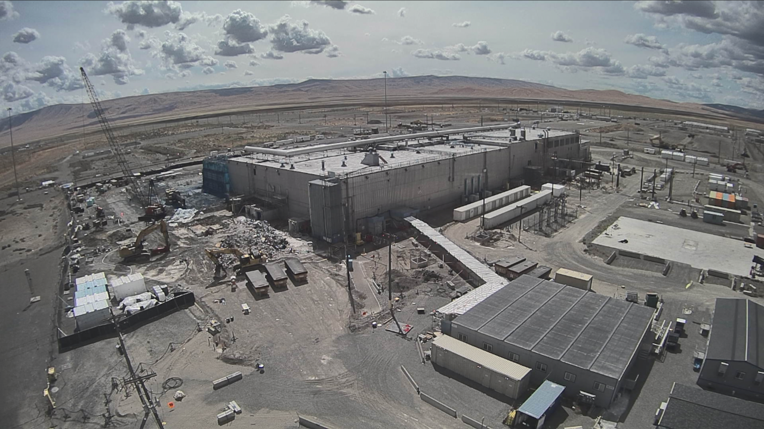
Plutonium Finishing Plant
2019
2018
2017
Notes:
PFP: Significant Challenges and Significant Progress

Slide 9
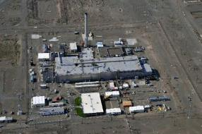
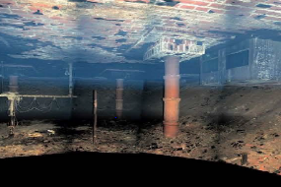
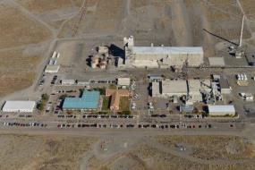
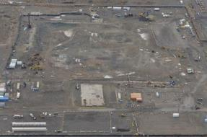
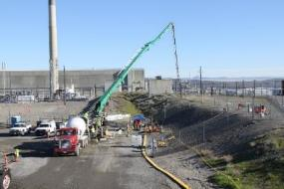
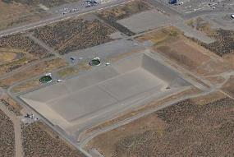
Risk Reduction to Support 24/7 Ops
Highest-Hazard Building Demolished
Risks Ranked for Mitigation, Ensuring Continuity of Operations
Risks Ranked for Mitigation, Ensuring Continuity of Operations
Plutonium Finishing Plant: August 2010
Z-9 Crib…
… Near Site Laboratory
Plutonium Finishing Plant: 2020
Waste Tunnels…
… Near Disposal Facility for Vitrified Waste
Notes:
… And this is where we’ll be in a few months – the building demolished, removing what was once one of the most hazardous buildings across the EM Complex.
That puts is in a great positon to mitigate a significant risk to the only laboratory on the Site.
In the PFP footprint – Z-9 crib, containing large amounts of plutonium.
The lab supports all Site operations, especially Tank Farms and WTP.
We saw the negative impacts legacy facilities can have on site operations.
When PUREX Tunnel 1 partially collapsed, that affected WTP operations.
We filled Tunnel 2, mitigating that risk to WTP and the nearby IDF.
The past ten years of cleanup has brought the contractors and offices closer together. We’re now doing cleanup work in close proximity to each other; coordination and clear communication between our organization is necessary.

