Slide 1
Jainism
Preetam Jain

Slide 2
History
Jainism is a very ancient religion with roots in Indian subcontinent and historical as well as archeological evidences point to Jainism to be at least 7000 years old.
Jainism has several similarities with Hinduism and Buddhism and some differences also.
Over centuries Jainism, Buddhism and Hinduism have always co-existed exchanged some vital concepts and practices with each other. Most notable being theory of Karma and idol worshipping.
Jainism was propagated over time through the teachings of purified and enlightened beings known as “Tirthankar”.
The last Tirthankar was Lord Mahavir who lived on earth between 597 BC-527 BC.

Slide 3



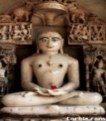


Timeline
Judaism
2600BC
Abraham
2200BC
Exodus from Egypt
1940sAD Israel
Christianity
30BC
Christ
Islam
571AD
Mohammed
Jainism
Beginningless/Endless
557BC, Mahavir
Buddhism
483BC
Gautam Buddha
Beginningless/Endless
Hinduism

Slide 4
Jain Fundamentals
Who Created the Universe:
  No one; It has no beginning and no ending. It changes forms.
Purpose of Life:
  Help each other; Realize one’s own full potential; To manage one’s passions/bad qualities;
Who controls your actions
  We are responsible for our own actions
How do we become happy
  By managing our passions, eliminating bad qualities (anger, greed, ego, pride, deceit, doubts)

Slide 5
Jain Fundamentals (cont.)
Human Suffering is due to:
  We are unable to understand our true nature
Is there reincarnation?
  Yes – until we reach full realization/enlightenment
Is there a Jain “bible”?
  Yes. It is called “Aagam”.
Tolerance for other religions:
  Yes. Respect and understand other faiths

Slide 6
Jain Fundamentals (cont.)
Why do we pray?
  To celebrate the qualities of perfect Soul

Slide 7
Jain Festivals
Lord Mahavir’s Birthday:
Lord Mahavir’s Nirvan Celebration:
  Diwali is the day of Mahavir Nirwan (departed earth), New year begining of day after Diwali
Paryushan Parva:
  Remembering and Practicing the qualities of the Soul. Seeking forgiveness from everyone for mistakes.

Slide 8
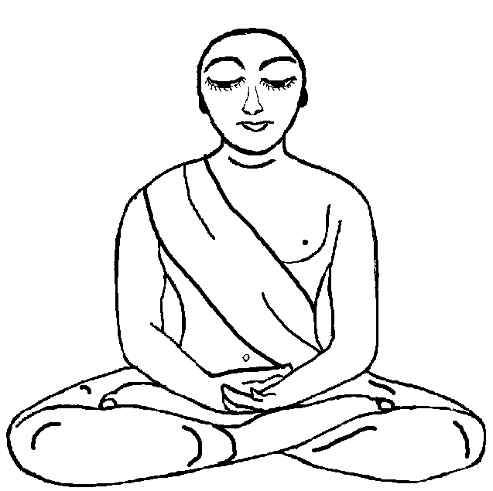


“Soul - God” – Each living being has a Soul; God is a fully enlightened Soul. Each Soul is capable of becoming God. Note: God is not external to us.

Slide 9


Different Core
Western Schools:
Eastern Schools:
External god controls you
God is the soul – within you
Religion/philosophy/science
separate
Religion and philosophy
are intertwined
Linear nature of life/death
Cyclic nature of life/death - nirvana
Karma determines your next life
As you sow so you reap on
judgement day

Slide 10
Essence of Jainism
in Thoughts/Speech/Action …
Ahimsa i.e. Non-Violence
  is most fundamental & sacrosanct to Jainism. It means to not to harm to ANY living being with actions, words, or thoughts EXCEPT for self defense. For this reason vegetarianism is hallmark Jain Practice.
Satya i.e. Truth.
  Always speak truth
Asteya i.e. no-stealing
  means not to take anything that is not given to you, or is simply not yours.
Bhramacharya i.e. celibacy
  it is control over desires. This requires control over our senses or ourselves in over indulgence in worldly pleasures
Aparigraha i.e. Non-Possession or non-Accumulation
  Do not accumulate anything more than necessary and share limited resources
Anekantavad i.e. Multiplicity of views
  On any issue, subject multiple views exist. Truth emerges from multiple views.

Slide 11
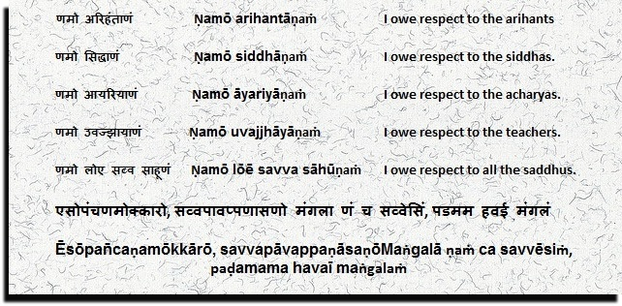
Jain Prayer

Slide 12
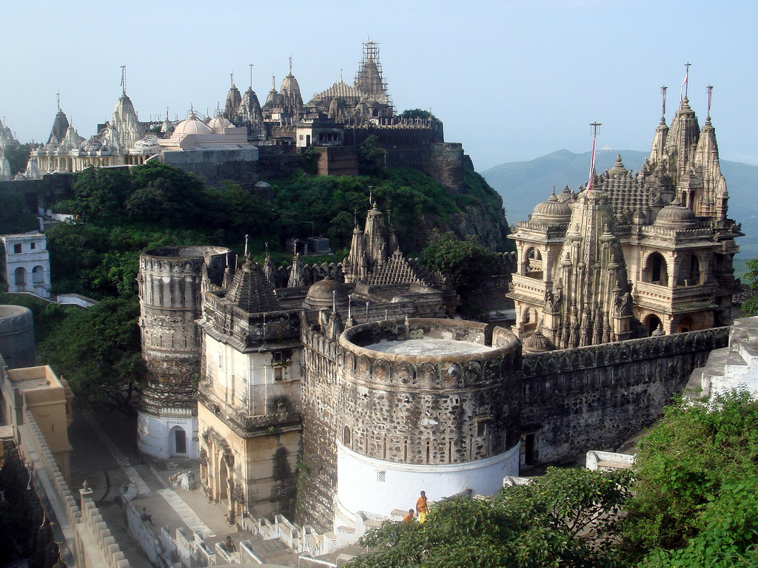
Famous Jain Temples
Palitana, Gujrat

Slide 13
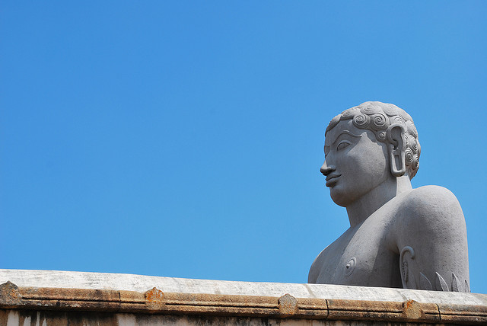
Famous Jain Temples
Gomateshwar, Karnataka

Slide 14

Famous Jain Temples
Pavapuri, Bihar

Slide 15
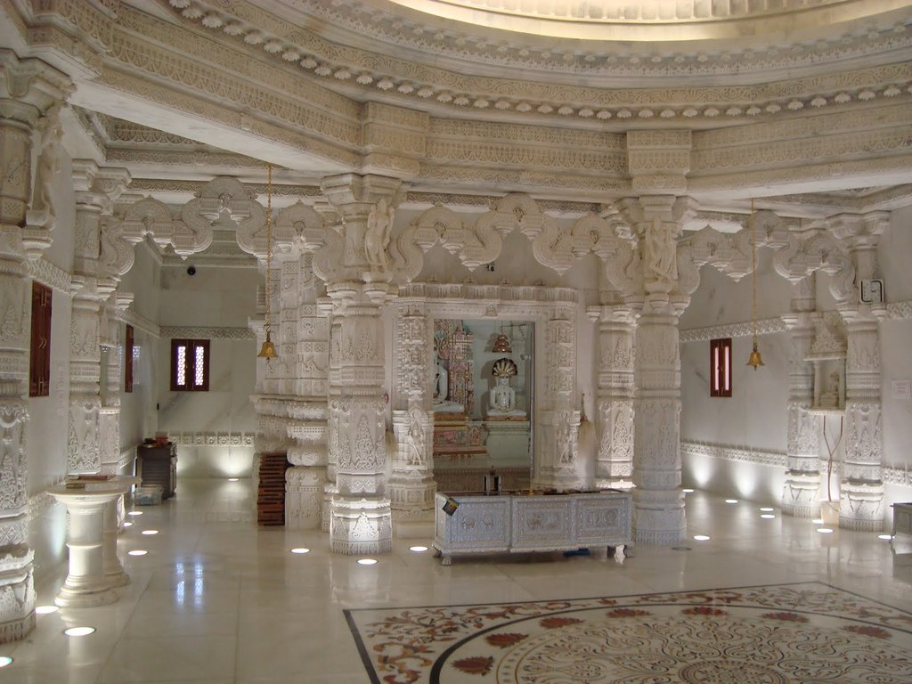
Famous Jain Temples
Atlanta, Georgia

Slide 16
References
www.jaina.org
Wikipeadia
www.hinduwebsite.com

