Slide 1
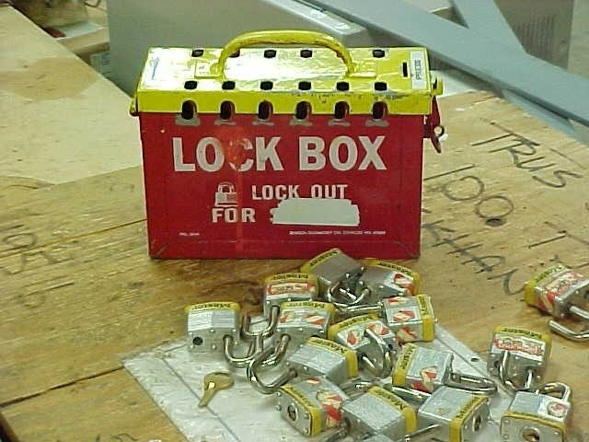
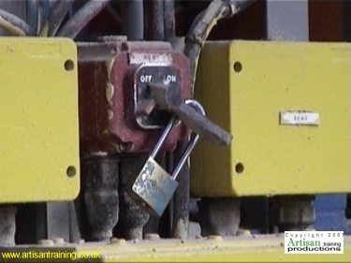
“LOCK OUT/TAG OUT”
Bureau of Workers’ Comp
PA Training for Health & Safety
(PATHS)
OSHA 29 CFR 1910.147
CONTROL OF HAZARDOUS ENERGY
LOCK OUT - TAG OUT
(LOTO)
PPT-026-05
1
Notes:
LOTO is on OSHA’s list of “Most-Cited” violations when the solution for companies can be remediated through implementation of a LOTO Program.

Slide 2
Topics
Purpose of Standard
LOTO Program
Authorized & Affected Employees
LOTO Procedures & Program
Training, Inspections, Testing
Contractors
PPT-026-05
2
Notes:
Topics discussed include:
Purpose of Standard
LOTO Program
Authorized & Affected Employees
LOTO Procedures & Program
Training, Inspections, Testing
Contractors

Slide 3
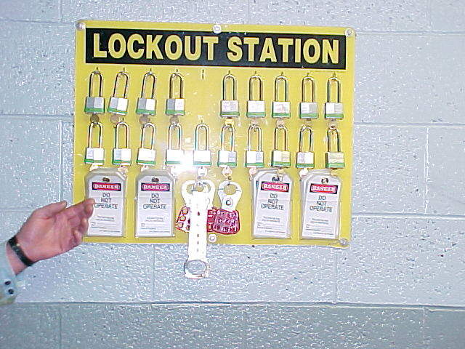
LOTO Mishaps are Severe!
Average lost work
days for failure to
LOTO is 24 days
per injury
120 workplace
fatalities annually
are related to
failure to LOTO
PPT-026-05
3
Notes:
The ramifications of an absent program can be severe.
Average lost work days for failure to LOTO is 24 days per injury
120 workplace fatalities annually are related to failure to LOTO

Slide 4
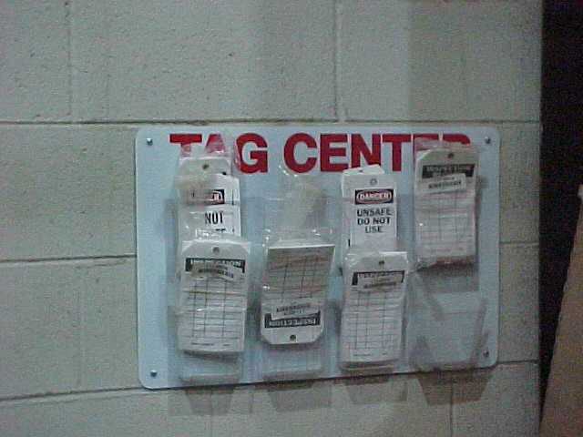
Tag Center
Centralized point to keep appropriate tags
PPT-026-05
4
Notes:
Your program should establish a Tag Center which is a centralized point at which to keep appropriate tags.

Slide 5
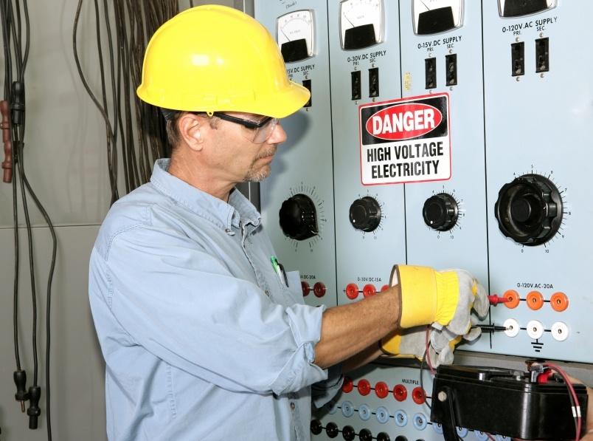
Purpose of LO/TO Standard
If a risk exists to any person upon unexpected start up or sudden release of stored energy, all protective measures must be taken to isolate all sources of hazardous energy
PPT-026-05
5
Notes:
The purpose of this standard as with all OSHA standards is to promote the safety of the employee in the workplace.
If a risk exists to any person upon unexpected start up or sudden release of stored energy, all protective measures must be taken to isolate all sources of hazardous energy.

Slide 6




Types of Energy Sources
List & Identify all Sources of Energy
Electrical
Hydraulic
Pneumatic
Thermal
Chemical
Mechanical
Cord & Plug
Equipment
Other Types
PPT-026-05
6
Notes:
Types of energy sources encompass the following. List and identify all sources toward which procedures and policies will be directed.
Electrical
Hydraulic
Pneumatic
Thermal
Chemical
Mechanical
Cord & Plug Equipment
Other Types

Slide 7
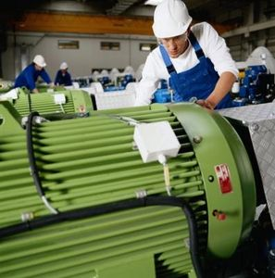
Authorization
Any employee involved in the
service or maintenance of any machine or equipment having potential for release of hazardous energy is authorized to Lock-out/Tag-out if he or she is adequately trained
PPT-026-05
7
Notes:
The authorization to perform LOTO rests with,
Any employee
involved in the service or maintenance of
any machine or equipment
having a potential for release of hazardous energy
is authorized to Lock-out/Tag-out if he or she is adequately trained

Slide 8
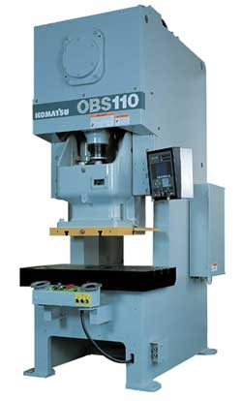
What Should be Done?
Appoint a “Program Administrator”
Determine what machines/equipment need to be locked/tagged out (e.g. by JHA/inspection/knowledge)
Purchase appropriate locks/tags
PPT-026-05
8
Notes:
What should be done?
Appoint a “Program Administrator”
Determine what machines/equipment need to be locked/tagged out (e.g. by JHA/inspection/knowledge)
Purchase appropriate locks/tags

Slide 9
What Should Be Done?
Develop a LOTO program
Determine status of
employees (authorized,
affected, etc.)
Provide training
Implement program
PPT-026-05
9
Notes:
Also,
Develop a LOTO program
Determine status of employees (authorized, affected, etc.)
Provide training
Implement program

Slide 10

Program Responsibility
Responsibility should be given to a “program administrator” for:
  Lock acquisition
  Safe work procedures
  Training coordination
  Contractor coordination
  Assisting supervisors in
  implementation and enforcement of
  disciplinary actions for non-compliance
PPT-026-05
10
Notes:
The responsibility of the program should be given to a “program administrator” for:
Lock acquisition
Safe work procedures
Training coordination
Contractor coordination
Assisting supervisors in implementation and enforcement of disciplinary actions for non-compliance

Slide 11
Program Responsibility
Conducting periodic inspections
Documenting changes in control
program as result of inspections
Assisting in development of
specific procedures
Maintaining program availability
for employees and interested
persons
PPT-026-05
11
Notes:
This Administrator should also be responsible for,
Conducting periodic inspections
Documenting changes in the control program as a result of inspections
Assisting in the development of specific procedures and
Maintaining program availability for employees and interested persons
As part of the LOTO program, the Program Administrator may want to consider having the authorized person’s picture placed on their tags/locks so that the “owner” of the tag/lock can be easily identified if their name is not recognized.

Slide 12
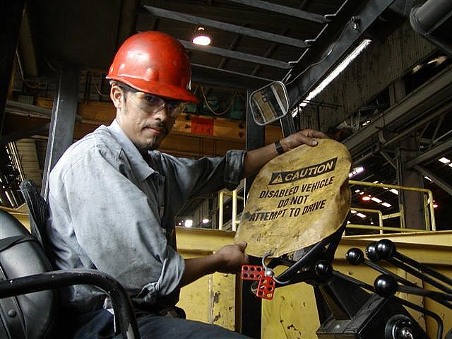
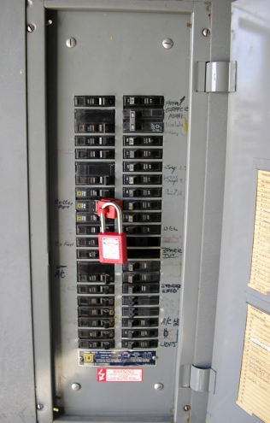
When to Apply LO/TO
Application of Lockout/Tagout is required:
  When servicing and/or maintaining
  machines or equipment
  If it is necessary to remove a guard
  or bypass safety device or interlock
  If an employee has the potential to
  be exposed to material being processed
  (point of operation) or the machine
  operating cycle
PPT-026-05
12
Notes:
Apply the LOTO provisions,
When servicing and/or maintaining machines or equipment,
If it is necessary to remove a guard or bypass safety device or interlock,
If an employee has the potential to be exposed to material being processed (point of operation) or the machine operating cycle

Slide 13
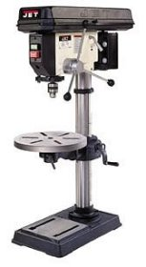
OSHA Exception to LOTO
Minor tool changes/adjustments/other minor servicing activities taking place during normal production operations that are: routine, repetitive, and integral to the use of the equipment for production (provided alternative measures offering effective protection are used)
Could changing a drill bit qualify as an exception?
Maybe, provided above criteria is met
PPT-026-05
13
Notes:
OSHA makes exceptions to the LOTO when all items can be satisfied.
Minor tool changes/adjustments/other minor servicing activities taking place during normal production operations that are: routine, repetitive, and integral to the use of the equipment for production (provided alternative measures offering effective protection are used)

Slide 14
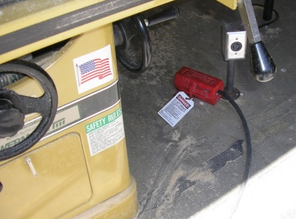
Exclusions
The LOTO Standard does not apply to:
Cord and Plug Electrical Equipment:
Plug has to be under the exclusive control of the
employee performing servicing or maintenance
Hot tap operations: Welding on transmission and distribution systems (water, gas, steam or petroleum products) when performed on pressurized pipelines, provided the employer demonstrates that:
– Continuity of service is essential
– Shutdown of system is impractical
– Documented procedures are followed
– Special equipment used to provide proven
effective protection for employees
PPT-026-05
14
Notes:
Exclusions also exist where the LOTO standard does NOT apply:
Cord and Plug Electrical Equipment:
Plug has to be under the exclusive control of the employee performing servicing or maintenance
Hot tap operations: Welding on transmission and distribution systems (water, gas, steam or petroleum products) when performed on pressurized pipelines, provided the employer demonstrates that:
– Continuity of service is essential
– Shutdown of system is impractical
– Documented procedures are followed
– Special equipment used to provide proven effective protection for employees

Slide 15
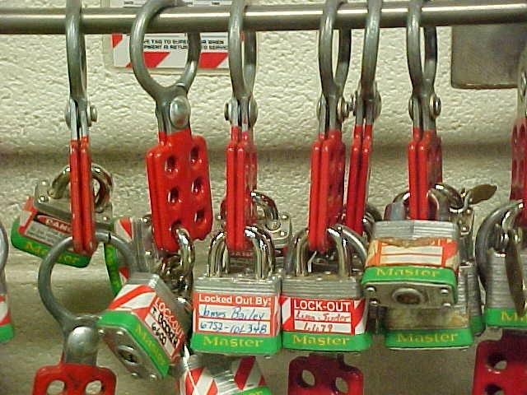
Authorized Devices
Shall be capable of withstanding
the environment to which they
are exposed for the maximum
period of time that exposure is
expected
Tag-out devices must be constructed
and printed so that exposure to
weather will not cause deterioration
or the message to become illegible
Shall indicate the identity of the
person applying the device
PPT-026-05
15
Notes:
The LOTO requires authorized devices be applied to notify other workers the program in in effect. These devices:
Shall be capable of withstanding the environment to which they are exposed for the maximum
period of time that exposure is expected
Tag-out devices must be constructed and printed so that exposure to weather will not cause deterioration or
the message to become illegible
Shall indicate the identity of the person applying the device

Slide 16
Documented Procedure for Every Machine
Not necessary if everything listed below exists:
Machine/equipment has no potential for stored or residual
energy or re-accumulation of stored energy after shut down
which could injure employees
Machine/equipment has single energy source readily
identified and isolated
Isolation and LOTO of that energy source will completely
de-energize and deactivate machine/equipment
Machine/equipment is isolated from that energy source and
locked out during servicing/maintenance
PPT-026-05
16
Notes:
Documented procedures for every machine are not necessary if EVERYTHING listed below exists.
Machine/equipment has no potential for stored or residual energy or re-accumulation of stored energy after shut down which could injure employees
Machine/equipment has single energy source readily identified and isolated
Isolation and LOTO of that energy source will completely de-energize and deactivate machine/equipment
Machine/equipment is isolated from that energy source and locked out during servicing/maintenance

Slide 17
Documented Procedure for Every Machine
Not necessary if all exist:
Single LOTO device will achieve a locked-out condition
LOTO device is under the exclusive control of the authorized
employee performing servicing/maintenance
Servicing/maintenance does not create hazards for others
The employer has had no accidents involving unexpected
activation/re-energization of machine/equipment being
serviced/maintained
PPT-026-05
17
Notes:
Not necessary if all the following also exist:
Single LOTO device will achieve a locked-out condition
LOTO device is under the exclusive control of the authorized employee performing servicing/maintenance
Servicing/maintenance does not create hazards for others
The employer has had no accidents involving unexpected activation/re-energization of machine/equipment being serviced/maintained

Slide 18
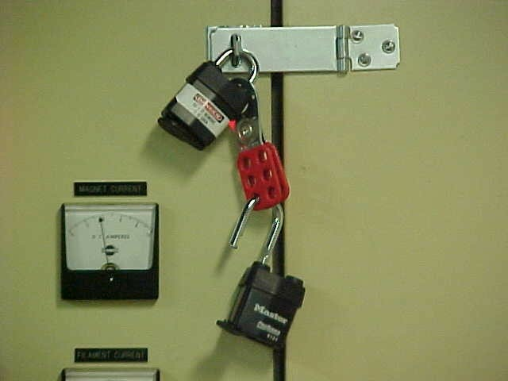
Authorized Employee
Person who locks or tags out machine
Suggestion: The Appendix of your LOTO Program should contain a list of Authorized Employees for the particular area/facility
PPT-026-05
18
Notes:
An Authorized Employee is one who locks or tags out a machine.
Suggestion: The Appendix of your LOTO Program should contain a list of Authorized Employees for the particular area/facility

Slide 19
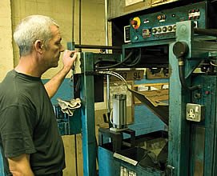
Affected Employee
Employees whose job
requires them to operate
the machine or process on
which maintenance or
service is being performed
Need to be notified upon
shutdown and start up
PPT-026-05
19
Notes:
The Affected Employee are those whose job
Requires them to operate the machine or process on which maintenance or service is being performed
Need to be notified upon shutdown and start up

Slide 20
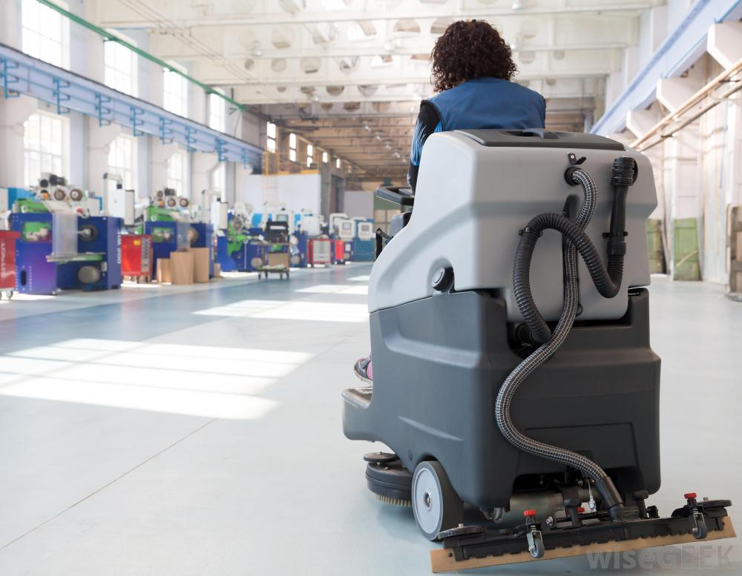
Other Employee
An individual who may be in the area and
affected by the shut down or start up of a
machine (e.g. janitor).
Required to recognize when energy
control procedures are being used,
Understand the purpose of the
procedure, and
Understand the critical
importance of not attempting to
start up or use equipment that
has been locked out or tagged out.
PPT-026-05
20
Notes:
Other employees are those whose job may put them in an area whereby they could be affected by the shut down or start up of a machine.
Required to recognize when energy control procedures are being used,
Understand the purpose of the procedure, and
Understand the critical importance of not attempting to start up or use equipment that has been locked out or tagged out.

Slide 21
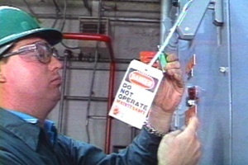
Affected Work Station
PPT-026-05
21

Slide 22
Individual Lockout
Shut down machine; power control off; lockout
Stored energy dissipated and then isolated
Engage controls for machine operation, verify OFF
Work may proceed
If shift changes, individual LOTO repeated by next shift
PPT-026-05
22
Notes:
An individual Lockout sequence would include:
Shut down machine; power control off; lockout
Stored energy dissipated and then isolated
Engage controls for machine operation, verify OFF
Work may proceed
If shift changes, individual LOTO repeated by next shift

Slide 23
Restoring Equipment to Service
Replace all guards and safety devices
Inspect work area to ensure all
nonessential items have been removed
and machine/equipment components are
operationally intact
Vents and bleeders closed, blinds
removed, blocks and tags removed
Employees notified and moved to safe
area
PPT-026-05
23
Notes:
Restoring Equipment sequences would also be included, e.g.
Replace all guards and safety devices
Inspect work area to ensure all nonessential items have been removed and machine/equipment components are intact
Vents and bleeders closed, blinds removed, blocks and tags removed
Employees notified and moved to safe area

Slide 24
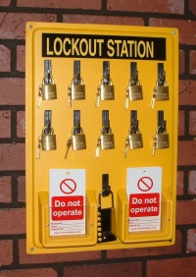
Restoring Equipment to Service
Each employee removes his or her lock
Machine re-started to ensure working
properly/safely
Affected employees notified that
machine/equipment back in service
PPT-026-05
24
Notes:
Restoration of service also has its stages.
Each employee removes his or her lock
Machine re-started to ensure working properly/safely
Affected employees notified that machine/equipment back in service

Slide 25
Group Lockout
Same as individual lockout except:
  Primary responsibility vested in authorized employee for set
  number of employees involved
  Provision for authorized employee to ascertain exposure
  status of individual group members
  When more than one crew, craft, department, etc. involved
  LOTO responsibility given to one authorized employee for
  coordination
  Each authorized employee affixes personal LOTO device to
  group LOTO device/lockbox when they begin work
PPT-026-05
25
Notes:
A Group Lockout is the same as an individual lockout with the following exceptions:
Primary responsibility vested in authorized employee for set number of employees involved
Provision for authorized employee to ascertain exposure status of individual group members
When more than one crew, craft, department, etc. involved LOTO responsibility given to one authorized employee for
coordination
Each authorized employee affixes personal LOTO device to group LOTO device/lockbox when they begin work

Slide 26
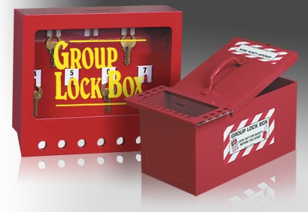
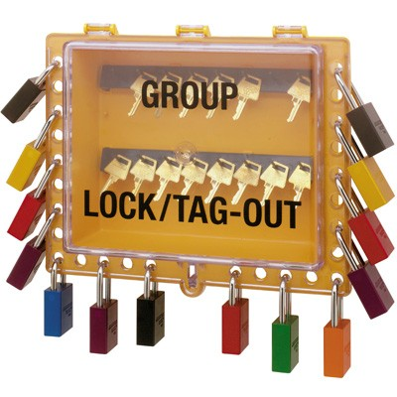
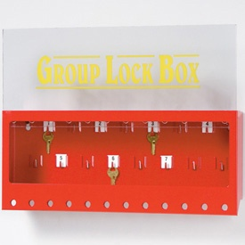
Group Lockout Boxes
PPT-026-05
26
Notes:
The slide shows variations of Group Lockout Boxes obtainable from vendors.

Slide 27
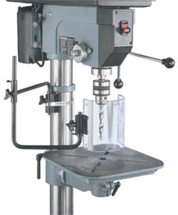
Group Restoration to Service
Each “trade” - replace all
guards and safety
devices
Vents and bleeders
closed, blinds removed,
blocks and tags removed
Each employee removes
his or her lock
PPT-026-05
27
Notes:
Group restoration to service also includes:
Each “trade” - replace all guards and safety devices
Vents and bleeders closed, blinds removed, blocks tags removed
Each employee removes his or her lock

Slide 28
Group Restoration to Service
Employees are notified and removed to a
safe distance
Group Authorized Person ensures machine
device operating properly/safely
Group Authorized Person notifies all
personnel/affected employees that
machine/equipment is back in service
PPT-026-05
28
Notes:
During Group Restoration,
Employees are notified and removed to a safe distance
Group Authorized Person ensures machine device operating properly/safely
Group Authorized Person notifies all personnel/affected employees that machine/equipment is back in service

Slide 29
Lock Removal Other Than Authorized Person
A situation may arise whereby a lock needs to be
removed and the authorized person who put it in
place is not on-site
Can be done as long as documented procedure is
followed
At a minimum the procedure must include: (1) Verification by the employer that the authorized employee
who applied the device is not on site;
(2) All reasonable efforts to contact the authorized employee
to inform him or her that the lock has been removed; and
(3) The employee is definitely informed of the removal of the
lock upon his or her return to work.
PPT-026-05
29
Notes:
There are times when a situation necessitates the removal of a lock and the authorized employee who put that lock in place is not on-site. That individual’s lock can be removed provided a documented procedure is in place which, at a minimum, includes the items listed.
NOTE: Obviously, the "one person, one lock, one key" practice is the preferred means and is accepted across industry lines, but it is not the only method to meet the language of the standard. However, prior to the use of a master key method, specific procedures and training, meeting the §1910.147(e)(3) exception, must be developed, documented, and incorporated into your energy control program. Among the features essential to a compliant master key procedure is a reliable method to ensure that access to the master key will be carefully controlled by the employer such that only those persons authorized and trained to use the master key in accordance with the employer's program can gain access.

Slide 30
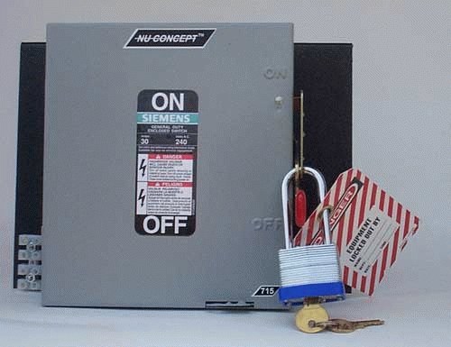
Long Term Safety Lockout
Extended period of time:
Machine’s use
discontinued or is no
longer part of operation
Long term locks
available for use by the
responsible person
PPT-026-05
30
Notes:
Some systems may be removed from service not to be replaced or awaiting replacement by newer equipment. Extended period lockouts may also be accommodated.
Machine’s use discontinued or is no longer part of operation
Long term locks available for use by the responsible person

Slide 31
Unauthorized Removal
Consequences of unauthorized removal of LOTO devices:
Should be listed in the program (let all personnel know what actions occur if somebody removes or damages LOTO devices without authorization)
Example: “Only an Authorized Person can remove personal locks (list names and departments of authorized persons).
If a LOTO device is removed, damaged, or disabled, the responsible employee will receive disciplinary action pursuant to …….”
PPT-026-05
31
Notes:
Your program should indicate the consequences of unauthorized removal of LOTO devices. These consequences
should be listed in the program (let all personnel know what actions occur if somebody removes or damages LOTO devices without authorization)
Example: “Only an Authorized Person can remove personal locks (list names and departments of authorized persons).
If a LOTO device is removed, damaged, or disabled, the responsible employee will receive disciplinary action pursuant to …….”

Slide 32
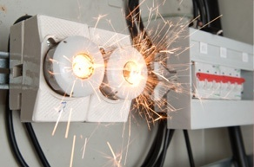
Subject to Disciplinary Action
All involved parties for
failure to implement LOTO
(including supervisors)
Misuse of LOTO equipment
Contractors who fail to adhere
PPT-026-05
32
Notes:
Indicate those actions subject to disciplinary action,
All involved parties for failure to implement LOTO (including supervisors)
Misuse of LOTO equipment
Contractors who fail to adhere

Slide 33
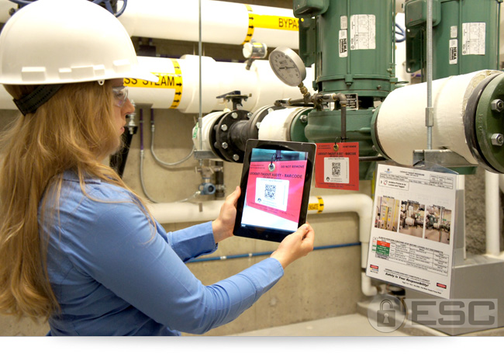
Tags
Used if energy isolating
device not capable of
being locked out
Tags should not be
removed without
authorization of the
authorized person
responsible for it
Tags must be legible
and understandable by
all employees
PPT-026-05
33
Notes:
Tags are used if an energy isolating device is not capable of being locked out
Tags should not be removed without authorization of the authorized person for it
Tags must be legible and understandable by all employees

Slide 34

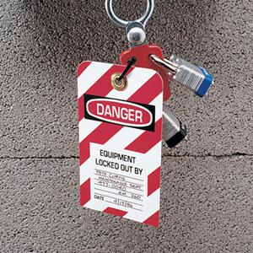
Tags
Tags and their means of attachment
must be made of materials that can
withstand environmental conditions
Tags must be securely attached to
energy isolating devices
PPT-026-05
34
Notes:
Tags and their means of attachment must be made of materials that can withstand environmental conditions
Tags must be securely attached to energy isolating devices

Slide 35
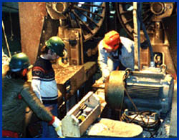
Training
1910.147 (c)(7)(i) = “The employer shall provide training to ensure that the purpose and function of the energy control program are understood by employees and that the knowledge and skills required for the safe application, usage, and removal of the energy controls are acquired by employees”
PPT-026-05
35
Notes:
Training is covered in the standard at 1910.147 (c)(7)(i) = “The employer shall provide training to ensure that the purpose and function of the energy control program are understood by employees and that the knowledge and skills required for the safe application, usage, and removal of the energy controls are acquired by employees”

Slide 36
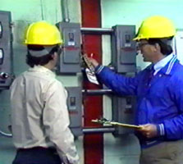
Training-All Employees
Training Should Include:
  Purpose of LOTO program
  Use of the energy control program
  LOTO devices and plant specifics
  Rules and consequences of
  unauthorized removal of LOTO devices
PPT-026-05
36
Notes:
Training should include:
- Purpose of LOTO program
- Use of the energy control program
- LOTO devices and plant specifics
- Rules and consequences of unauthorized removal of LOTO devices

Slide 37
Training – Authorized Employees
In Summary: List & Identify all Sources of Energy
Electrical
Hydraulic
Pneumatic
Thermal
Chemical
Mechanical
Cord & Plug
Equipment
Other Types
PPT-026-05
37
Notes:
Training for Authorized Employees should include the following for purposes of structuring their JHA (Job Hazard Analysis) and policies:
Electrical
Hydraulic
Pneumatic
Thermal
Chemical
Mechanical
Cord & Plug Equipment
Other Types

Slide 38
Training Authorized Persons
In addition to basic LOTO training given to all employees, training for “Authorized Persons” should also include:
  When to implement LOTO
  Recognition of hazardous energy sources
  Type and magnitude of energy in workplace
  Returning equipment to service
  If questions on application–specific actions to
  be taken
PPT-026-05
38
Notes:
In addition to basic LOTO training given to all employees, training for “Authorized Persons” should also include:
When to implement LOTO
Recognition of hazardous energy sources
Type and magnitude of energy in workplace
Returning equipment to service
If questions on application–specific actions to be taken

Slide 39
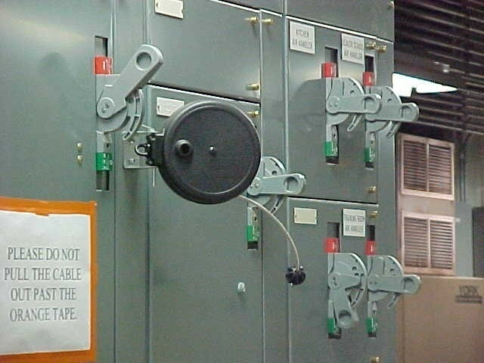
Retraining
Authorized and Affected persons is required when:
New equipment brought into the workplace
Change in job assignment
Changes in LOTO equipment
Periodic audit identifies need
PPT-026-05
39
Notes:
Retraining of both, Authorized and Affected Persons is required when:
New equipment brought into the workplace
Change in job assignment
Changes in LOTO equipment
Periodic audit identifies need

Slide 40
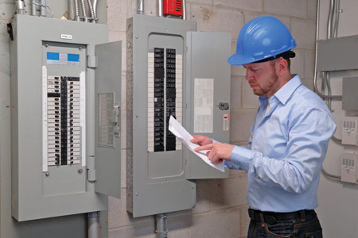
Periodic Inspection
Periodic inspection should be
performed at least annually by an
authorized employee other than the
one(s) using the energy control
procedure being inspected
Periodic inspections are conducted to
correct deviations or inadequacies
“Certify” inspections done:
- Identify machine or equipment - Date of inspection - Person performing inspection - Employees included
PPT-026-05
40
Notes:
Periodic inspection should be performed at least annually by an authorized employee other than the
one(s) using the energy control procedure being inspected
Periodic inspections are conducted to correct deviations or inadequacies
“Certify” inspections were done by including:
- Identify machine or equipment
- Date of inspection
- Person performing inspection
- Employees included

Slide 41
Testing/Positioning of Machines, Equipment, Components
In situations where LOTO devices must be temporarily removed from the energy isolating device and the machine/equipment has to be energized to test or position:
­ Clear the machine or equipment of tools and materials
­ Remove employees from the machine/equipment area
­ Remove the LOTO devices
­ Energize and proceed with testing/positioning
­ De-energize all systems and reapply energy control
measures to continue servicing/maintaining
PPT-026-05
41
Notes:
In situations where LOTO devices must be temporarily removed from the energy isolating device and the machine/equipment has to be energized to test or position:
­ Clear the machine or equipment of tools and materials
­ Remove employees from the machine/equipment area
­ Remove the LOTO devices
­ Energize and proceed with testing/positioning
­ De-energize all systems and reapply energy control measures to continue servicing/maintaining

Slide 42
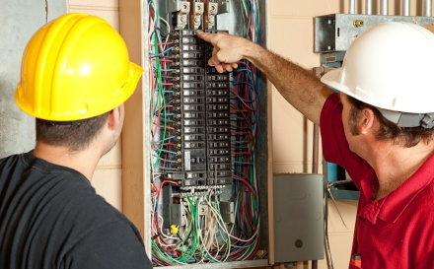
Contractors
Exchange LOTO
procedures
Agree on procedures
before work begins
Discipline of contractor
and/or contractor
employees for failure
to use LOTO
PPT-026-05
42
Notes:
Contractors may do work which interrupts production. Meet with contractors prior to work.
Exchange LOTO procedures
Agree on procedures before work begins
Discipline of contractor and/or contractor employees for failure to use LOTO

Slide 43
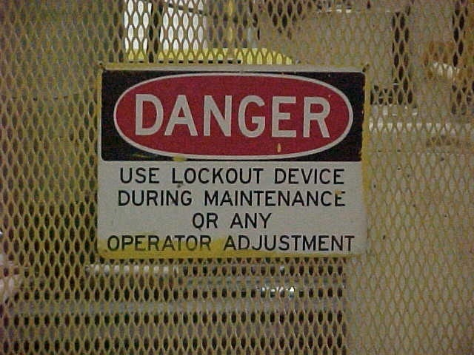
Appropriate Posting
PPT-026-05
43
Notes:
Areas which, through JHA and inspection, have been deemed LOTO locations, post accordingly.
Some facilities have created facility maps which indicate the locations and specific processes.
For each area, a procedure has been identified in a LOTO Procedure Manual.

Slide 44
End Result
Due to OSHA and as a best practice,
facilities should have a LOTO
program in place where appropriate
Employees should receive LOTO
training as appropriate and training
should be documented
Employees need to understand when
LOTO in use they should not attempt
to remove or otherwise re-energize
the machine
PPT-026-05
44
Notes:
Due to OSHA and as a best practice, facilities should have a LOTO program in place where appropriate
Employees should receive LOTO training as appropriate and training should be documented
Employees need to understand when LOTO in use they should not attempt to remove or otherwise re-energize the machine

Slide 45


Contact Information
Health & Safety Training Specialists
1171 South Cameron Street, Room 324
Harrisburg, PA 17104-2501
(717) 772-1635
RA-LI-BWC-PATHS@pa.gov
Like us on Facebook! - https://www.facebook.com/BWCPATHS
PPT-026-05
45
Notes:
We invite you to contact us for more information on other free power point programs any free training at your location.

Slide 46

Questions
PPT-026-05
46

