Slide 1
Dear Teacher,
These slides were created to support the lessons in the CSO Teacher’s Guide for
“BOLD Voices: A Beethoven Celebration,” November 2019.
You are welcome to modify, convert to a different format, or use as is in any way that would be useful to your teaching.

Slide 3
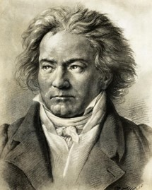
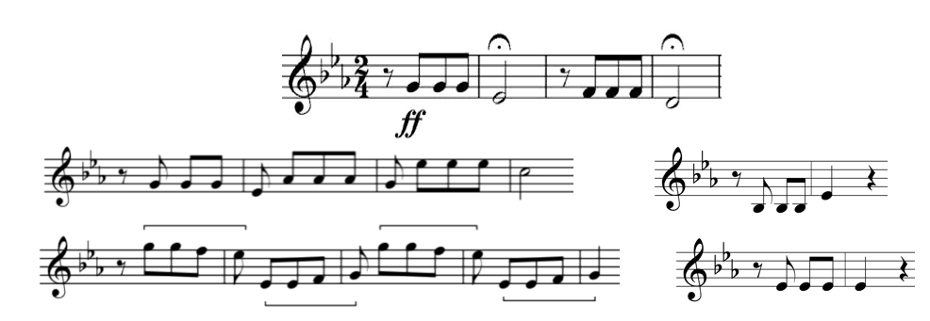
Symphony No 5, Mvt. 1

Slide 4
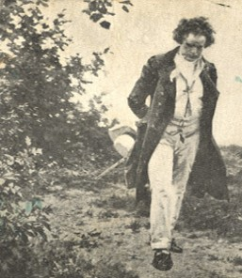
Symphony No 6, Mvt. 4
SYMPHONY No. 5
Allegro con brio
Andante con moto
Scherzo. Allegro
Allegro
SYMPHONY No. 6
Cheerful feelings after arriving in the country
Scene at the brook
Happy gathering of country folk
Thunderstorm
Shepherd’s Song; Cheerful and thankful feelings after the storm

Slide 5
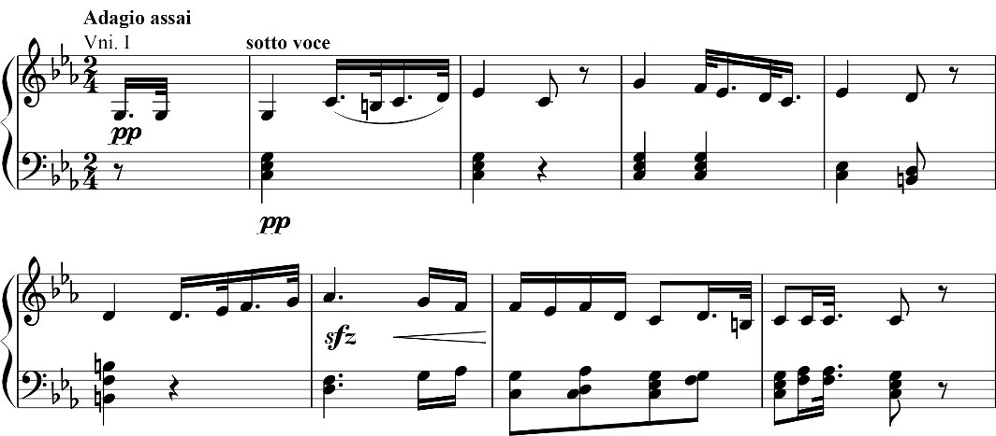
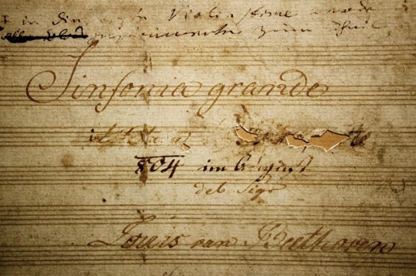
Symphony No 3, Mvt. 2

Slide 6
Symphony No 9, Mvt. 4
If it feels like no one hears you,
listen to your inner voice.
Search inside yourself, be brave,
and make a new creative choice.
Music moves us; be inspired
by all those who’ve come before.
Speak your truth and share with others;
that’s what music was made for!

Slide 7
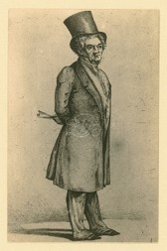
Symphony No 9, Mvt. 4

Slide 8
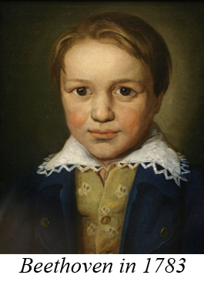
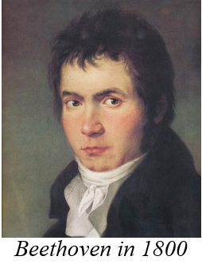
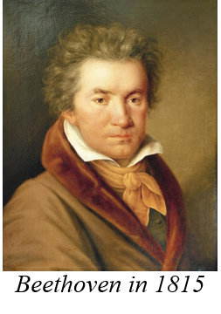
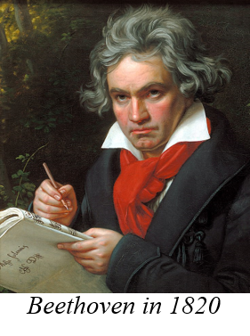
Symphony No 1, Mvt. 4

Slide 9
Symphony No 1, Mvt. 4
1,2,3—2,3,4—3,4,5—4,5,__
1,3,5—2,4,6—3,5,7—4,__,__

Slide 10
1,2,3—2,3,4—3,4,5—4,5,__
1,3,5—2,4,6—3,5,7—4,__,__
Symphony No 1, Mvt. 4
1
2
3
4
sequence patterns in music

Slide 11
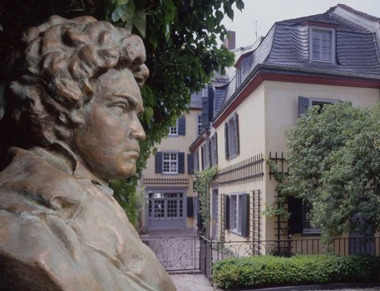
1,2,3—2,3,4—3,4,5—4,5,__
1,3,5—2,4,6—3,5,7—4,__,__
Symphony No 9, Mvt. 2

Slide 12
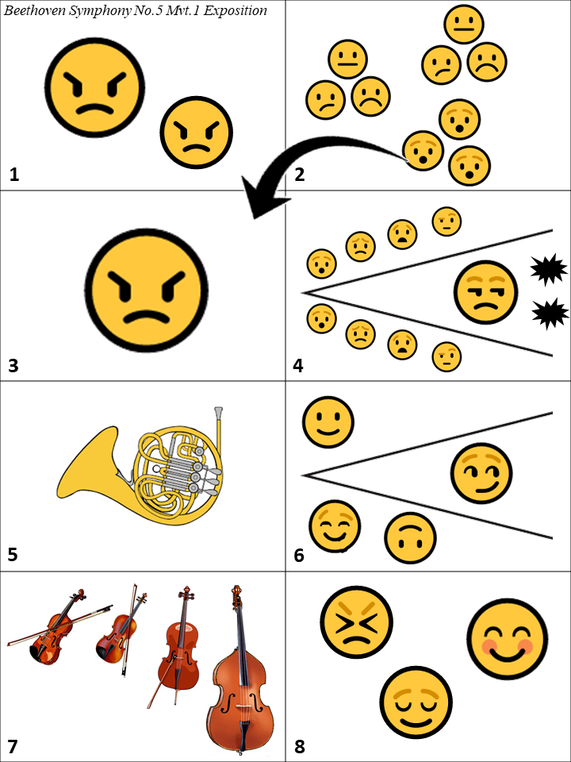
Symphony No 5, Mvt. 1

Slide 13
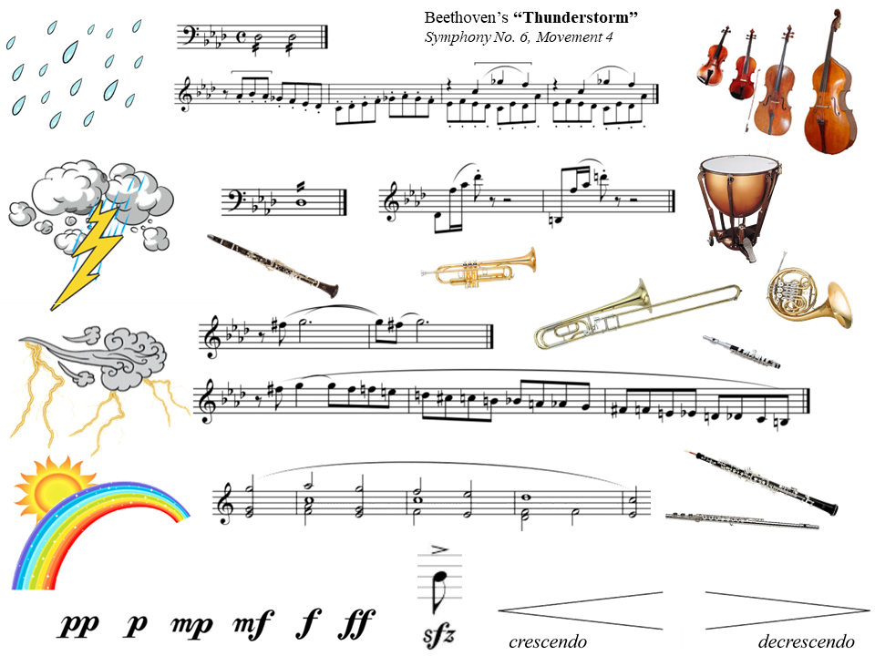

Slide 14
How Do You Feel?
https://gozen.com/a-better-way-to-teach-kids-about-emotions

Slide 15
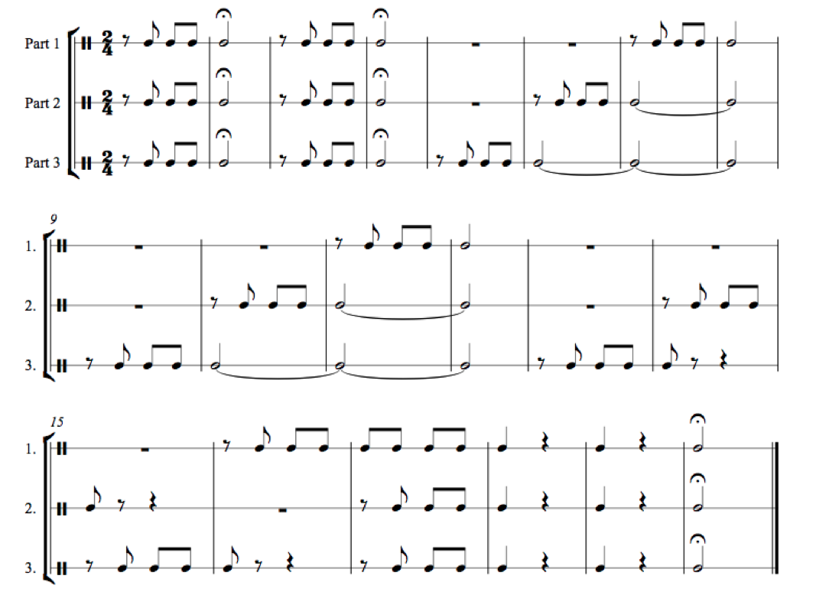
Play the Fifth!
https://www.downsjuniormusic.com/beethoven.html

Slide 16
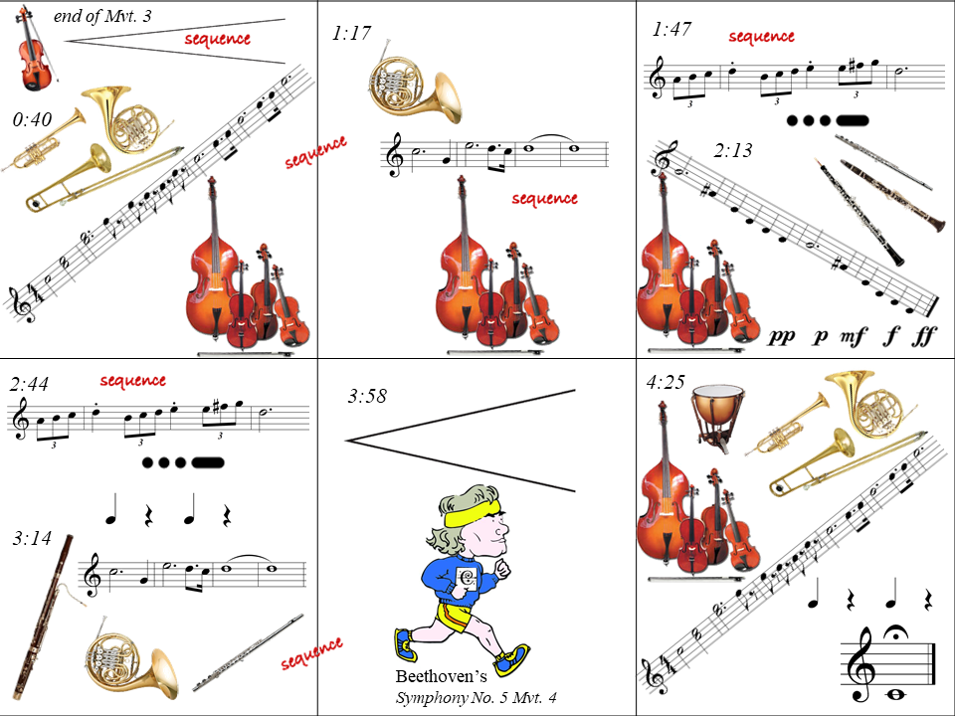

Slide 17
