Slide 1
Protecting Your [INSERT APPROPRIATE TERM] in Public Health Emergencies:
Your Jurisdiction Seal Here
Partnering with Organizations to Dispense Medications
Name of Presenter
Organization Name
Date of Presentation
Notes:
INTENT: Cover slide for presentation. Update using your own customized logos, visuals and presenter information.
KEY POINTS: Not Applicable (NA)
ADDITIONAL INFORMATION:
[Insert Appropriate Term] is used throughout this presentation template to prompt you to tailor the presentation to your specific audience. For example, if presenting to a private sector business, consider using Employees; if presenting to a faith based organization, consider Congregation or Members; if presenting to a university, consider Faculty and Students etc.
For purposes of this presentation template, the Slide Master shows
PROTECTING YOUR EMPLOYEES IN PUBLIC HEALTH EMERGENCIES
Do not forget to [Insert Appropriate Term] on the Slide Master also.

Slide 2
Objectives
Understand public health’s role in emergencies
Understand the specific threat scenario
aerosolized release of anthrax
Understand the concept of Mass Dispensing
Closed Points of Dispensing (POD)
Understand how your organization can help
Obtain a commitment to move forward with discussions on partnering with [INSERT HEALTH DEPARTMENT NAME] to become a Closed POD
Notes:
INTENT: To state the objectives of the presentation.
KEY POINTS:
Briefly discuss what you hope the audience will gain from this presentation.
Explain how your objective is to gain a commitment.
Depending on the composition of your audience (decision maker, middle management) you may consider revising the last bullet to either ask for a commitment to become a Closed POD or ask for a commitment to continue discussions to the next level of approval for the organization to become a Closed POD.
ADDITIONAL INFORMATION: NA

Slide 3
Public Health Emergency Preparedness
Public Health Emergencies
Roles in preparedness
Federal
State
Local
Tribal
Private Sector
Non Govermental Organizations
[INSERT JURISDICTION NAME] Public Health Emergency
ADD A VISUAL
Notes:
INTENT: Provide an overview of public health and its role in emergency preparedness and response.
KEY POINTS:
Explain how public health emergencies can result from various hazards - natural disasters (e.g., tornado, hurricane); disease outbreaks (e.g., pandemic flu); deliberate acts (e.g., aerosolized release of anthrax).
Discuss public health preparedness planning and how the National Response Framework supports integrated collaborative planning at all levels, including the private sector.
Discuss all-hazards planning and response in your jurisdiction. Consider using examples of how your health department has participated in recent local public health emergencies or exercises focusing on countermeasure distribution and dispensing.
ADDITIONAL INFORMATION:
Some jurisdictions break these points into a series of slides providing more information on the Strategic National Stockpile (SNS) and Cities Readiness Initiative (CRI).
If you expand on the SNS, be aware that the audience may conclude that you are asking them to provide long term storage of medical countermeasures as a Closed POD. Stress that the requirements related to receiving and dispensing medical countermeasures by Closed PODs is time of event only.

Slide 4
Our Problem
Planning Scenario
- Aerosolized release of anthrax
Goal
- 48 hour response time
ADD A VISUAL
[SHOW SNS 6 MINUTE VIDEO
“TAKING CARE OF BUSINESS”]
Notes:
INTENT: Use this slide to explain to the audience that although plans are in place to protect the community during public health emergencies, there is a particular scenario where countermeasure dispensing assistance is requested.
KEY POINTS:
Introduce the threat of aerosolized release of anthrax and the need to provide medication to the population within 48 hours.
Stress that the 48 hour goal is based on the impact of disease progression and not an arbitrary performance standard.
Use the video to provide the initial introduction to Closed PODs .
ADDITIONAL INFORMATION:
It is important to keep the focus on those scenarios that require the dispensing of oral antibiotics within 48 hours (aerosolize release of anthrax as the foundation). Some jurisdictions have found that audiences who have been heavily involved in pandemic influenza planning (federal organizations, private sector) may try to relate the pandemic influenza response to the 48 hour scenario response. It is important to keep them from getting confused and focused on the 48 hour response goal.
DON’T FORGET - when customizing the slide, delete the box that states “Show SNS 6-Minute Video”.

Slide 5
Public Health’s Response
Points of Dispensing (PODs):
Primary method to dispense medications to the public
Common areas located throughout the community (gyms, civic centers, community centers)
Managed and operated by the local public health department
What this means to [INSERT JURISDICTION NAME]
[INSERT JURISDICTION POPULATION STATISTICS BASED ON CENSUS]
[INSERT INCREASED POPULATION STATISTICS BASED ON OTHER FACTORS SUCH AS INCREASED POPULATION DUE TO EMPLOYMENT CENTERS, TOURISM, UNIVERSITY AND/OR UNDOCUMENTED POPULATIONS]
To dispense medication to [INSERT TOTAL POPULATION] is a monumental task
We need help
Notes:
INTENT: Introduce the concept of mass dispensing.
KEY POINTS:
Describe the POD and its general functions
Explain how PODs are the traditional method of dispensing medication.
Discuss your population statistics so the audience will begin to associate the impact of the 48 hour timeline on your community.
Introduce the challenges with PODs such as long lines, public anxiety etc. in your discussion to begin to show how the Closed POD option is an alternative to consider.
Ask for help - if you do not ask for help, you will not receive help.
ADDITIONAL INFORMATION:
DON’T FORGET - Ensure you readjust the fonts on this slide after adding population statistics.

Slide 6
How You Can Help
Partner with [INSERT HEALTH DEPARTMENT NAME] and become a Closed Point of Dispensing (POD)
Medications dispensed to a specific group designated by the organization
Not open to the public*
Managed by organization’s staff
Notes:
INTENT: Introduce the idea of forming a partnership with public health to operate a Closed POD.
KEY POINTS:
Describe how Closed PODs are an alternate method of dispensing medication in an emergency.
ADDITIONAL INFORMATION:
(*) Some jurisdictions are asking organizations to become open PODs once their designated population has received medication.

Slide 7
Choosing to Become a Closed POD
Benefits our community
Helps achieve community dispensing goal more rapidly
Decreases the number of people going to open PODs
Benefits your organization
Protects [INSERT APPROPRIATE TERM] and their families
Helps to ensure your organization’s continuity of operations
Exhibits your commitment to our community
Notes:
INTENT: Explain how Closed PODs benefit the community and the organization.
KEY POINTS: The suggested benefits listed are not all inclusive. Develop your list to support your community.
Benefits to Community – Briefly describe your mass dispensing plan by addressing the number of PODs your jurisdiction currently requires. Show how their support will enhance the overall plan to protect the community.
Benefits to Organizations – Based on your research on the organization, highlight benefits that will support their focus, industry and core values.
ADDITIONAL INFORMATION: Some jurisdictions have found the following tips helpful when discussing benefits of being a Closed POD.
If you have other Closed PODs and no confidentiality restrictions, use feedback from those organizations when discussing the benefits. For example, “XYZ Corp. is one of our Closed POD partners and the major benefit to them was …”
Refer back to the Taking Care of Business: An Introduction to Becoming a Closed Point of Dispensing video for additional benefits.
Offer free advertising that the organization is “public health prepared” and actively involved in the public health of the community by putting their logo on your website or providing a link to their community service pages.
(SLIDE TRANSITION) to support your transition to the Responsibilities discussion that follows, consider an inclusive partnership phrase such as, “By volunteering to partner with XYZ public health, we are committed to ensuring you are prepared to operate a Closed POD”.

Slide 8
[INSERT YOUR HEALTH DEPARTMENT] Responsibilities
Develop guidelines to ensure safe dispensing of medication
Assist in development of organization’s Closed POD plan
Provide all medication and accompanying information sheets for dispensing
Provide training and exercise support
Provide tools, templates and ongoing technical assistance
Notes:
INTENT: Discuss the responsibilities of your local public health department in this partnership effort.
KEY POINTS:
Customize around your local public health department’s plans and policies and how you will inform the organization about your guidelines.
Discuss the importance of developing a plan and how their plan will support the overall dispensing strategy for your jurisdiction.
Discuss the items and resources you will provide. Show examples of planning resource templates on hand.
ADDITIONAL INFORMATION: Continue to stress the partnership.

Slide 9
Your Responsibilities
Designate liaisons to coordinate with public health officials
Develop a Closed POD plan
Determine dispensing location(s)
Develop procedures
Activation and recall procedures
Security planning
Receipt of medication
Dispensing procedures
Provide staff
Provide non-medical supplies (tables, chairs, printers, pens, paper, etc)
Participate in training and exercise opportunities
Operate a Closed POD during an emergency
Notes:
INTENT: Discuss the responsibilities of the organization.
KEY POINTS:
Identify a liaison or project manager for the organization
Explain that they are responsible for a plan that meets the overall intent of public health to dispense medication but is developed based on their particular organizational design and structure.
Determine a dispensing location - suggest sample dispensing locations such as a break room, conference room, auditorium, parking lot with pop up tents. Work with the organization to identify the best locations. Stress the need for alternate locations to support contingency operations.
Develop dispensing procedures – highlight some of the key procedures.
Explain how the organization will provide the Closed POD staff from within their organization. Depending on your jurisdictional dispensing policies (medical model vs. non-medical model) describe how you will augment the staff with health departments/medical professionals. Again, reiterate your commitment to ensuring the staff is properly trained.
Briefly touch on supplies that will be needed.
Provide a few examples of the type of training and exercises your jurisdiction has developed.
ADDITIONAL INFORMATION: NA

Slide 10
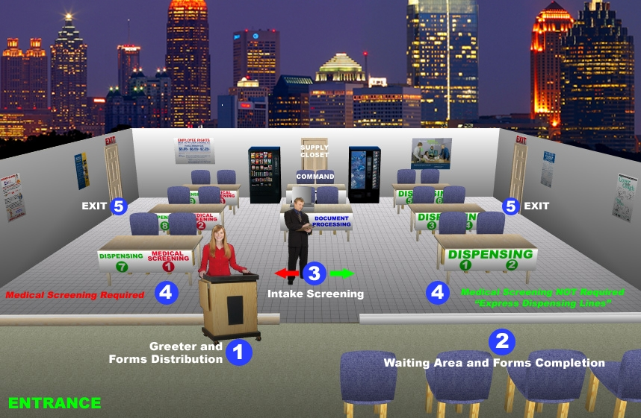
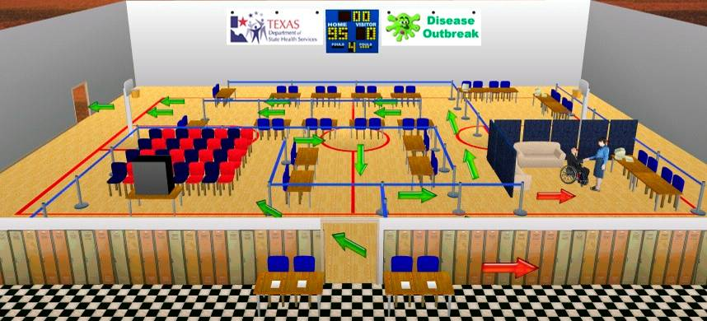
Understanding the Process
Screening
Dispensing
Education
Notes:
INTENT: Provide a visual to help the audience conceptualize the Closed POD.
KEY POINTS:
Tailor the slide by choosing a visual or including your own that depicts the Closed POD design best suited for your audience. If speaking to a business or federal agency, the break room may appeal. Although the gymnasium is more suited for a traditional POD open to the public, if speaking to a large faith based organization that has a fitness center, the gymnasium may appeal.
Walk the audience through the Closed POD highlighting the key functions of screening, dispensing and educating.
Screening – consider discussing why screening is important; how you will provide the necessary forms and training based on algorithms to properly screen; explain the advantage of being a Closed POD and the potential to pre-screen their designated population in accordance with The Health Insurance Portability and Accountability Act (HIPAA) policies.
Dispensing - explain how the health department will provide guidance and direction on dispensing medications based on established medical protocols.
Education – explain how you will provide the necessary drug fact sheets, follow-up and adverse reaction reporting information to ensure their designated population is informed of dosing instructions, potential adverse reactions and follow up information.
ADDITIONAL INFORMATION: NA
[Break Room]
[Gymnasium]

Slide 11
Medical
Medical Issues
Use of medical professionals
Medical vs. Non-Medical Models
Dispensing Protocols during emergencies
Head of Household Policies
Notes:
INTENT: Address the concerns related to the use of medical staff at Closed PODs.
KEY POINTS:
Medical vs. Non- Medical model of dispensing – discuss the use of medical staff given the organization’s access to occupational health and/or other providers and your jurisdiction’s policies.
Explain how medical concerns will be addressed at the Closed POD.
Elaborate briefly on the use of protocols to support rapid dispensing.
Address the head of household policy and the number of bottles per family in your jurisdiction.
ADDITIONAL INFORMATION: It is important to assure the audience that there is equity to all people in your community in that the dispensing procedures occurring a the Closed POD are the same as those occurring at the PODS open to the public.

Slide 12
Liability Issues
Liability Protection
Federal legislation
Public Readiness and Emergency Preparedness (PREP) Act
State/Local legislation
[INSERT APPLICABLE STATE/LOCAL LEGISLATION]
Pharmacy laws related to dispensing medication
Agreements
Notes:
INTENT: Address the concerns related to legal and liability issues of operating Closed PODs.
KEY POINTS:
Describe the legal protections afforded based on federal, state and local statutes.
Focus on regulations and policies that cover public health preparedness, volunteers and mass dispensing of medical countermeasures during an emergency.
Encourage consultation with legal counsel.
Agreements – although memorandums of agreement (MOA) and memorandums of understanding (MOU) are not considered legally binding documents, you could stress the need to develop an MOA/MOU to ensure each party was aware of the expectations of operating a Closed POD.
Discuss if your health department requires a specific agreement.
ADDITIONAL INFORMATION: Prepare to transition to your closing slides.

Slide 13
Protect what means most to you and your organization…
Notes:
INTENT: This is the first of a two slide closing - really drive it home because you want this organization as a partner!
KEY POINTS:
You may consider reviewing your objectives presented on the introductory slide.
Re emphasize that you understand that the people within their organization are important and you want to partner with this organization to help protect them.
Put emphasis on partnership and collaboration and that they won’t be alone in this process.
TAKE QUESTIONS HERE
ADDITIONAL INFORMATION: Consider using photos of the your local community and telling a quick story who the people are to lend a sense of community investment. This allows the organization to see the people that live and work in the community that could be impacted by an emergency.

Slide 14
Is your organization ready to partner with [Insert health department] and become a Closed POD?
Notes:
INTENT: Seal the deal and ask for the commitment. Tailor this slide appropriately, but the intent is to ask for the partnership.
KEY POINTS:
If yes, provide the next coordination steps.
Obtain the name of the organization’s liaison(s) that will work with you to develop the plans.
Set up a meeting to discuss planning templates, timelines and agreements.
If the organization likes the idea, but is not the decision maker, develop next steps to meet with the decision maker.
If the answer is not sure, offer to answer any questions or provide clarification on points; leave a card and brochure; and commit to follow up in a week.
If the answer is no, determine if you want to pursue the reason. Thank the organization for their time; leave a card and brochure to make yourself available for future contact.
ADDITIONAL INFORMATION: NA

