Slide 1
Restraints and Time Out Rooms: Requirements and Alternatives: Part 1
Jennifer Zalucky, Behavior Specialist & Educational Consultant
Shenendehowa Central School District
Julie M. Keegan Esq.,
Disability Rights New York: Parent/Student Attorney
© NYS Special Education Task Force – March 2015

Slide 2
Session Plan
Overview of legal requirements regarding the use of emergency interventions (restraints) and time out rooms
Concerns related to use of restraint and time out room
Alternatives & best practices
Questions & answers

Slide 3

Use of Restraints & Time Out Rooms

Slide 4
The Costs of Restraint and Use of Time Out Rooms
Student injuries
Staff injuries
Emotional injuries – trauma, PTSD, anxiety, depression
Impact on other students
Notes:
Research confirms that restraint and seclusion can physically and emotionally harm children—traumatizing and scaring them, and even worsening behaviors that practitioners are seeking to reduce.
The use of seclusion and restraint is dangerous and traumatic not only to the individuals subjected to these practices, but also for the staff implementing them.
Students with disabilities (served by IDEA) represent 12% of the student population, but 58% of those placed in seclusion or involuntary confinement, and 75% of those physically restrained at school to immobilize them or reduce their ability to move freely.

Slide 5
Sources & Resources
Dangerous Use of Seclusion and Restraints in Schools Remains Widespread and Difficult to Remedy: A Review of Ten Cases, United States Senate Health, Education, Labor, and Pensions Committee (Feb. 12, 2014)
http://www.help.senate.gov/imo/media/doc/Seclusion%20and%20Restraints%20Final%20Report.pdf
Data Snapshot: School Discipline, U.S. Department of Education Office for Civil Rights Civil Rights, Data Collection Issue Brief No. 1 (March 2014)
http://www2.ed.gov/about/offices/list/ocr/docs/crdc-discipline-snapshot.pdf

Slide 6
DRNY Investigative Study
Survey
  English: https://www.surveymonkey.com/s/restraint_seclusion_schools
  Spanish: https://es.surveymonkey.com/s/Restriccion_y_aislamiento_schools
Interviews with survey participants
Review of reports and complaints filed with the NYS Education Department
Review of laws in other states
Review of federal initiatives
Review of research on impact of restraint and seclusion on students

Slide 7
Restraints (“Emergency Interventions”)
8 NYCRR 200.22 (d)
“Emergency” - a situation in which immediate intervention involving the use of reasonable physical force is necessary; i.e. situations in which non-physical procedures cannot reasonably be employed:
  to protect oneself from physical injury;
  to protect another person from physical injury;
  to protect school property
  to restrain or remove a pupil whose behavior is interfering with the orderly exercise and performance of school functions, powers and duties, if that pupil has refused to comply with a request to refrain from further disruptive acts.

Slide 8
Use of Restraints: Requirements
Limited Purpose - restraint cannot be used as:
Punishment
A substitute for systematic behavioral interventions that are designed to change, replace, modify or eliminate a targeted behavior (i.e. a Behavior Intervention Plan)

Slide 9
Definitional Issues/Concerns
Physical “Escort” v. Physical Restraint
Broad scope of situations in which restraints are permissible
  Situations in which non-physical procedures cannot reasonably be employed
  . . .to restrain or remove a pupil whose behavior is interfering with the orderly exercise and performance of school functions, powers and duties, if that pupil has refused to comply with a request to refrain from further disruptive acts

Slide 10
Use of Restraints: Requirements, cont’d
Training - staff who may be called upon to use restraints must be trained in safe & effective restraint procedures
  Strategies for Crisis Intervention & Prevention (SCIP)
  Therapeutic Crisis Intervention (TCI)
  “Handle with Care” – new program offered by BOCES
Issues/Concerns
  What constitutes “safe & effective”
  No statewide training or State-endorsed training
  Who determines if student can safely tolerate a physical restraint?
  No apparent consequences if untrained staff impose a restraint

Slide 11
Restraints: Required Documentation
Each use of restraint must be documented as follows:
Name and date of birth of the student;
The setting and the location of the incident;
The name of the staff or other persons involved;
A description of the incident and the emergency intervention used, including duration;
A statement as to whether the student has a current behavioral intervention plan; and
Details of any injuries sustained by the student or others, including staff, as a result of the incident.
Must be submitted to/reviewed by school supervisory personnel and, as necessary, the school nurse or other medical personnel.
Notes:
What isn’t required? What’s missing?

Slide 12
Documentation Issues/Concerns
Required Documentation does not currently include:
Specific description of events/issues leading to restraint
Description of what non-physical, de-escalation procedures were tried before restraint imposed
Type of restraint
Name of witnesses
Actions that will be taken to avoid future use of restraints. For example:
  Alternative de-escalation strategies
  Functional behavior assessment & behavior intervention plan (initial or updated)
  Crisis intervention plan

Slide 13
Notice to Parents & Others
“The parent of the student shall be notified.”
8 NYCRR 200.22(d)
Issues/Concerns
Notified how? When? What information?
What rights does parent have?
  Debriefing ?
  Complaint procedure?
  Avoiding future restraint?

Slide 14
Use of Time Out Rooms
8 NYCRR 200.22(c)
An area for a student to safely deescalate, regain control and prepare to meet expectations to return to his or her education program.
Must be part of Behavior Intervention Plan
  must state maximum duration in room as behavioral consequence.
  Parent must be notified TOR is part of BIP.
  Parent must be allowed to see room
Exception: TOR can be used for unanticipated situations that pose an immediate concern for the physical safety of a student or others

Slide 15
TOR – Room Specific Requirements
Must provide a means for visual and auditory monitoring of the student at all times
Must be of adequate size to allow the student to move about and recline comfortably.
Wall and floor coverings designed to prevent injury
Adequate lighting and ventilation.
Room temperature within the normal comfort range.
Clean and free of objects and fixtures that could be potentially dangerous to a student.
Must be unlocked and the door must be able to be opened from the inside. The use of locked rooms or spaces for purposes of time out is prohibited.
Staff shall continuously monitor the student in a time out room.

Slide 16
TOR – General Requirements
District must have policy & procedures regarding:
Prohibiting placing a student in a locked room or space or in a room where the student cannot be continuously observed and supervised;
Time limitations for the use of the time out room;
Staff training on the policies and procedures related to the use of time out room;
Data collection to monitor the effectiveness of the use of time out rooms; and
Information to be provided to parents

Slide 17
Time Out Rooms - Issues/Concerns
Notice to Parents - no legal obligation to inform parent of each time out room incident
Are restraints being used to get the student to the time out room
What happens if student wants to get out?
Disciplinary v. therapeutic uses
No process for debriefing/discussion to prevent future use

Slide 18
Additional Considerations for Restraints and Time Out Rooms
Need for periodic review procedure
Need for written school-wide policies and training on such policies
Need for data reporting and data collection at district level and at state level
Statewide database
Statewide complaint procedure

Slide 20
Restraints and Time Out Rooms:
Requirements and Alternatives, Part 2
Jen Zalucky

Slide 21
 Restraint and Seclusion:
What are the behaviors that lead to:
    Restraint? Seclusion?
How do we get there?
        >> Stress <<

Slide 22
 Stressors → Behavior
Adult Stressors | Adult Response

Slide 23
 Stressors → Behavior
Adult Stressors | Adult Response
Performance Pressure Feeling incompetent, loss of power Physical discontent Illness Relationship conflict Money Hunger Fatigue Shame/Embarrassment/Disrespect Personal loss Injury Noise Crowding Messy house/ vehicle Disappointment

Slide 24
 Stressors → Behavior
Adult Stressors | Adult Response
Work Pressure Feeling incompetent, loss of power Physical discontent Illness Relationship conflict Money Hunger Fatigue Shame/Embarrassment/ Disrespect Personal loss Injury Noise Crowding Messy house/ vehicle Disappointment | Avoid work Solitude Read, watch t.v., listen to music Yoga Sleep Eat, Drink Talk it out (with a friend) Yell, Swear Cry Use sarcasm, Shame Hit/ Slam Work out Clean Build Medicate

Slide 25
 Stressors → Behavior
Student Stressors | Student Response

Slide 26
 Stressors → Behavior
Student Stressors | Student Response
Work Pressure Feeling dumb, work too hard Sitting too long Not feeling well No friends, not fitting in, break-ups Money Hunger Fatigue Shame/Embarrassment/Powerless Personal loss Injury Noise Crowding Disorganized, can’t find materials/work Disappointment/ Rejection

Slide 27
 Stressors → Behavior
Student Stressors | Student Response
Work Pressure Feeling dumb, work too hard Sitting too long Not feeling well No friends, not fitting in, break-ups Money Hunger Fatigue Shame/Embarrassment/Powerless Personal loss Injury Noise Crowding Disorganized, can’t find materials/work Disappointment/ Rejection | Truancy Leave room, hide in bathroom, nurse Read, watch t.v., listen to music Yoga Sleep Eat Talk it out (with a friend) Yell, Swear Cry Use sarcasm, threaten, Shame Hit/ Slam Run Rip papers, dismantle pen Doodle, build with Legos Self-medicate (drugs, alcohol)

Slide 28
 Setting Conditions
~Anything that makes a challenging behavior more or less likely to occur
Organizational Culture
Physical Environment
Programs, Activities, Routines
Individual Characteristics
Relationships

Slide 29
 Behavior Management
Prevention
    Learning Environment, Classroom Plan, Plan Implementation, Teaching Style, Student Interaction, Rapport Building, Adequate Support,…
Intervention
    Behavior Supports, Modifications, Accommodations,…
Response
  Consequence (positive and negative)
What’s missing?

Slide 30
 Prevention
Create a learning environment that is conducive to all learners
Set achievable goals
Consider individual needs and abilities
Develop and communicate your behavior plan and implement it with fidelity
Build trust
Establish an “all students can learn/all students are welcome” climate
Reward success
Train staff

Slide 31
 Intervention
All behavior has meaning. Behavior is driven by needs and wants.
Stop, Look, Listen – What is really happening here? What is this child “saying”
Self talk – What am I thinking? Am I in the best frame of mind to respond thoughtfully and logically?
How is the environment affecting this situation?
What response is best for this situation?
Communication, Behavior Supports, First Aid, Co-regulation

Slide 32
 Response
Consequences – What immediately follows the behavior?
Adult response? Peer response?
Positive responses should outweigh negative by at least 2:1, but the recommended ratio is 5:1.
Rewards should be meaningful to the individual student
What drives a behavior should drive our response (Proactive vs. Reactive)
Consequences should be fair (not equal)
Time-out only works when time-in is preferred
Clean slate

Slide 33
 Good Practice
Control Own Frustration
  Expect Realize Understand
Avoid Constant Power Struggles
  Positive self-talk
  Implement strategies to get out of the conflict cycle
  Use behavior support techniques
Build Competence
  Avoid unreachable demands
  Set up activities based on natural strengths
  Reward success

Slide 34
 Key Principles
All students need behavior support at some time
Cognition and behavior are inter-related
All behavior is driven by needs and wants
Problem behaviors should be identified as “errors in learning” that require systematic, explicit instruction
Determining if problem behaviors are skill deficits and/or performance deficits is important to identify early
Proactive approaches, involving positive behavior supports, are more time and cost effective than reactive approaches
Fair does not mean equal

Slide 35
 Crisis
  ~A crisis occurs when a child’s inability to cope results in a change in behavior
  ~A crisis is a collision of setting conditions and triggers
  Sometimes, behavioral display results in a level of physical behavior that poses an imminent threat to the safety of self or other which requires a physical response, but not always.

Slide 36
 Crisis Intervention, Goals & Outcome
  Goal: To Support and Teach
  To provide support in a way that reduces stress and risk
  To teach more alternative, prosocial ways of handling stress
  Outcome:
            Decrease in Undesired Behavior
            Increase in Prosocial Behavior
            Feel Safe
            Learn

Slide 37
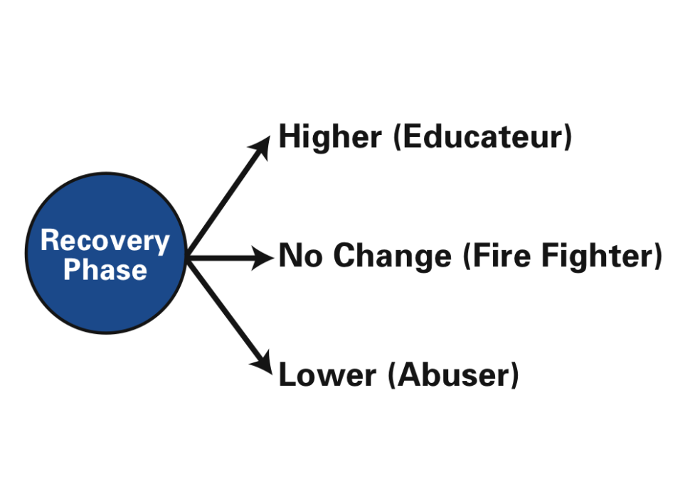
 Outcome

Slide 38
 Regulations
May provide reasonable force…(see Julie’s slides)
Incumbent upon all agencies to provide training to all staff who work with students who have higher risk of exhibiting such behaviors

Slide 39
 Crisis Intervention Programs
Examples…
Strategies in Crisis Prevention and Intervention (SCIP)
Crisis Prevention Institute (CPI)
Therapeutic Crisis Intervention (TCI)
  TCI is a program developed through Cornell University. The aim of the program was to create a model for various agencies to use in their efforts to prevent crises from occurring, de-escalate potential crises, and manage acute behavior by teaching students positive coping skills and creating positive learning environments.
  TCI is research-based guidelines for implementing strategies to reduce high-risk interventions.

Slide 40
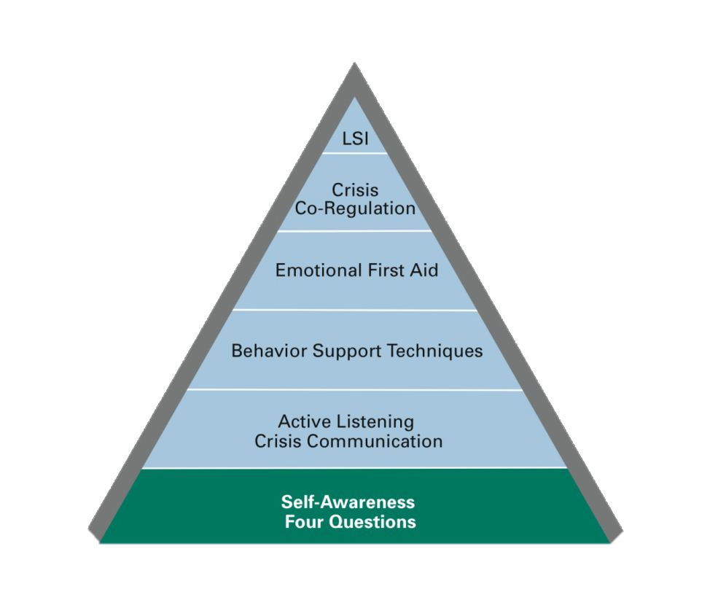
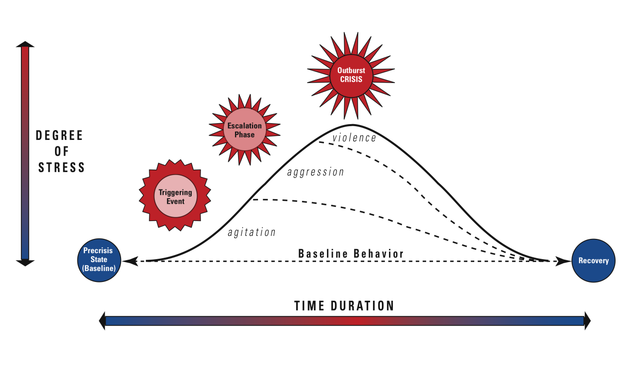
 The TCI Model
Stress Model of Crisis
Skill Building Pyramid

Slide 41
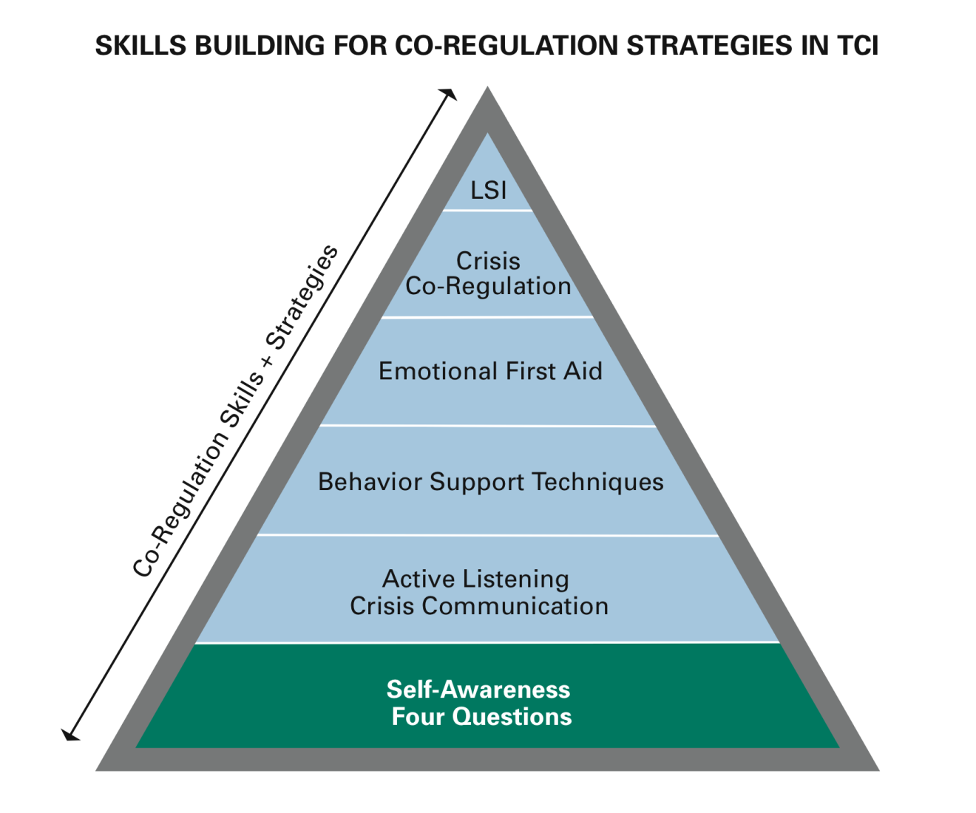
 How Do I Respond? (TCI)
Life Space Interview
What to Do, Say and Think in Crisis
Dynamic Risk Assessment
Respond & Resolve the Immediate Crisis
Manage the Environment, Prompt, Caring, Help, Distract, Redirect, Move closer, Direct, Time Away
Verbal and Non verbal Responses
What the child is saying, How I’m feeling, How the environment is affecting, Best response?

Slide 42
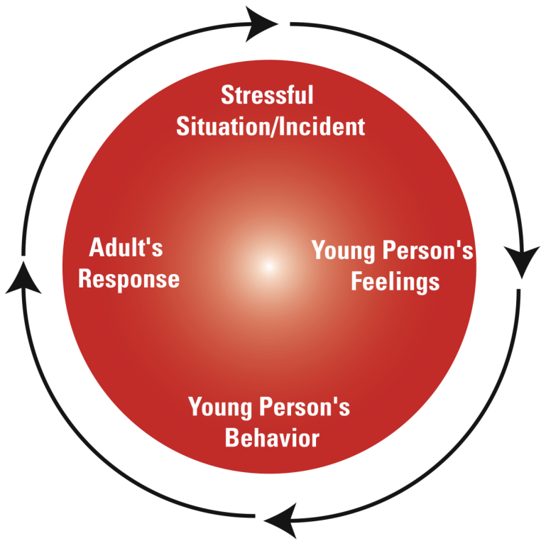
 The Conflict Cycle (TCI)
Using positive self-talk
Listening and validating feelings
Managing the environment, e.g., removing others
Giving choices and the time to decide
Redirecting the young person to another positive activity
Appealing to the young person’s self- interest
Dropping or changing the expectation

Slide 43
 Physical Restraint Should Only Be Used When..
(All three must be met)
Agency policies and state regulations approve restraint
Young person’s Individual Crisis Management Plan indicates it (ICMP)
Our professional dynamic risk assessment indicates it

Slide 44
 Individual Crisis Management Plan
~Plan to respond to high risk behaviors
Safety Concerns/Warning (medical, physical, psychological)
Potential Triggers (personal, family, social, etc.)
High Risk Behaviors (what are people likely to see?)
Intervention Strategies for: Pre-Crisis, Triggering, Escalation, Outburst, Recovery
Emergency Contacts
Review Date for ICMP and by whom?

Slide 45
 Physical Restraint Should Never Be Used to...
(TCI)
Demonstrate Authority
Enforce Compliance
Inflict pain or harm
Punish or discipline

Slide 46
 Physical Restraint Should Not Be Used If…
(TCI)
You cannot control the young person safely
You are not in control or are too angry
Sexual stimulation is the motivation
You are in a public place
Young person has a weapon
Young person’s medical condition prohibits it
Young person has emotional problems risking re-traumatization
Young person is on medication(s) that affects his/her system

Slide 47
 Documentation
(TCI)
Who, what, when, where?
What were the antecedents?
What did staff do to de-escalate the situation?
If physical contact occurred, who did what (be specific)?
How long did the restraint last?
Staff/Child Injuries? Medical Attention?
What plan was developed in the Life Space Interview?
Was follow up needed? Was the family notified?

Slide 48
 Protocols & Policies
Policy for:
  Functional Behavior Assessments
  Behavior Intervention Plans
  Individual Crisis Management Plans
Restraint policy? Documentation policy?
Training protocol?
Supervision?

Slide 50
 Final thoughts…
“Children do well if they can. If they’re not doing well, something is standing in their way.”
~Ross Greene, Author of the Explosive Child

