Slide 1


2017
PARAMEDIC REFRESHER COURSE

Slide 2
Paramedic Refresher
Module VII
OPERATIONS
Provider Hygiene and safety ems culture of safety crew resource management Ambulance safety pediatric transport field triage-Disasters/MCI

Slide 3
EMS PROVIDER HYGIENE, SAFETY, AND VACCINATIONS
Objectives
• Identify proper hand washing technique
• Identify appropriate use of alcohol-based hand cleaner
• Discuss the CDC’s recommendations of vaccines for healthcare providers
• Assess eye safety indications and measures

Slide 4
EMS PROVIDER HYGIENE, SAFETY, AND VACCINATIONS
Emergency Medical Services (EMS) providers play an important role in the prevention and control of infections. EMS providers are at the front line of medical care and have a high risk of exposure to patients with known or unknown infectious diseases or germs. The emergence of antimicrobial-resistant bacteria such as methicillin resistant Staphylococcus aureus (MRSA) and vancomycin-resistant enterococcus (VRE), along with growing concerns regarding the spread of Clostridium difficile (C. diff) and viruses, are major problems facing all healthcare providers, including EMS providers.

Slide 5
EMS PROVIDER HYGIENE, SAFETY, AND VACCINATIONS
Standard precautions are meant to reduce the risk of transmission of bloodborne and other pathogens from both recognized and unrecognized sources. They are the basic level of infection control precautions which are to be used, as a minimum, in the care of all patients.
Hand hygiene is a major component of standard precautions and one of the most effective methods to prevent transmission of pathogens associated with health care. In addition to hand hygiene, the use of personal protective equipment should be guided by risk assessment and the extent of contact anticipated with blood and body fluids, or pathogens.

Slide 6
EMS PROVIDER HYGIENE, SAFETY, AND VACCINATIONS
Did you know?
  72=the number of hours cold and flu germs can survive on common surfaces
  300=the number of surfaces a child can touch and retouch in 30 minutes
  10,000=the number of bacteria in a sneeze
  189 million = the number of school days every year lost to the common cold

Slide 7
EMS PROVIDER HYGIENE, SAFETY, AND VACCINATIONS
Gloves
  Wear when touching blood, body fluids, secretions, excretions, mucous membranes, non-intact skin
  Change between tasks and procedures on the same patient after contact with potentially infectious material
  Remove after use, before touching non-contaminated items and surfaces, and before going to another patient. Perform hand hygiene immediately after removal

Slide 8
EMS PROVIDER HYGIENE, SAFETY, AND VACCINATIONS
Always wash hands
  Before and after patient contact
  Before eating
  After cleaning the ambulance or equipment
  After using the restroom
  After nose blowing, coughing, or sneezing

Slide 9
EMS PROVIDER HYGIENE, SAFETY, AND VACCINATIONS
Perform hand hygiene by means of hand rubbing or hand washing
Perform hand washing with soap and water if hands are visibly soiled, or exposure to spore-forming organisms is proven or strongly suspected, or after using the restroom. Otherwise, if resources permit, perform hand rubbing with an alcohol-based preparation
Ensure availability of hand-washing facilities with clean running water
Ensure availability of hand hygiene products (clean water, soap, single use clean towels, alcohol-based hand rub). Alcohol-based hand rubs should ideally be at least %60 alcohol
Hand washing (40–60 sec): wet hands and apply soap; rub all surfaces; rinse hands and dry thoroughly with a single use towel; use towel to turn off faucet
Hand rubbing (20–30 sec): apply enough product to cover all areas of the hands; rub hands until dry
Notes:
CDC Recommendations

Slide 10
EMS PROVIDER HYGIENE, SAFETY, AND VACCINATIONS
Facial protection (eyes, nose, and mouth)
  Wear (1) a surgical or procedure mask and eye protection (eye visor, goggles) or (2) a face shield to protect mucous membranes of the eyes, nose, and mouth during activities that are likely to generate splashes or sprays of blood, body fluids, secretions, and excretions
Eye protection devices
  Goggles
  Face Shields
  Safety glasses
  Full-face respirators

Slide 11
EMS PROVIDER HYGIENE, SAFETY, AND VACCINATIONS
Ambulance Cleaning & Disinfection
    Cleaning is defined as the physical removal of foreign and organic materials such as blood, body fluids, and disease causing microorganisms or germs from a surface or object. Cleaning physically removes, but does not kill, germs. Cleaning is accomplished by using water, detergents, and a scrubbing action. The key to cleaning is the use of friction to remove debris and reduce presence of germs. Disinfection is the process used to kill and prevent the growth of germs on objects and surfaces. Disinfection is accomplished through the use of chemical products regulated by the U.S. Environmental Protection Agency (EPA). Disinfectants should only be used after items have been thoroughly cleaned. Cleaning and disinfection is a two-step process. Following cleaning, the disinfectant should be applied or reapplied and allowed to remain on the surface for the full contact time. Contact time, or kill time, is the length of time that the disinfectant must remain on the surface or object, as specified by the manufacturer.

Slide 12
EMS PROVIDER HYGIENE, SAFETY, AND VACCINATIONS
Recommended Vaccinations for healthcare providers
  Hepatitis
  Influenza
  MMR (measles, mumps and rubella)
  Varicella
  Pertussis
  Consider vaccines recommended for disaster response

Slide 13
EMS PROVIDER HYGIENE, SAFETY, AND VACCINATIONS
Vaccines
  Help prevent transmission of certain diseases
  Some are attenuated (weakened or killed) viruses
  Some mimic certain diseases and Produce antibodies in the blood
  Some provide antibodies directly

Slide 14
EMS PROVIDER HYGIENE, SAFETY, AND VACCINATIONS
Is it the Law?
  The Society of Healthcare Epidemiologists of America, The Association of Professionals in Infection Control and Prevention and The American Academy of Pediatrics are all in favor of mandatory vaccinations for healthcare workers
  As of right now it is different by state
  Should an exposure occur documented evidence of immunization must be readily available

Slide 15
EMS CULTURE OF SAFETY
Objectives
  Define culture of safety
  Identify and explain the six core elements necessary to advance an EMS Culture of Safety
  Identify the role of the EMS providers in establishing a culture of safety within EMS organizations

Slide 16
EMS CULTURE OF SAFETY
What is a Culture of Safety?
“The enduring value and priority placed on worker and public safety by everyone in every group at every level of an organization. It refers to the extent to which individuals and groups will commit to personal responsibility for safety; act to preserve enhance and communicate safety concerns; strive to actively team, adapt and modify (both individual and organizational) behavior based on lessons learned from mistakes; and be rewarded in a manner consistent with these values.”

Slide 17
EMS CULTURE OF SAFETY
EMS has been identified as a high-risk industry and safety impacts more than just EMS personnel. Safety in EMS affects our patients, EMS responders, and the public and includes factors such as vehicle operations, medical errors, infectious diseases, scene safety and responder health and fitness.

Slide 18
EMS CULTURE OF SAFETY
Common Themes of Risks
  Lack of teamwork
  Distracted or inattentive
  Lack of training or knowledge
  Lack of standardization
  Complacency
  Fatigue or tiredness
  Negative culture of safety
  Lack of communications
  Protocol deviations
  Poor system design or process

Slide 19
EMS CULTURE OF SAFETY
The six core elements
  Just Culture
    Development of environments in which EMS personnel are safe to report errors
    Assess risks in order to identify means of overcoming factors that contribute to errors
    Blaming or punishing is not an option in a Just Culture

Slide 20
EMS CULTURE OF SAFETY
The six core elements
  Coordinated support and resources
    Creation of a guidance and resource coordination body
      Purpose is to determine the best way to effectively serve EMS in the support role
      Partner with governing bodies to serve as a conduit of information and resources for EMS Safety
      No oversight or authority

Slide 21
EMS CULTURE OF SAFETY
The six core elements
  EMS Safety Data System
    Data driven decisions and policies related to EMS safety can only be made if all data is accessible on a national level.
    A robust, secure system would allow access to researchers, decision makers, and national stakeholder groups.
    Data sets have been identified; data will be analyzed and used to inform future plans, initiatives, processes, and policies in order to protect the health and well-being of EMS personnel, their patients, and the general public

Slide 22
EMS CULTURE OF SAFETY
The six core elements
  EMS Education Initiatives
    Safety starts with EMS leaders and educators and involves everyone
    Initial EMS programs must encourage a culture of safety throughout the program
    Continuing education and new employee onboarding must infuse culture of safety throughout the curriculum

Slide 23
EMS CULTURE OF SAFETY
The six core elements
  EMS safety standards
    Safety standards for patient and responder safety must be developed using data and evidence
    EMSSRC can coordinate the efforts to combine work and data completed by various EMS stakeholders and projects

Slide 24
EMS CULTURE OF SAFETY
The six core elements
  Requirements for reporting and investigation
    Mandates for reporting safety are necessary so a common language and data set can be created to improve responder and patient safety
        Determining what data are already mandated and available
        Determining what data are necessary and useful
        Learning from those with hands-on experience
        Assigning and obtaining authorization for an investigative body
        Identifying existing best practices

Slide 25
EMS CULTURE OF SAFETY
The role of providers
  Be open to any team members raising safety concerns, regardless of their tenure and rank
  Be willing to report errors
  Collaborate with management
  Seek opportunities to expand knowledge base on culture, patient safety, latest info and research on clinical safety, responder safety, personal protective equipment, etc., and be willing to bring these to the attention of management
  Ask medical director what can be done to improve safety for responders, patients and the public
  Report safety hazards
  Perform safety checks, vehicle inventory and safety inspections conscientiously
  Be willing to speak up when a partner or other responder seems fatigued or under mental or emotional stress
  Maintain personal physical well-being, get enough sleep and exercise;
  Take advantage of CE opportunities to learn about your own physical and mental wellness

Slide 26
EMS CULTURE OF SAFETY
Why a Culture of Safety is Important?
Occupational Fatality Rate
  12.7 per 100,000 per year
Non-fatal injuries
  34.6 Per 100 full-time workers per year
Studies regarding fatigue and safety outcomes
  1.9% greater odds of injury
  2.2% greater odds of medical error
  3.6% greater odds of safety-compromising behavior
Notes:
OSHA stats

Slide 27
CREW RESOURCE MANAGEMENT
Objectives
  Define Crew Resource Management (CRM)
  Explain the benefits of CRM to EMS
  State the guiding principles of CRM and briefly explain each
  Explain the concept of communication in the team environment using advocacy/inquiry or appreciative inquiry
  State characteristics of effective team leaders
  State characteristics of effective team members
  Explain how the use of CRM can reduce errors in patient care

Slide 28
CREW RESOURCE MANAGEMENT
Crew Resource Management (CRM)
  CRM is a set of training procedures for use in environments where human error can have devastating effects. Used primarily for improving safety, CRM focuses on interpersonal communication, leadership, and decision making. It raises the safety and quality service bars, as well as enhances and strengthens the daily operations.
  Using CRM methods, crews can avoid, manage and mitigate human errors. And as secondary benefits, CRM programs improve morale and enhance efficiency of the department.

Slide 29
CREW RESOURCE MANAGEMENT
CRM IS
  A comprehensive system for improving crew performance
  A process addressing the entire crew and other related staff
  A system that can be extended to all forms of air crew training
  A concentration on crew member attitudes and behaviors and their impact on safety
  An opportunity for individuals to examine their behavior and make individual decisions on how to improve teamwork
  A utilization of the crew as the unit of training
  Active participation training that focuses on safety improvement

Slide 30
CREW RESOURCE MANAGEMENT
Benefits of Crew Resource Management to EMS
  Overarching aim is to minimize errors
  Improved safety for patients and care providers
  Improved team performance
  Improved situational awareness
  All team members have equal value and input
  All members of the organization participate in CRM and CRM training

Slide 31
CREW RESOURCE MANAGEMENT
CRM Guiding Principles
  Situational Awareness
    The accurate perception of current operations, other people, equipment, and the surrounding world, both now and in the near future.
  Group Dynamics
    A system of behaviors and psychological processes occurring within a social group.
  Workload Management
    The process of effective workload distribution which is crafted to enable the team member to achieve optimal performance and productivity levels.

Slide 32
CREW RESOURCE MANAGEMENT
CRM Guiding Principles
  Effective Communications
    Communication is a two way process that involves both how we send and receive messages.
  Risk Management
    An assessment of the likelihood of an acceptable outcome to a given decision or judgment.
  Stress Awareness
    A condition or feeling experienced when a person perceives that demands exceed the personal and social resources the individual is able to mobilize.

Slide 33
CREW RESOURCE MANAGEMENT
CRM Guiding Principles
  Human Factors
    Physical and psychological behavior in relation to particular environments, products, or services.
  Decision Making
    The thought process of selecting a logical choice from the available options

Slide 34
CREW RESOURCE MANAGEMENT
Advocacy and Inquiry Communication; appreciative inquiry
  Four steps to using inquiry/advocacy or appreciative inquiry to improve communication among teams
      Alert the other members of the team to a situation or action of concern
      State the problem as it is seen
      State a solution or alternative
      Obtain agreement among the team to alter plan or action

Slide 35
CREW RESOURCE MANAGEMENT
Communication in the Team
    Frame of Mind
    If you assume that you are obviously right and that your job is to get others to realize what you already know, you will be unable to create mutual learning. Therefore:
    Assume you may be missing things others see, and seeing things others miss. If you start with this assumption, you will listen more intelligently and inquire more genuinely without downplaying your own views.
    Assume others are acting in ways that make sense to them and that they are seeking to act with integrity.
    Seek to understand what leads to behavior you find problematic. Are people caught in dilemmas? Are you contributing to the problem?

Slide 36
CREW RESOURCE MANAGEMENT
Advocacy
  Help others see what you see and how you think about it by giving examples of the data you select, stating the meaning that you find in the examples, and explaining the steps in your thinking.
  Describe your understanding of the other person’s reasoning.
  If you see negative consequences to what others are doing, identify the consequences without attributing intent to create those consequences. Distinguish between intent and impact.
  When you choose to disclose your emotions, do so without implying that the other person is primarily responsible for creating your emotional reactions.

Slide 37
CREW RESOURCE MANAGEMENT
Inquiry
  Find out how others see the situation by asking them to give examples of the data they select and to explain the steps in their thinking.
  Ask for help in finding out what you may be missing by encouraging others to identify possible gaps or errors in your thinking.
  When you have difficulty with how others are acting, ask them to explain what leads them to act as they do, in a tone that suggests they may have a reasonable answer.
  Inquire into others emotions.
  Ask for help in exploring whether you are unknowingly contributing to the problem.

Slide 38
CREW RESOURCE MANAGEMENT
Effectiveness of the team
    Characteristics of effective team leaders
      Creates, implements and revises an action plan
      Communicates accurately and concisely while listening and encouraging feedback
      Receives, processes, verifies, and prioritizes information
      Reconciles incongruent information
      Demonstrates confidence, compassion, maturity, and command presence
      Demonstrates a role of authority for the group and scene
      Maintains accountability for team’s actions/outcomes
      Assesses situation and resources and modifies accordingly

Slide 39
CREW RESOURCE MANAGEMENT
Effective teamwork does not automatically happen simply because a group of emergency responders arrive on the scene of a medical emergency. "Outer-loop,” or non-team-leader-initiated communication is common during a resuscitation attempt and has the potential to be distracting for the team leader as well as other non-participating members. Successful teams are composed of responders who understand the roles and responsibilities of every other member. These teams are trained to cooperate and reduce conflict.

Slide 40
CREW RESOURCE MANAGEMENT
  Characteristics of effective team leaders
    Maintains situational awareness
    Utilizes appreciative inquiry/ inquiry/advocacy when miscommunication or potential errors occur
    Uses closed-loop communication
    Reports progress on tasks
    Performs tasks accurately and in a timely manner
    Addresses safety concerns and is safety conscious at all times
    Treats all team members as equals and with equal level of respect, regardless of rank or experience level

Slide 41
CREW RESOURCE MANAGEMENT
  Characteristics of effective team members
    Communicates accurately and concisely while listening and accepting feedback
    Demonstrates followership–is receptive to leadership
    Demonstrates confidence, compassion, maturity
    Maintains situational awareness
    Utilizes appreciative inquiry, advocacy/inquiry when miscommunications or potential errors occur

Slide 42
CREW RESOURCE MANAGEMENT
  Characteristics of effective team members
    Uses closed-loop communication
    Reports progress on tasks
    Performs tasks accurately and in a timely manner
    Advocates safety concerns and is safety conscious at all times
    Treats all team members as equals and with equal level of respect, regardless of rank or experience level
    Immediately suggests corrective action if a harmful intervention is ordered/performed by others

Slide 43
CREW RESOURCE MANAGEMENT
One of the key components of CRM is recognizing that you should provide others with information, and solicit it from them as well. For example, while running a cardiac arrest, the lead paramedic says, "Everyone shut up, I need to concentrate." From a CRM perspective, this would be totally wrong. Perhaps the EMT or firefighter has a list of the patient's medications that hints at hypoglycemia as the cause of their cardiac arrest. You can calm the scene without shutting down all communication.
Perhaps it’s better to say, “The patient is pulseless and apneic, and we want good CPR and ventilations. Let's keep the voice level at a normal volume, please. Does anyone have any information as to the cause of the arrest?”

Slide 44
CREW RESOURCE MANAGEMENT
What about afterward? Recap the call and discuss it openly! After an EMS call the team leader should talk with the other crew members about what we did well and what we could have done better. If there is something you'd prefer other crew member’s did differently, this is the time to mention it. This will open the atmosphere for discussion and bring problems members might not have been aware of into the open.

Slide 45
CREW RESOURCE MANAGEMENT
What are the Effects of using Crew Resource Management to reduce errors in patient care?
  Increased communication among team leaders and team members can reduce potential safety concerns for the crew
  Increasing patient safety, mitigation or elimination of errors, and increasing the overall effectiveness of a team are benefits of increased communication and effective communication techniques, such as:
  i. The process of identifying a potential or actual error,
  ii. Supplying information,
  iii. Suggesting alternative actions,
  iv. Agreeing on a new plan,
  c. Team members experience a safe environment in which to identify human errors and suggest ways to mitigate or eliminate errors.
  d. Routine training and practice of CRM can increase self-awareness and self-efficacy for all personnel

Slide 46
CREW RESOURCE MANAGEMENT
One example of CRM in EMS is the use of helicopters for medical transports. This is a very effective and critical resource for medical emergencies around the world. The use of this resource requires and incorporates a team which must work in unison to both safely operate the helicopter, as well as provide state-of-the-art medical service to the patient(s).

Slide 47
Ambulance Safety
Objectives
  • Discuss federal initiatives developed to monitor and analyze ground ambulance crashes
  • Identify the significance of ambulance crashes through the use of national data
  • State specific factors that contributed to injuries and fatalities sustained during ambulance crashes
  • Evaluate the policies and procedures at each participant’s own EMS service related to protecting patient and provider safety during ground ambulance transport

Slide 48
Ambulance Safety
Federal initiatives developed to monitor and analyze ground ambulance crashes
    The National Highway Traffic Safety Administration (NHTSA) collects, reports, and analyzes data on crash characteristics in which an ambulance is involved
    The NHTSA Office of EMS (OEMS) has collaborated with NHTSA’s Special Crash Investigations Program (SCI) to conduct more in depth analysis on ambulance crash data in order to identify common data sets among events. The data gleaned can inform decisions and recommendations in the future. Efforts include creating a common reporting system or MMUCC
    NHTSA strives to collaborate with national and other stakeholder partners to improve safety for EMS personnel, patients, and the general public in relation to ground ambulance transport

Slide 49
Ambulance Safety
  Data is disseminated in order to assist national stakeholders, state, and local officials in developing policies and procedures to protect EMS personnel and patients, as well as the general public
  NHTSA participates in monitoring ambulance defects as cause of crashes
  NHTSA promotes the implementation of National Strategy for EMS Culture of Safety
  NHTSA participates in efforts to improve ground ambulance standard
  Participation with National Fire Protection Agency (NFPA) and National Institute for Occupational Safety and Health (NIOSH).

Slide 50
Ambulance Safety
Identifying the significance of ambulance crashes through the use of national data from NHTSA
    Average of 4,500 crashes/year
      i. 1,500 of these are “injury crashes” with approximately 2,600 injured
      ii. 59% while in emergency use
      iii. Annual mean of 29 fatal crashes/year with 58% while in emergency use
      iv. 42% non-emergency use
      1. Of the fatalities
      a. 4% ambulance driver
      b. 21% ambulance passenger
      c. 63% occupant of other vehicle
      d. 12% non-occupant

Slide 51
Ambulance Safety
  2. Of the injuries:
    17% ambulance driver
    29% ambulance passenger
    54% occupant of other vehicle

Slide 52
Ambulance Safety
  Limitations of data
      i. Only includes crashes that occur on a road way customarily open to the public
      ii. Not all vehicle crashes in the country are reported to the police
      iii. Police may not record ambulances accurately on crash report
      iv. Does not distinguish between ambulance types
      v. Does not determine when the crash occurred (en-route to scene, en-route to hospital)
      vi. Does not collect data showing the proportion of time an ambulance is on the road
      vii. Does not currently differentiate ambulance occupants in the passenger seat or patient compartment of the ambulance
      viii. In the future Model Minimum Uniform Crash Criteria (MMUCC) will improve data collection and lead to better analyses.

Slide 53
Ambulance Safety
Specific factors that contributed to injuries and fatalities during ambulance crashes
  Statistics
    84% were unrestrained EMS providers
    Unsecured patients (both shoulder and lateral restraints)
      a. 33% were secured by both restraints
    44% of patients were ejected from the cot in serious crashes
    61% of patients were restrained with lateral belts only
    38% had shoulder harnesses available but were unused

Slide 54
Ambulance Safety
Evaluate the policies and procedures at your own EMS service
    What are your agency’s current policies/guidelines regarding securing a patient to the cot during transport?
        a. Are those adequate to prevent injury in the event of an ambulance crash
    What changes would you recommend to reduce the risk of patient injury in the event of an ambulance crash?
    What are your agency’s current policies/guidelines regarding securing EMS providers in the patient compartment during transport
        Are those adequate to prevent injury in the event of an ambulance crash?

Slide 55
Ambulance Safety
Evaluate the policies and procedures at your own EMS service
  4. What changes would you recommend to reduce the risk of EMS provider injury in the event of an ambulance crash?
  5. What are your agency’s policies/guidelines regarding securing equipment and supplies in the patient compartment?
    a. Are those adequate to prevent patient and/or EMS provider injury in the event of an ambulance crash (or during transport)?
  6. What preventative measures does your agency have in place regarding driving an ambulance to decrease the risk of ambulance crashes?

Slide 56
Ambulance Safety
Operators should have knowledge of state laws relating to the operation of the ambulance and privileges in any or all of the following categories:
  Speed
  Warning lights
  Sirens
  Right-of-way
  Parking
  Turning

Slide 57
Ambulance Safety
Preparation for the Call
  Check equipment
    Mechanical/fluids
    Walk-around
    Communication
    Treatment supplies
    Safety equipment
    Other supplies

Slide 58
Ambulance Safety
Risk vs Benefit
  Response and transport time (Is a lights and sirens response going to change the outcome of this patient?)
  Urgency of Medical Care (Will 5 minutes change the outcome of this patient?)
  Occupant safety/protection (Are unsafe driving practices that endanger the vehicle occupants an acceptable risk for the benefit of the patient?)
  Public safety (Are unsafe driving practices that endanger the public an acceptable risk for the benefit of the patient?)

Slide 59
Ambulance Safety
What does an ambulance
crash really cost?
    Loss of life or debilitating injury
    Negative impact on the agency/system
    Loss of equipment (damaged in the crash)
    Loss of ambulance (Will you have to wait for an insurance check before you can order a new vehicle? How will your agency function without this vehicle?)
    Increased insurance rates

Slide 60
Ambulance Safety
Common problems that occur because agencies lack:
  Specific safe driving policies
  Enforcement of seat belt use (front and back)
  Emergency driving policies (when, for what)
  Intersection approach policy
  Driver selection process
  Mandatory, standardized driver training
  An overall culture of safety

Slide 61

The FICEMS
The Federal Interagency Committee on Emergency Medical Services (FICEMS) was created by the Secretaries of Transportation, Health and Human Services and Homeland Security to ensure coordination among the federal agencies involved with state, local, tribal or regional emergency medical services and 9-1-1 systems
In 2006 the FICEMS along with the CDC formed a workgroup to examine evidence based practices of triage and recommend a national standard.

Slide 62
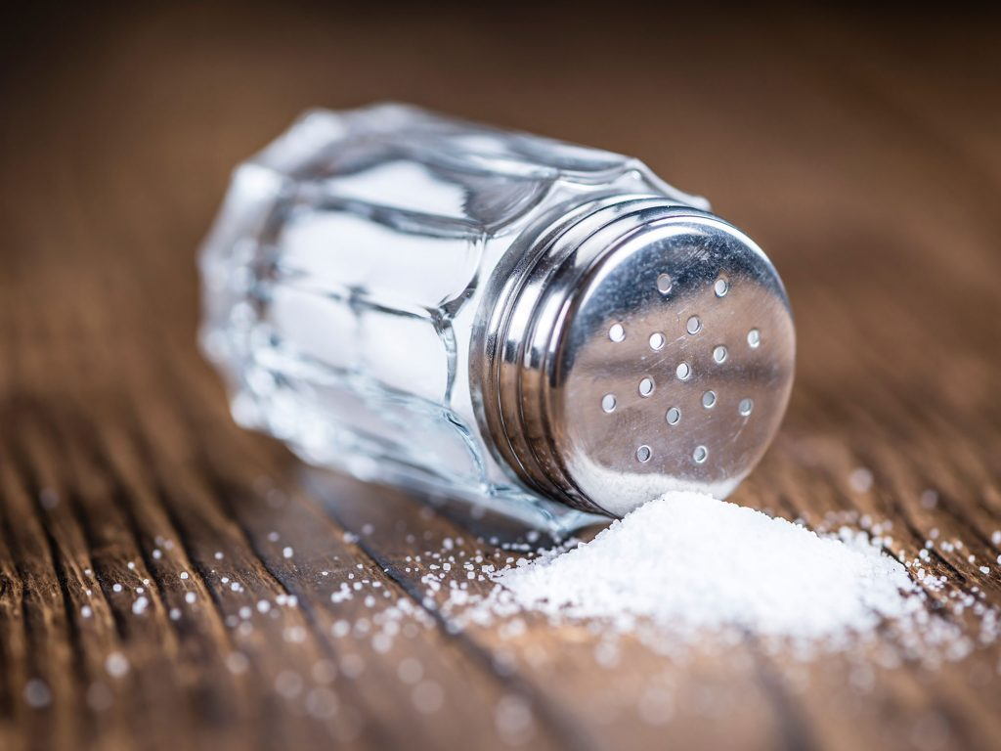
The SALT Workgroup
The SALT workgroup noted that different jurisdictions use different MCI triage techniques and many MCIs cross jurisdictional lines.
They conducted an exhaustive literature review on each triage system and found no clinical or operation evidence to support one to be apoted nationally.
So they created the SALT triage system. Based on the best research and evidence, to make a simple, life saving triage system for national adoption.

Slide 63
The Model Uniform Core Criteria (MUCC)
The Model Uniform Core Criteria (MUCC) for Mass Casualty Triage is a science and consensus based national guideline that recommends 24 core criteria for all mass casualty triage systems.
The Salt Group realized that real changes needed to be made to get everyone on the same page with triage and MCI and created the MUCC which is working to create national standards for EMS agencies for Triage based on clear evidence based research.

Slide 64
Different Methods of Triage
START (Simple Triage and Rapid Transport)
JumpSTART (Pediatric START)
SALT (Sort, Assess/Lifesaving interventions, Transport/Treatment

Slide 65
START Triage: “RPM 30-20 Can Do”
Move walking wounded away from the incident area to minor holding area.
Use the RPM-30-2-Can Do to assess for
Immediate, Delayed and Expectant/Deceased
Respirations = Less than 30/min
Perfusion = Capillary refill less than 2 seconds
Mental Status = “Can Do” Can follow simple commands
If all of these criteria are met the Patient is considered Delayed
If any of these criteria are not met the Pt. is considered Immediate
Any Patient with apnea that doesn’t have return of respirations with airway repositioning is considered Deceased/Expectant

Slide 66
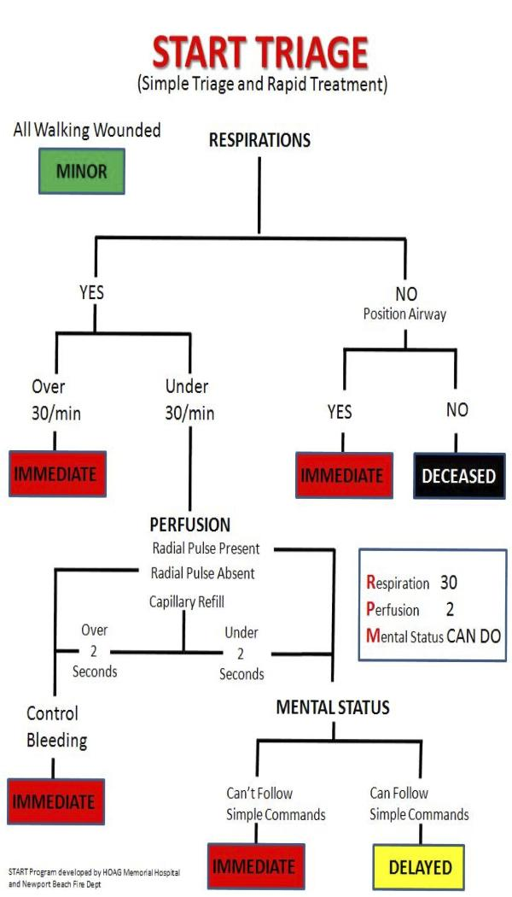
START Triage: “RPM 30-20 Can Do”

Slide 67
JumpSTART Triage: “RPM 30-2 Can Do 15-45”
Move walking wounded away from the incident area to minor holding area.
Use the RPM-30-2-Can Do-15-45 to assess for
Immediate, Delayed and Expectant/Deceased
Respirations = Less than 30/min, over 15, but under 45
Perfusion = Capillary refill less than 2 seconds
Mental Status = “Can Do” Can follow simple commands if able
If all of these criteria are met the Patient is considered Delayed
If any of these criteria are not met the Pt. is considered Immediate
Any Patient with apnea that doesn’t have return of respirations with airway repositioning and 5 breaths is considered Deceased/Expectant

Slide 68
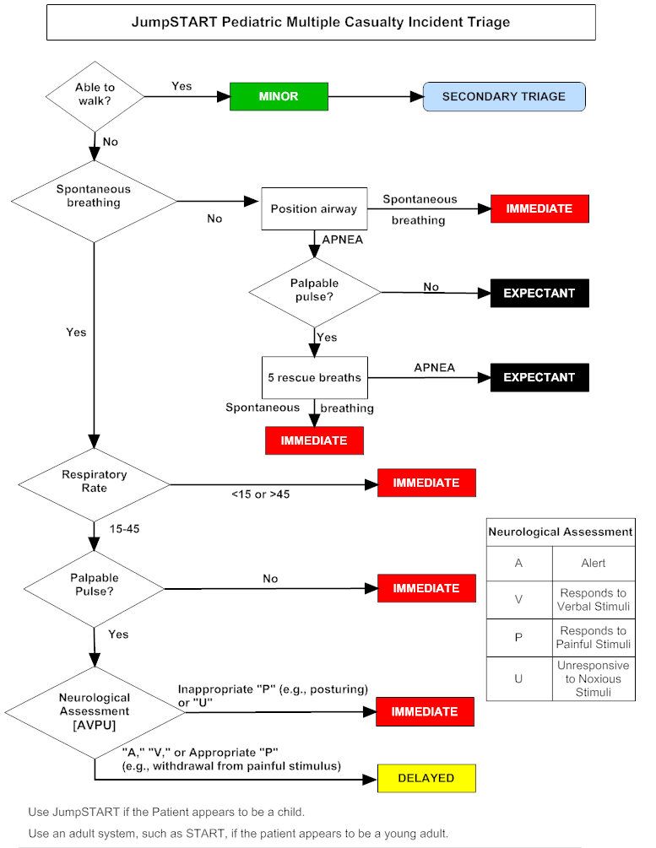
JumpSTART Triage: “RPM 30-2 Can Do 15-45”

Slide 69
The Sort in SALT
Sort the Walkers and the Wavers by making an announcement, “walk to the ambulance if you need help” Assess Third
then Sort make a second announcement, “Wave to me if you need help” Assess Second
Patients lying still that do not answer need to be assessed First
Assess/Make Life Saving Interventions LSI: Perform rapid assessment for obvious life threats. Perform any LSI you are equipped and trained for that will take < 1min and does not require a second provider. (Eg: Tourniquet, Needle Decompression, open airway, Rescue breaths for children. )

Slide 70
The A in Assess in SALT
Deceased/Black:
Anyone with injuries incompatible with life.
Adult with return of spontaneous respirations after airway is opened
Pediatric that does not have return of spontaneous respirations after airway is opened and 2 rescue breaths.
Black tags do not move forward to Casualty Collection Point

Slide 71
The A in Assess in SALT
Does this Patient?
Obeys commands or makes purposeful movements?
Have peripheral pulse?
In respiratory distress?
Has a Major Hemorrhage now controlled?
If any of the answers is “No”
Ask “Will this Patient survive with what we have available?”
If no they are Black/Expectant.
If yes Red Tag/Immediate
Red tags are taken to casualty collection point first!

Slide 72
The A in Assess in SALT
Does this Patient?
Obeys commands or makes purposeful movements?
Have peripheral pulse?
In respiratory distress?
Has a Major Hemorrhage now controlled?
If all of these questions answer is, YES
But you still find a significant injury the the Patient is yellow/delayed
Yellow Tags go to the causality collections point after all red tags are taken.

Slide 73
The A in Assess in SALT
Does this Patient?
Obeys commands or makes purposeful movements?
Have peripheral pulse?
In respiratory distress?
Has a Major Hemorrhage now controlled?
If all of these questions answer is, YES
and you find no significant injury the the Patient is
The Patient is considered a Green Tag/Minor
Green Tags walk themselves or are taken last to the casualty collection

Slide 74
SALT: Transport and Treatment
Patients then come into the casualty collection point for secondary triage and then on to their respective Treatment areas to be transported from the scene based on their level of injuries.

Slide 75
Summary
EMS is moving towards a national standard of MCI/ Disaster Triage based on science and operations evidence based research. The SALT method is the front runner at this time.
Correct Triage and movement of Patients to appropriate treatment areas is a very difficult and important part of MCI’s.

Slide 76
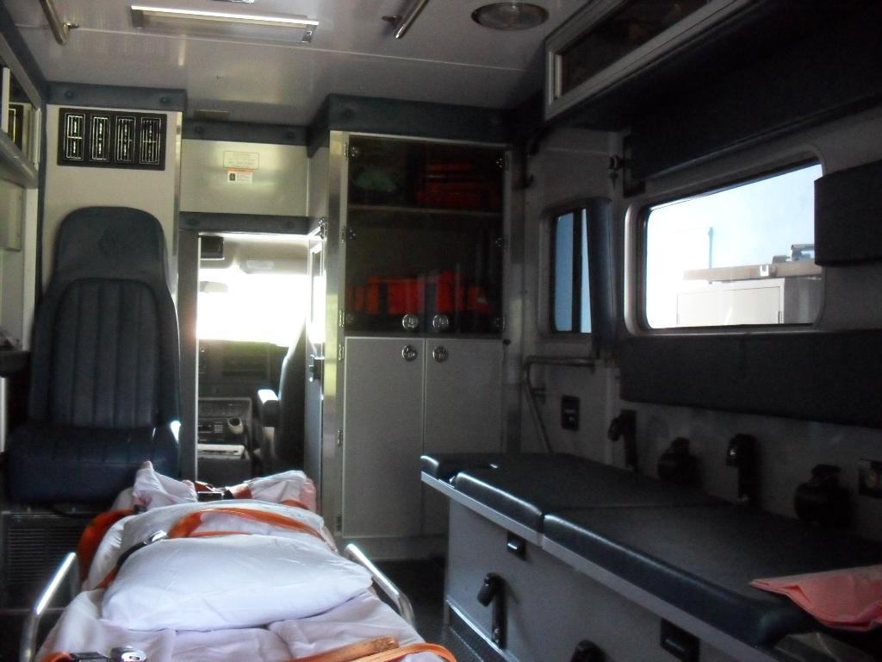
Inappropriate Placement of Pediatrics for Transport
It is unsafe to transport pediatric patients on the bench seat even in a child restraint system.
It is unsafe to transport pediatric patients on the cot without a child restraint system.
NEVER ON PARENT’S LAP

Slide 77
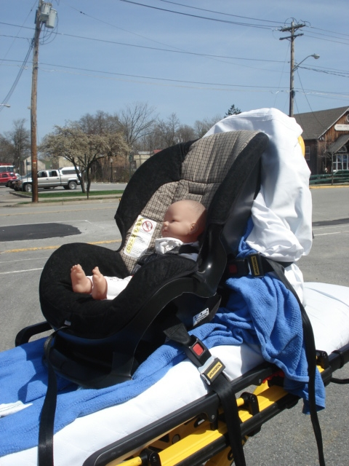
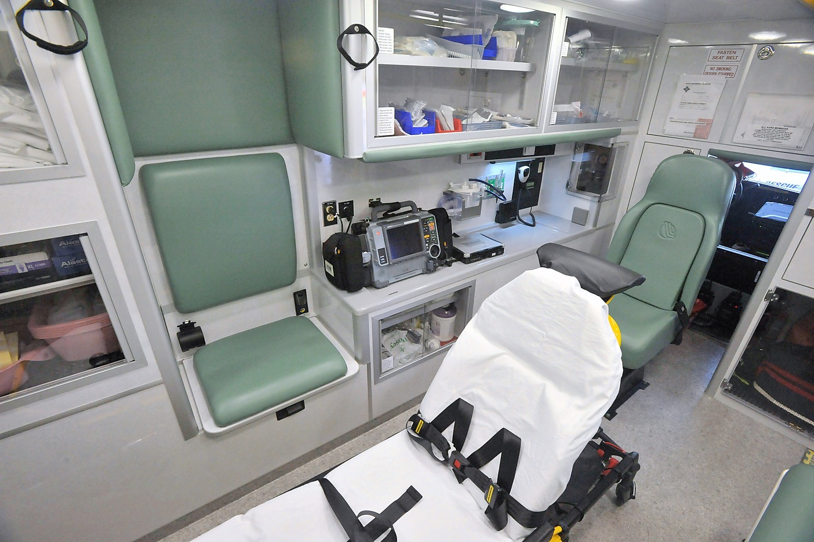
Inappropriate Placement of Pediatrics for Transport
It is unsafe to attach a car seat to your cot to transport a pediatric. Only car seat and cot systems that have been crash tested together as a restraint system can be used.
If the CPR seat is used keep the child seat facing forward or backward. Child car seats are not designed for heavy side impacts.

Slide 78
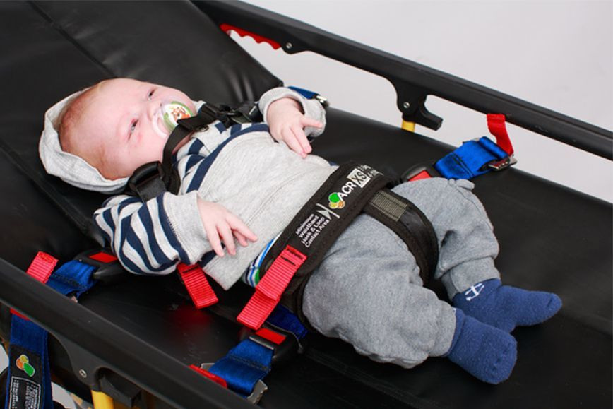
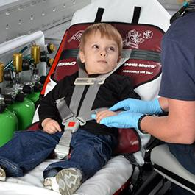
Appropriate Methods for Pediatric Transport
Commercially available weight based child restraint systems are some of the best ways to ensure you have the
appropriate seat required
The Pedi-Mate Child restraint system prepares you for peds from 10-40 lb (4.5-18 kg).

Slide 79
Appropriate Methods for Pediatric Transport
Pediatric Patients should always be transported in a tested child restraint system that has been tested with the cot as a restraint system that meets FMVSS No. 213. This is the safest way to transport a Pediatric Patient including newborns.
The Pediatric Patient should never be allowed to ride on parent’s lap or in their arms.

Slide 80
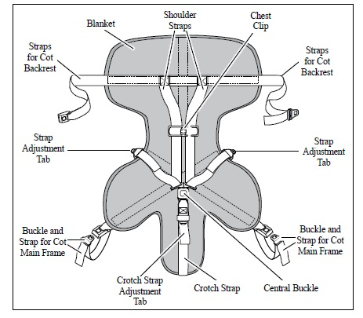
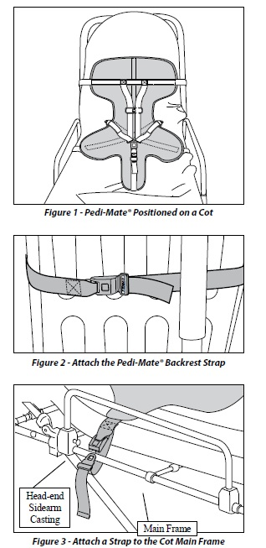
Attachment of Child Restraint Systems to EMS Cot
It is imperative that you know your child restraint system and how to properly apply it
Always secure the device to the frame of the cot as it was intended

Slide 81
Transporting Peds with Spinal Immobilization
Pediatric Patients that require immobilization should have an appropriate pediatric spine board or device that allows for back boarding of a pediatric with a long board. The child should be secured to the immobilization device and then the device should be secured or tethered to the cot.
Dear TO Barry;
It is my regret to inform you that I could not find an appropriate picture of a pedi spine board “tethered” to a cot as indicated by the NREMT website for Transporting Peds on a board. Please locate or make one thank you.
Sincerely;
W.Poe

Slide 82
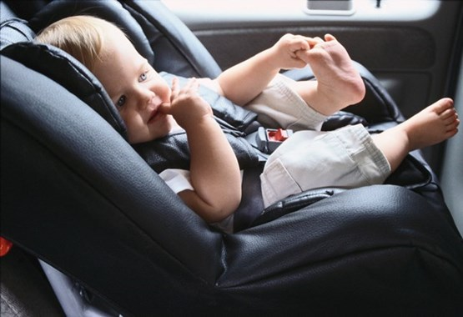
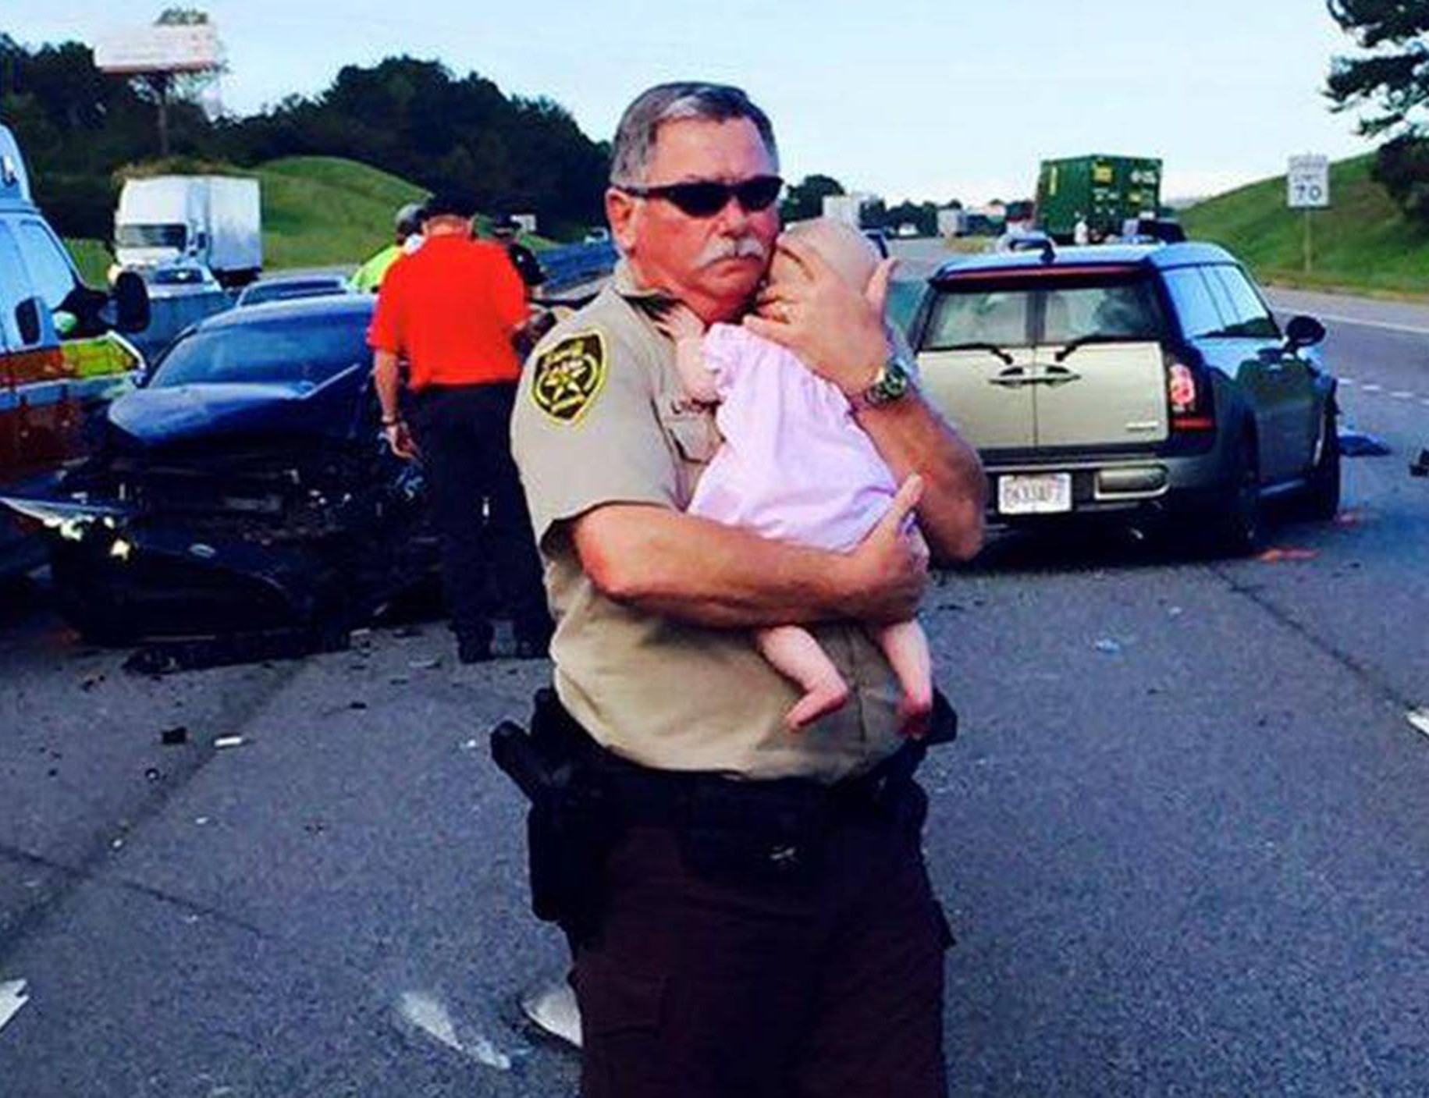
Modes of transports for uninjured/not ill Pediatrics
Another passenger vehicle can take the child so long as they have the correct size car seat
Leave the child on the scene with a person of authority or family if available

Slide 83
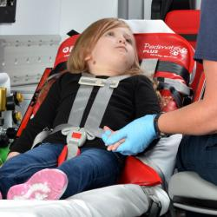
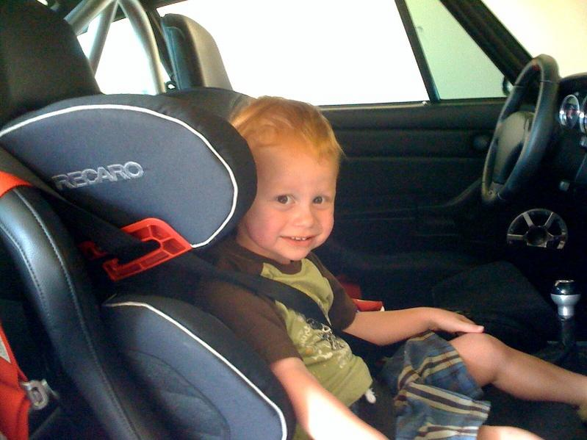
Modes of transports for uninjured/not ill Pediatrics
You may call in an additional
unit to transport the child even if uninjured as it may be the safest way
You may place a child in their seat in the front passenger seat of the ambulance with the front airbag turned off

Slide 84
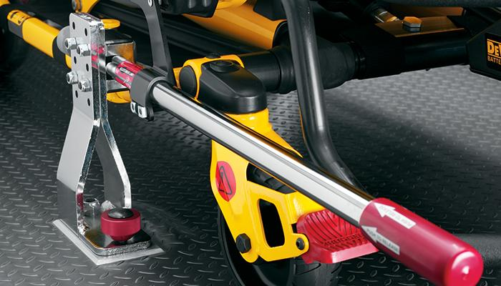
Limitations of EMS for Pediatric Transports
Not much research on child- restraint systems is done for ambulances.
Due to lack of research it’s hard to create or recommend evidence-based guidelines of EMS
Child restraint systems are only as effective as the manner in which they are secured to a cot and in an ambulance

Slide 85

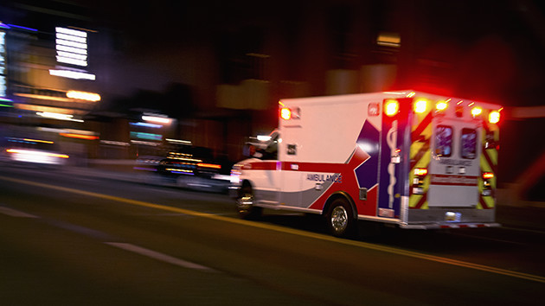
Making Pediatric Transports Safer
The National Association of State EMS Officials has created a Safe Transport of Children Committee with the following goals:
To recommend the criteria or specifications for proper restraint of children in ambulances. Such criteria will be evidence-based and will consider safety of both patients and providers
To have the recommended criteria adopted by one or more accredited standard setting organizations.
To develop a strategy and resources for educating EMS providers on safely transporting children in ground ambulances based on the recommended criteria or standards.

Slide 86
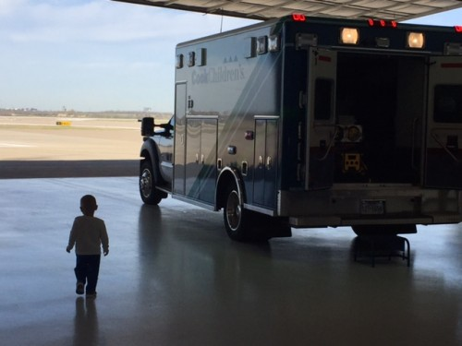
Summary
Pediatric Patients need to have appropriate restraint system
Never let a child ride on a parent’s lap
Restraint systems are strapped to cot frame
Protect our future and properly place pediatrics in your unit

