Slide 1


Pikes Peak Rose Society
& Evergreen Heritage
NEVER FORGET GARDEN INITIATIVE
at Evergreen Cemetery
Presented by
Anita Eckley, Master Rosarian, PPRS &
Brenna Bosch, Consulting Rosarian, PPRS

Slide 2

From the Society of the Honor Guard of the Tomb of the Unknown Solider –
Through an initiative started in 2018, the Tomb of the Unknown Soldier Never Forget Garden is a nationwide invitation to all Americans and freedom loving people to plant gardens as a visual way to represent America’s unwavering commitment to our sacred duty to recognize, remember, and honor our veterans, many who continued to serve as first responders, and their families now and for many years to come. There are many ways and traditions that are available to express patriotism, love, mourning and remembrance. A “Never Forget Garden” can provide an elegant expression of that which deeply resides in the heart of our fellow Americans:
“I will Never, Ever Forget You — I am in it with you.”
Origin of the Never Forget Garden

Slide 3

The Tomb of the Unknown Soldier at Arlington Cemetery honors that soldier from World War I, who represents all who followed General George Washington into the field of battle, all who served in wars and armed conflict that came after 1776, today’s heroic military, and all who will serve in the future.
– Richard A. Azzaro, former Tomb Guard; a Founder and former President of the Society of the Honor Guard, Tomb of the Unknown Soldier; Director of the ‘Never Forget Garden’ Committee.
What is the Tomb of the Unknown Solider?

Slide 4
The Society of the Honor Guard has proposed ‘Never Forget Gardens’ as an important way to observe the Centennial of the Tomb of the Unknown Soldier, and to ensure the millions of America’s war dead are forever honored and remembered. The Centennial will take place in the eleventh month, the eleventh day at the eleventh hour of 2021 (November 11, 2021). The national effort led by the Society of the Honor Guard encourages the installation of ‘Never Forget Gardens’ “to involve every individual, village, hamlet, town and city, and all branches of the uniformed services and civilian government.”
– Richard A. Azzaro, former Tomb Guard; a Founder and former President of the Society of the Honor Guard, Tomb of the Unknown Soldier; Director of the ‘Never Forget Garden’ Committee.
Centennial Celebration

Slide 5
Why the interest in Rose Gardens?
The white rose has been adopted as the official flower of the Society of the Honor Guard, Tomb of the Unknown Soldier in memory of the fact that a bouquet of white roses was used in the selection of America’s Unknown Soldier on November 11, 1921. - ARS Resolution excerpt

Slide 6

From the ARS website –
By ARS RESOLUTION, President Robert Martin and the ARS Board of Directors has unanimously joined the CENTENNIAL COMMEMORATION.
America’s Rose Garden has established a ‘Never Forget Garden to commemorate the Centennial of the Unknown Soldier and as a permanent installation to honor all veterans.
The new garden is named for US Navy Veteran and American Rose Society members: it is the “DAVE AND SANDY LONG NEVER FORGET GARDEN.”
American Rose Society Support of the
Never Forget Garden Initiative

Slide 7
We can’t all attend the Centennial Ceremony at Arlington Cemetery, but each of us can create a place in our own garden to express patriotism, with the noble purpose of remembering all whose lives were courageously given in service to our country, both at home and abroad; not just for the Centennial, but for all time. The Society of the Honor Guard believes your garden will serve as a ‘proxy’ for the Tomb at Arlington.
You will find your ‘Never Forget Garden’ becomes a place where you can memorialize a family member or friend, and remember veterans and their families. It will be a place of beauty and of calm reflection. You will put your heart into your garden as you carefully tend the flowers and other plants, and encourage birds and butterflies. Every ‘Never Forget Garden’ will offer a personal experience in a very personal and private space for those who want to express their love of country, to express love, respect and gratitude, and to remember. – Marilyn Wellan, American Rose Society Representative to the Centennial and past ARS President
Create Your Never Forget Garden at Home

Slide 8
The Site for the PPRS/Evergreen Heritage
Never Forget Garden
EVERGREEN CEMETERY
Evergreen Cemetery was established shortly after the town was founded in 1871 and deeded to the City of Colorado Springs in 1875 by city founder, General William Jackson Palmer.
In 1993, Evergreen was placed on the National Register of Historic Places, only the second cemetery in the state to receive such an honor.
The cemetery is 220-acres.
The Cemetery is located at 1005 Hancock Expressway, Colorado Springs, CO 80903

Slide 9
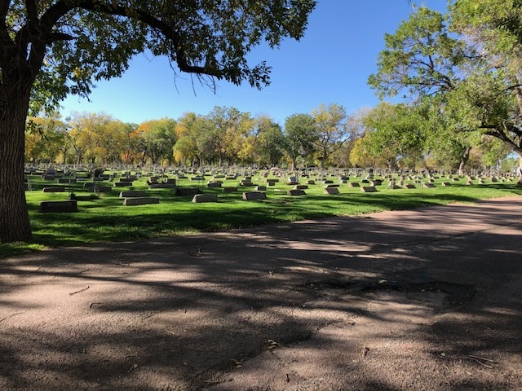
Evergreen Cemetery

Slide 10
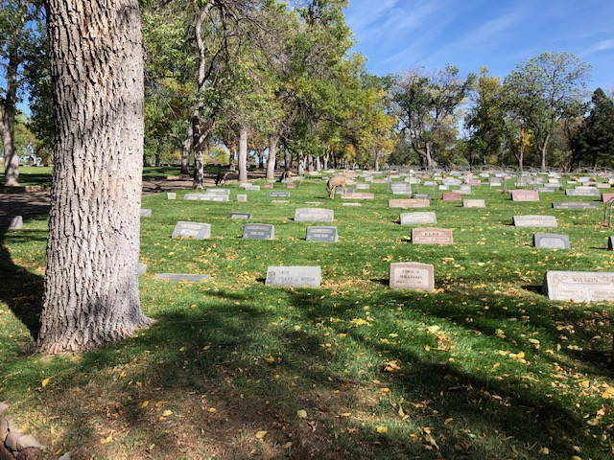
Evergreen Cemetery

Slide 11
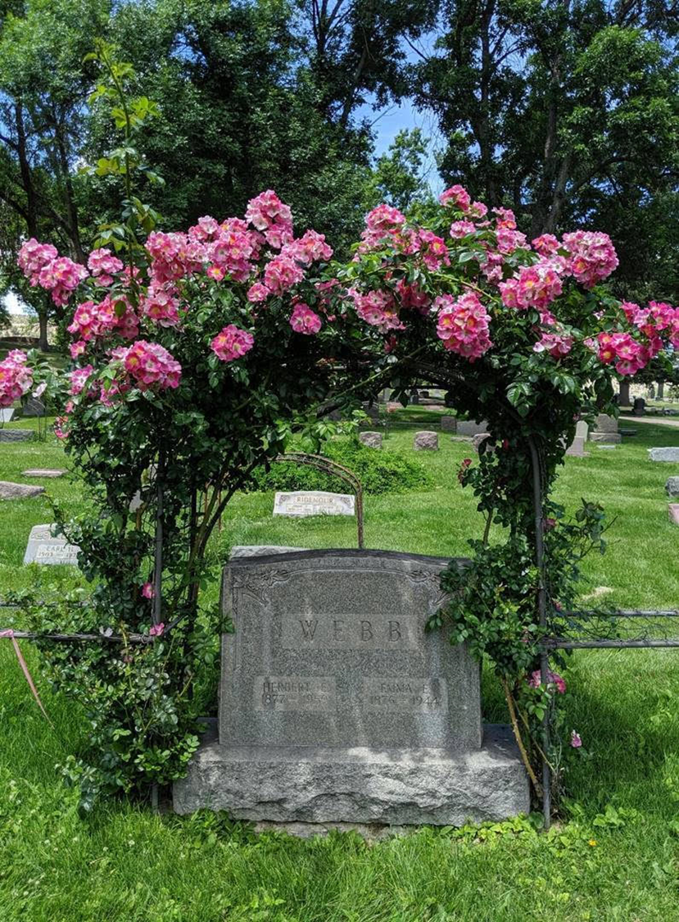
Evergreen
Cemetery

Slide 12
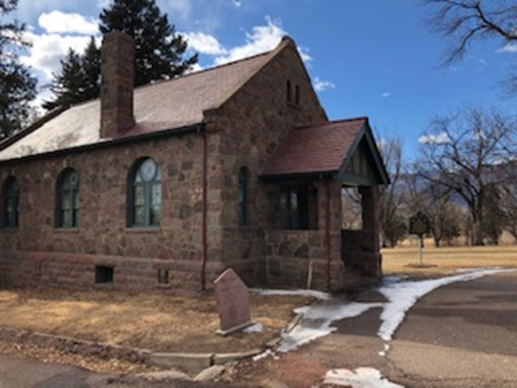
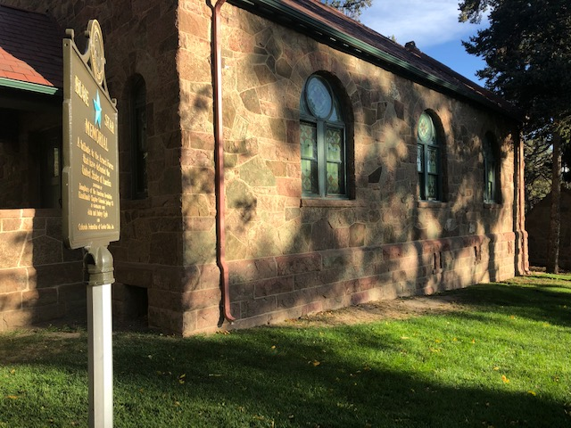
The Chapel at Evergreen Cemetery

Slide 13
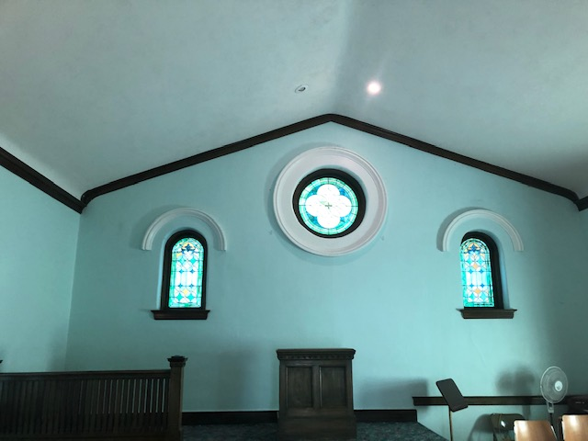
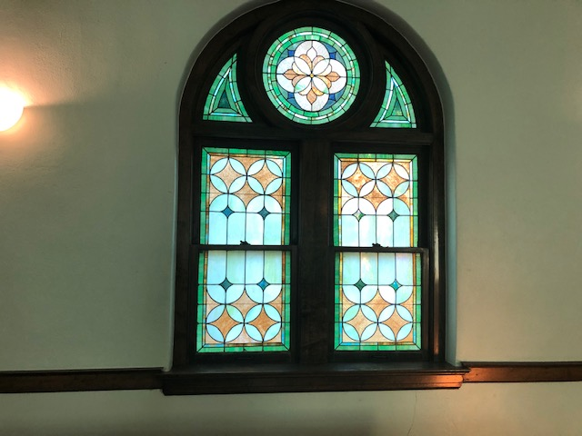
The Chapel at Evergreen Cemetery

Slide 14
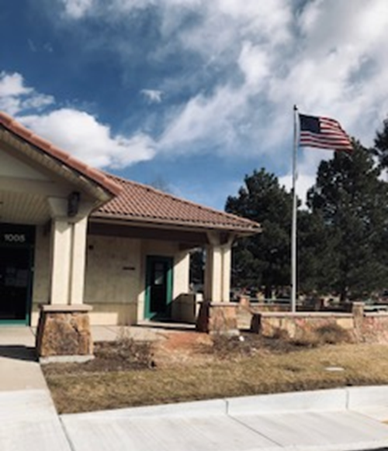
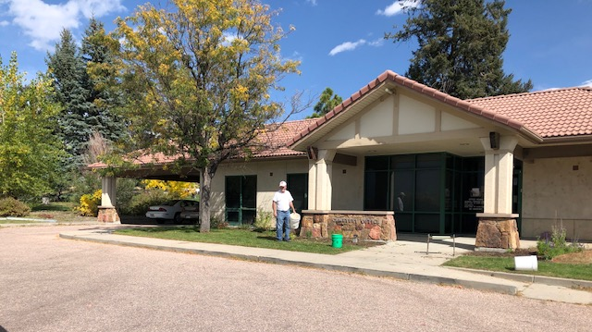
Future Site of the Never Forget Garden at Evergreen Cemetery
PPRS President, Mike Eckley, weeding the garden site in preparation for rose planting in Spring 2021.

Slide 15
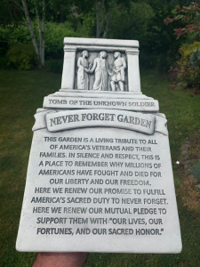
The Official Never Forget Garden Marker
Pikes Peak Rose Society member, Maria Asaro, has pledged funds to purchase this marker which will make the garden complete.

Slide 16

Evergreen Heritage aka Evergreen Cemetery Benevolent Society is a 501(c)(3) nonprofit organization founded to preserve the resting places of our pioneers.
Volunteers help with many events and fund-raising projects as well as maintenance projects at the cemetery.
Evergreen Heritage

Slide 17
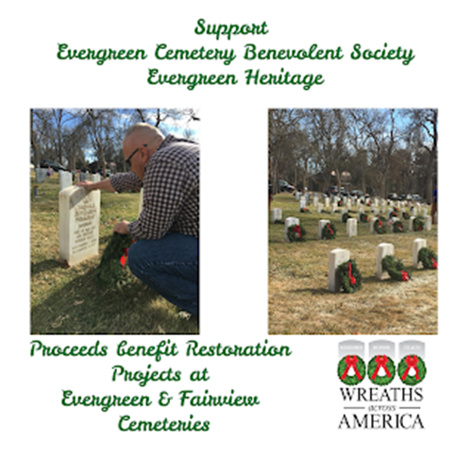
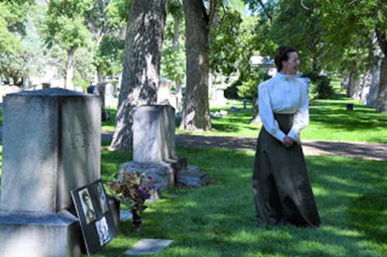
Evergreen Heritage

Slide 18
The Pikes Peak Rose Society/Evergreen Heritage Never Forget Garden is also a teaching garden. Consulting Rosarians and Master Rosarians from the Pikes Peak Rose Society demonstrate rose pruning and rose care here for their members, Evergreen Heritage members and the public. Please join us for a rose care session here. For session dates and times, contact PPRS on their website, www.pikespeakrosesociety.org or chat with the presenter after the talk. Thank you.

