Slide 1
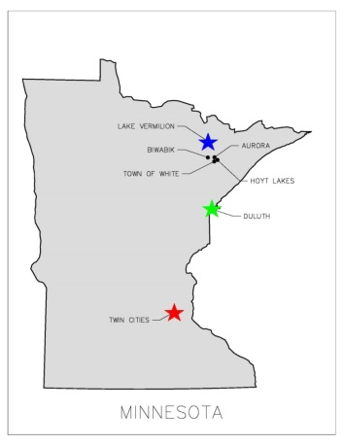
EAST MESABI JOINT WATER SYSTEM A JOINT VENTURE BETWEEN THE east range communities
REQUEST
A $6 million request for State Funding in 2019 to build a comprehensive
municipally owned cooperative joint drinking water system serving the
East Range.
POTENTIAL
Phase One ensures the ability to provide essential water services to citizens
of the City of Aurora and the Town of White. Phase Two will provide
essential water services to the cities of Biwabik and Hoyt Lakes.
PROJECT HISTORY
In 1953 - Aurora treatment plant built which serves both City of Aurora & Town of White residents
In 1997 - Planning began to serve an extended area of the East Range (Pineville, Scenic Acres) with investment in new infrastructure
In 2011 - Planning began for a Joint Water Facility on the East Range
In 2013 - Production tax money was awarded to the City of Biwabik for planning for a new water source
In 2018 - $2.5 million of bond money was authorized for the Joint Water Project
Extensive preliminary engineering has been completed
Favorable pilot studies at the water source have been completed
Funding is needed for transition from preliminary project planning to implementation

Slide 2
EAST MESABI JOINT WATER SYSTEM A JOINT VENTURE BETWEEN THE east range communities
CONSOLIDATION OF ESSENTIAL SERVICES
East Range Joint Powers Board established in 1984 among cities of Aurora, Biwabik, Hoyt Lakes, and the Town of White; actively provides economic development & governance for projects including the Joint Water Project
East Range has consolidated many essential services for economic and financial impact (police, ambulance, EMT, recreation, equipment/major purchases, comprehensive planning and shared staff)
This project aligns with those existing strategic initiatives that provide essential shared services to the East Range Communities
Cost savings for new project will be achieved by using Township owned property at new plant location; current water tower owned by Aurora; and extensive current infrastructure of water lines, lift stations, and pumps
COMPELLING CRITICAL NEEDS:
Potential imminent failure of current well at Scenic Acres location serving 92 homes
Antiquated Aurora intake facility (1953) threatened by rising pit waters
Arcelor Mital’s mining operations will displace Biwabik’s current water intake system
Targeted new joint water source assures a higher quality and inexhaustible supply of water

Slide 3
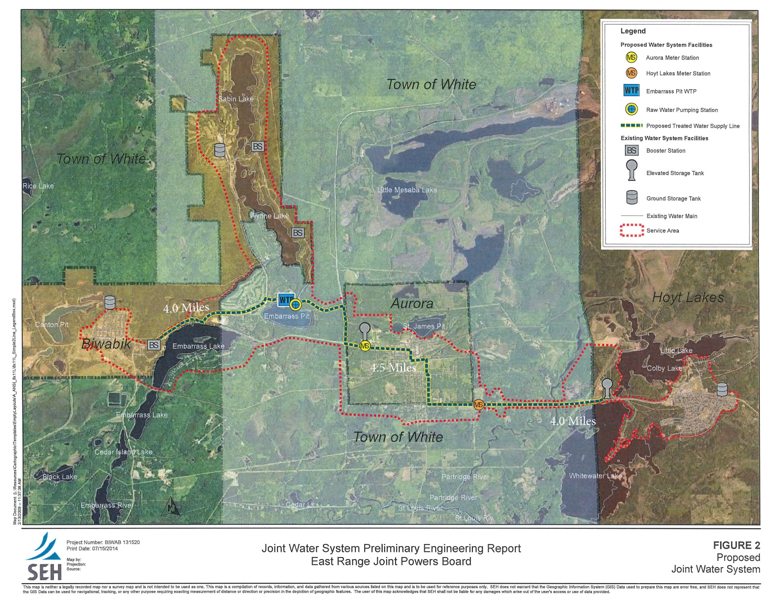
MAP OF AREA to be SERVED
Area served is six miles wide, 48 square miles
Centrally located plant will provide quality water to over 6000 residents
Notes:
The total coverage area for service with the new plant location is 6 miles wide, approximately 48 square miles.
Old language:
The impact of a new joint water facility is far reaching on the East Range and addresses current emergency & safety needs. The future economic development impact would provide quality water to over 6000 residents. Currently, the neighboring communities of Aurora, Biwabik, and Hoyt Lakes each own and operate their own water supply, treatment and distribution system. The town of white is served through the Aurora plants but owns it’s own infrastructure.

Slide 4
PROJECT COSTS/SOURCES
Funding Source | Prior Years | FY 2019
State of MN General Obligation Bonds | $2,500,000 | $6,000,000
Other Local Government Funds (City/Entity Match) | $0 | $4,300,000
Pending Government Funds (City/Federal) | $0 | $4,400,000
TOTAL | $2,500,000 | $14,700,000
Project Costs |  | FY 2019
Embarrass Pit Intake Facility | $0 | $3,800,000
Embarrass Pit WTP | $0 | $11,000,000
Pineville/Scenic Acres Trunk Main | $0 | $2,400,000
TOTAL | $0 | $17,200,000
Notes:
As stated previously, this request is for $8.6 M in state funding to continue this project. If successful in obtaining funding, final design and land acquisition work shall begin in Fall 2018 with construction in 2019-20.
Cost of $17.2 M includes everything (engineering, architectural, and inflation – all in)
Construction Management – 2018
Plant construction
Distribution System Upgrades

Slide 5
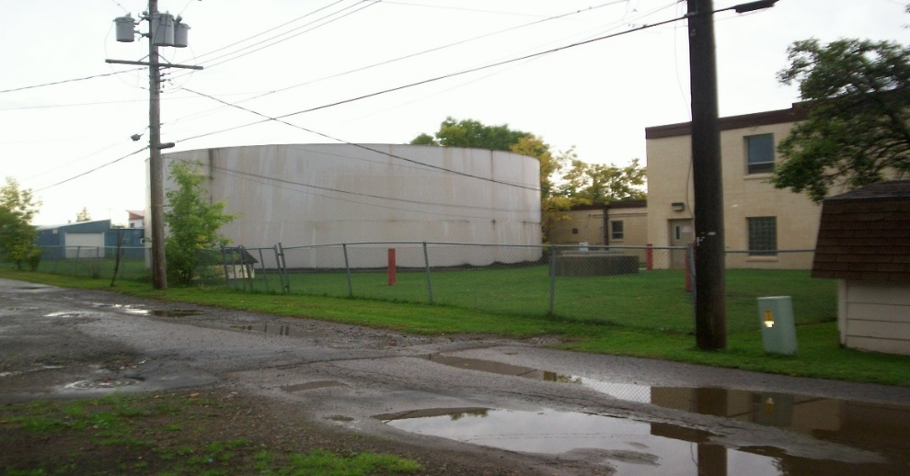
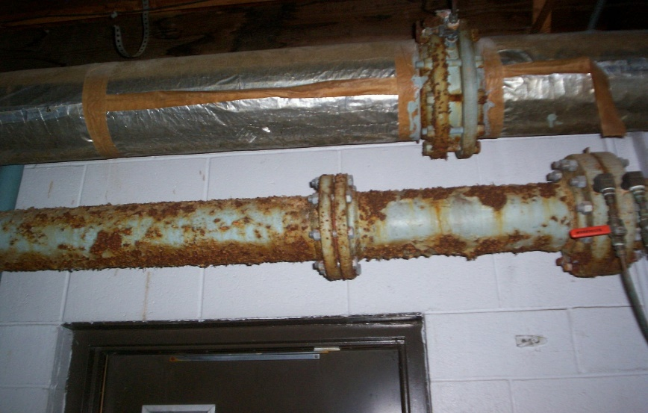
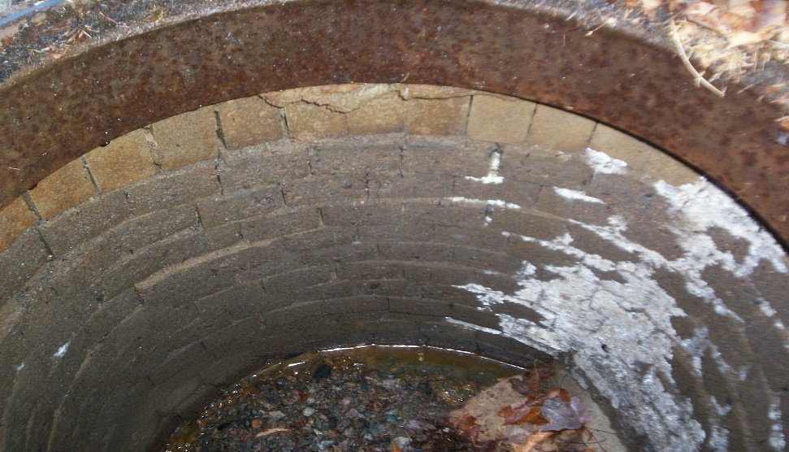
Current facilities lack expansion room, Have obsolete equipment, & are in poor condition
Notes:
The Aurora plant is facing significant current and long range challenges. To address these challenges, the potential for a joint water system for the communities has been studied for feasibility. The studies have shown that a joint water system provides economies of scale for the member communities and offers more reliability than separate systems.
Completion of this project will ensure a more economical approach to these member communities in providing quality water to their residents and will drastically reduce their annual operating and maintenance costs.
Another concern of the Aurora plant is lack of expansion space as you can see from the pictures above.

Slide 6
Projected outcomes
Provides water services, from a more stable and higher quality water source to better serve our citizens
Allows a more cost effective service while meeting current and future environmental concerns
Supports collaboration, improves efficiencies, meets compliance standards not currently being met, and addresses emergency/safety concerns
Provides an opportunity for growth and expansion for Economic Development and/or Residential Growth in over 295 acres of undeveloped property
Providing water to these communities in a coordinated, consolidated manner will be more fiscally responsible and have a tremendous economic impact
Notes:
Pairing and sharing is not a new venture for us. We have historically been combining services in areas such as Public Safety, Economic Development, Community Development and Staffing. Based on the history of our Joint Cooperative and Collaborative efforts, we are confident that if the project were to secure funding, this project would prove feasible as we have a long history of successful cooperative efforts.

Slide 7
Thank you
This is a critical time to move to a more efficient, cost effective facility. This is the proper long term investment for our region and for the state.
Thank you for the opportunity to present our project today!
Contacts: Douglas Gregor, Mayor of the City of Aurora
(218) 229-2614
Jon Skelton, Chairman of the Township Board
(218) 229-2813

