Slide 1
Thinking Outside the Box
Being creative with challenges

Slide 2
Notes:
Presented with ideas of functions needed but Ecometry does not seem to have the functionality.
Like using a Food Processor to make Juice.
Sometimes complex, sometimes simple.

Slide 3
Agenda
Warranty Repair
Write off Debits via file
Assign Web Orders to specific Sales People
Remote Location Order Entry and Processing
Bulk order processing without producing a collate
Provide in house credit for return regardless of pay method

Slide 4
Warranty Repair
Need:
Ability to receive back product and track it through the warehouse for repair and send it back when complete.
Notes:
Doll Hospital
Uses Customer Service Tracking and Customization Workstation functionality

Slide 5
Warranty Repair
Setup:
Specific Source code(s) for warranty
Customer Service Track Reasons
Customer Service Track Follow-Up Action(s)
Create Work Station/Secondary Customization Codes
Stock Adjustment Reason(s)
Create Master Customization Codes
Create Secondary Customization Code Details
G1 item(s)
Letter recapping details of warranty
Letter acknowledging receipt of item
Modify your Order Processing job streams to include a new program, WRKSTRTE
Set up Working Days Calendar
Set Controls
BARCODE-BOM
BILL-OF-MAIL
G1-ON-BILL-MATRL
CUSTOMIZE-SPLIT
GROUP-CUSTOMIZE
ITEM-CONSOL
Warehouse for Warranty Parts
Notes:
Code Descriptions – Code Type SR (Service Track Reason), FA (Follow-up Action), WS (Work Station – Secondary Cust Cd) and AJ (Stock Adjustment Reason)
Master customization code for each unique customization routine
Secondary customization code for each workstation
Enter Master Customization code in Cust Cd for each G1 product
Between ORDRPICK and PICKLOTS add -
!RUN WRKSTRTE.CODE2.!SG2VER;LIB=G

Slide 6
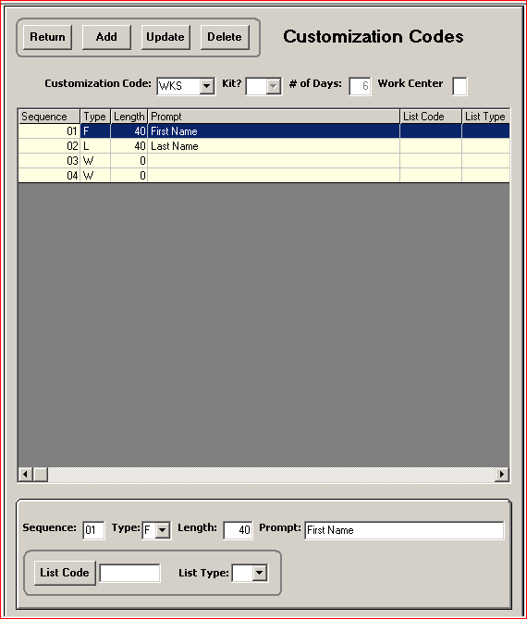
Notes:
Customization Code - 3 alphanumeric characters. You will add a fourth character later; consider these three the "base" code for the product's entire customization routine.
# of Days – Total number of days to complete warranty repair - required.
Work Center - blank when creating Master customization codes.
Type - Customization Insert Types
Master customization codes - last two sequence lines must contain a W in the Type box.
3 sequence lines required: one line any valid code or a blank, and two lines with a W.

Slide 7
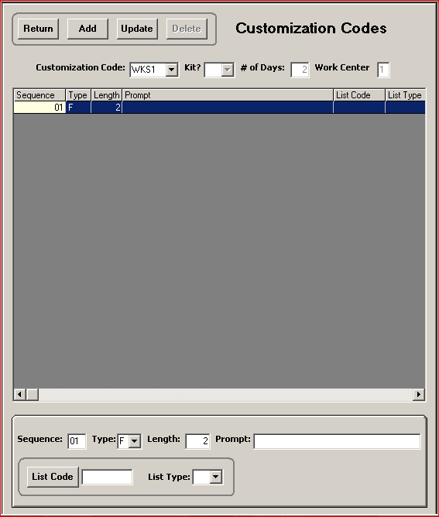
Notes:
Customization Code - 3-position Master customization code, followed by a sequential number that corresponds to each Workstation's sequential step in the customization process.
Note: same as Workstation code descriptions set up in Code Desc, WS.
# of Days - Days for workstation to complete task - required.
Direct Commerce uses the value to calculate the expected completion date for each workstation and the final completion date. Referred to as the Workstation Routing Information - displayed in an abbreviated form on the collate and Bill of Materials, and within the Customer Service.
Work Center - Enter a value from A-Z or 1-9 to identify the workcenter. Optional - logical grouping of workstations that perform the same function to combine for reporting purposes. For example, if you have two different customization routines that include the engraving workstation, each would have a different workstation code, based on the master workstation customization code. You could use the same workcenter code for both engraving workstations to link them on the Workstation reports.
Valid Insert Type in the Type other than W or G.
Length – not zero

Slide 8
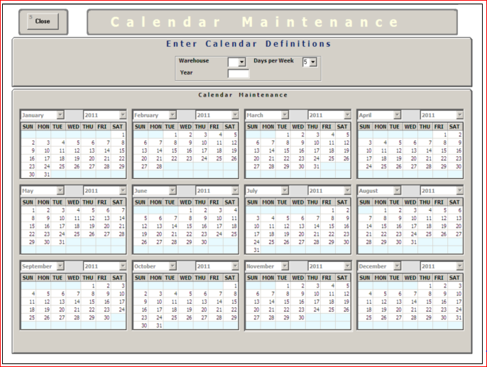
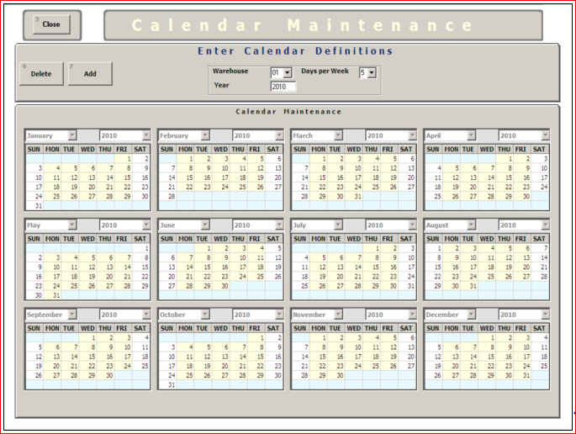
Notes:
working days highlighted in yellow
5 day week
Provides for accurate time estimates and scheduling

Slide 9
Warranty Repair
BARCODE-BOM –
Y - To print an order# / line# bar code on the Bill of Materials
BILL-OF-MAIL –
Y - To print a separate Bill of Materials
G1-ON-BILL-MATRL –
Y – To print G1 products that are components of kits on the Bill of Materials
N/blank – To omit G1 products that are components of kits from printing on the Bill of Materials.
CUSTOMIZE-SPLIT –
zz - To place products in separate picklots
GROUP-CUSTOMIZE –
ID - To print a Bill of Materials for single customized product orders
GM - To print a gift message on the gift message sticky label on a specialized Bill of Materials form.
ITEM-CONSOL –
N - To produce a separate line for each customized product on the order
Notes:
Code Descriptions – Code Type SR (Service Track Reason), FA (Follow-up Action) and WS (Work Station – Secondary Cust Cd)
Master customization code for each unique customization routine and enter in Cust Cd for each G1 product
Between ORDRPICK and PICKLOTS add -
!RUN WRKSTRTE.CODE2.!SG2VER;LIB=G

Slide 10
Warranty Repair
Customer calls in for Warranty Repair.
Rep logs call using Customer Service Tracking leaving the track open until the item is received.
Send letter confirming warranty details
When item is received the track should be closed and a letter should be sent letting the customer know the product was received.
An order should be entered with a unique source code for a G1 item that is specified as the warranty item. The original order number should be entered in the PO Number Field to tie the two orders together.

Slide 11
Warranty Repair
There should be a separate warehouse with inventory for the parts that are needed for repairs. These parts can either be added to the order before processing or they can be stock adjusted out using a specific reason for warranty as needed.
The workstation functionality should be used to track the repair through the warehouse.
Once the repair is complete the order should be picked, packed and shipped.
Notes:
Check in and check out at each workstation
Order action created showing details

Slide 12
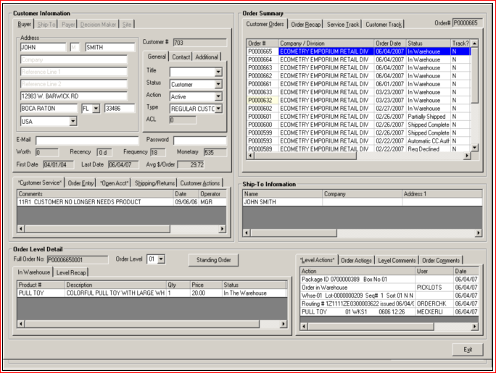
Notes:
The date of check-in, in the Date column (06/04/07)
The product checked into the workstation (PULL TOY)
The division (01)
The workstation (WKS1)
The estimated date of completion (0606)
The time of check-in (12:26)

Slide 13
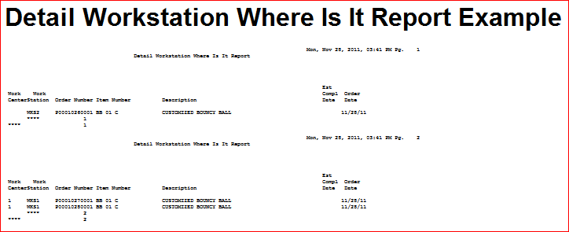
Warranty Repair

Slide 14
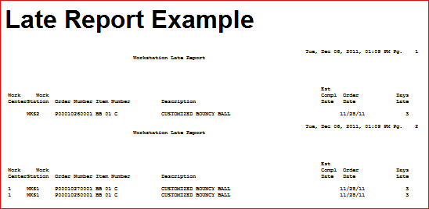
Warranty Repair

Slide 15
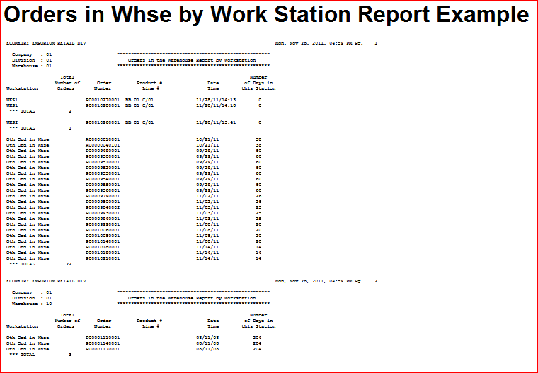
Warranty Repair

Slide 16
Write off Debits via file
Need:
The ability to write off specific Debits based on a file of data that is passed every month.
Notes:
Wholesale client
discount buy over time
treats discount as a credit and uses it to close out some invoices
OA Lock Box Functionality

Slide 17
Write off Debits via file
Setup:
Set DOC-ASSIGN-FILE and MAKE-LKBX-OA-PA controls
Create process to identify debits to be written off and create file in OA Lockbox format
Notes:
DOC-ASSIGN-FILE - next document number assignment for lock-box entry
MAKE-LKBX-OA-PA - On Account Credits created as PA type (Payment Applied)
File – outside process or query to extract data into file

Slide 18
Write off Debits via file
Create a file of credits to be applied to the debits in question
Open A/R Lockbox File Layout Header Information
Record Type 00
Field Name | Description | Format | Position
IN-BTCH-TYPE | Record Type, always "00" (required) | XX | 1-2
IN-BTCH-DATE | Date the Batch file is run (yymmdd) Note: This date is not used or stored. | X(6) | 3-8
IN-BTCH-NO | Increment by one for each batch (required) | X(8) | 9-16
FILLER | Filler, zero fill | X(8) | 17-24
IN-BTCH-DIV | Direct Commerce Division Code | XX | 25-26
IN-BTCH-CO | Direct Commerce Company Code | XX | 27-28
FILLER | Spaces | X(32) | 29-60

Slide 19
Write off Debits via file
Open A/R Lockbox File Layout Payment Information
Record Type 10
Field Name | Description | Format | Position
IN1-REC-TYPE | Record Type, always "10" (required) | XX | 1-2
IN1-ORDER-NO | Order Number (required) | X(12) | 3-14
IN1-CUST-NO | Customer Number, zero filled to the left | 9(10) | 15-24
IN1-AMT | Amount Of Payment, zero filled to the left with an implied decimal between positions eight and nine (required) | 9(8)V99 | 25-34
IN1-DATE¹ | Date of payment (ccyymmdd) | X(8) | 35-42
IN1-REF-NO | Reference Number – User-defined sequence, incremented for each record, zero filled to the left (required) | 9(11) | 43-53
FILLER | Spaces | X(7) | 54-60

Slide 20
Write off Debits via file
Run OA Lockbox job
Use reports generated from the OA Lockbox job to create a journal entry to write off the debit and payment in your GL

Slide 21
Batch Order Entry/Web Rep Assignment
Need:
The ability to assign specific salespeople to orders input via Batch Order Entry (TAPEMACS) or Web Order.
Notes:
Batch Order Entry Reject Queue
Pending Resolution

Slide 22
Batch Order Entry/Web Rep Assignment
Setup:
Set TAPE-MACS-REJ-DB
Batch Order Entry 20 (Reject MGR Review) and 24 (Reject Orders on Hold)
Setup user defined Batch Order Entry/Tapemacs Reject Code
Create or modify process that creates the file or sends the Weborder data to pass the reject code
Notes:
TAPE-MACS-REJ-DB - Batch Order and/or Ecometry Online rejects are saved for Pending Resolution
Batch Order Entry 20 - Ecometry Online orders rejected for reasons represented by code type TP reason codes are sent to the Batch Order reject queue in Pending Resolution. One for each Order Entry Rep

Slide 23
Batch Order Entry/Web Rep Assignment
When passing the data in the Batch Order Entry file or via Weborder you will pass the reject code for the specific salesperson in the Error Flag field in the 15 record.
The 15 record will have the Entry Operator in the ENTERED-BY field.
Orders will go to the specific bucket in Pending resolution for each Rep

Slide 24
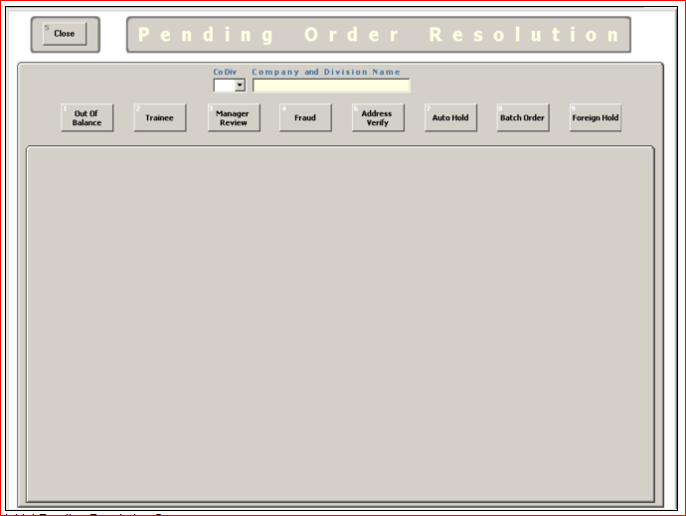

Slide 25
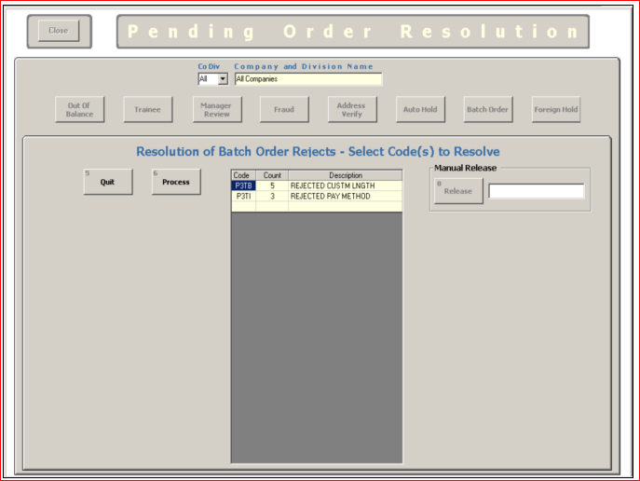

Slide 26
Remote Location Order Entry
Need:
The ability to enter orders from a remote location.
Notes:
Remote Events with no internet
Use Batch Order Entry PARM 85 POS
Orders will be passed in as Prepaid and Shipped

Slide 27
Remote Location Order Entry
Setup:
Create a P.O.S. Division (7X)
Add the new division in Company-Division Maintenance
Add new department(s)
Add GL accounts
Set up all the transaction codes
Set Control switches
Create 7X warehouse
Create Items
Offers / sources
Ship Method (Customer Pickup)
P&H routines
Create access database in Batch Order Entry File Layout
Create Screen for the Registers or provide the Register access to the database to capture data

Slide 28
Remote Location Order Entry
Enter Inventory for specific event in the 7X warehouse
Enter order data via the screen or Access Database
Create Batch Order Entry File using the data from the Access Database
Run Batch Order Entry using parm 85
Order will be shipped complete and prepaid

Slide 29
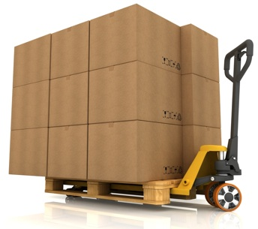
Bulk Order Processing without a Collate
Need:
The ability to process orders in bulk without producing a collate.
Notes:
Wholesale Customer
Wants file or no packing slip
Collate Extract Functionality

Slide 30
Bulk Order Processing without a Collate
Setup:
Create Offers/Sources
Create Items
Create a new unique Ship Method
Enter Ship Method
Enter Shipper Group
Enter Postage and Handling Routine
Enter the Postage and Handling Code in each Offer
Tie each Postage and Handling Code to each valid Ship Method and create a Postage and Handling Routine
Enter Sectional Centers for each Ship Method in Sec Ctr Zones
Enter Zone Charges (What the Carrier charges)
Set up your Alternate Ship Method table for each Ship Method for each Sectional Center that has a zone of zero.
Set Control switches – COLLATE-FILE, COLLATE-FILE-SM and NO-DIV-BREAK
Notes:
Code Description Code Type PH – PH Routine Screen – in Offer Screen
COLLATE-FILE - set to Y to write ALL collate data to file instead of printing hard copies
COLLATE-FILE-SM - refines the setting of COLLATE-FILE and will print hard copy collates for all ship methods except for those in this control (up to 10).
NO-DIV-BREAK – set to N to break collate spoolfiles by division

Slide 31
Bulk Order Processing without a Collate
Bulk orders must be entered using the specific ship method setup for this purpose
When order processing runs all orders with the specific ship method will appear in the collate file instead of being in the spoolfile to be printed

Slide 32
In House Credit for Return
Need:
The ability to provide a credit to be used on a future order rather than refund.
Notes:
Wholesale Customer
Wants file or no packing slip
Collate Extract Functionality

Slide 33
In House Credit for Return
Process an exchange return for a new item
When entering the new exchange order enter it for a Gift Certificate or Coupon product
The order will process and the Gift Certificate/Coupon will process

