Slide 1
Waco Light’s Up for Christmas 2024

Slide 2
Contest Judges
Doris Weaver, Mayor of Fallston
Hope Weaver
Sharon W. Messer

Slide 3
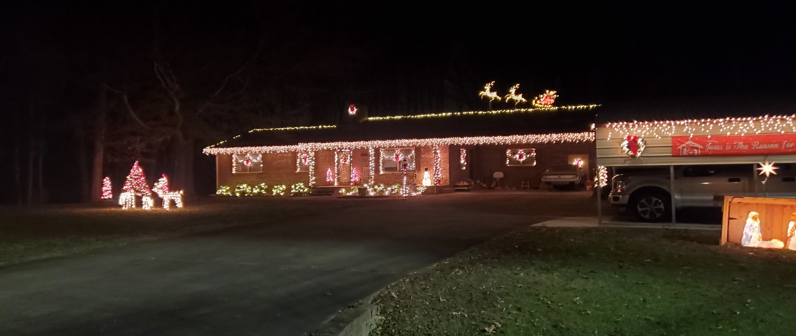
The power of communication
2023 Contest Winner:
Becky and Chester Haynes 416 Phillips Dr.

Slide 4
There were 30 homes judged
The decorations ranged from a classic tree in a window to blinking lights, inflatables and animations.

Slide 5
Scoring
Coverage 0 – 10 points
Atmosphere 0 – 10 points
Showmanship 0 – 10 points
Festiveness bonus 0 – 5 points
Traditional theme 0 – 5 points
Extra effort 0 – 5 points
Christmas tree visible 0 – 5 points
Total points available 50

Slide 6
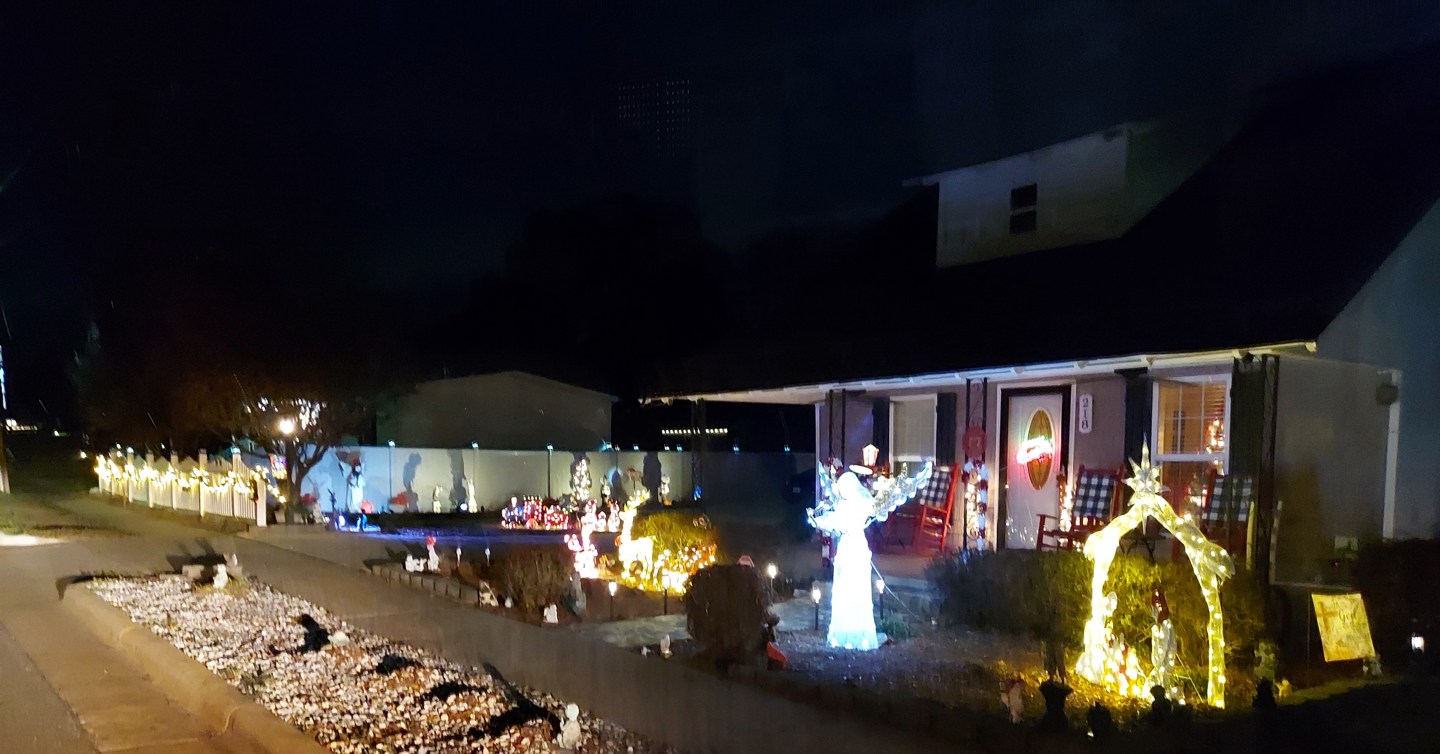
Selecting visual aids
Enhancing your presentation
5th Place - Score 36: Carla Mull
218 North Main St.

Slide 7
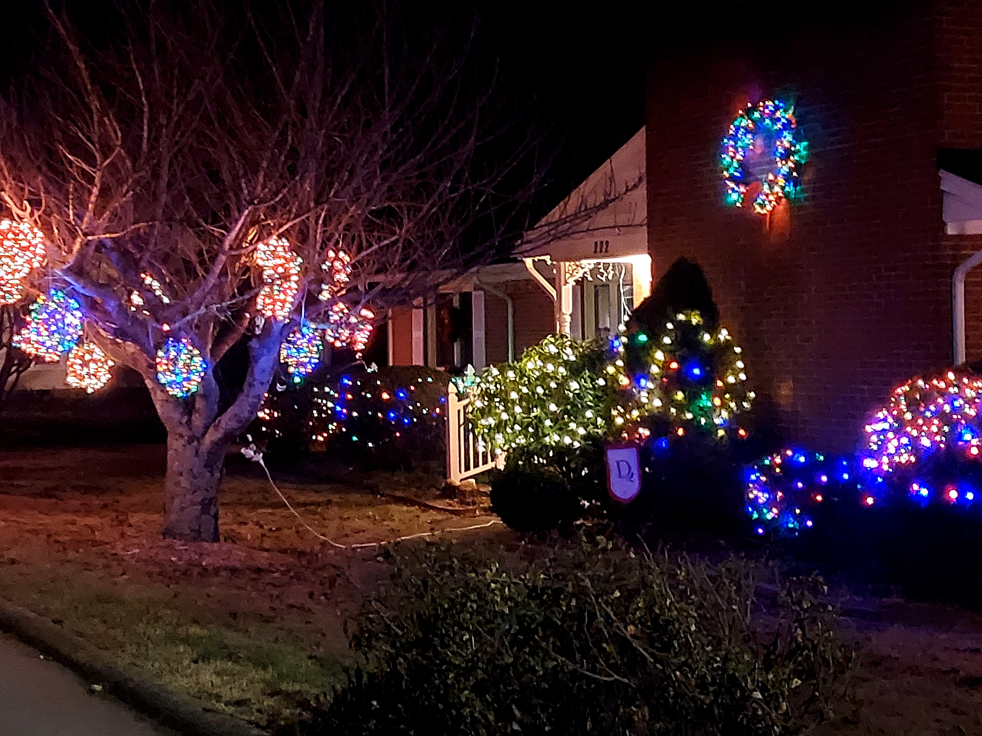
Effective delivery techniques
This is a powerful tool in public speaking. It involves varying pitch, tone, and volume to convey emotion, emphasize points, and maintain interest.
Pitch variation
Tone inflection
Volume control
Effective body language enhances your message, making it more impactful and memorable.
Meaningful eye contact
Purposeful gestures
Maintain good posture
Control your expressions
4th Place - Score 38: Pat Darty
222 South Main St.

Slide 8
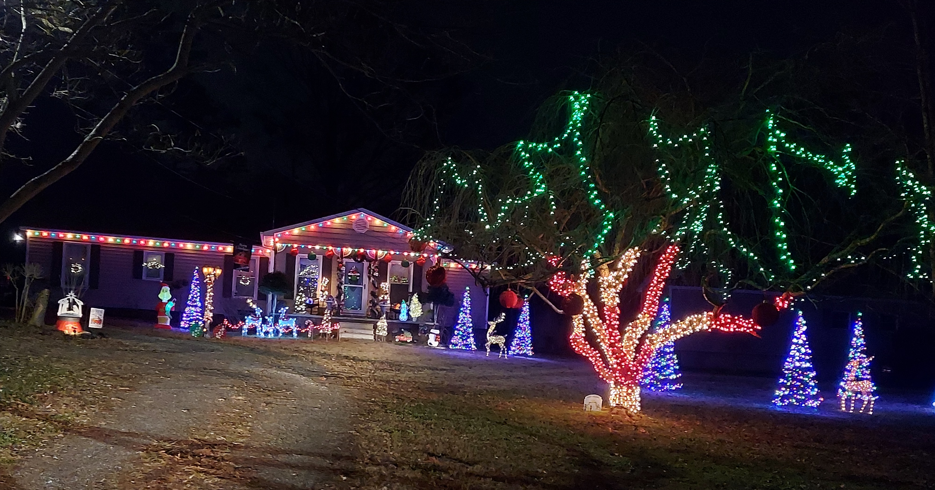
Effective delivery techniques
This is a powerful tool in public speaking. It involves varying pitch, tone, and volume to convey emotion, emphasize points, and maintain interest.
Pitch variation
Tone inflection
Volume control
Effective body language enhances your message, making it more impactful and memorable.
Meaningful eye contact
Purposeful gestures
Maintain good posture
Control your expressions
3rd Place - Score 42: Kim and Isreal Hamilton
303 Devenny Rd.

Slide 9
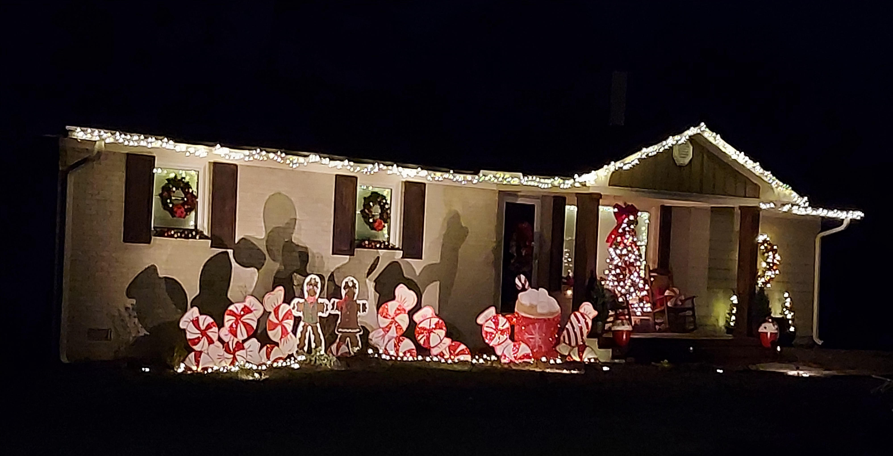
Navigating Q&A sessions
Know your material in advance
Anticipate common questions
Rehearse your responses
Maintaining composure during the Q&A session is essential for projecting confidence and authority. Consider the following tips for staying composed:
Stay calm
Actively listen
Pause and reflect
Maintain eye contact
2nd Place - Score 46: Chris Ross Family
245 Devenny Rd.

Slide 10
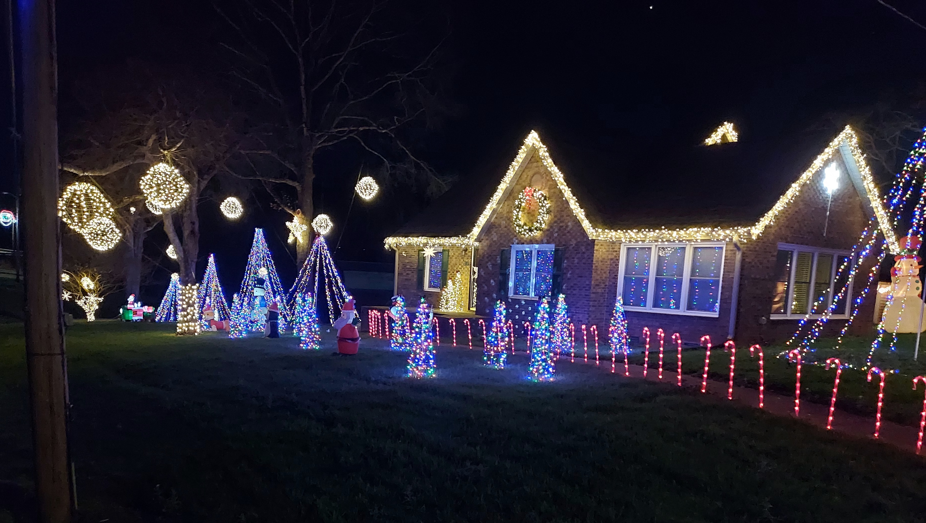
Navigating Q&A sessions
Know your material in advance
Anticipate common questions
Rehearse your responses
Maintaining composure during the Q&A session is essential for projecting confidence and authority. Consider the following tips for staying composed:
Stay calm
Actively listen
Pause and reflect
Maintain eye contact
1st Place - Score 50: Darrel and Amanda Vess
Cherryville Rd.

Slide 11
Speaking impact
Your ability to communicate effectively will leave a lasting impact on your audience
Effectively communicating involves not only delivering a message but also resonating with the experiences, values, and emotions of those listening

