Slide 1

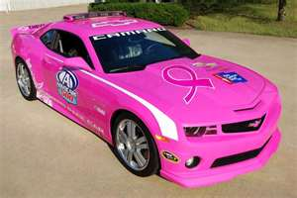
A NASCAR Victory is….
Setting the Pace
Grants & Matching Gifts
Quan B. Myles

Slide 2
What’s on TRACK for today
Introduction of the Pit Crew
Committee Objectives – (Fuel Cell)
  Holds the fuel supply
Grants – (Superspeedway)
  Long distance racetracks that also include road courses
Matching Gifts (Pole Position)
  Foremost position on the starting grid, awarded to the fastest qualifier
Wrap-up (Final Lap)
Questions (Post Race – Press Conference)

Slide 3
Grants & Matching Gifts Objectives
Grant Writing
Develop two major grants ($5K and over)
Develop two minor grants (under $5K)
Develop grants for target groups: Adult Seniors, Youth Development and Leadership Development
Complete Foundation Profile for Giving Foundation
Develop a Grants Submission Strategy with potential funders
Measure, Track & Assess
Matching Gifts
Increase member’s Employer Matching Gift contributions
Develop Matching Gift Campaigns
Provide diverse “Giving Options”
Provide “Donor Tools & Resources” for members and potential donors
Measure, Track & Assess

Slide 4
Grants – The Superspeedway
Grant Writing Process
  Program Profile
  Research Team
  Proposal Writing Team
Where are we now?

Slide 5

Matching Gifts – Pole Position
PROC 250
Many Ways to Increase our PROC Pole Position (PPP)!
  Member Assessment
  Member Employer Matching
  Member Partnership Employer Matching
  Family & Friends Employer Matching
  Birthday Endowments (ie: Solicit via Facebook or PROC website)
  AKAversary Endowments
  United Way/Combined Virginia Campaign / Combined Federal Campaign
  Congratulatory Beaux Patron Ads

Slide 6
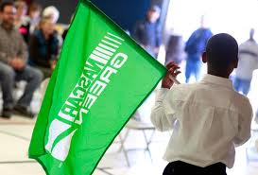
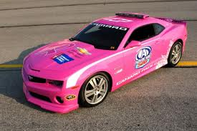
Wave the GREEN Flag to start Setting the Pace for the . . . .
PROC 250

Slide 7
Questions?
PROC 250

