Slide 1
Rehabilitation After Critical Illness
How to be NICE
– the Russells Hall Way?
Jane Bradbury – Critical Care Sister
Dr Chand Patel – Consultant in Anaesthetics & Intensive Care Medicine
Russells Hall Hospital, Dudley West Midlands
Notes:
Introduction
Discuss not NICE clinical guideline 83 way

Slide 2
NICE CG83 (March 2009)
Approximately 110000 people / year spend a period of time in Critical Care Units in England and Wales (ICNARC CMP data)
Little understanding as to what happens to those discharged home
Only a handful of hospitals have established specialist clinics
Notes:
Read out the general drift from NICE..

Slide 3
Research has shown that these patients do have important continuing problems! (weakness, loss of energy and physical difficulties, anxiety, depression, loss of mental faculty, Post traumatic stress disorder(PTSD) )
Family members become informal care givers – huge financial and psychological burden)
Notes:
Can state that most patients have no issues but need to identify high risk patients ( example on next slide)

Slide 4
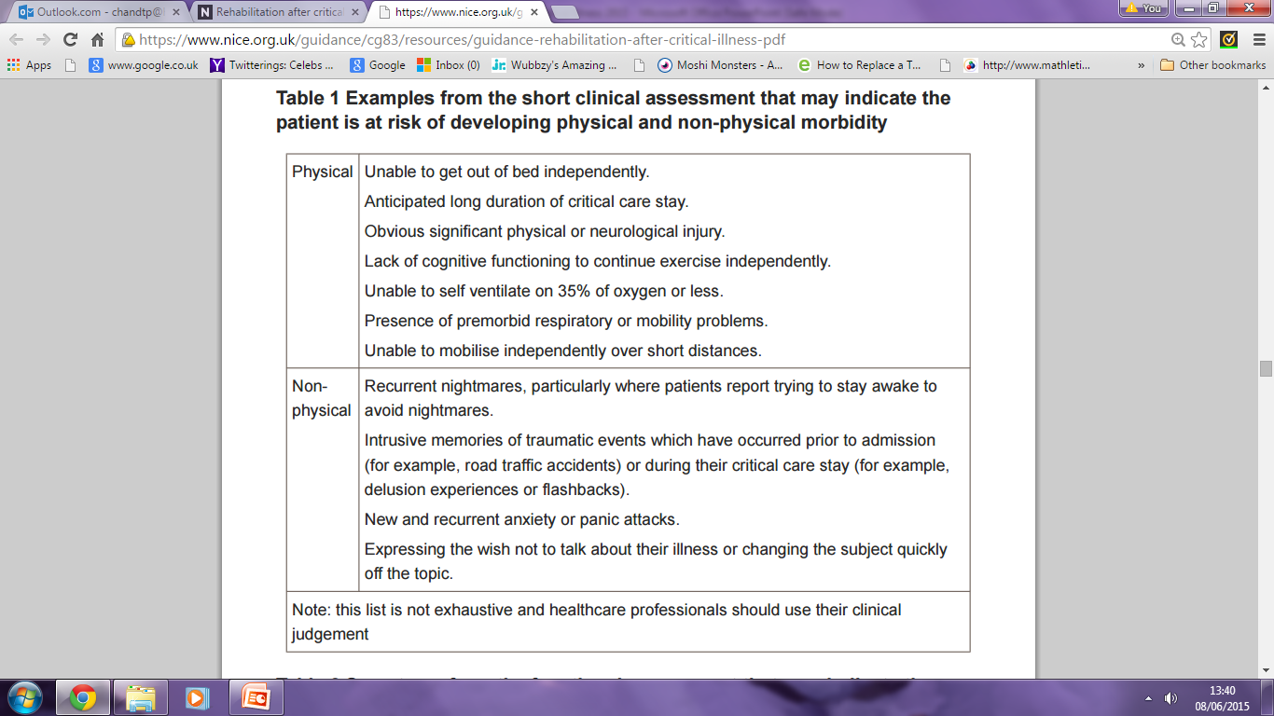
Notes:
Short clinical tool for identifying high risk patients

Slide 5
Initial Meeting to go over logistics
ITU Consultant
Lead Outreach Sister
ITU + Outreach Nurse
Critical Care Physiotherapist
Dietician
Clinical Psychologist

Slide 6
How best to deliver the service to deal with the complexity of the problems ?
Multidisciplinary team approach to deliver Patient
Centred Care
Issues to resolve:
How to put a Team together within our financial, time and resource
constraints
Who to follow up
How to get the service quickly off the ground
What other problems were facing the patients specific to our organisation after
discharge from Intensive Care ?

Slide 7
Aims of MDT:
1)Optimise high risk patients before they are discharged
2)Anticipate and identify potential problems they might face once back in the community.
Deal with them before discharge to minimise stress to patient and carers.
If 1 and 2 met then hopefully improved quality of life achieved earlier.
Notes:
Self explanatory

Slide 8
Who to follow up?
All patients invasively ventilated for 48 hrs or more
All patient admitted for renal support with 2 or more
organ failure plus or minus ventilatory support
Notes:
Elaborate as no guidance we decided on the initial criteria and then added the multiorgan no ventilated patients

Slide 9

Service launch
Fortnightly MDT ward rounds to accommodate Team Members
Notes:
To get service off the ground asap plus to address optimisation post ICU discharge it was agreed fortnightly ward rounds would initially accommodate all MDT members.

Slide 10
MDT Ward round members
Consultant ITU
ITU + Outreach sister
Critical Care Physiotherapist
Critical care Dietician
( +/- Psychology Student)
Patients displaying signs of Psychological sequelae:
Direct referral pathway to Clinical Psychologist.

Slide 11
Pre RHH Rehab Team: Typical Pathway of ITU/ Hospital Survivor
Problems uncovered by MDT
ITU
HDU
Ward
OUTREACH
Ward
?
Discharged to community
?
Parent TeamOPD
?
?
?

Slide 12
Multitude of problems affecting rehab
Nutrition ++++
e.g -catering issues
-motor skills
-location on ward
Only brief periods out of bed+++ ,
Sideroom +++
Lack of stimulation+++
Orientation in time+++
“Post code lottery” ++
Parent Teams grasp of complexities++
Drug prescription issues++
Notes:
Read out list and mention that the list is actually huge.

Slide 13
RHH Rehab Team: Present Pathway of ITU/ Hospital Survivor
ITU
MDT
Rehab Ward Round
MDT
Phone Call Follow up
OPD letter review
HDU
Ward
OUTREACH
Ward
Discharged to community
?
Parent TeamOPD
?
?
?
Notes:
Can mention here how MDT members began to learn about aspects of each others areas and how the ward staff ,allied health professionals and parent team members are guided to resolve issues.
Each patient has a bespoke plan of care based on needs and also importantly the individuals lifestyles and interests before admission to hospital

Slide 14
RHH Rehab Team: Planned Pathway of ITU/ Hospital Survivor
ITU
MDT
Rehab Ward Round
MDT
Phone Call Follow up
MDT
HDU
Ward
OUTREACH
Ward
Discharged to community
2weeks
MDT
OPD
MDT
Follow
up
?
Notes:
This is ultimate plan and hopefully will be in place in near future allowing us to address many of the recommendations in the NICE guidance.

Slide 15
Example 1
79M Septic shock/faecal peritonitis
Prolonged stays in bed – developing HAP and pleural effusions. Not encouraged to be independent or self motivated.
Poor nutritional intake – slow recovery and motivation
Labelled Vascular Dementia as failed MMT – inappropriate timing
No rehab beds – rehab at ward level
Multiple OPD at various locations, same consultant.
Notes:
Mr JS

Slide 16
Example 2
71 M: Retired paramedic. Head injury, short stay on ITU
Continued refusal to engage in rehab process
Declined all nutrition / hydration:
“JUST LET ME GO HOME!”
Long periods flat in bed – Postural hypotension on sitting – unable to stand
Referral to psychiatry / psychology differing opinions
Review of medication – improvement in motivation and thus rapid improvement
Notes:
BT– fall fractured base of skull wanted to go home but not wanting to engage in rehab process to prove capable.

Slide 17


