Slide 1

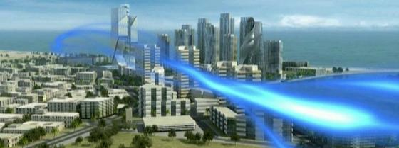
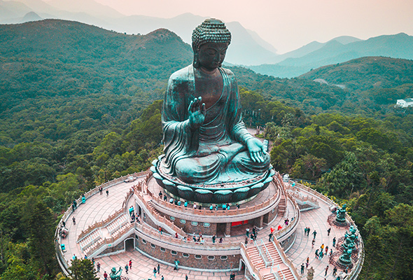

KRSTAL SUNCITY INFRA PROJEKTS PVT LTD-SITC &NTph1-5

Slide 2


DPR-INDEX-chapter1
24x7x365x59mth
1-MOU@MPidc-alongwith the MoA,AoA,MCA regns
2-Terms-volumes,creations,incentives,taxes,subsidies,grants,jobs
3-REFERENCES
4-HOLDING/Parent & Backgrounds-Existing & New Registrations
5-SPV-SITC...Swastika International Trade Centre
6-SPV-NTph@NakshatraTownships,Phases1-2-3-4-5toBeNamed
7-REGISTRATION and Compliance Flow
8-Central Govt#terms, incentives,subsidies,infra,grants,volumes
9-Finance Process Flow & Backups@SITC-explained in page 5
10-Finance Process Flow & Backups@NTph-explained in page 5

Slide 3


DPR-INDEX-chapter1
24x7x365x59mth
11-CONSITUTION of the consortium@SITC-Flow Process
12-CONSITUTION of the consortium@NTph-Flow Process
13-PRE-LAUNCH Flow Process
14-LAUNCH Process Flow
15-Existing prepared Prototype DPR & DPR process flow
16-INTERNATIONAL/Global Launch flow process
17-Marketing Flow & BackUps
18-HR & ADMIN flow & backups
19—MASTER PLAN FLOW PROCESS
20-ARCHITECTURE-DESIGNING & LICENSING flow process

Slide 4


DPR-INDEX-chapter1
24x7x365x59mth
21-Material Suppliers,empanelment,tendering,JV,flow
22-Directors,Project Heads,Service Providers,process
23-SEGREGATIONS, SECTORS,SITC process flow
24-SEGREGATIONS, SECTORS,NTph1-5 process flow
25-SITC#Actual construction process flow
26-NTph1-5#Actual construction process flow
27-SITC#finishing,handover,OC,CC, process flow
28-NTph1-5#finishing,handover,OC,CC, process flow
29-SITC#next & others, process flow
30-NTph1-5#next & others, process flow

Slide 5


EXPLANATION of Index Topics
Here is an Example Description of Index Topic numbers 9 &10-Finance Process & Backups Flow-Similar for both SPVs-SITC & NTph1-5
1-We@Krs, bring in 10 crore inr equity/assets, each to these new SPVs,#SITC & NTph1-5
2-Mpidc,Mpgov,EY,CII,FICCI,Assocham,Mccia,
Tie,Iod,others,together bring 10 cr and get 20 cr in 3 years,can exit If reqd after few months.
3-Central Govt infusion as per declarations=100 cr to start with multiple times, maybe>10000cr
4-100 SMEcorporates @10 cr each, input get retuns of 100 cr revenues/turnover & 30 cr profits in 4-5 years So 100x100 cr=10,000 cr revenue=20% equity of 1 spv
5-SMEcorporates who do not have 10 cr for input, but have around 50-100 cr current revenues, can join with 3 cr input and we raise funds on their financials and they will get 30 cr revenues & 9 cr profits in 4-5yrs

Slide 6
EXPLANATION of Index Topics
6-Project Finance from NBFC/MutualDebtFunds/Banks=1000 cr inr
7-PreSales token @1% of 50k cr=500 cr inr
8-bank guarantees of suppliers/mfg/tenders@1% of 10k cr=100 cr
9-StartUp listing on BSE & Singapore/japan@5% equity=2500 cr inr But at Discount=1250 cr to be doubled in 4-5years
10-other 99+1=100@krs=growth to 1 billion each@seed capital from KRS=100 billion as backUps and our own hundreds of thousands of crores ,pending amounts to be realized, to be infused timely into similar indian and global projects apprpriately ASAP...

Slide 7


DiGiTaL LaUnCh
Own Websites,
Own Youtube Channel
Own Media Channels
Our Links on central govt,state govt,cii,ficci,others websites
Facebook business
Twitter
LinkedIn
INSTAGRAM
EMAIL TEMPLATES
GOOGLE ADWORDS
PINTEREST
99ACRES/KRS NUMEROUNO
GMAIL/EMAIL
TUMBLER
MESSENGER
TieUpSites&Channels

Slide 8


DiGiTaL LaUnCh
TieUp StockXchanges,GlobalChambers,GlobalGovts
Own SocialMedia Channels/handles2beCreated
QUORA/QQ
FLIKR
FOCUS.COM
YELP INC
IBIBO
MOUTHSHUT
REDDIT
XING-europe
TIKTOK
TELEGRAM
WECHAT
WHATSAPPgroups
WIKIPEDIA
BAIDU,WEIBO
Train,Bus,Cable
BSE,NSE,AIRPORT,Banners,Boards

