Slide 2
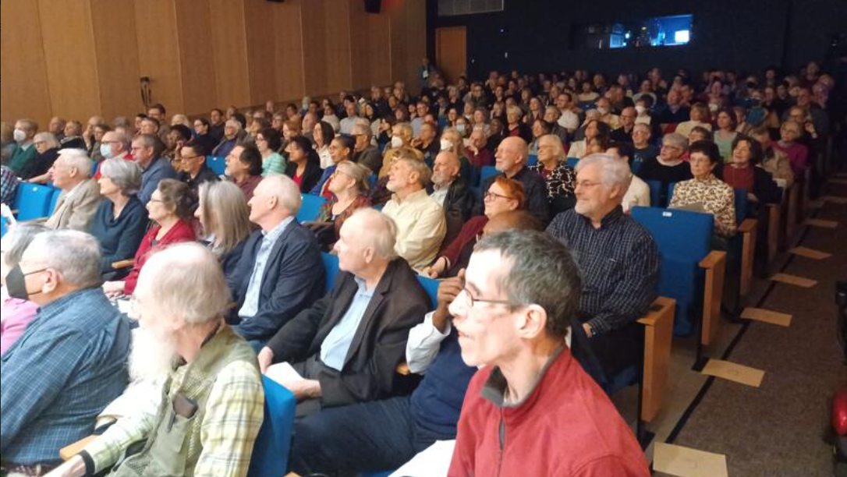

Slide 3
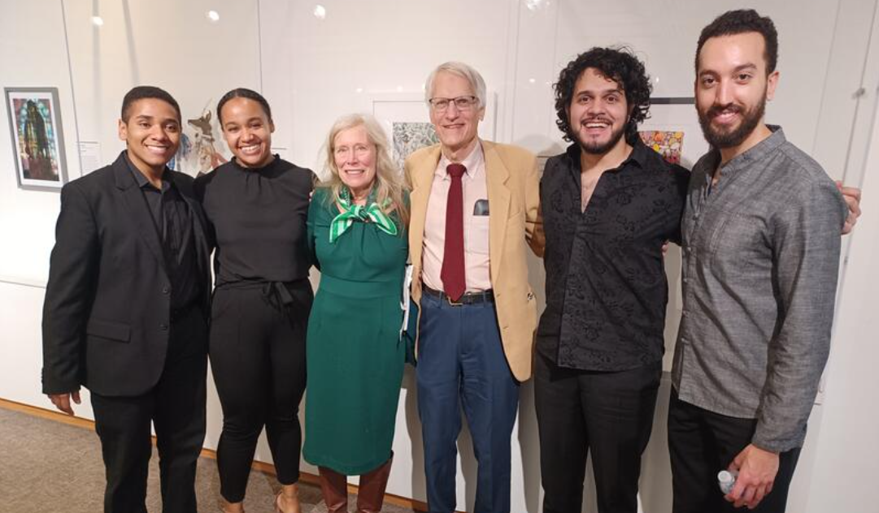
Photos from yesterday

Slide 4
TWO REMAINING CONCERTS IN THE CALENDAR YEAR
October 15, 2023 Mac McClure & Juan Carlos Higuita SOLD OUT
October 27, 2023 Zuill Bailey & Natasha Paremski @ Executive Mansion
Mansion Bill($35 x 122ppl) = $4270 +15% facility fee $ 641 Wine Bill $ 825 Glass Rental $ 422 Artist Fees $7000 Lodging $ 720 Piano Tuning & Repair $ 322 Total Expenses $14,200 Total Revenue $16,700 Cleared $2500
EAK

Slide 6
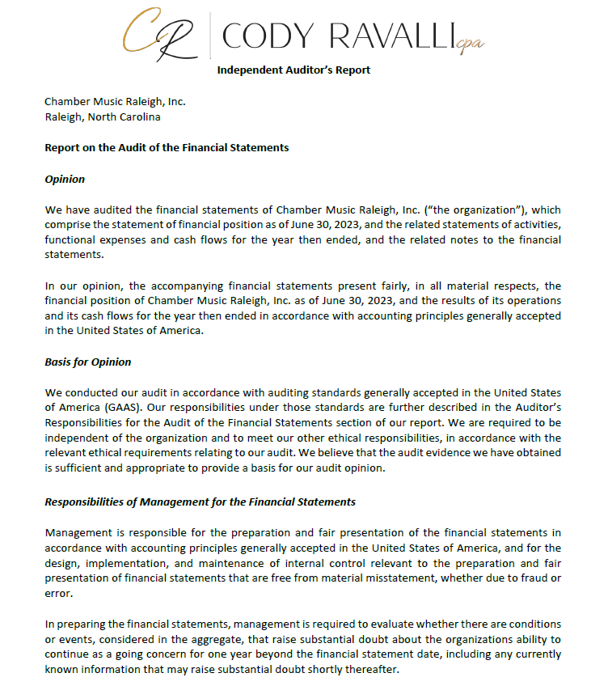
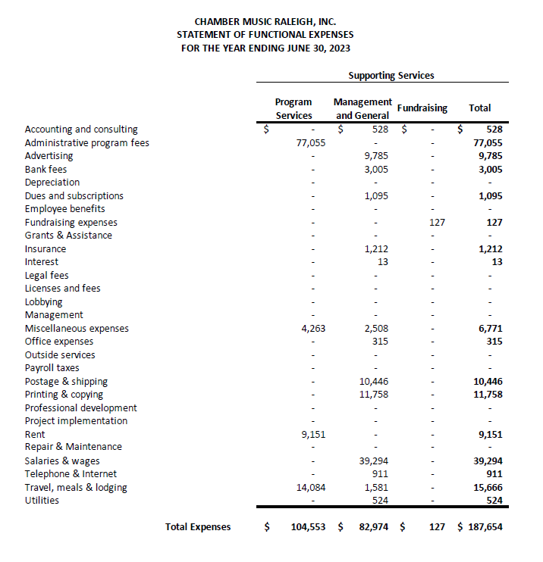
CORAC REQUEST GOES FROM $24,999 to $46,913

Slide 7
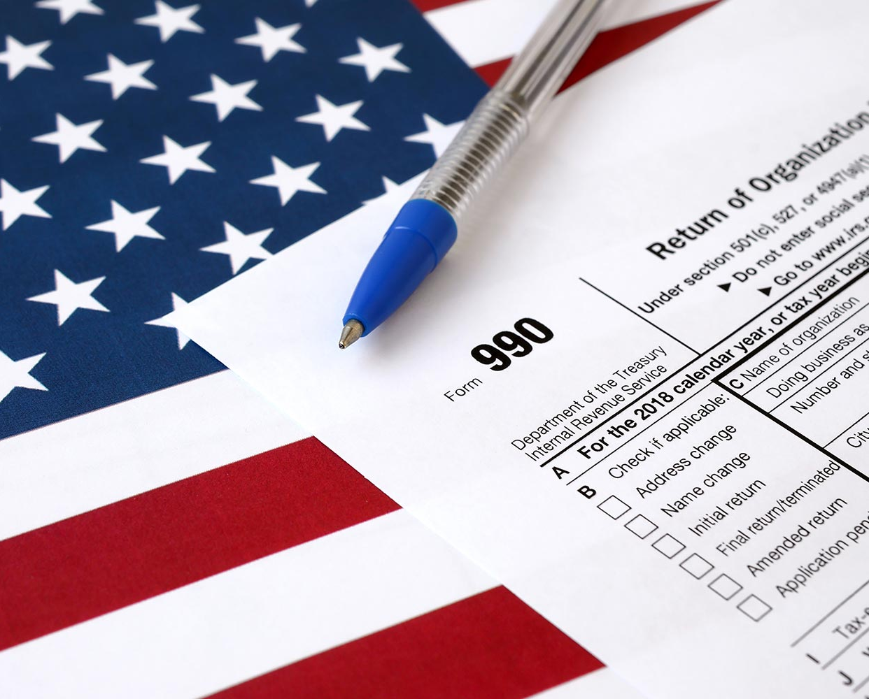
2016 Filed by Auditor 2017 Filed by Auditor 2018 Faxed Again 1/26 2019 Faxed Again 1/26 2020 Filed (E-file) 2021 Filed (E-file) 2022 Not Filed Yet – Extension 2023 due November 15, 2024 Green Showing on IRS Website Red Not Showing on IRS Website

Slide 8
Season 82 Subscriptions
NCArtist = .09
VA = .125
Individual Ticket Sales
SALES
ARTIST FEES
$5,794
$4,000
$6,144
$7,064
$5,000
$6,931
$3,000
$5,339
$7,000
$4,069
$5,000
$4,270
$8,000
$2,991
$ 4,000
TOTAL $ 36,458
$3,608
$36,000

Slide 9
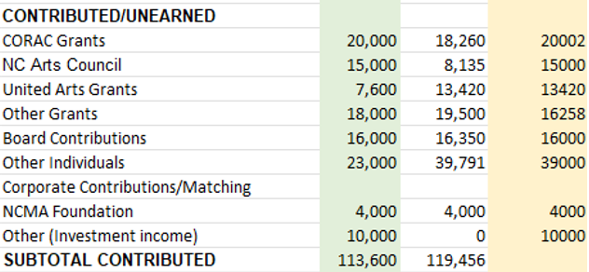
EOY
BUDGETED
DEC 31
SEASON 81
SEASON 82
$20,002
$31,670*
$21,000
$21,000 NEA/SAF
$14,250
$38,652
$4,000
$15,000 ASC BOARD GRANT
36% Donations & Sponsorships
33% Grants 26% TICKET SALES 5% ENDOWMENT INCOME
1/3
PNC Balance = $112,785.55

Slide 10
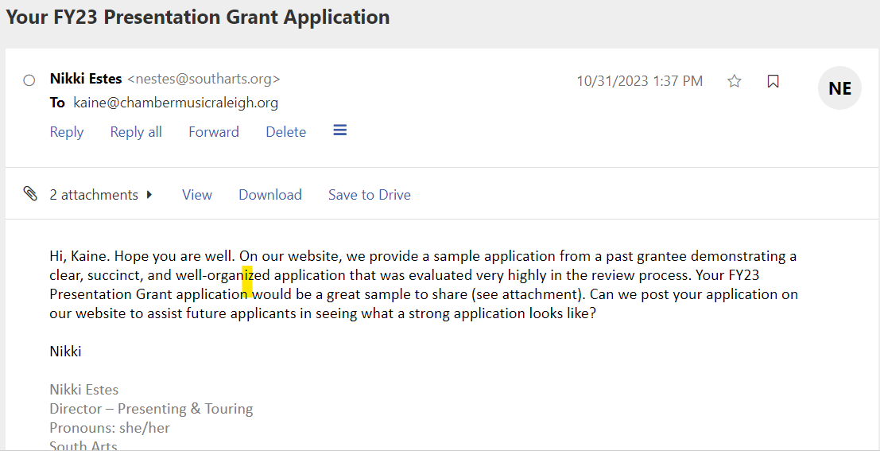

Slide 11
RALEIGH ARTS COUNCIL January 4, 2024 NAT’L ENDOWMENT FOR THE ARTS February 28, 2024 NC ARTS COUNCIL March 1, 2024 SOUTHARTS March 1, 2024 UNITED ARTS COUNCIL April 5, 2024 NC HUMANITIES September 12, 2024

Slide 12
PNC Balance = $112,785.55
12 Month CD @ 5% APY $60,000 → $3000
SEEKING BOARD ACTION
14 Month CD @ 5.4% APY $60,000 → $3780
4% but variable and withdraw any time
SAVINGS ACCT

Slide 13
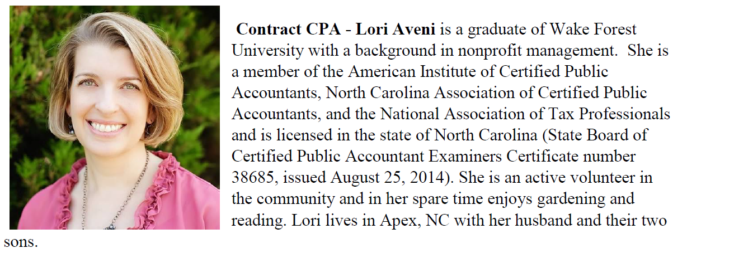
TEAM UPDATE
Lori is closing her Apex Office April 15 and going 100% remote from the NC mountains.
Anne DiDomenico made a donation honoring Angela Hodge. Sol Eichner will be her first concert with CMR (since 2018, at least)

Slide 14
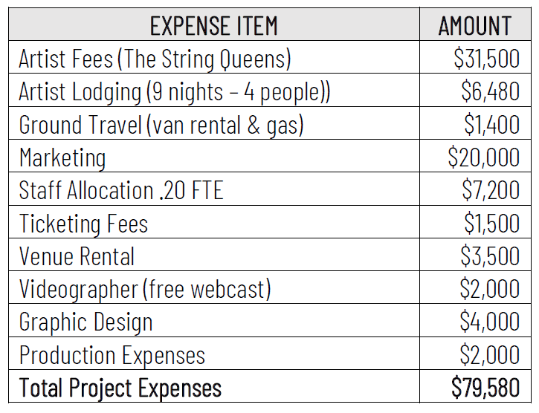
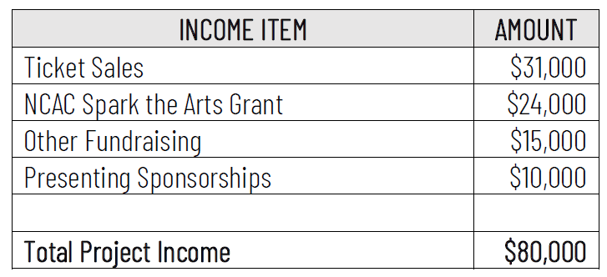
REVISED BUDGET SUBMITTED WITH NC ARTS COUNCIL SPARK THE ARTS GRANT

Slide 15
Current MOU $300/concert (really $700/concert with $4k Foundation Support)
Met with Katherine White, Moses Green & Janette Hoffman January 31 Available Dates for Us October 13 & 20, 2024
November 17, & 24, 2024
December 1 & 8, 2024
January 12 & 26, 2025
February 2, 9, 16, & 23, 2025
March 9, 16, & 30, 2025 Any April – September dates like Mother’s Day May 11 will have to be booked through CateringWorks waiving room rental –
Season 83 – September opener in another venue (Borromeo/Verona Octet) April is in Cary, as usual and May 11 using catering
SUMMER CONCERTS CONFUSING WITH MOSES’ OUTDOOR
CONCERTS
PARKING ISSUES
PRIME CATERING MONTHS
White: “New MOU for Season 83 would be without the exchange of money”

Slide 17
Current MOU $300/concert (really $700/concert with $4k Foundation Support)
Met with Katherine White, Moses T. Alexander Greene & Janette Hoffman January 31 Available Dates for Us October 13 & 20, 2024
November 17, & 24, 2024
December 1 & 8, 2024
January 12 & 26, 2025
February 2, 9, 16, & 23, 2025
March 9, 16, & 30, 2025 Any April – September dates like Mother’s Day May 11 will have to be booked through CateringWorks waiving room rental –
Season 83 – September opener in another venue (Borromeo/Verona Octet) April is in Cary, as usual and May 11 using catering
SUMMER CONCERTS CONFUSING WITH MOSES’ OUTDOOR
CONCERTS
PARKING ISSUES
PRIME CATERING MONTHS
White: “The new MOU for Season 83 would be without the exchange of money”

Slide 18
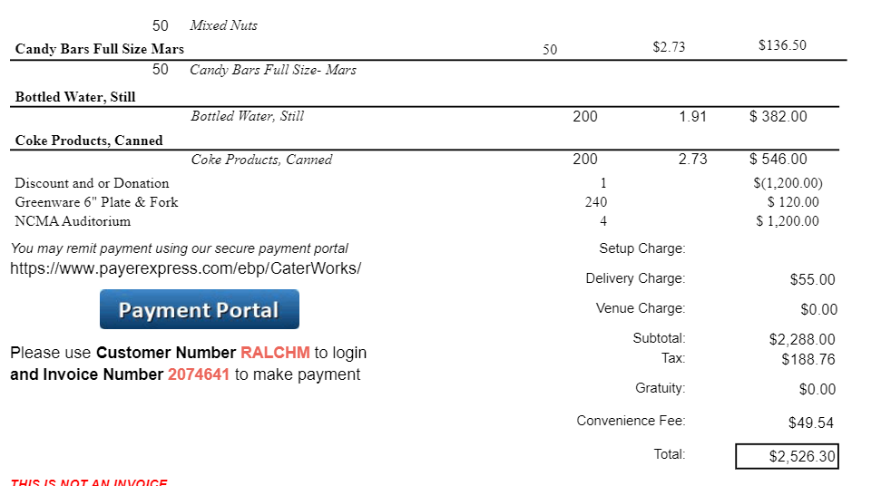
Will they let us buy water only? $439.30

Slide 19
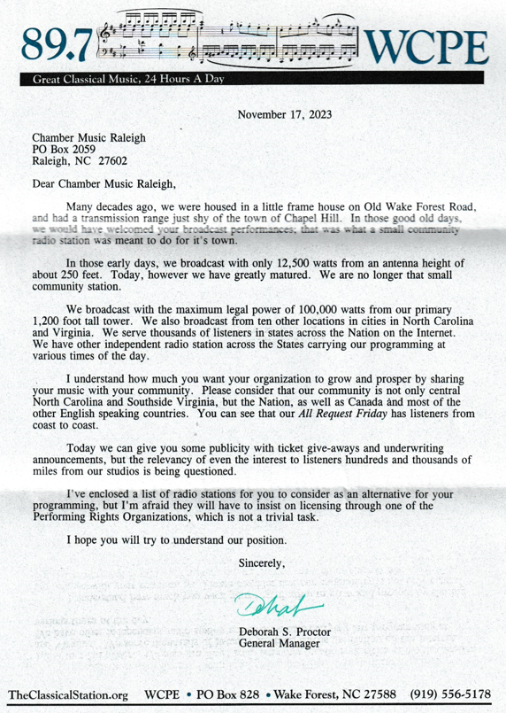

Slide 20
