Slide 1
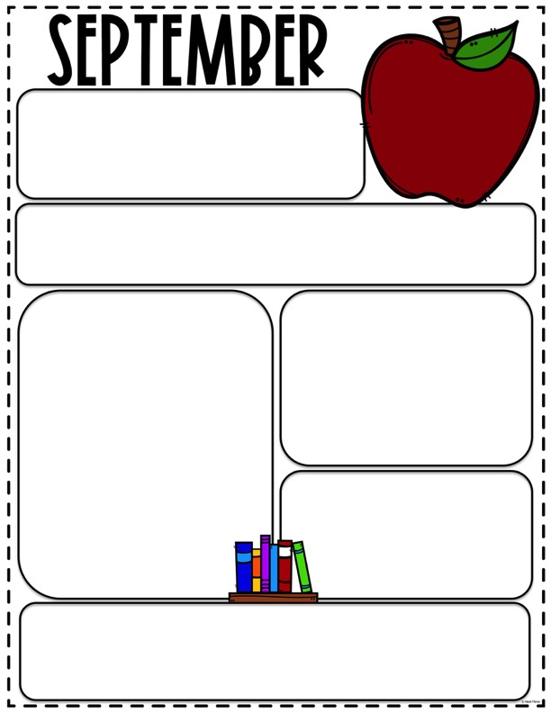

HOLIDAY
We will be closed Monday September 1st for
Labor Day
HELPFUL HINTS
Please write you child name on all items brought to school:
Lunchboxes, water bottles, jackets and books.
Also please make sure your child has a change of clothes in their cubby.
Our Learning Goals
BIG SCHOOL
I CARE RULES
UNIVERSE & PLANETS
CONTINENTS
LITTLE SCHOOL
COLORS
SHAPES
NUMBERS
LETTERS
M, R, T, A, H
LUNCH BOX REMINDERS
Please put ice packs in lunchboxes.
Packing a nutritious lunch for your child
Helps build brain power. Lunches
Should include; protein, fruit,
vegetables and dairy.
For more lunch box ideas check out the “Parent corner” tab on our website at
WWW.MERCEDMONTESSORISCHOOL.ORG
You will also find the monthly newsletter and our holiday schedule on our website
Dates to Remember
Picture day will be Wednesday September 17th
BOOK ORDERS
Each month we will hand our a book order flyer for you to choose age appropriate book
for you child's home library. To order these book go to www.scholastic.com/bookclubs
and use class code NY986 at checkout. Orders for September are Due 9/9/2025

