Slide 1

Adult Protective Services

Slide 2
Adult Protective Services History
  The Adult Protective Services (APS) Law (Act 70 of 2010) was enacted to provide protective services to adults between 18 and 59 years of age who have a physical or mental impairment that substantially limits one or more major life activities
Funding first provided during state fiscal year 2012-13
Act 70 is the bridge between CPSL and OAPSA and mirrors OAPSA in many ways

Slide 3
Adult Protective Services History
Prior to April 1, 2015, there was a Memorandum of Understanding (MOU) between the Department of Human Services (DHS) and the Pennsylvania Department of Aging (PDA) to provide interim APS coverage prior to completion of the competitive bidding process
Effective April 1, 2015, Liberty Healthcare Corporation is the statewide contracted provider of protective services

Slide 4
Liberty Healthcare Responsibilities
What is the APS Agency (Liberty Healthcare Corporation) required to do?
Investigate allegations
Determine if abuse, neglect, exploitation or abandonment has occurred
Provide services to adults who voluntarily consent
Cooperatively develop a service plan with agency staff, the adult, the adult’s guardian and other family and advocates when appropriate
Provide services in the least restrictive environment and the most integrated setting
Provide Guardianship as needed

Slide 5

Liberty Healthcare APS Regions

Slide 6
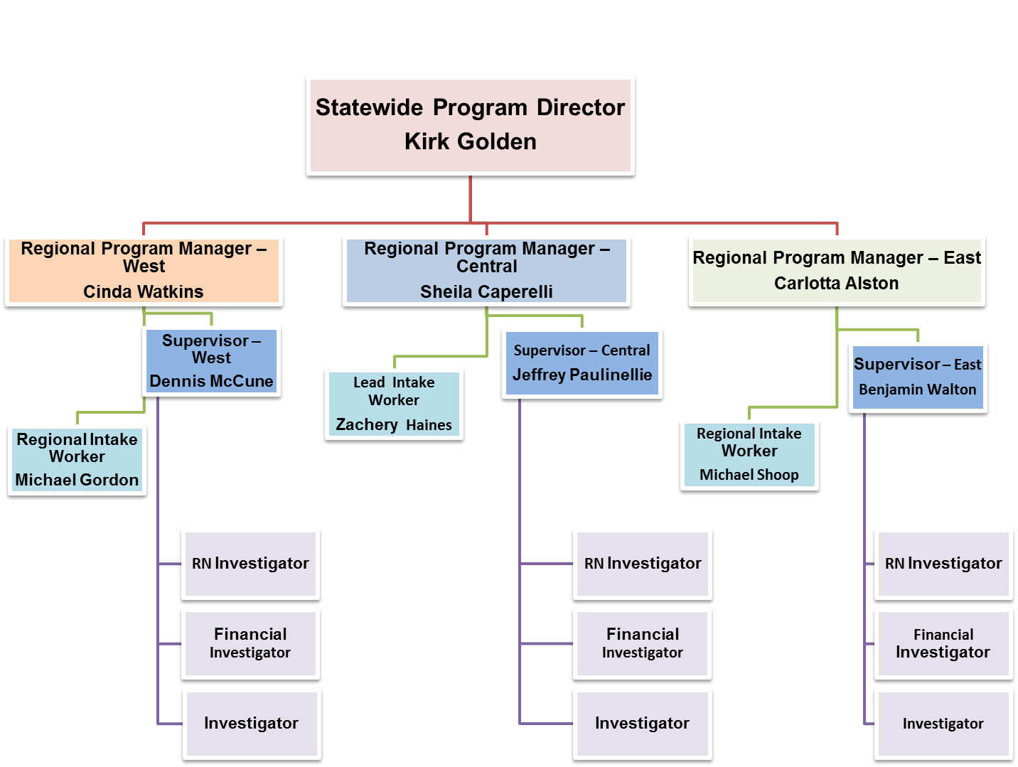
Liberty Healthcare Organizational Structure

Slide 7
Liberty Healthcare APS Statewide Contacts

Slide 8
Eligibility Criteria
Who is eligible to receive protective services?
A resident of the Commonwealth
An adult between 18 and 59 years of age with a physical or mental impairment that substantially limits one or more major life activities
An adult who needs the assistance of another person to obtain protective services in order to prevent imminent risk to person or property

Slide 9



APS Process
Reporter contacts Protective Services Hotline (1800-490-8505) to report an allegation of suspected abuse, neglect, exploitation or abandonment of an individual between 18 and 59 years of age with a physical or mental impairment
Mandated Reporters must also contact law enforcement and DHS for cases of suspicious death, serious injury, serious bodily injury or sexual abuse.
Protective Services Hotline is answered by local Area Agency on Aging (AAA) who completes a Report of Need (RON) and documents the report in the Social Assistance Management System (SAMS)

Slide 10




The AAA notifies Liberty Healthcare that the RON is in SAMS.
Liberty Intake staff also notify all appropriate licensing agencies of the Report of Need
Liberty Healthcare Intake Staff evaluate information in the RON to determine if individual meets eligibility criteria and classifies the case as either “Priority, Non-priority, or No Need”
Cases determined to be “No Need” will be reviewed by an APS Supervisor and may be referred for other services as needed

Slide 11



APS Process
All cases classified as “Priority” or “Non-priority” are assigned to an APS caseworker for investigation. Investigations must be initiated within 24 hours for “Priority” cases and within 72 hours for “Non-priority” cases.
APS Caseworker initiates investigation within required timeframes, assesses risk, investigates allegation(s), determines if allegation is substantiated or unsubstantiated, and mitigates risk if necessary.

Slide 12


APS Process
APS may provide or arrange for services intended to ensure the adult’s immediate safety and well-being.
An adult shall
only receive protective services voluntarily. In no event may
protective services be provided to an adult who refuses consent to the services or who, having
consented, withdraws the consent, unless the services are
ordered by a court.
Protective services provided must be the least restrictive and in the most integrated setting.

Slide 13
Report of Need Categorization
Priority: Priority reports require immediate attention because specific details in the report indicate the possibility that the adult reported to need protective services is at imminent risk of death or serious injury or serious bodily injury. The investigation shall be initiated immediately for a priority report.
Non-priority: A non-priority report does not appropriately fall within the priority category and, therefore, does not require immediate attention by the agency. These investigations must be initiated within 72 hours.

Slide 14
Report of Need Categorization
No need for protective services: A report shall be placed in this category when the person reported to be in need of protective services meets either of the following criteria:
(a) has the capacity to perform or obtain, without help, services necessary to maintain physical or mental health
(b) is not at imminent risk or danger to his person or property

Slide 15
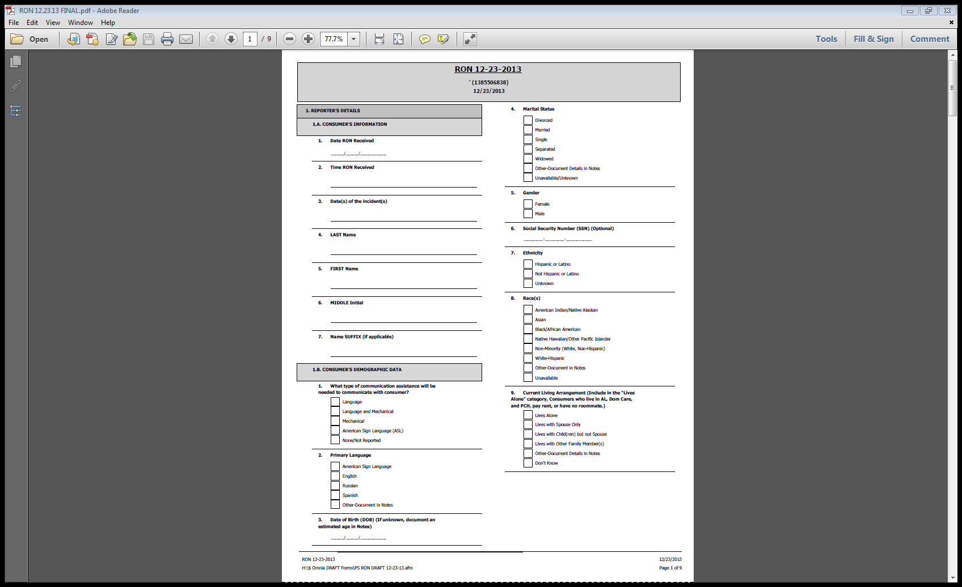
Report of Need

Slide 16
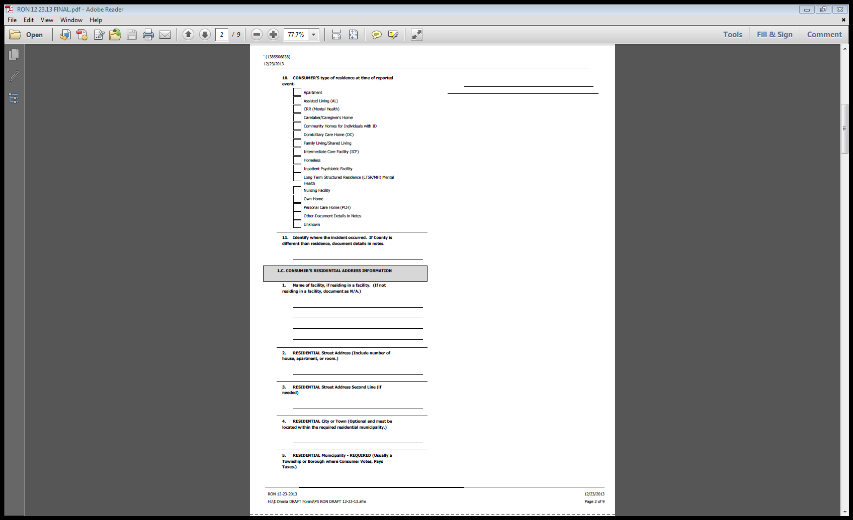
Report of Need

Slide 17
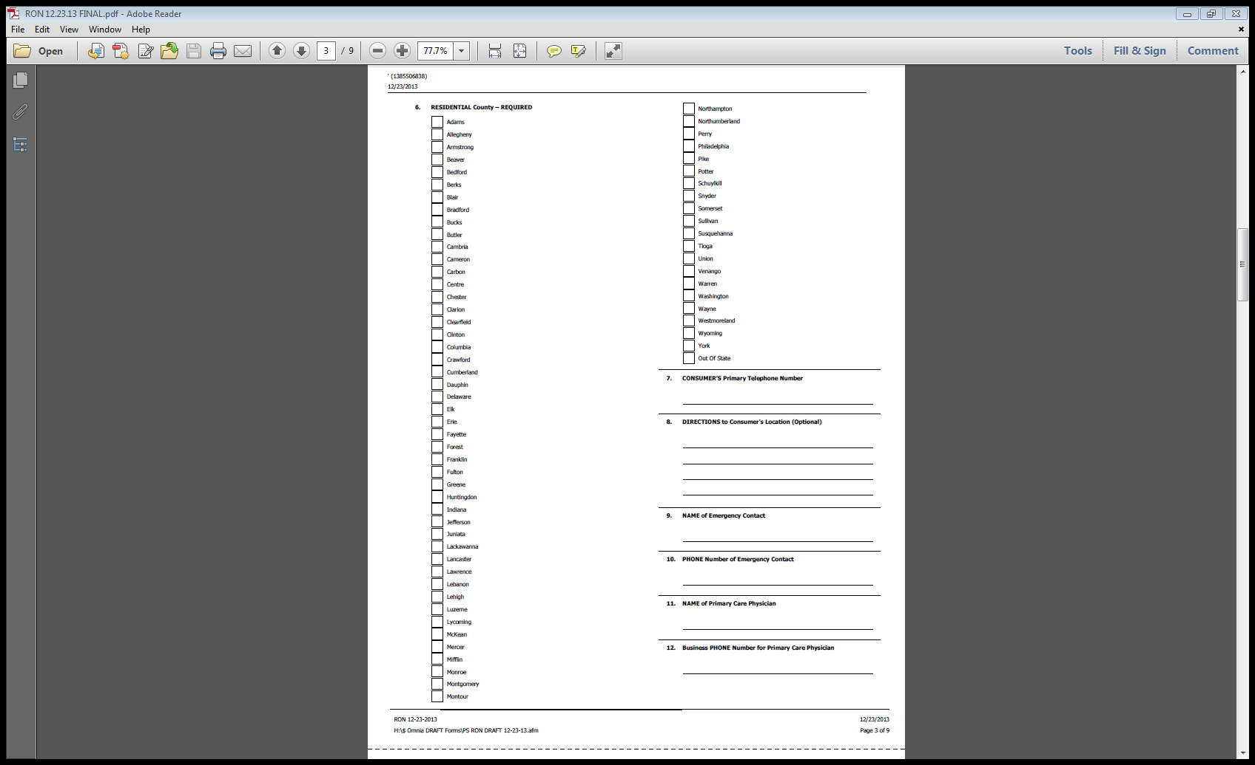
Report of Need

Slide 18
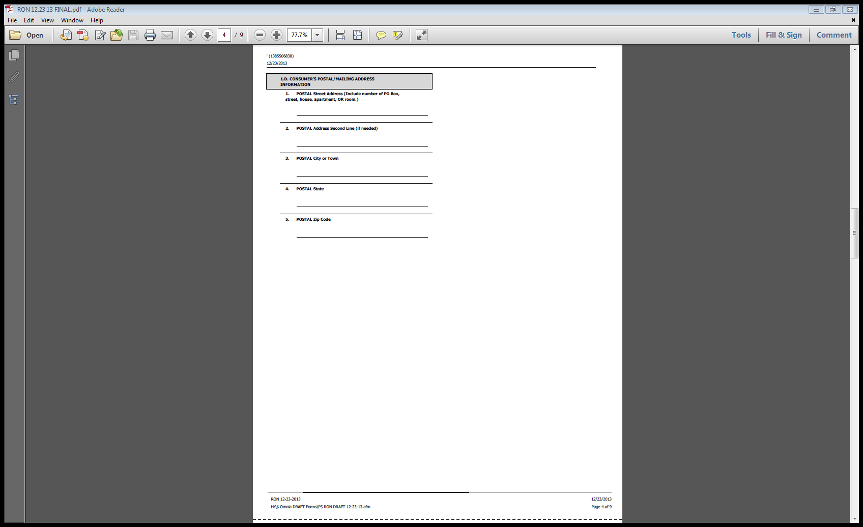
Report of Need

Slide 19
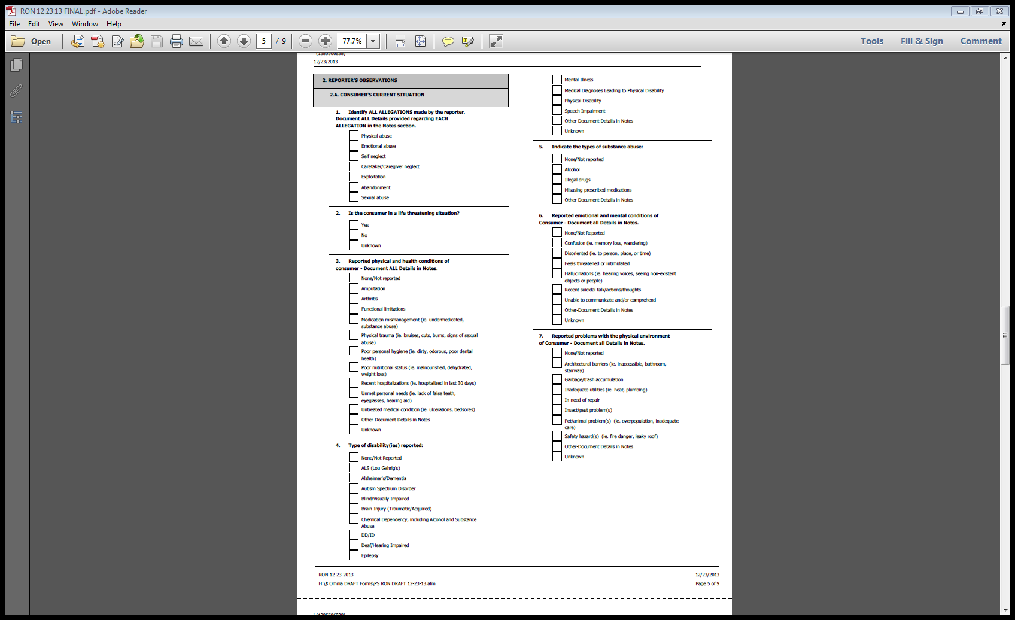
Report of Need

Slide 20
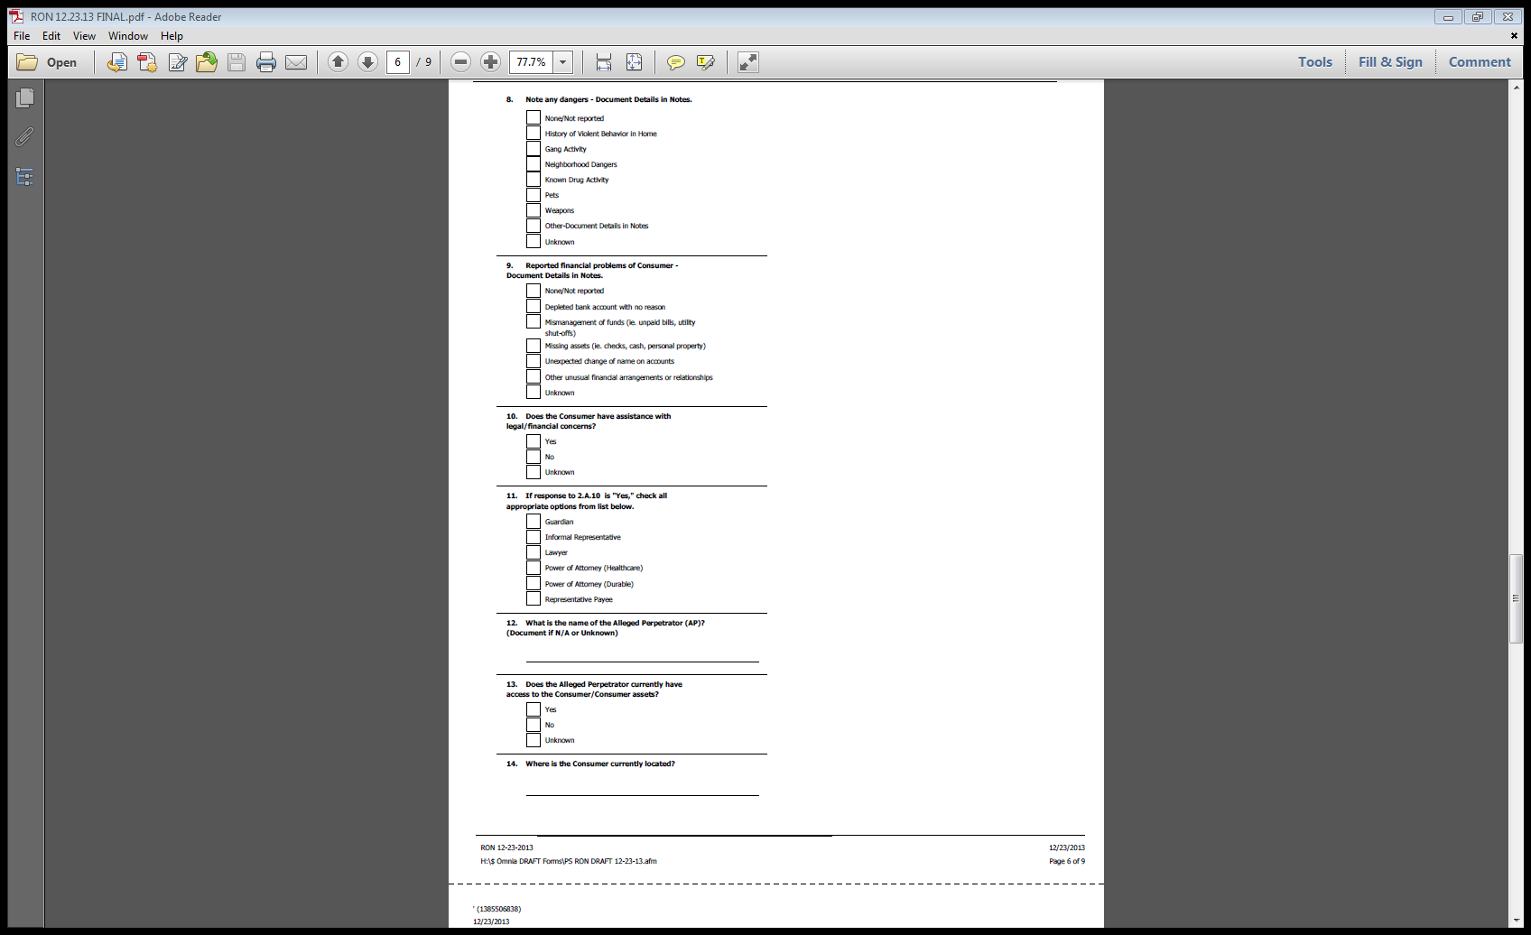
Report of Need

Slide 21
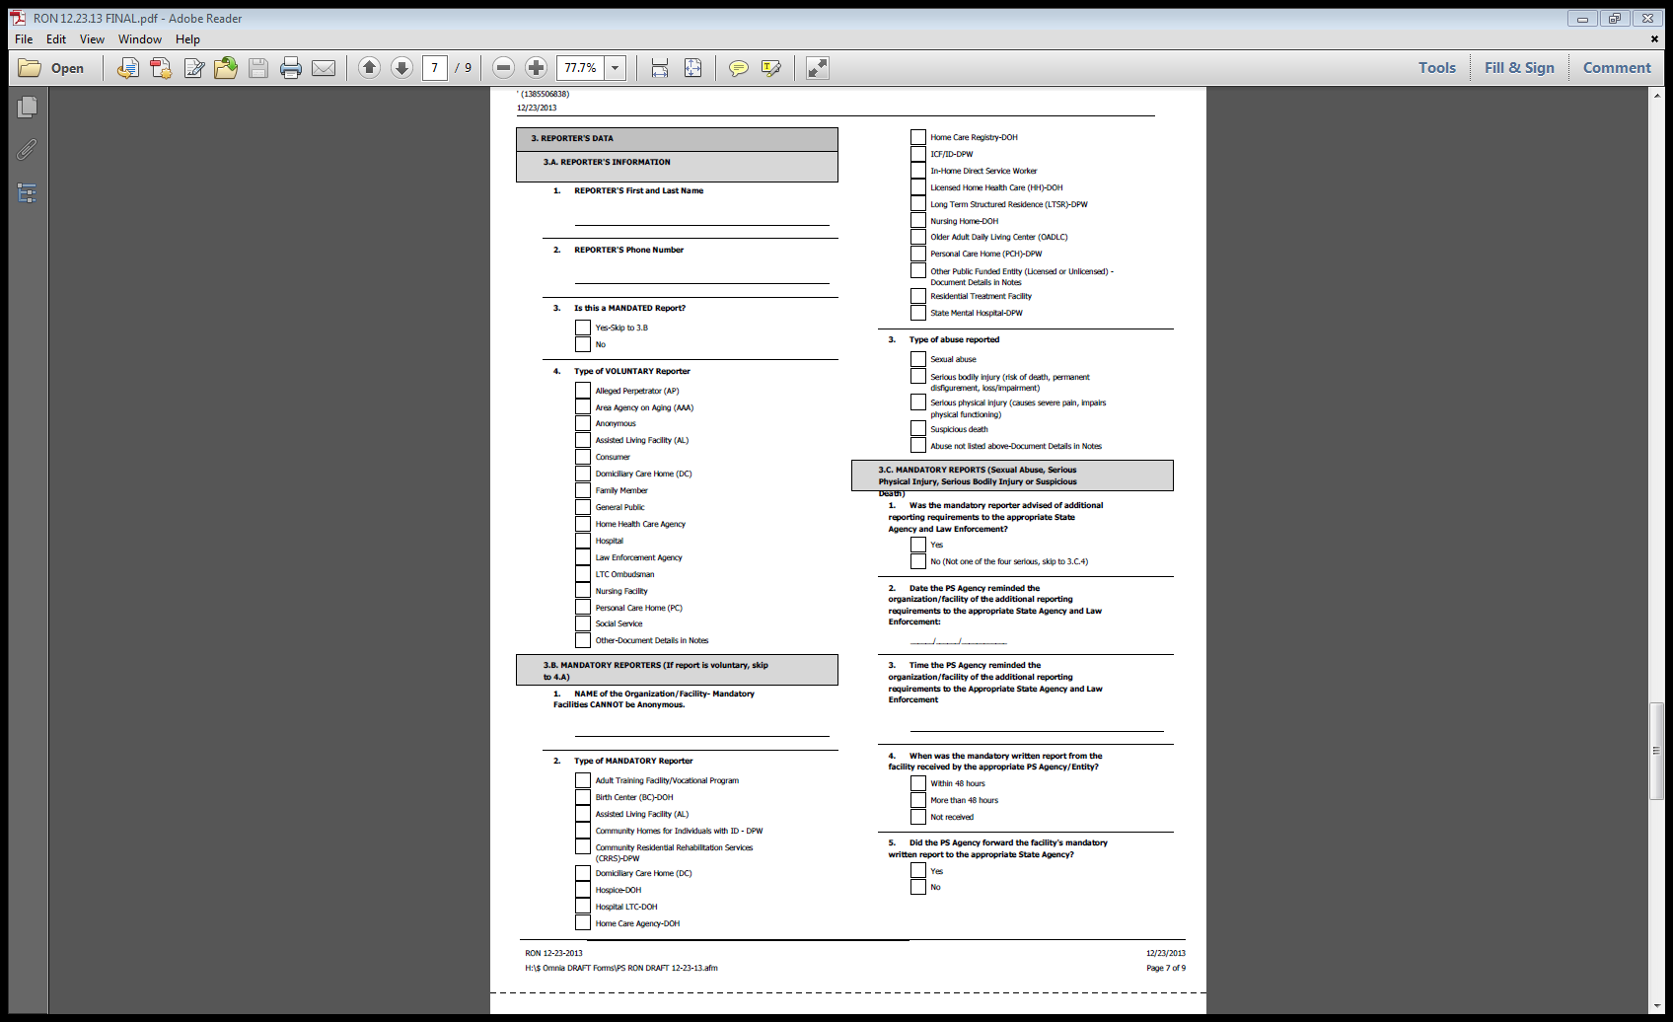
Report of Need

Slide 22
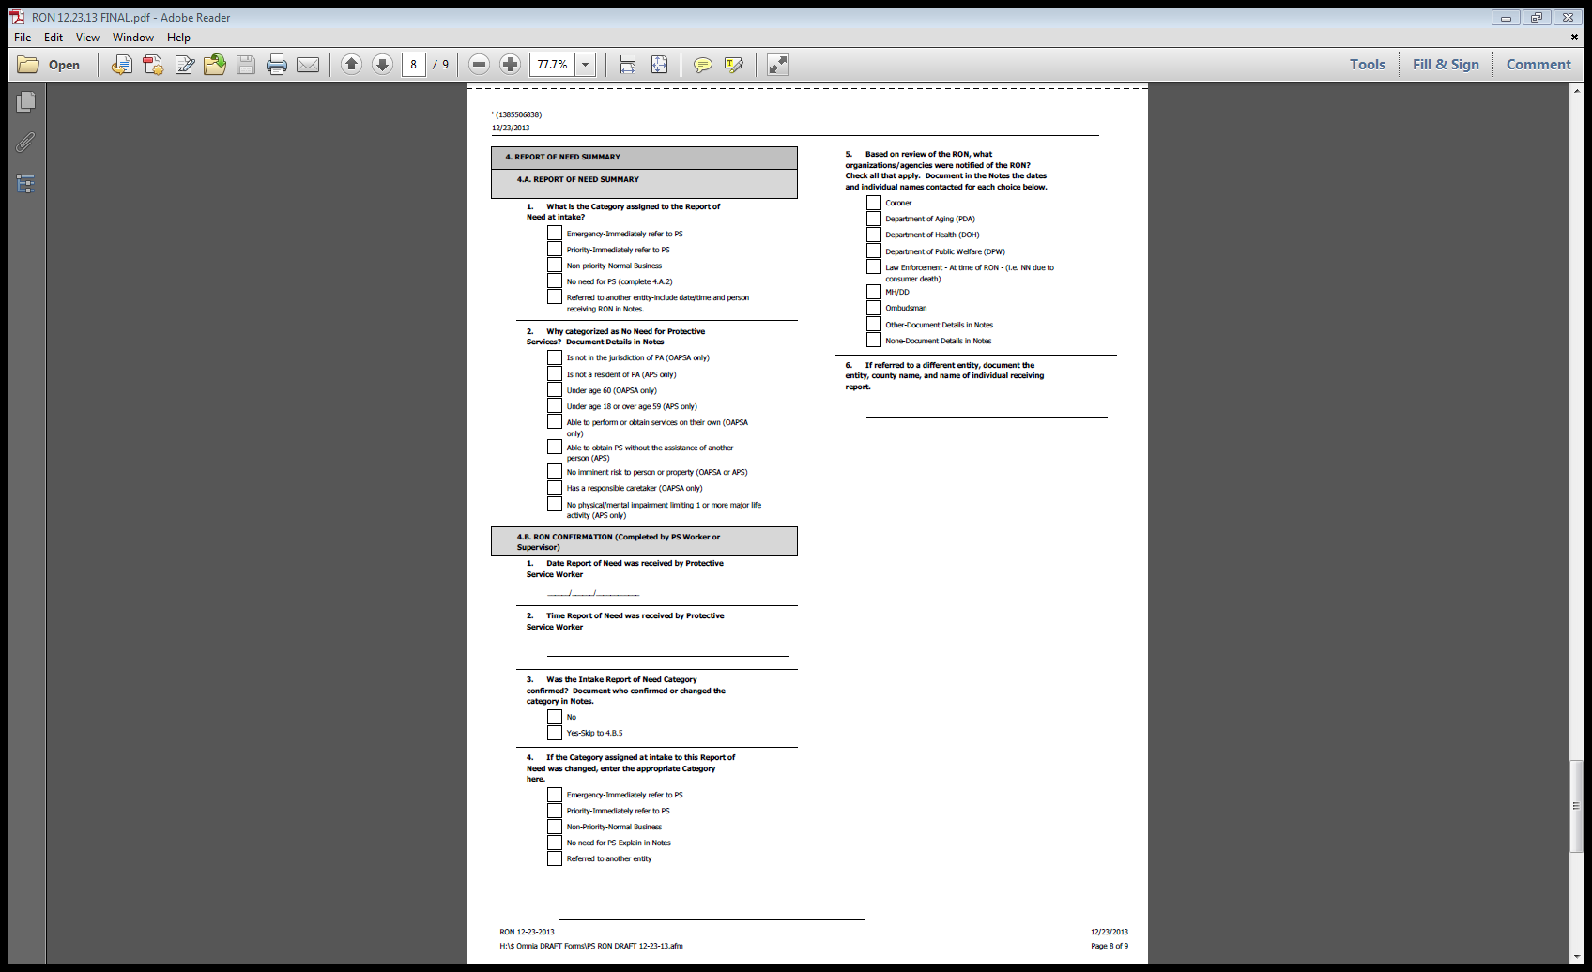
Report of Need

Slide 23
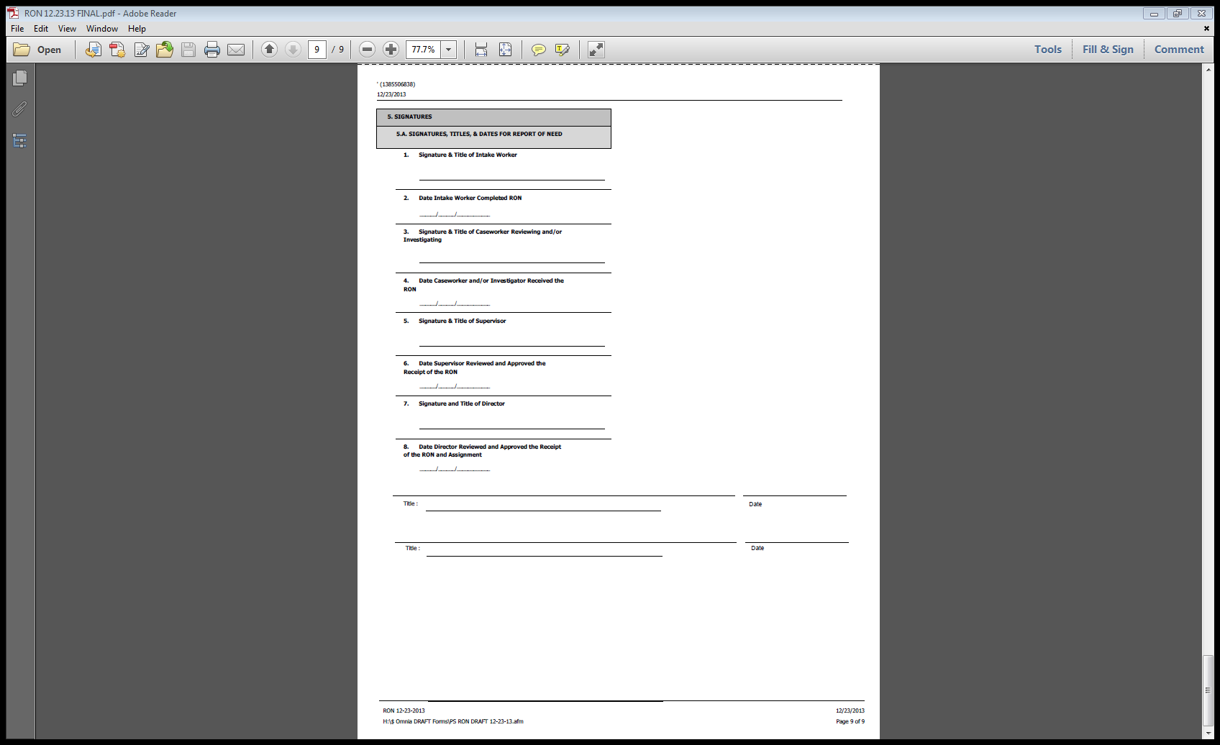
Report of Need

Slide 24
Mandatory Reporters
Who is a mandated reporter?
Assisted Living Facility
Domiciliary Care Home
Home Health Care Agency
Intermediate Care Facility for Individuals with Intellectual Disabilities or with Other Related Conditions
Nursing Facility
Older Adult Daily Living Center
Personal Care Home
Residential Treatment Facility
An organization or group of people that use public funds and is paid, in part, to provide care and support to adults in a licensed or unlicensed setting

Slide 25
General Reporting Requirements
An administrator or employee who has reasonable cause to suspect that a recipient is a victim of abuse, neglect, exploitation or abandonment will immediately make an oral report to the statewide Protective Services Hotline by calling 1-800-490-8505.
Within 48 hours of making the oral report, the administrator or employee will email a written report to Liberty Healthcare at the following address: RA-PWAPSMandatoryRon@pa.gov or fax the report to 484-434-1590. The following written report forms may be used:
  The mandatory reporting form found on the Department’s website;
  An administrator or employee of a nursing facility, licensed by Department of Health, may submit a PB-22 form;
  An administrator or employee may submit a Home and Community Services Information System (HCSIS) incident report (Printable Summary) or an Enterprise Incident Management (EIM) report.

Slide 26
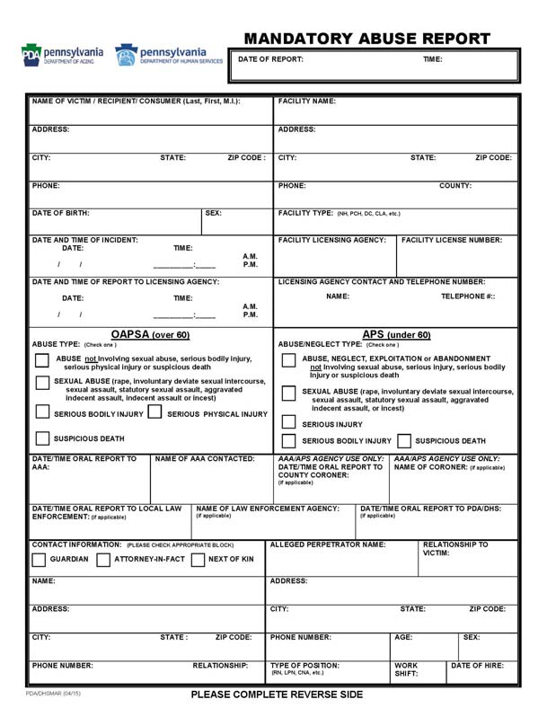
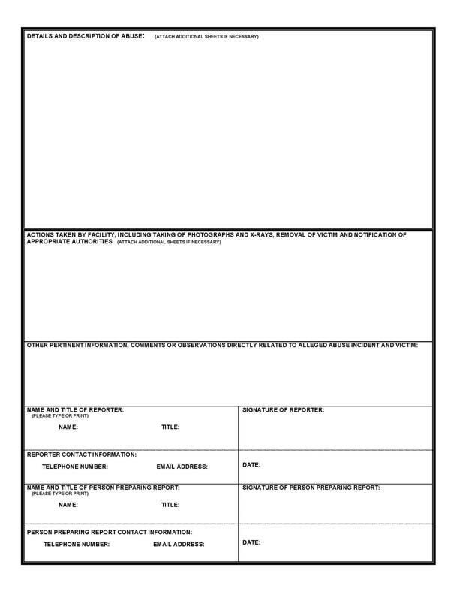
General Reporting Requirements
An administrator or employee of a facility will continue to follow all required incident management regulations, policies and procedures

Slide 27
Additional Reporting Requirements
If the case involves sexual abuse, serious injury, serious bodily injury or suspicious death, in addition to the previous steps, an employee/administrator must also:
Make an immediate oral report to law enforcement
Make an immediate oral report to the DHS staff responsible for the Adult Protective Services Program at 717-265-7887
Within 48 hours of making the oral report, submit a written report to law enforcement. This written report can be the mandatory reporting form found on the Department’s website, the PB-22, a HCSIS incident report, or the EIM report form.
Please see the written guidance provided to employees and administrators of facilities for specific details and definitions

Slide 28
Statutory Definitions
Abuse:
Infliction of injury, unreasonable confinement, intimidation or punishment with resulting physical harm, pain or mental anguish
Willful deprivation by a caregiver of goods or services which are necessary to maintain physical or mental health
Sexual harassment, rape or abuse as the term is defined in 23 Pa.C.S. § 6102
Neglect: The failure to provide for oneself or the failure of a caregiver to provide goods, care or services essential to avoid clear and serious threat to the physical or mental health of an adult

Slide 29
Statutory Definitions
Exploitation: An act or course of conduct by a caregiver or other person against an adult or an adult’s resources, without the informed consent of the adult or with consent obtained through misrepresentation, coercion or threats of force, that results in monetary, personal or other benefit, gain or profit for the perpetrators or monetary or personal loss to the adult
Abandonment: The desertion of an adult by a caregiver

Slide 30
Statutory Definitions
Serious bodily injury:
Injury that:
(1) creates a substantial risk of death; or
(2) causes serious permanent disfigurement or protracted loss or impairment of the function of a body member or organ
Serious injury:
An injury that:
(1) causes a person severe pain; or
(2) significantly impairs a person's physical or mental functioning, either temporarily or permanently

Slide 31
Statutory Definitions
Sexual abuse:
Intentionally, knowingly or recklessly causing or attempting to cause rape, involuntary deviate sexual intercourse, sexual assault, statutory sexual assault, aggravated indecent assault or incest, as defined by 18 Pa.C.S. (relating to crimes and offenses)

Slide 32
Sexual Harassment
Sexual Harassment:
Sexual harassment is unwelcome sexual advances, requests for sexual favors, and other verbal or physical conduct of a sexual nature.
NOTE: Sexual harassment is an abuse that requires reporting to the Protective Services Hotline; however, it is not sexual abuse which requires reporting to DHS and local law enforcement.

Slide 33
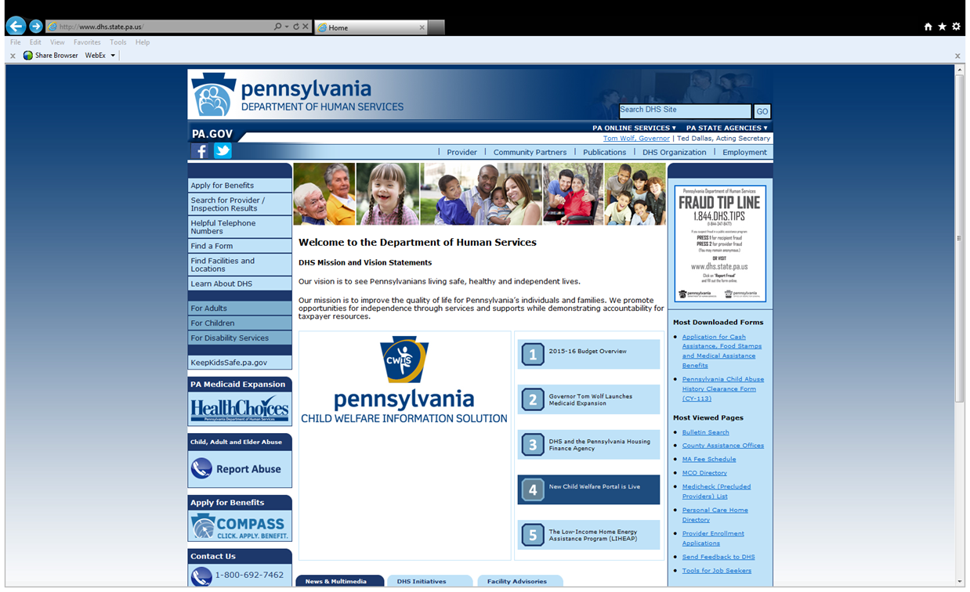
http://www.dhs.state.pa.us

Slide 34
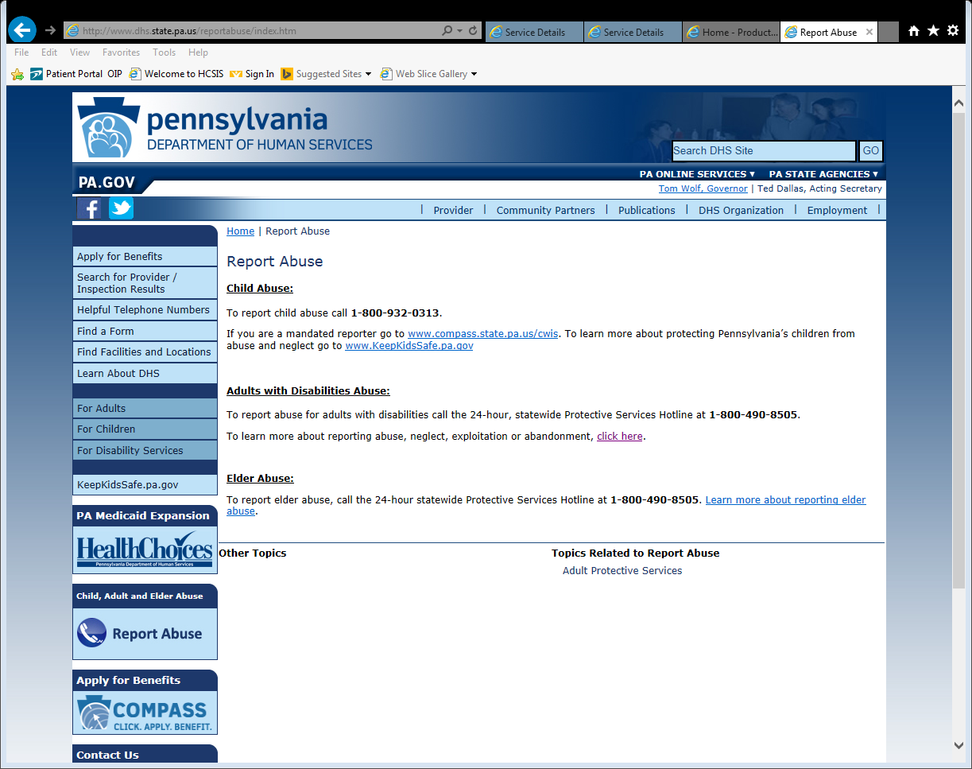
http://www.dhs.state.pa.us

Slide 35
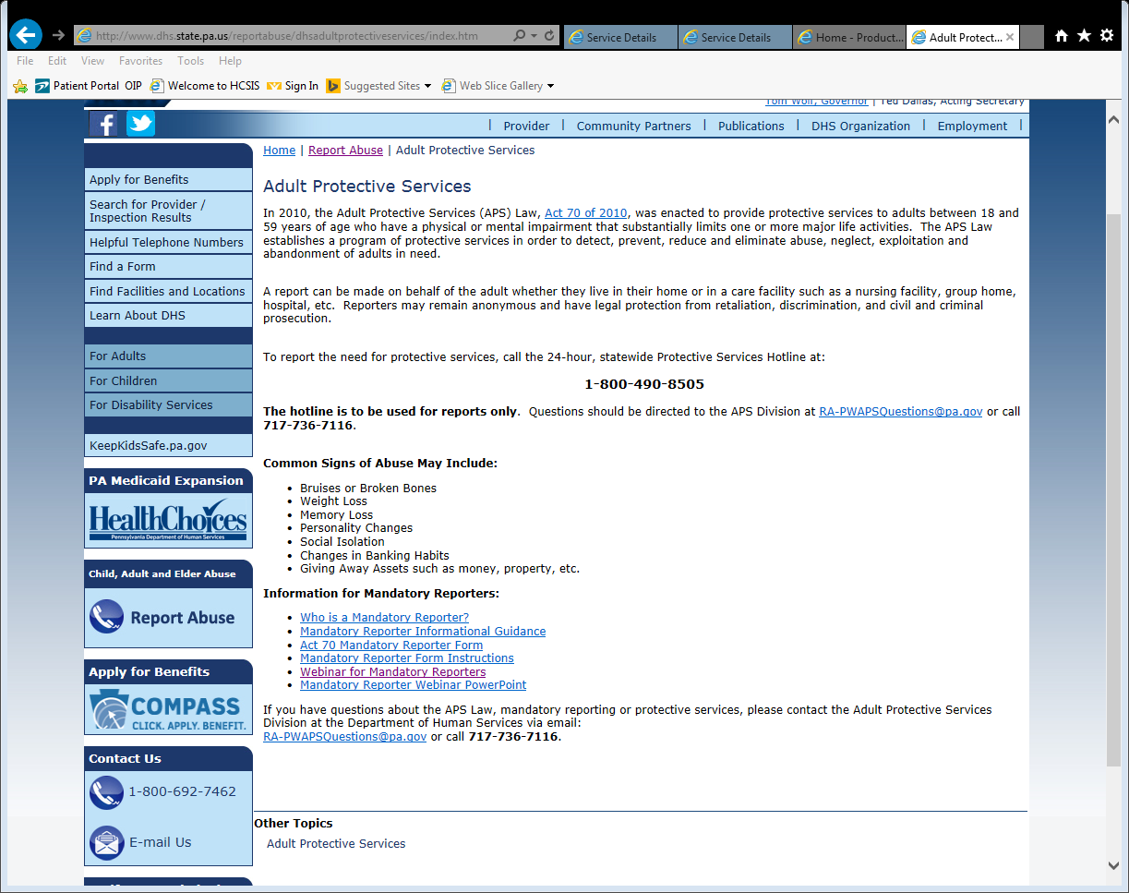
http://www.dhs.state.pa.us

Slide 36
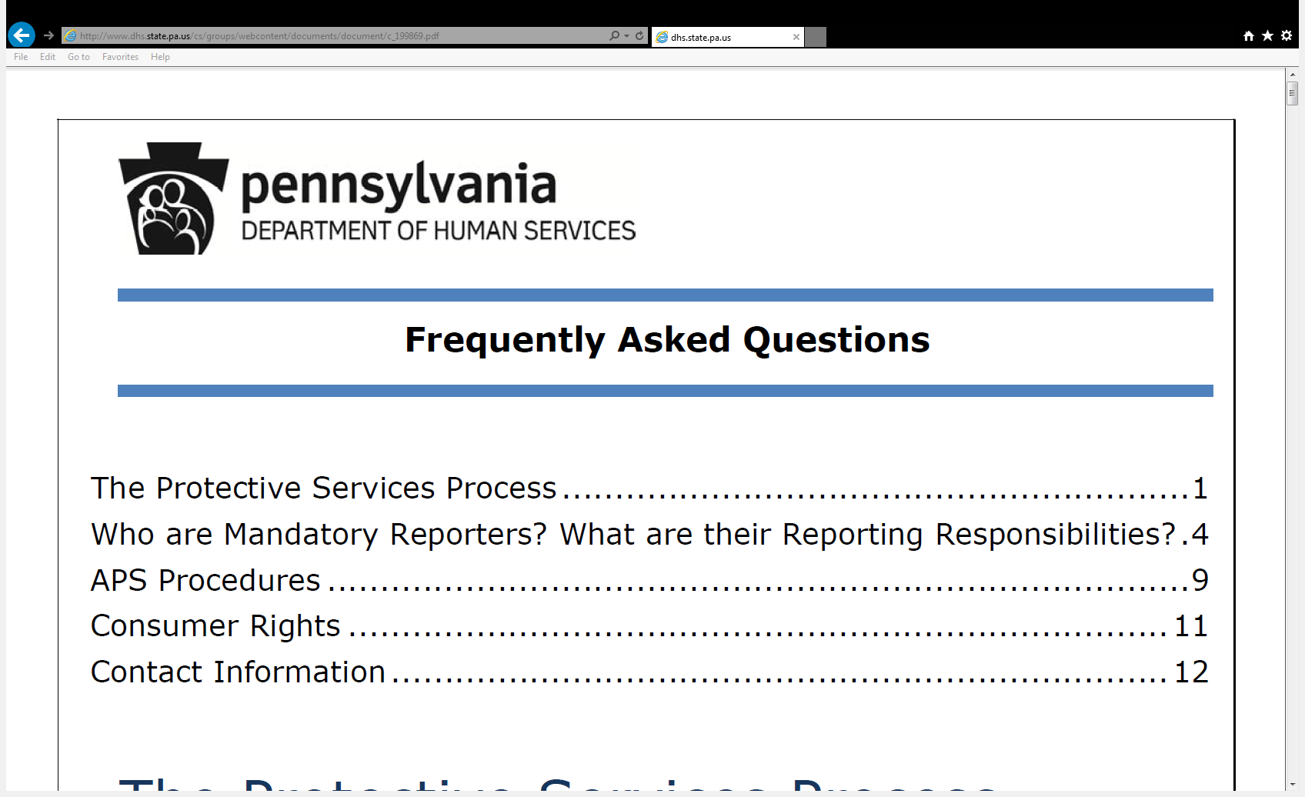
Frequently Asked Questions (FAQs)

Slide 37
Questions and Additional Information
Questions or requests for additional information regarding the Adult Protective Services program can be sent to the following email address:
RA-PWAPSQuestions@pa.gov
If you do not have access to email, please call:
717-736-7116

