Slide 1

Personalized Care and Tailored Treatment Plans for Gynecologic Cancers
Practical Nurse Guidance on Utilizing
Modern Therapeutic Approaches
Kimberly Halla, MSN, FNP-C
Family Nurse Practitioner
Arizona Center for Cancer Care
Scottsdale, Arizona

Slide 2

Housekeeping Notes
Thank you to PeerView, the Foundation for Women's Cancer, and the National Ovarian Cancer Coalition for providing this session and AbbVie, AstraZeneca,
Daiichi Sankyo, and Pfizer for providing the educational grants for this activity.
To receive CME/CE credit, you must complete the online post-test and evaluation at the conclusion of the meeting
Post-test and evaluation: PeerView.com/GynCancer-Survey-XRZ
Your evaluation of the activity is important in helping us to better meet your educational needs—we welcome your opinions and comments
We want this session to be interactive—asking and answering questions provides an optimal learning experience
Notes:
CME: General notes for the speaker

Slide 3
Accreditation Information
In support of improving patient care, this activity has been planned and implemented by PVI, PeerView Institute for Medical Education, the Foundation for Women's Cancer, and the National Ovarian Cancer Coalition. PVI, PeerView Institute for Medical Education, is jointly accredited by the Accreditation Council for Continuing Medical Education (ACCME), the Accreditation Council for Pharmacy Education (ACPE), and the American Nurses Credentialing Center (ANCC), to provide continuing education for the healthcare team.
Nurses
Successful completion of this nursing continuing professional education activity will be awarded
1.0 contact hour(s) and 0.75 contact hour(s) in the area of pharmacology.
Partnership
This activity has been developed in partnership with the Foundation for Women's Cancer and the National Ovarian Cancer Coalition.
Support
This activity is supported by independent educational grants from AbbVie, AstraZeneca, Daiichi Sankyo, and Pfizer Inc. and Genmab.

Slide 4
Disclosure Policy
PVI, PeerView Institute for Medical Education, disclosure policy adheres to The Standards for Integrity and Independence in Accredited Continuing Education. All individuals in a position to control the content of a CE activity, including faculty, planners and reviewers are required to disclose all financial relationships with ineligible companies (commercial interests) that as an entity produces, markets, re-sells or distributes healthcare goods or services consumed by or used on patients. All relevant conflicts of interest have been mitigated prior to the commencement of the activity.
Planning Committee and Reviewer Disclosures
Planners, independent reviewers, and staff of PVI, PeerView Institute for Medical Education, do not have any relevant financial relationships related to this CE activity unless listed below.
Disclosures
Co-Chair/Planner
Kimberly Halla, MSN, FNP-C
Arizona Center for Cancer Care
Scottsdale, Arizona
Kimberly Halla, MSN, FNP-C, has a financial interest/relationship or affiliation in the form of:
Consultant and/or Advisor for Seagen.
Speaker for Eisai, Inc.; Genmab A/S; GSK; Merck & Co., Inc.; and Seagen.

Slide 5
Personalized Care and Tailored Treatment Plans for Gynecologic Cancers
Practical Nurse Guidance on Utilizing
Modern Therapeutic Approaches
Kimberly Halla, MSN, FNP-C
Family Nurse Practitioner
Arizona Center for Cancer Care
Scottsdale, Arizona

Slide 6
Our Goals for Today
Augment your knowledge of the latest evidence supporting the use
of personalized therapeutic approaches for gynecologic cancers
Equip you with strategies to counsel patients with gynecologic cancers about available therapies, the importance of biomarker testing,
and various support resources
Provide guidance for team-based strategies to optimize practical care delivery, including mitigation and management of adverse events

Slide 7



How Common Is Endometrial Cancer?¹
Across all cancer types in the United States, uterine cancer represents
3.4% of new cases | 2.2% of deaths
Estimates for 2024
67,880 new cases | 13,250 deaths
Cases by Stage
5-Year Relative Survival by Stage
64 years
median age at diagnosis
80.8%
5-year relative survival (2014-2020)

Slide 8
How Common Is Cervical Cancer?¹
Across all cancer types in the United States, cervical cancer represents
0.7% of new cases | 0.7% of deaths
Estimates for 2024
13,820 new cases | 4,360 deaths
Cases by Stage
5-Year Relative Survival by Stage
50 years
median age at diagnosis
67.4%
5-year relative survival (2014-2020)

Slide 9
How Common Is Ovarian Cancer?¹
Across all cancer types in the United States, ovarian cancer represents
1% of new cases | 2.1% of deaths
Estimates for 2024
19,680 new cases | 12,740 deaths
Cases by Stage
5-Year Relative Survival by Stage
63
median age at diagnosis
91.9%
71.5%
5-Year Relative Survival, %
31.4%
36.3%
50.9%
5-year relative survival (2014-2020)
Notes:
12/3 – updated date range in lower box

Slide 10
The Oncology Nurse’s Role in Gynecologic Cancer Care
What nurses bring to
the table
Understanding of practical implementation approaches for numerous agents
(eg, chemotherapy, immunotherapy, PARP inhibitors, ADCs, combinations)
Support for patients receiving a variety of therapies
Vigilance and education on associated AEs
Nurses Are Gate Keepers and Provide Holistic Support to Patients
They bring clinical trial expertise to patients, coordination of care, psychosocial assessments, facilitation of communication across disciplines, guidance for support service referrals, and more

Slide 11

Role of Nurses in the Wider Care Team Supporting
Patients With Gynecologic Cancers
Ensuring medication access, practicing medication therapy management, assessing patients and managing AEs
Educating patients and care partners, managing AEs, and navigating care
Pharmacist
Oncology nurse
Patient with gynecologic cancer
Oncologist
Pathologist
Assessing patients and planning treatment
Molecular testing
Disease progression

Slide 12


Patients Benefit From Using Reputable Sources for
Their Educational Information
The National Ovarian Cancer Coalition
provides invaluable support to those with ovarian cancer and their caregivers.
ovarian.org
The Foundation for Women’s Cancer
provides multilingual gynecologic cancer resources for patients, families, and communities. foundationforwomenscancer.org
NOCC has a number of resources available, including information on biomarkers, clinical trials, and side effect management, to aid patients at any stage of their ovarian cancer journey.
FWC steadily pursues its mission of supporting research, education, and public awareness of gynecologic cancers, risks, prevention, early detection, and optimal treatment.

Slide 13
Survival Disparities: Endometrial vs Cervical Cancers¹⁻³
2.1
Overall, mortality rates for endometrial cancer are increasing (2% annually, 2008-2018)
However, the burden for Black patients has increased disproportionately and now represents one of the largest racial disparities in cancer settings
Significant racial disparities are also seen with cervical cancer mortality rates
Furthermore, Black and Hispanic women are more likely to be diagnosed at a later stage
Uterine Cancer
Mortality Rate (per 100,000)
Mortality Rate Ratio
White
Black
Asian/Pacific Islander
Hispanic
3.0
2.0
Cervical Cancer
Mortality Rate (Per 100,000)
1.0

Slide 14
Survival Disparities:
Endometrial vs Ovarian Cancers¹⁻³
Overall, mortality rates for endometrial cancer are now comparable to ovarian cancer
  This change comes from declining rates for
  ovarian cancer and increasing rates for
  endometrial cancer (2% annually, 2008-2018)
However, the burden for Black patients has
increased disproportionately and now
represents one of the largest racial
disparities in cancer settings
Mortality Rate (Per 100,000)
Mortality Rate (Per 100,000)
Non-Hispanic Black
Non-Hispanic White
Time, y
Time, y
Hispanic
Non-Hispanic
Asian/Pacific Islander
Ovarian
Endometrial
Mortality Rate (Per 100,000)
Mortality Rate (Per 100,000)
Mortality Rate (Per 100,000)
All Races
Time, y
Time, y
Time, y

Slide 15
BRCA and Beyond in Advanced High-Grade Ovarian Cancer
BRCA1 germline mutations 8%
Approximately 50% of patients with high-grade serous EOC have HRD¹
BRCA1 and BRCA2 mutations are the most common alterations among those who are HRD
Around 16% have a germline BRCA mutation²; 4%-7% have a somatic BRCA mutation³
BRCA mutation testing is essential and routine clinical practice^{4,5}
BRCA1 somatic mutations 3%
Other 21%
BRCA2 germline mutations 6%
BRCA2 somatic mutations 3%
HR DEFICIENT
NER
mutations
4%-8%
MMR
mutations
3%
CDK12 mutations 3%
RAD51C promoter methylation 2%
FA gene mutations 2%
Core RAD gene mutations 1.5%
Cyclin E1 amplification 15%
HR DNA damage gene mutations 2%
PARP inhibitors have clinical activity
beyond BRCAm ovarian cancer
HR PROFICIENT
EMSY
amplification
6%
POSSIBLY
HR DEFICIENT
PTEN
homozygous
loss 7%

Slide 16








PARP Inhibitors Exploit the Baseline Vulnerability of Cells With Inherent DNA Repair Deficiency¹
PARP inhibitor
PARP inhibitor
PARP
Increase in DSBs
in replicating cells
PARP
Trapped PARP
on SSBs
DSBs
HRR-deficient cancer cell
Normal cell

Repair of DSBs via
the HRR pathway and
cell survival
✓
Reliance on error-prone pathways leads to DNA damage accumulation and cell death

Slide 17
FDA-Approved PARP Inhibitors for First-Line Maintenance in Patients With Newly Diagnosed Advanced Ovarian Cancer¹⁻⁵
Indications for Maintenance Therapy
1L maintenance following response to platinum-based chemotherapy for newly diagnosed, advanced stage, high-grade ovarian cancer
Niraparib: all (any BRCA or HRD status)
Olaparib: germline or somatic BRCA alteration
Olaparib + bevacizumab: germline or somatic BRCA alteration and/or HRD-positive tumors

Slide 18
Common AEs With PARP Inhibitors^{1,2}
Hematologic
Nonhematologic
Rare
Anemia
Nausea/Vomiting/
Diarrhea/Constipation
AML
Thrombocytopenia
Asthenia/Fatigue
MDS
Neutropenia
Alopecia
Pneumonitis

Slide 19
Common AEs With PARP Inhibitors:
Management Strategies¹⁻²
Hematologic AEs
Interrupt PARP inhibitor and monitor blood counts weekly until grade 1 or resolved If hematologic profile recovers, consider restarting drug at a reduced dose Monitor CBC Month 1: weekly Months 2-12: monthly After month 12: periodically If hematologic profile has not recovered to grade ≤1 after 4 weeks, refer to hematologist for bone marrow analysis and cytogenetics
Nonhematologic AEs
Prophylactic antiemetics 30 minutes prior to dosing Lifestyle modifications—promote small meals Nausea: Taking before bedtime can help patients sleep through the nausea or reduce impact Insomnia: If nausea is not a concern, taking in the morning may help with any insomnia Consider dose interruption or dose reduction if severe fatigue Consider American ginseng to help with fatigue
Hypertension and Cardiovascular AEs
Monitor BP and heart rate Months 1-2: weekly Months 3-12: monthly After month 12: periodically Closely monitor patients with cardiovascular disorders Medically manage hypertension with antihypertensive medications and dose adjustment, if necessary

Slide 20
Extending Combination Approaches…
Studies are underway to assess additional combination approaches, including both PARP inhibitors as well as checkpoint inhibitors
Phase 3 DUO-O: Newly diagnosed FIGO stage III-IV high-grade
ovarian cancer
    Chemo Phase: chemo + bevacizumab + durvalumab
    Maintenance Phase: bevacizumab + durvalumab + olaparib
    PFS was improved with inclusion of both a PARP inhibitor and a checkpoint inhibitor

Slide 21


Helpful Free Resources for
Healthcare Providers to Provide Their Patients
nocc@ovarian.org • 888-OVARIAN • ovarian.org

Slide 22
Shifting the Paradigm:
Personalizing Treatment With Molecular Profiling¹
POLE (ultramutated)
POLE: ultramutated, 100-500 mutations/Mb | 5%-10% of endometrial cancers High mutation burden leads to better immune response, excessive mutations lead to inability to proliferate
dMMR/MSI-H: 10-20 mutations/Mb | 20%-30% of endometrial cancers Hereditary (Lynch syndrome) or somatic
CN low/NSMP/TP53 WT/MSS: 2-3 mutations/Mb, endometrioid, G1 | Most common endometrial cancer Low-grade tumors Estrogen/progesterone positive PTEN, PIK3CA, ARID1A, and KRAS mutations
CN high/TP53 abn: 2-3 mutations/Mb, high grade | Often serous or mixed histology Poorest prognosis
+
+
+
+
+
+
+
+
+
+
+
+
+
+
+
+
+
+
+
+
+
+
+
+
+
+
+
+
+
+
+
+
Progression-Free Survival, %
+
+
+
+
+
+
+
+
+
+
+
Copy-number low (endometrioid)
+
+
+
+
+
+
+
+
+
+
+
+
+
+
+
+
+
+
+
+
+
+
+
+
+
+
+
+
+
+
+
+
+
+
+
+
+
+
+
+
+
+
+
+
+
+
+
+
+
+
+
+
+
+
+
+
+
+
+
+
+
+
+
+
+
+
+
+
+
+
+
+
+
+
+
+
+
+
+
+
+
+
+
+
+
+
+
+
+
+
+
+
+
MSI (hypermutated)
+
+
+
+
+
+
+
+
+
+
+
+
+
+
+
+
+
+
+
+
Copy-number high (serous like)
Log-rank P = .02
Time, mo

Slide 23
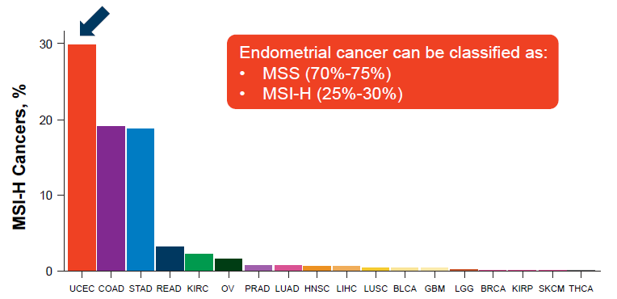
MMR Incidence in Endometrial Cancer^{1,a}
Endometrial cancer can be classified as
pMMR/MSS (70%-75%)
dMMR/MSI-H (25%-30%)
Notes:
UCEC, uterine corpus endometrial carcinoma (n = 437); COAD, colon adenocarcinoma (n = 294); STAD, stomach adenocarcinoma (n = 278); READ, rectal adenocarcinoma (n = 96); KIRC, kidney renal clear cell carcinoma (n = 279); OV, ovarian serous cystadenocarcinoma (n = 63); PRAD, prostate adenocarcinoma (n = 463); LUAD, lung adenocarcinoma (n = 480); HNSC, head and neck squamous cell carcinoma (n = 506); LIHC, liver hepatocellular carcinoma (n = 338); LUSC, lung squamous cell carcinoma (n = 443); BLCA, bladder urothelial carcinoma (n = 253); GBM, glioblastoma multiforme (n = 262); LGG, brain lower grade glioma (n = 513); BRCA, breast invasive carcinoma (n = 266); KIRP, kidney renal papillary cell carcinoma (n = 207); SKCM, skin cutaneous melanoma (n = 268); THCA, thyroid carcinoma (n = 484).

Slide 24
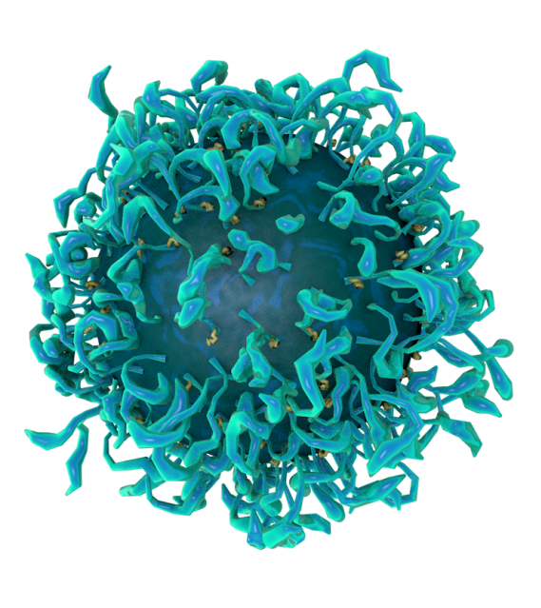
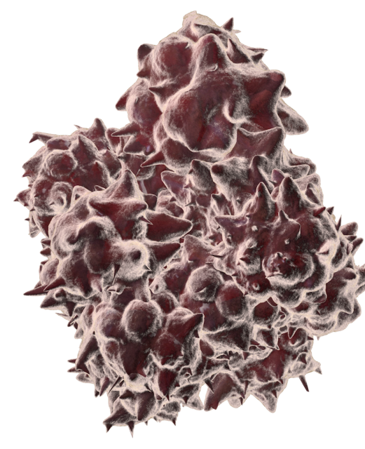
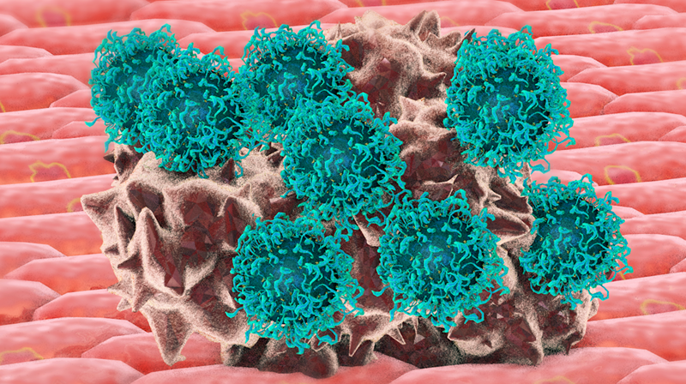
Immunotherapy as an Anti-Cancer Strategy
T Cell
Cancer Cell
Cancer cells can avoid detection by the body’s immune system (T cells)
Immune checkpoint inhibitors
“take the brakes off” the body’s immune system and allow T cells to attack and destroy cancer cells

Slide 25
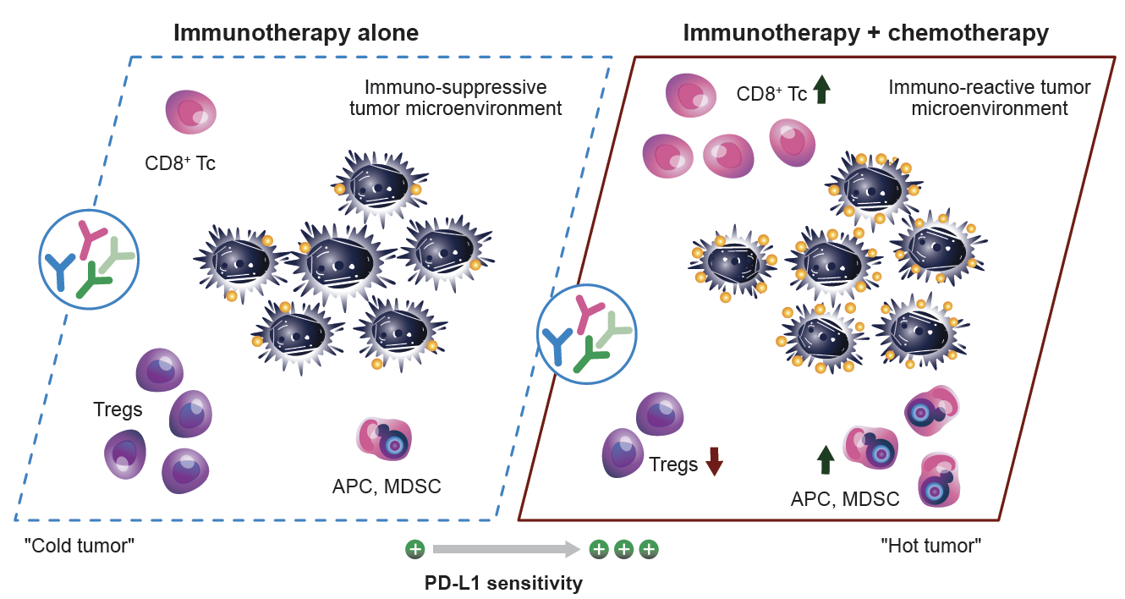
Combination Approaches: Leveraging ICI Activity¹
The combination of immunotherapy and chemotherapy can
increase tumor sensitivity
to PD-L1–targeted mAbs
Chemotherapy
  Induces upregulation of PD-L1 on cancer cells
  Facilitates infiltration of CD8⁺ T cells and NK cells
  Increases maturation of APCs (including dendritic cells and tumor macrophages)

Slide 26
FDA-Approved 1L Immunotherapy Options for Endometrial Cancer¹⁻³
IO Regimen | Trial Name | FDA Approved
Durvalumab + Chemo | DUO-E | 2024: Durvalumab + chemo followed by single-agent durvalumab for patients with dMMR endometrial carcinoma
Pembrolizumab + Chemo | NRG-GY018 | 2024: Pembrolizumab + chemo followed by single-agent pembrolizumab for patients with either dMMR or pMMR endometrial carcinoma
Dostarlimab + Chemo | RUBY – Part 1 | 2024: Dostarlimab+ chemo followed by single-agent dostarlimab for patients with either dMMR or pMMR endometrial carcinoma

Slide 27
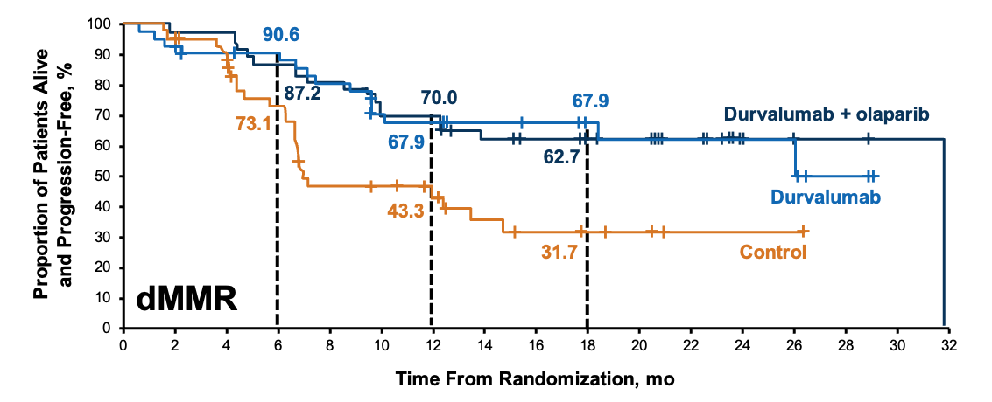
Phase 3 DUO-E: Improved Survival With Durvalumab Plus Chemotherapy in dMMR Subgroup¹
+
+
+
+
+
+
Durva + ola
+
+
+
+
+
+
+
+
+
+
+
+
+
+
+
+
+
+
+
+
+
+
+
+
+
+
+
+
+
+
+
+
+
+
+
+
+
+
+
+
+
+
+
+
+
+
+
+
+
+
+
+
+
+
+
+
+
+
+
+
+
+
+
+
+
+
+
+
+
+
+
+
+
+
+
+
+
+
+
Durva
12 months
89.2
91.2
74.4
+
+
+
+
+
+
+
18 months
89.2
86.1
65.8
+
+
+
+
+
OS, %
+
+
+
+
Control
+
+
+
dMMR
Time Since Randomization, mo
 | Durvalumab + Olaparib Arm (n = 48) | Durvalumab Arm (n = 46) | Control Arm (n = 49)
Median PFS, mo | 31.8 | NR | 7.0
HR vs control | 0.41 | 0.42 | –
 | Durvalumab + Olaparib Arm | Durvalumab Arm | Control Arm
Median OS, mo | NR | NR | 23.7
HR (95% CI) vs control | 0.28 | 0.34 | –
June 14, 2024: Durvalumab + chemotherapy followed by single-agent durvalumab
approved by the FDA for patients with dMMR endometrial carcinoma

Slide 28
NRG-GY018:
Survival Benefit With Pembrolizumab Plus Chemotherapy^{1,2}
dMMR Cohort
pMMR Cohort
mPFS NR vs 7.7 mo
HR = 0.3 (95% CI, 0.19-0.48)
P < .001
mPFS 13.1 vs 8.7 mo
HR = 0.54 (95% CI, 0.41-0.71)
P < .001
+
+
+
+
+
+
+
+
+
+
+
+
+
+
+
+
+
+
+
1.0
+
1.0
+
+
+
+
+
+
+
+
+
+
+
+
+
+
+
+
+
+
+
+
+
+
+
+
+
+
+
+
+
+
+
+
+
+
+
+
+
+
+
+
+
+
+
+
+
+
+
+
+
+
+
+
+
+
+
+
+
+
+
+
+
+
+
+
+
+
+
+
+
+
+
+
+
+
+
+
+
+
+
+
+
+
+
+
+
+
+
+
+
+
+
+
+
+
+
+
+
+
+
+
+
+
+
+
+
+
+
+
+
+
+
+
+
+
+
+
+
+
+
+
+
+
+
+
+
+
+
+
+
+
+
+
+
+
+
+
+
+
+
+
+
+
+
+
+
+
+
+
+
+
+
+
+
+
+
+
+
+
+
+
+
+
+
PFS, Probability
+
PFS, Probability
+
+
Pembrolizumab + chemo
+
+
Pembrolizumab + chemo
+
+
+
+
+
+
+
+
+
+
+
+
+
+
+
+
+
+
+
+
+
+
+
+
+
+
+
+
+
+
+
+
+
+
+
+
+
+
+
+
+
+
+
+
+
+
+
+
+
+
+
+
+
+
+
+
Placebo + chemo
+
+
+
+
Placebo + chemo
+
+
+
+
Time, mo
Time, mo
OS analysis also suggested a favorable benefit for both cohorts
June 17, 2024:
Pembrolizumab + chemotherapy followed by single-agent pembrolizumab approved by the FDA for patients with either dMMR or pMMR endometrial carcinoma^{2,3}

Slide 29
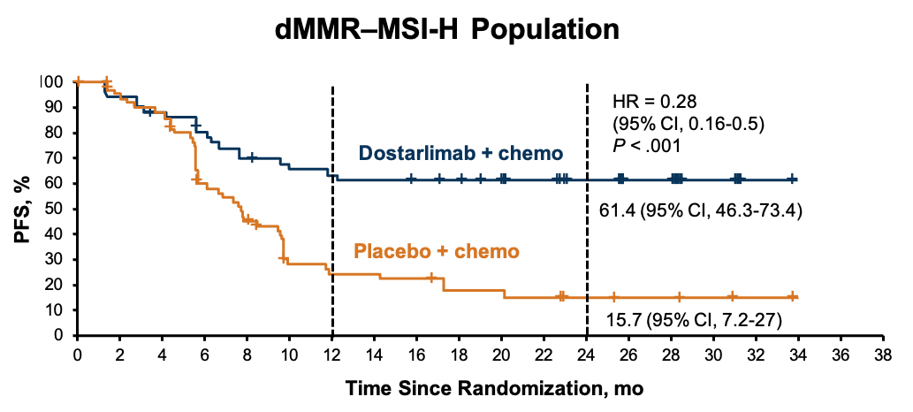
Phase 3 RUBY (Part 1):
Improved Survival With Dostarlimab Plus Chemotherapy^{1,2}
Substantial PFS Benefit in dMMR/MSI-H Population
Substantial OS Benefit in dMMR/MSI-H Populationª
Median duration of follow-up, 36.6 mo^{b}
HR = 0.32
(95% CI, 0.17-0.63)
P = .0002
+
+
+
+
+
+
+
+
+
+
+
+
+
+
+
+
+
+
+
100
82.8
+
+
+
+
+
+
+
+
+
+
+
+
+
+
78.0
+
+
Dostarlimab + CP
+
+
+
+
Probability of Survival, %
57.5
+
+
+
+
+
+
+
+
+
+
+
+
+
+
46.0
+
+
+
+
+
+
 | Median (95% CI), mo | Events, n/N (%)
Dostarlimab + CP | NE (NE-NE) | 12/53 (22.6)
Placebo + CP | 31.4 (20.3-NE) | 35/65 (53.8)
OS maturity |  | 47/118 (39.8)
Placebo + CP
41.5% of patients in the placebo + CP arm received subsequent immunotherapy
Time Since Randomization, mo
August 1, 2024
Expanded FDA approval of dostarlimab + chemotherapy followed by single-agent dostarlimab for patients with either dMMR or pMMR endometrial carcinoma^{3,4}

Slide 30
Rationale for Combining ICI and PARPi
With Chemotherapy
ICI
Durable activity in both dMMR/MSI-H and pMMR/MSS previously treated EC^{1,2}
Chemotherapy
Enhances immunogenic cell death^{3,4}
Broad clinical activity when combined with anti–PD-1 in several cancers⁵⁻⁸
PARPi
  Adding a PARPi to ICI may further improve outcomes, including in patients with pMMR/MSS disease, a population with high unmet need⁹⁻¹²

Slide 31
Potential Benefit With Addition of PARPi to ICI Plus Chemotherapy in pMMR Endometrial Cancerª
RUBY Part 2¹
DUO-E²
PFS
OS
PFS
OS
+
+
+
+
+
+
+
+
+
+
+
+
+
84.4
+
+
+
+
+
Not mature
+
+
+
+
+
+
83.1
+
+
54.7
+
+
+
+
+
+
+
+
+
+
+
+
+
+
+
+
+
82.4
59.4
+
+
+
+
+
+
+
+
+
Proportion of Patients Alive
and Progression-Free, %
+
+
+
+
+
+
+
+
+
+
+
+
+
+
+
+
+
+
+
+
+
+
+
+
+
+
+
+
+
+
+
Probability of PFS, %
+
+
+
+
+
+
+
+
+
+
+
+
+
+
+
+
+
+
+
+
+
+
+
+
+
+
+
+
+
+
+
+
+
+
+
+
+
+
+
Durva + ola + CP
+
+
+
+
+
+
+
+
+
+
+
+
+
+
+
+
+
+
+
+
+
+
+
+
+
+
+
+
+
+
+
+
+
+
+
+
+
+
+
+
+
+
+
+
+
+
+
+
87.3
82.5
81.0
+
+
+
+
+
+
+
+
+
+
+
+
+
+
+
+
+
+
+
+
+
+
+
+
+
+
+
+
+
+
+
+
+
+
+
+
+
+
+
+
+
+
+
+
+
+
+
+
+
+
+
+
+
+
+
+
+
+
42.0
+
+
+
+
76.9
71.1
69.9
+
+
+
+
+
+
+
+
+
+
+
+
+
+
+
Dostar + nira + CP
+
+
+
+
+
+
+
+
+
+
+
+
+
+
+
+
+
+
+
+
+
+
+
+
+
+
+
OS, %
+
+
+
+
+
+
+
+
+
Durva + ola + CP
+
+
+
+
+
+
+
+
+
+
+
+
+
+
+
+
+
+
+
+
+
+
+
+
+
+
+
+
+
Durva + CP
+
+
+
+
+
+
+
+
+
+
+
+
+
+
44.4
+
+
+
+
+
+
31.1
+
+
+
+
+
+
+
+
+
+
+
+
+
+
+
+
+
+
+
+
+
+
+
+
+
+
+
+
+
+
+
+
+
Control
+
+
40.8
+
+
+
+
+
+
+
+
+
+
+
+
31.3
+
+
+
+
+
+
+
Placebo IV + placebo PO + CP
+
+
+
+
Durva + CP
+
+
20.0
+
+
+
Control
Time Since Randomization, mo
Time Since Randomization, mo
Time Since Randomization, mo
Chemotherapy period
HR = 0.63 (95% CI, 0.44-0.91); P = .0060 Dostar + Nira + CP | HR = 0.76 (95% CI, 0.59-0.98); Dostar + CP |  |  | HR = 0.57 (95% CI, 0.44-0.73); Durva + Ola + CP | HR = 0.77 (95% CI, 0.60-0.97) Durva + CP | HR = 0.69 (95% CI, 0.47-1.00); Durva + Ola + CP | HR = 0.91 (95% CI, 0.64-1.30); Durva + CP
Hazard ratios are improved with the addition of a PARPi to the
checkpoint inhibitor/chemo regimen in patients with pMMR endometrial cancer
More analysis needed to identify which subgroup derives the most benefit

Slide 32
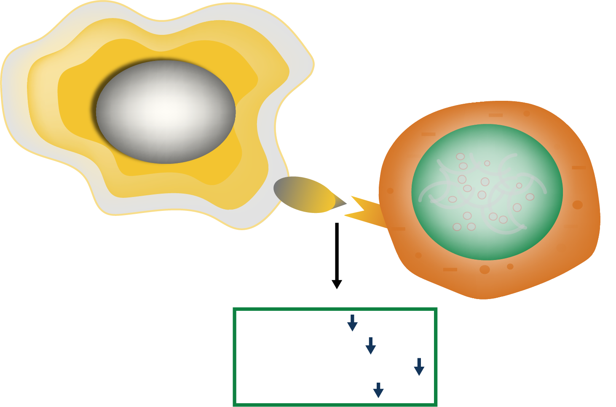
PD-1/PD-L1 Axis Controls Immune Tolerance
Within the Tumor Microenvironment¹⁻²
NCCN Guidelines for 1L Therapy for PD-L1-positive cervical cancer:
Pembrolizumab + cisplatin
(or carboplatin)/paclitaxel ± bevacizumab (category 1)
For metastatic or recurrent cervical cancer,
PD-L1 testing is required to initiate treatment with immunotherapy
  IHC method (22C3)
  Considered PD-L1–positive if CPS is ≥1
Other tests, such as MSI and TMB, can help identify patients with unresectable or metastatic solid tumors who may be eligible for treatment with PD-1/PD-L1 targeted therapy
Cancer cell
PD-L1/PD-L2
PD-1
T cell
1. Activation
2. Proliferation
3. Cytokine secretion
4. T-cell survival

Slide 33
Frontline Treatment in Cervical Cancer:
Immunotherapy Plus Chemotherapy
Phase 3 KEYNOTE-826: Pembrolizumab + Chemotherapy ± Bevacizumab¹
PFS
OS
PD-L1 Combined Positive Score of ≥1
PD-L1 Combined Positive Score of ≥1
2021 Full FDA Approval²
Indication For the treatment of patients with persistent, recurrent, or metastatic cervical cancer whose tumors express PD-L1
I
I
I
I
I
I
I
HR = 0.62
(95% CI, 0.5-0.77)
P < .001
I
I
I
Pembrolizumab
I
I
I
I
Pembrolizumab
I
Patients, %
Patients, %
I
I
I
I
I
I
I
I
I
I
I
I
I
I
I
I
I
I
I
I
I
I
I
I
I
I
I
I
I
I
I
I
I
I
I
I
I
I
I
I
I
HR = 0.64
(95% CI, 0.5-0.81)
P < .001
I
I
I
I
I
I
I
I
I
I
I
I
I
I
Placebo
I
I
I
I
I
Placebo
Time, mo
Time, mo
    Substantial PFS
    and OS benefits
 | Pembro | Placebo
Median, mo (95% CI) | 10.4 (9.7-12.3) | 8.2 (6.3-8.5)
 | Pembro | Placebo
24-mo estimate of patients alive, % (95% CI) | 53 (46-59.4) | 41.7 (34.9-48.2)

Slide 34




irAEs From Immune Checkpoint Inhibitors
Can Affect Any Organ System¹
Dermatologic
Rash, pruritus
Gastrointestinal
Diarrhea, nausea, vomiting
Endocrine
Hypothyroidism
Pulmonary
Pneumonitis
Consider Treating With…
Topical steroids, topical antihistamines
Steroids, antiemetics, antidiarrheals
Synthroid
Steroids
Identify experts in each specialty for collaboration; use e-consults to start early intervention while the specialist appointment is being made

Slide 35





irAE Grading and Management¹⁻³
 | Grade 1 Minimal or no symptoms; diagnostic change only
 | In general, checkpoint inhibitor therapy should be continued with close monitoring, with the exception of some neurologic, hematologic, and cardiac toxicities
 | Grade 3/4 Severe or life-threatening symptoms
 | Grade 3 Hold checkpoint inhibitor therapy Initiate high-dose corticosteroids If symptoms do not improve with 48-72 h of high-dose corticosteroids, infliximab may be offered for some toxicities Taper corticosteroids over the course of at least 4-6 wk When symptoms and/or laboratory values revert to grade ≤1, rechallenging with immunotherapy may be offered; however, caution is advised, especially in those patients with early-onset irAEs; dose adjustments are not recommended Grade 4 In general, permanent discontinuation of checkpoint inhibitor therapy is warranted, with the exception of endocrinopathies that have been controlled by hormone replacement
 | Grade 2 Mild to moderate symptoms
 | Hold checkpoint inhibitor therapy for most grade 2 toxicities Consider resuming immunotherapy when symptoms and/or laboratory values revert to grade ≤1 Corticosteroids (initial dosage of 0.5-1 mg/kg/d of prednisone or equivalent) may be administered; treat until symptoms improve to grade ≤1 and then taper over 4-6 wk

Slide 36



irAE Grading and Management: Organ-Specific Toxicities¹⁻³
Gastrointestinal
Educate patients about supportive care to maintain hydration and dietary changes; GI consultation: consider colonoscopy and EGD
Grade 1 (<4 stools above baseline) Consider holding ICI Antispasmodic Antidiarrheal: loperamide, diphenoxylate/ atropine | Grade 2 (4-6 stools above baseline) Hold ICI Prednisone 1-2 mg/kg/d (if no response in 2-3 d, increase to 2-4 mg/kg/d) If refractory, consider infliximab If infliximab resistant, consider vedolizumab | Grade 3 (>6 stools above baseline) Discontinue anti–CTLA-4 ICI; consider restarting anti–PD-1/L1 ICI if resolved Grade 4 (life-threatening) Permanently discontinue ICI Consider inpatient care Prednisone 2-4 mg/kg/d (if no response in 2-3 d, consider infliximab)
Endocrine/Thyroid
Levothyroxine: adjust levels to maintain free T4 at midrange; typically 1.6 mcg/kg/d
Asymptomatic hypothyroidism TSH 4-10, T4 norm: continue ICI TSH >10, T4 norm: continue ICI, consider levothyroxine TSH low, T4 low/norm: consider central hypothyroidism | Clinical hypothyroidism Monitor TSH and free T4 every 4-6 weeks Levothyroxine replacement Consider endocrine consultation Exclude concomitant adrenal insufficiency
Dermatologic
Educate patients about supportive care and sun protection (eg, sunscreen, sunglasses)
Mild grade 1 (<10% BSA) Continue ICI Treat with moderate-potency topical steroids Oral antihistamines Topical emollients | Moderate grade 2 (10%-30% BSA) Consider holding ICI Treat with high-potency topical steroids and/or prednisone 0.5-1.0 mg/kg/d Oral antihistamines Topical emollients | Severe grade 3/4 (>30% BSA) Hold ICI Treat with high-potency topical steroids Prednisone 0.5-1.0 mg/kg/d (increase up to 2.0 mg/kg/d, if not responsive) Admit for management and dermatology consult
Refer to NCCN Guidelines

Slide 37

Immune-Related Adverse Events
Can Occur at Any Time
Variable Timing of irAEs¹
Patient Communication
Is Essential
Discuss potential onset, duration, and symptoms
of irAEs
Patients may be more
likely to adhere to treatment when they have a full
picture of irAEs
Colitis
Pneumonitis
Toxicity, grade
Endocrinopathy
Skin, rash, or pruritus
Liver toxicity
Nephritis
>30
Duration of Treatment, wk

Slide 38

Practical Considerations for Checkpoint Inhibitors from a Nurse’s Perspective
Dosing/Administration
Dosing and scheduling considerations
Patient/Care Partner/Care Team Education
Educate on more common AEs and have a high level of suspicion for other AEs
Encourage patients to call in sooner rather than later
Ensure clinic staff are aware of monitoring parameters and common AEs
AE Monitoring and Management
Ensure routine follow-up and proper laboratory monitoring with the care team
Assist with supportive care and immunosuppressive therapy as needed (eg, corticosteroids)
Collaborate with the care team regarding therapy adjustments, holds, or reinitiation of medications

Slide 39


Practical Tips for Discussing Molecular Testing
With Patients
Molecular profiling has completely
transformed our therapeutic approach
🗹
Explaining the importance of molecular classification to patients is critical;
it could be described as the “last name” of the tumor
🗹
Patients should understand that the molecular profile of their tumor will affect the choice of therapy and their potential outcomes
🗹
Although ICIs are benefitting all patients, depth of response to each treatment varies based on molecular subgroup individualized therapy is crucial

Slide 40


Antibody–Drug Conjugates (ADCs) in Gynecologic Cancer: Patient and Clinician Insights
Important Questions for…
Patients
Providers
What are the benefits of ADCs?
Which ADC is right for me?
What are the risks of ADCs?
Why does the provider think I should take a particular ADC?
Which ADCs are available?
How do you integrate ADCs
into clinical practice?
How do you address workflow
challenges associated with ADCs?
How do you prevent and mitigate AEs?

Slide 41
Antibody–Drug Conjugate (ADC):
Understanding Their Composition and Structure¹
Antibody
Guidance system for cytotoxic drugs
Target Antigen
Recognition of target on cancer cell
Linker
Bridge between antibody and drugs and to control the release of the drugs into the cancer cells
Drug/payload
Warhead for destroying cancer cells
ADCs are typically composed of a monoclonal antibody covalently attached to a cytotoxic drug via a chemical linker
ADCs combine both the advantages of highly specific targeting ability and highly potent killing effect to achieve accurate and efficient elimination of cancer cells

Slide 42

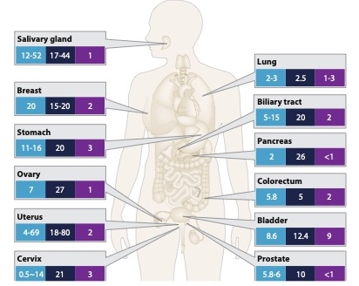
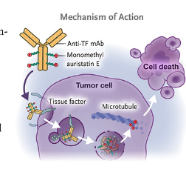
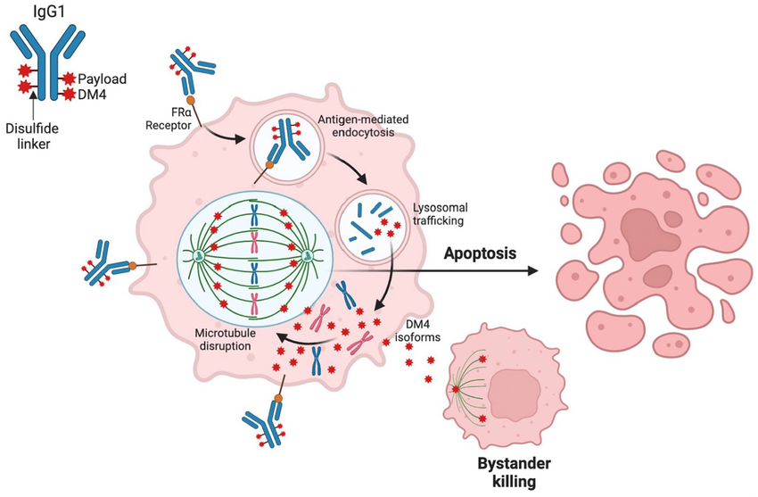
Optimal ADC Targets in Gynecologic Cancers
Tissue factor (TF):
transmembrane receptor highly expressed in squamous cell and adenocarcinoma of the cervix
Folate receptor alpha (FRα):
membrane protein that binds to
and transports folate into cells and is highly overexpressed on certain cancer cells
HER2:
Overexpression, Amplification, and Mutations Across Tumor Types¹⁻⁴
  Under normal conditions, it is involved in the coagulation cascade
  Under oncogenic conditions, it is involved in tumor angiogenesis, proliferation, and thrombosis
  High-grade serous ovarian cancer has approximately 80% of cells positive for some expression of FRα
  FRα overexpression allows for ADC-based
    Delivery of a highly potent molecule of chemotherapy to FRα cells
  Diffusion of the payload into FRα-negative cells that are adjacent via the bystander effect
Notes:
FRa image: https://journals.sagepub.com/doi/10.1177/11795549231187264

Slide 43
Plenty of Payloads:
FDA-Approved ADCs Across Gynecologic Tumors
ADC | Target | Trial Name | FDA Approved | Treatment Setting
Tisotumab vedotin (TV)¹ | Tissue factor | Phase 3 innovaTV-301 | Cervical 2021: Accelerated Approval 2024: Full Approval | 2L or later
Mirvetuximab soravtansine (MIRV)² | FR⍺ | Phase 3 MIRASOL | Ovarian 2024: Full Approval (FR⍺-positive) | 2L or later
Trastuzumab deruxtecan (T-DXd)³ | HER2 | Phase 2 DESTINY Pan-Tumor-02 | 2024: HER2 IHC3+ tumor agnostic (cervical, endometrial, ovarian) | 2L or later
https://www.accessdata.fda.gov/drugsatfda_docs/label/2024/761208s007lbl.pdf
https://www.accessdata.fda.gov/drugsatfda_docs/label/2024/761310Origs005lbl.pdf
https://www.accessdata.fda.gov/drugsatfda_docs/label/2024/761139s028lbl.pdf

Slide 44
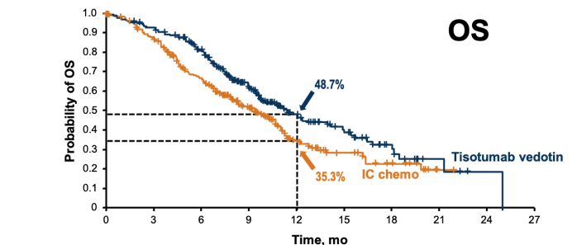
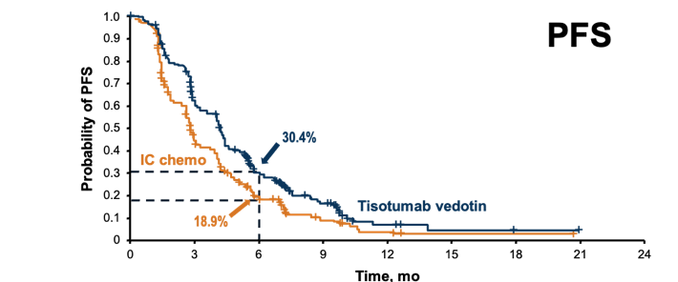
Phase 3 innovaTV 301:
Tisotumab Vedotin in Recurrent or Metastatic Cervical Cancer¹
Improved median PFS:
4.2 mo vs 2.9 mo
(HR: 0.67)
Improved median OS:
11.5 mo vs 9.5 mo
(HR: 0.7)
Treatment with tisotumab vedotin resulted in significantly greater efficacy than chemotherapy
in patients with r/m cervical cancer after previous systemic therapy

Slide 45
Adverse Events of Special Interest for Tisotumab Vedotin^{1,a}
 | Grade 1-2 AESIs in tisotumab vedotin arm
 | Grade ≥3 AESIs in tisotumab vedotin arm
 | Grade 1-2 AESIs in IC chemotherapy arm
 | Grade ≥3 AESIs in IC chemotherapy arm
There were no
grade 4 or 5 AESIs
Most were Grade 1-2
Dose discontinuation because of ocular and peripheral neuropathy events occurred in 5.6% of patients for each arm
Ocular
Peripheral Neuropathy
Bleeding
Most Common Preferred Terms for Each AESI
Ocular: conjunctivitis (30.4%), keratitis (15.6%), dry eye (13.2%)
Peripheral neuropathy: peripheral sensory neuropathy (26.8%), paresthesia (2.8%), muscular weakness (2.4%), peripheral sensorimotor neuropathy (2.4%)
Bleeding: epistaxis (22.8%), hematuria (3.2%), vaginal hemorrhage (3.2%)

Slide 46
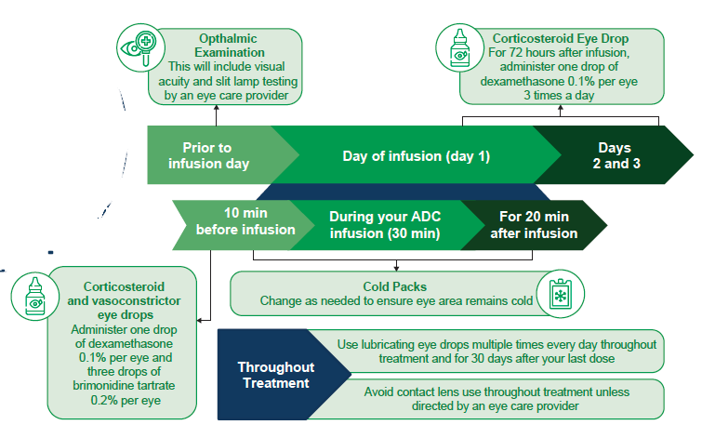
Expert Insights on the Effective Implementation of Tisotumab Vedotin and Practical Tips for Its Use^{1,2}
Important Provider/Patient Discussion Points
Treatment schedule and dosing
Management of AEs
  Potential for dose holds
  or reductions
Ocular AEs: focus on expectations, prevention, plan
for eye drops/regimens
  Timeline of eye drops
  (prior to infusion/day of infusion/days after infusion)
  Types of eye drops
  Patient reminder tools
  Educate eye care specialists

Slide 47
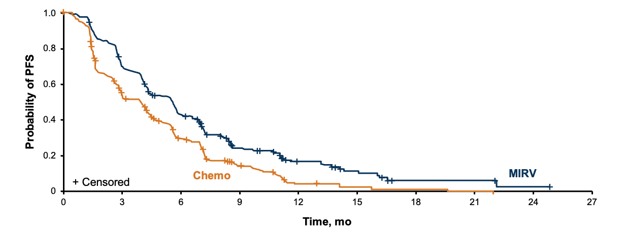
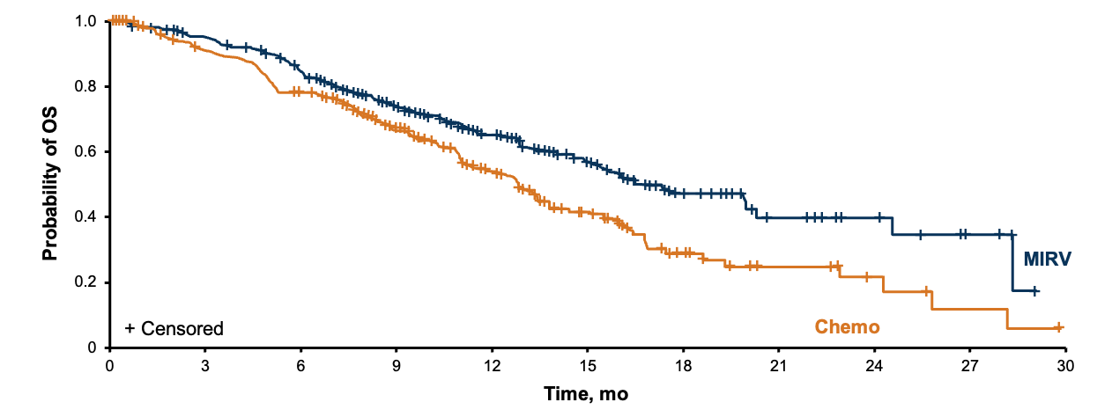
Phase 3 MIRASOL:
Mirvetuximab Soravtansine in Pre-treated Ovarian Cancer¹
INV-PFS: Primary Endpoint
 | MIRV (n = 227) | IC Chemo (n = 226)
mPFS (95% CI) | 5.62 (4.34-5.95) | 3.98 (2.86-4.47)
Events, n (%) | 176 (77.5) | 166 (73.5)
HR (95% CI) | 0.65 (0.52-0.81)
P | <.0001
MIRASOL
35% improvement
in PFS with MIRV vs chemotherapy
33% improvement
in OS with MIRV vs chemotherapy
ORR more than doubled: 42% vs 16% with MIRV vs chemotherapy
(P < .0001;
12 CRs vs 0 CRs)
 | MIRV (n = 227) | IC Chemo (n = 226)
mOS (95% CI) | 16.46 (14.46-24.57) | 12.75 (10.91-14.36)
Events, n (%) | 90 (39.6) | 114 (50.4)
HR (95% CI) | 0.67 (0.50-0.89)
P | .0046
OS: Key Secondary Endpoint

Slide 48
Safety Profile of Mirvetuximab Soravtansine: TEAEs^{1,a}
Grade
All
3+
MIRV (n = 218)
IC chemo^{b} (n = 207)
Frequency, %
1
0
0
0
0
0
Pac
PLD
Pac
PLD
Pac
PLD
Pac
PLD
Pac
PLD
Pac
PLD
Pac
PLD
Pac
PLD
Pac
PLD
Pac
PLD
Pac
PLD
MIRV
Topo
Topo
Topo
Topo
Topo
Topo
Topo
Topo
Topo
Topo
Topo
MIRV
MIRV
MIRV
MIRV
MIRV
MIRV
MIRV
MIRV
MIRV
MIRV
Neutropenia
Anemia
Thrombocytopenia
Peripheral Neuropathy^{c}
Alopecia
Diarrhea
Nausea
Stomatitis
Blurred Vision
Keratopathy
Dry Eye
Hematologic
General
Gastrointestinal
Ocular

Slide 49




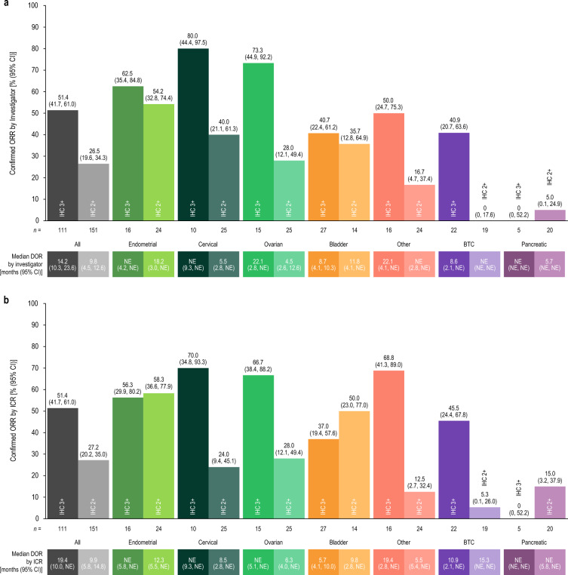

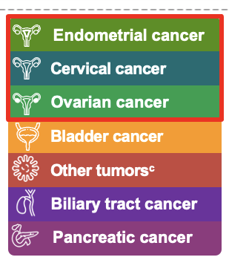





Responses With T-DXd Observed
Across Gynecologic Tumors by HER2 Status^{1,a,b}
Endometrial cancer
Cervical cancer
Ovarian cancer
Bladder cancer
Other tumors^{c}
Biliary tract cancer
Pancreatic cancer
80
(44.4-97.5)
73.3
(44.9-92.2)
All
Endometrial
Cervical
Ovarian
62.5
(35.4-84.8)
51.4
(41.7-61.0)
54.2
(32.8-74.4)
Confirmed ORR by Investigator
(95% CI), %
40
(21.2-61.3)
26.5
(19.6-34.3)
28
(12.1-49.4)
IHC 3+
IHC 2+
IHC 3+
IHC 2+
IHC 3+
IHC 2+
IHC 3+
IHC 2+
n =
111
151
16
24
10
25
15
25
All
Endometrial
Cervical
Ovarian
Median DOR
by investigator (95% CI), mo
14.2
(10.3-23.6)
9.8
(4.5-12.6)
NE
(4.2-NE)
18.2
(3.0-NE)
NE
(9.3-NE)
5.5
(2.8-NE)
22.1
(2.8-NE)
4.5
(2.8-12.6)
Meric-Bernstam F et al. J Clin Oncol. 2024;42:47-58
Oaknin A et al. Adv Ther. 2024;41:4125-4139.

Slide 50
Application of T-DXd Across Gynecologic Tumors
Updated NCCN Guidelines for
Endometrial, Cervical, and Ovarian Cancers¹⁻³
  Second- or subsequent-line therapy:
  T-DXd added for HER2-positive tumors (IHC 3+ or 2+)
  Useful in certain circumstances
April 2024: Accelerated FDA Approval⁴
For adult patients with unresectable or metastatic HER2-positive (IHC3+) solid tumors who have received prior systemic treatment and have no satisfactory alternative treatment options

Slide 51
Safety Findings With T-DXd^{1,a}
n (%) | Gynecologic Cohorts (N = 120)
Any drug-related TEAEs | 106 (88.3)
Drug-related TEAEs grade ≥3 | 54 (45.0)
Serious drug-related TEAEs | 18 (15.0)
Drug-related TEAEs associated with dose discontinuations | 7 (5.8)
Drug-related TEAEs associated with dose interruptions | 24 (20.0)
Drug-related TEAEs associated with dose reductions | 35 (29.2)
Drug-related TEAEs associated with deaths | 2 (1.7)^{e}
Most Common Drug-Related TEAEs (>10%) in Gynecologic Cohorts
Nausea​
Fatigue^{b}
Diarrhea
Anemia​
Neutropenia^{c}​
Vomiting​
Decreased appetite​
Alopecia​
Thrombocytopenia^{d}
Grade ≥3
Any grade
ILD/Pneumonitis Adjudicated as T-DXd Related, n (%) | Grade 1 | Grade 2 | Grade 3 | Grade 4 | Grade 5 | Any Grade
Gynecologic cohorts (N = 120) | 4 (3.3) | 8 (6.7) | 0 | 0 | 1 (0.8) | 13 (10.8)

Slide 52






Detecting and Managing T-DXd–Related ILD:
The Five “S” Rules¹
1
2
3
4
5
Screen
Scan
Synergy
Suspend
Treatment
Steroids
Careful patient selection is warranted before initiating T-DXd to optimize the monitoring strategies based on baseline risk
Screening continues during treatment,
with regular clinical assessments to exclude signs/
symptoms of ILD
The fundamental diagnostic tools for ILD remain radiological scans, with preference for high-resolution CT scans of the chest
A baseline scan is recommended, with repeat scans to be performed every
6-12 weeks
Minimizing the risk
of ILD involves
teamwork, which includes educating patients and all the care team, as well
as multidisciplinary management once ILD is suspected
T-DXd should always be interrupted if ILD is suspected; it can only be restarted in the case of asymptomatic ILD that fully resolves
The mainstay for treating T-DXd–induced ILD remains corticosteroids, with
the dose adapted to the toxicity grade

Slide 53
Educating Your Patients and Staff About the Importance of and Access to Clinical Trials
Why is clinical trial participation important?
Clinical trials are a key step for translating research into medicines that can cure illness, slow disease, and improve QOL for patients
Robust participation in clinical trials with diverse enrollment means a shorter timeline between medical discovery and patient access to potentially life-changing treatments
Greater participation=
patient access to new therapies
Lack of participation=
delays and higher costs
Increased patient awareness
Lack of patient awareness
Clinical Trial Participation
Offers Dual Benefits for Patients
Potential personal benefit: Patients may experience improved disease outcomes and better health if they receive otherwise unavailable medical therapies
Social benefit: Clinical trial participation helps provide access for patients who may benefit from the new treatment option by moving a new therapy closer to market
Increasing diversity in clinical trial enrollment is crucial
Providers need to discuss with and offer clinical trial opportunities to all patients

Slide 54

FWC Provides Numerous Clinical Trial Resources

Slide 55
Nurses’ Role in Shared Decision-Making
Nurses Can Support Patient Engagement
Be a patient advocate
Offer information using patient-friendly terms on expectations for each therapy option (chemotherapy, immunotherapy, PARP inhibitors, ADCs, combinations)
Discuss support systems and social factors via multiple methods
Support: transportation to clinic, support groups like NOCC, FWC, social work, etc.
Methods: verbal, written, care partner, phone recording, calendar, etc.
Educate on adverse events
and management strategies
Communicate with other
HCPs to close the loop

Slide 56


How Can Patient Advocacy Groups Help?
Discussion
Patients who have recurrent cancer have a lot on their plate
Although there are a lot of ongoing clinical trials, the most common scenario is that there are no trials available at the center where a patient is being treated
How does a patient decide to travel from a home clinic in a small town to a major academic center where a clinical trial is being conducted?
Do patients on your trials travel far?
How can we support patients in these decisions?
Are there resources available to facilitate clinical trial enrollment?

Slide 57

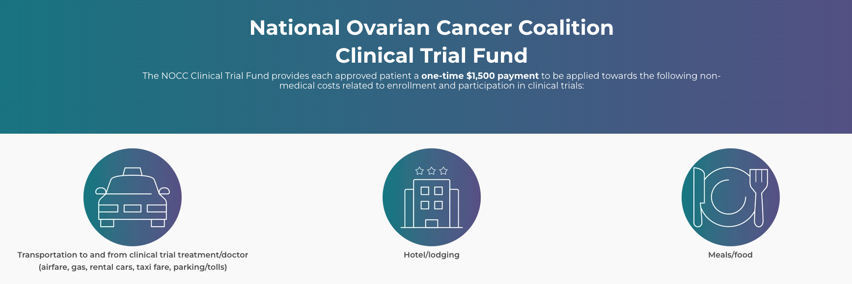


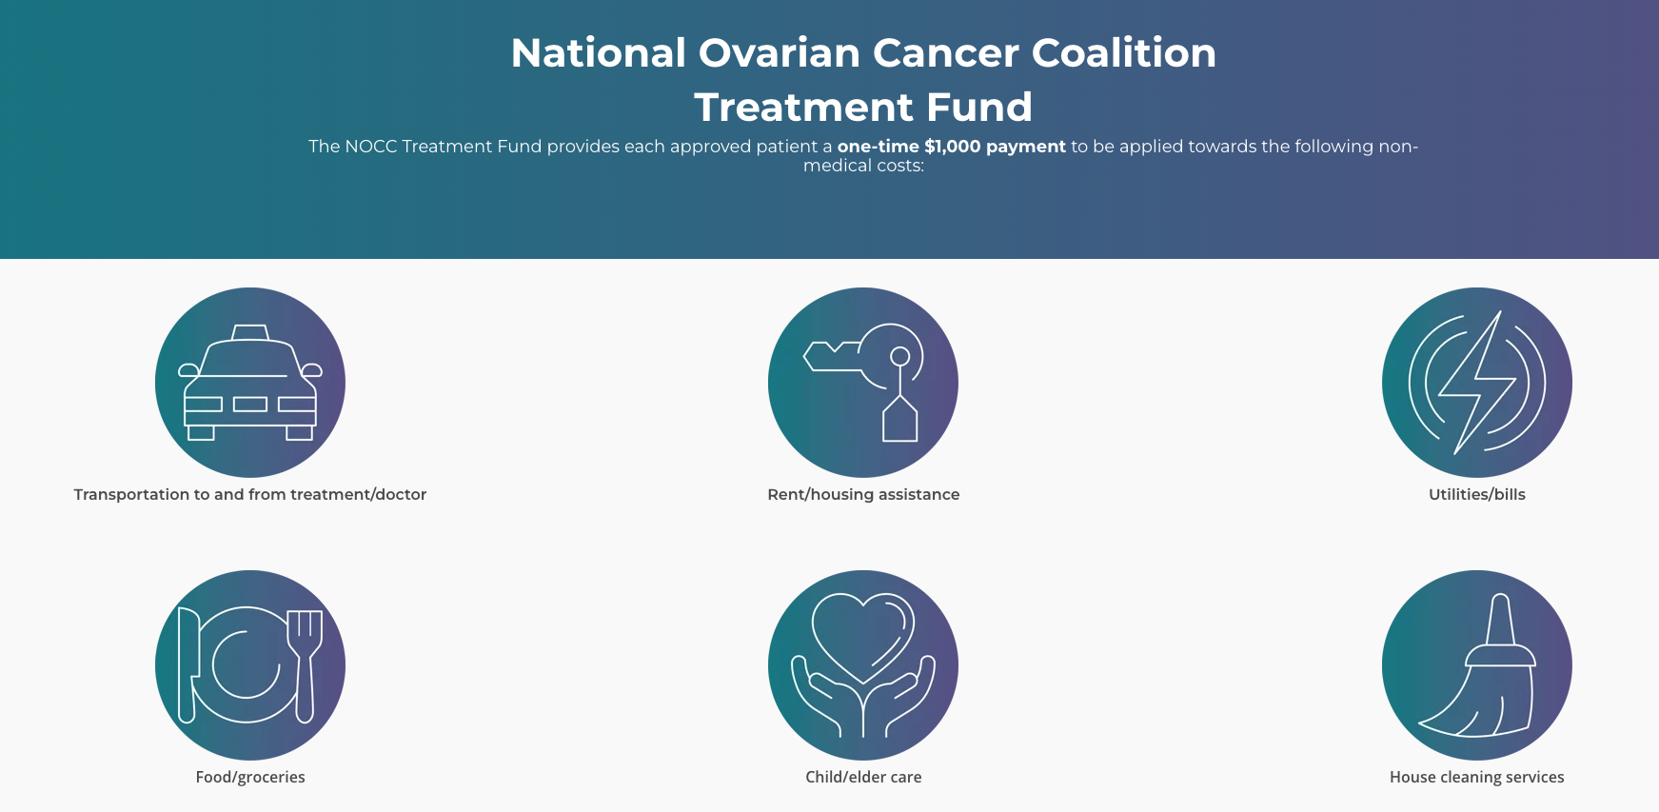
NOCC Is an Excellent Resource for Nurses, Patients, and Caregivers
Talk to your patients about
NOCC’s support resources
Peer support programs, including the survivor peer-to-peer support group and caregiver peer support group
Support services such as financial assistance, counseling/coping, meal delivery service, and care packages
Financial Assistance
nocc@ovarian.org • 888-OVARIAN • ovarian.org

Slide 58



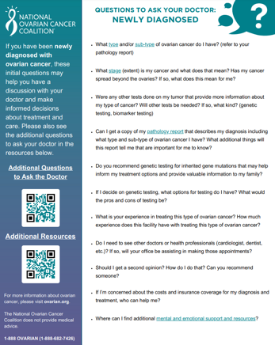
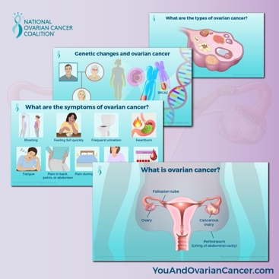



Tools for Patient Education:
Free Online Resources
NOCC
nocc@ovarian.org
888-OVARIAN • ovarian.org
FWC
foundationforwomenscancer.org
Comprehensive online education,
including animated Patient Guide videos, an extensive resource library (English and Spanish), Ask the Experts, Facebook Live Series, online wellness symposiums,
and more!
Interactive video education, Compassionate Caregivers
video series, clinical trials guide, resources in English, Spanish, and Mandarin, and more!

Slide 59
Summary and Parting Thoughts:
What Does This Mean for Nurses?
Biomarker testing is imperative for all patients with gynecologic cancers
Different issues may arise with immunotherapy, PARP inhibitors, ADCs and various combinations
  Distinct AE profiles—be prepared for potential toxicity, variable onset timing, and dose adjustment needs
  Prioritize clinical trial enrollment for all patients with a focus on increasing diversity
Educate patients and care partners
  They will have questions as they experience these newer modalities
  They will ask you questions they don’t ask doctors
    Be prepared
    Know how to answer
    Know where to direct queries

Slide 60
Visit us at
PeerView.com/GynCancer-Survey-XRZ
Please remember to complete and submit your
post-test and evaluation for CE credit
Thank you for joining us!

Slide 61
Abbreviations
1L: first line
2L: second line
AACR: American Association for Cancer Research
ADC: antibody–drug conjugate
AESI: adverse events of special interest
AML: acute myeloid leukemia
APC: antigen-presenting cell
ASCO: American Society of Clinical Oncology
BLCA: bladder urothelial carcinoma
BRCA: breast invasive carcinoma
CD8: cluster of differentiation 8
CN: copy number
COAD: colon adenocarcinoma
CP: chemotherapy
CPS: combined positive score
CTLA-4: cytotoxic T-lymphocyte–associated protein 4
dMMR: deficient mismatch repair
DSB: DNA double strand break
EC: endometrial cancer
EGD: esophagogastroduodenoscopy
EOC: epithelial ovarian cancer
ESMO: European Society for Medical Oncology
FA: fanconi anemia
FIGO: International Federation of Gynecology
and Obstetrics
FR⍺: folate receptor alpha
FWC: Foundation for Women’s Cancer
GBM: glioblastoma multiforme
HCP: healthcare professional/provider
HNSC: head and neck squamous cell carcinoma
HR: hormone receptor
HRD: homologous recombination deﬁciency
HRR: homologous recombination repair
IC: induction chemotherapy
ICI: immune checkpoint inhibitor
IHC: immunohistochemistry
ILD: interstitial lung disease
irAE: immune-related adverse event
KIRC: kidney renal clear cell carcinoma
KIRP: kidney renal papillary cell carcinoma
LGG: lower grade glioma
LIHC: liver hepatocellular carcinoma
LUAD: lung adenocarcinoma
LUSC: lung squamous cell carcinoma
MDS: myelodysplastic syndrome
MIRV: mirvetuximab soravtansine
MMR: major molecular response
mOS: median overall survival
mPFS: median progression-free survival
MSI: microsatellite instability
MSI-H: microsatellite instability high
MSS: microsatellite stable
NCCN: National Comprehensive Cancer Network
NER: nucleotide excision repair
NK: natural killer (cell)
NOCC: National Ovarian Cancer Coalition
NR: not reached
NSMP: non-specific molecular profile
ORR: overall response rate
OV: ovarian serous cystadenocarcinoma
PARP: poly ADP-ribose polymerase
PARPi: poly ADP-ribose polymerase inhibitor
PD-1: programmed cell death protein 1
PD-L1: programmed death-ligand 1
PLD: pegylated liposomal doxorubicin
pMMR: proficient mismatch repair
PRAD: prostate adenocarcinoma
READ: rectum adenocarcinoma
SGO: Society of Gynecologic Oncology
SKCM: skin cutaneous melanoma
SSB: single-strand break
STAD: stomach adenocarcinoma
T-DXd: trastuzumab deruxtecan
TEAE: treatment-emergent adverse event
TF: tissue factor
THCA: thyroid carcinoma
TMB: tumor mutational burden
TV: tisotumab vedotin
UEC: uterine endometrioid carcinoma
WT: wild type

