Slide 2
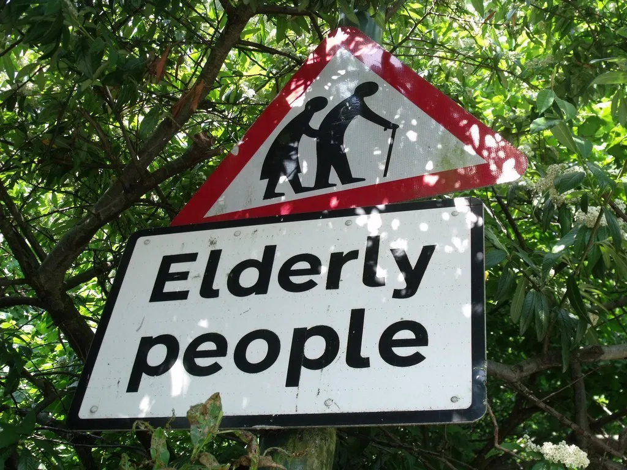
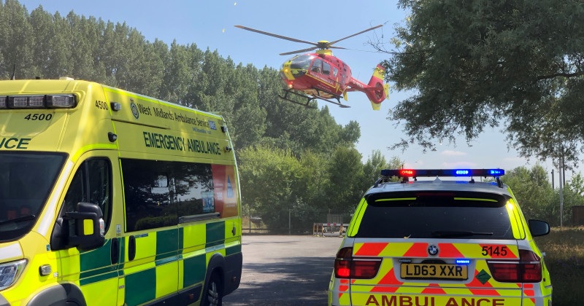
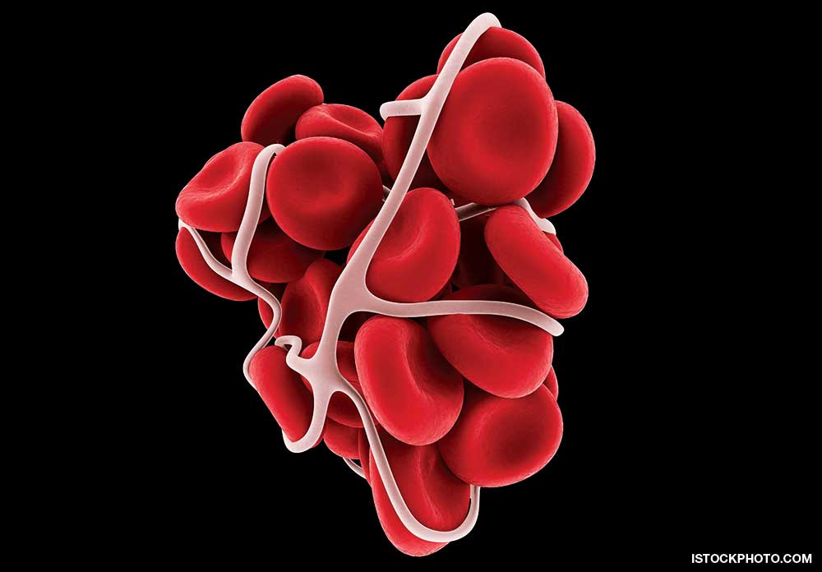

Slide 3
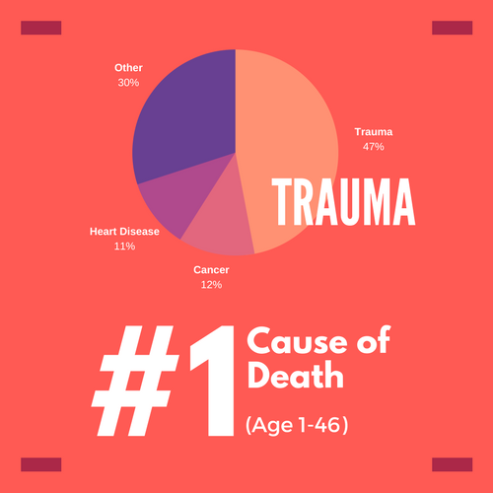

Slide 4
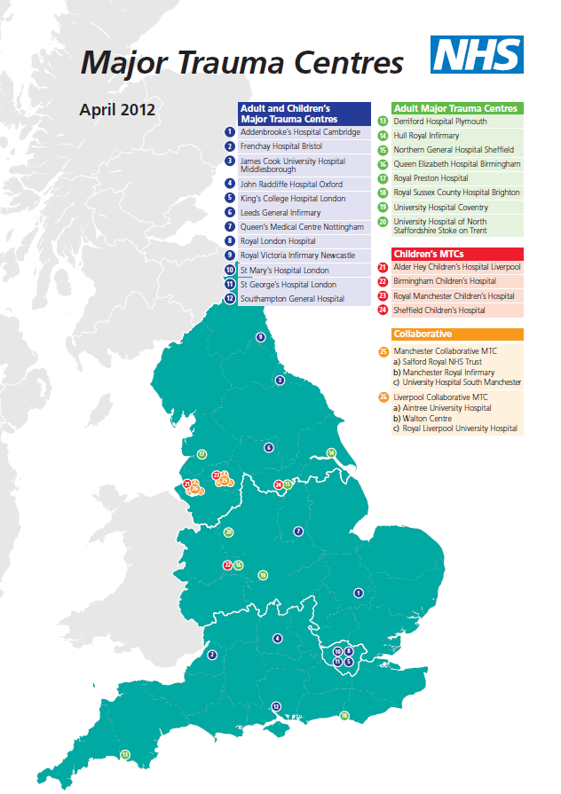
National Audit Office estimate 20 000 cases of MT occur in Eng each year
Resulting in 5400 deaths
Majority of MT in Eng is road traffic accidents.
Major impetus to improve care came with the publication of the NAO Report ‘Major Trauma Care in England’ in 2010.
Identified deficiencies in trauma care within the NHS and a failure to reorganize care, despite repeated reports and evidence of poor outcomes.
This report recommended the establishment of regional Major Trauma Networks.
Bespoke networks designed to deliver good care, irrespective of where the injury occurred, getting the patient to the:
‘right place at the right time for the right care’

Slide 5
www.midlandsnetworks.org.uk
@MidlandsCCTNB
Isochrones were a factor originally 45mins to an MTC, now 60mins
Birmingham Black Country Hereford & Worcester Trauma Network
Central England Trauma Network
North West Midlands & North Wales Trauma Network
All 3 networks went live on 26th March 2012.
Only 2 changes from TU to LEH - City hospital & Alexandra.

Slide 6
www.midlandsnetworks.org.uk @MidlandsCCTNB
Queen Elizabeth Hospital Birmingham Children's Hospital
Birmingham Heartlands Hospital
Hereford Hospital
New Cross Hospital
Russell's Hall Hospital
Sandwell Hospital
Walsall Hospital
Worcester Hospital
Alexandra Hospital City Hospital Good Hope Hospital
Solihull Hospital
Moseley Hall Hospital
Robert Jones & Agnes Hunt Hospital
Royal Stoke University Hospital
Leighton Hospital
Glan Clwyd Hospital
Ysbyty Gwynedd Hospital
Wrexham Maelor Hospital
Royal Shrewsbury Hospital County Hospital, Stafford
Telford Hospital
Haywood Hospital
University Hospital of Coventry and Warwickshire Kettering General Hospital
Northampton General Hospital Warwick George Eliot
Central England Rehabilitation Unit Stoke Mandeville Hospital
West Midlands Ambulance Trust
East Midlands Ambulance Trust
North West Ambulance Trust
Welsh Ambulance Trust
EMRTS.
TAAS.
Midlands Air Ambulance.

Slide 7
The NHS in England has saved an additional 1,600 patients with severe injuries since major trauma centres were established in 2012, thanks to the top teams of surgeons, doctors and clinical staff.
Patients also spent fewer days in hospital and had improved quality of life after receiving critical care.
Changing the System - Major Trauma Patients and Their Outcomes in the NHS (England) 2008–17
Serious trauma, life changing illnesses and injuries requiring rehab services
Lack of recognition in the subsequent rehab needs.
Trends in odds of surviving major trauma: April 2008–March 2017.
Changing the System - Major Trauma Patients and Their Outcomes in the NHS (England) 2008–17

Slide 8
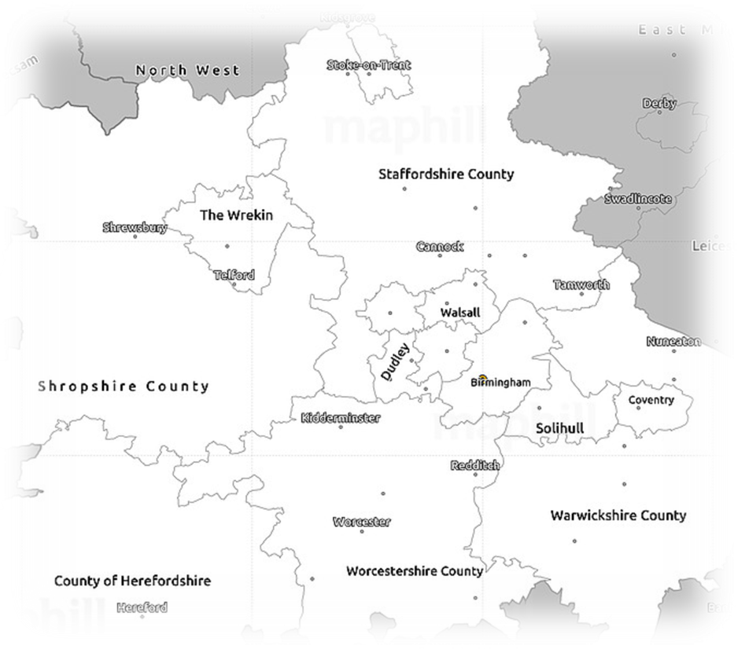
www.midlandsnetworks.org.uk
@MidlandsCCTNB
Specialist rehab bed capacity
Onsite specialist rehab provision
Rehab / Trauma coordinator
No. of Clinicians from Specialities Orthogeriatrian’s, IR, Psychology
No 24/7 ED Consultant provision
MTC Manager continuity
Helicopter landing provision & Nightly landing provision

Slide 9
www.midlandsnetworks.org.uk
@MidlandsCCTNB
CT performance
Tri-Network Pelvic pathway
BOAST4 Coverage. Theatre capacity issue.
Repatriation – Care closure to home, very limited spec rehab provision
Legacy Neuro pathways – Confusion on decision making
Neuro support and decisions
Inconsistent Pre hospital provision
Paramedic’s using the triage tool
Spinal capacity at Regional centre

Slide 10
www.midlandsnetworks.org.uk
@MidlandsCCTNB
One of top 3 busiest MTC
Previous leader with BOAST4 fractures
Higher than average getting transfers within 2 days
In the top 3 for outcomes
NICE heads Ct’d within Hr Always above national ave
Higher than ave Consultant led trauma triage
Previously described by Peer review as one of best functioning networks in country.

Slide 11
www.midlandsnetworks.org.uk
@MidlandsCCTNB
Trauma Related Issues Database (TRIDs)
Triage tool
Pre-hospital merit teams
Regional Trauma Desk
Regional Silver Trauma Triage tool
Access to Pre hospital eprf
Development of the West Mids Framework
High risk event guidance and pathways
Paediatric retrieval service used for Trauma

Slide 12
www.midlandsnetworks.org.uk
@MidlandsCCTNB
Prevention projects
Paed knife crime
Red thread
All triage tool + gets Consultant led team
All transfers in within 2 days
“Code Red” alert for Trauma calls to mobilise required teams
Military centre to advance research and education
Telemedicine referral systems

Slide 13
www.midlandsnetworks.org.uk
@MidlandsCCTNB
Build on the last 7 yrs.
Make of the next 7 yrs.
Continue to Network

