Slide 1
EMS Safety: the Combative Patient
Connie J Hall 2017

Slide 2
Overview
Common causes of combative patients
Use of Force Continuum
Excited Delirium and treatment overview
When it all goes south!
Training
National Association of EMS Physicians – Position Paper
Special Situations

Slide 3
THE HEADLINES READ…
“Restrained patient chokes and threatens to kill medic”
“Man slips out of handcuffs – jumps out of ambulance.”
“Punched in the face – Female EMT attacked while attempting restraint.”
“EMTs attacked when patient slips out of restraints”
https://youtu.be/NwJdiDgzjeU
http://dt4ems.com/danger-hidden-in-plain-sight-patient-restraints/

Slide 4
Common causes of combativeness
A = Acidosis or alcohol
E = Epilepsy
I = Infection
O = Overdose
U = Uremia
T = Trauma or tumor
I = Insulin
P = Psychosis
S = Stroke
Most frequent chemical causes are stimulants, such as cocaine, or hallucinogens.
PCP
MDMA (ecstasy)
Flakka
Bath Salts
LSD, etc.
“EXCITED DELIRIUM”

Slide 5
Excited delirium
“Excited (or agitated) delirium is characterized by agitation, aggression, acute distress and sudden death, often in the pre-hospital care setting. It is typically associated with the use of drugs that alter dopamine processing, hyperthermia, and most notably, sometimes with death of the affected person in the custody of law enforcement”
(2011, Takeuchi, Aherm, Henderson)

Slide 6
Treatment of ExDS
Dual Response: Law enforcement & EMS
Attempt verbal de-escalation
  Calm voice, short sentences, simple vocabulary
  Minimize lights and sirens that could further agitate or provoke fear
Physical Restraint
  Four point method “one-hand up, one hand down”
  No “hog-tying”
Sedation
  Benzodiazepines
  Ketamine
  Antipsychotics
Fluid Resuscitation
  Key supportive for treatment of ExDS. Pt extreme exertion & hyperthermia

Slide 7
When it all goes south!
If things take a turn for the violent, EMS providers can make suitable use of Law Enforcements first four levels of the Use of Force Continuum.
Level 1: Law Enforcement officer presence
Level 2: Verbal Communication
Level 3: Control holds and restraints
Level 4: Chemical agents

Slide 8
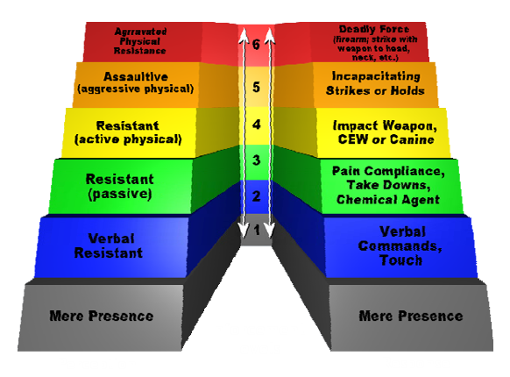

Slide 9
Level 1: Law Enforcement Presence
The mere presence of a law enforcement officer, on its own, may be enough to prevent or abort a patient encounter. However, it may sometimes exacerbate violence.

Slide 10
Level 2: Verbal communication
Practice verbal de-escalation techniques, and give the patient space. Keep your hands open, and it might be helpful to reduce stimulus – that means sending other people away from the scene.
Avoid prolonged direct eye contact, and don’t argue with the patient. It is easy to argue back at a combative patient, but keep your voice low, remain calm, and explain what you’re doing or going to do.

Slide 11
Level 3: Control holds & restraints
If at all possible leave restraint to the professionals.
There is no specific or “magical technique” to restraints. There are however two guiding principles:
  Body parts to Body Mass
    “Press the body part to the body mass of the individual you are trying to medically restrain”
  Control the Middle Joint
    Example: Elbow control is the principle that must be followed while applying restraints to the upper limbs. Simple elbow control controls the entire arm. Grabbing a person by the wrist does nothing to control the strength of that limb.
    http://dt4ems.com/danger-hidden-in-plain-sight-patient-restraints/

Slide 12
Level 4: Chemical agents
To the Law Enforcement Officer this would be OC spray, to the EMS provider medication.
The goal is to reduce combativeness, not to render the patient unconscious. Medications should be administered intramuscularly or intranasally, whichever is safest for the provider.

Slide 13
The problem with EMS & patient restraint is…training!

Slide 14
Comparing Restraint Training
Average Training Hours
Law Enforcement
Medical Staff
40 – 80 Defensive Tactics (AKS Mechanics of Arrest & Control Tactics)
8 Actual Handcuffing (Temporary means of restraint)
8 Baton Skills
4-8 OC/Pepper Spray
4-8 Taser
40-80 hours rage time (if it has a head, cuff it)
Hundreds of hours of laws (criminal/traffic etc) to teach when to and when NOT to take custody (apply restraints i.e. handcuffs
0 – 4 on the application of soft restraints
0 the mechanics to “control” a person to get them into a position in which to apply the actual restraint.
0 on when to or when not to place a person into medical restraints
0 on critical thinking skills to recognize custody vs care
http://dt4ems.com/danger-hidden-in-plain-sight-patient-restraints/

Slide 15
Training in Level 1: Presence
EMS providers should work with local law enforcement to develop training scenarios, policies, and response plans to bring awareness to this serious EMS concern.
Establish when law enforcement is needed and policies on patient restraint, methods of restraint, and EMS transport of a handcuffed individual.

Slide 16
TRAINING IN LEVEL 2: De-escalation
There are several programs used by today’s Law Enforcement Officer’s to teach de-escalation techniques.
Verbal Judo
L.E.A.D.S. (Law Enforcement Active De-escalation Strategies)
P.E.R.F. – 30 guiding principles of police use of force.
EMS could make great use of George Thompson’s Verbal Judo (the book is a great read, full of information)

Slide 17
Training Level 3: Control holds & restraints
DT4EMS – Defensive Tactics 4 Escaping Mitigating Surviving
Training with local police departments
Basic martial arts classes

Slide 18
Training Level 4: Chemical agents
Provide your EMS providers with combative patient training.
Train how to administer medication in a combative, restrained patient.
Continuously monitor new drugs and research on combative patients and or illegal drugs/ medical conditions.

Slide 19
NAEMSP – position paper
Patient Restraint in Emergency Medical Services Systems
Douglas F. Kupas, MD, Gerald C. Wydro, MD

Slide 20
NAEMSP Paper Highlights
Look for and treat medical conditions first.
Look for and treat reversible conditions before restraining patient.
Restraint in hobble or hogtie is particularly dangerous
Method of patient restraint must allow for continuous patient assessment and for medical interventions during transport.
Many EMS educational programs do not address agitated delirium and its complications.
EMS personnel should anticipate the potential for exposure to blood and body fluids.
Do not transport in the prone position

Slide 21
What do you think?
Combative patient – Interfacility transfer loading at the hospital
Combative patient – during transport
What are some other situations?

