Slide 1

“It’s All About
Classical Music”
Sponsored by “The Steinway Society of Riverside”
Mr. McSymphony™’s
A Mr.McSymphony™ Program
©2015 all right reserved
1

Slide 2
COMPOSER LIST
ON A CLEAN SHEET OF WHITE PAPER, WRITE THE NUMBERS FROM ONE TO ELEVEN VERTICALLY DOWN THE LEFT SIDE OF THE PAPER.
2. SKIP A SPACE BETWEEN EACH NUMBER.
3. CIRCLE THE NUMBERS 1,5,7 & 10. THESE WILL BE THE
COMPOSERS IN THE MYSTERY COMPOSER TEST AT THE END OF THE PROGRAM
4. AS THE COMPOSER’S NAME APPEAR ON THE SCREEN WRITE HIS NAME TO THE NEXT AVAILABLE NUMBER STARTING WITH THE NUMBER ONE.
2

Slide 3
MUSIC PERIODS
BAROQUE- 1550-1750
CLASSICAL- 1750-1850
MODERN PERIODS- AFTER 1850
3

Slide 4
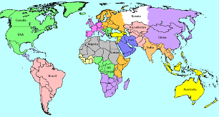
Map of World
4

Slide 5
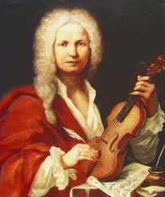
Vivaldi’s
“THE FOUR SEASONS”
BAROQUE MUSIC
5

Slide 6
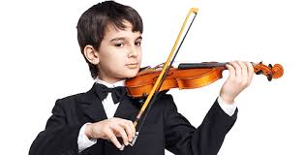
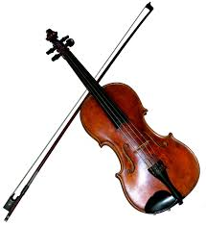
Antonio Vivaldi
“The Four Seasons”
Most of the sounds come from violins
6

Slide 7
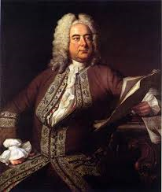
George Frideric Handel
BAROQUE MUSIC
7

Slide 8
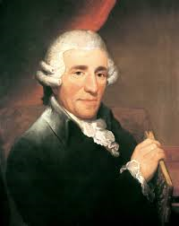
Franz Joseph Haydn
8

Slide 9
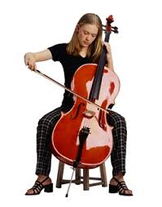
Cello – a large violin
THE CELLO IS ONE OF FOUR
4 STRING INSTRUMENTS IN A SYMPHONY ORCHESTRA
9

Slide 10
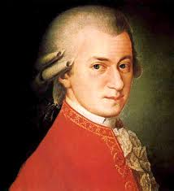
Wolfgang Amadeus Mozart
10

Slide 11
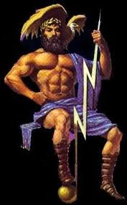
Jupiter –
Roman God
Name of Mozart’s Symphony
11

Slide 12
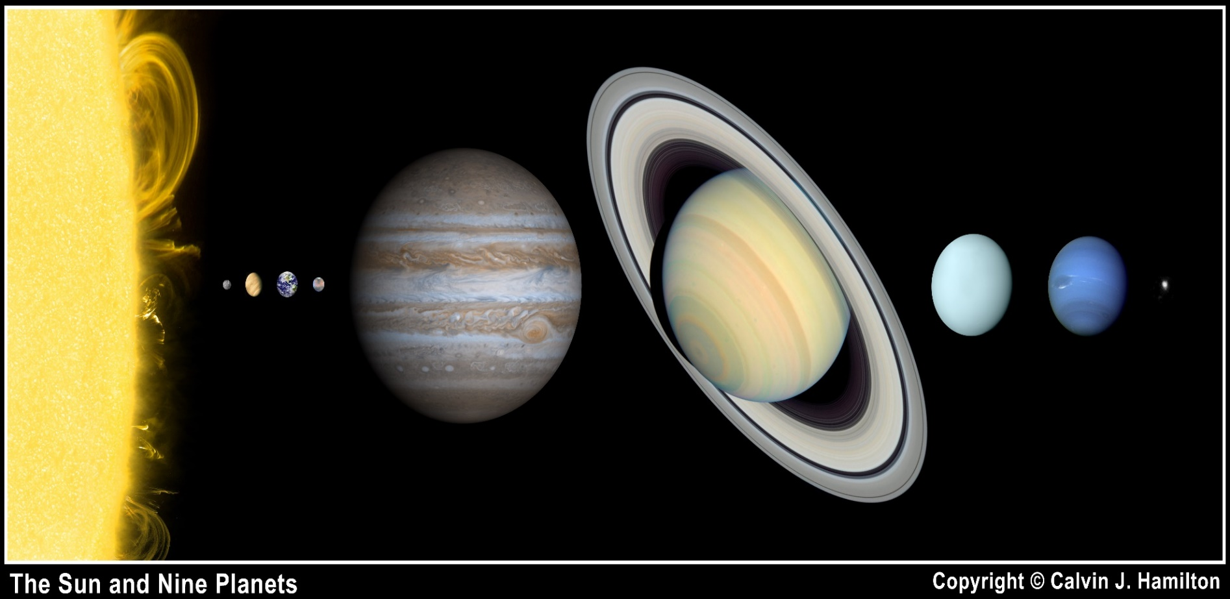
CAN YOU NAME THE PLANETS?
12

Slide 13
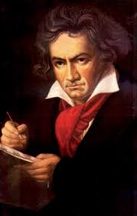
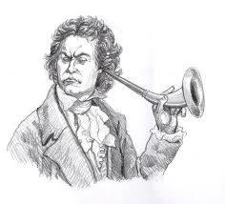
Ludwig Van Beethoven
He had a hearing problem
13

Slide 14
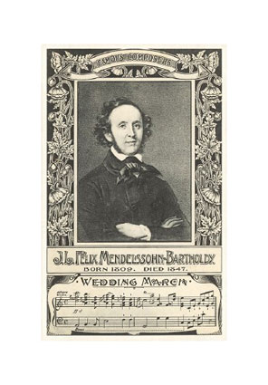
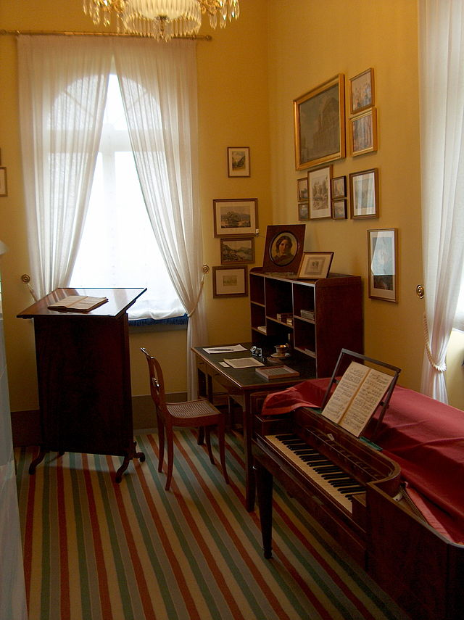
FELIX MENDELSSOHN
Felix’s Studio
HE WROTE THE FAMOUS
“WEDDING MARCH”
14

Slide 15
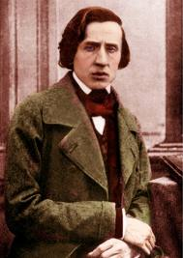
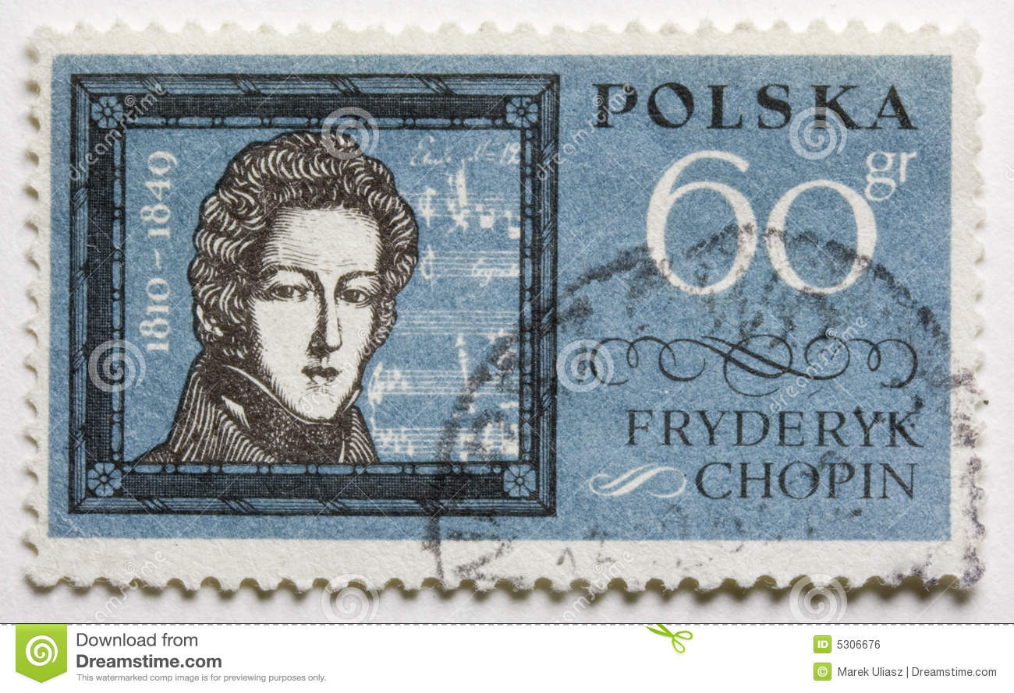
Frederic Chopin
1810-1849
A Polish Stamp in his honor
15

Slide 16
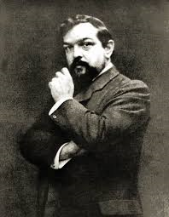
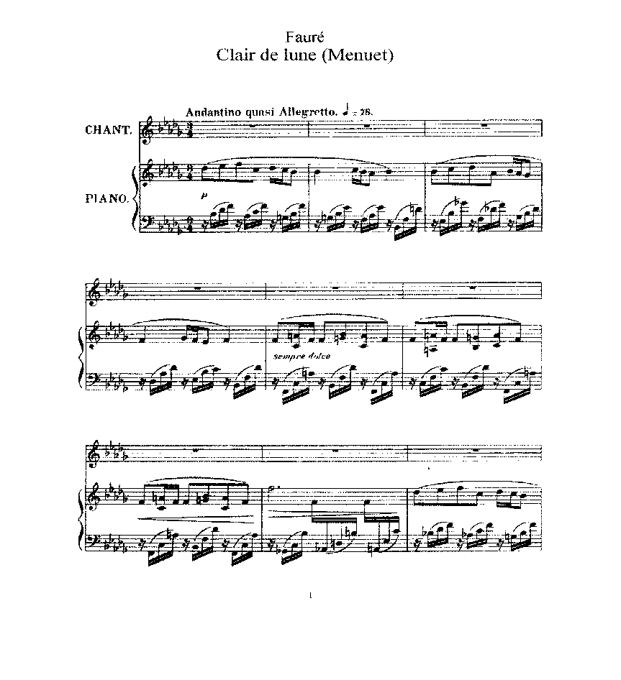
Claude Achille Debussy’s
“Clair de Lune”
THE SCORE
16

Slide 17
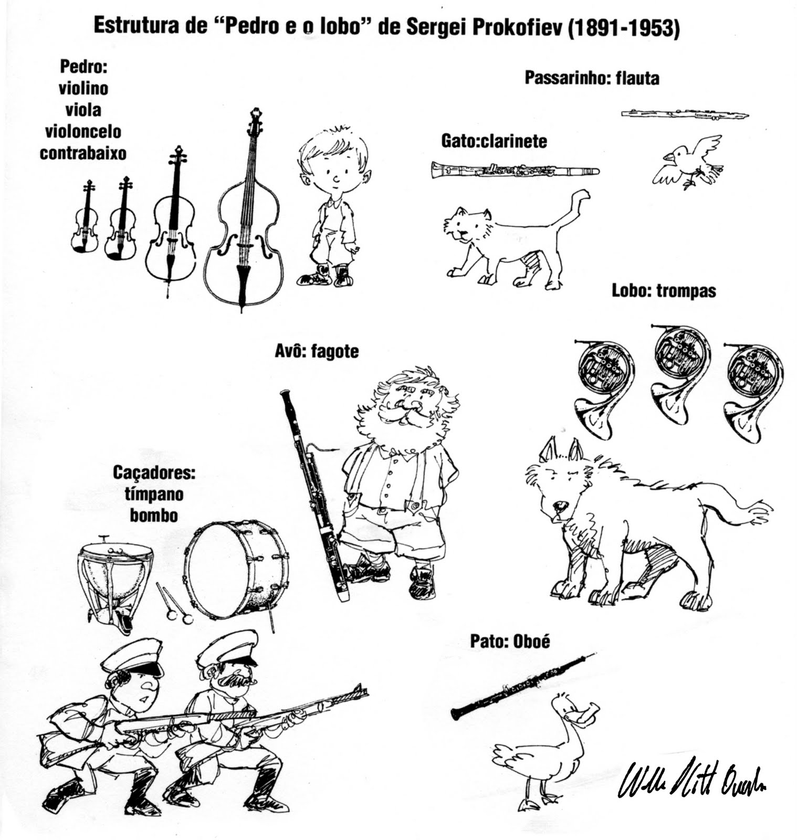

Sergei Prokofiev’s
“Peter and the Wolf”
17

Slide 18
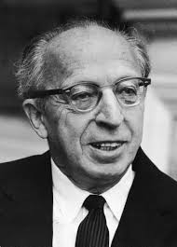
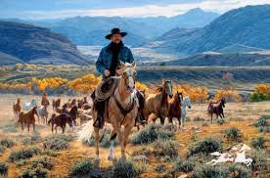
Aaron Copland
“Prairie Night” from “Billy The Kid”
18

Slide 19
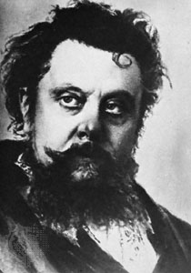
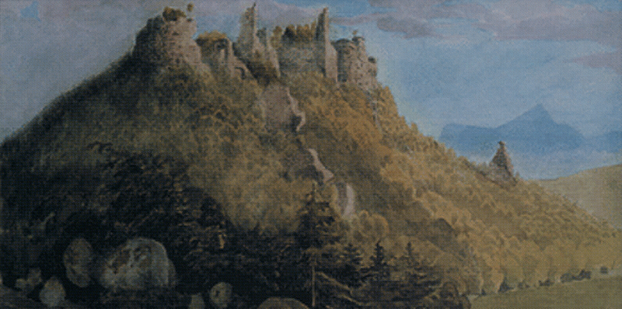
MODEST MUSSORGSKY
19
“A Night on Bald Mountain”

Slide 20
Mystery Composers
#3. All of his works feature
the “PIANO”
#4. Took lessons from
“ Haydn and Mozart”
#1. Hint- This piece is
titled “SPRING”
#2. Hint-First great
“American Composer”
20

Slide 21
The End
“It’s All About Classical Music”
21

