Slide 1
DASHAVATARA
The Ten Incarnations

Slide 2
Dashavatara
Dasha – Ten
Avatara – Incarnation
The Ten Incarnations of Lord Vishnu
According to Hindu mythology Lord Vishnu, the protector of the universe incarnated in various life forms.
Whenever Dharma was threatened Vishnu is said to have taken a life form or an ‘avatara’ to restore order and protect people against evil elements in society.

Slide 3
Ten Incarnations of Lord Vishnu
Matsya (Fish)
Kurma (Turtle)
Varaha (Boar)
Narasimha (half man and half lion)
Vamana (short/dwarf man)
Parashurama (parashu-axe; Rama = name of God)
Rama
Krishna
Buddha (or Balarama)
Kalki

Slide 4
THE FIRST SIX INCARNATIONS OF VISHNU DARWIN'S THEORY OF EVOLUTION
Matsya (Fish)
Life starts in water (600 million-400 million years ago)
Kurma (Turtle)
The first amphibians emerge (100 million years ago)
Varaha (Boar)
The first mammals evolve (60 million years ago)
Narasimha (half man-half lion)
Half man-half animal appear (30 million years ago)
Vamana (short man)
Homo Erectus, upright, yet short and weaponless
(5 million - 2 million years ago)

Slide 5
TRIVIA
What does Dasha mean in Sanskrit?
TEN
What does Avatara mean in Sanskrit?
INCARNATION
Dashavataras are incarnations of _________.
LORD VISHNU

Slide 6
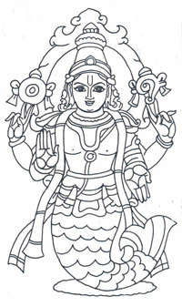
MATSYA AVATARA
Matsya - Fish

Slide 7
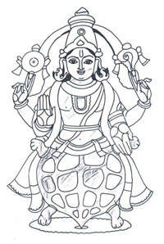
KURMA AVATARA
Kurma - Turtle

Slide 8
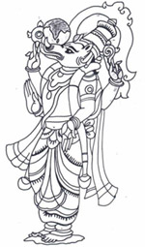
VARAHA AVATARA
Varaha - Boar

Slide 9
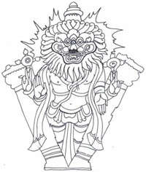
NARASIMHA AVATARA
Nara – Man Simha - Lion

Slide 10
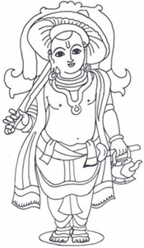
VAMANA AVATARA
(Dwarf)

Slide 11
TRIVIA
What does Matsya mean in Sanskrit?
FISH
What does Kurma mean in Sanskrit?
TURTLE
What does Varaha mean in Sanskrit?
BOAR

Slide 12
TRIVIA
What does Nara mean in Sanskrit?
MAN
What does Simha mean in Sanskrit?
LION
What is the Avatara that follows Narasimha?
VAMANA

Slide 13
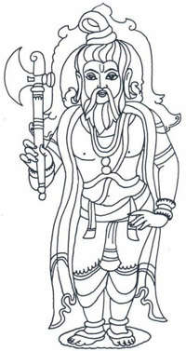
PARASHURAMA AVATARA
(parashu=axe; Rama = name of God)

Slide 14
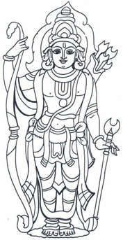
RAMA AVATARA
Rama = handsome

Slide 15
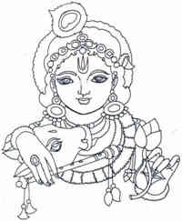
KRISHNA AVATARA
Krishna = Dark

Slide 16
Some Observations
Parashurama: Man with a crude weapon – used to defend himself against predators; Parashurama is known for his wrath and fury – aggressive man.
Rama: Man with a much more refined skill and weapon – bow and arrow to defend himself; Rama is known for his pure and uncorrupt disposition.
Krishna: Man with shrewdness in politics and warfare – a musical instrument, flute is also played by Krishna. A politically savy and manipulative, yet, refined and cultured man.

Slide 17
TRIVIA
What is the first avatara of Vishnu?
MATSYA
What avatara comes after Kurmaavatara?
VARAHA
What avatara comes after Vamanaavatara?
PARASHURAMA

Slide 18
TRIVIA
What avatara comes after Rama avatara?
KRISHNA
What does parashu mean?
AXE
What is Rama’s weapon?
BOW & ARROW

Slide 19
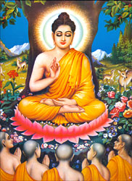
BUDDHA AVATARA

Slide 20
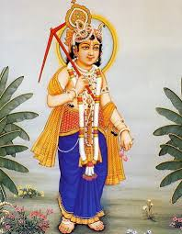
BALARAMA AVATARA

Slide 21
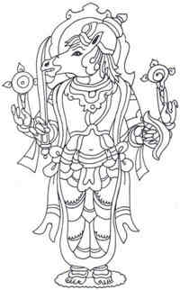
KALKI AVATARA

Slide 22
Some Observations
Buddha: Man who gave up warfare and sought peace and renunciation.
Balarama: Man who was skilled in agriculture and cultivation of land for his survival.
Kalki: Man yet to come - the mission of KalkiAvatara is to re-establish the religious principles, which have disappeared in the iron age of hypocrisy and quarrel.

Slide 23
QUESTIONS
List the first five avataras of Vishnu in order.
MATSYA
KURMA
VARAHA
NARASIMHA
VAMANA
Complete the list…..
PARASHURAMA
RAMA
KRISHNA
BUDDHA/BALARAMA
KALKI

