Slide 1
JOURNEY TO WELLNESS ….. LIVE LIFE IN BALANCE

Slide 2
RELATIONSHIP WITH FOOD!
"Eat often – snack often," While this may seem contrary to traditional dieting advice, as long as you keep an eye on calories and portions, eating often will stave off hunger attacks that ultimately sabotage your diet. "When you're starving, you grab whatever is available -- and that's the quickest way to get off your eating plan"
Notes:
How many of you don’t eat til the end of the day , or eat 3 really big meals a day. Or your biggest meal is in the evening.

Slide 3
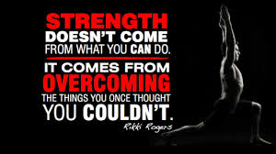
60/40split
60 % of success comes from eating right , and having a positive mental attitude towards the foods you eat. 40% of success comes from exercising often , you must make the commitment to yourself . Commit- Achieve – Receive!!
Notes:
Losing weight and keeping it off requires an holistic approach, combing proper meal planning, good workouts, Knowing WHY you over eat, and understanding how to push yourself towards CHANGE! Your desire to change has to be stronger than your desire to stay the same! your body is your vehicle – you’re a farreri so fuel yourself with ultra clean fuels and maintaince , and of course you’re a ferrari so you have the need for speed – get out and burn up the track!!

Slide 4
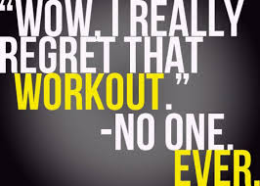
Stop the “BUT….”
Don't blame your genes! Yes, everyone is built differently, and some of us gain weight more easily than others. But to say, “I can't make any improvement because I have fat genes” is B.S !! OR because I have some other “dis”ease…. It's not true, and it's disempowering. No matter what your genes are, you have the ability to make the right choices about eating and exercise."
Notes:
No excuses , no but’s , we all draw the same minutes in a day , we make excuses for ourselves – we take the easy over the hard.

Slide 5
It’s all in the fist
PORTIONS: When we talk about portions , it’s as easy as looking at your fist. One plate consists of a fist size of meat and 2 palms of vegetables. AND 1 small fist size of whole grains. You should be able to see your plate!!
Notes:
Refer to your handouts you’ll see the hand sizes represented. When in doubt never eat a portion of anything larger than your fist.

Slide 6
How many meals a day ??
I'm talking 6 small meals a day – if this doesn’t fit your work schedule then minimum to 5 . By eating more often your body knows when it’s next meal is going to be so it will go ahead and use the energy from the food you ate.
If you yo-yo and don’t eat 4 to 5 hours your body says hold on we need to store fat because we don’t’ know when our next meal is…
Notes:
We are not dieting people , we are eating to lose. What are the first 2 letters in the word diet , D-I-E !!

Slide 7
Eat what is made “ on a plant ” not what is made in plant !
Lets talk about processed foods and what I like to call “white Death!” how to satisfy taste buds with real food.
This after all is what our body is craving. FOOD be thy MEDICINE - Hippocrates

Slide 8
Carbs , Protein , Fats
45% carbs 30 % protein 25% fats You’ll eat small, frequent meals. Most of your food is lean protein, low-fat dairy or soy, fruits, vegetables, whole grains, beans, and nuts.
It’s based on 4-3-2-1 Reverse Pyramid: four servings of fruits and vegetables, three servings of lean protein, two servings of whole grains, and 200 calories of “extras.”
Most foods are low in calories but high in fiber, to help you feel fuller longer. By eating five to six small meals and snacks, you’ll keep your blood sugar and hunger in check
Notes:
Eat proteins, carbs and fats in one meal. Do not just eat carbs… then protein later…

Slide 9
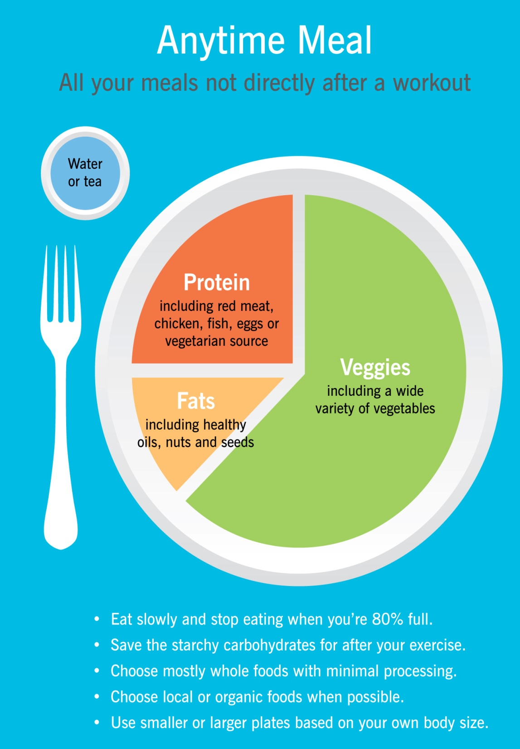
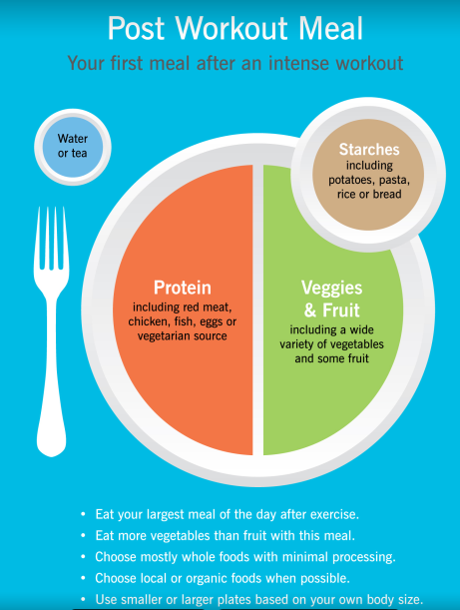

Slide 18
Notes:
Lets talk about our bowels!! 3 times a day! Your plate should always be colorful~ like a rainbow . Processed foods add food coloring just so our mind is attracted to it!

Slide 21
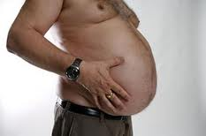
Food Intolerances
Wheat belly
Anti-acids, allergens, and MSG
Notes:
So why do we eat these things if they make us feel horrible?? Are body is telling us these things aren’t good for us with allergies and stomache aches , acid reflux etc.

Slide 22
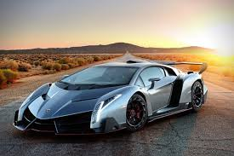
What C.A.R. are YOU ?
Commit . Achieve. Receive … Think of your self at the finish line.. If you want to run like a race car , you must treat your “vehicle like a race car.
Notes:
Restaurants and eating out…. Dessert in just stressed spelt backwards!

Slide 23
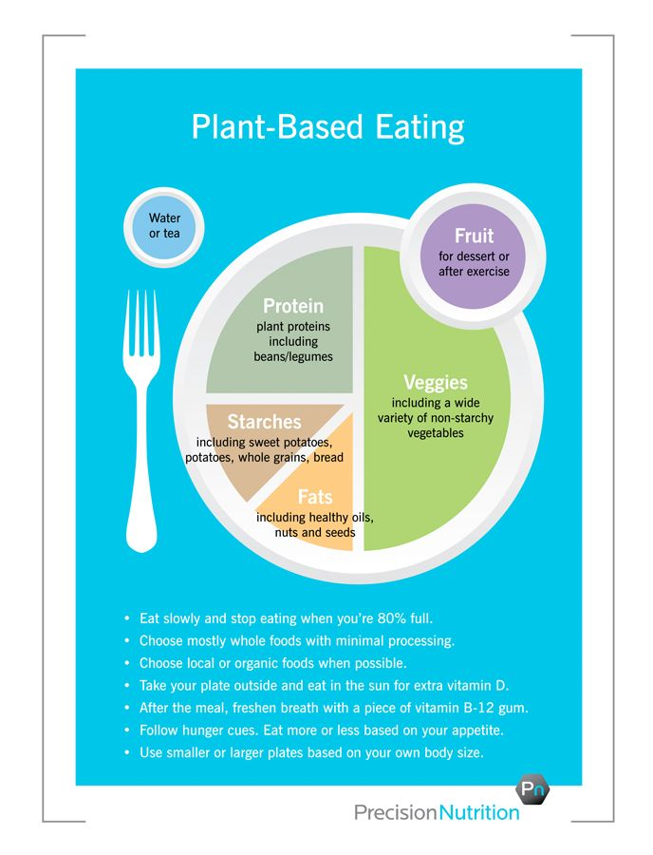
Vegans
Vegetarians have plenty of choices. I was a vegan for 13 years , it’s a very healthy way to live and great for the digestive tract. Please be reminded that you really need to keep your vitamin B’s in check .as well as iron and sodium levels.
Notes:
Beans and lentils !! I do recommend protein some egg whites or fish as they contain omega 3,6,9 – and some amino acids that are not found in plant based protein. Whey isolate is my choice.

Slide 24
--Danger –- Do NOT eat after 8pm !
Notes:
Huge !! Questions

Slide 25
Questions and Concerns
Notes:
Resources … lets get going. Buddy systems– shopping store tour. Reading labels .

