Slide 1
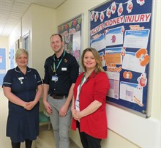
Acute Kidney Injury
Chris Meally
Alison Bakewell
Claire Hayward
@GEHNHSNEWS
A Journey of Continuous Improvement
Notes:
Intro slide Chris & Claire

Slide 2
Acute Kidney Injury (AKI) is…
Kidneys are important to our wellbeing, looking after our bodies through the production of urine to get rid of excess water & toxins.
AKI is a sudden & recent reduction kidney function that causes them to not work properly. It can range from minor loss of kidney function to complete kidney failure.
It is not caused as a result of a physical blow to the body.
100,000 deaths a year are associated with AKI, up to 1/3 of those deaths could be avoided.
1 in 5 people admitted to hospital as an emergency has AKI.
Notes:
Chris

Slide 3
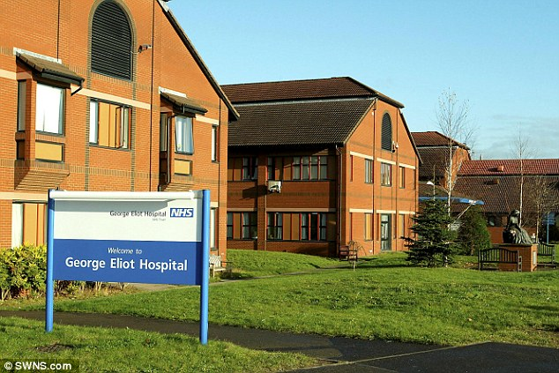
George Eliot Hospital
Serves population of 290,000 in Nuneaton, Bedworth, North Warwickshire and Hinckley & Bosworth
Integrated acute, community and primary care provider with 352 beds.
1 of 11 Keogh Trusts placed in ‘Special Measure’ – In Jan 2014 the Trust had made significant improvement and is now rated ‘Good’ overall by CQC
No dedicated renal team on site
Potential increased risk of delay in recognition and treatment to our patients.
Notes:
Claire – link in incident re patient deterioration on CDU due to failure to recognise

Slide 4
Context
Lack of clear lead driving AKI within the Trust.
Aware that without an onsite renal team patients could be a risk of deteriorating if not recognised in a timely manner.
Frustration with current management of AKI and previous care bundle.
Wanted to integrate the systems we use to drive change and improve patient safety.
National recommendations for AKI that required implementation.
Notes:
Chris

Slide 5
Timeframe
Chris stepped forward as AKI lead
Implemented AKI algorithm to the laboratory IT system
Reviewed previous NHS patient safety alerts into AKI to formalise a strategy
AKI steering group was formed, made up of Chris, Claire & Ali
Drafted AKI local policy and care bundle
NHSI release Patient safety alert regarding AKI
Plan in place to ensure compliance with this alert
Launch of AKI Strategy
Comms release, posters, video, social media
Retweets by ThinkKidneys
AKI alerting system in use
Began presenting monthly AKI data to mortality meeting
NHSI publish AKI QI project on their website as a learning tool
Production of annual AKI report
March 2016
April
May
June
July
August
September
October
February 2017
April
During monthly mortality meeting made a presentation into AKI and urged Trust to focus on this important area
Outlined AKI strategy and changes required
Reviewed national recommendation on management of AKI from NICE & Think Kidneys
Reached out to other trusts regarding AKI
Meeting with MD & DON to outline proposed AKI strategy and formalise next steps
Identified Outreach team as response team for AKI S2,3
Worked with IT to plan out an automated alerting system
Production of AKI Video
Arrival of AKI bundle from print company
Ratification of AKI local policy
Creation of Patient information leaflet for those affected by AKI
Appointment of AKI lead
Launch of deteriorating patient group where AKI feeds into
Notes:
Claire

Slide 6
AKI Response Algorithm
Once AKI Alert generated by pathology system all AKI Stage 2 and 3 will generate an automated email to the Critical Care Outreach Team
Outreach team will be notified of email via audio alert on their mobile tablet.
On receipt of the email they will follow the following process:
These actions ensure prompt recognition and management of affected patients
Hospital Inpatient
If outreach team is unavailable they will inform the responsible team of the AKI alert, in hours this will be the patient's parent team and out of hours is the on call team.
The email alert consists of:
- AKI Stage
- Patient Name, Hospital Number, Date of Birth
- Patient Location
-Click through function to view blood results
If outreach team available they will review patient, ensure AKI bundle is implemented and ensure medical and nursing team are aware of the AKI alert
Notes:
Chris

Slide 7
Notable Improvements
Downward trend in AKI
↓ Total AKI alerts for inpatients
↓15.95% reduction in total number of AKI alerts generated by inpatients (351→295).
↓ Number of affected inpatients
↓9.09% reduction in total number of inpatients affected by AKI (121→110).
Reduction in number of patients affected by all stages of AKI with greatest reduction seen in the most severe stage (AKI stage 3)
↓8.49% reduction in pts affected by AKI stage 1 (106→97).
↓18.75% reduction in pts affected by AKI stage 2 (32→26).
↓23.81% reduction in pts affected by AKI stage 3 (21→16).
Notes:
Chris

Slide 8
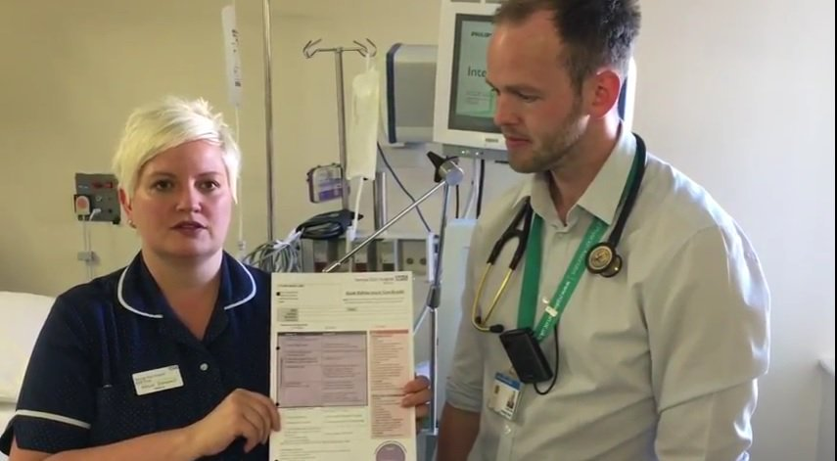
Positive outcomes
Less patients affected by AKI.
No incidents of failure to recognise AKI patients since launch of strategy.
Improved patient and staff awareness, senior commitment and buy in.
Automated alerts with 24/7 response team leading to quicker recognition and response.
Quantitative data to improve patient safety, detect trends earlier and inform staff about processes of care and outcomes
Improved relationships with our local tertiary centre UHCW.
NHSI published project work on their website.
Formation of Deteriorating Patient Group.
Change at an organisational level.
“The AKI alerting process gets the outreach team to the patient sometimes before the patient even triggers a concern, to enable them to be quickly reviewed, speeding up bundle completion and leading to better outcomes for our patients.”
Alison Bakewell, Lead for Critical Care Outreach, Matron for Patient Safety
Notes:
Claire

Slide 9
A journey of continuous improvement

