Slide 1
10 Startup Lessons for Young Entrepreneurs.
By Francis Nwokike

Slide 2
1. KNOW WHAT YOU WANT
If you are a “Jack of all trades” you will find it difficult being a master in one business. You need to concentrate on building and promoting a business. Do not start a business because you heard it bring high returns, venture into a business you love and have background information on, study the business carefully, build an energy around the business, acquire more skill on the business, apply your own ideas, bring in experts that will help you grow the business. No life ever grows great until it is focused. Here are some questions you must ask yourself before starting: What do I want? What must I do to have it? Where can I get the necessary skill? How would I feel when I have it?
“The more you know what you want, the less you lose focus.”

Slide 3
2. DON’T EXPECT TO START PERFECTLY
Procrastination is the killer of dreams. Do not expect to have enough money or investors before you can start that new business. You can start very little, what matters is your dream for the business. You can only stop growing when you stop dreaming higher. Do not be content with where you are per time, always aim for the top while you gradually take the steps.
“Do not despise the days of small beginning”

Slide 4
3. HAVE YOUR CUSTOMERS AT THE BACK OF YOUR MIND
Every business is set up not for the owner but for the people. Whatever business you plan to venture into, have your intending customer’s interest at the back of your mind. If your service/product is good, you will have not only return customers but referral customers too. Your satisfied customers will be part of your media team. LOL. Funny but it’s the truth. But in the reverse case, you can only see a dissatisfied customer once. If possible, when starting that business, conduct a survey on what the people want.
“A bad product can only be sold to a wise unsuspecting customer once”

Slide 5
4. INTEGRITY MATTERS
Integrity is regarded by many people as the honesty and truthfulness or accuracy of one’s actions. It is the concept of consistency of actions, values, methods, measures, principles, and morals. You must be truthful and upright when dealing with your subordinates, customers and investors. This act of honesty can help sustain your business even after you are gone. Don’t create barriers that can stop your journey to success by being greedy.
“Integrity is needed by every man to excel. If one is not upright with a given skill, that skill will not only be killed but have the capacity to kill the bearer” ”

Slide 6
5. SUCCESS IS A GRADUAL PROCESS
f you want to stay on top, climb, if you want to fall from the top, jump. You must do what is required to acquire what is desired. Do not rush success. It takes the demands of discipline and diligent to be successful. Take your success journey one day at a time, be focused on your defined goal and be determined to attain your goal and you will definitely get there. Stop jumping up, just grow up. No one ever arrived at a future that he has not seen.
“On your way to success, if you don’t suffer the pains of discipline, you will suffer the pain of defeat”

Slide 7
6. LEARN HOW TO MARKET
If you cannot market your product, you are not going to succeed as an entrepreneur. As a matter of fact, I think marketing should be one of the basic concepts a young entrepreneur must learn how to do. There are different forms of marketing, so depending on the service you are rendering or product you are selling, you can choose the best that suits your business and brings higher returns.
A young entrepreneur should keep assessing different market strategies until he finds the most effective. He should also seek the service of a good marketing manager to help promote his business.
“The heart of your business success lies in its marketing”

Slide 8
7. BE UPDATED WITH THE TRENDS
Every successful business grew over the years. No conglomerate or group of companies started at the top. It was all a process. Success in business is not a one-time event; it is an on-going process. You must give room for growth. Do not be content with the success of yesterday; always strive to beat your own record. That way, your business will keep on growing, your investors will be happy to remain and inject more funds. Always remain focused and dedicated to your goal. Have a clear goal and pursue it. Your business growth also depends on your marketing strategy. Marketing helps in getting your product known and good sales come from good marketing.
“Without continual growth and progress, such words as improvement, achievement, and success have no meaning”

Slide 9
8. DON’T OVER PROMISE AND UNDER DELIVER
In the business world like I mentioned earlier, integrity matters. If you are rendering a service make sure you deliver as promised. If you promise your customers anything, try to keep your promise, it will help build a trust between you and the customer thereby making return customers. In one of my small service business, I try to promise my customers and over deliver. Meaning, when I give completion date of 48 hours, I call them before 36 hours that their job is done and awaiting collection. It always made them happy and wants to come back. That is one secret to success, making happy customers.
“Always know the limit of what you can do”

Slide 10
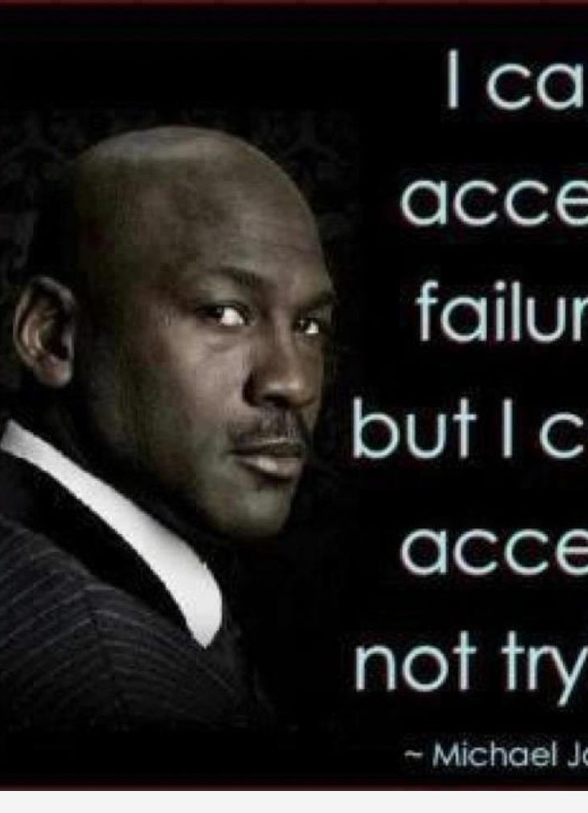
9. DON’T BE AFRAID TO FAIL
Life is too short to let fear make the decisions for you. It is not easy to overcome the fear of failure but once you build up the confidence to not let fear hold you back you will achieve more success. Tony Robbins said “I’ve come to believe that all my past failure and frustrations were actually laying the foundation for the understandings that have created the new level of living I now enjoy.” So if you must be successful, be ready to face failure. Many successful entrepreneurs failed countless times before they succeeded, let your passion for the business see you through.
“You’ll always miss 100% of the shots you don’t take.” – Wayne Gretzky

Slide 11
10. BELIEVE IN YOURSELF
If you don’t believe in yourself, you cannot succeed in your business adventure. You cannot sell very well what you don’t believe in. No matter what you are facing, always brace up to the challenge. Be proud of yourself and the small success you achieved and you will be a big success.
“What would life be if we had no courage to attempt anything?” – Vincent van Gogh

