Slide 1
Emergency Medical Responder
Chapin Area Rescue Squad

Slide 2
Chapter 1: EMS Systems

Slide 3
Objectives
Understand EMS Systems and how they impact public health
Identify the role of EMRs in the system
Understand the importance of Quality Improvement
Identify the importance of documentation and EMS research

Slide 4
Introduction
An emergency medical responder (EMR) is the first medically trained person to arrive on the scene of an emergency.
For the CARS, you most likely will operate the ambulance and arrive with an EMT/paramedic
Nationally, EMR initial care is usually followed by:
Emergency medical technicians (EMTs)
Paramedics
Nurses and physicians
Other allied health professionals

Slide 5
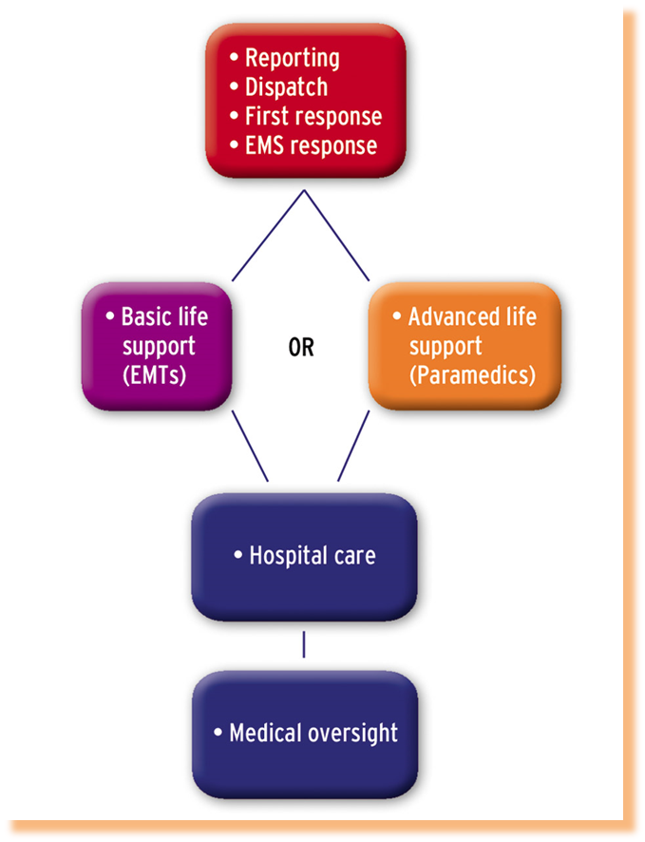
The EMS System
Reporting (caller to 911)
Dispatch (West Central Joint Dispatch aka Control)
EMS Response (with LE and Fire)
Advanced Care (ALS if needed)
Hospital (PAH or patient choice)
Specialty Care Center (Stroke, Burn, Cardiac)

Slide 6
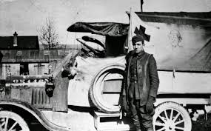
EMS History
Ambulance transport during WWI
In the 50s and 60s was provided by funeral homes
Rescue Squads later, but lagged behind military care
1966, Accidental Death and Disability: The Neglected Disease of Modern Society
1970s DOT became oversight for EMS nationally
1980s EMS saw advanced care become common

Slide 7
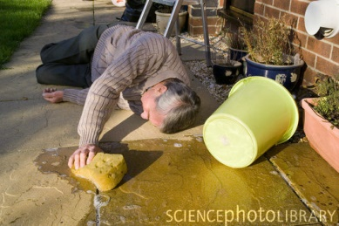
Role of the EMR
EMR skills form the foundation of the EMS training
As an initial responder, offer first assessment of what is happening
Initiate care that will impact all future decisions

Slide 8
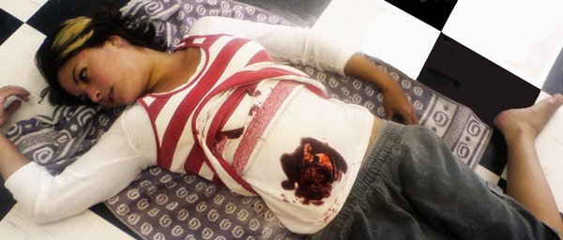
EMR Training
Skills are divided into two main groups:
Those needed to treat injured trauma patients:
Controlling airway, breathing, and circulation
Controlling external bleeding (hemorrhage)
Treating shock
Treating wounds
Splinting injuries to stabilize extremities

Slide 9
EMR Training
Those needed to care for patients experiencing illness or serious medical problems:
Heart attacks
Seizures
Problems associated with excessive heat or cold
Alcohol and drug abuse
Poisonings
Bites and stings
Altered mental status
Behavioral or psychological crises
Emergency childbirth

Slide 10
Quality Improvement
Process used by medical care systems to evaluate the effectiveness and safety of current treatments and procedures
Six components:
Safety: The actions of EMRs must not cause harm to patients, bystanders, or EMS providers.
Effectiveness: EMR care should be based on scientific knowledge and provide the desired benefit to the patient.
Patient-centeredness: Be responsive to the patient’s physical needs as well as his or her values, religion, and heritage.
Timeliness: Provide care in a timely manner.
Efficiency: Always strive to deliver care without wasting supplies, equipment, or time.
Equitability: Patient care should not vary between people of different genders, ethnic backgrounds, geographic locations, or socioeconomic levels.

Slide 11
Documentation
CARS uses computer based reporting often times EMRs will not complete the reports, however…
Documentation should include:
The condition of the patient when found
The patient’s description of the injury/illness
The initial and later vital signs
The treatment you gave the patient
The agency and personnel who took over treatment of the patient
Any other helpful facts

Slide 12
Review
The four basic goals of EMR training are to know what not to do, how to use your EMR life support kit, how to improvise, and how to assist other EMS providers.
The typical sequence of events of the EMS system is reporting, dispatch, emergency medical response, EMS vehicle response, and hospital care.
The overall leader of the medical care team is the physician or medical director.

