Slide 1
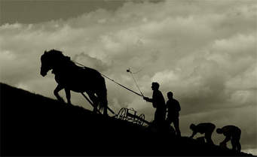
Farming Church Cultivation Plans

Slide 2

Faith Formation Plan
Develop more interactive activities for faith formation for all ages (i.e. skits, plays, packing snack packs)
  - Expand Bible Studies
  -Invite other churches
  -18-30 ish age group
  -Various locations
      and times of day

Slide 3

Trust Cultivation Plan
  To better serve and hold each other accountable, each Council Member received a copy of Church Council duties as outlined in our Constitution. This list will be also mailed to the congregation prior to nominating and electing new council members.
  Small wins – below are items we can publicly affirm in living towards our church’s calling:
    New Pastor (not small)
      New opportunities (Faith Formation Plan)
    Our Music Program
      New Cantor
      Favorite Hymn Suggestions
      Larger choir
      Concerts (Rich Mullins)
    Member Care
    Church Security
    Enhanced Website and Social Media.

Slide 4

Leadership Cultivation Plan
Church Council will take some Personality/Leadership Style Inventories to help us identify our styles, develop a common language and better understand each other. Once council decides which inventory is most helpful, we will invite the congregation to take the inventory through our Sunday School classes.

Slide 5

Leadership Cultivation Plan cont.
Church Council will be watching each other this month looking for Christ-like leadership in others. We are each going to bring back what we saw to our next meeting.
Pastor Gina will meet with each council member over the next few months to discuss how things are going between us and God. She is encouraging each of us to start daily devotionals if we are not already.

Slide 6
Future Plans
Vision

