Slide 1
Our Experience of Evacuating a Critical Care Unit - UHNM
Matron Claire Hughes
Deputy Matron Lesley Smith
Aspiring Matron Jill Bogucki

Slide 2
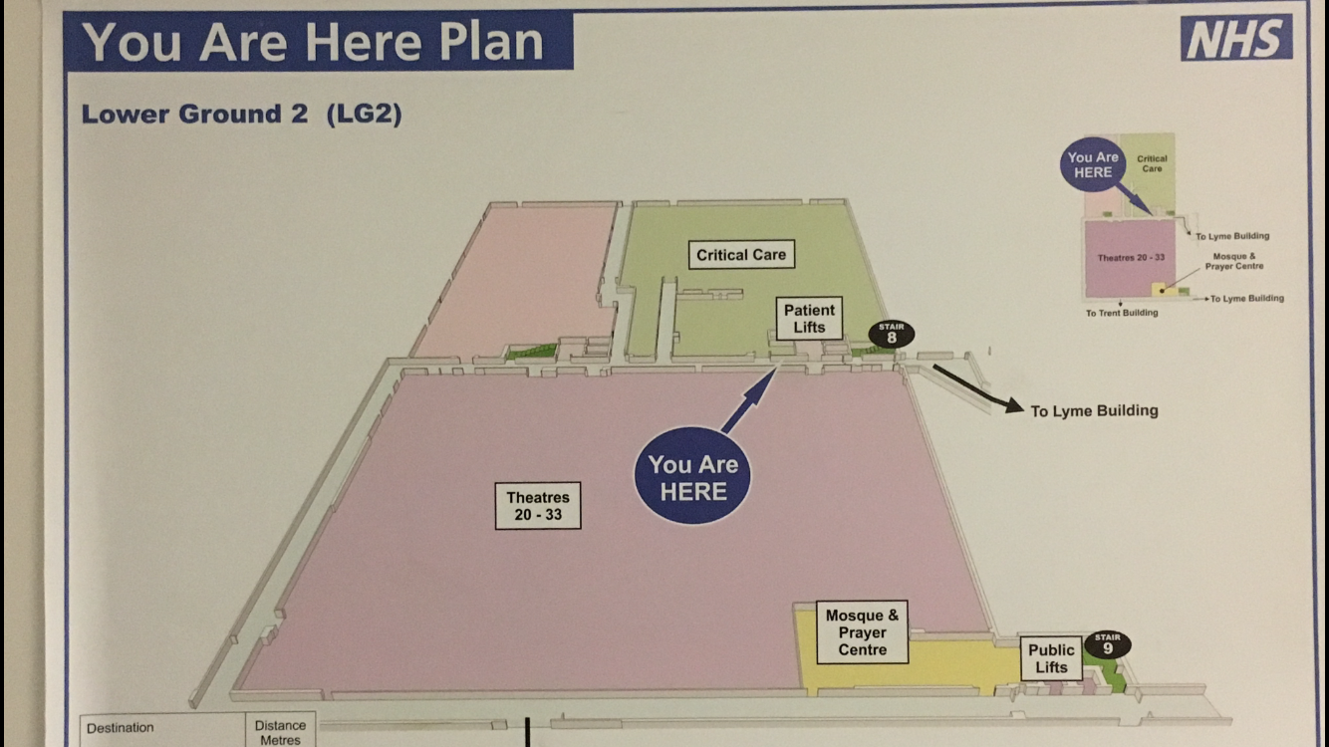
Our Location

Slide 3
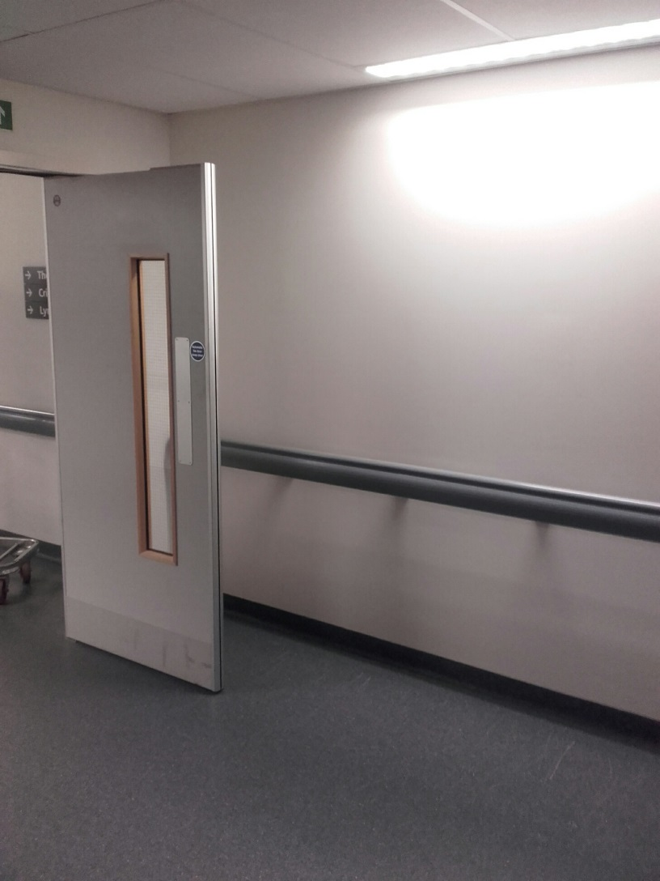
Wednesday 7th June 2017
7 Cages lined up along the corridor
3 Cages set alight
18:00hrs – Reported smell of smoke LG2 outside theatres directly opposite Critical Care
Fire Brigade arrived within minutes
18:25hrs – Critical Care instructed to evacuate
18:30hrs – Major Incident protocol activated

Slide 4
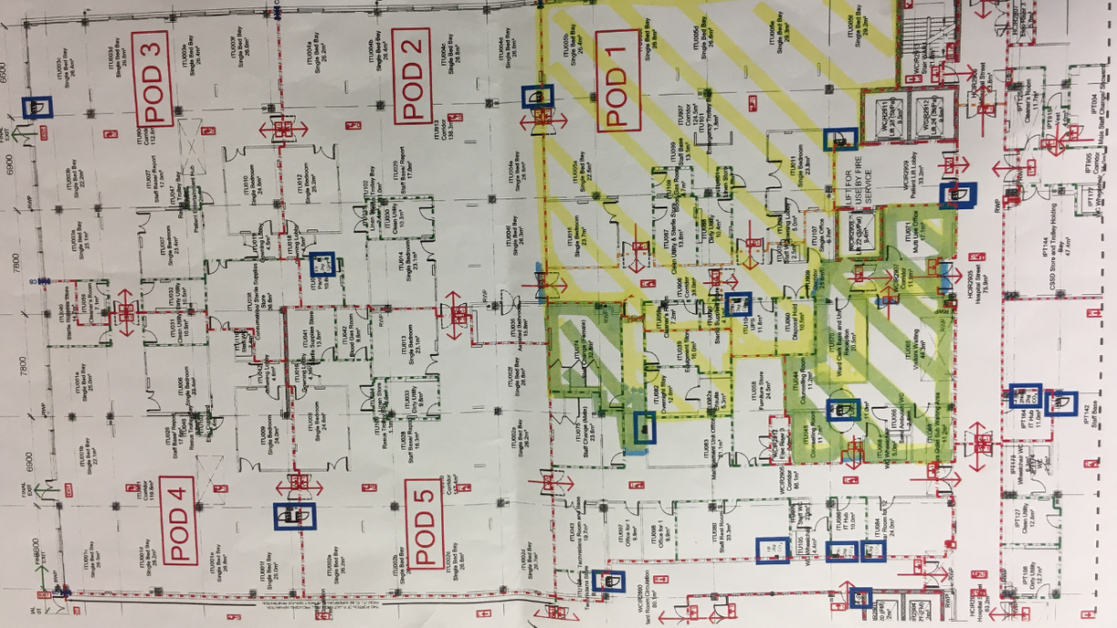
Critical Care Floor Plan
5 Pods containing 8 beds = 40 patients
Smoke visibly seen in Pod 1 & 5
Pod 1,2 & 5 evacuated level 3 patients to theatres in the Lyme building through the fire escape in pod 3
The remaining level 2 patients from the above pods were evacuated into pod 3 and SAU

Slide 5
Plan of Action
Nurse in charge coordinated the entire incident
Luckily – staff still on site due to timing of incident
More luckily – audit afternoon for theatres therefore CEPOD activity only, subsequently available spaces in anaesthetic rooms and PACU
Human Factors training evidently came into fruition

Slide 6
From Start to Finish
Consultants aware of evacuation plans and process commenced (4 Consultants on site) (3 Junior Doctors) & (3 ACCP’s)
Plan A&B discussed
  A–move sickest patients first
  B-move as per protocol - 1 pod at a time considering fire compartments (preferred option)
All pods informed of incident and evacuation plans – preparation required
SOC assisted with information regarding available bed space, anaesthetic cover, theatre staff & equipment
NIC ensured O2 available for all patients
Pod 5 patients put onto portable vents ready for transfer – first patient ready within 20 minutes
Non ventilated patients prepared for evacuation to car park area adjacent to the pods. Patients with higher acuity evacuated to PACU – then it started to rain!
NIC liaised with fire officer
32 patients evacuated to a safe area within 1 hour

Slide 7
Staff remained calm due to Nurse in Charge enhanced communications (evidenced by feedback from other departments)
The wider Critical Care Team ensured timely decontamination of affected areas to minimise further disruption.
Patients able to return to pods at 20:10hrs
All patients back on the unit by 21:00hrs
Staff debrief undertaken at 21:30hrs

Slide 8
Post Incident Learning
Critical care (Specialities) to work collaboratively at times of major incident
More Major Incident training – Utilising SIM
To increase attendance to Corporate Fire Training for Managers
Consider evacuation plans including multiple exit strategies depending on location of incident
Assembly point A & B for staff coming on site
Clear communication for staff not on duty
Fire officer lacked understanding of preparation time required to evacuate a Critically ill patient
Ability to identify where patients were evacuated to
Nurse in charge unaware of assistance potentially available from the West Midlands Hazard Response Team

Slide 9
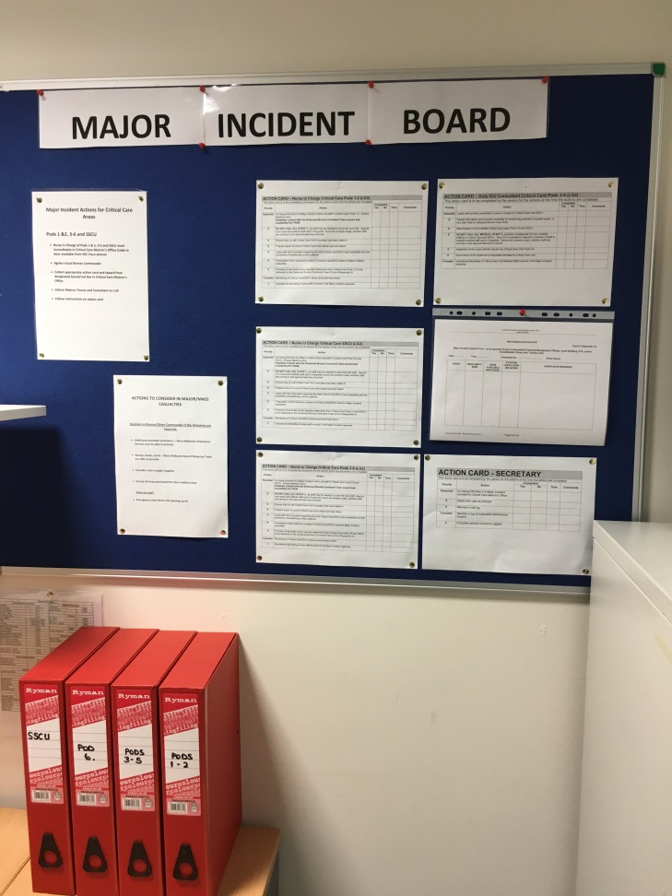
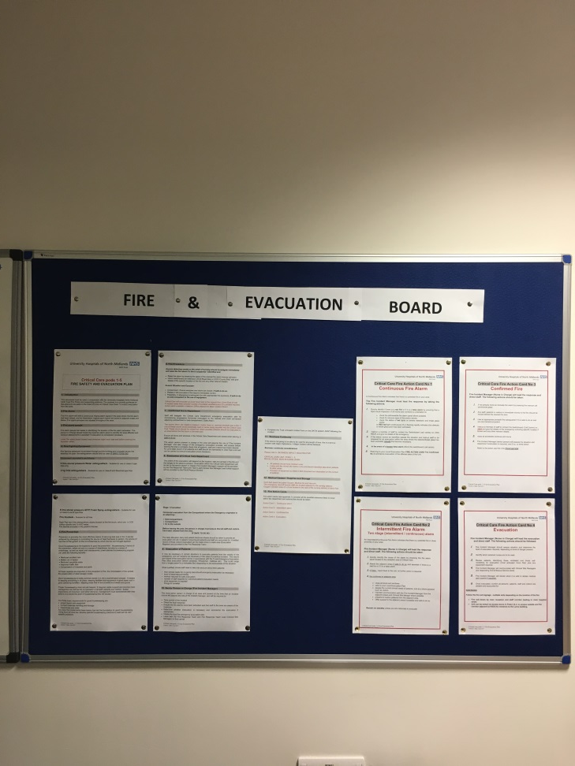
Critical Care – Command Centre

