Slide 1
The Christian Ambassador
Craig Vincent Mitchell, PhD
Web site: craigvincentmitchell.co
E- mail: craigvmitchell@gmail.com

Slide 2
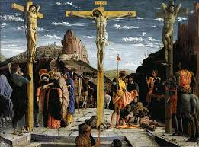
King Jesus and the Kingdom of God
Jesus came preaching about the coming of the Kingdom of God
The Sermon on the Mount explains the ethics of the Kingdom of God.
The Sermon on the Mount also invites people to join the kingdom
Jesus established the kingdom of God with his death, burial, and resurrection.

Slide 3
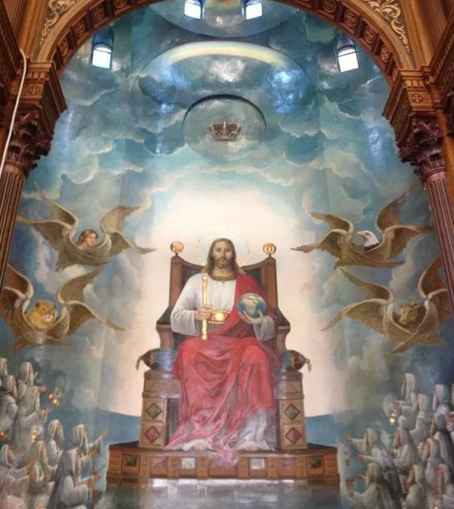
King Jesus and the Kingdom of God
Hebrews 1: 3-4
The Son is the radiance of God’s glory and the exact representation of his being, sustaining all things by his powerful word. After he had provided purification for sins, he sat down at the right hand of the Majesty in heaven.

Slide 4
The Church as an Embassy
 | Embassy | Church
Purpose | To represent their government to the people of a foreign country | To represent the Kingdom of God to the people of a foreign country and thereby transform that culture. We are salt and light (Matthew 5: 13-15).
Mission | To set terms and conditions of peace to a foreign government | The Great Commission Matthew 28: 18-20 Preach the Gospel to the lost and teach believers to grow in Christ-likeness
Policy | The ambassadors follow the policies set by their earthly king or ruler. | The Christian ambassadors find the policy of the Kingdom of God in the Bible.

Slide 5
The Church as an Embassy
 | Embassy | Church
Culture | A temporal earthly, unrighteous kingdom. | An eternal, heavenly, righteous kingdom of priests.
Ambassadors | Ambassadors are the are appointed by officials of their government to represent their interests of their country to a foreign government. The ambassadors live in another country, but they do not identify with it. They seek to achieve the goals of the kingdom that they represent. | 2 Corinthians 5:18-20 All Christians are transformed into new creatures and are made diplomats for Christ. These Christian ambassadors live in the world, but they are not of it. Christian ambassadors seek first the kingdom of God and its righteousness (Mat 6:33).

Slide 6
II Corinthians 5: 19- 21
That God was reconciling the world to Himself in Christ, not counting men’s sins against them. And He has committed to us the message of reconciliation. We are therefore Christ’s ambassadors, as though God was making his appeal through us. We implore you on Christ’s behalf: Be reconciled to God. God made Him who had no sin to be sin for us, so that in Him we might become the righteousness of God.

Slide 7
The Structure of the
Local Church/ Embassy
Pastor
(Chief of Mission)
Elders
(Deputy Chiefs of the Mission)
Church Member
(Foreign Service Officer)
Church Member
(Foreign Service Officer)
Church Member
(Foreign Service Officer)
Church Staff
(Specialists)
Church Member
(Foreign Service Officer)

Slide 8
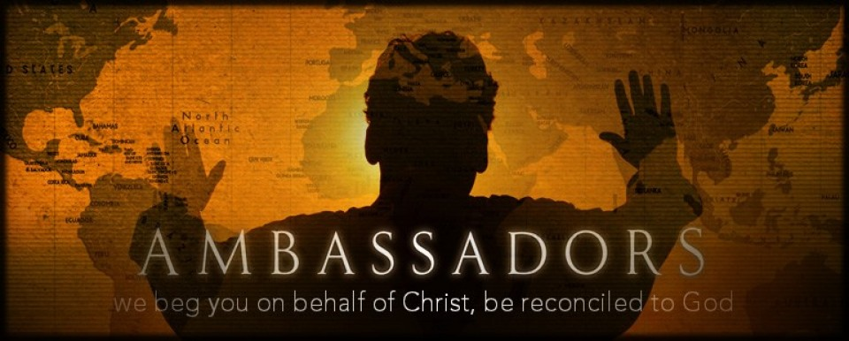
Ambassadors for
Jesus Christ

Slide 9
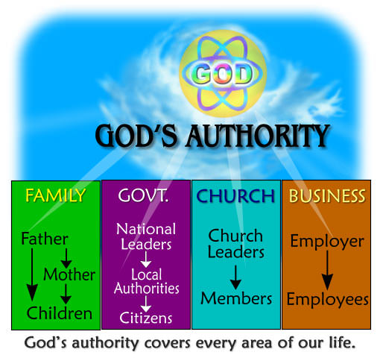
The Local Church Member
The Local Church is an embassy of the Kingdom of God to the community in which it is located.
Every Church member is an ambassador (Foreign Service Officer) to that community.
Every Church member is an ambassador to his workplace.
Every Church member is an ambassador to his family.

Slide 10
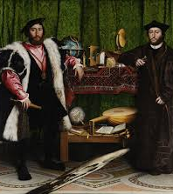
The Ambassador
An ambassador is an official representative of his king and or nation.
Because he represents his nation, he must live in a dignified (holy) manner.
He does not present his own views, but only the views of his king (as found in the Bible).

Slide 11
The Christian Ambassador
God has providentially placed every believer to be an ambassador to
His family
  Be a good witness and spread the Gospel
His workplace
  Be a good witness and spread the Gospel
His nation
  Be a good witness and spread the Gospel
Ambassador
Family
Workplace
Nation

Slide 12
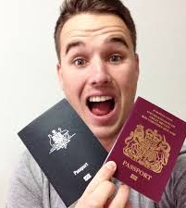
Dual Citizenship
The Christian is a citizen of the Kingdom of God. He is also a citizen of the earthly kingdom in which he resides.
He must obey the laws of the earthly kingdom until it conflicts with the word of God.

Slide 13

Romans 13: 1-5
Everyone must therefore submit himself to the governing authorities, for there is no authority except that which have been established by God. Consequently; he who rebels against the authority is rebelling against what God has instituted, and those who do so will bring judgment upon themselves. For rulers hold no terror for those who do right, but for those who do wrong.

Slide 14
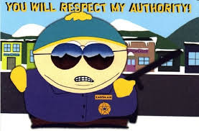
Romans 13: 1-5
Do you want to be free from the fear of the one in authority? Then do what is right and he will commend you. For he is God’s servant to do you good. But if you do wrong, be afraid, for he does not bear the sword for nothing. He is God’s servant, an agent of wrath to bring punishment on the wrongdoer. Therefore it is necessary to submit to the authorities, not only because of possible punishment but also because of conscience.

Slide 15
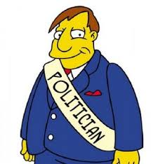
1 Peter 2: 13-17
Submit yourselves for the Lord’s sake to every authority instituted among men: whether to the king, as the supreme authority, or to governors, who are sent by him to punish those who do wrong and to commend those who do right. For it is God’s will that by doing good you should silence the ignorant talk of foolish men. Live as free men, but do not use your freedom as a cover up for evil; live as servants of God. Show proper respect to everyone: Love the brotherhood of believers, fear God, honor the King.

Slide 16

Taxation
Christians should pay their taxes. Jesus Christ paid taxes:
  Matthew 17: 24-27
  Matthew 22: 15- 22
  Luke 20: 20-26.
Paul tells us that we should pay our taxes
  Romans 13: 6-7.

Slide 17
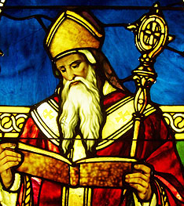
Christians in Government
Augustine of Hippo asserted that “Christ’s servants, whether they are kings, or princes, or judges, or soldiers are bidden, if need be, to endure the wickedness of an utterly corrupt state, and by that endurance to win for themselves a place of glory in the Heavenly Commonwealth, whose law is the will of God.”

Slide 18
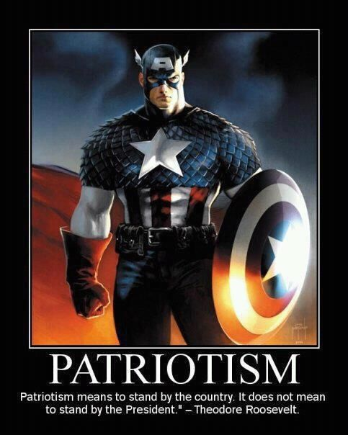
Patriotism
Augustine argues that “Christianity does not destroy patriotism but reinforces it by making of it a religious duty. The Old Testament prophets and the New Testament writers alike command obedience to civil authority and to the laws of the city. To resist these laws is to defy God’s own ordinance, inasmuch as civil society is intended by God himself as a remedy for evil and is used by him as an instrument of mercy in the midst of a sinful world, as St Paul teaches in Romans 13.”

Slide 19
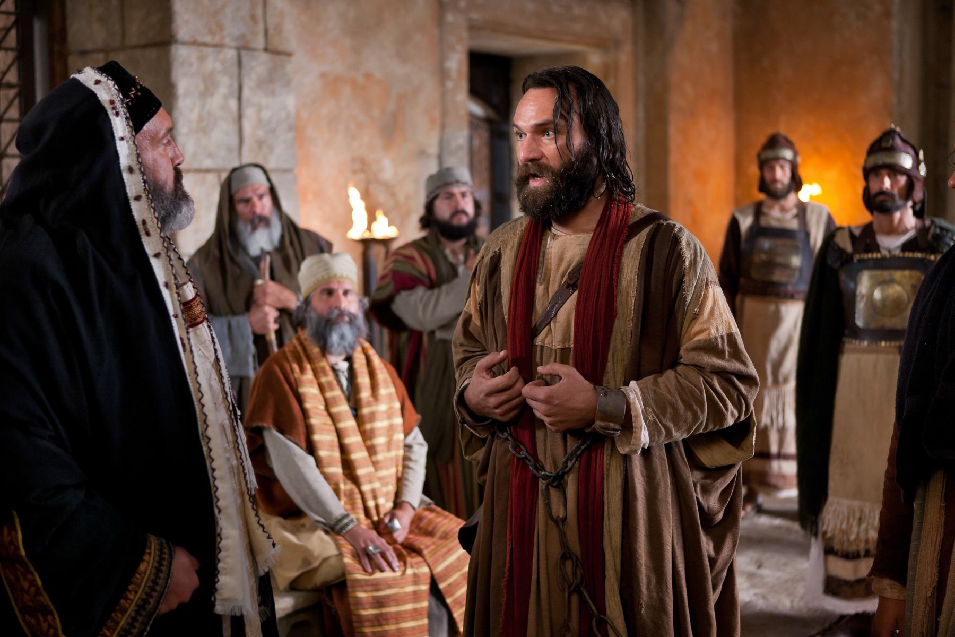
Acts 5:27-29
Having brought the apostles, they made them appear before the Sanhedrin to be questioned by the high priest. “We gave you strict orders not to teach in this name, “ he said. “Yet you have filled Jerusalem with your teaching and are determined to make us guilty of this man’s blood.”
Peter and the other apostles replied: “We must obey God rather than men!”
Consequently, we should obey the authorities until their commands conflicts with God’s.

Slide 20
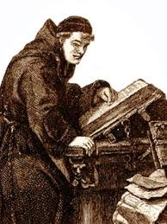
Christian Worldview: Work
Brother Lawrence wrote Practicing the Presence of God, it was published in 1693.
He wrote, “One must serve God in a holy liberty and do one’s work without distress or anxiety, calling the soul gently and quietly back to God so soon as we find it drawn away from Him”

Slide 21

Christian Worldview: Work
Martin Luther believed that vocational calling extended beyond just the Gospel ministry. He believed that God gifts men to do different kinds of work and that they should glorify Him in their work

Slide 22

Your Work Matters
Whatever you do, work at it with all your heart, as working for the Lord, not for men.
Colossians 3: 23

Slide 23
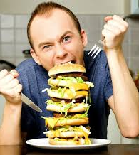
Eating and
Drinking Matters
So whether you eat or drink or whatever you do, do it all for the glory of God.
I Corinthians 10: 31

Slide 24
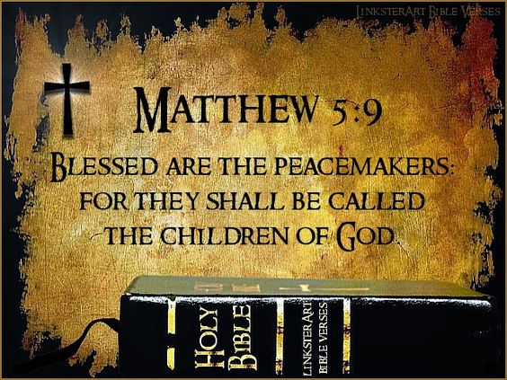
Conclusion
Everything that the Christian Ambassador does should glorify Jesus Christ.
The good Christian ambassador only presents the view of his king as expressed in the Bible.
The good ambassador is quick to give people the terms of peace (the Gospel of Jesus Christ).

Slide 25
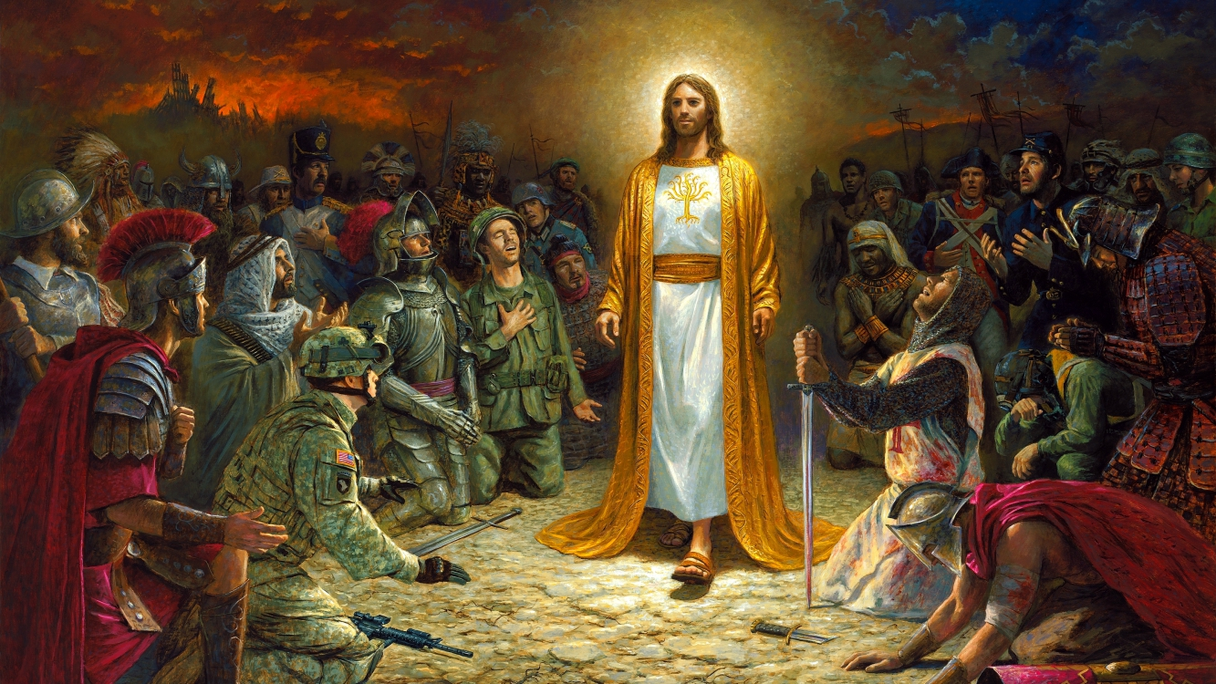
One day all will bow their knee to the true King of Kings

