Slide 1

The Royal Canadian Navy
Naval Reserve
(NAVRES)

Slide 2
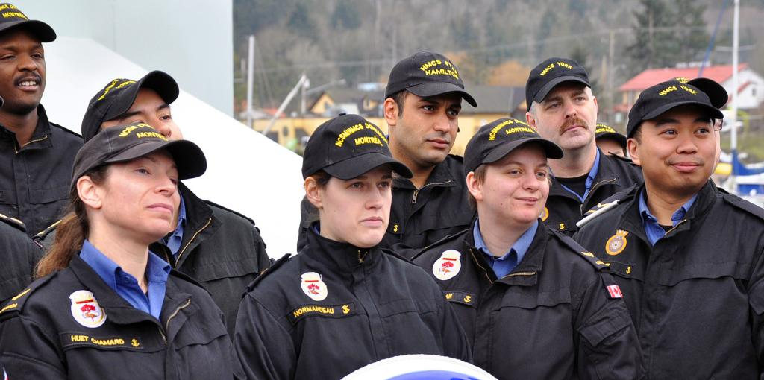
The Naval Reserve

Slide 3

The Royal Canadian Naval Reserve
traces its origins to the
Royal Canadian Naval Volunteer Reserve (created in 1923).
The Naval Reserve was formed in 1945 replacing the volunteer unit and was renamed with the current title in 1968.
We are quickly approaching the
100 Year Anniversary of the
Naval Reserve in 2023.
HISTORY

Slide 4


Located in Québec City, Naval Reserve Headquarters coordinates the activities of 24 Naval Reserve Divisions (NRD) located in most major cities across the country.
Naval training in the NRDs is usually one or two evenings per week and one weekend per month.
Over 5,000 part-time citizen sailors from all walks of life, training in a chosen naval trade.
about

Slide 5
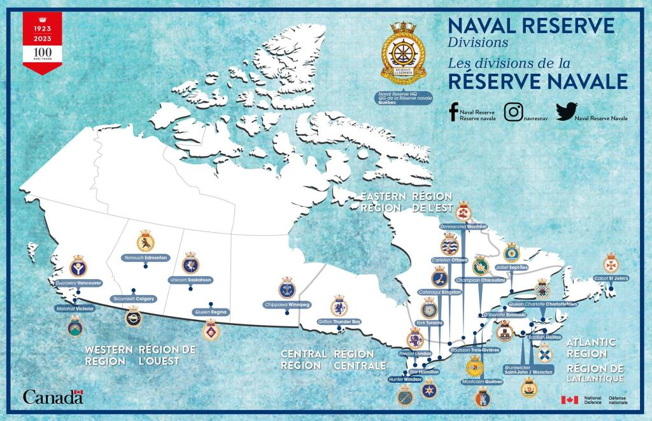

Slide 6
Naval Reserve is part of Total Force Plan
Canada has multi-purpose, combat-capable Forces that are prepared for the broad range of tasks assigned to them, including: observation, peacekeeping and
peace-enforcement missions; combat and interdiction operations;
mine-clearance, and protection of displaced persons.
Their duties also include surveillance and control of Canadian territory, airspace and maritime approaches, civil defence and protection of infrastructure, search and rescue, and disaster relief. As well as being equipped to deal with terrorist and asymmetrical threats in Canada and abroad, the Canadian Armed Forces support the civilian authorities of other federal departments and agencies, and other levels of government, with respect to environmental surveillance, counter-terrorism, illegal immigration and drug trafficking.
Defence's "immediate family" comprises over 100,000 Canadians, including the members of the Regular Force and the Reserve Force, the Canadian Rangers and the civilian employees of the Department of National Defence. The Department also supports the Canadian Cadet Movement.
Total force

Slide 7
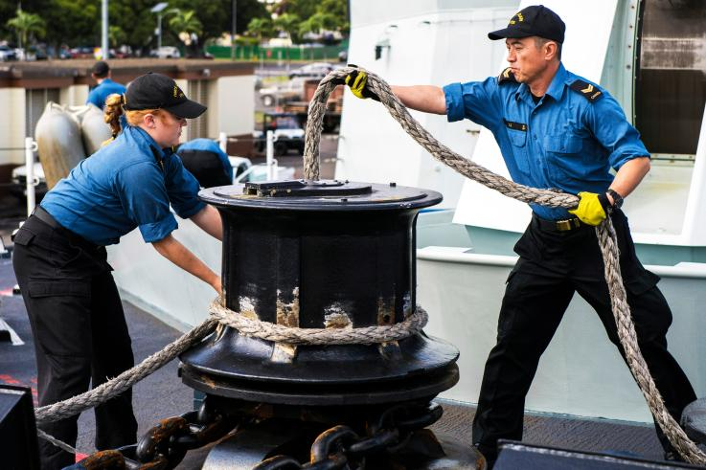
A Naval Reserve focused on providing a sustainable strategic
source of personnel for CF operations within a "One Navy" concept.
vision

Slide 8
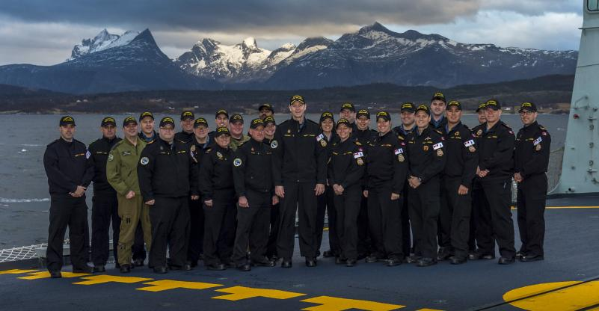
The mission of the Naval Reserve is to generate trained individuals
and teams for Canadian Forces operations, including domestic safety operations as well as security and defense missions, while at the same time supporting the Royal Canadian Navy's efforts in connecting with Canadians through the maintenance of a broad national presence.
mission

Slide 9
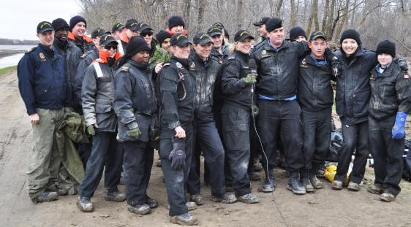
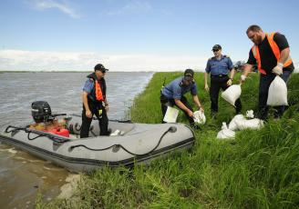
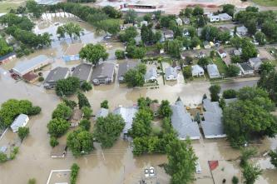
Respond to domestic safety operations with trained sailors
and small boat expertise.
tasks

Slide 10


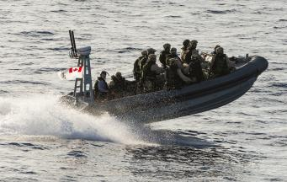
Provide specific unique skill sets for security missions for
the Royal Canadian Navy.
tasks

Slide 11
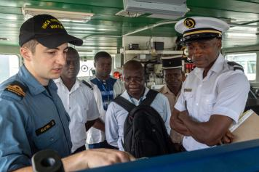
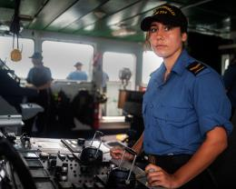
Augment the fleet on any platform or shore capacity
for defence missions, both at home and abroad.
tasks

Slide 12
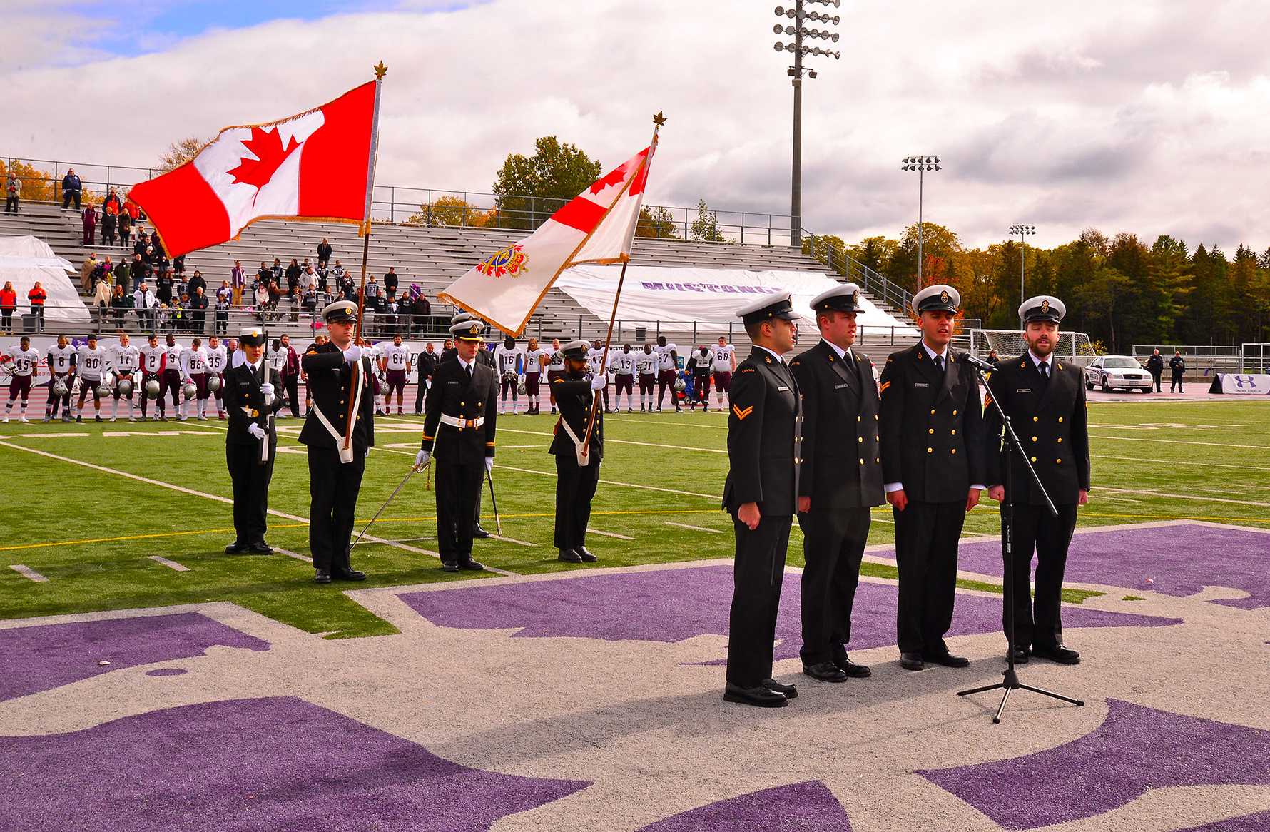
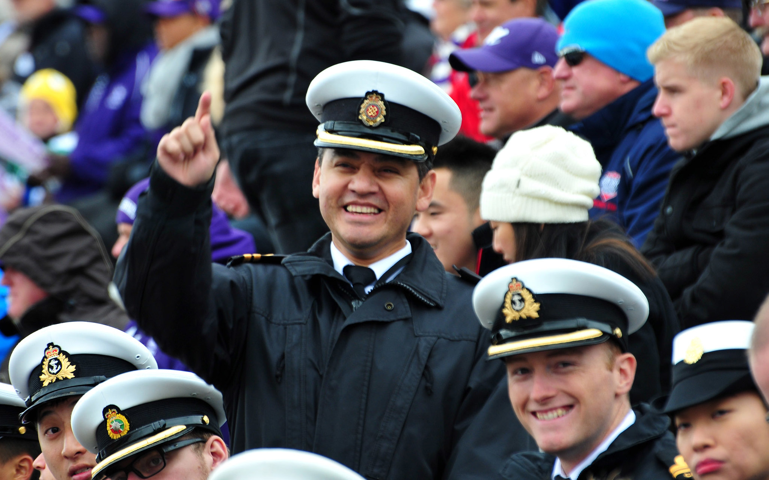
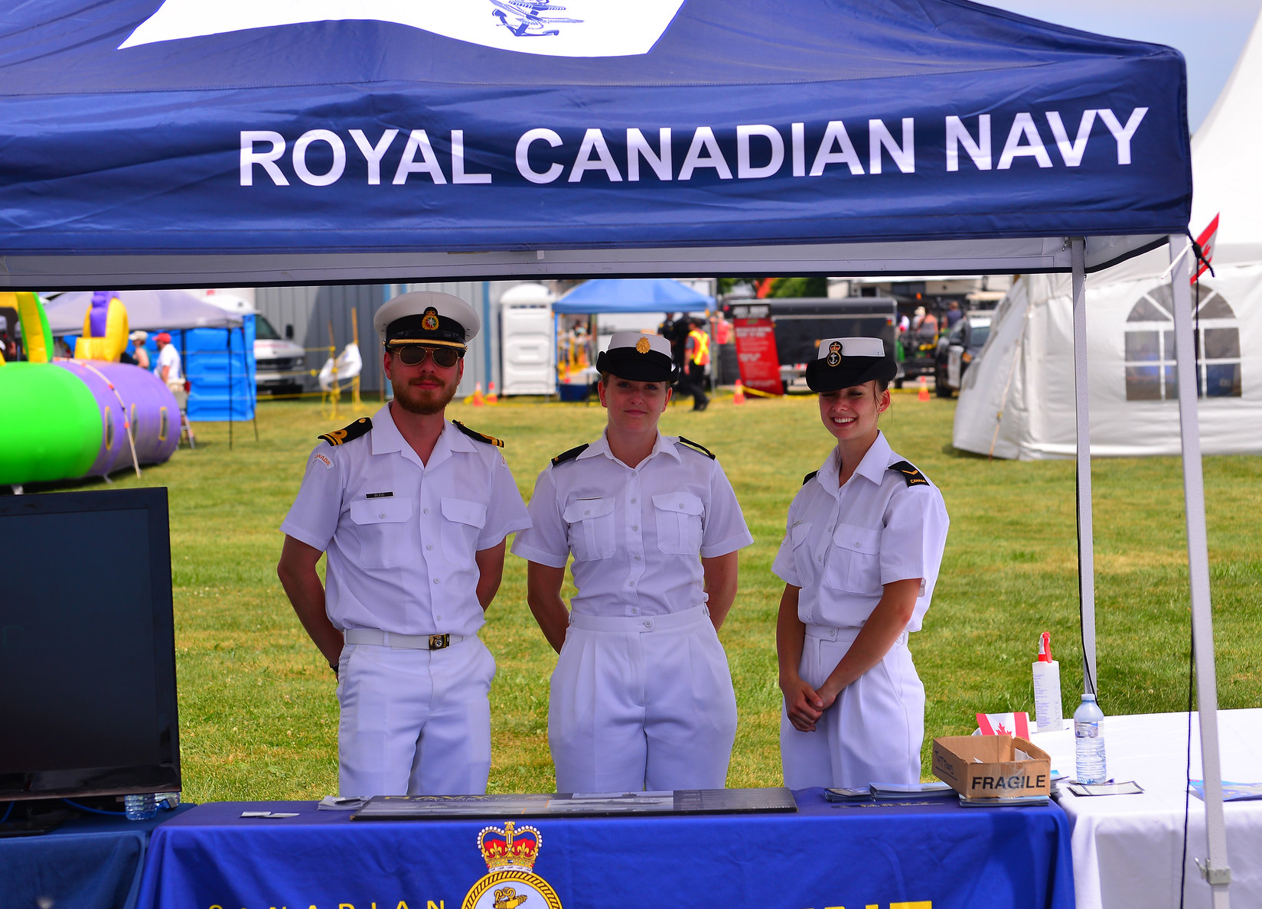

Provide the linkage for the Royal Canadian Navy to local communities.
tasks

Slide 13
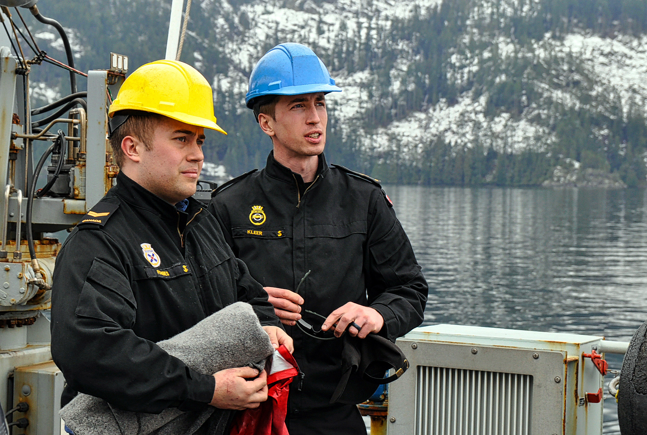

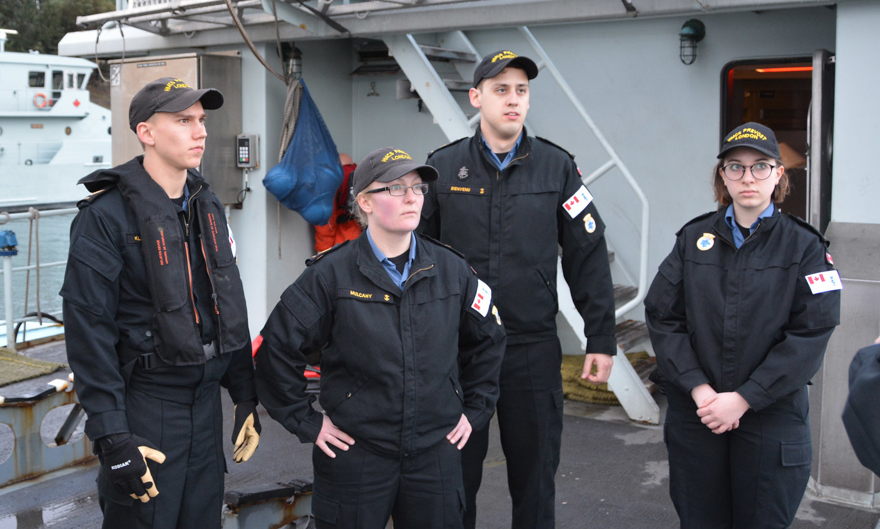
Naval Reservists are individuals engaged in their civilian lives while pursuing a military career. They work for the Navy in the evenings, on weekends and during the summer period, in a occupation of their choice. They can be students, teachers, lawyers, delivery persons, secretaries, or other members of society. Most serve on a part time basis, with no obligation to participate in any mission overseas. However, many full-time employment opportunities and deployments are available to those Reservists who volunteer for them.
people

Slide 14

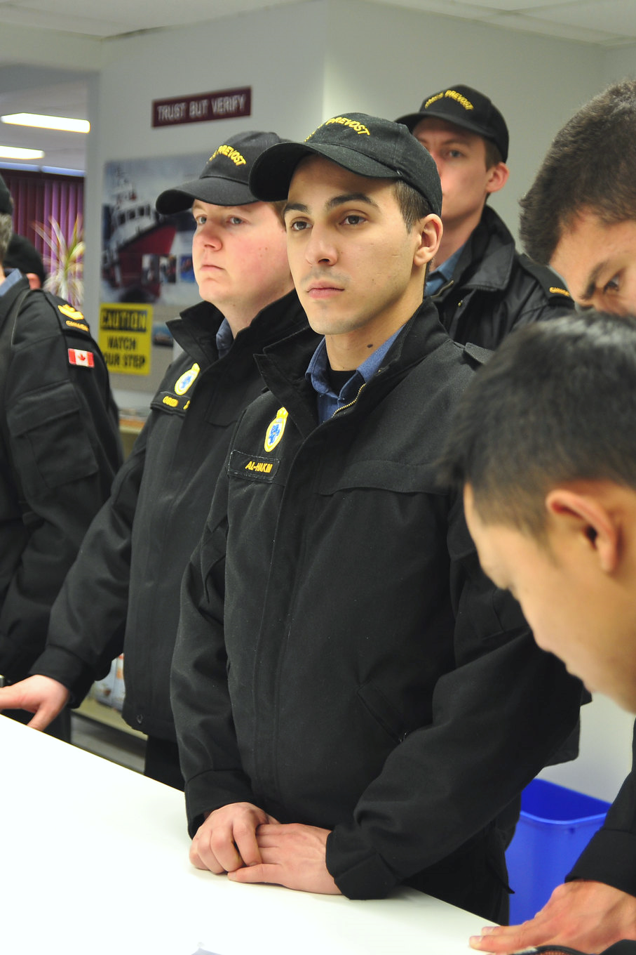

Naval Reservists are active members of your community who are willing to share their experience and who can attest that the Canadian Armed Forces and our government are committed to defending this nation and her people.
people

Slide 15
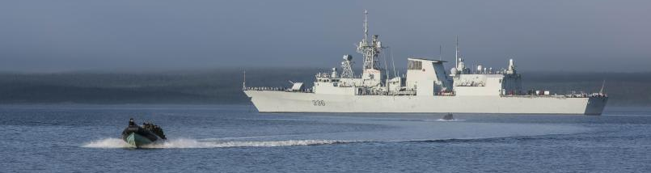
Defending Canada’s territorial waters.
Helping to protect Canada’s sovereignty.
Contributing to the defense of North America with our allies.
Supporting Canadian interests abroad.
Providing assistance to the civil authorities.
Participating in peacekeeping missions and humanitarian assistance operations.
Dnd mission

