Slide 1
Various Sources of Finance Available to an Entrepreneur
By
Devra Gartenstein

Slide 2
Businesses run on money; you'll most likely have to think about financing often, even if your company is profitable. When sorting through available sources of finance, research interest rates and repayment terms. Also consider how easy or difficult it will be to have access to funds, and trade-offs for the convenience of readily available cash.

Slide 3
Personal Nest Egg
It's not uncommon for business owners to finance business activities with personal money, especially if a company is a sole proprietorship, which is closely tied financially to its owner's assets. Keep track of how much money you're putting into your business and check in with your assets regularly regarding how much you're willing and able to risk. If you have partners, agree about terms and ownership responsibilities before you infuse capital.

Slide 4
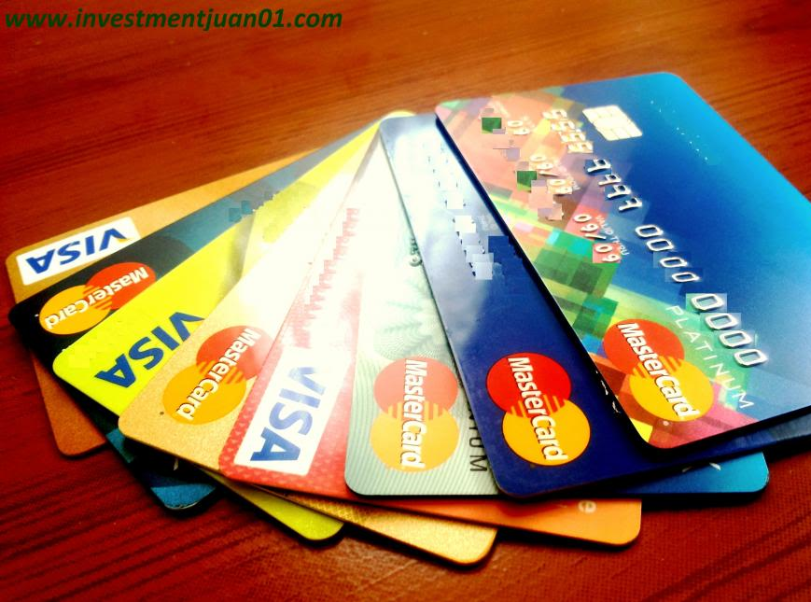
Credit Cards and Credit Lines
If your company is in reasonably good financial standing, you'll most likely be able to get a business credit card from your bank. Unless there's a deep recession with a tight lending climate, business credit cards are relatively easy to get, although their rates tend to be high. You may also qualify for a business line of credit. Like a business credit card, the funds available to you through a line of credit become available to borrow again as you pay them. Interest rates on credit lines are usually much lower than on credit cards. A business line is usually linked to your company bank account, making it convenient for you to access capital.

Slide 5
Internal Sources of Financing
You may not need to borrow money at all to finance company operations. If your business is profitable, it will earn more than it spends and more than it pays you in owner income, and you can use some of that money to finance expansion and day-to-day cash flow. Other internal sources of financing include selling assets such as equipment you no longer use and managing your capital closely by seeking advantageous payment terms from vendors and requiring that customers pay you promptly.

Slide 6
Crowd Funding
If your business has a dedicated following, you can launch a crowdfunding campaign using a platform such as Kickstarter or GoFundMe. Crowdfunding platforms let you set the terms and rewards – which may range from a heartfelt thank you to valuable merchandise. If you launch a Kickstarter campaign, you won't receive any of the money pledged unless you reach your funding goal. If you use GoFundMe, you get to keep all the money even if you don't reach your goal.
Although GoFundMe's approach is relatively risk free, Kickstarter's all-or-nothing policy creates a sense of urgency that spurs people to donate. When launching a crowdfunding campaign, be sure to include the cost of rewards in your budgeting process.

Slide 7
Bank and SBA Loans
Another option that many small business owners pursue are loans. Business loans can come from banks or from other institutions, like business organizations and microlending platforms. In many cases, these loans are backed by the United States Small Business Association (SBA). Securing an SBA-backed loan is typically an easier, less risky process for the borrower than obtaining a bank loan, but there are circumstances under which an entrepreneur is better served by a non-SBA backed loan. The SBA looks for a track record of a couple of years, so if you are entirely new to the entrepreneurship game, you may not qualify for an SBA loan

