Slide 1
2015 Lifesharing Conference
Everything you wanted to know about budgets!
Presented by Maggie Rothenberger
Director, Lifesharing, KenCrest Services

Slide 2
Resources
Service Definitions
http://www.dhs.state.pa.us/cs/groups/webcontent/documents/document/c_179843.pdf
Rate memo
http://documents.odpconsulting.net/alfresco/d/d/workspace/SpacesStore/6c8b77eb-981b-4f00-8776-c226d7c8f358/FY_2015-2016_Proposed_Department_Established_Fees_Info_Memo_048-15.pdf
Chapter 6500- licensing regulations
http://www.pacode.com/secure/data/055/chapter6500/chap6500toc.html
Chapter 51- Waiver regulations
http://www.pacode.com/secure/data/055/chapter51/chap51toc.html

Slide 3
Websites that are your friends
www.palifesharing.com
http://www.odpconsulting.net/
http://pic.odpconsulting.net/ (provider information center)
http://www.dhs.state.pa.us/provider/longtermcareservices/index.htm

Slide 4
Websites that are your friends- Continued
Welfare Fraud checks:
https://exclusions.oig.hhs.gov/
http://www.dhs.state.pa.us/publications/medichecksearch/index.htm
https://www.sam.gov/portal/SAM
Free Criminal site:
https://ujsportal.pacourts.us/
USPS site for Zip to run non-contiguous;
https://tools.usps.com/go/ZipLookupAction_input

Slide 5
Waiver funding
Medicare- entitlement program- pay into it and you are entitled to get something out of it. (SSDI)
Medicaid- needs based. You need to meet the qualifications to obtain this. (SSI)
Waiver funding is from Medicaid which is needs based
Consolidated (2176) and PFDSW- ones we will be working on today
Notes:
Medicaid- reason why you can’t double bill while in hospital
Consolidated- needs have to be met PFDSW- $30,000 cap and this can’t be used for LS

Slide 6
Did you know…..
All waiver funding is split between federal and state dollars?
Federal is: %52.01
State is: %47.99

Slide 7
Residential Habilitation (bundled/ per diem services)

Slide 8
Residential Habilitation is daily billing
Substitute care is considered to be in program as money is being paid for a service.

Slide 9
Not able to use some discreet services because it’s residential habilitation

Slide 10
Family Living? Don’t you mean Lifesharing?

Slide 11
Cost Based Rates
The more you spent on programming in 2014, determine your rates for this fiscal year 2016
Eligible costs- are costs associated with providing waiver services. (Staffing, benefits etc.)
Ineligible costs- fire extinguishers, smoke detectors et.

Slide 12
Zone Rates
Zone 1- Adams, Cumberland, Dauphin, Delaware, Lancaster, Lebanon, Lehigh, Montgomery, Northampton, Perry, Philadelphia and York
Zone 2- Allegheny, Berks, bucks, Chester, Franklin, Fulton
Zone 3- All others

Slide 13
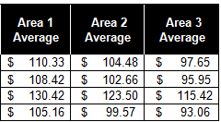
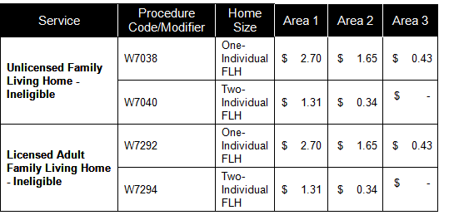
New Provider Rates- FY 2016

Slide 14
Don’t forget your checks and loads
Initially all 3 welfare fraud checks
Non contiguous check through ODP
Load the site in HCSIS
Complete Promise application
When application returned, be sure to have the SC’s attach the services in the ISP

Slide 15
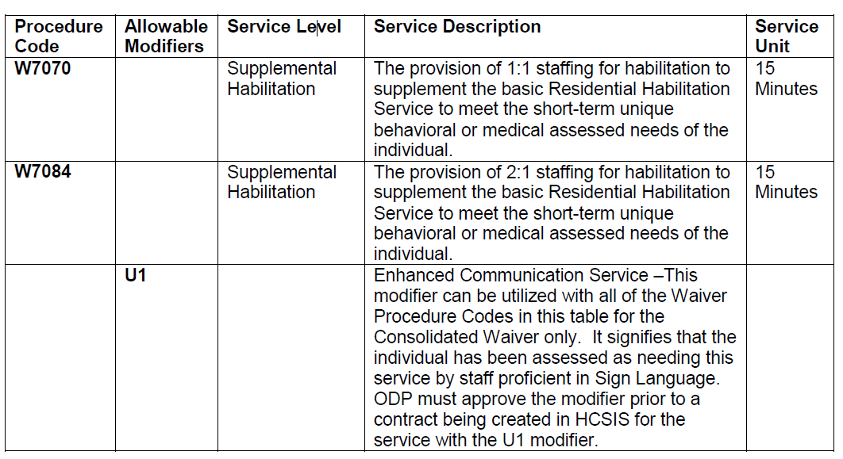
Supplemental Habilitation- Unit based (Licensed Only)

Slide 16
Additional Individualized Staffing- Unit Based (Licensed only)

Slide 17
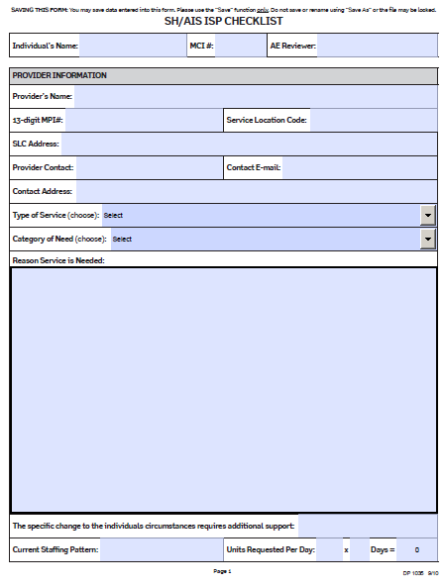
DP 1035- submit to SC and AE for AIS and SH

Slide 18
30 Hour Rule- Part of the 6500 regs

Slide 19
Who CAN’T do Lifesharing? It’s a licensing regulation
6500.4. Definitions.
Relative—A parent, child, stepparent, stepchild, grandparent, grandchild, brother, sister, half brother, half sister, aunt, uncle, niece or nephew.

Slide 20
Critical Revision?

Slide 21
Base Funding
These are state funds only and not drawn down from Medicaid
Sometimes base funds are used for people who don’t qualify for waiver services but still need supports
Requires a separate contract with the Administrative Entity
Not all agencies have a base funding contract
If you have one, you can provide base funded services
Base funded services may have different codes…be sure to check your service definitions

Slide 22
Lifesharing discreet eligible services
Why are they important to you?
Home and Community habilitation- in place of a day program (8am-5pm)
Home modifications
Vehicle modifications
Nursing

Slide 23
Home and Community Habilitation as a day program
By the way….Anything can be habilitation!!!!

Slide 24
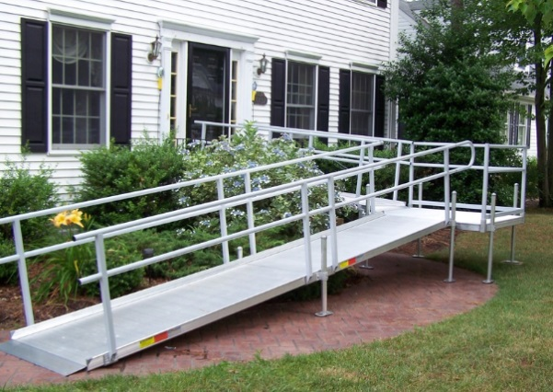
Home modifications

Slide 25
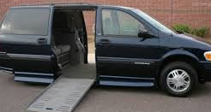
Vehicle Modifications

Slide 26
Nursing Services

Slide 27
Service Requirements (must be RN or LPN)

Slide 28
High Cost budget….What?
Ideas you can use it for?????
Increased medical need
Increased behavioral need
Increased transportation
Benjamin and Harry Settlements for adaptations

Slide 29
Fee for Service Discreet or Ala carte services
Not part of the cost report
Can be considered retained earnings
Can use revenues to supplement intake and to pay for ineligible expenses

Slide 30
Home Based Services Why is a good idea to do them?
Respite
Home and Community Habilitation
Transportation

Slide 31
Now let’s practice

