Slide 1
The Great Employee Migration and What to Do About It
Gregory Blueford
Associate, Fisher Phillips

Slide 2
The Problem
The Cause
What to Do About It:
Recruiting Trends and Tips
Retention Fixes Trends and Tips
Key Takeaways

Slide 3
The Problem

Slide 4
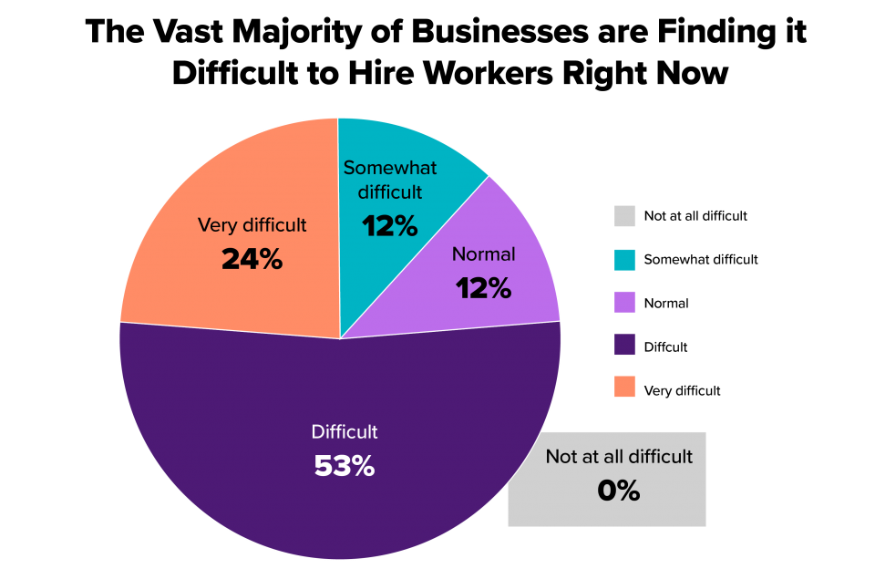
U.S. Chamber of Commerce

Slide 5
94% of employers reported that they have experienced more difficulty than normal in retaining and recruiting workers in 2021, with more than half (53%) reporting “severe” difficulty compared to normal times.
Notes:
And even though a quarter of workplaces have seen more women than men leave their organizations in 2021 as a result of family care responsibilities, only 4% of employers have attempted to create better family care opportunities to attract and retain workers. That’s according to the results of the latest FP Flash Survey conducted by Fisher Phillips, with over 600 respondents providing their thoughts between November 3-9. The results of this survey provide an eye-opening glimpse into the tenuous state of affairs that the nation’s employers find themselves in, many nervous about whether 2022 will bring about a much-needed rebound toward normalcy – or whether an Omicron-driven descent further into the workforce shortage doldrums. Here are the five biggest takeaways from our survey, and some action items you can take to address the family care gap and associated “she-cession” at your workplace.

Slide 6
The Problem – The Great Employee Resignation
Some statistics
September 2021: 4.4 million workers quit their jobs
November 2021: 4.5 million workers quit their jobs
December 2021: another 4.3 million workers quit their jobs (about 3 percent of the workforce)

Slide 8
The Problem – The Great Employee Resignation
Is Disproportionally Female – The “She-cession”:
One of four employers – 28% – indicate that they have lost more women than men.
Research is showing that the women who left the workforce in 2020 have not returned. Of those women returning, many are changing industries.
Industries that have seen more women leave their organizations:
53% of Healthcare
36% of Hospitality
36% of Finance & Insurance
34% of Retail employers
31% of Education employers
29% of Professional Services

Slide 9
The Cause
Notes:
Retirements - layoffs; reemployment at 60 is not easy
2.5MM missing workers are retirees (Goldman Sachs)
Automated hiring
Over 10MM workers are filtered out by hiring software (Harvard Business)

Slide 10
The Problem – What is the Cause?
Flash Survey – What do Employers Say:
60% said that employees were departing for “higher-paying” jobs;
36% said that workers reported being stressed or “burned out;”
Particularly in healthcare / education
35% cited family care responsibilities;
33% left for better work/life balance;
29% said departing for jobs with greater benefits/perks; and
22% are saw an increase in employees retiring from the workforce.
Notes:
Retirements - layoffs; reemployment at 60 is not easy
2.5MM missing workers are retirees (Goldman Sachs)
Automated hiring
Over 10MM workers are filtered out by hiring software (Harvard Business)

Slide 11
The Problem – What is the Cause?
Studies – What do Employees Say:
The big three:
Increased pay, the desire to work remotely, need for flexibility
Burn out – mental health
Feeling disconnected and not a part of the whole
Not feeling heard, cared for or invested in
A demand for corporate responsibility
Alternative sources of revenue
Readjusted priorities and expectations
Notes:
Retirements - layoffs; reemployment at 60 is not easy
2.5MM missing workers are retirees (Goldman Sachs)
Automated hiring
Over 10MM workers are filtered out by hiring software (Harvard Business)

Slide 12
But, the Problem has Changed – The Great Employee Migration
Employees are migrating from “crummy jobs” to “better jobs” and from “companies that don’t seem to care” to “companies that really really care.” And for many workers this means moving to companies with opportunities for growth, promotion, and even a new industry.

Slide 13
The Problem– The Great Employee Migration
More than 45% of ees today work remotely (25% full time) = changing jobs is a simple as getting a new email address.
Only 11% of companies offer formal career programs for ees = the only opportunity to grow is by leaving.
Only 13% of companies survey ees to understand what they need = employers don’t understand what ees want
Only 18% actively manage and optimize workloads to remove stress = ees don’t feel that their employers care

Slide 14
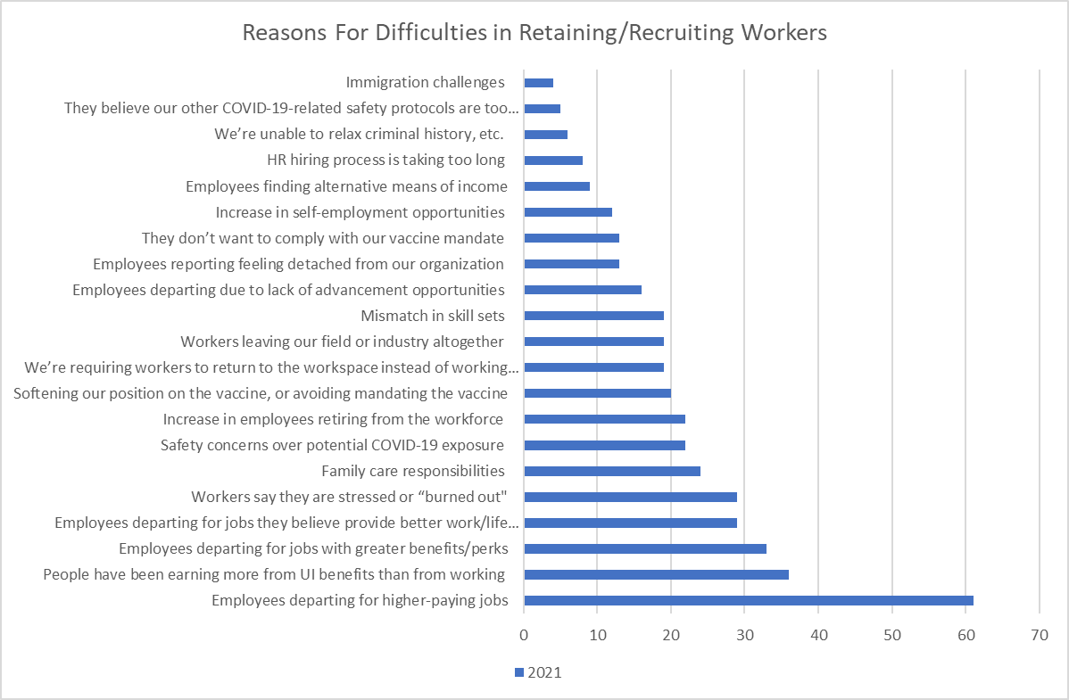

Slide 15
What Do We Do?

Slide 16
What Do We Do?
It’s too easy to leave – We Need to Create Stickiness
The pandemic has changed employee mindsets –
Employees know we can flex,
That work can be accomplished in many ways
That they are valuable
Alternative sources of income
Employers are upping their game, / greater competition
Employee expectations are at an all time high
Employees want different things
Notes:
The pandemic has changed people’s mindsets. Some people have had to confront a lot of loss over the last year and a half, and perhaps this brought about a realization that our time here is limited. Its caused employees to reflect on their own career trajectory and decide whether they are happy doing the same job or want to do something else. And some employees are simply scared of working in person and getting sick.

Slide 17
What Do We Do?
How Do You Create Stickiness – REMEMBER:
They don’t see you investing in their growth / no career path
They don’t feel like you care
They feel detached
They are stressed, exhausted and often dealing with mental health issues
They expect corporate responsibly and good corporate citizenship
They are demanding remote work, and they know it can be done
They want greater work-life balance and flexibility
They are feeling stressed / and burned out
= it’s time to embrace your workforce!

Slide 18
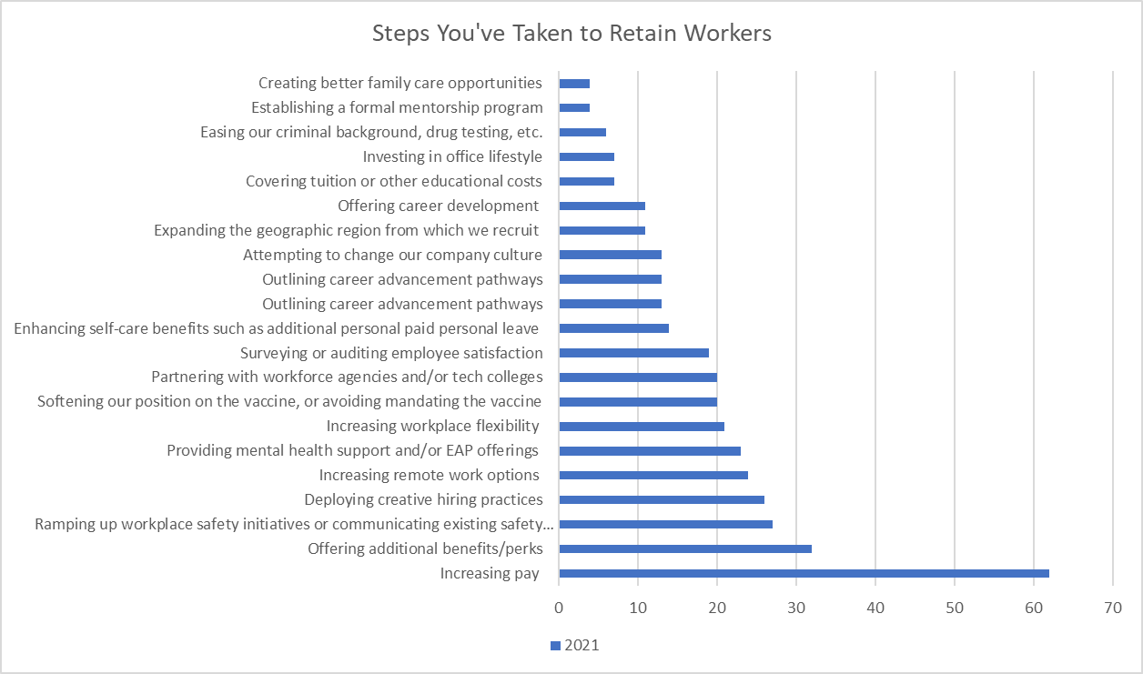

Slide 19
What Are Other Employers Doing?
75% - Increasing pay was the step most often deployed by employers in 2021 to retain and recruit
38% - using creative hiring practices – new sources, expanding the applicant pool, reducing desired experience, referral bonuses, etc.
36% are offering additional benefits/perks
35% have increased workplace flexibility (hours, schedules, dress code, etc.)
30% have increased remote work options
29% are improving HR processes (perhaps through technology) to speed up the recruiting and hiring process
24% are providing mental health support and/or EAP offerings;
23% are ramping up workplace safety initiatives or communicating existing safety measures
21% are surveying or auditing employee satisfaction

Slide 20
What Do We Do?
Recruiting

Slide 21
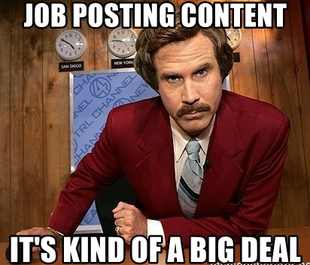
Job Postings / Advertising: Reputation Matters
How up-to-date is your website?
Do you have a social media presence?
Are their awards or surveys listing you as a top place to work?
How can you market your business as a good place to work?
Get creative
Notes:
Recruiting via social media is also on the rise:
High speed
Cost effective
Current employees may play a role (i.e. sharing job postings)
Know your audience.
Gen X: Facebook
Millennials: Facebook; Instagram
Gen Z: Instagram; YouTube; Snapchat; Facebook

Slide 22
Position Summary
Do you love to write? Are you a skilled lawyer interested in leaving billable hours and arguments with opposing counsel behind? Do you crave an opportunity to flex your creative muscles? Do you want a position that has flexible working hours around your schedule and allows you to work remotely (if you want)? Do you want to be part of a team where your work will be valued, your job has real meaning, and you have an opportunity for growth? Do you want to be part of something big?
If you’re eagerly nodding your head right now, the Legal Content Counsel job is for you. This brand new position will play an integral role in …..…We’ll work with you to help form the job into a role that matches your strengths, giving you room to grow it into something bigger.
Personal Attributes
You halve the ability to draft and edit content into compelling way.
You have a keen editor’s eye and you immediately noticed the typo in the prior sentence. You have strong feelings about the Oxford comma, the number of spaces that should exist after a period, and the singular “they.”
You are intensely curious.

Slide 23
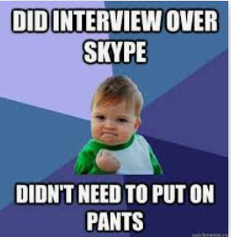
Virtual / Social Media Recruiting
HERE TO STAY
It’s where the applications are
Cost savings
Easier scheduling
More efficient
Provides accelerated timelines
Ongoing safety concerns
Candidate preference
Notes:
We are seeing a trend that a hiring process that combines virtual and in-person processes will be come increasingly standard, with the thought that the reduced cost and time savings of conducting recruiting efforts virtually is worth it.
But you have to know how to effectively use virtual recruiting and to leverage it to your advantage.

Slide 24
Consider Remote Candidates
Virtual offices
Employees out of state or even out of country
Watch your tax implications
Watch your state labor code requirements
Notes:
As you’re evaluating the position, consider whether it is one that could be done remotely.
Although not necessarily a new concept, the pandemic caused many companies really across the globe to have to reconsider how it can get its employees to work. Now this obviously doesn’t apply in all industries – if you’re in the manufacturing business, your workforce is obviously not working remotely – but many companies have found ways to make it work.
It has really become the new reality for a lot of employers.
Now, that brings on its own set of legal issues (like pay and tax implications, potential regulatory issues) – which really is a topic for another presentation but which I’m happy to discuss with you offline if you have questions about – but remote work is something that has kept a certain demographic of employee engaged.

Slide 25
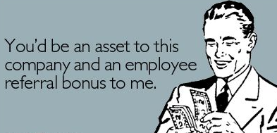
Recruit Internally
Consider Referral Incentives – recognition, rewards, bonuses
Ask current employees to help. Happy employees are among your best recruiters
Talk with current employees.
May be more familiar with the requirements of the position.
May have internal candidate suggestions.
May have suggestions for external referrals.

Slide 26
Think Broadly About Your Applicant Pool
Diversity, equity, and inclusion is KEY:
It ensures that you are looking at all possible candidates and not missing quality employees
It makes for a better culture
It discourages “group think”
It increases innovation
Employees and expect and demand it
It’s the right thing to do

Slide 27
Think Broadly About Your Applicant Pool
Implicit bias
Automatic screening
Over 10MM workers are filtered out by hiring software (Harvard Business)
Older workers
2.5MM missing workers are retirees (Goldman Sachs)
Parents returning to the workforce
Folks entering the workforce – cross generational
Notes:
Retirements - layoffs; reemployment at 60 is not easy
2.5MM missing workers are retirees (Goldman Sachs)
Automated hiring
Over 10MM workers are filtered out by hiring software (Harvard Business)

Slide 28
What Do We Do?
Retention

Slide 29
Number 1: Company Culture
Many of the “whys” relate back to culture
It’s the supervisor, not the money
Personal connections
Recognition
Growth
Being heard

Slide 30
Company Culture – It’s Time to Ask
You need to know why employees are leaving and what they want:
Consider ‘Town Halls’
Use a survey
Encourage feedback
Notes:
Meaningfully engage your staff. Leaders should conduct night shift and weekend meetings with staff and listen to their ideas and concerns. Listening to, respecting, and responding to staff concerns will help identify opportunities to implement meaningful changes that are responsive to employee needs. Following through on these opportunities will help retain valued staff and attract productive new employees.
Many parents and caregivers do not feel comfortable voicing when they need help or when need to take time to care for their family. These deeply rooted cultural hesitancies should be eradicated through an overhaul to the company culture.
Employers should increase communication around available caregiving benefits, provide data on the percentage of employees accessing these benefits, and have executives and other leadership lead by example in accessing these benefits.

Slide 31
Company Culture – Make a Change
Make a Change:
Meaningfully engage your staff
Go to them
Listen, respect and respond to concerns
Implement meaningful changes that are responsive to employee needs
Notes:
Many parents and caregivers do not feel comfortable voicing when they need help or when need to take time to care for their family. These deeply rooted cultural hesitancies should be eradicated through an overhaul to the company culture.
Employers should increase communication around available caregiving benefits, provide data on the percentage of employees accessing these benefits, and have executives and other leadership lead by example in accessing these benefits.

Slide 32
Company Culture - Supervisors
360-degree surveys
Do your employees feel comfortable coming to you with problems?
How much of your day do you spend personally interfacing with your subordinates?
Have you created a safe place?
Training

Slide 33
The Big Three: Increasing Pay
Money talks - 75% of employers state that increasing pay has been their top method of improving recruitment and retention
Recognize that although will it may cost more to fill certain shifts, those costs may not necessarily be as high as using a supplemental staffing company if you are able to retain employees and create a more satisfying work environment for your employees.
Notes:
Adjust Policies and Benefits to Support Working Caregivers: Depending on the size of your business, consider offering on-site childcare or subsidies for childcare. If this scale of benefits is not possible, consider working with various agencies to offer employees the benefit of pre-screened back-up childcare providers, set up nanny-share opportunities, or offer paid family leave. Another option is to offer flexible working arrangements such as job-sharing or reduced hours to accommodate caregiving responsibilities. Finally, consider offering other mental health benefits such as flex days and/or access to therapy to curb the likely existence of burnout associated with juggling work and family care responsibilities. Regardless of the size of your business, it is key that there is a transparency of the caregiving benefits offered and employees are encouraged to access them.
3 Steps to Curb the “She-cession” At Your Workplace
Cleverly coined the “she-cession,” the term refers to the mass exodus of women from the workforce since the start of the pandemic. Recent labor statistics report a loss of upwards of 2.5 million women leaving the U.S. workforce since March 2020. Nearly two years into the pandemic, our survey reveals that 28% of employers – with a particular impact in the healthcare, hospitality, retail and other high-contact industries – are continuing to see women leave the workforce to a larger extent than men. Additionally, many women who left the workforce in 2020 simply have not returned. Of those women returning, many are changing industries and leaving those hit hardest by the pandemic (such as the healthcare and the hospitality industries).
If the workforce shortage crisis is to end, getting women back into the workforce will be key to any form of economic recovery. Therefore, in order to rebound as quickly as possible and take advantage of the many women looking to return to rewarding job opportunities, you should act quickly and decisively to implement efforts to curb the damage of “she-cession.” Three critical steps include:
Step 1: Empower Women. It is important for female workers to connect with female leaders within your organization. Create a forum for women leaders and employees to come together and share ideas and support each other’s efforts. Take formal steps such as creating support systems including an on-ramp path for women returning to the workforce or sponsoring programs for women to advocate for each other.
Step 2: Invest in DEI Efforts. Your organization could play a key role towards mending what has been broken. Invest in equity efforts including unconscious bias training and have leaders speak out against gender or caregiver biases in the workplace. Perform an annual pay equity analysis to undercover and rectify wage discrepancies. Track outcomes for promotions and raises by various categories including gender to ensure the company’s practices are fair and consistent.
Step 3: Be Transparent and Communicate Openly. Transparency is a non-negotiable for the post-COVID workforce. Following your efforts in Step 1 and 2, communicate to the workforce about what you’ve uncovered and the steps you are taking to improve the culture of the workplace. Communicate often with women in the workforce and include women’s voices and interests in the decision-making process. Share updates on business changes and any key decisions that impact employees’ lives. Celebrate and champion women’s achievements and efforts.

Slide 34
The Big Three: Flexibility
A recent EY survey of more than 16,200 employees globally found that more than half would consider ditching their job after the pandemic if they weren't offered enough flexibility on where and when they work.
Employers are considering:
4 days work weeks
Alternative work weeks
Creating leniency with respect to family care
Increase family and maternity/paternity leaves, including paid time
Adjusting policies and benefits to support working caregivers
On-site childcare or subsidies for childcare
Pre-screened back-up childcare providers
Notes:
Depending on the size of your business, consider offering on-site childcare or subsidies for childcare. If this scale of benefits is not possible, consider working with various agencies to offer employees the benefit of pre-screened back-up childcare providers, set up nanny-share opportunities, or offer paid family leave. Another option is to offer flexible working arrangements such as job-sharing or reduced hours to accommodate caregiving responsibilities. Finally, consider offering other mental health benefits such as flex days and/or access to therapy to curb the likely existence of burnout associated with juggling work and family care responsibilities. Regardless of the size of your business, it is key that there is a transparency of the caregiving benefits offered and employees are encouraged to access them.

Slide 35
The Big Three: Remote Work
Microsoft’s Work Trend Index found that 70% of workers want flexible remote work options to continue and 66% of companies are considering redesigning office space for hybrid work.
Flexjobs study found that 58% of responding employees want to be full-time remote post pandemic, while 39% want a hybrid environment.
There is “no place like home” – employees are leaving now that they are required to return, and:
Other companies are willing to hire them from all over the globe to work from home
Gas prices are sky rocketing – some employers are considering subsidies / stipends
Gen Z struggled most with
Notes:
Gen Z makes up a significant portion of the modern workforce.
According to Microsoft’s 2021 Work Trend Index, moving fully remote has been difficult for this generation:
Lack of in-person networking options
Greater impact of isolation from remote work
Lack of financial means to create proper workplaces at home
Struggling to maintain work/life balance
Lack of engagement
Loss of connections may mean loss of innovation
https://www.microsoft.com/en-us/worklab/work-trend-index/hybrid-work

Slide 36
The Big Three: Remote Work
It’s not necessarily a bad thing:
16% of companies in the world are 100% remote.
77% of remote workers say they’re more productive from home.
85% of managers believe teams with remote workers will become the new norm.
74% of workers say that having the option to work remotely would make them less likely to leave a company.
The three biggest challenges associated with remote work are unplugging after work (22%), loneliness (19%), and communication/collaboration (17%).

Slide 37
The Big Three: Remote Work
At the same time, don’t assume everyone wants to be remote – Surprisingly, it was Gen Z who struggled the most with remote work.
They crave in-person networking options
They need in-person training
They have a greater impact of isolation from remote work
They have a lack of financial means to create proper workplaces at home
They are struggling to maintain work/life balance
They are feeling a lack of engagement
And, a loss of connections may mean loss of innovation
Notes:
Gen Z makes up a significant portion of the modern workforce.
According to Microsoft’s 2021 Work Trend Index, moving fully remote has been difficult for this generation:
Lack of in-person networking options
Greater impact of isolation from remote work
Lack of financial means to create proper workplaces at home
Struggling to maintain work/life balance
Lack of engagement
Loss of connections may mean loss of innovation
https://www.microsoft.com/en-us/worklab/work-trend-index/hybrid-work

Slide 38
Reconsider Performance Standards
Employers learned from the pandemic that physical clock time doesn’t necessarily equate to productivity or creativity.
Instead of valuing hours or time in the office, look critically at what really matters to the job.
Look strategically at what success means for each role and reset goals like narrowing the scope or extending deadlines.

Slide 39
Addressing Attrition By Women
Empower Women. Connect female workers to female leaders. Create a forum for women leaders and employees to come together and share ideas and support each other’s efforts. Consider an on-ramp path for women returning.
Invest in DEI Efforts. Invest in equity efforts including unconscious bias training and have leaders speak out against gender or caregiver biases in the workplace. Perform an annual pay equity analysis to undercover and rectify wage discrepancies.
Be Transparent and Communicate Openly. Communicate often with women in the workforce and include women’s voices and interests in the decision-making process. Celebrate and champion women’s achievements and efforts.

Slide 40
Tackling Mental Health
At any one time, 1 in 6 employees within a workplace will be struggling with their mental health.
83% of employees feel emotionally drained by work
59% of employees say supervisor does not provide enough support to help them manage their stress
Less than 5% of employees strongly agreed that their employer provides a safe environment for employees who live with mental illness
--Mental Health America

Slide 41
Tackling Mental Health
Promote employee wellbeing
Wellness programs
EAP access
Alternate career tracks
Alternate work assignments
Promote work-life integration

Slide 42
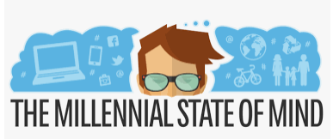
Addressing Employee Expectations
Today’s Workforce: Gen Z (born between 1997 and 2012) and Millennials (born between 1981 and 1995/6) make up 46% of the full-time workforce in the United States.
41 million Boomers
53 million Gen X
56 million Millennials
And, adding 65 million Gen Z
Notes:
In terms of competition for talent, I think it’s important to be aware of what the modern workforce looks like.
This new demographic of employee is often considered to be more technologically advanced than prior generations.
Also considered more socially aware. “Diversity, equity, and inclusion” is not just a catchphrase; it’s a requirement.
This has greatly influenced hiring.

Slide 43
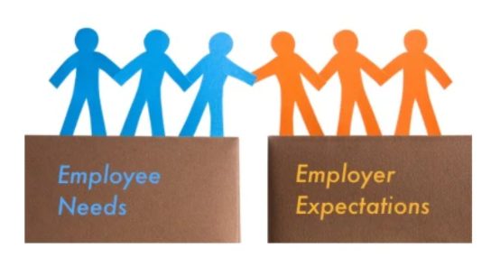
Addressing Employee Expectations
Flexibility
Work/life balance
Autonomy
Work environment
Recognition
Transparency
Security
Corporate Citizenship
Notes:
Employees want options:
Work-life balance
Flexibility
Remote or hybrid or in-person environment
Security has become front and center in the minds of many employees:
Financial
Benefits
Company stability

Slide 44
Addressing Employee Expectations
Corporate Responsibility:
75% of millennials would take a pay cut to work for an environmentally responsible company
30% report already leaving jobs
due to lack of a sustainability plan
Nearly half of employees
surveyed at leading tech
companies said a company’s
efforts toward climate change
would affect where they want
to work

Slide 45
Addressing Employee Expectations
Social Justice:
Corporate behavior and compliance
Branding
Fair treatment for all
Corporate positions on political and social justice issues – BLM, #Metoo, gun violence, Russia’s invasion of the Ukraine

Slide 46
Using Technology to Your Advantage
Technology has changed the workplace, you might as well embrace it:
On the rise for decades
Intense accelerations w/ COVID - Zoom phenomena
Employees are attracted to sophisticated tech
It can create that connectively ees crave
It can help overcome other concerns – wage-hour
Look for opportunities to develop your own tech-driven systems.

Slide 47
Final Takeaways
Recruit aggressively, creatively, and strategically
Make yourself competitive – consider pay, benefits, flexibility, remote work and how you sell yourself
Embrace your workforce – it’s not you vs. them anymore
Evaluate your culture – talk to your employees
Find out where you are winning and where you can improve
Consider today’s employee’s expectations – remote work, flexibility and corporate citizenship
Compare that to what your actual needs are in today’s workplace, not what you have traditionally though your business needs are
Proactively address burn out and mental health issues
Use technology to your advantage

Slide 48
Questions?

Slide 49
Thank You
Gregory Blueford
Associate, Fisher Phillips
gblueford@fisherphillips.com
916.210.0372

