Slide 1
Building Health Literacy in Ohio:
The Inaugural
Ohio Health Literacy Partners Conference
O C T O B E R 4 , 2 0 1 9 A S H L A N D U N I V E R S I T Y

Slide 2
Health Literacy: A Foundation for Clear Health Communication and Patient Safety
OCTOBER 4, 2019
Karen Komondor, RN, BSN, CCRN
President, Ohio Health Literacy Partners
Director, Organizational Development and
the Health Literacy Institute,
St. Vincent Charity Medical Center,
Cleveland, Ohio

Slide 3
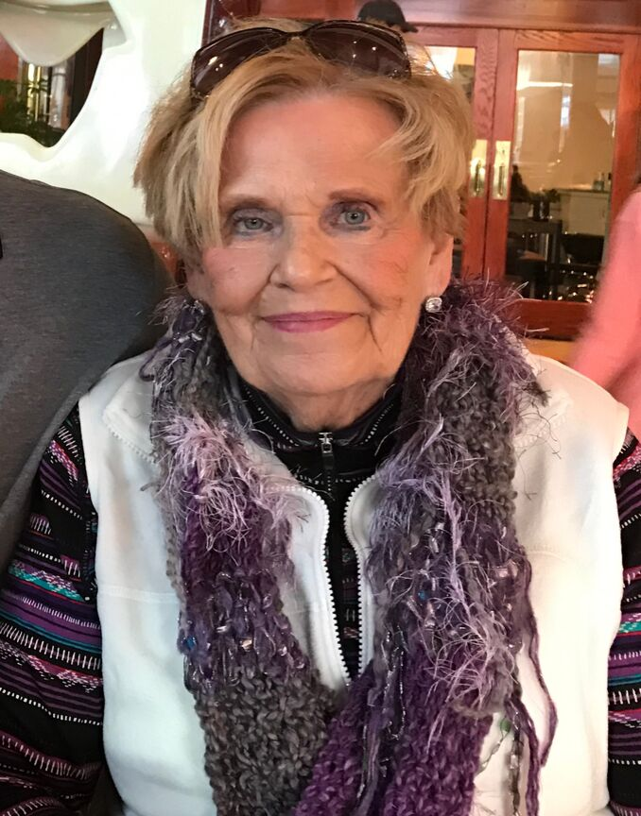
Meet Nancy
Notes:
wife, Mom, Grandmother, greatgrandmother, former business owner....... CABG - AF- Coumadin. At 6mos checkup, doc said he was starting her on ASA. She misunderstood, stopped her Coumadin, and ended up in the ICU on a vent with multiple PEs

Slide 4
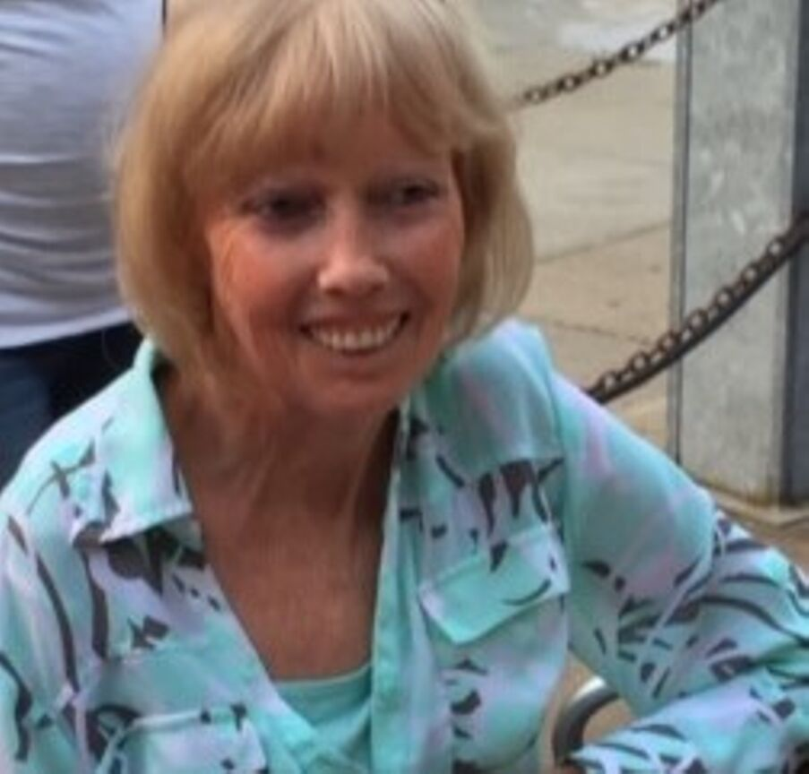
Meet Lynn
Notes:
DX CREST Scleroderma in her 30's.
Has suffered numerous surgeries including....
Has had several sepsis admissions secondary to pneumonia. The last time was secondary to a wound infection on her leg after d/c from shoulder replacement.......
Ultimately underwent BKA
Stas for amputations and sepsis

Slide 5
Literacy
The ability to read, write, compute,
think critically to achieve one’s potential.
U.S. Department of Education. 1993
Knowledge and competence in a specific area
(i.e. computer literacy, health literacy)

Slide 6
"The degree to which individuals have the
capacity to obtain,
process, and understand
basic health information
and services needed to
make appropriate health decisions.”
"The degree to which an individual has the capacity
to obtain, communicate,
process, and understand health information and services in order to make
appropriate health decisions"
Health literacy applies to all individuals and to health systems
Calgary Charter on Health Literacy,
2011
IOM 2004
Plain Writing Act, ACA, 2010
Health Literacy Defined
Notes:
The definition is evolving

Slide 7
“Health literacy occurs when a society provides accurate health information and services that people can easily find, understand, and use to inform their decisions and actions.”
Healthy People 2030
HHS 2019
Notes:
Public comment closed 8/31/19

Slide 8
CURRENT SKILL LEVELS
66% of Cleveland residents are functionally illiterate
Some Cleveland neighborhoods have an illiteracy rate as high as 95%
20 percent of the population in 14 Ohio counties is operating at the lowest level of literacy
Average American reads at the 8th
grade level
One out of five read below grade level five.
US Department of Education, 2003
National Institutes
of Literacy
Seeds of Literacy, 2019
Notes:
Functional illiteracy is defined as having math, reading, or language skills below a 4th grade level
Because majority (80-92%) sepsis cases are present on admission- important to look outside hospital walls-EMS...need to be made aware for teaching opportunities
Who else needs info? Partner w community

Slide 9
Real Life Examples
Scope of the Problem
https://www.youtube.com/watch?v=ubPkdpGHWAQ

Slide 10
What is it Like?
•The following passage simulates what a reader with low general literacy sees on the printed page.
•Read the entire passage out loud.
•You have 1 minute to read.
•Hint: The words are written backwards and the first word is “cleaning”

Slide 11
GNINAELC
– Ot erussa hgih ecnamrofrep, yllacidoirep naelc eht epat sdaeh dna natspac revenehw uoy eciton na noitalumucca fo tsud dna nworb-der edixo selcitrap. Esu a nottoc baws denetsiom htiw lyporposi lohocla. Eb erus on lohocla sehcuot eht
rebbur strap, sa ti sdnet ot yrd dna yllautneve kcarc eht rebbur. Esu a pmad tholc ro egnops ot naelc eht tenibac. A dlim paos, ekil gnihsawhsid
tnegreted, lliw pleh evomer esaerg ro lio.

Slide 12
How do you clean the capstan?

Slide 13
WORD EXERCISE
Expected Return Calculate
Option Exercise Equal
Strike Probability Underlying
Value Present Price
Net Negative Price
Spot Below Zero
Time Today Using

Slide 14
WORD EXERCISE
“If you’re using expected return to calculate the option’s probability-weighted net present value, if you set the expected return below zero, the time value will go negative. If you set the strike price equal to zero, the
option value will equal the exercise-today value, which will be equal to the spot price of the underlying.”
Source: Black-Sholes Made Easy
by Jerry Marlow, p. 193

Slide 15
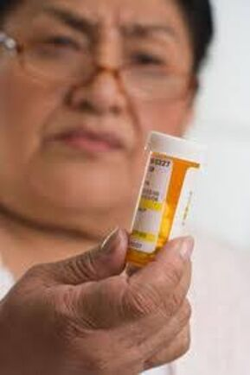
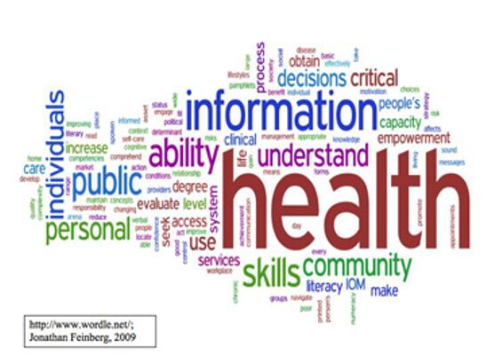
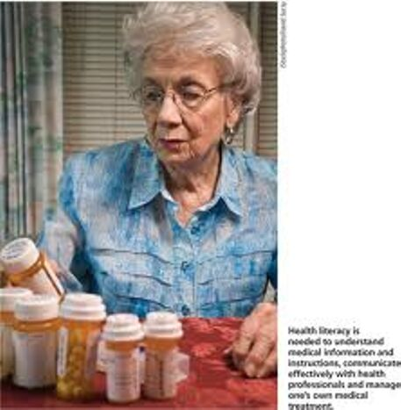
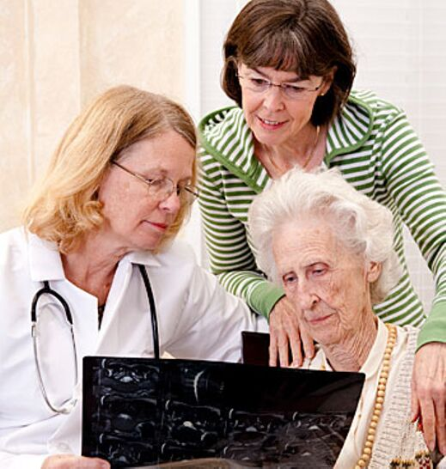
Health Literacy Affects Everyone!
Notes:
Because of the complexity and the overwhelming amount of health information available today, Americans of all literacy levels have difficulty processing and understanding health information

Slide 16
WHY IS HEALTH LITERACY IMPORTANT?
Up to 80 percent of medical information
provided by healthcare providers is forgotten immediately by patients.
Almost half of the information that is
remembered is incorrect.
Most health information materials are written at the 12th grade level or above.
AMA Foundation 2007

Slide 17
Nearly half of all American adults-90 million people-have only basic or
below-basic health literacy skills and have difficulty understanding and acting on health information
Scope of the Problem

Slide 18
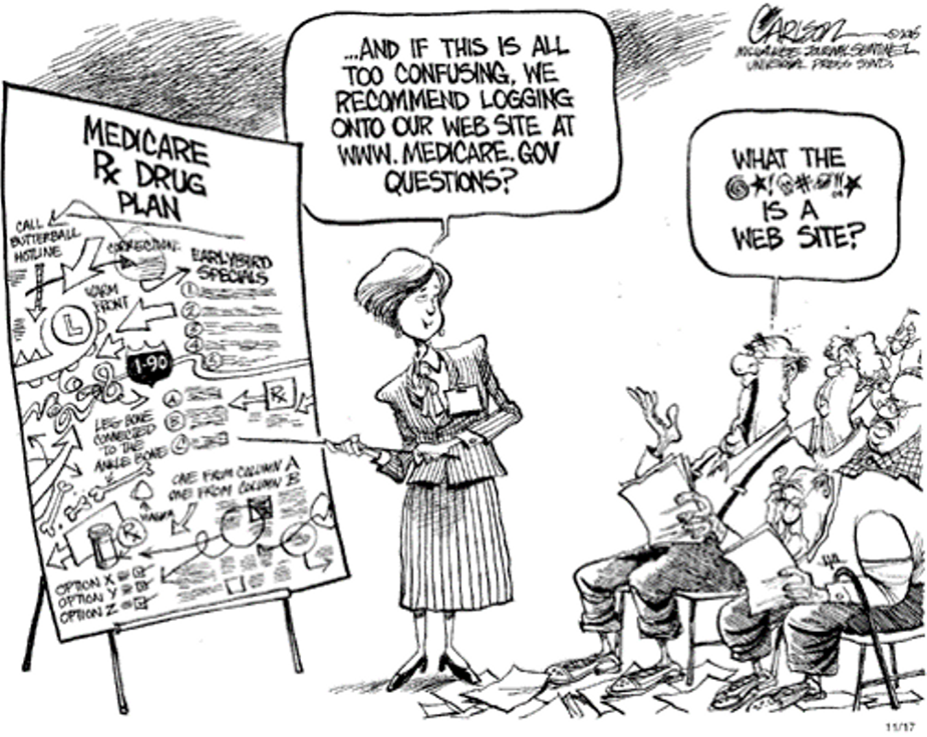
Scope of the Problem

Slide 19
"Mr. Smith, let's review the results
of your blood tests. Your CBC, BMP, and LFTs were basically negative. You have prediabetes and a slightly elevated LDL, and since your BMI is 28, you should watch your diet and exercise more to prevent metabolic syndrome. Oh, and it's OK to keep taking an occasional NSAID with food for your idiopathic knee pain."
Scope of the Problem

Slide 20
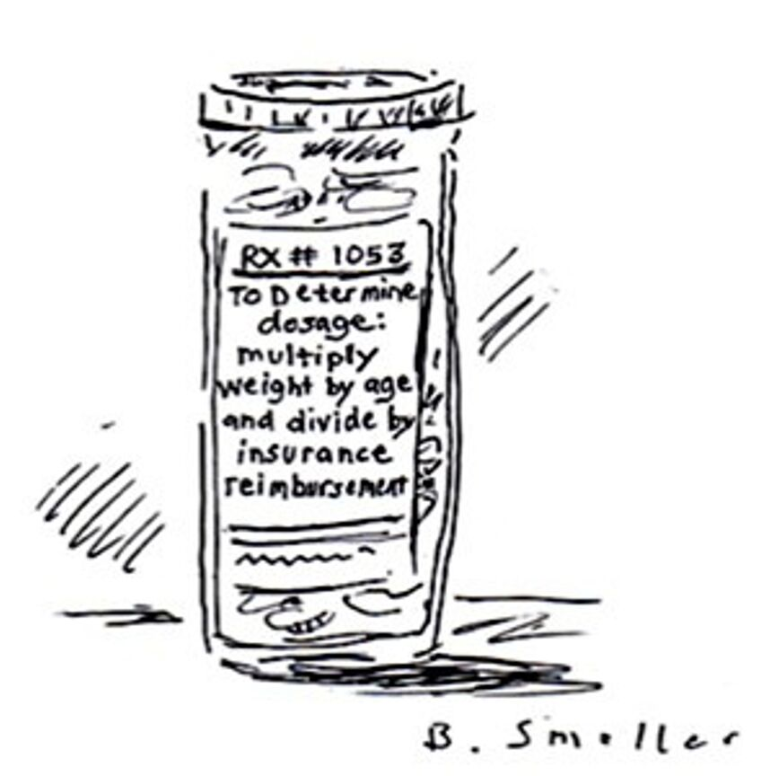
Scope of the Problem

Slide 21
Healthcare is more complex now
40 Years Ago
Today
1 Doctor
1 Pharmacist
No Forms
In-Patient
650 Medicines
Many Providers
Chain Drug Stores
Numerous Forms
Out-Patient
24,000Medicines
Scope of the Problem

Slide 22
Persons with limited health literacy skills have:
•Higher utilization of treatment services
Hospitalization
Emergency services
•Lower utilization of preventive services
Scope of the Problem

Slide 23
$106-$238 billion is lost every year on health care costs due to
a disconnect in the delivery of health information
Scope of the Problem
A Vernon, (2oo7). Low Health Literacy:
Implications for National Health Policy

Slide 24
Medical jargon
Written education materials
Diagnosis
Filling out forms
COMMON HEALTH LITERACY
CHALLENGES
Consent forms
Prescribed medicine
Navigating
Benefit Information
Notes:
Not understanding main health problem

Slide 25
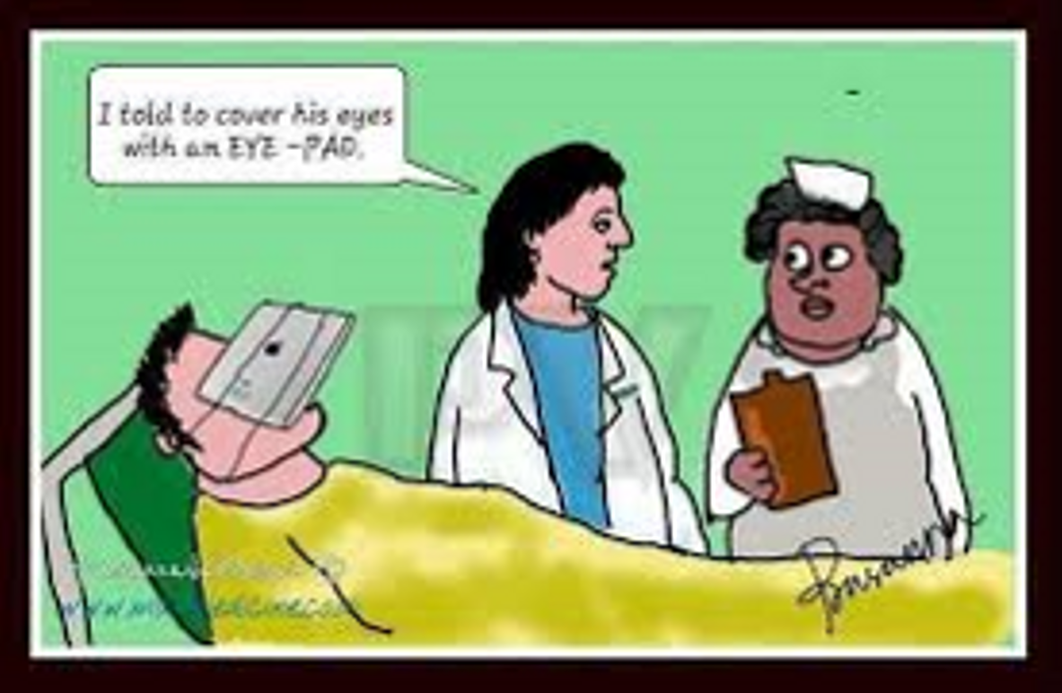
?????????????

Slide 26
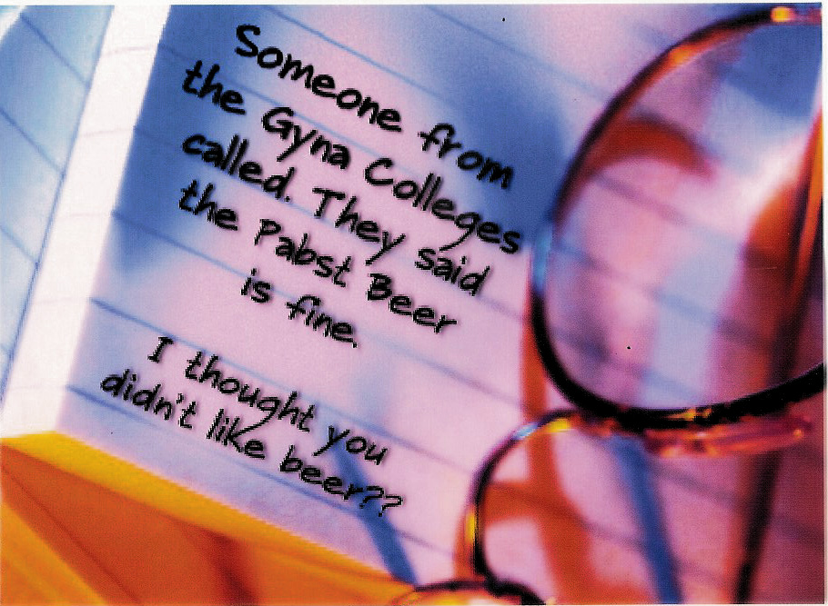
?????????????

Slide 27
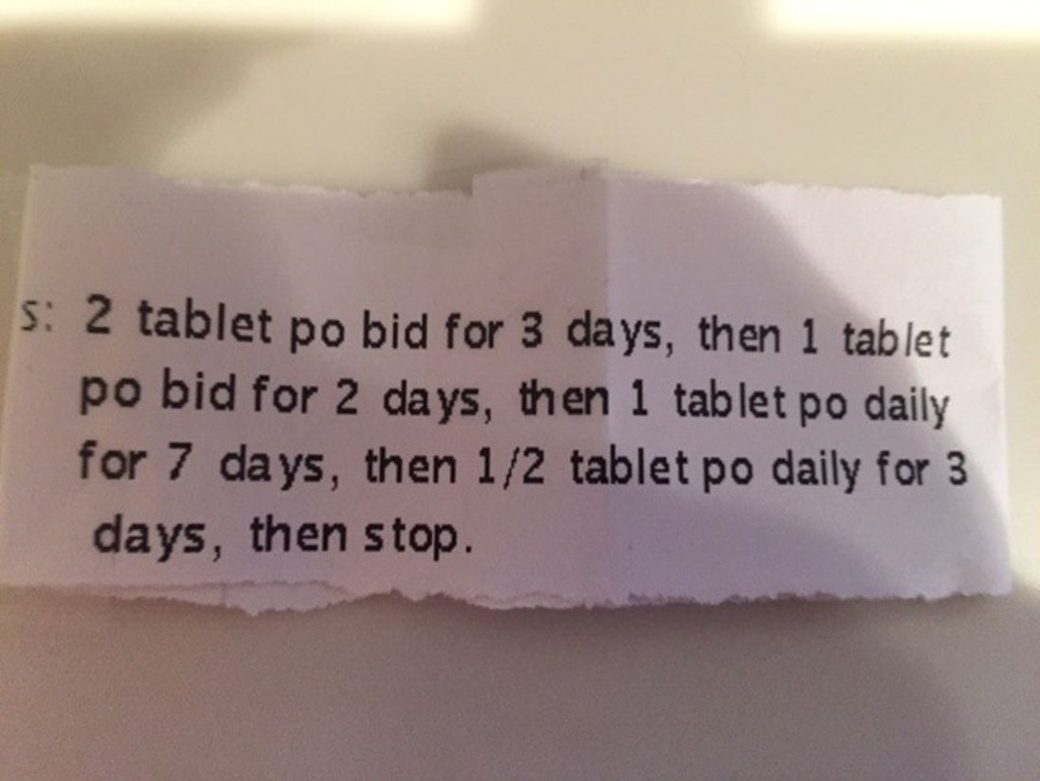
?????????????

Slide 28
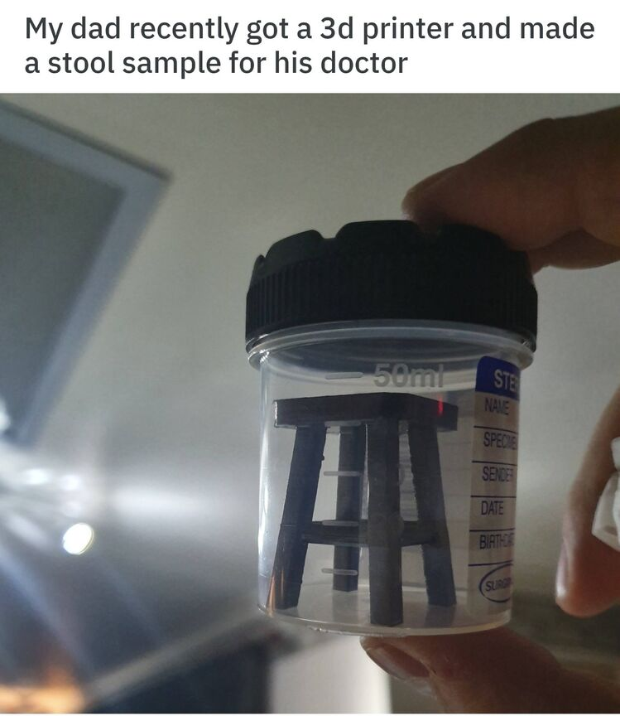
?????????????

Slide 29
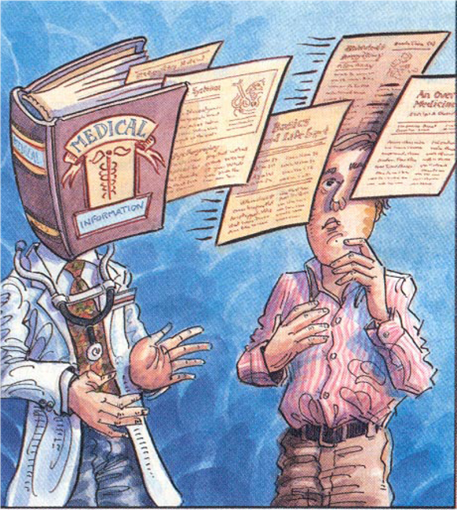
Mismatched Communication
Patient process:
Obtaining,
Understanding, remembering and acting on information
Provider process:
Giving
information

Slide 30
Cycle of Crisis Care:
A Patient Experience
Koch, et al 2012
Health Affairs
Notes:
In years past, health literacy issues have often been viewed in terms of individual patient deficits – that is, a patient’s lack of knowledge and skills regarding health issues. We now recognize that health literacy is a dynamic systems issue –it reflects both the complexity of health information coming from our health care system and the difficulties of navigating our health care system. I would like to illustrate how our health care system often requires patients to possess and demonstrate multiple skills that many people find challenging, and how these challenges can lead to a cycle of crisis care. You can see at the top you have a person who seeks medical help…

Slide 31
Cycle of Crisis Care:
A Patient Experience

Slide 32
Cycle of Crisis Care:
A Patient Experience

Slide 33
Cycle of Crisis Care:
A Patient Experience

Slide 34
Cycle of Crisis Care:
A Patient Experience

Slide 35
Cycle of Crisis Care:
A Patient Experience

Slide 36
Cycle of Crisis Care:
A Patient Experience

Slide 37
Cycle of Crisis Care:
A Patient Experience

Slide 38
Cycle of Crisis Care:
A Patient Experience

Slide 39
Cycle of Crisis Care:
A Patient Experience

Slide 40
Cycle of Crisis Care:
A Patient Experience

Slide 41
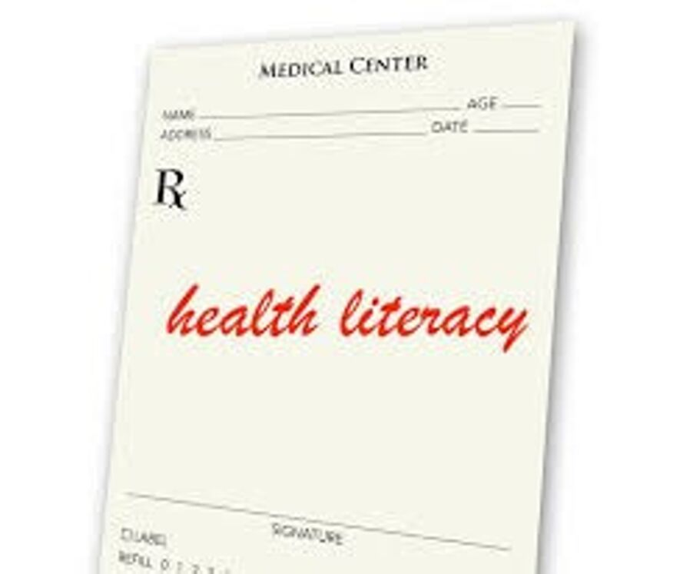
STRATEGIES TO IMPROVE HEALTH LITERACY

Slide 42
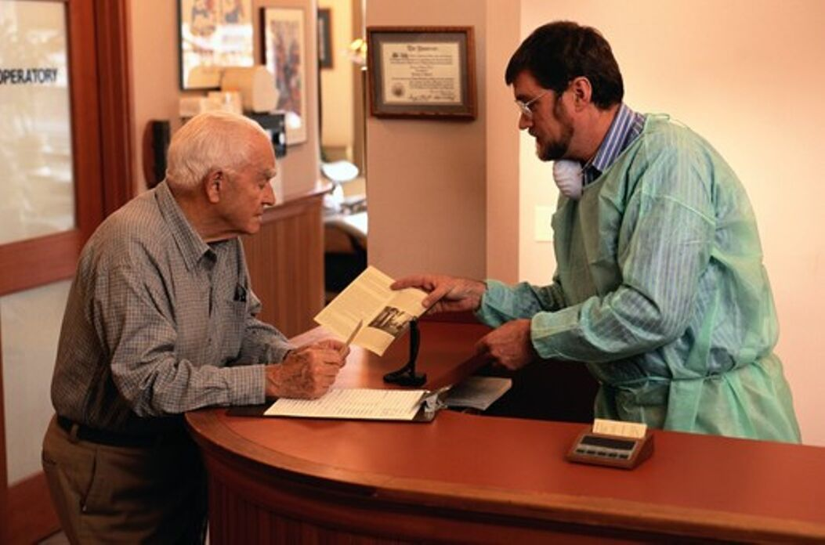
Universal Precautions
Many patients are at risk for misunderstanding but it's hard to identify them.
Everyone benefits from clear communication
Notes:
Structuring the delivery of care as if everyone may have limited health literacy:
You cannot tell by looking.
Higher literacy skills ≠ understanding.
Anxiety can reduce ability to manage health information.
Everyone benefits from clear communications.

Slide 43
1. Conduct Patient-Centered Visits
Engage
in a dialogue with the patient
Listen
more and speak less
Encourage
questions
Strategies
Notes:
studies have shown that patients speak on average, 23 seconds before they are interrupted
When allowed to speak, average is 90 sec.
Do not say: Do you have questions?
Instead: What questions do you have?

Slide 44
ASK ME 3
WHAT IS MY MAIN PROBLEM?
WHAT DO I NEED TO DO?
WHY IS IT IMPORTANT?

Slide 45
Ask Questions!
Strategies
https://www.youtube.com/watch?v=jfylYtyb8tE
Notes:
studies have shown that patients speak on average, 23 seconds before they are interrupted
When allowed to speak, average is 90 sec.
Do not say: Do you have questions?
Instead: What questions do you have?

Slide 46
2. Explain things clearly using
plain language
•Slow down the pace of your speech
•Use
analogies
•Use
plain, non-medical
language
Strategies
Plain lanuage is communication your reader or listener understands immediately - "Living room language"

Slide 47
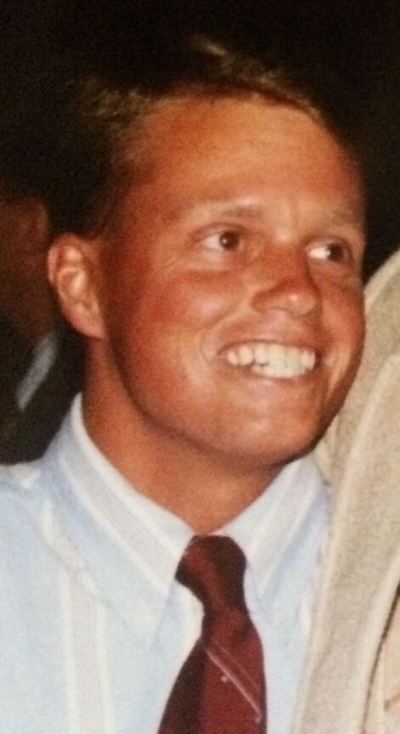
Meet Bernie

Slide 48
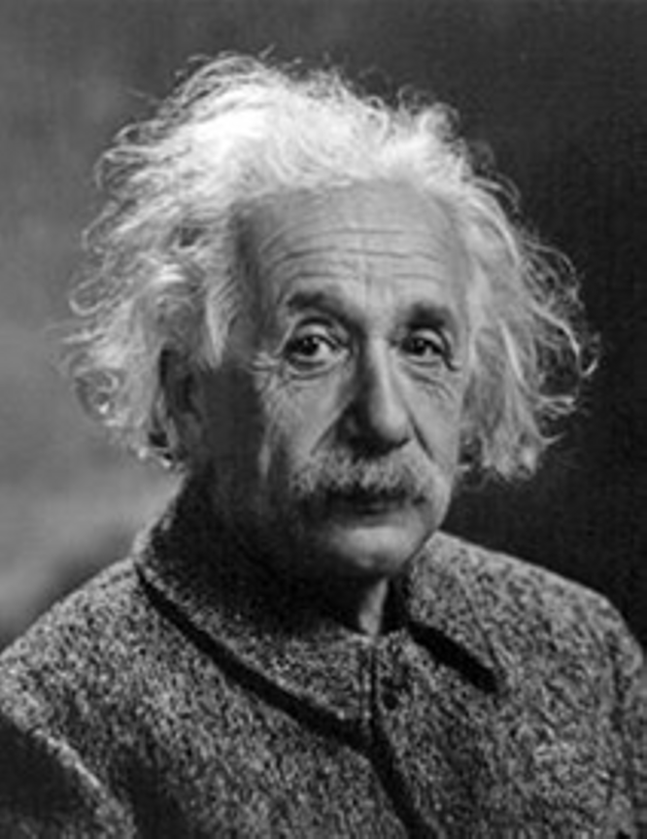
Any intelligent fool can make things bigger and more complex... It takes a touch of
genius - and a lot of courage to move in the opposite direction.
Albert Einstein

Slide 49
3. Focus on Key Messages
"Need to know" and "Need to do"
Review each point and repeat.
"Chunk and Check"
Strategies
Notes:
advice is remembered better, and patients are more likely to act on it, when the advice is given in small pieces and is relevant to the patient’s current needs or situation

Slide 50
3. Focus on Key Messages
Example:
Key Messages: The most important concepts
First visit for patient with newly diagnosed Type II DM
Suggested key messages in red
–How the body controls blood glucose
–Sugar level in blood is too high
–Self-management of diabetes medications
–Start medicine to lower sugar
–Potential complications of diabetes
–Testingthe blood sugar level
–Proper diet
Strategies
Notes:
advice is remembered better, and patients are more likely to act on it, when the advice is given in small pieces and is relevant to the patient’s current needs or situation

Slide 51
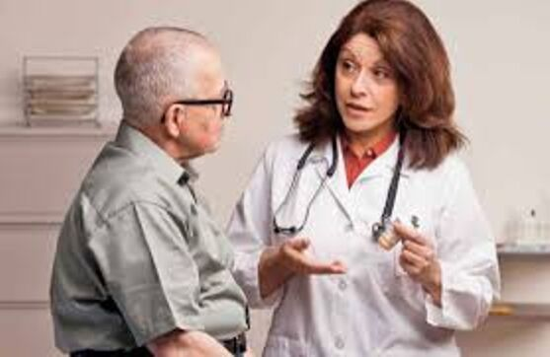
4. Use Teach-back
Do not ask,
"Do you understand?”
or
"Do you have any questions?
Asking
patients to repeat in their own
words what
they need to know or do, in a non-shaming way.
A chance to check for understanding and, if necessary, re-teach the information.
Strategies

Slide 52
Teach-back
Not a
test of the patient, but of how well you explained
a concept.
"I want to be sure I explained everything clearly, so can you please tell me how you would describe this to your spouse"?
Strategies

Slide 53
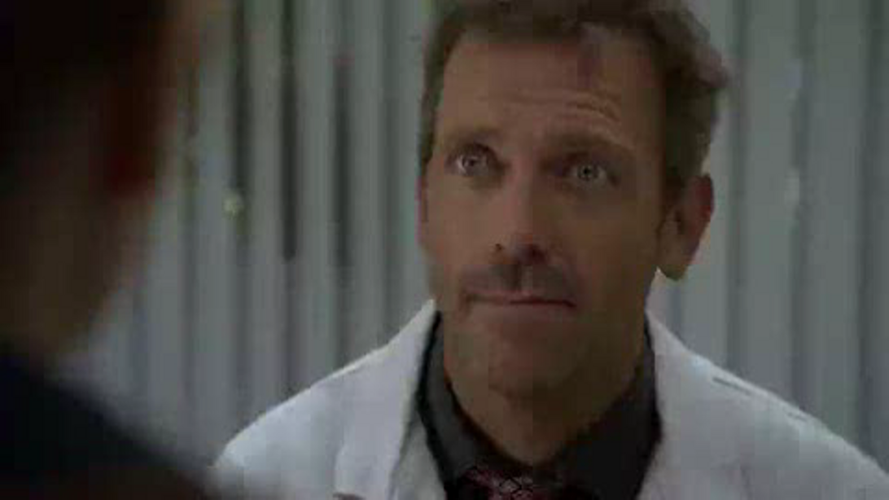
Strategies

Slide 54
Potent Case for Teach-back
https://www.youtube.com/watch?v=zSSoYmQS6Ng
Strategies

Slide 55
5. Patient-friendly
Educational Materials
•Emphasize what the patient should do
•Minimize information about anatomy and
physiology
•Limit
use of contractions and hyphenated words
Strategies

Slide 56
Patient-friendly
Educational Materials
Keep it simple
Simple words
(1-2 syllables)
Short sentences
(4-6 words)
Short paragraphs (2-3 sentences)
No medical jargon
Headings and bullets
Use an active voice
Speak to and like your audience
Use lots of white space.
Strategies

Slide 57
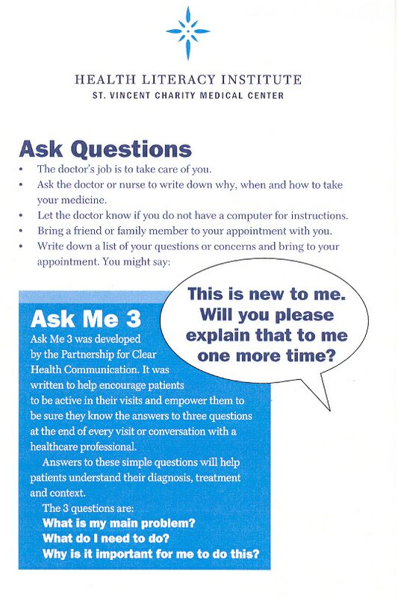
SVCMC Efforts

Slide 58
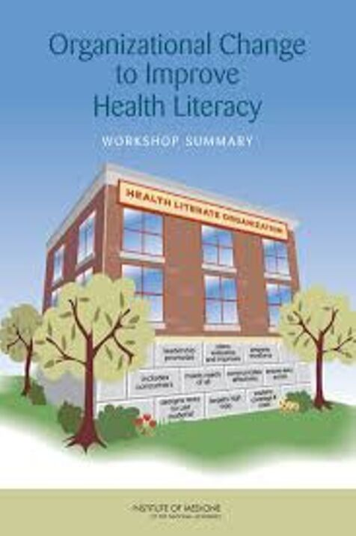
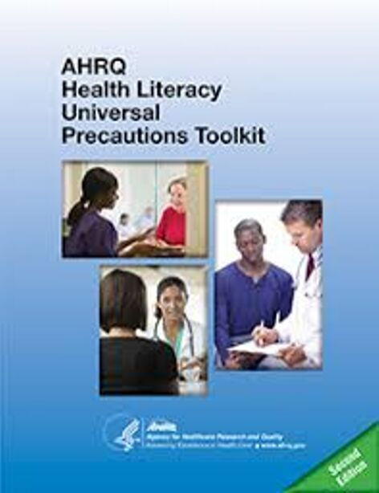
National Efforts

Slide 59
The Joint Commission
Communication
is a cornerstone of
patient safety and
quality care
Every patient has a right to receive information in a manner he or she
understands
When a patient understands what is being said about his or her care, treatment and
services, the patient is
more likely to fulfill
critical heath care
responsibilities

Slide 60
Mission: Empower Ohioans to make informed health choices
Improve health literacy in communities across the state of Ohio.
Enhance health professionals’ health literacy competencies.
Promote and support health literacy in organizations.

Slide 61
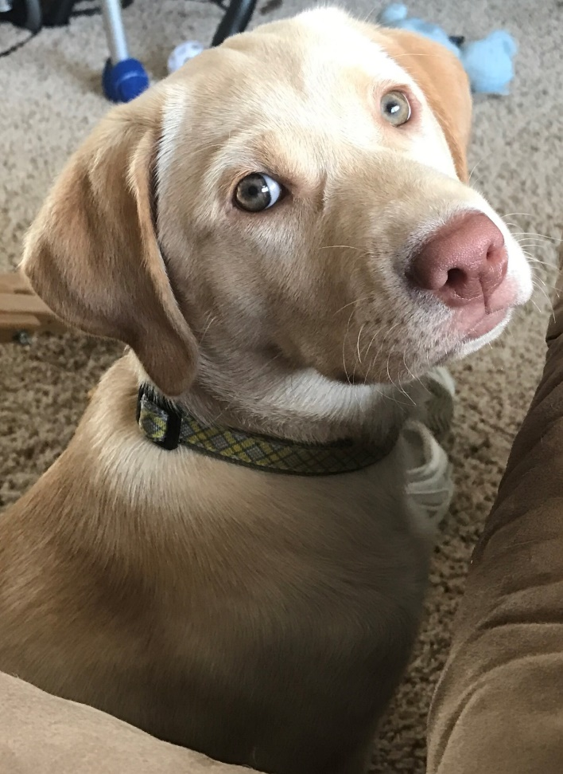
Meet Sophie

Slide 62
