Slide 1
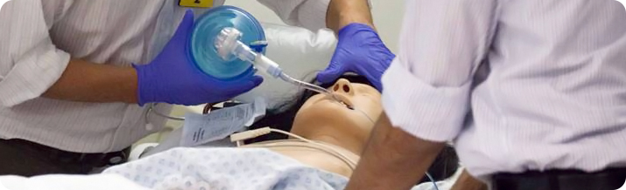
Simulation in Critical Care
Dr Peter Isherwood
Consultant in Critical Care Medicine & Anaesthesia and Clinical Lead for Simulation UHB
Honorary Senior Clinical Lecturer UoB
Notes:
Thanks to CCN for invite
Ashley Miller and Mamta Patel

Slide 2

Notes:
What am I talking about ?
What might these guys want to know

Slide 3
an instructional process that substitutes real patient encounters with artificial models, live actors, or virtual reality patients.
David Gaba, 2004
A way of learning
an experiential learning system in which one or more elements of reality are replicated
Peter Isherwood, just now
Notes:
Critical Care Tutorials Lecture …

Slide 4
Simulation
Actor
Dumb Manikin
Role Play
Part Task Trainers
Patient Simulators
Screen Based
Desk Based
VR
Multidisciplinary Immersive Team Training
Major Incident planning

Slide 5
Concrete Experience
Reflective Observation
Abstract Conceptualisation
Active Experimentation
Notes:
Washing Martins Car!

Slide 6
Notes:
What might these guys want to know
where to use it
how to use it
evidence for it
doing it
Support

Slide 7
Perhaps
When
How
Why
Support
Notes:
So these are some ideas that came to mind
When can the use of simulation be of benefit
Why would we want to use it
How do we use it
and being intensivists – how can we get even better at it
So lets begin with When it potentially could be used, the top two are likely to be safety & education

Slide 8
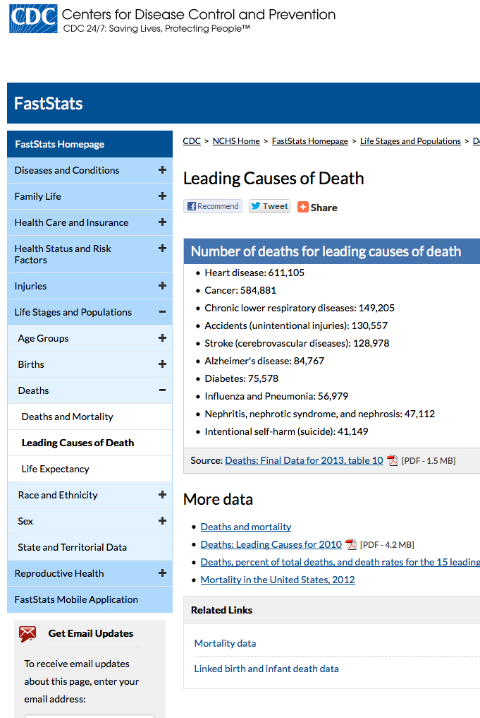
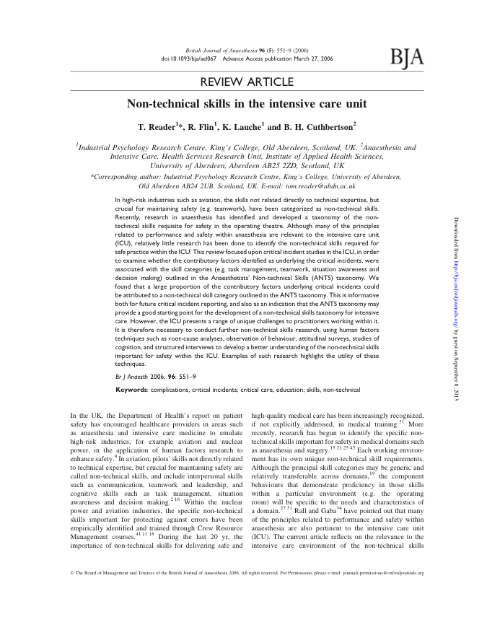
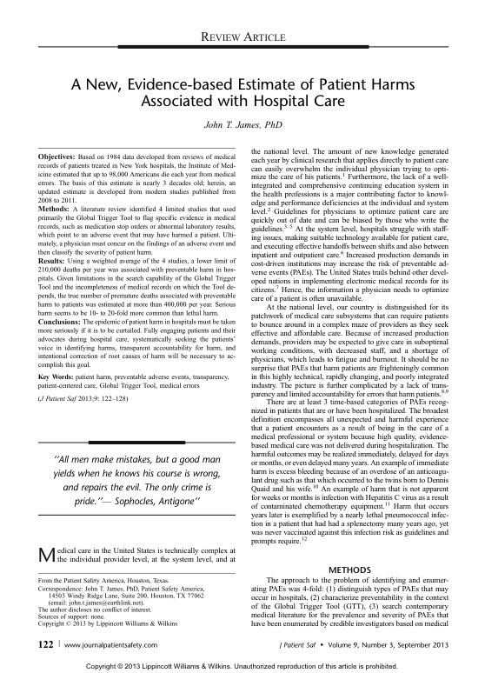
Patient Safety / Human Factors
Notes:
2000 DoH – Organisation with a memory
Institute of medicine – To err is human
Journal of patient safety, Sept 2013
210,000 deaths per year was associated with preventable harm in hos- pitals. Given limitations in the search capability of the Global Trigger Tool and the incompleteness of medical records on which the Tool de- pends, the true number of premature deaths associated with preventable harm to patients was estimated at more than 400,000 per year.
Reader / Flin 2006,
2677 incidents
(5610 contributory factors)
50% NTS

Slide 9
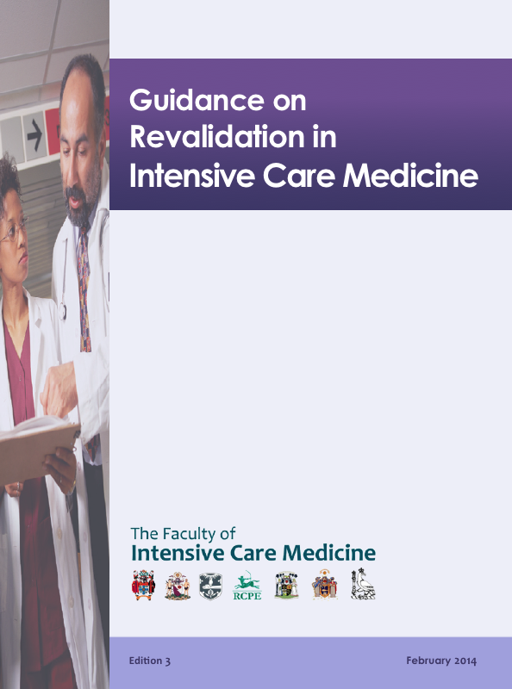
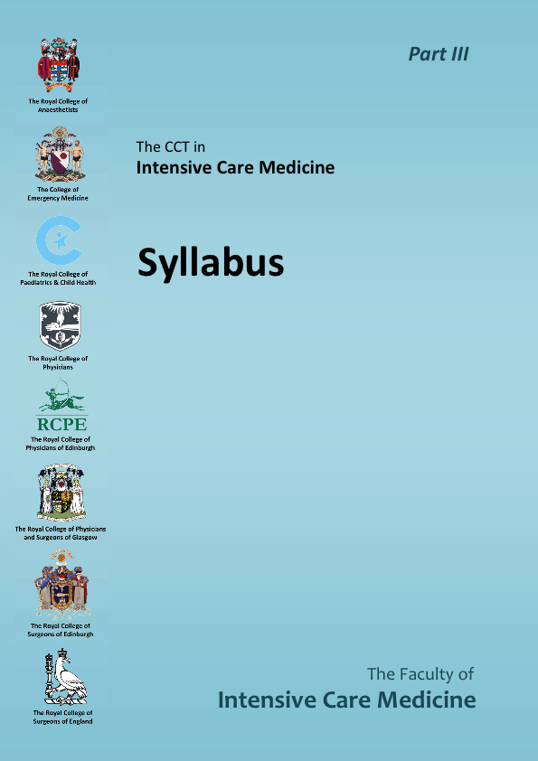
Education / Revalidation
Notes:
FICM CCT Syllabus
24 / 96 Curriculum competencies
Revalidation
knowledge, skills and performance
communication, partnership and team work
Quality improvement activity
Colleague feedback

Slide 10
Further
Assessing System Resilience / performance
Introducing new technologies / systems
Critical Incident Analysis / prevention
Notes:
so that’s a few areas when the use of simulation may be an option so lets move on and look at why simulation

Slide 11
How ?
Notes:
How to use education

Slide 12
Using Simulation Efficiently
Core Knowledge
Skills
Drills
Performance
Task Trainers
Epidural
CVC
PVC
Chest Drain
Suture Trainers
BVM
Airway
Dumb Manikin
ALS
ATLS
CICV
Actor / Patient Simulator
Advanced Practice
Human Factors
Not Simulation!
Immersion (Fidelity)
Debriefing, Faculty, Preparation, Time
Notes:
Match the level and choice of simulation to the learning outcomes you wish to generate

Slide 13


Slide 14
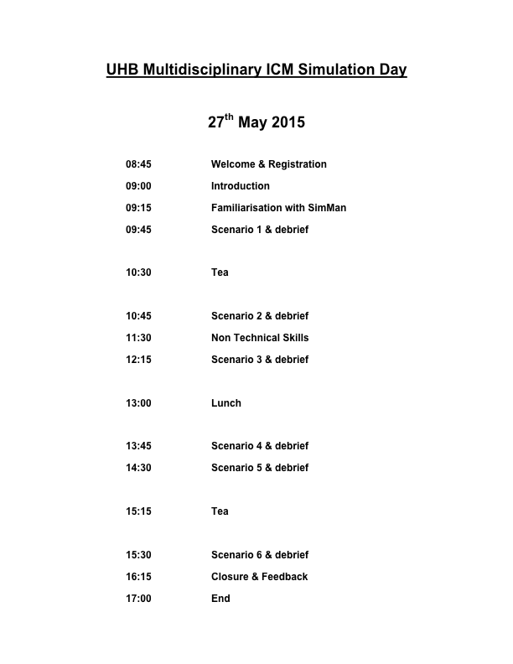

Slide 15
Resources
Trained & Willing Faculty
Time
Space
Scenarios & Props

Slide 16
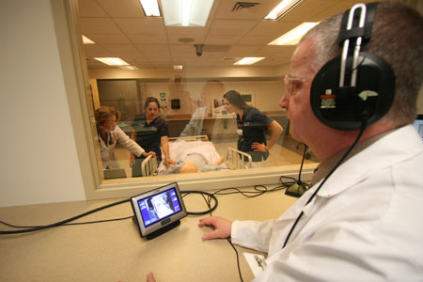
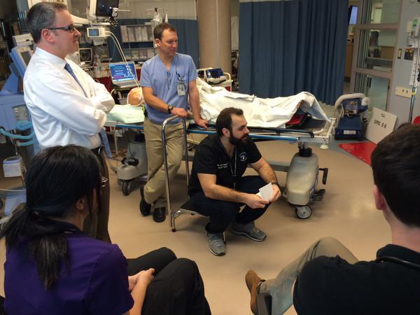
Where
Lab
In-Situ
Notes:
In situ
Postgraduate teams in a clinical environment
Situation awareness
Clinical Systems and kit
Governance
Confidentiality
Competing resources

Slide 17
Achievable
“Video has had to be removed, as the file was 130mb – apologies”
Notes:
12 people
Recent Pilot
Confidentiality – Consent given

Slide 18
Why?
Lets look at evidence for education…

Slide 19


Healthcares biggest issues ?

Slide 20
Well..
Increased knowledge retention, ability and self-confidence to perform (Under Grad Pharmacology)
Improved clinical skills & knowledge (4th year students cardiology placements)
Implementation of simulation training improves work place ACLS protocol implementation (Anaesthesia)
Improves clinical performance (Anaesthesia)
Improved laparoscopic performance in the operating room (Surgery)
Improved technical proficiency, self confidence & teamwork (Obstetrics)
Demonstrated reduction in neonatal injury post simulation training (Obstetrics)
Improved team performance (ED)
The Utility of Simulation in Medical Education: What Is the Evidence?
MOUNT SINAI JOURNAL OF MEDICINE 76:330–343, 2009
Notes:
Increased knowledge retention, ability and self-confidence to perform (Under Grad Pharmacology)
Improved clinical skills & knowledge (4th year students cardiology placements)
Implementation of simulation training improves work place ACLS protocol implementation (Anaesthesia)
Improves clinical performance (Anaesthesia)
Improved laparoscopic performance in the operating room (Surgery)
Improved technical proficiency, self confidence & teamwork (Obstetrics)
Demonstrated reduction in neonatal injury post simulation training (Obstetrics)
Improved team performance (ED)

Slide 21
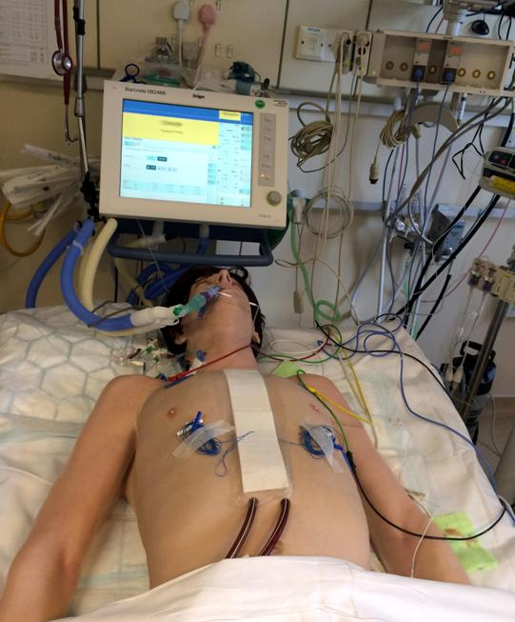
and in critical care
Improving handover
Modelling unit capacity
Airway training
Resuscitation Training
Evaluating team performance
Decreased complications during CVC insertion
Diagnostic performance

Slide 22
‘‘no (other) industry in which human lives depend on skilled performance has waited for unequivocal proof of the benefits of simulation before embracing it.’’
Gaba 1992
Notes:
Simulation can be used to improve team working skills
Teams that have better team working skills have been shown to have better clinical outcomes
Simulation has not conclusively been demonstrated to improve patient outcomes
Rail / Military / Aviation / petrochemical / nuclear
UHB 5.4 million clinical negligence payouts 2013-14
NHS 1.2 Billion NHS AL - Clinical negligence expenditure including interim payments in 2012/13

Slide 23

Notes:
Team with high performance have better team skills
Simulation training improves team skills
so

Slide 24
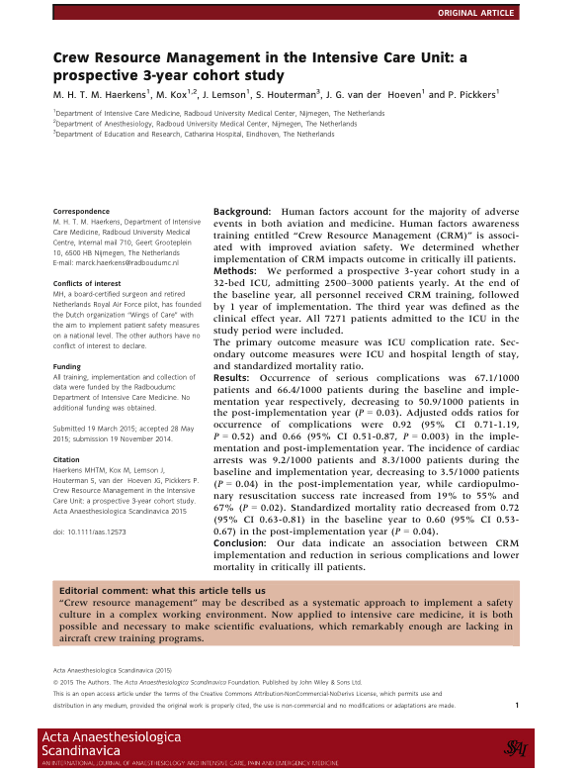
Crew Resource Management in the Intensive Care Unit: a prospective 3-year cohort study; Acta Anaesthesiologica Scandinavica (2015)
67 – 66 – 50.9 / 1000 serious complications (p=0.03)
9.2 – 8.3 – 3.5 / 1000 cardiac arrests (p=0.04)
19% - 55% - 67% ROSC (p=0.02)
0.72 – 0.60 (p=0.04_
Notes:
3 years
32 bedded netherlands
2500 – 3000 patients year
1/3 cardiothoracic
cohort study
baseline
implementation year
post-implementation year
CRM
lectures
workshops
video
interactive workshops

Slide 25
Using Simulation Efficiently
Core Knowledge
Skills
Drills
Performance
Task Trainers
Epidural
CVC
PVC
Chest Drain
Suture Trainers
BVM
Airway
Dumb Manikin
ALS
ATLS
CICV
Actor / Patient Simulator
Advanced Practice
Human Factors
Not Simulation!
Immersion (Fidelity)
Debriefing, Faculty, Preparation, Time
Notes:
Match the level and choice of simulation to the learning outcomes you wish to generate

Slide 26
Sources of Support
Your education / simulation team
Patient safety advocates / leads
Human factors advocates / leads
HEWM
Regional colleagues
Simulation training courses
National associations
Notes:
resources
in house training
Faculty
HEWM
Developing regional simulation plans
Regional colleagues
watch course / share ideas / share scenarios and props / share faculty

Slide 27


Slide 28
Many thanks
peter.isherwood@uhb.nhs.uk
UoB / UHB PGC in Multidisciplinary
Healthcare Simulation

