Slide 1

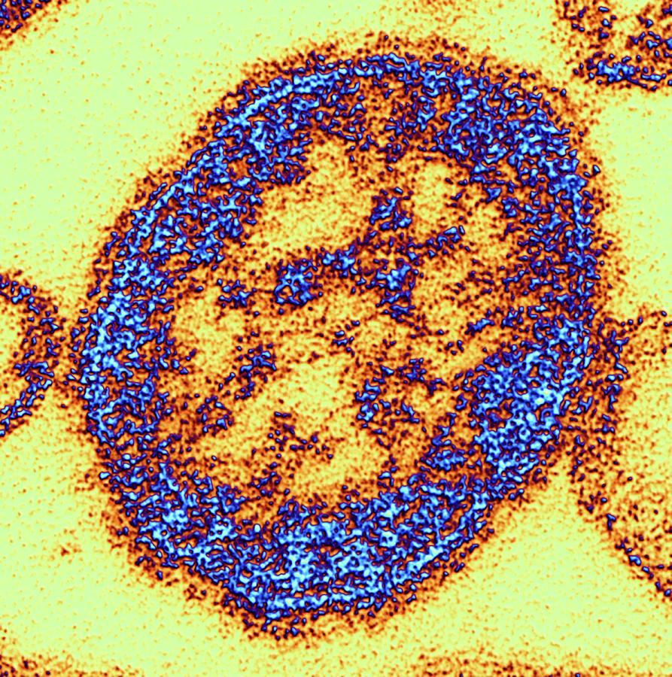
Measles Table Top Exercise
Liisa Jackson
Medical Reserve Corps Director
www.mrcvolunteer.org

Slide 2
Welcome and Introductions
Name
Agency
Position

Slide 3
Administrative
Phones, pagers, radios
Restrooms
Breaks
Fire Exits
Assembly Points
No Smoking
Refreshments

Slide 4
Exercise Agenda
1:00 PM – 1:15 PM
Welcome and Introductions
1:15 PM – 1:30 PM
EPI Overview
1:30 PM – 1:45 PM
Exercise Briefing
1:45 PM – 2:20 PM
START EX - Module 1: Initial Case
2:20 PM – 2:30 PM
Break
2:30 PM – 3:10 PM
Module 2: Expanding Problem
3:10 PM – 3:20 PM
Break
3:20 PM – 4:00 PM
Module 3: Stretched Resources
4:00 PM – 4:30 PM
Hot Wash & Participant Evaluation

Slide 5
Goal of the Exercise (TTX)
To practice coordination and communication activities in an Measles virus scenario among
• Hospitals and Healthcare Organizations
• Local/State Public Health Agencies
• Emergency Management
• Public Information
• Public School Systems
• Fire/Emergency Medical Services

Slide 6
Preparedness Capabilities
Capability Program Core Crosswalk
Information Sharing HPP and PHEP Operational Communications
Medical Surge HPP and PHEP Public Health and Medical Services
Healthcare System Recovery (Continuity of Operations)
PHEP Planning

Slide 7

Objectives
Exercise Objective #1:
Healthcare System Recovery Discuss how healthcare/public health agencies maintain continuity of the healthcare delivery by coordinating across functional healthcare organizations and encouraging business continuity planning. This coordination assists healthcare organizations to sustain and reestablish essential services during and after an all hazards incident and enables a rapid and more effective recovery.
(Applicable HCCDA Factors # 11 and #14.)

Slide 8
Objectives
Exercise Objective #2:
Information Sharing Discuss how healthcare/public health agencies will coordinate with local and state agencies to share and disseminate Measles Virus incident related information
Exercise Objective #3:
Medical Surge Discuss how healthcare agencies will continue to provide care during a Measles Virus incident that exceeds the limits of the normal medical infrastructure.

Slide 9
Roles & Responsibilities
Players: Players are personnel who are active in discussing roles and responsibilities during the exercise.
Observers: Observers do not directly participate in the exercise. Observers participate to gain situational awareness on key stakeholders response activities.
Facilitators: Facilitators provide situation updates to control the pace of the exercise and moderate discussions.
Evaluators: Evaluators are assigned to observe and document certain objectives during the exercise.

Slide 10
Exercise Structure
This exercise will be a facilitated exercise. Players will participate in full group discussions during the following three modules:
Module 1: Initial Cases
Module 2: Expanding Problem
Module 3: Stretched Resources

Slide 11
Assumptions & Artificialities
Plausible scenario, events occur as presented.
No “hidden agendas” or trick questions.
Everyone receives information at about the same time.
Non-participating entities will respond as expected in applicable plans

Slide 12
Summary Instructions
Work across agencies to complete tasks – don’t just work with your table.
Use your plans, policies, practices to complete tasks.
The schedule needs to be flexible

Slide 13

Measles Review
Transmission
Signs and Symptoms
Complications
Disease Burden

Slide 14
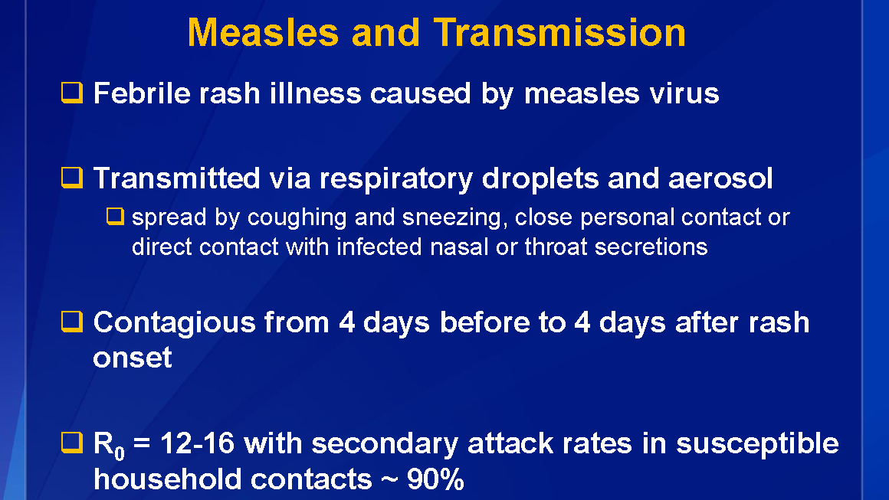

Slide 15
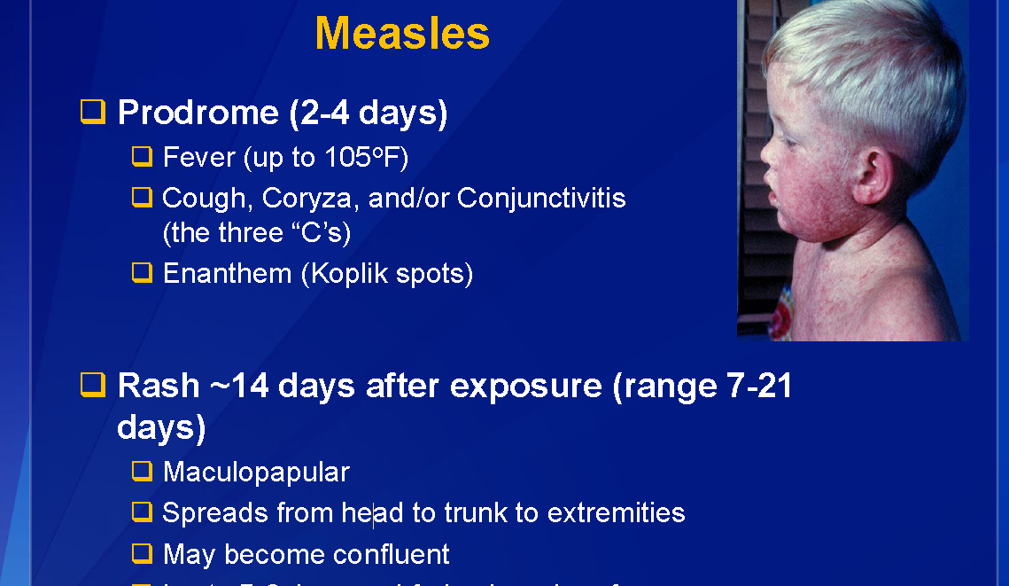

Slide 16
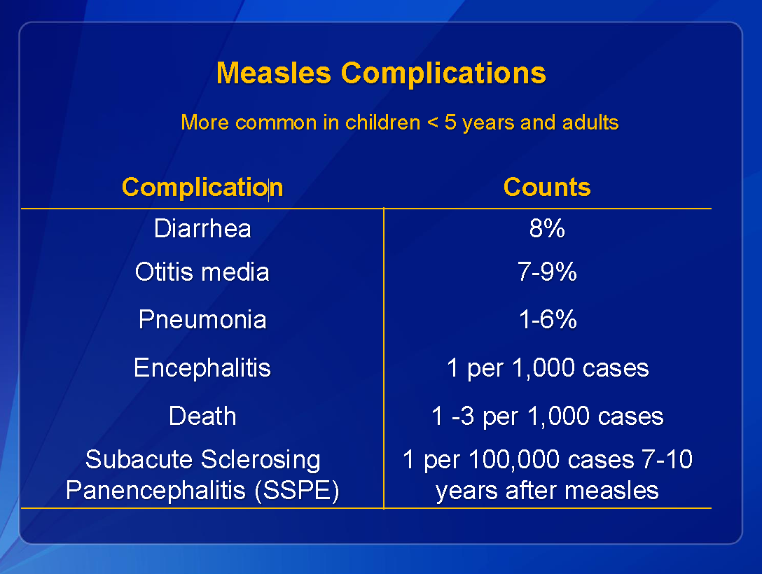

Slide 17
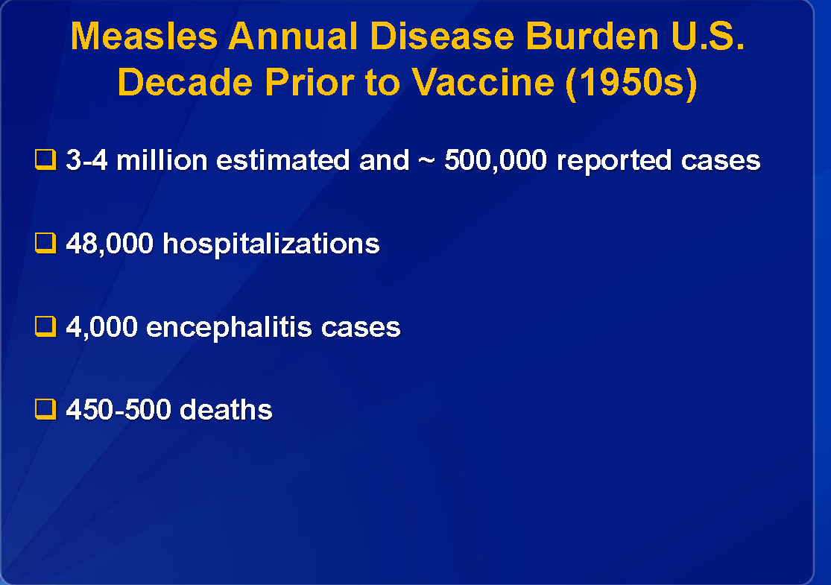

Slide 18

Measles-current events
Ban of unvaccinated kids from public areas
Cases and outbreaks
Non-Medical Exemptions
Highest populations of anivaxxers

Slide 19
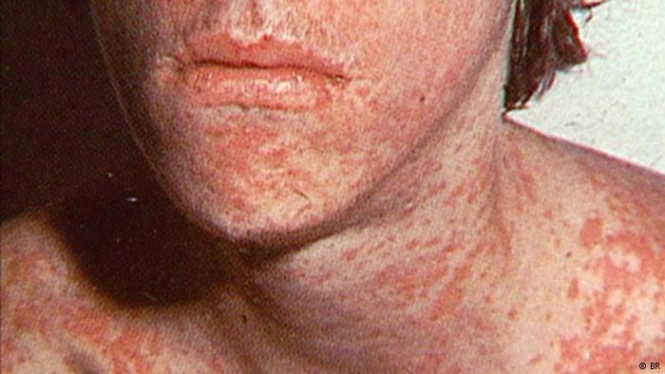
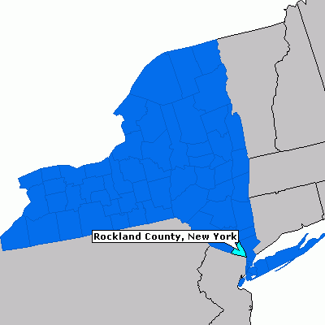
BREAKING NEWS (CNN) 9:57 AM ET, Wed March 27, 2019
NY county bans unvaccinated kids from public areas!
Unvaccinated people under age 18 are banned from public places in Rockland County, New York, as of midnight Wednesday, according to John Lyon, director of strategic communications for County Executive Ed Day. Day announced the order Tuesday.
The declaration is an effort to contain an outbreak of measles that began in October; 153 cases have been confirmed in the county

Slide 20
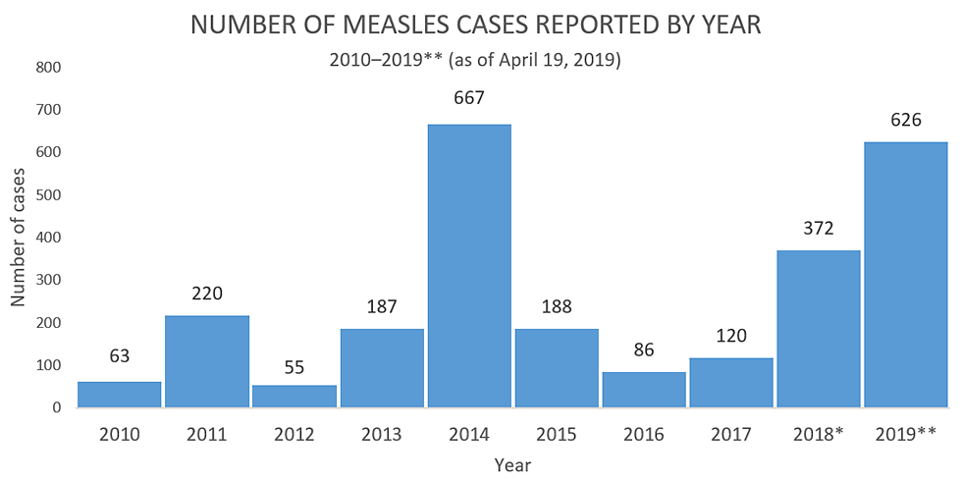
Measles cases and outbreaks
Measles outbreak in Washington State
Measles in Washington has spread and health officials urge immunization. The Washington State Department of Health reminds people to take precautions to help stop the spread of measles.
BOSTON (AP) — Public health officials in Boston are warning of a possible measles exposure after an individual with a confirmed case of the disease traveled from New York City to Boston and then to New Hampshire.
Health officials said the possible exposure occurred Tuesday when the individual boarded a 4 p.m. Greyhound bus from New York to Boston before taking a 10 p.m. Boston Express Bus from Logan International Airport to Manchester, New Hampshire.
Officials said anyone on the buses or at the South Station bus terminal in Boston between 8:30 p.m. and midnight could have been exposed and could become ill between March 3 and March 19 — up to 21 days following a potential exposure.
2019 has just started, but we already have reports of measles cases and exposures in at least 368 people in 18 states, including Arizona (1), California (8), Colorado (1), Connecticut (3), Georgia (3), Hawaii (2), Kentucky (1), Illinois (5), Kentucky (1), Michigan (22), Missouri (1), Nevada (1), New Hampshire (1), New Jersey (4), New York (227), Oregon (10), Texas (14), and Washington (73).
The Texas Department of State Health Services (DSHS) has confirmed 14 measles cases in Texas this year. DSHS is urging health care providers to consider measles when diagnosing patients because early identification, along with immunization, is key to preventing measles from spreading.
.
The last large outbreak of measles in California was associated with Disneyland and occurred from December 2014-April 2015, when at least 131 California residents were infected with measles; the outbreak also infected residents of six other states, Mexico, and Canada.
In 2019, one outbreak of three cases linked to a patient with international travel has been reported in California. As of March 22, 2019, seven confirmed measles cases, including the three outbreak-associated cases, have been reported in the following jurisdictions.

Slide 21
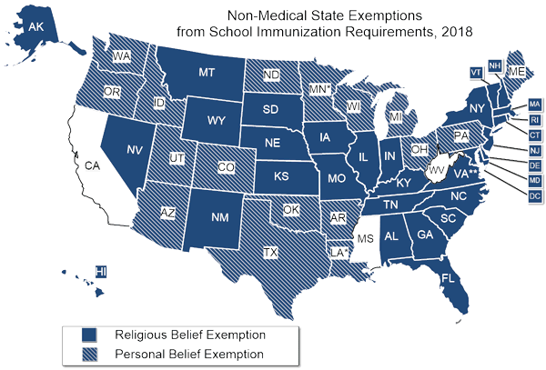
Non-Medical State Exemptions

Slide 22
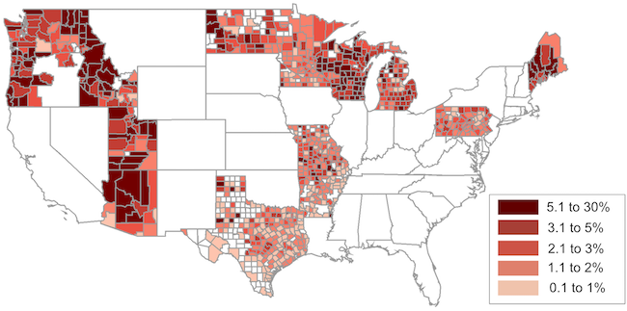
Highest population of antivaxxers

Slide 23
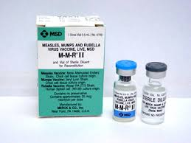
Measles Vaccine
U.S. History

Slide 24
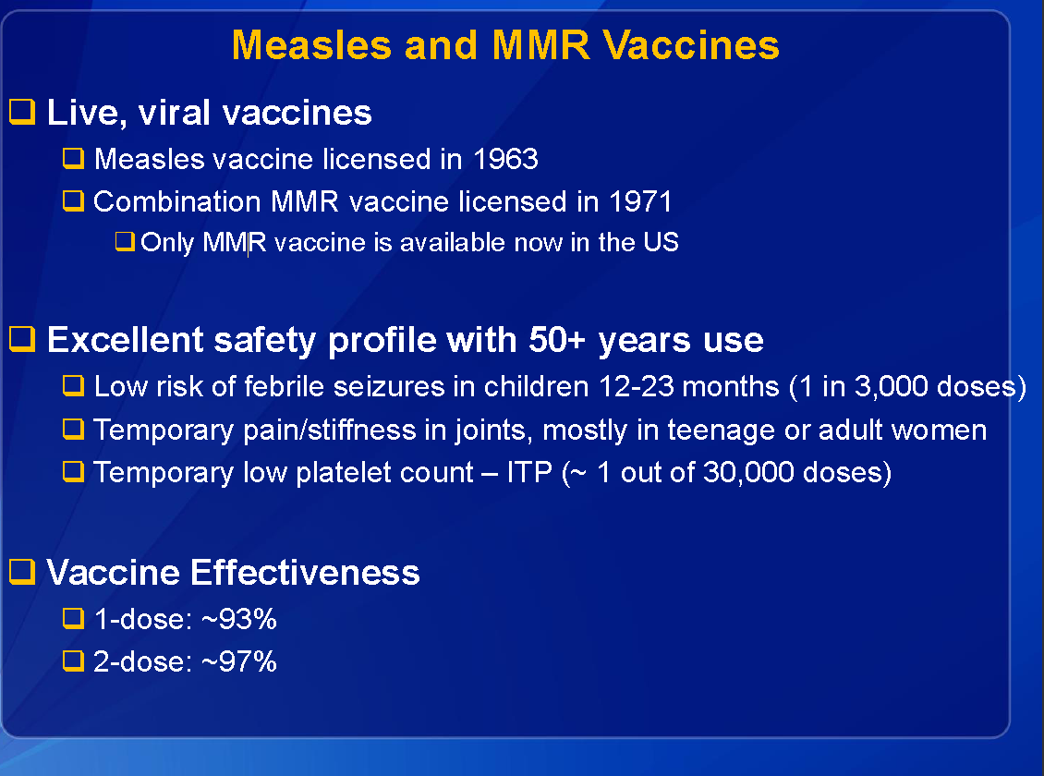
Notes:
Second dose was recommended in 1989

Slide 25
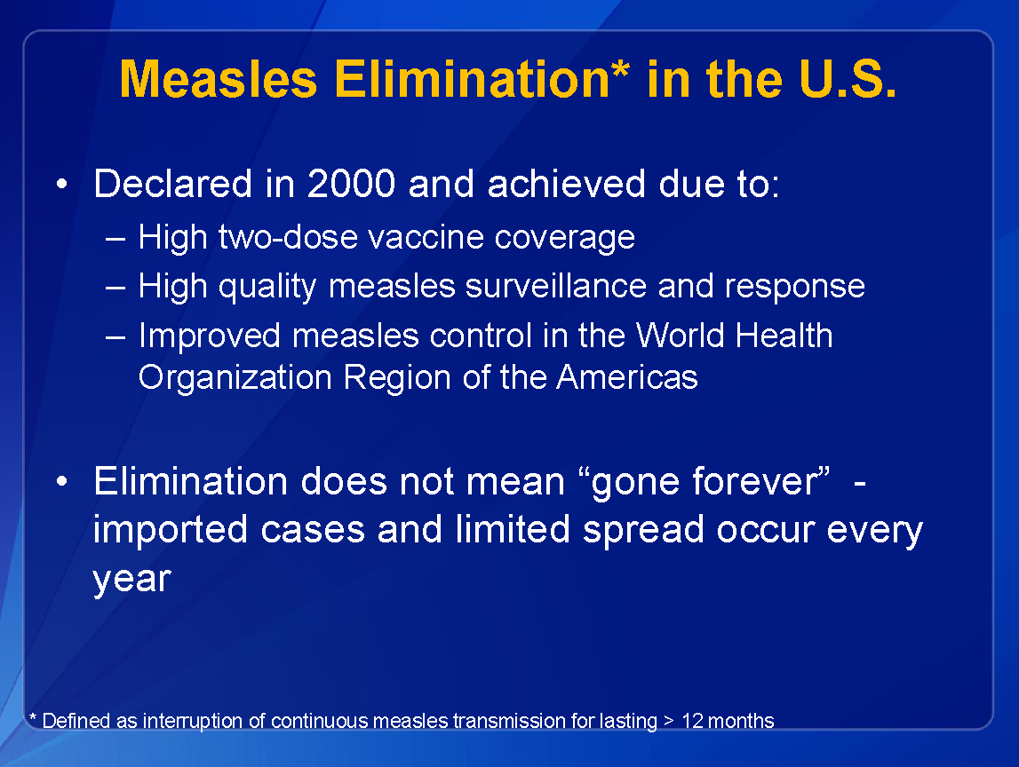

Slide 26
MMR Vaccine
Almost 100% effective – one of the best
Adults may need one too
It’s never too late to get the vaccine!

Slide 27
Module 1
Let’s start the scenario!
Initial Cases

Slide 28
May 25, 2019 (Day 1)
17-Year Old Katie Hardy New Bedford goes to the doctor
Cough, sore throat, runny nose, fever, achiness
Flu is widespread – given flu test and sent home to rest
Rapid Flu test comes back negative

Slide 29
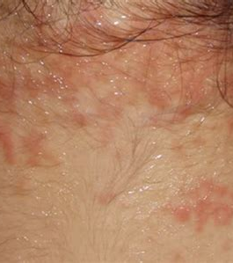
May 28, 2019- (Day 4)
17-Year Old Katie Hardy
Itchy & Red Eyes
Reddish-Brown rash near hairline
Fever at 102.2

Slide 30


May 28, 2019 – (Day 4)
17-Year Old Katie Hardy goes to ER at South Coast Hospital
Doctor isolates in exam room
State Lab approves measles test
Test comes back positive for Measles
Contact tracing begins immediately

Slide 31
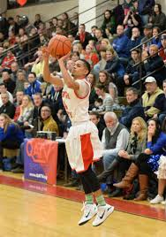
May 28, 2019 – (Day 4)
Contact Tracing Information
New Bedford HS Basket Ball Team Playing Fall River
200+ people – kids, parents and spectators

Slide 32
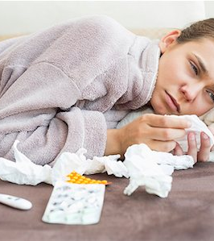
May 29, 2019 – (Day 5)
Measles outbreak?
5 people who were at the game are showing similar symptoms
Sore throat
Cough
Watery/reddish eyes
Elevated temperatures

Slide 33
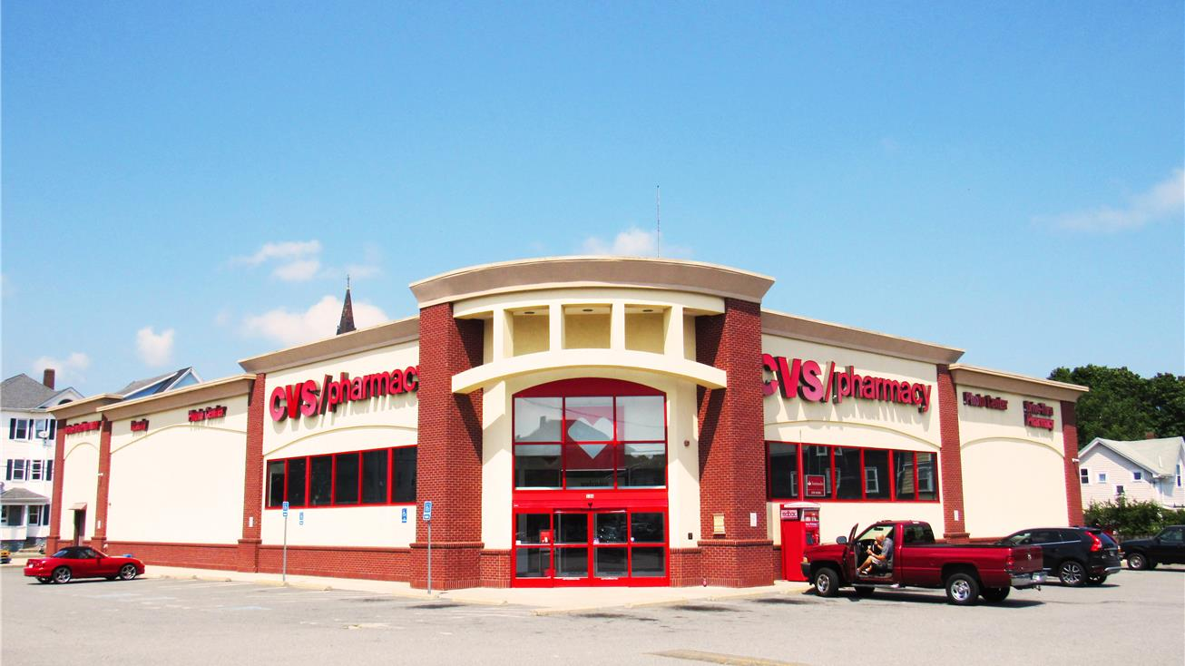
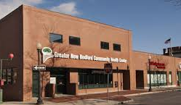
March 29, 2015 – Sunday (Day 5)
2 boys go to South Coast Medical Center
1 adult goes to CVS Minute Clinic
1 girl and 1 adult go to Greater New Bedford Community Health Center
3 Tests come back positive for Measles
1 adult at CVS Minute Clinic
1 girl and 1 adult go to Greater New Bedford Community Health Center

Slide 34

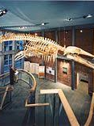
May 30, 2019 – (Day 6)
Contagious time period began May 24th
Contagious individuals spent time at:
New Bedford Food Festival (working refreshment stand as team fundraiser)
Downtown New Bedford (4 hours shopping and eating)
Whaling Museum

Slide 35
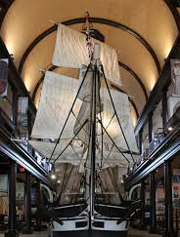
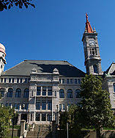

Module 1 – Key Issues
4 people with confirmed cases of the measles
Suspected cases are linked to traveler at Whaling Museum
Unknown number of people exposed – symptoms do not appear for 7-21 days after exposure
Siblings attend other schools
Highly infectious disease that can infect over 90% of unvaccinated people
Local Media is reporting on Measles cases

Slide 36
Module 1
Breakout discussions
Each table discuss what your agency would be doing at this time

Slide 37
Module 1
Report Actions
Each agency report actions that would be taken

Slide 38
Module 2
Expanding Problems

Slide 39
June 6, 2019 – (Day 13)
New cases
93% vaccination rate in Region
2 new cases / infected individual every 10 days

Slide 40
June 7, 2019 – (Day 14)
Family of 3 walk into New Bedford Health Dept.
Rapid Flu test negative -all 3 test positive for measles
2 private physicians in New Bedford report seeing suspected cases, sent to Hospital for further evaluation
2 children at Elementary School diagnosed with measles.
Both admitted to Baptist South Coast Medical Center with complications

Slide 41
June 8 to 12 (Day 15 - Day 19)
3 Residents of New Bedford Senior Center test positive
4 elementary kids ER at South Coast Medical Center
Calls coming into New Bedford Health Department
Greater New Bedford Community Health surged with people worried about Measles
Pregnant mother & infant son admitted to Hospital with severe complications from measles
2 brothers from Fall River High School diagnosed with measles at St. Anne's Medical Center

Slide 42
Day 15 - Day 19 cont.
5 new measles cases reported at New Bedford High School
3 new measles cases reported at elementary schools
2 new cases reported at Fall River elementary schools

Slide 43
Module 2 – Key Issues
28 new measles cases in New Bedford-Fall River area
Mostly children under age 18
Cases have been reported in abutting communities, calculation of 512 people infected within 70 days
Schools open Monday – What should parents do?
National News Media has arrived and are parked at local schools, Dept. of Health, Hospitals

Slide 44
Module 2
Breakout discussions
Each table discuss what your agency would be doing at this time and who you would be partnering with

Slide 45
Module 2
Report Actions
Each agency report actions that would be taken and who they would be working with

Slide 46
Module 3
Stretched Resources

Slide 47
Days 20-70
Hospitals, Health Department Clinics, & private physicians all report increased patient loads, many of which are worried well
280 new measles cases have been confirmed in the region, which is less than the 512 expected cases in previous projections
Vaccination drives have resulted in long lines but people are voluntarily getting vaccinated
These efforts will continue until no new cases are diagnosed for 42 consecutive days

Slide 48
Days 20-70, cont.
All of the communities in the Region have been impacted
Hot Spots – New Bedford, Fall River, Dartmouth, Fairhaven and Acushnet
Other Areas of Concern – Westport, Summerset and Swansea
These efforts will continue until no new cases are diagnosed for 42 consecutive days

Slide 49
Module 3 – Key Issues
280 new cases in the region
Staff and resources for all disciplines have been stretched, and are in need of assistance
Preventative measures are beginning to work. Total number of new cases are 60% of what was expected
The outbreak is expected to continue for several months. Outbreak not deemed clear until 42 consecutive days without a new measles case

Slide 50
Module 3
Breakout discussions
Each table discuss what your agency would be doing at this time and what additional resources would you need

Slide 51
Module 2
Report Actions
Each agency report actions that would be taken, who you would be working with and where would you get the additional resources

Slide 52
Group Hot Wash
Group Discussion – Brief Out
Three Strengths
Three Areas for Improvement
Lessons Learned
Role of Healthcare Coalition
Please complete the evaluation form and turn it in to the facilitator or other designated person.

Slide 53
Thank you for your time and valuable input
Liisa Jackson
Medical Reserve Corps Director
www.mrcvolunteer.org
LiisaJackson@mrcvolunteer.org
#774-278-0059

