Slide 1

Little Actors’ Studio
presents
Bells Ferry Elementary School Drama Club
St. Paul United Methodist Church
Friday, March 27 7PM
Saturday, March 28 7PM

Slide 2
Director’s message
Little Actors’ Studio is proud to partner with Bells Ferry Elementary School this year for the first time to facilitate the after-school Drama Club. We chose The Lion King KIDS as our very first production because of all the lessons we learn from it.
The “Circle of Life” teaches us that we have a responsibility to one another as we are all connected in a great circle. Through “He Lives in You”, we learn to “remember who you are”. And we teach leadership with the idea to be “be brave when you have to”. The children have been challenged to learn Swahili, Zulu, and Xhosa languages.
We give a bittersweet goodbye to our dear 5th graders as they grow up and move on to Middle School, but hope they will return to play with us during the summers.
It is an awesome responsibility to be molding the minds of these precious little actors and not one that we take lightly. We ask them to stretch themselves by singing like no one is listening, dancing like no one is watching, and acting like your character is real! I believe that drama club helps little humans gain self-confidence, out-of-the-box thinking, and the ability to work cooperatively with others. These skills will help them throughout their lives.
We are grateful to the village of adults who have helped us behind the scenes encouraging these little actors. From now on, wherever they go, they will always be a part of something special.
We hope you take what you’ve learned here and use it to do great things while never letting go of your creativity. We are thankful every day that we can be your teachers. It is truly a gift.
Our favorite thing about drama club is watching the bravery displayed by our little actors as they go out on stage and sing, dance, and act. Their favorite part might be dressing up, learning the exciting music, or kicking up their heels, but surely your favorite part will be watching the joy of our little actors as they bring you The Lion King KIDS!
-- Ms. Amber and Mr. Alex

Slide 3
Production Credits
Artistic Director/Choreographer Alex Lopez
Assistant Director/Choreographer Nadia Opperman
Business and Technical Director Amber Lopez
Costume Designer Amber Lopez
Set and Prop Design
Amber Lopez, Alex Lopez, Nadia Opperman,
LAS Drama Parents and Friends
Photography Ludmillo Pierre
Thank you to the many parent volunteers who have helped cut, paint,
screw, move sets, costumes, fan-o-grams and kid wrangle!
Thank you to Bells Ferry Elementary School, especially Mrs. Bass!
Thank you to St. Paul United Methodist Church for providing us with a performance space at the last minute and helping the show to go on!

Slide 4
Musical Numbers
One By One
Villagers
Circle of Life
Animals and Rafikis
I Just Can’t Wait to Be King
Young Simba, Zazu, Animals, and Young Nala
Be Prepared
Scar and Hyenas
The Stampede
Wildebeest
Hakuna Matata
Timon, Pumbaa, Young Simba, Animals 1
Can You Feel the Love Tonight?
Timon, Pumbaa, Ensemble, Simba, Nala
He Lives in You
Ensemble
Luau Hawaiian Treat
Animals
Finale
Ensemble

Slide 5
cast
Scar Addie Baker
Giraffe/Wildebeest/Timon Alexander Harris
Python/Wildebeest Anika Avula
Rafiki Apolline Blanche
Zazu Arielle Kambui
Shenzi Autumn Padgett
Villager/Hyena Brenton Davis Jr.
Rhino/Wildebeest Brooklyn Ford
Young Simba Caleb Morrison
Leopard/Wildebeest Camryn Murray
Hyena/Nala Charlie Simmons
Villager/Hyena Clarke Head
Ed Cordelia Torres
Mufasa Eden Richards
Rafiki Elijah Shelton
Gazelle/Wildebeest/Pumbaa Gabrielle Kambui
Hyena/Simba Grayson Smith
Cheetah/Wildebeest Harper Carpenter
Villager/Hyena Josiah Latham
Banzai Kai Nero
Villager/Hyena Khloe Burl
Sarabi/Zebra/Wildebeest Lael Belay
Rafiki Maria Soares
Villager/Hyena Mirabelle Messina
Ostrich/Wildebeest Moriah Banner
Elephant/Wildebeest Nicholas Arasi
Rafiki Riley Cruz
Rafiki Sarang Moon
Young Nala Skylar Webb

Slide 6
Credits
Music and Lyrics by
Tim Rice
Elton John
Additional Music and Lyrics by
Lebo M, Mark Mancina, Jay Rifkin, and Hans Zimmer
Music adapted & arranged by
Will Van Dyke
Book by
Roger Allers
Irene Mecchi
Based on the Broadway production directed by
Julie Taymor
Originally Produced on Broadway by
Disney Theatrical Group
The Lion King KIDS is presented through and licensed by special arrangement with Music Theatre International (MTI). All authorized performance materials are also supplied by MTI.
www.mtishows.com

Slide 7
African Language Glossary
One by One (Zulu)
Ibambeni njalo, bakithi: Hold on tight, my people.
Ningadinwa: Don’t get weary.
Ningaphelelwa ngamandla: Don’t lose your strength.
Siya babona ngeke balunge: We can see they will not succeed.
Sizo nqoba: We will win.
Ngeke balunge: They will not succeed.
Zobona: Come and see.
Umhlaba wa bantu: This land of our people.
Gazi la bantu: Blood of the people.
Siya zidla ngalo: We are proud of it.
Kumnandi kwela kith’e Africa: This beloved land, our beloved Africa.
Circle of Life with Nants' Ingonyama (Xhosa)
Nants' ingonyama, bakithi, baba: Here comes the lion, my people,
the father (of our nation).
Sithi hu ‘ngonyama: We hail this coming of the lion.
‘Ngonyama nengwe bo: The lion and the leopard.
Nants' ingonyama, bakithi babo: Here comes the lion, my dear people. Ingonyama nengwe ’namabala: The lion wears the leopard spots.
(connotes royalty)
Ingonyama nengwe wema: The lion and the leopard, oh what a sight!
Balek’ ingonyam’i ya gale’: Run, the lion will attack!

Slide 8
African Language Glossary
(cont.)
Hakuna Matata (Swahili)
Hakuna matata: No worries.
Tamatiso (Zulu)
Tamatiso, a so, a helele ma: A popular South African nursery rhyme underscoring children’s fondness for ketchup, or tomato sauce.
He Lives in You (Zulu)
Ingonyama nengwe ’namabala: The lion wears the leopard spots.
(connotes royalty)
Oh oh iyo: (ancestral echoes that imply “This is it!”)
Mamela: Listen.
Hela, hem mamela: Pay attention and experience this.
Finale (Zulu)
Busa le lizwe bo: Rule this precious land.
Busa lomhlaba: Rule this earth.
Busa ngo thando bo: Rule with love.
O, busa Simba iyo: Oh, rule, Simba.

Slide 9
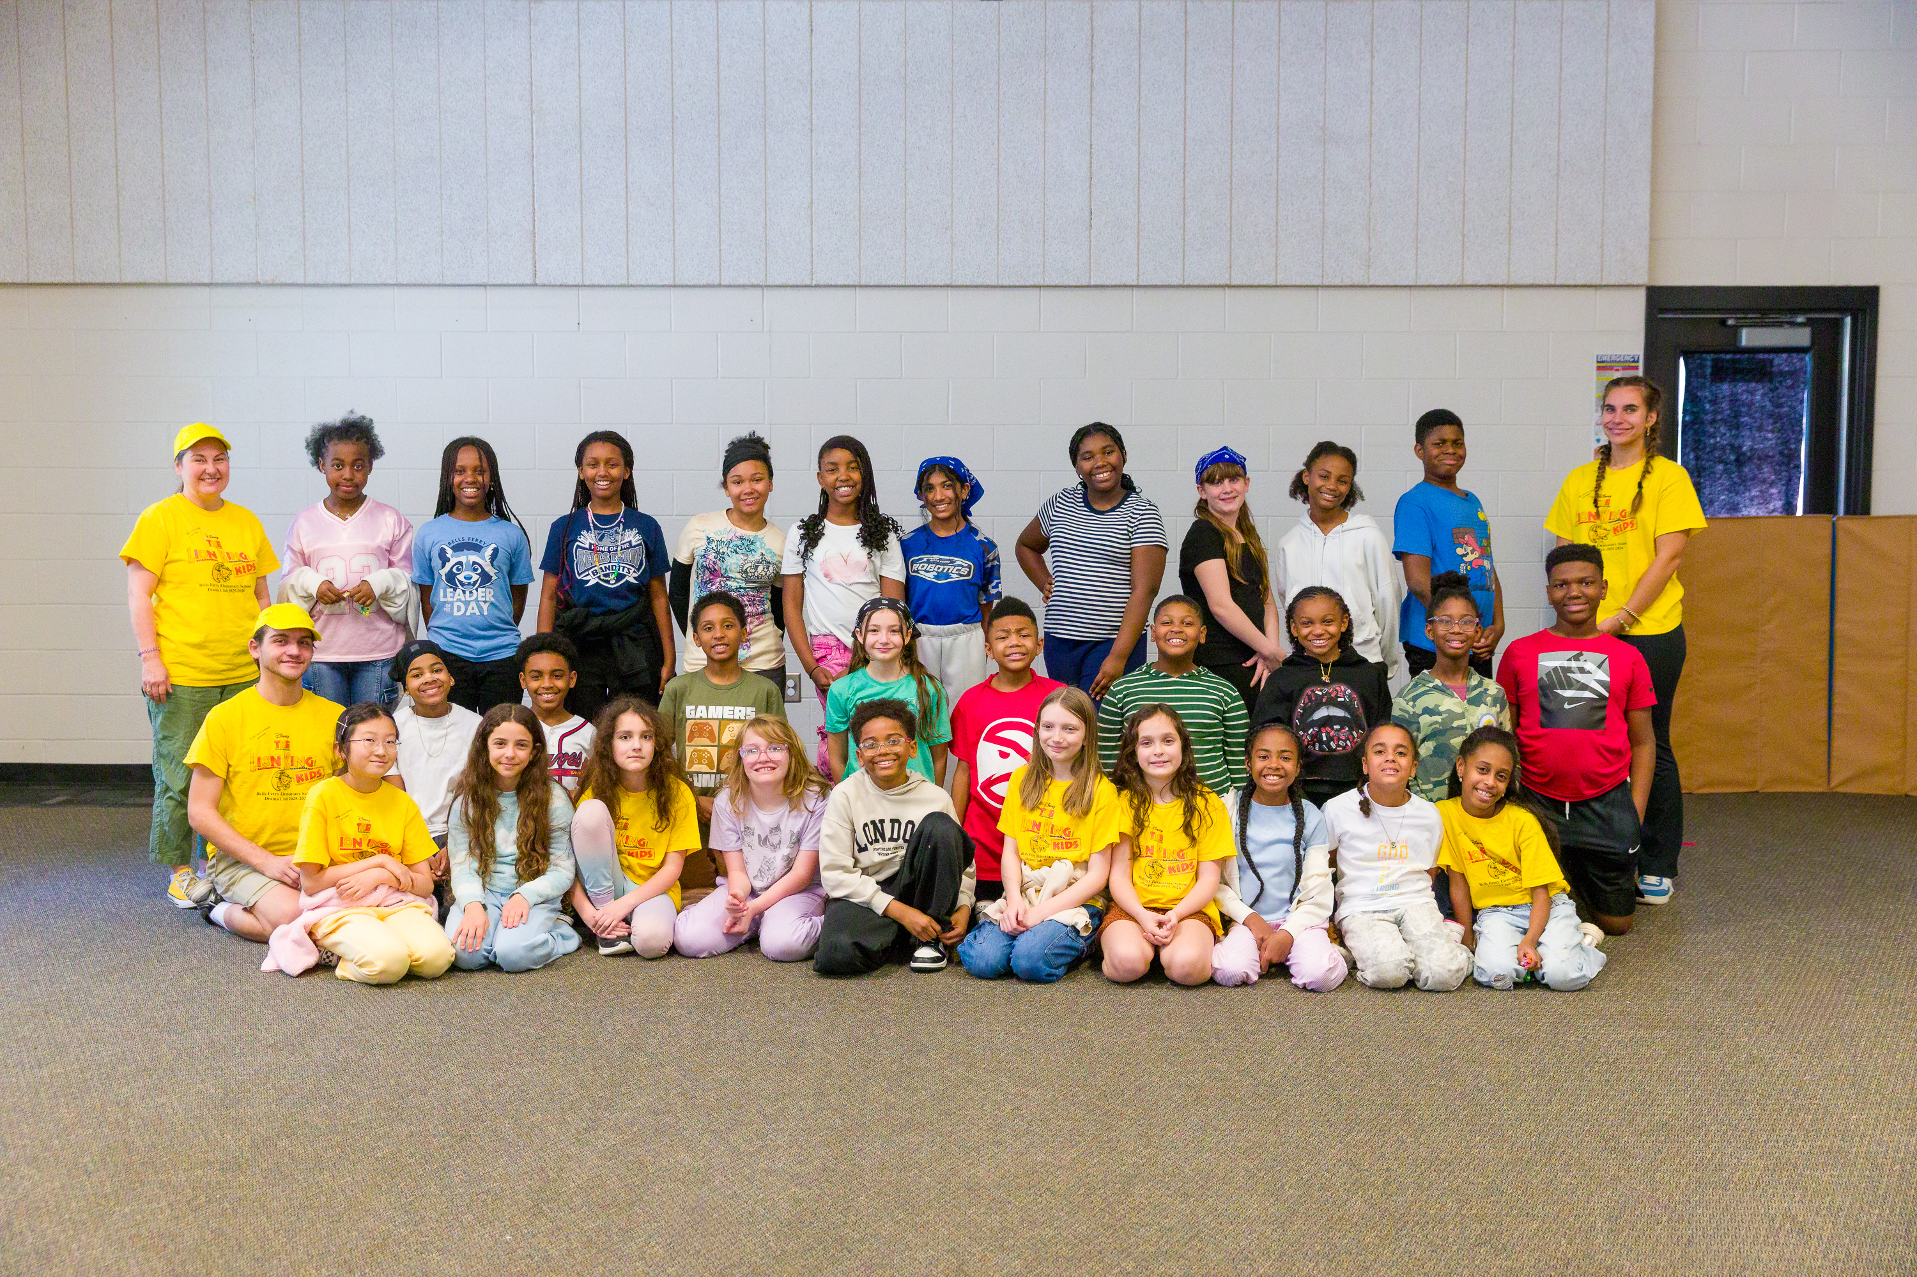
Little Actors’ Studio
www.littleactorsstudio.org
Summer Camps
June 8-19 Shrek Jr. the Musical
July 13-24 Write Your Own Musical
TLC Dance Studio
Join Us
FOR ALL THE
FUN!

